Slide 1


Slide 2
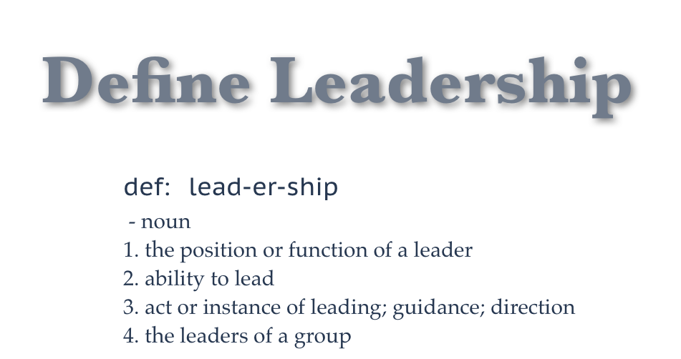
Notes:
Difference between management and leadership – managers tweak the system, leaders transform the system EX: Cahmberline and Churchhill

Slide 3
Leadership
Is
Influence
Notes:
Power vs. influence.

Slide 4
Notes:
Skills can be built – training, mentoring and modeling

Slide 5
TWO TYPES OF LEADERS
TRANSACTIONAL
TRANSFORMATIONAL
I often avoid getting involved. I tend to be passive.
I loosely monitor what’s happening and step in only if things go really bad.
I listen to others and coach them to bring out their best.
I ask others for their thoughts and perspectives.
I’m genuinely positive, enthusiastic, and cast a compelling vision.
I often talk about shared mission, vision, and values with the team.
My simple presence can inspire others’ confidence.

Slide 6
Attributes of a Leader
VISION
STRATEGIST
MOTIVATOR
CHERISHED VALUES
PROBLEM SOLVER
EMPATHY
WISE RECRUITER
FIVE “C’S” OF RECRUTING
Christian Commitment
Calling
Character
Chemistry
Competency
Notes:
Vision – Better way to do everything and we are out to find it. Ex: We will be the best Christian organization in the USA - Transformed Doctors, Transforming the World
Strategist – How do we get to where we need to go? Knows the way.
Motivator – Knows where need to go and takes others with you? “pull others after you”, Persuasive communicator to influence people to commit.
Cherished Values – This is who we are and this is how we act.
Problem Solver – If we didn’t have problems we wouldn’t have jobs. Conflicts and Jobs - Timely, thoroughly, considering options, reevaluate
Empathy – truly care about those they influence. Start where they are and take them where they need to go.
Wise Recruiter – five C’s,, not afraid to hire someone smarter than them

Slide 7
Attributes of a Leader
VISION
STRATEGIST
MOTIVATOR
CHERISHED VALUES
PROBLEM SOLVER
EMPATHY
WISE RECRUITER
PSYCHOLOGICAL BOND
INTEGRITY
STEWARD OF PEOPLE
BALANCED
UTILIZE POWER RIGHTLY
WILLING TO BE:
  SCRUTINIZED
  PAY THE PRICE
  TAKE A PUNCH
  TO FAIL
  TO PERSIST
Notes:
Psychological Bond – Winston Churchill – Confidence when afraid, certainty without vascillating EX: After Normandy invasion – Now is not the end. It is not even the beginning of the end, but it is perhaps, the end of the beginning.
Integrity – Character is most important. Fair, Truthful, Biblical, Achilles Heel. Be above reproach “Now the overseer must be above reproach…” 1 Tim. 3:2 NIV
People Steward – Sacred trust. Not rule by fear or intimidation. Spiritual responsibility to help them to become all designed them to be.
Balanced – learn the art of gracioulsy saying “no”. I have another priority right now. Right priorities – God-Spouse/Children. Balance between getting it done and relationships
Utilize Power Rightly – Positional, Expert, Personal Attraction, Effort – All needed to be use at proper time but first the least.
Willing to be
Scrutinized – put under the microscope, loss of privacy
Pay the Price – in time, energy, not 9 to 5 leader. Work harder than everyone
To Fail – handle failure and try again – if you are not failing some you are not skating near enough to the edge.
To Persist – ordinary people with extraordinary determination. EX: Abraham Lincoln – failed in election after election. Civil War going bad with battle after battle lost.

Slide 8
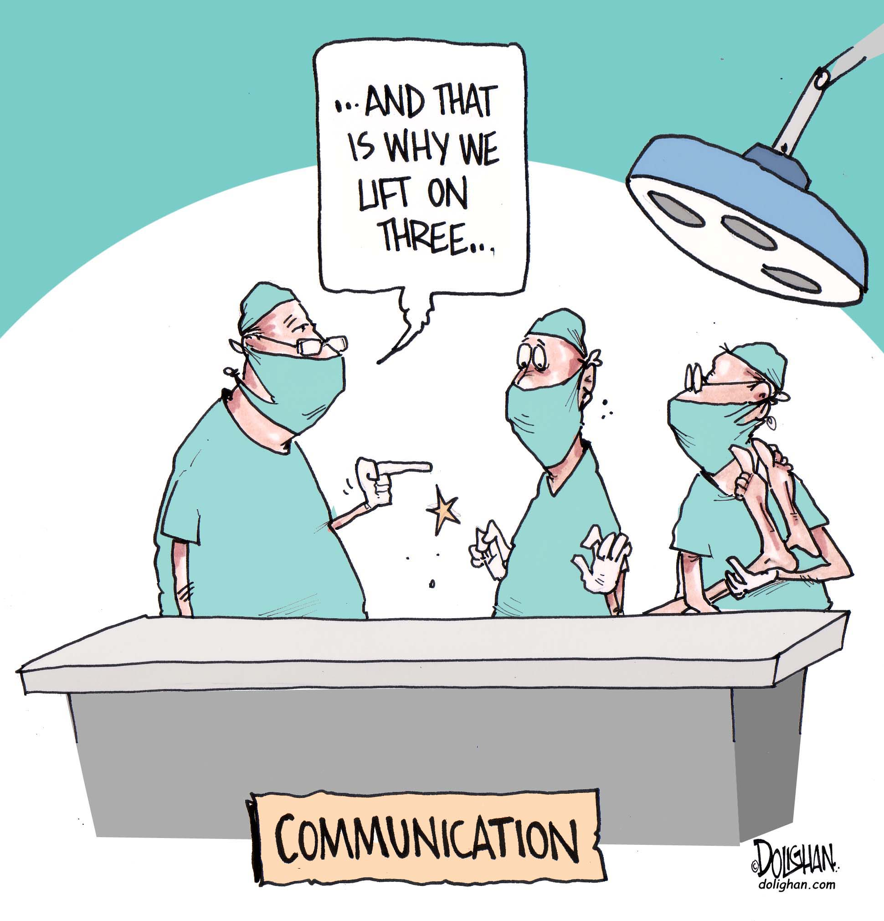
E
S
S
E
N
T
I
A
L
S

Slide 9

Notes:
Going down one way street the wrong way – bedlam – Communications is two way street
Principles
Evoke a response – to let you know that the person heard, understood, accepts it and will act up on it in a timely manner.

Slide 10

METHODS
Notes:
Going down one way street the wrong way – bedlam – Communications is two way street
Principles
Evoke a response – to let you know that the person heard, understood, accepts it and will act up on it in a timely manner.
Use appropriate method - Ex: difference between using PA system, memo, e-mail, phone call or personal meeting - .body language,
Ex: Always give bad news in person
Don’t avoid conflict – it will come back to bite you

Slide 11



APPROPRIATE
PERSON
SHOULD DELIVER
THE MESSAGE
Notes:
Going down one way street the wrong way – bedlam – Communications is two way street
Principles
Evoke a response – to let you know that the person heard, understood, accepts it and will act up on it in a timely manner.
Use appropriate method - Ex: difference between using PA system, memo, e-mail, phone call or personal meeting - .body language,
Ex: Always give bad news in person
Don’t avoid conflict – it will come back to bite you
Appropriate person should deliver the message – EX: Right level of leader – Ex. Dr. bad news on diagnosis vs. ignoring the person just above problem level
Be empathetic with your listeners – Bridge from where they are to where you want them to go. From what the know and believe to what you want the to know or believe. EX: PAS EX: Inviting over to your house and it was so clean and nice. The hospital is our house
More communication is verbal than non verbal – tone, pacing, volume, gestures. Ex: Because I love you

Slide 12

Build a Bridge
Notes:
Going down one way street the wrong way – bedlam – Communications is two way street
Principles
Evoke a response – to let you know that the person heard, understood, accepts it and will act up on it in a timely manner.
Use appropriate method - Ex: difference between using PA system, memo, e-mail, phone call or personal meeting - .body language,
Ex: Always give bad news in person
Don’t avoid conflict – it will come back to bite you
Appropriate person should deliver the message – EX: Right level of leader – Ex. Dr. bad news on diagnosis vs. ignoring the person just above problem level
Be empathetic with your listeners – Bridge from where they are to where you want them to go. From what the know and believe to what you want the to know or believe. EX: PAS EX: Inviting over to your house and it was so clean and nice. The hospital is our house.

Slide 13

Notes:
Going down one way street the wrong way – bedlam – Communications is two way street
Principles
Evoke a response – to let you know that the person heard, understood, accepts it and will act up on it in a timely manner.
Use appropriate method - Ex: difference between using PA system, memo, e-mail, phone call or personal meeting - .body language,
Ex: Always give bad news in person
Don’t avoid conflict – it will come back to bite you
Appropriate person should deliver the message – EX: Right level of leader – Ex. Dr. bad news on diagnosis vs. ignoring the person just above problem level
Be empathetic with your listeners – Bridge from where they are to where you want them to go. From what the know and believe to what you want the to know or believe. EX: PAS EX: Inviting over to your house and it was so clean and nice. The hospital is our house
More communication is verbal than non verbal – tone, pacing, volume, gestures. Ex: Because I love you

Slide 14


Notes:
Going down one way street the wrong way – bedlam – Communications is two way street
Principles
Evoke a response – to let you know that the person heard, understood, accepts it and will act up on it in a timely manner.
Use appropriate method - Ex: difference between using PA system, memo, e-mail, phone call or personal meeting - .body language,
Ex: Always give bad news in person
Don’t avoid conflict – it will come back to bite you
Appropriate person should deliver the message – EX: Right level of leader – Ex. Dr. bad news on diagnosis vs. ignoring the person just above problem level
Be empathetic with your listeners – Bridge from where they are to where you want them to go. From what the know and believe to what you want the to know or believe. EX: PAS EX: Inviting over to your house and it was so clean and nice. The hospital is our house
More communication is verbal than non verbal – tone, pacing, volume, gestures. Ex: Because I love you
Skill of listening and interpreting – Listen, clarify by speaking back what you thing they mean, ponder and the respond. If you are angry – wait. EX. – Field Director

Slide 15

Effective Techniques
Notes:
Going down one way street the wrong way – bedlam – Communications is two way street
Principles
Evoke a response – to let you know that the person heard, understood, accepts it and will act up on it in a timely manner.
Use appropriate method - Ex: difference between using PA system, memo, e-mail, phone call or personal meeting - .body language,
Ex: Always give bad news in person
Don’t avoid conflict – it will come back to bite you
Appropriate person should deliver the message – EX: Right level of leader – Ex. Dr. bad news on diagnosis vs. ignoring the person just above problem level
Be empathetic with your listeners – Bridge from where they are to where you want them to go. From what the know and believe to what you want the to know or believe. EX: PAS EX: Inviting over to your house and it was so clean and nice. The hospital is our house
More communication is verbal than non verbal – tone, pacing, volume, gestures. Ex: Because I love you
Skill of listening and interpreting – Listen, clarify by speaking back what you thing they mean, ponder and the respond. If you are angry – wait. EX. – Field Director
7. Adult Teaching Techniques – examples, stories, object lessons, slogans, sound bites, analogies

Slide 16

Notes:
Going down one way street the wrong way – bedlam – Communications is two way street
Principles
Evoke a response – to let you know that the person heard, understood, accepts it and will act up on it in a timely manner.
Use appropriate method - Ex: difference between using PA system, memo, e-mail, phone call or personal meeting - .body language,
Ex: Always give bad news in person
Don’t avoid conflict – it will come back to bite you
Appropriate person should deliver the message – EX: Right level of leader – Ex. Dr. bad news on diagnosis vs. ignoring the person just above problem level
Be empathetic with your listeners – Bridge from where they are to where you want them to go. From what the know and believe to what you want the to know or believe. EX: PAS EX: Inviting over to your house and it was so clean and nice. The hospital is our house
More communication is verbal than non verbal – tone, pacing, volume, gestures. Ex: Because I love you
Skill of listening and interpreting – Listen, clarify by speaking back what you thing they mean, ponder and the respond. If you are angry – wait. EX. – Field Director
Positive Attitude – attitude carries enormous weight. Pick words and tone carefully. Even if you are delivering bad news. Negative news delivered in a positive tone. Ex: right sizing.

Slide 17

CONSISTENCY
Notes:
Going down one way street the wrong way – bedlam – Communications is two way street
Principles
Evoke a response – to let you know that the person heard, understood, accepts it and will act up on it in a timely manner.
Use appropriate method - Ex: difference between using PA system, memo, e-mail, phone call or personal meeting - .body language,
Ex: Always give bad news in person
Don’t avoid conflict – it will come back to bite you
Appropriate person should deliver the message – EX: Right level of leader – Ex. Dr. bad news on diagnosis vs. ignoring the person just above problem level
Be empathetic with your listeners – Bridge from where they are to where you want them to go. From what the know and believe to what you want the to know or believe. EX: PAS EX: Inviting over to your house and it was so clean and nice. The hospital is our house
More communication is verbal than non verbal – tone, pacing, volume, gestures. Ex: Because I love you
Skill of listening and interpreting – Listen, clarify by speaking back what you thing they mean, ponder and the respond. If you are angry – wait. EX. – Field Director
Positive Attitude – attitude carries enormous weight. Pick words and tone carefully. Even if you are delivering bad news. Negative news delivered in a positive tone. Ex: right sizing.
8. Consistency - same message, repeated (7 times), same from all leadership = EX: Gene

Slide 18
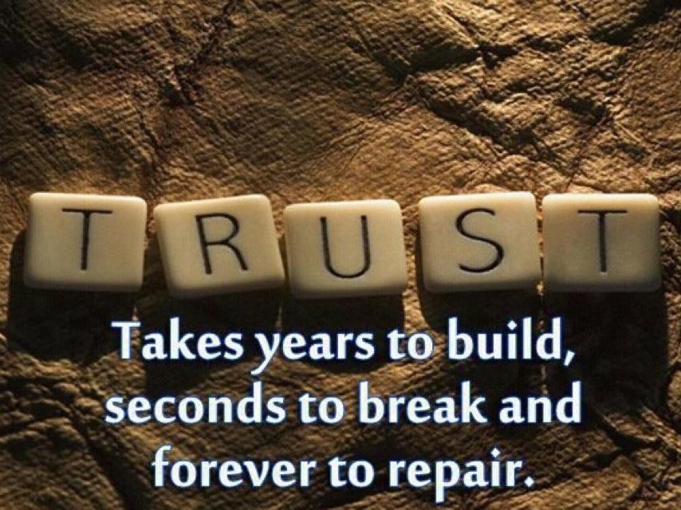
Notes:
Going down one way street the wrong way – bedlam – Communications is two way street
Principles
Evoke a response – to let you know that the person heard, understood, accepts it and will act up on it in a timely manner.
Use appropriate method - Ex: difference between using PA system, memo, e-mail, phone call or personal meeting - .body language,
Ex: Always give bad news in person
Don’t avoid conflict – it will come back to bite you
Appropriate person should deliver the message – EX: Right level of leader – Ex. Dr. bad news on diagnosis vs. ignoring the person just above problem level
Be empathetic with your listeners – Bridge from where they are to where you want them to go. From what the know and believe to what you want the to know or believe. EX: PAS EX: Inviting over to your house and it was so clean and nice. The hospital is our house
More communication is verbal than non verbal – tone, pacing, volume, gestures. Ex: Because I love you
Skill of listening and interpreting – Listen, clarify by speaking back what you thing they mean, ponder and the respond. If you are angry – wait. EX. – Field Director
Positive Attitude – attitude carries enormous weight. Pick words and tone carefully. Even if you are delivering bad news. Negative news delivered in a positive tone. Ex: right sizing.
8. Consistency - same message, repeated (7 times), same from all leadership = EX: Gene
9. Trust – no matter how well you communicate, you have to have trust. One of main reasons communication not accepted. EX: Be careful when you put things in writing. Comes back to haunt you. Lack of trust cause of interpersonal conflicts. EX: news or politician.

Slide 19
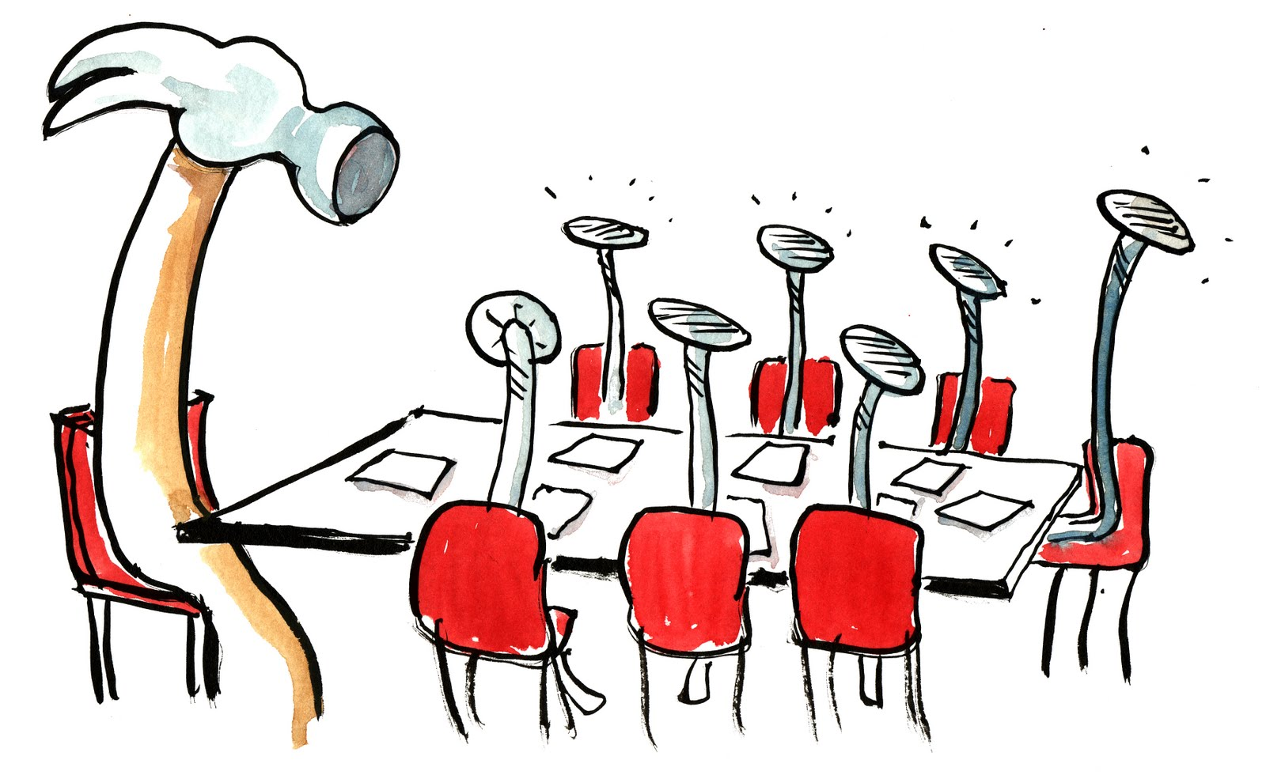
NAILING YOUR MEETING!
Notes:
Necessary evil that must be mastered.
Can consume way to much time and effort. EX: If you have an hour meeting with eight people you have consumed
Tend to end up at the lowest common denominator in decision making
How to you run a good one.

Slide 20

Meetings
Notes:
Consume time – determine to have fewer of them and ruthlessly replace them with better alternatives
Stand up meetings are reliably shorter (1/3) , more pleasant and more effective than sit-down meetings and produce the same results on less time.
Examine meetings you are having – Are the needed? What are they accomplishing? Are those you can TERMINATE and accomplish your goals in other ways?

Slide 21

Involving as Few People
as Possible
Notes:
Is that person needed? Don’t just have so won’t be left out. Each should contribute. Don’t waste productivity.
Survey participants – Would you rather not be in this meeting? (If don’t contribute, won’t). How can we do this more efficiently> Who needs to be here.

Slide 22

K
E
E
P
I
T
B
R
I
E
F
Notes:
Start on time whether people there are not.
Keep the meeting on track.
Set a time limit – no longer than an hour
Critique the Meeting

Slide 23

Notes:
Keep it focused on what is important.
Recap discussions,
Ask questions
Keep input concise. “How would you summarize what you want to say in one sentence?”
Use visual aids if helpful
Make decisions.
Don’t let one person dominate
Two way street - leave time for discussion/brainstorming

Slide 24

Notes:
Prepare
Agenda – distribute so people will be ready with opinions, input and data. Where and when it will be held and how long will last.
Send background materials, handouts, previous minutes- review before come
Premeeting discussions with important stakeholders
Get the info out of the way EX: Reports distributed – “progress” “problems” “plans”

Slide 25

FINISH
WELL
Notes:
Finish – assignments, minutes if indicated – complex and many things to do like a board meeting. , committees if not all needed to proceed.
Evaluate

Slide 26
BEST
CHRISTIAN WORKPLACE
Notes:
What an unexpected surprise and honor! Christianity Today and the Christian Management Association gave CMDA the first “Best Christian Workplace in the U.S.” award sever- al years ago after surveying and interviewing our staff. As you can imagine, other organizations contacted us asking for the secret of our success. I confess I had to sit down and put into words some of the principles that guide us. Some were so ingrained that we had not even thought about them.
I want to share those with you but also take it a little further by walk- ing down memory lane. How would I apply these principles in a medical missions outreach if I were back in missions and doing what you are doing today? Though the applications may be different, the principles are the same whether you are running a large mission hos- pital, managing a clinic, in charge of a community health program, or running CMDA.

Slide 27

Notes:
Do not misunderstand me. CMDA is not the perfect workplace. We have our problems. Like you, I have had to fire people, solve interpersonal conflicts, calm irate constituents, deal with financial shortfalls, revamp governance structures, and much more. However, when followed, what principals are most likely to create a workplace where staff members are joyous, fulfilled, and working hard for the Lord?

Slide 28
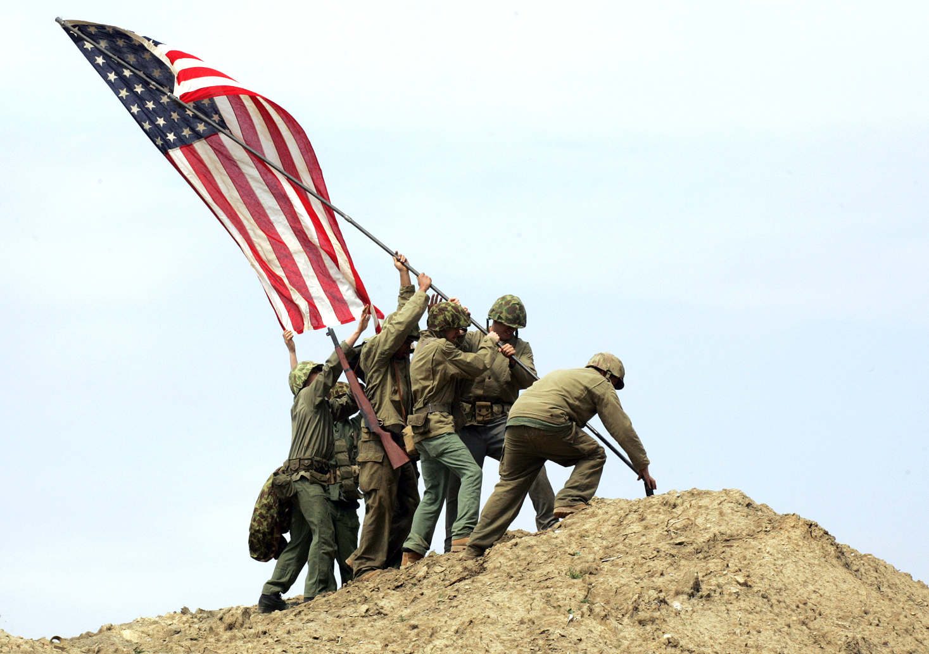
Rally Around the
Mission
Notes:
You have to know where you are going before people will rally to the cause. Corporately, that means developing clear purpose, mis- sion, vision, values, and goal documents. With staff, it is answering the questions, “Why should I invest my life in this?” and “Will it make a
difference for the kingdom?”You want everyone involved to see the organization’s mission as their mission and feel it is so important that they are eager to get up every morning to do it. This is done on many levels but let me give you an example.
CMDA’s slogan used to be “A Fellowship of Christian Doctors.” Does that stir your heart? Are you willing to shout that as your battle cry? No, of course not. Fellowship is important, but it is the byproduct of being in mission together. We changed our slogan to “Changing the Face of Healthcare, By Changing the Hearts of Doctors,” which later morphed into “Changing Hearts in Healthcare.”
We rally around our mission in publications to our members, but we also rally around it with our staff. We share stories of how the mission is being accomplished. We dream up new ways to accomplish it. I talk about our mission every chance I get. Employees need to know that what they are doing is important and that they are making a differ- ence.
EX: Best Hospital in Africa

Slide 29

Notes:
Adopt Instead of Hiring
As we discussed in Part 1, we do not hire senior staff, we adopt them into our family. We will not settle for a “C” potential employee, but look for only “A” ones. If you do that, there will be an exponential multiplication effect in impact. That is why Gene Rudd and I are always involved in hiring key people. Of course, we look for people with the right skills but they also must be called by God to work at CMDA. If we do not sense that, we do not hire them. They also must have the personality, work ethic, and spiritual depth to complement and enhance our staff mix. One bad apple can spoil the whole bushel.
Does that mean everyone is the same? No. That would be like making breakfast bread with only flour but no yeast, shortening, raisins, or cinnamon. Your workplace ingredients must blend so that the sum is more than the parts. Hiring staff is serious business and is one of the most important things leaders do. For lower level staff, we utilize our best staff at the level above them to make the decision.
The other aspect of adoption versus hiring is that I contract for services for a certain amount of work when hiring. In adoption, I take on a stewardship responsibility to nurture, train, cherish, encourage, discipline, and develop the individual God has entrusted to my sphere of influence.

Slide 30

CREATE
A CARING ATMOSPHERE
Notes:
More than ever, people need community. This is more true in the United States - where community is breaking down - than in many other countries, but we have a basic human need to be loved and cared about by others. It is impossible to carry out our stewardship responsibility unless we are involved in individual lives. That goes beyond making sure they are doing their job, to cultivating genuine relationships bearing the fruits of kindness. Actions are much more important than words. Gene is much better at this than I am, since I am on the road so much. He calls to meet needs when employees are sick, goes and sits in the emergency room, visits in the hospital, or gives medical advice. He helps people move, does counseling, and many other caring things. He creates an atmosphere and sets a stan- dard that others emulate.
Staff at CMDA genuinely care about each other and express it in con- crete ways. Each year at our staff Christmas party, we have an orna- ment exchange. Whoever’s ornament you get becomes your prayer partner for the year. Many staff do special things for their prayer part- ner throughout the year.
One of the barriers to a caring community is the “great divide” that can exist between missionary and national staff. There may be a car- ing atmosphere among the missionaries but little going on across the deep valley. Address this in practical ways. Invite key staff over for meals, start a Bible study in your home, work on something together outside the medical/dental work situation, visit their homes, offer to help them with a personal project, or love on their children. In medi- cine, patients first want to know that you care. It is the same in the workplace.

Slide 31

Notes:
Grow in Christ Together
At Tenwek, we used to have chapel for patients in various places si- multaneously in the hospital every day. If I were to do it over, I would have chapel service for my staff during work hours at different times twice a week so everyone could attend. Employees who worship to- gether are drawn together as they grow closer to Christ. These should
be high quality services with a variety of speakers from inside and outside the workplace. We have chapel twice a week at CMDA. We bring in special speakers, use PowerPoint, watch music videos, and learn through training courses. We never want chapel to get stale and each service must meet attendees at their point of need.
One of our former staff members was a very successful pastor who served as the staff chaplain and organized, led, and evaluated our spiritual ministry. He was also available for counseling and encour- agement. The deepest bonds are forged in the fire of seeing Christ working in our lives and our co-workers’ lives.

Slide 32
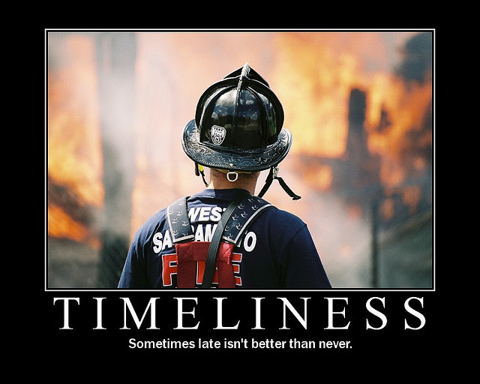
Notes:
Timeliness
We get so busy working that we fail to deal with problems and issues in a timely manner. We need to have our antennas up to snoop out interpersonal frictions, overworked staff, and underperforming employees. We need to identify what isn’t working and could be tuned up, and what isn’t working and is beyond salvage. Most importantly, we need to deal with problems quickly.
I like to garden but hate to pull weeds. If I do not do it frequently, the small, easy-to-remove weeds turn into deeply invasive, almost immovable parasites that damage the growth of fruit and disrupt the root systems of other plants when removed.
The same is true in the workplace. The postponement of dealing with problems, especially people problems, always makes the situation worst. It also damages morale and destroys trust in leadership. Deal with issues when they are small in a loving but uncompromising manner. As with your children, staff members need to know where their boundaries are and what happens when they are crossed. We set up a system of verbal cautions, written warnings, and probation tools to use in dealing with underperforming or problem people. We work hard to salvage every one of our adoptees due to our steward- ship responsibility, but staff members have seen that we do not shy away from hard decisions and do not ignore difficult problems.
Labor laws and cultural mores impact how you can deal with em- ployee situations in many countries. You may have to adapt your techniques to the local situation, but it is critical that you deal with little problems before they become big ones. You must also do so in a consistent and Christ-like manner. That is the key to building confi- dence in you as a leader.

Slide 33

Notes:
Transparency
Make sure you and other leaders are clearly seen for who you are, for the decisions being made, and for where the organization is head- ing. Transparency means employees can see both the good and the bad. On a personal level, share your own spiritual struggles and the ways God is teaching and maturing you. Don’t hide your life behind a mirage of being a super-saint. Recently, I listened to a riveting mes- sage on forgiveness by Chuck Swindoll. It was so compelling and unforgettable because his wife Cynthia shared about conflicts with and alienation from her extended family, her own depression, and suicidal ideation. Her transparency ministered to me.
In a cross-cultural situation, this has to be done in the right manner, but it is still important. It lets others see that you are not perfect and God continues to work in you. Apologize when you wrong someone, admit your bad decisions, and confess your mistakes.
Be transparent at an organizational level as well. To feel a sense of ownership of the ministry, staff members need to know what is go- ing on. At the same time, teach them what needs to be kept in the workplace family and what they may tell others. Ask them to pray for you and other leaders within the organization and be open to their care and counsel.

Slide 34

MAKE
Notes:
Make Memories Frequently
Look for any excuse to have fun together. We work hard and play hard at CMDA. One time, we sensed everyone had spring fever on a beau- tiful day, so we had a surprise “Banana Split Party” with ice cream and all the toppings. I then announced that I thought “split” should mean that we all leave work early by a couple of hours! It is surprising how fast people can shut down their computers and get into their cars!
We involve our staff in planning our parties and I’m always willing and ready to be the one laughed at. At our Christmas get-together one year, we played “Celebrity Hollywood Squares.” They gave nine staff members a bag with a costume in it that they had to put on. I was
Elvis. It was a whole other me with a white sequined jumpsuit, cape, and fake sideburns! We always have a staff member photograph the craziness and put it up on the staff-only part of our website. (No, I’m not going to give you the URL!) The employees rush home to show their families all the fun we had and regularly visit the site with other employees for a few more belly laughs. We also have events for ev- eryone to bring their spouses and children three times each year.
When Gene and I turned fifty years old within a few months of each other, the staff picked us up out of our offices in wheelchairs for a “Fifties Party.” Everyone dressed the part and my assistant brought in sundaes on roller skates. The cakes looked like vinyl records and I ended up getting a pie in the eye before the event was over.
One spring, we celebrated Easter by hiding more than one hundred plastic eggs full of goodies and one grand prize throughout the of- fices. It took more than two weeks for all of them to be found. We regularly put together competitions, contests, and other activities to make memories and lots of conversation.
I guess you get the picture. Shared memories bind us together. In the midst of a busy work schedule in a medical mission situation, you need emotional release. Laughter is great medicine so organize a game night, put together a fun contest, or have a party. People will work better for it.

Slide 35
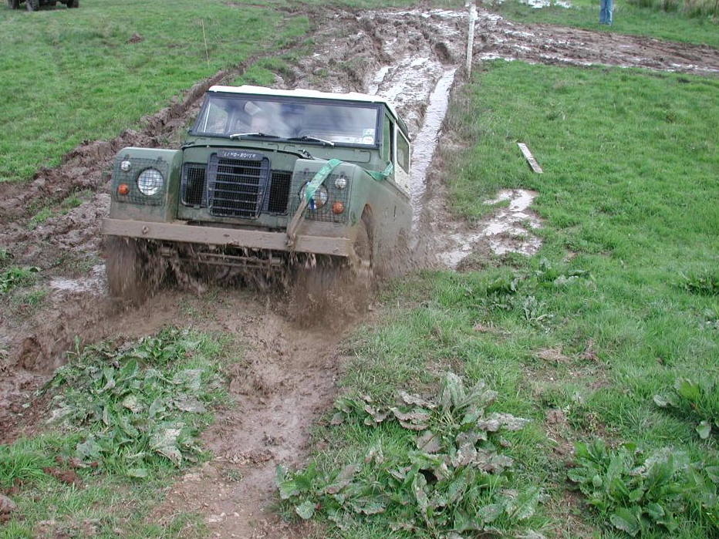
Don’t Get Stuck in a RUT
Notes:
Don’t Get Stuck in a Rut
Traditions are important, but variety is the spice of life. Take this situation, for example. I’ve been on a thousand or more forgettable airplane trips, but I still remember getting on a late night Southwest flight from San Antonio to Dallas because the stewardesses had dressed for bed with housecoats, curlers, and the yucky green face- mask that some women put on for their complexion. They told us that they were trying to get us guys ready for what we were going to see when we got home! It was hilarious and unpredictable.
At CMDA I continually emphasize that there is a better way to do everything and all of us should be out to find it. I’ve also been known to say, “If you don’t like change, don’t work here!” Like high performance racecars, a high performance organization must be continually tuned. The key is to get everyone working on the car together. Everyone’s ideas are equal so we have a suggestion box and an open door policy to our offices. We take every opportunity available to brag on an individual’s good idea.
We also keep barriers between departments low by encouraging staff to help each other out whenever we can. I recently had a weekly meeting with one of my department heads. She had a large mailing to get out. I suggested we rent a DVD and show it on the big screen in our assembly hall and invite staff to come in with their kids and have an envelope stuffing party. This was a first for us, and it helped to get us out of a rut while also creating a few memories.

Slide 36

KEEP IT FLAT
Notes:
Keep it Flat
As organizations grow, they can get multilayered. Some of this is mandatory or leaders can’t manage well. If you are responsible for too many people, you can’t meet with them regularly to motivate, guide, and supervise them. The problem is that the more layers there are, the more communications and relationships become compartmentalized. Feelings of “them versus us” fester and tensions quickly escalate.
Ideally, one person can directly supervise five to ten people well. Keep your organization as “flat” as possible to avoid problems. To do this at CMDA, Gene and I function as co-CEOs. I’m ultimately responsible, but we divide up senior staff and he supervises half while I supervise the other half. We meet individually with each person we supervise for at least thirty minutes each week for a scheduled meeting and our doors are open if needs arise. If I’m traveling, Gene has full authority to make decisions. We laughingly say that we don’t always make the same decisions, but we don’t make any higher percentage of wrong ones! We communicate regularly and make sure that employees don’t play one of us against the other.
We also manage CMDA like we care for patients. If a decision is need- ed, we pull together the people needed for input and make the deci- sion then. We avoid committees that stagnate, taking decisions to the lowest common denominator. We empower staff with the authority they need to operate well and let them know what things we need to be informed of or require approval for. This system builds trust.
We work hard to build relationships with staff members who are more than one layer below us. For example, the cleaning staff comes by ev- ery day to pick up my trash. We talk about our dogs, building a house, the weather, and killing E. coli in well water, all in just a few minutes of conversation. It is important to be approachable and available.

Slide 37
COMMUNICATE
CONSISTENTLY

Slide 38



OILING
THE
GEARS
Notes:
COMMUNICATE CONSISTENTLY - Communication is the oil that makes an organization work smoothly. Without it, the machinery soon seizes up. There should be “standing communications” in the form of policy manuals and other written regulations and guidelines. There should be frequent formal communication such as newsletters, staff meetings, e-mail or bulletins, and there should be informal communication happening in and between organizational layers. Answer the standard questions of who, what, when, where, and, more importantly, why.
When I was leading our community health ministry, we printed a monthly newspaper for our 500 volunteers and many more health committee members. Each month we had at least one story in the paper about each outreach site. People love to read an article about someone they know. The newspaper also contained reports on con- tests, ideas to increase effectiveness, stories of changed lives, visitors who dropped by, and what others were saying about our program. Communication lubricated our organization and became the fuel that drove it.
I heard it said of Martin Luther that he prayed at least an hour each day, but he prayed two hours if he was going to be really busy. That is not only a good spiritual principle, but also a tenet that should guide the communication within our organization. The busier things are, the more we need to go out of our way to keep people informed.
One of the most important things to communicate is the success of your product. Share stories of how your outreach is impacting lives and the words of appreciation from those you are affecting. Staff members need to be reminded at every opportunity that they are making a difference in things they deeply care about. I encourage you to examine your workplace and see which principles you do or could employ. Figure out applications that will work where you are. We can all have a best Christian workplace!

Slide 39
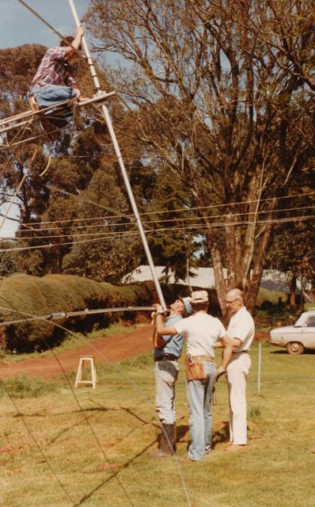
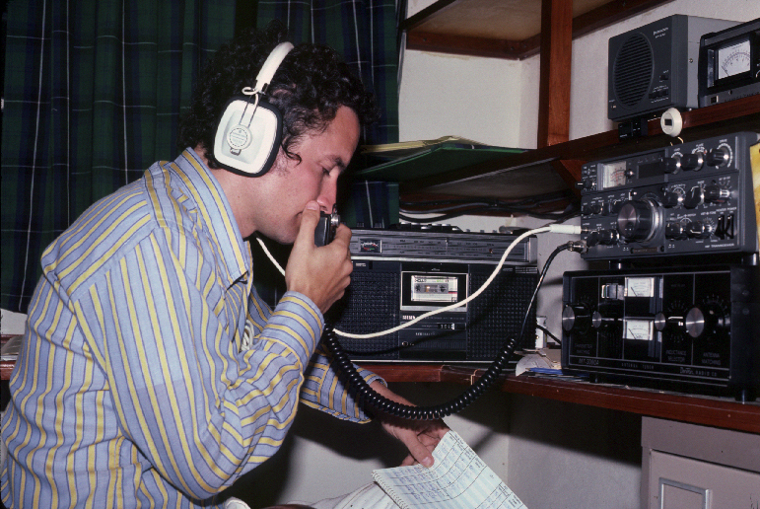
Notes:
COMMUNICATE CONSISTENTLY - Communication is the oil that makes an organization work smoothly. Without it, the machinery soon seizes up. There should be “standing communications” in the form of policy manuals and other written regulations and guidelines. There should be frequent formal communication such as newsletters, staff meetings, e-mail or bulletins, and there should be informal communication happening in and between organizational layers. Answer the standard questions of who, what, when, where, and, more importantly, why.
When I was leading our community health ministry, we printed a monthly newspaper for our 500 volunteers and many more health committee members. Each month we had at least one story in the paper about each outreach site. People love to read an article about someone they know. The newspaper also contained reports on con- tests, ideas to increase effectiveness, stories of changed lives, visitors who dropped by, and what others were saying about our program. Communication lubricated our organization and became the fuel that drove it.
I heard it said of Martin Luther that he prayed at least an hour each day, but he prayed two hours if he was going to be really busy. That is not only a good spiritual principle, but also a tenet that should guide the communication within our organization. The busier things are, the more we need to go out of our way to keep people informed.
One of the most important things to communicate is the success of your product. Share stories of how your outreach is impacting lives and the words of appreciation from those you are affecting. Staff members need to be reminded at every opportunity that they are making a difference in things they deeply care about. I encourage you to examine your workplace and see which principles you do or could employ. Figure out applications that will work where you are. We can all have a best Christian workplace!

Slide 40

Notes:
The problem wasn’t the local grapevine. The problem was I had ig- nored it. If you ignore the local grapevine, it will hang you. I’ve seen it in missionary institutions, community programs, and even among missionary colleagues. In fact, the longer you ignore the grapevine, the quicker it will get its revenge on you.

Slide 41

Notes:
You ignore the grapevine by:
Not acknowledging it exists
Not realizing its power
Not being attached to the vine
Not feeding it

Slide 42

Notes:
Not Acknowledging it Exists
People love to talk and speculate. Not only do they speculate, but they assume. Your good friends always assume you have the best motives and intentions. Those who don’t like you always assume you are up to something bad. Though the majority of people fall in the middle of that spectrum, they are not the silent majority. They all pass the message down the line and are strongly influenced by what they hear through unofficial channels. The grapevine is always on and functioning because everyone has a desire to be on the “inside” and know what is going on.

Slide 43

Notes:
NOT REALIZING ITS POWER
Knowledge is power. Those who don’t like you or are just suspicious by nature regularly feed the grapevine with their own assertions and sometimes outright lies. The more sensational the information, the greater their alleged power, and the faster the story travels. Those in the middle are negatively influenced and don’t usually share what they heard with your friends, so it doesn’t get back to you until you have a huge problem. You may only recognize a few rumblings be- fore the eruption that can badly damage you or your ministry.
nurse at our hospital was loved by our staff and she loved to joke with them and vice versa. One day at the end of some banter, she said in a joking way, “See you later alligator, after while crocodile.” A staff member who was present immediately connected to the grape- vine and spread the word that the nurse was calling national staff animals, a deep insult in the Kipsigis culture. The sensational accusation reached all the way to authorities in Nairobi, six hours by car. Within days, threats of deportation followed until the waters were calmed.

Slide 44
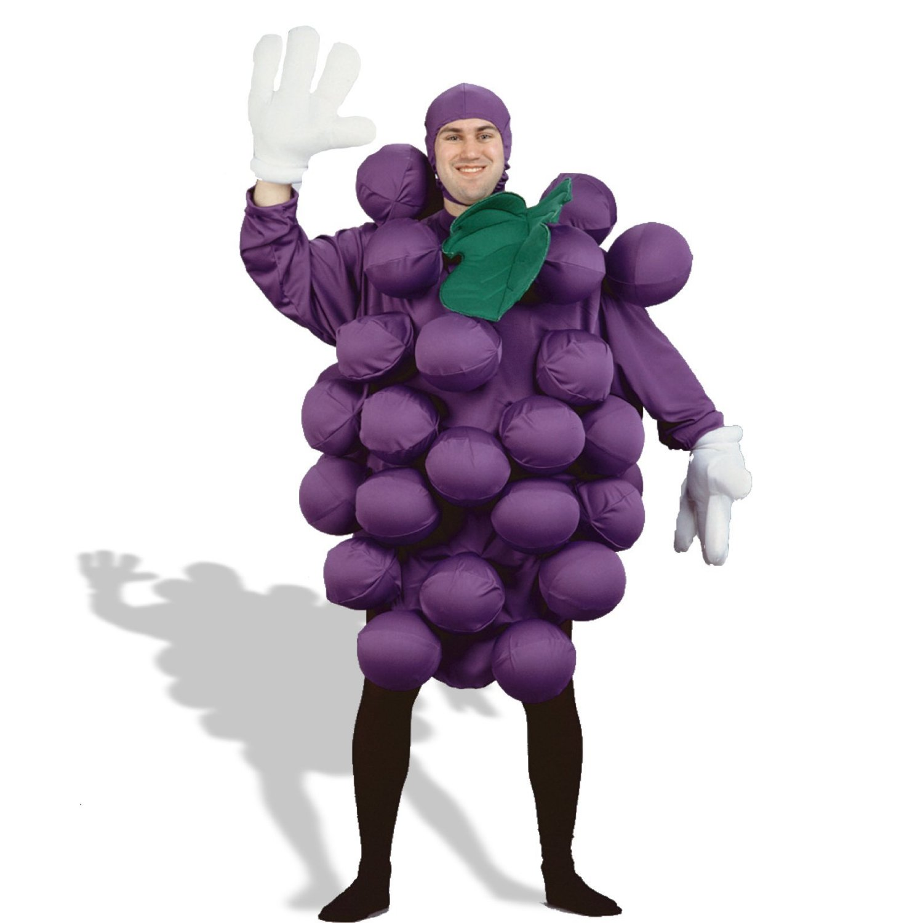
Not Being Connected to the Grapevine
Notes:
NOT BE CONNECTED TO THE GRAPEVINE IS DANGEROUS
I doubt I have to convince you about the grapevine. You probably have your own stories. You have experienced its power, a power further amplified by working cross-culturally. You cannot eliminate the grapevine, but you can get attached to it, learn to counter its negative effects, and even utilize it for your purposes. In today’s vernacular, you can go “viral.

Slide 45

WEED IT
And
FEED IT

Slide 46

Notes:
Here are the keys:
Communicate, communicate, communicate
Locate a few good grapevine nodes
Preempt
Proactively keep the information flowing

Slide 47

Constantly Communicate
Notes:
The best way to head off rumor, gossip, and innuendo is to constantly communicate formally through staff meetings, written information, and recruiting other authority figures to communicate your message. That means you must keep your leaders well informed and encourage them to speak out. You may want to create a communication “tree.” Recently, we cancelled church due to snow. The person making that decision accessed the church phone tree and, within an hour or so, members were informed.

Slide 48
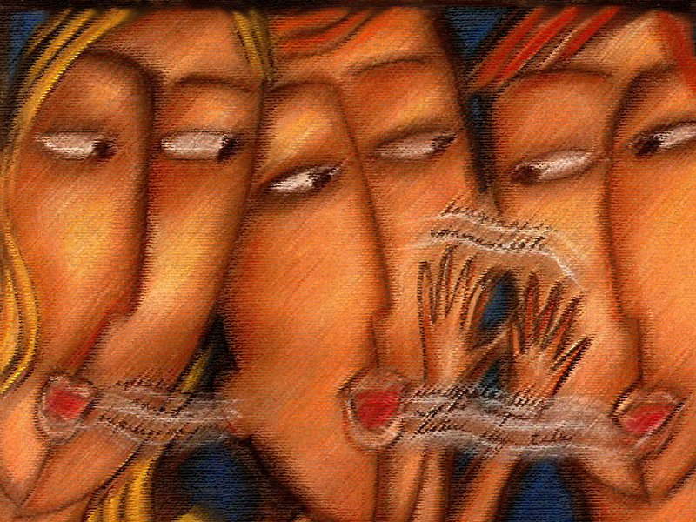
Find a Few Good Grapevine
Nodes you Can Feed
Notes:
Find a Few Good Grapevine Nodes you Can Feed
Part of communicating about controversial, easily misinterpreted, or crisis situations is deciding what messages you want to send down the grapevine. I remember watching a news report about a group of people watching a surfing event who had been swept off some rocks where they were observing the competitors. The person in charge of the event had her message ready with four key points: “We had medical personnel there quickly; we told people to watch the web- cast instead of coming when there were few safe places to observe the competition; we had a sign posted warning people not to stand on these rocks; and our hearts go out to those injured.” She had a well-prepared message which she delivered on national news and disarmed her critics before they had time to poison the grapevine.
Ask yourself, what do people need to know? What questions or con- cerns would I have about this situation if I were receiving this news? How can this information be twisted and what do I need to say to pre- vent that? How can I explain this in the most understandable way?
Use the informal as well as formal communication network. Who are the effective nodes on the grapevine? What “inside” scoop can you give them that you want to be heard by everyone? Often the grapevine is more trusted than the formal communication network so don’t neglect to feed it.

Slide 49

P
R
E
E
M
P
T
Notes:
Part of communicating about controversial, easily misinterpreted, or crisis situations is deciding what messages you want to send down the grapevine. I remember watching a news report about a group of people watching a surfing event who had been swept off some rocks where they were observing the competitors. The person in charge of the event had her message ready with four key points: “We had medical personnel there quickly; we told people to watch the web- cast instead of coming when there were few safe places to observe the competition; we had a sign posted warning people not to stand on these rocks; and our hearts go out to those injured.” She had a well-prepared message which she delivered on national news and disarmed her critics before they had time to poison the grapevine.
Ask yourself, what do people need to know? What questions or concerns would I have about this situation if I were receiving this news? How can this information be twisted and what do I need to say to prevent that? How can I explain this in the most understandable way?
You are only going to get one opportunity to give information the first time. Make sure you think it through and do it right.
You also need to preempt or correct bad information traveling on the grapevine whenever possible. Remember the old Abbot and Costello comical sketch, “Who’s on first?” When it comes to communication, you want to be.
That means you need to have your ears to the ground listening to what is on the grapevine. When you sense a problem, you want to get your communication engine revved up and get your message out. The longer you delay, the more damage the wrong information will have.
136 Beyond Medicine Leadership Skills 137
Years ago, a single national nurse in Kenya took an overdose of chloroquine in a failed abortion attempt. She killed her baby and herself. It was a tragedy that could have been made much worse by sensa-tional stories on the grapevine. We called a staff meeting as quickly as possible to explain what happened and our efforts to save her life. We expressed God’s love for her and her grieving relatives, and talked about how this type of tragedy could be prevented in the future. We flooded the grapevine with the facts and our concern so it was our message and not the rumors that circulated around the hospital and in the community.

Slide 50

KEEP THE
INFORMATION
FLOWING
Notes:
Here are a couple of caveats. If you have bad news, get all of it out there at once in the most comprehensive way possible. A few years ago, we had to lay off 20 percent of our staff for financial reasons. Af- ter making the termination decisions, I kept that information private. I met with all our staff to explain our financial situation, its implica- tions, what we were planning to do, and that those affected would be notified in the next few hours so as not to drag out the pain. I explained the severance package and we would work hard to help those affected find other jobs. I told them how I made the decision on who would be let go. I emphasized they were selected not because they were doing a bad job, but because we had some redundancy in their areas of responsibility. I expressed my sorrow for those affected and optimism for the future – CMDA was going to do well after this “right sizing” and those still employed were not in danger of losing their jobs. Then Gene Rudd or I met personally with each person af- fected.
Get the idea? It was bad news, but I made sure I gave all the bad news at once, and answered questions before they were asked or before employees were tempted to feed the grapevine with speculations.
The best way to avoid being blindsided by the grapevine is to sys- temize and prioritize your formal and informal communication both horizontally and vertically with your staff members. It is lots of work, but well worth the effort. Don’t ignore it!

Slide 51
cmda.org

