Slide 1


THE HEALTH CONSEQUENCES OF HUMAN TRAFFICKING
GLORIA HALVERSON M.D.

Slide 2
Role of the Health Care Professional
2005 European study-
28% of human trafficking victims had encountered a health care provider while they were still in captivity
                Zimmerman,2008
Notes:
Multicountry

Slide 3
Role of the Health Care Professional
2007 ER study
76% heard of trafficking
13% felt they could identify a victim
< 3% had ever had training on recognizing a TIP victim
Chisolm-Strike,Richardson,2007
Notes:
One of the few arenas that interact with trafficked people

Slide 4
Trafficking harms women in insidious ways that create “messy” health problems
The physical and mental health consequences are not a side effect of trafficking but a central theme
Trafficking is a health care issue in that health care is central to restoring the well being of the trafficking survivor
The health risks and consequences of trafficking in women
and adolescents: findings from a European study,2003

Slide 5
HEALTH CARE ACCESS
LACK OF PREVENTIVE SERVICES
LACK OF ACCESS TO CARE*
LATE SERVICES
*20% Interviewed victims could identify a location capable of rendering care
Restricted freedom, lack of finances, language skills
Zimmerman,2003

Slide 6
Health Issues Associated with Victims of Human Trafficking
Victims suffer from host of physical and psychological problems stemming from:
  Inhumane living conditions
  Poor sanitation
  Inadequate nutrition
  Poor personal hygiene
  Brutal physical and emotional abuse
  Dangerous workplace conditions
  General lack of quality medical care
Notes:
work in dangerous conditions, subjected to brutal physical and emotional attacks

Slide 7
PREEXISTING CONDITIONS
POVERTY – 70% poor or very poor
PHYSICAL ABUSE- 50%
SEXUAL ABUSE – 32%
PHYSICAL & SEXUAL ABUSE -22%
HEALTH IGNORANCE 48% no knowledge of STI’s or HIV
Notes:
Poverty itself associated with increased morbidity and nortality

Slide 8
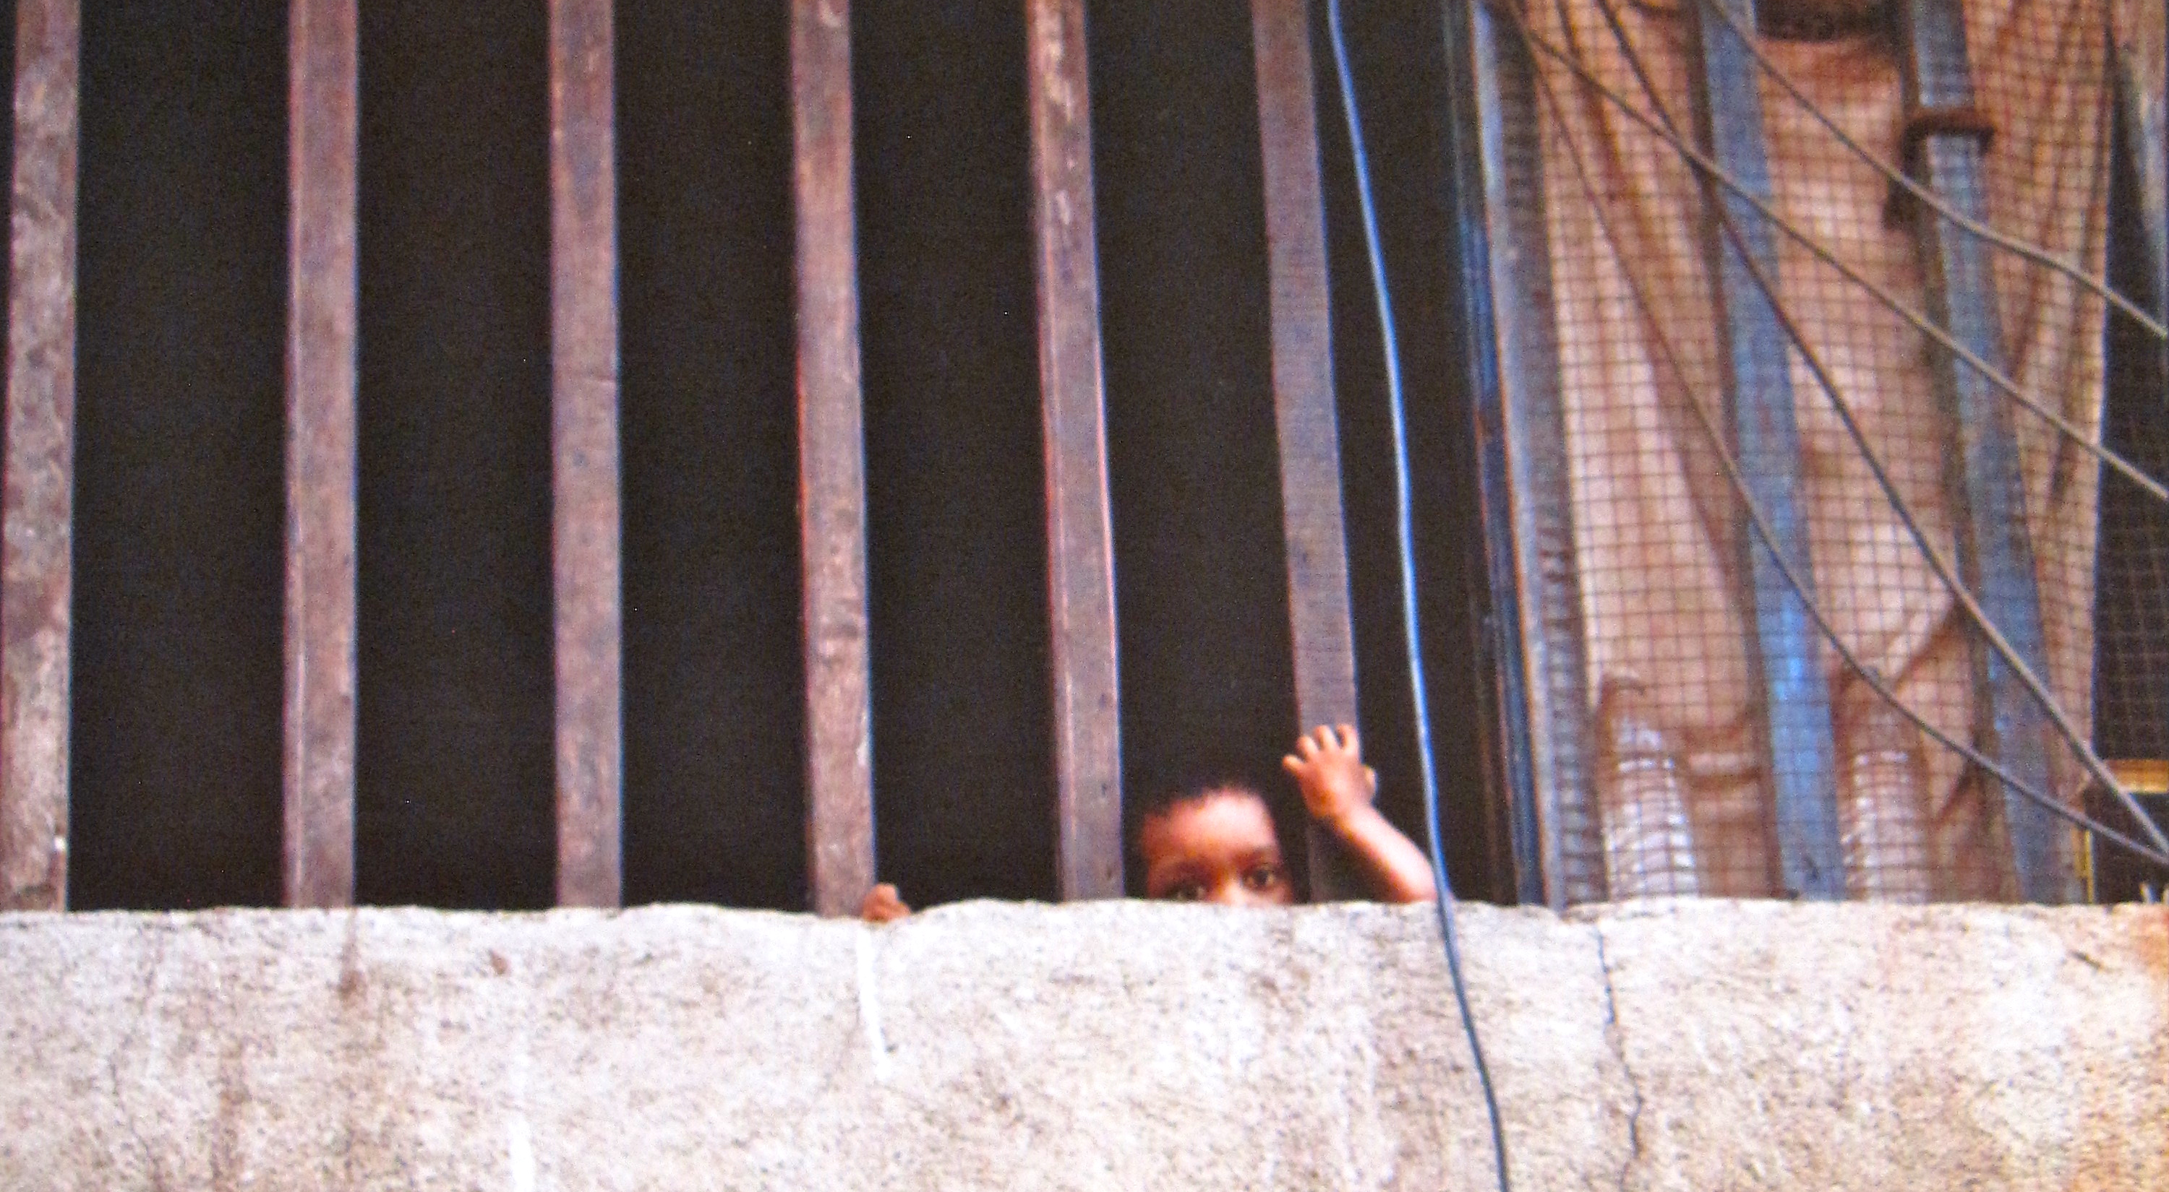
Poor Living Conditions

Slide 9
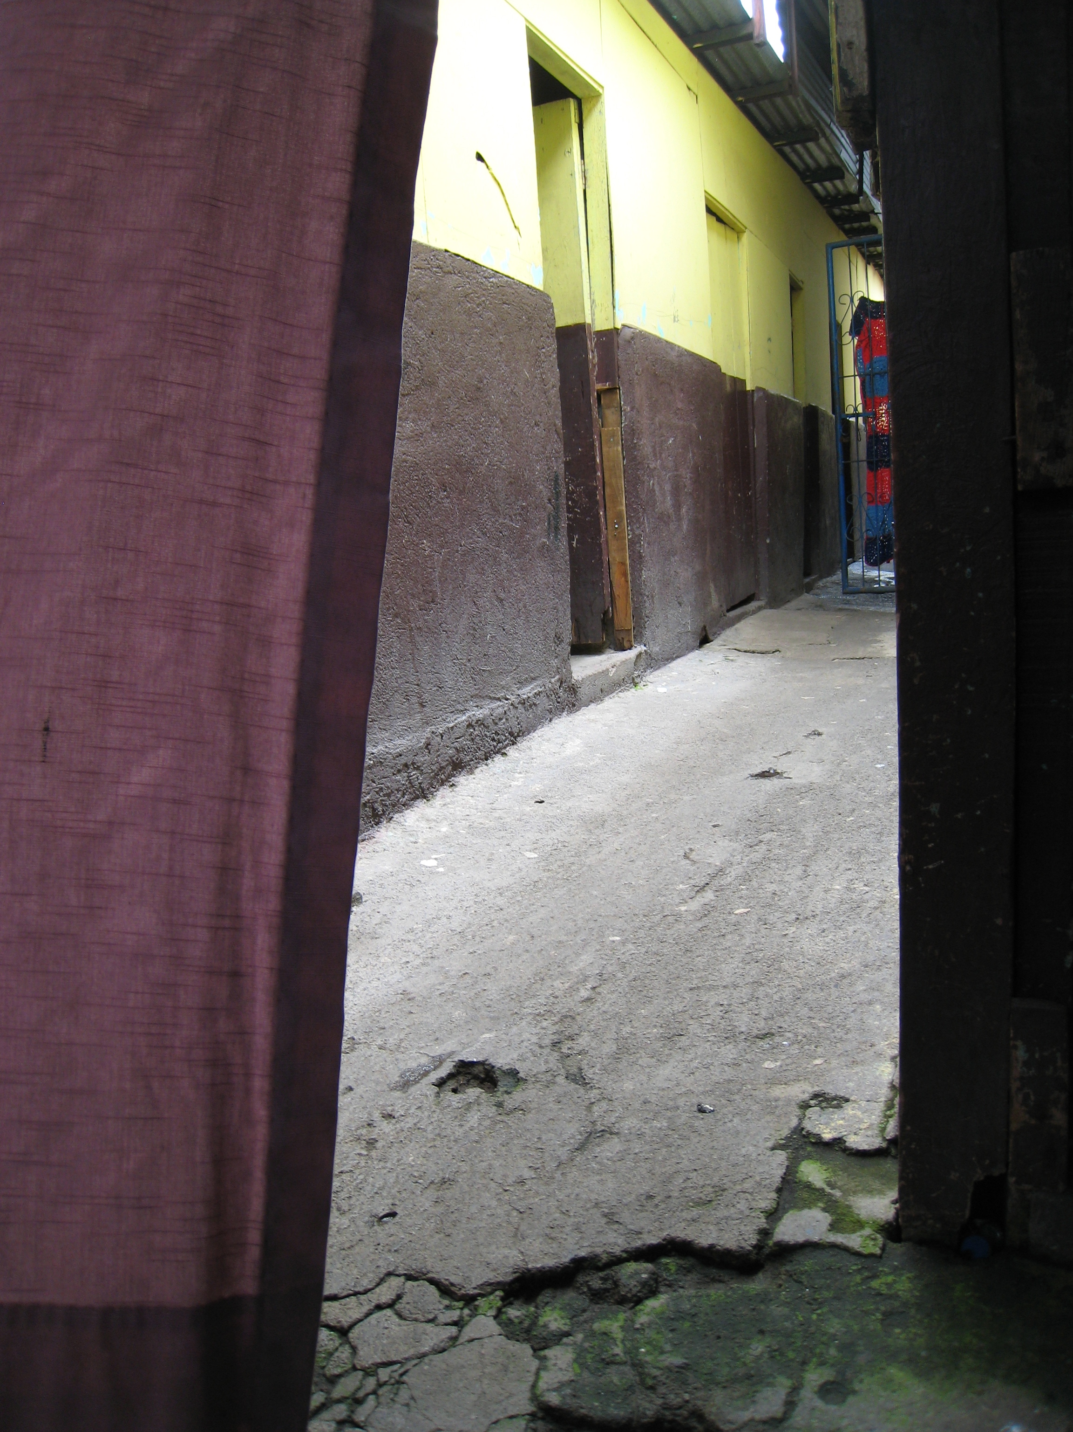
Poor Living Conditions
Malnutrition
Diarrhea
Scabies
Head Lice
Typhoid
Tuberculosis
Impetigo

Slide 10
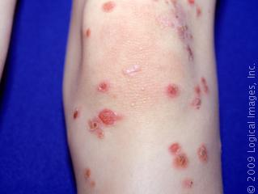
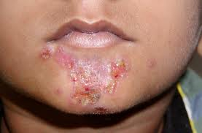
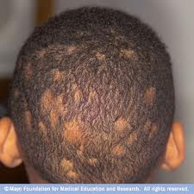
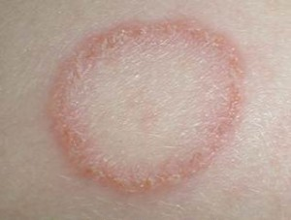
Notes:
scabies

Slide 11
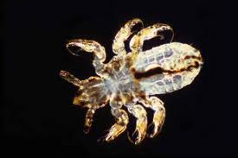
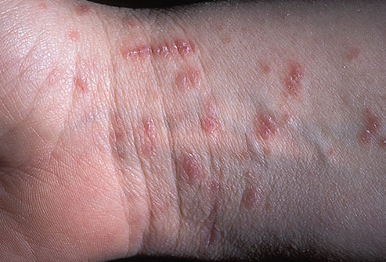
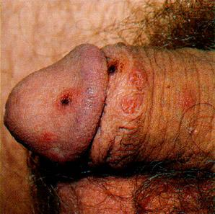
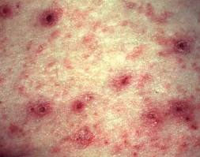

Slide 12
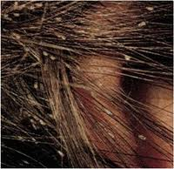
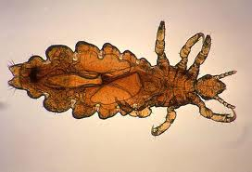
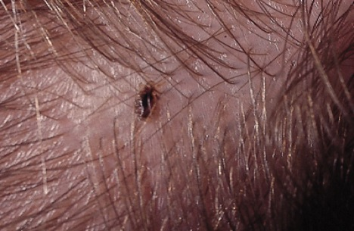
Notes:
lice

Slide 13

The most common physical health symptoms reported by women at 0-14 days
81% headaches
71% dizzy spells
63% memory problems
69% back pain
60-70% various sexual health problems
82% fatigue
63% reported more than 10 concurrent physical health problems upon entering
posttrafficking programs Zimmerman 2003

Slide 14
WEIGHT LOSS
EATING DISORDERS
SLEEP DISTURBANCES

Slide 15
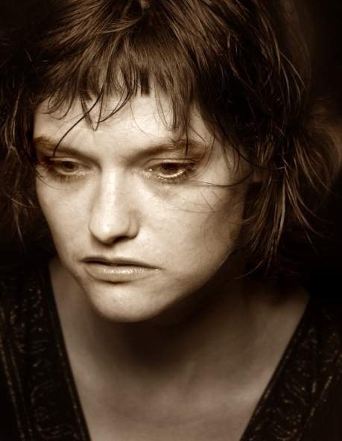

Mental Health Consequences
PTSD 68%
Acute Anxiety 91%
Depression 85%
Insomnia
Hyperalertness
Loneliness 88%
Fear 85%
Tension 84%
Flowers,2001. Raymond and Hughes,2001
Notes:
827 people in 9 different countries

Slide 16
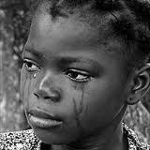
MENTAL HEALTH CONSEQUENCES
Mind/body separation
Disassociated ego states
Shame
Grief
Distrust
Hatred of men
Suicidal thoughts 67%, selfhatred

Slide 17
MENTAL HEALTH CONSEQUENCES
Isolation
Fear of the authorities
Sense of betrayal; since the trafficker has been characterized by the victims as:
  Acquaintances (46%)
  Friends (8%)
  Boyfriend/husband (3.5%)
  Neighbor/family friend (3.2%)
  Relative (2.2%)
Notes:
MOST VICTIMS FIRST RECOGNIZE THE GRAVITY OF THEIR PREDICAMENT SOMETIME IN TRANSIT

Slide 18
Mental Health issues for Children
Affective disorders
Behavioral disorders
Cognitive problems
Acute anxiety and stress
Conduct disorders
Personality disorders
Poor academic achievement
Poor interpersonal relationships

Slide 19

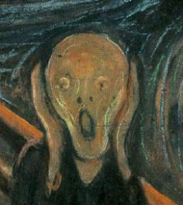



PANIC ATTACKS

Slide 20
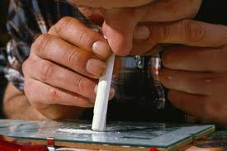

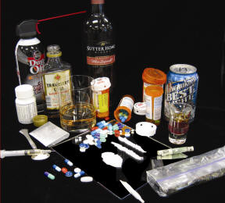
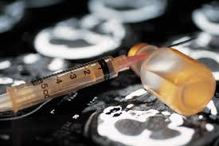
SUBSTANCE ABUSE
Notes:
To soothe her pain
To control by pimp
withdrawal

Slide 21
Mental Health Care
Trauma from Sexual Violence
Cognitive behavioral therapy
Trauma informed mental health services
Substance abuse therapy
Notes:
Substance abuse therapy- underutilized- fear of discrimination, shame

Slide 22
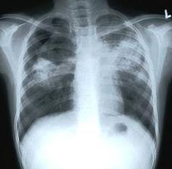
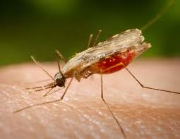
Infectious diseases
From place of origin- undiagnosed or treatment stopped
From transit- crowded, poorly ventilated, contaminated water
From destination- neglected

Slide 23
PHYSICAL ABUSE
FRACTURED BONES
JOINT DISLOCATION
BRUISES
CUTS AND PUNCTURE WOUNDS
DENTAL INJURIES
FACIAL INJURIES
BURNS
HEAD TRAUMA, CONCUSSION, HEADACHES
PERFORATED TYMPANIC MEMBRANE

Slide 24
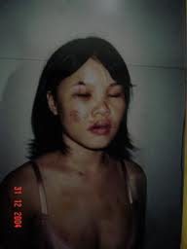
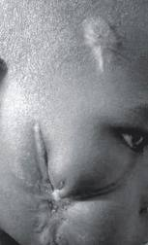
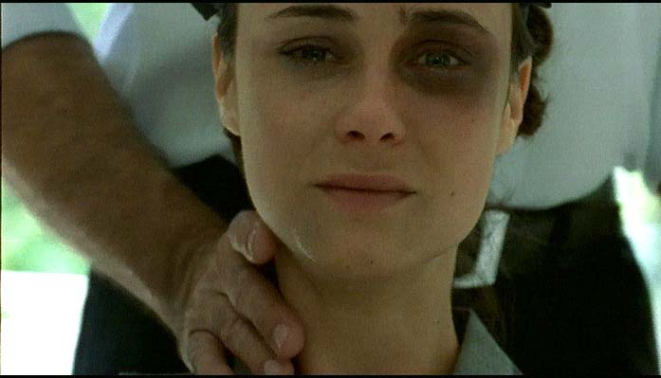
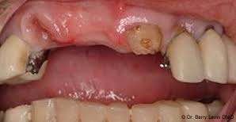

Slide 25
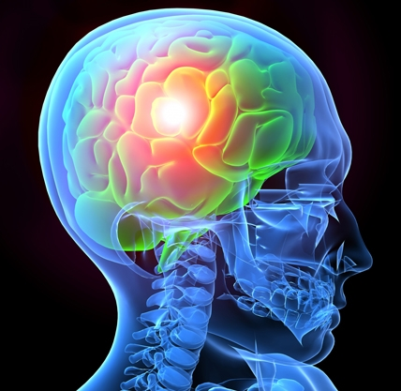


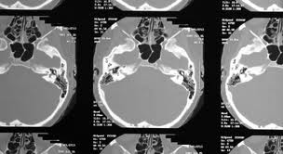

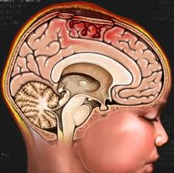
TRAUMATIC BRAIN INJURY
Notes:
Affect memory, recall of events- giving a coherant history

Slide 26
SEXUAL EXPLOITATION
HIV/AIDS
HEPATITIS
SEXUALLY TRANSMITTED INFECTION
PREGNANCY
-ectopic pregnancy
-abortion complications
VAGINAL TRAUMA
CANDIDA
UTI’S
Raymond and Hughes, 2001

Slide 27
SEXUAL EXPLOITATION
SEXUALLY TRANSMITTED INFECTIONS
  PELVIC INFLAMMATORY DISEASE
  CHLAMYDIA
  GONORRHEA
  SYPHILIS
  TRICHOMONIASIS
  GENITAL HERPES
  GENITAL WARTS
  PUBIC LICE

Slide 28
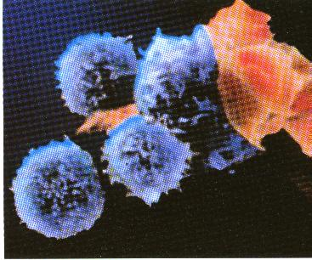
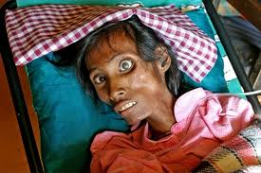
HIV/AIDS SYMPTOMS
FLULIKE SYMPTOMS
WEIGHT LOSS
ANOREXIA
DIARRHEA
ORAL CANDIDA
TB
KARPOSI’S SARCOMA
ORAL HAIRY LEUKOPLAKIA

Slide 29
Trafficked Women vs. Legal Prostitutes
Risks and vulnerabilities for HIV
  Illiteracy
  Low awareness of STI’s and HIV
  Limited access to health care
  Limited ability to negotiate with clients
  Reluctance to seek services when available for fear of arrest and deportation

Slide 30
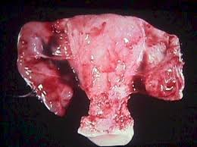

PID

Slide 31
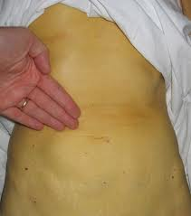
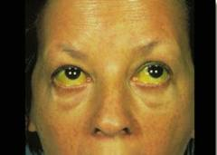
Notes:
HEPATITIS

Slide 32
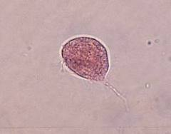
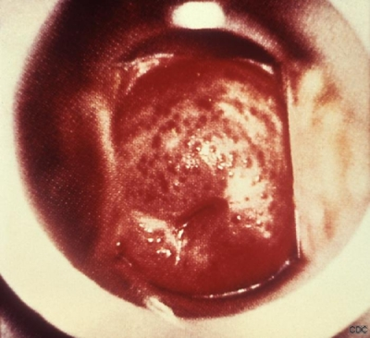
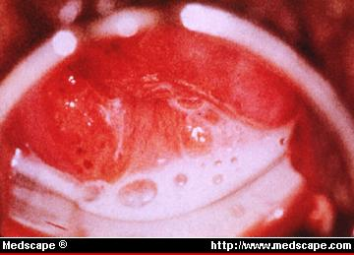
Notes:
TRICH

Slide 33
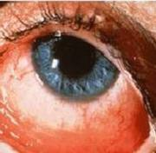

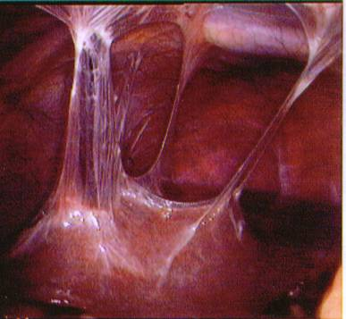
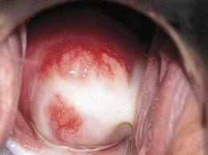
Notes:
Disease formerly known as Reiter’s syndrome- reactive arthritis can’t see, can’t pee, can’t climb a tree

Slide 34
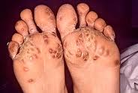
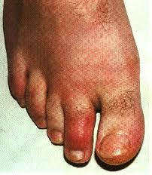
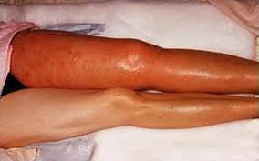

Slide 35
FACTORS INFLUENCING THE PREVALENCE OF STI’S AMONG TRAFFICKING VICTIMS
Degree of sexual exploitation
Lifetime number of sexual partners-
Victims of sexual trafficking have been reported as being forced to have sex with as many as 40-50 men per night
Condom use
Trauma
Coitus during menstruation
Vaginal douching
Notes:
25% increased STI’s in teens sexually assaulted
≥ 50 % prostitutes in one study douche regularly

Slide 36
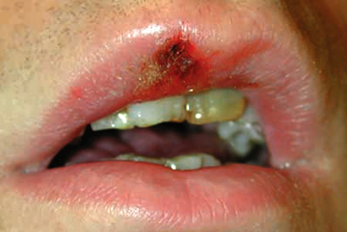
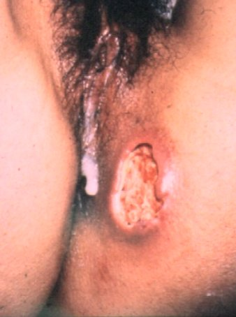
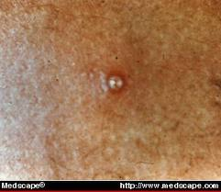

Slide 37
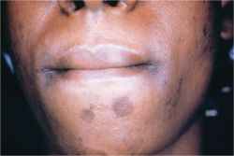
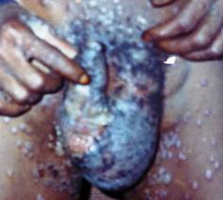
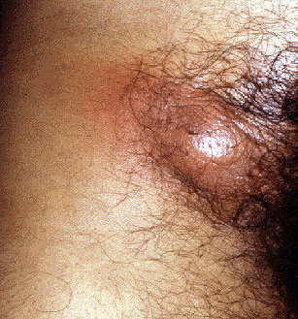
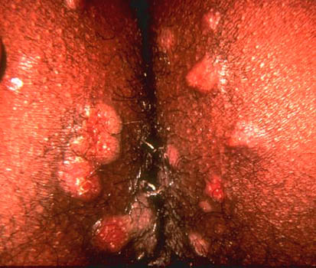
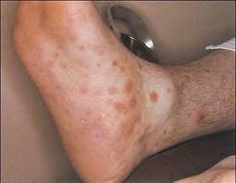
Notes:
2ndary syphilis

Slide 38



Notes:
Congenital syphilis

Slide 39


Notes:
gumMA
PRESENTATION 3 SYP + HIV

Slide 40


Slide 41



Slide 42


Slide 43
CONSEQUENCES OF PREGNANCY IN PROSTITUTED CHILDREN
9 million girls per year
Maternal deaths 4752
Induced abortions 1,224,000
Abortion related complications 367,200
Abortion related deaths 710
Lancet 2002

Slide 44

ABORTION COMPLICATIONS
PROLONGED BLEEDING
HEAVY BLEEDING
FEVER
LOWER ABDOMINAL PAIN
FOUL VAGINAL DISCHARGE

Slide 45

LATE ABORTION COMPLICATIONS
PREMATURITY
INCOMPETENT CERVIX- PG LOSS
PLACENTA PREVIA
INFERTILITY
CHRONIC PELVIC PAIN

Slide 46
LONG TERM CONSEQUENCES
UNWANTED PREGNANCY
INFERTILITY
CHRONIC PELVIC PAIN
AIDS
ECTOPIC PREGNANCIES
CERVICAL CANCER

Slide 47


Slide 48

Notes:
Majority HPV disappears without rx

Slide 49



Visual Inspection Methods
VIA - visual inspection with acetic acid & naked eye
VIAM - visual inspection with acetic acid & low magnification
VILI - visual inspection with Lugol’s Iodine

Slide 50

Reproductive Considerations
HIV testing
Pregnancy test
STI screening
Contraception options
Safe sex counseling
? Syndromic treatment
Notes:
Contraception without counselling doesn’’t prevent STI’s

Slide 51






Labor Trafficking

Slide 52
Specifically Labor trafficked Persons
Often diseases of poverty
Often physically abused
Often sexually abused
Same chronic diseases of general population but less treated/more advanced
Diseases from unsafe working conditions

Slide 53
Specifically labor trafficked victims
  Diseases from poor ventilation and exposure to chemicals and other toxins
    Respiratory
    Skin
  Injuries from repetitive motion
    Musculoskeletal
  Injury from loud environment
    Ear
  Injuries from unsafe conditions
    Eye
    Musculoskeletal
Notes:
Skin infections, burns, trauma, dermatitis
Burns, cuts, fractures

Slide 54
Lab Considerations
CBC with diff
HIV
Serology for hepatitis B and C, syphilis
Chest xray
Stool ova and parasites
TB skin test
Pap smear
Cervical/vaginal swab- chlamydia, trichomonas
Pharyngeal, high rectal and vaginal swabs- GC
U/A
Rape kit for forensics

Slide 55
PREVENTIVE CARE
SUPPLY IMMUNIZATIONS
PAP SCREENING
DENTAL
HEARING
VISION
Notes:
CHILDREN OFTEN NO PREVENTIVE CARE
Broken teeth or jaws,poor oral health-neglect, poor diet, poor physical health
´

Slide 56
A Complex Victim Group
Disclosure barriers
Fear of retaliation by traffickers
Fear for family safety
Guilt of her perceived complicity in what occurred
Guilt over any criminal activities in which she participated
Shame about what she has done, particularly sexual activities
Little trust in officials, e.g., police, immigration, health workers
Loyalty to traffickers as coping mechanism

Slide 57
Communicating with Victims of Human Trafficking
Before questioning potential trafficking victim:
  Isolate individual from person accompanying her/him without raising suspicions
  Individual accompanying patient may be trafficker posing as spouse, other family member or employer
Notes:
You may want to say that your ER/health clinic policy is to examine the patient alone.
It’s also important to enlist a trusted translator/interpreter who also understands the patient’s cultural needs. Don’t rely on the individual accompanying the patient to translate, since this individual could be the trafficker and will likely sanitize the patient’s responses.
If the patient is a child, it is important to call in a social services specialist skilled in interviewing children who are trafficking or abuse victims.

Slide 58
Communicating with Victims of Human Trafficking: Messages
Gaining victim’s trust important first step in providing assistance
Sample messages to convey:
  We are here to help you.
  Our first priority is your safety.
  If you are a victim of trafficking and you cooperate, you will not be deported.
  We will give you the medical care that you need.

Slide 59
Additional Systems Review
HEENT
  Head trauma?
  Frequent headache?
  Pharyngeal trauma?
  Dental or gingival pain?
  Visual changes?
Neck
  Hx strangulation?
CV
  Chest trauma?
Respiratory
  Possible TB exposure (living conditions? #people sharing a room?)
GI
  Abdominal trauma?
  Chronic diarrhea

Slide 60
Additional Systems Review
GU
  Sexual trauma including foreign objects?
Musculoskeletal
  Fractures?
  Burns? Contractures?
Neurological/Behavioral
  Seizure activity?
  Head trauma?
  Sleep disorders?
Nutrition
  Deficiencies? (food intake? content?)
  Disordered eating?
Dermatological
  Scabies? Lice? fine hair? (nutritional deficiencies?)
  Burns?
  Impetigo? Fungal infections?

Slide 61
TRAUMA INFORMED CARE
Give priority to survivor’s physical and emotional safety
Concurrently address co-occurring problems
Use an empowerment philosophy to guide service delivery
Maximize survivor’s choice and control of services
Emphasize survivor’s resilience
Minimize the potential of the survivor experiencing additional trauma
Notes:
Includes learning about how their responses stem from the past

Slide 62
Foundational Goals of Trauma Informed Care (Lancet 2010)
Integrated care- body, mind and spirit- a whole person
Non-judgmental, caring approach
Adapted to individual’s needs
Cultural, gender, and age appropriate care
Notes:
Not just a list of clinical sx
Empowering- her rights, bodily integrity,participation in decision making

Slide 63
Cultural/Educational/Social differences
What is the problem?
What do you think caused your problem?
Why do you think the problem started when it did?
How does it affect you?
What worries you most? (severity? duration?)
What kind of treatment do you think you should receive?

Slide 64



Notes:
Privacy, confidentiality

Slide 65


1. know your resources
2. develop protocols
3. research needed
Notes:
Research- difficult- duration, cost, access to victims
Risk factors, prevention,, health consequences,best practices

Slide 66
“The healthcare community must become more engaged in increasing the recognition of trafficked women and girls in healthcare settings, in provision of appropriate services, and in helping shape public policy to address what is one of the most disturbing health issues of our time.”
                Chris Beyrer, Lancet, 2004

Slide 67

Kay Chernush for the U.S. State Department.
"If therefore the Son shall make you free,
you shall be free indeed.”
--John 8:36

