Slide 1
Welcome to ICD-10: Important New Codes
W61.33 - Pecked by a chicken
V91.07XA - Burn due to water-skis on fire
R46.1 - Bizarre personal appearance)
W22.02XD - Walked into a lamppost
T71.224 - Asphyxiation due to being trapped in a car trunk
Z63.1 - Problems in relationship with in-laws
V95.42 - Forced landing of spacecraft injuring occupant
Y92146 - Hurt at swimming pool of prison as the place of occurrence
Y92253 - Hurt at the opera

Slide 2
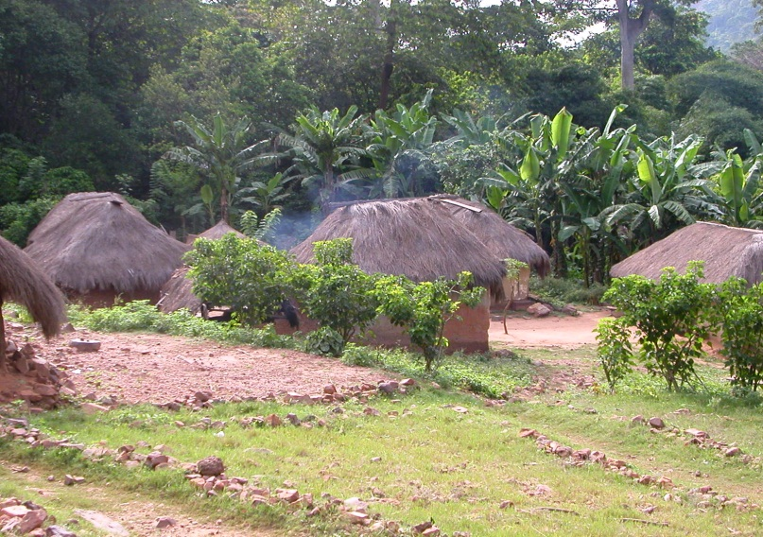
Merging First World Quality With Third World Resources
Stephen P. Merry, MD, MPH, DTM&H
Assistant Professor of Family Medicine
Chair, Mayo International Health Program
Mayo Clinic, Rochester
Notes:
How many students, physicians, NP/PA
How many have done clinical work in LMIC?
How many expect to do so in the future.

Slide 3
Alternative Title:
Cost Effective Care in Low Income Countries:
Quality Care With Less Resources
Stephen P. Merry, MD, MPH, DTM&H
Assistant Professor of Family Medicine
Chair, Mayo International Health Program
Mayo Clinic, Rochester
Notes:
How many students, physicians, NP/PA
How many have done clinical work in LMIC?
How many expect to do so in the future.

Slide 4
Disclosures
Financial Disclosures
  None
Off label drug use
  None
4

Slide 5
Learning Objectives
Treat chronic diseases in resource-limited settings in a rational, cost-effective way.
Follow an income-based diagnosis and treatment protocol for hypertension, type 1 and 2 diabetes, maternity care, surgery, cancer screening, and acute care.
Design treatment protocols based on guiding principles of cost-effectiveness.

Slide 6
Medical Missionaries Behaving Badly in LIC
Export US treatment protocols
Treat diseases with little regard to benefit or cost
“We shouldn’t treat them any differently than we’d want to be treated…”

Slide 7
The Overview Slide
Careful consideration of the ratio of the whole care process to benefits
:
in the context of the resources of patient/family/employer/country (whoever is paying)
Cost effective care
Cost : [from access to diagnosis to treatment to follow-up] | Benefit (in Disability Adjusted Life Years - DALYs)

Slide 8
Disclaimer
I’m a clinician
  Patient-centric, practice-based view on cost effectiveness analysis
  Goal – practical point of care concepts and tools
Cost effective analysis is based on assumptions (usually based on evidence from HIC)
Goal – thought provocation.

Slide 9
Cost Effectiveness Analysis
Analysis of the “care delivery value chain”
  Prevention
  Testing/Screening
  Staging
  Delaying progression of disease
  Initiation of therapy
  Continuous disease management
  Management of deterioration
Rhatigan et al. Applying the Care Delivery Value Chain: HIV/AIDS Care in Resource Poor Setttings. Harvard Business School working paper, 2009

Slide 10
Cost Effectiveness Analysis
Searches for “best buys”
  E.g. smoking cessation vs statins for CVD prevention.
Expresses decisions in cost per benefit (usually cost in US$/DALY gained)
Requires clear knowledge (or an informed guess) of numbers needed to treat for one to benefit.
WHO and World Economic Forum, “From Burden to ‘Best Buys’”, 2009

Slide 11
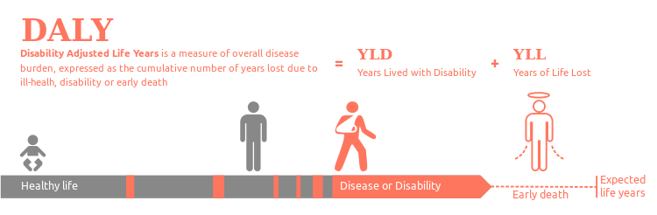
What Is A Reasonable Cost?
How much is a patient willing to pay (WTP) for the estimated value of the treatment?
What is 1 DALY worth
  1-3 x the per capita GDP (WHO)
  1-3 x the per capita family income - (income of the family / # in family) x 3 ?

Slide 12
Case 1: Hypertensive Guinean Farmer
A 55 yo Guinean farmer; drinks heavily, BP 159/99, BMI 33, exam normal.
Recommend lifestyle changes, BP checks by a CHW, and return or see CHC nurse if consistently elevated above 160/100.
Do “a” and start HCTZ.
Do “b” and check a potassium, creatinine, fasting glucose, U/A, CBC, and ECG
Do “c” and also check his cholesterol level and initiate statin and ASA if elevated.

Slide 13
What is HTN?
JNC 7 and WHO
Normal = systolic <120 mmHg and diastolic <80
Pre-hypertension: systolic 120-139 or diastolic 80-89
Hypertension:
  Stage 1: systolic 140-159 or diastolic 90-99
  Stage 2: systolic 160 or diastolic 100

Slide 14
Hypertension in Africa
Adapted from Edwards R, Unwin N, Mugusi F et al. Hypertension prevalence and care in an urban and rural area of Tanzania 2000. J Hypertens; 18:145-52.

Slide 15
Hypertension is the Leading Cause of Heart Failure in Africa
(Urban Cardiology Practice in Ghana)
Amoah AG, Cardiology, 2000
Notes:
Amoah AG. Cardiology 2000; 93(1-2):11-8
572 consecutive patients with heart failure referred to the National Cardiothoracic Centre, Accra, Ghana, over a 4-year period were evaluated for the aetiology of heart failure using two-dimensional Doppler echocardiography with colour flow. The mean age of the subjects with heart failure was 42.3 +/- 0.9 years. The male to female ratio was 1.2:1.0. Combined heart failure was seen in 50.5% of subjects. Peak incidence of heart failure occurred in the 5th decade. The main causes of heart failure were hypertension (21.3%; n = 122), rheumatic heart disease (20.1%; n = 115) and cardiomyopathy (16.8%; n = 96). Congenital heart disease and coronary artery disease accounted for 9.8 and 10% of cases, respectively. The commonest rheumatic valvular lesion was mitral regurgitation (78%). Dilated cardiomyopathy was the commonest form of idiopathic cardiomyopathy (67.7%; n = 65). Endomyocardial fibrosis and hypertrophic cardiomyopathy accounted for 22.9% (n = 22) and 9.4% (n = 9), respectively, of cardiomyopathies.

Slide 16
Paternalism vs. Shared Decision Making
Treat > 140/90 without risk factors?
NNT* = 700/year (mild HTN) to prevent 1 CV death.
If cost of Rx = US$50/year, is the farmer REALLY consenting to US $35,000 (given a 1 in 700 chance of benefit per year) to save ~10 years life (about $3,500/DALY gained)
*Number Needed to Treat for one person to receive a defined benefit in a given period of time

Slide 17
Paternalism vs. Shared Decision Making
WHO suggests max DALY cost should be 2-3x per capita GNP (skewed by the wealthy)
Perhaps a better threshold for max DALY is 2-3x his family per capita income
Given he makes $200/year and has a family of 4 (3 wives, no children still at home) then … max DALY cost = ($200 x 3) ÷ 4 = $150/DALY.

Slide 18
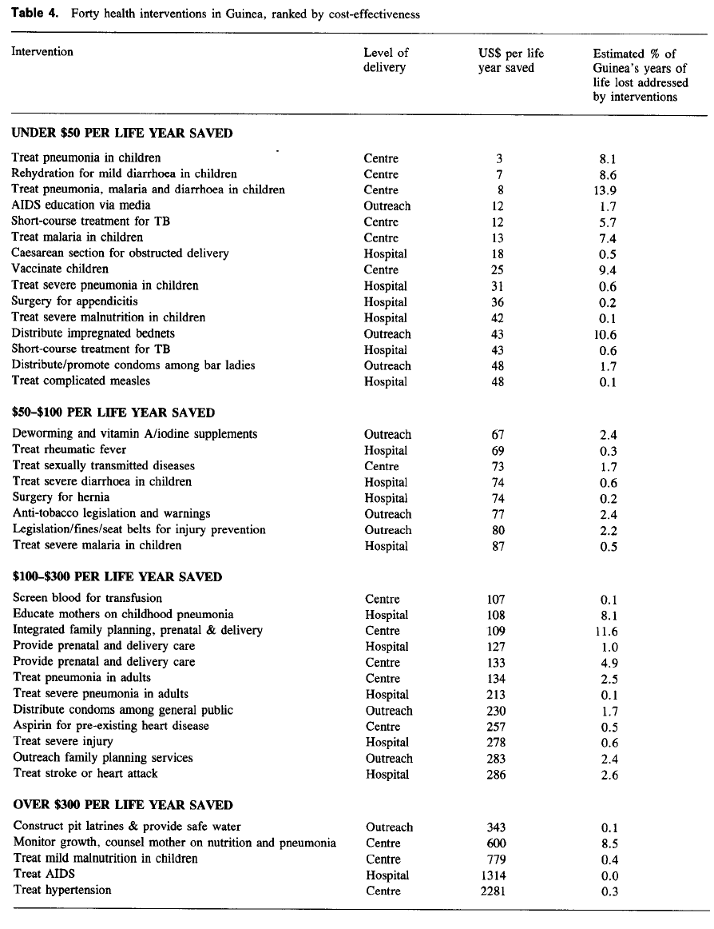
40 Health Interventions in Guinea, ranked by cost-effectiveness.
HTN treatment is the least cost effective.
Jha et al, Health Policy and Planning, 1998

Slide 19
Case 1: Hypertensive Guinean Farmer
A 55 yo Guinean farmer; drinks heavily, BP 159/99, BMI 33, exam normal.
Recommend lifestyle changes, BP checks by a CHW, and return or see CHC nurse if consistently elevated above 160/100.
Do “a” and start HCTZ.
Do “b” and check a potassium, creatinine, fasting glucose, U/A, CBC, and ECG
Do “c” and also check his cholesterol level and initiate statin and ASA if elevated.

Slide 20
Case 1 Alternative₁:
Change scenario - 35 yo business owner, family of 6, makes $2000/year.
NNT = 700/year (mild HTN) to prevent 1 CV death.
If cost of Rx = US$50/year, is the farmer REALLY consenting to US $35,000 (given a 1 in 700 chance) to save ~35 years life => cost Rx = $1,000/DALY
If max DALY cost = 2-3x per capita family income then ($2000 annual income ÷ 6 people in family) x 3 = $1000 so therefore treatment stage 1 HTN is cost effective.

Slide 21
Case 1 Alternative₂:
55 yo business owner with stage 2 HTN.
NNT = ~35/year to prevent 1 CV death.
Cost/DALY = $175 (given Rx = US$50/year, then cost = US$1,750 to save ~10 years life.
Treatment of stage 2 HTN is cost effective for most.

Slide 22
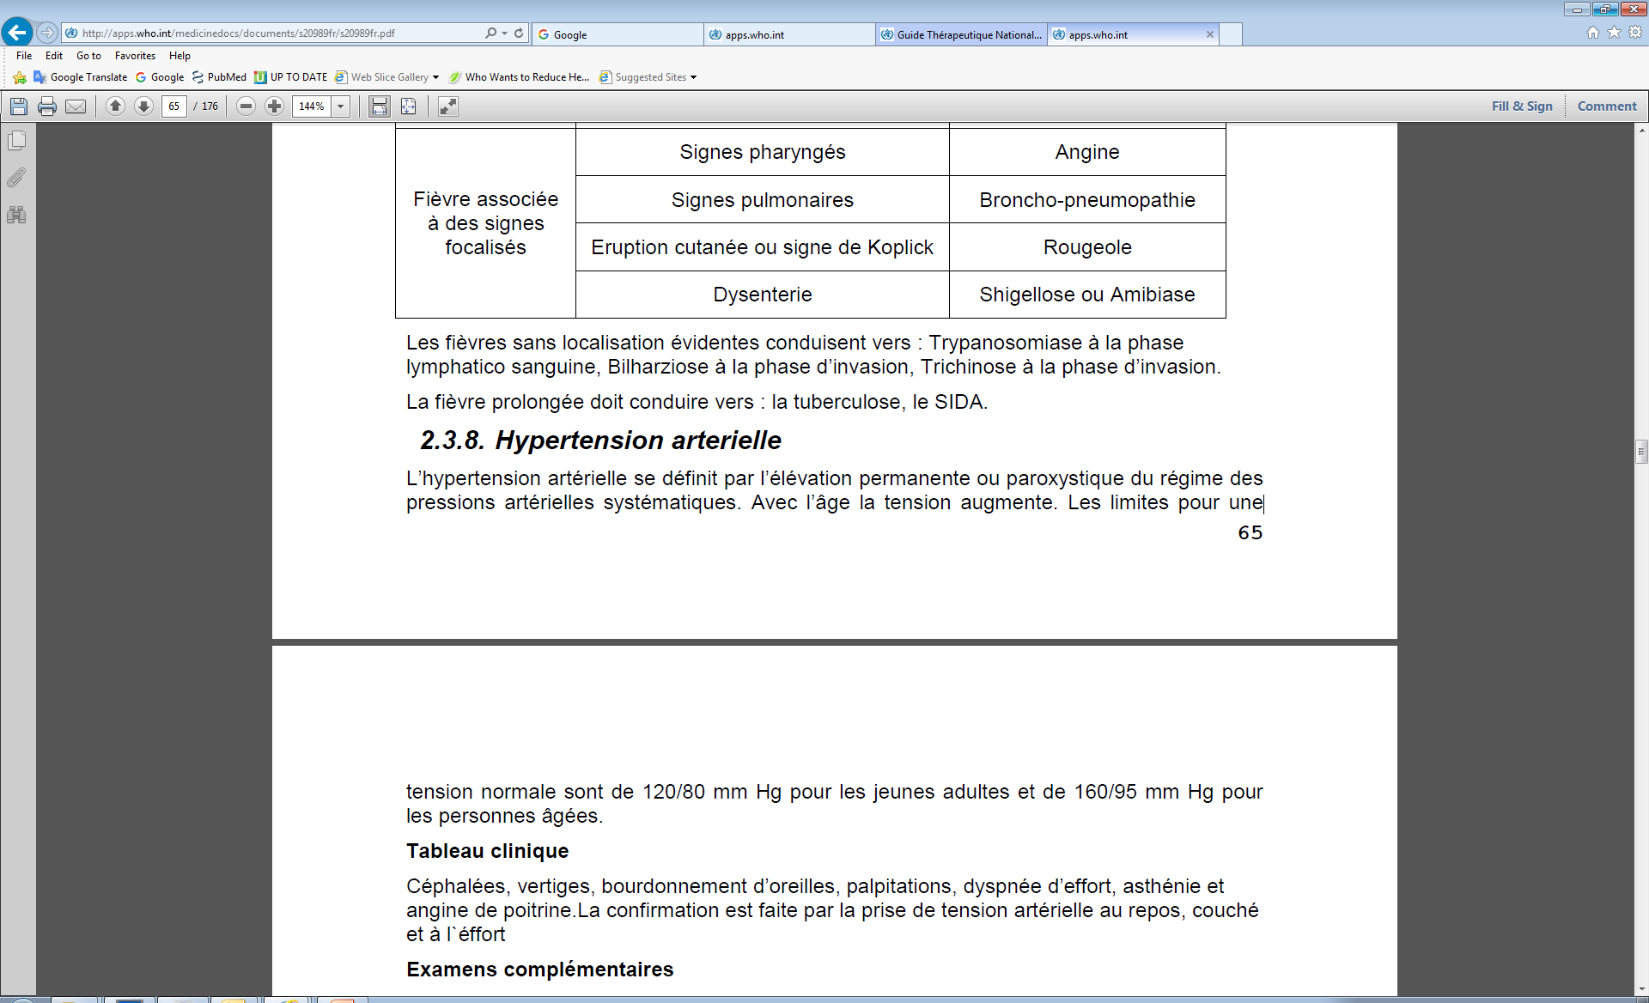
Guinea Guide Thérapeutique Nationale

Slide 23
Who to Treat?
Depends…
  Risk factors
  Access to care and follow up
  Availability/cost of meds
  Comorbidity
  Household finances

Slide 24

#Rationing

Slide 25
Wait…Are You Saying Life Isn’t Worth That?
No…
This is normal, of course, in US practice too…(to a far lesser degree).
Examine the total costs per benefit in light of resources.
Treat if the treatment is cost-effective for this patient.
This is not as easy as a simple calculation…

Slide 26
Where is that money coming from?
Could have been used for
  Children’s nutrition
  Wife’s prenatal care
Could have more resources than his income:
  A rich uncle in the city?
  Barter economy might mean more ability to pay if sells.

Slide 27
What will happen if I don’t treat…
CVA or CHF and disability of bread winner.
Never come back – my one chance to treat?
Disenchanted with mission hospital – “I came to get treated b/c I didn’t feel well!” but ...
  Were his symptoms from HTN? (treat him for the disease he came there for – that matters)
  Does he think your pills will certainly prevent death/disability?
  Does he know there’s a low chance of that?

Slide 28
If you do decide to treat…
Hx
Exam
Labs
  Dip U/A; maybe other if history, exam or urinalysis suggests need and can afford.
    Creatinine
    (K+)
    (ECG)
    (Lipids)
    (Fasting blood sugar)

Slide 29
Choose Meds & Methods Wisely
Start with Thiazide diuretics - cheap, few side effects
  Hydrochlorthiazide 25 mg daily # 400 + 1 banana/day
  “See me in 1 year” – sooner if high risk.
  Annual to q 5 year check on co-morbidities, compliance, refills, (dip urine).

Slide 30
Risk Stratification of hypertensive patients
 | Grade 1 (140-159/90-99 mm Hg) | Grade 2 (160-179/100-109 mm Hg) | Grade 3 (≥ 180/110 mm Hg)
No risk factors | Low risk | Medium risk | High risk
1-2 risk factors | Medium risk | Medium-high risk | Very high risk
≥ 3 risk factors, LVH, proteinuria, raised creatinine, grade 2 retinopathy. | High risk | High risk | Very high risk
Associated clinical condition = stroke, CAD, CHF, CRF, DM neph, grade 3+ hypertensive retinopathy | Very high risk | Very high risk | Very high risk
Adapted from WHO Guidelines

Slide 31
How should we treat mild HTN in LIC?
Depends… “Shared Decision Making”
  Risk factors
  Finances, values and preferences
Lifestyle modification if appropriate
  Weight loss, if obese
  Plant-based diet, NAS if not already eating.
  Exercise, if sedentary.
  Less alcohol if drinking in excess
Meds aren’t the only answer…

Slide 32
Lifestyle Modifications in the Management of Hypertension
Modification | Recommendation | Approximate systolic BP reduction
Weight reduction | Maintain BMI 18.5 – 25 | 5-20 mm Hg per 10 lb loss
Adopt DASH eating plan | Diet rich in fruits, vege’s, low fat dairy, reduced sat. fat | 8-14 mm Hg
Dietary sodium reduction | Low salt diet – 2.4 gm sodium | 2-8 mm Hg
Physical activity | 30 min per day brisk activity | 4-9 mm Hg
Limit alcohol | No more than 2/day men and 1/day women | 2-4 mm Hg
Adapted from JNC 7

Slide 33
Patient Education - HTN
HTN increases the risk of many diseases – stroke, heart attack, etc.
Lifestyle mod is AS EFFECTIVE as medicine
  It’s lots cheaper with multiple other benefits
  Patients in LIC will follow your advice.
HTN requires lifelong treatment
You need to take your medicine daily.
HTN treatment won’t make you feel much better but it’s good for you.

Slide 34
Choose Meds Wisely
Goal
  Cheap
  Convenient
  Effective risk reduction
  No side effects

Slide 35
Second Rx:
Choose Meds Wisely
All meds ~ same benefit in large studies (ALLHAT).
Start with Thiazide diuretics - cheap, few side effects, superior in CHD prevention
CCB’s work best in Africans
Notes:
Major outcomes in high-risk hypertensive patients randomized to angiotensin-converting enzyme inhibitor or calcium channel blocker vs diuretic: The Antihypertensive and Lipid-Lowering Treatment to Prevent Heart Attack Trial (ALLHAT). AUSOJAMA 2002 Dec 18;288(23):2981-97. CONTEXT: Antihypertensive therapy is well established to reduce hypertension-related morbidity and mortality, but the optimal first-step therapy is unknown. OBJECTIVE: To determine whether treatment with a calcium channel blocker or an angiotensin-converting enzyme inhibitor lowers the incidence of coronary heart disease (CHD) or other cardiovascular disease (CVD) events vs treatment with a diuretic. DESIGN: The Antihypertensive and Lipid-Lowering Treatment to Prevent Heart Attack Trial (ALLHAT), a randomized, double-blind, active-controlled clinical trial conducted from February 1994 through March 2002. SETTING AND PARTICIPANTS: A total of 33 357 participants aged 55 years or older with hypertension and at least 1 other CHD risk factor from 623 North American centers. INTERVENTIONS: Participants were randomly assigned to receive chlorthalidone, 12.5 to 25 mg/d (n = 15 255); amlodipine, 2.5 to 10 mg/d (n = 9048); or lisinopril, 10 to 40 mg/d (n = 9054) for planned follow-up of approximately 4 to 8 years. MAIN OUTCOME MEASURES: The primary outcome was combined fatal CHD or nonfatal myocardial infarction, analyzed by intent-to-treat. Secondary outcomes were all-cause mortality, stroke, combined CHD (primary outcome, coronary revascularization, or angina with hospitalization), and combined CVD (combined CHD, stroke, treated angina without hospitalization, heart failure [HF], and peripheral arterial disease). RESULTS: Mean follow-up was 4.9 years. The primary outcome occurred in 2956 participants, with no difference between treatments. Compared with chlorthalidone (6-year rate, 11.5%), the relative risks (RRs) were 0.98 (95% CI, 0.90-1.07) for amlodipine (6-year rate, 11.3%) and 0.99 (95% CI, 0.91-1.08) for lisinopril (6-year rate, 11.4%). Likewise, all-cause mortality did not differ between groups. Five-year systolic blood pressures were significantly higher in the amlodipine (0.8 mm Hg, P =.03) and lisinopril (2 mm Hg, P<.001) groups compared with chlorthalidone, and 5-year diastolic blood pressure was significantly lower with amlodipine (0.8 mm Hg, P<.001). For amlodipine vs chlorthalidone, secondary outcomes were similar except for a higher 6-year rate of HF with amlodipine (10.2% vs 7.7%; RR, 1.38; 95% CI, 1.25-1.52). For lisinopril vs chlorthalidone, lisinopril had higher 6-year rates of combined CVD (33.3% vs 30.9%; RR, 1.10; 95% CI, 1.05-1.16); stroke (6.3% vs 5.6%; RR, 1.15; 95% CI, 1.02-1.30); and HF (8.7% vs 7.7%; RR, 1.19; 95% CI, 1.07-1.31). CONCLUSION: Thiazide-type diuretics are superior in preventing 1 or more major forms of CVD and are less expensive. They should be preferred for first-step antihypertensive therapy.

Slide 36
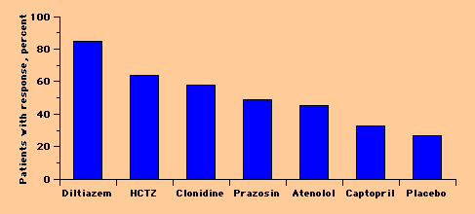
Antihypertensive Medication Response in US African Americans
Materson, NEJM, 1993

Slide 37
Choosing Meds Wisely
Amlodipine or Verapamil cheap and effective second line
CCB’s, Alpha-B’s, methyldopa, reserpine, hydralazine - effective without a Thiazide.
B-blockers and ACE’s - made more effective in Africans with a Thiazide.
Choose med based on co-morbidity e.g.
  Start with ACE if DM2
    Expect a creatinine rise up to 0.3 mg/dl
    Check creatinine and K+ after ~ 2 weeks

Slide 38
The ABCD’s of Choosing HTN Meds Wisely
Class of Drug | Indication | Contraindication/Side effects/Monitoring
Alpha-blocker (Hytrin) | BPH | Orthostatic hypotension
ACE/ARB *** Lisinopril etc Diovan, Candesartan | CHF, DM nephropathy, renal disease | Cough (ACE), hyperK+, renal impairment. K+ and Creatinine at 2 weeks, annual
Beta-blocker (Atenolol, Metoprolol) | CAD, pregnancy, (CHF) | CHF, brady, asthma
Calcium blocker (Verapamil, Cardizem) | CAD | Don’t use with B-blocker
Calcium blocker (DHP class: Norvasc) | CAD, isolated systolic HTN in elderly | Ankle edema, flushing, HA
Diuretic (Thiazide e.g. HCTZ or Chlorthalidone) | Low cost, edema, highly effective with ACE/ARB | Hypokalemia Check K+ at 2 weeks to 1 mo then annually. NAS diet.

Slide 39
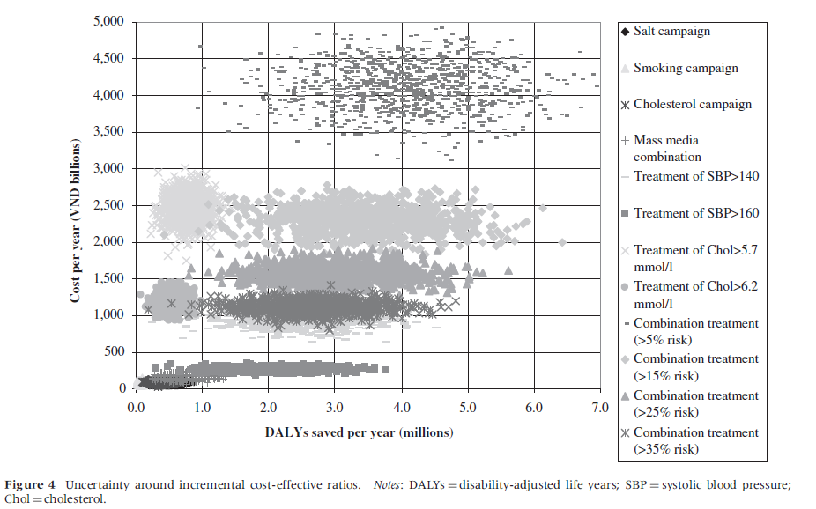
Ha DA, Chisholm D Cost-effectiveness analysis of interventions to prevent cardiovascular disease in Vietnam. Health Policy and Planning 2011;26:210–222.

Slide 40
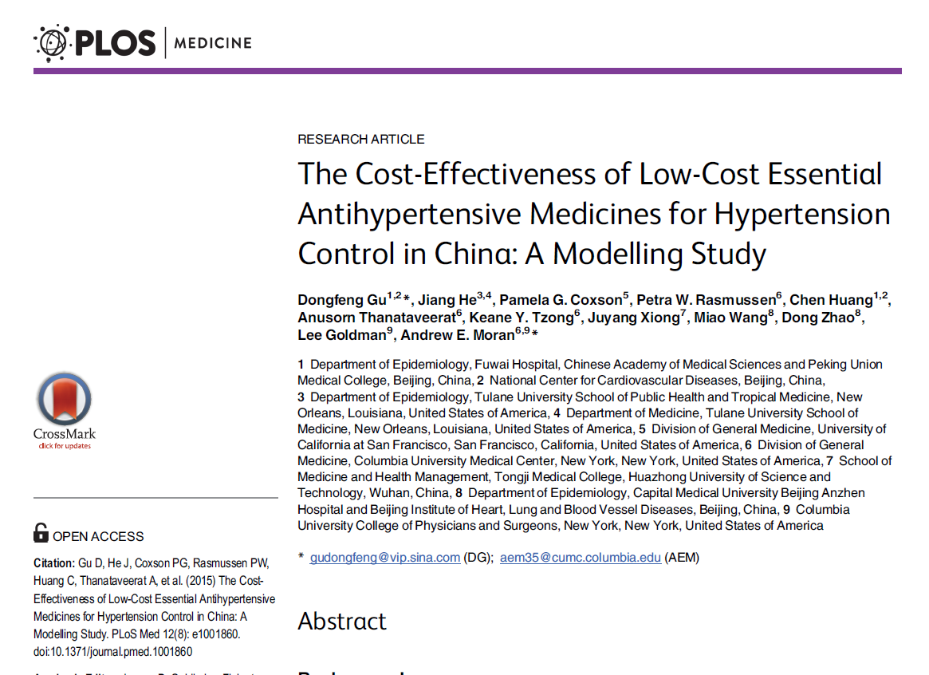
Treatment of stage 1 hypertension not cost-effective in even China (at 1x GDP)

Slide 41
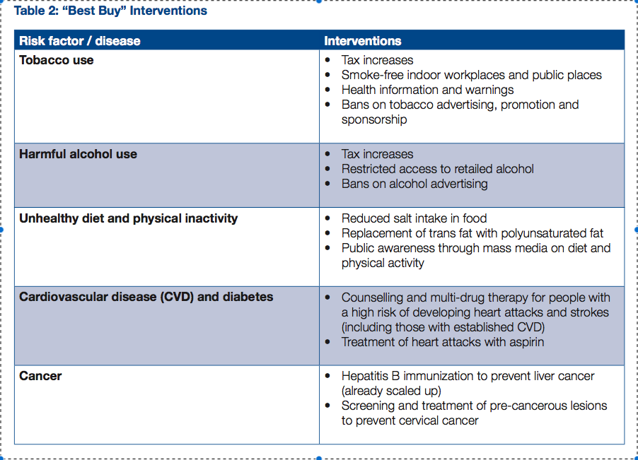
Best Buys
WHO and World Economic Forum, “From Burden to ‘Best Buys’”, 2009

Slide 42
Cost-Effectiveness Analysis
WHO-Choice ((CHOosing Interventions that are Cost-Effective): http://www.who.int/choice/cost-effectiveness/en/
  program in the World Health Organization that helps countries decide health system priorities based on considerations of costs and impacts.
One Health Tool – software – released 2012 http://www.who.int/choice/onehealthtool/en/
  software tool designed to inform national strategic health planning in low- and middle-income countries

Slide 43
Cost-Effectiveness Analysis
Economic evaluation: http://www.who.int/choice/documents/economic_evaluation/en/
  publications seeking to analyze cost:benefit for a variety of diseases and syndromes
Country specific research needed!…

Slide 44
Therefore…
I can’t (or shouldn’t) practice “there” just like I practice here.
Someone has thought about what should be screened, prevented, diagnosed and treated (the WHO policy analysts and hopefully the MOH)
I should integrate with national practice standards.

Slide 45
Case 2: The Togolese Boy With DM1
A 7 year old boy in DKA presents to your rural mission hospital. His village has no electricity. His family lives on < $2/day per person. His father asks you to d/c his son home to die. You would
Become angry and give dad your “man up” pep talk
Keep him hospitalized and think about it later.
Find the funds for home monitoring and insulin.
Have a compassionate discussion with the dad and child, explain the Gospel, pray with him, and d/c the boy per his father’s wishes.

Slide 46
DM1 – A Terminal Disease in LIC
Costs exceed household resources.
Hold your Western indignation – DM1 rarely treated in LIC (without relief type aid which maybe you/the hospital decides to provide).
  E.g. - International atttention focused on providing specifically for DM1 costs (c.f. http://www.un-ngls.org/IMG/pdf_MDGs_and_Diabetes_Factsheet.pdf)

Slide 47
Less Than 5% of DM1 Is Treated in Low Income Countries

Slide 48
BRIEF DEBRIEF

Slide 49
Case 3: 60 year old Togolese DM2
60 yo man with type 2 diabetes mellitus. He lives with his son, a subsistence farmer, but is himself inactive. Exam significant for obesity otherwise normal. You would
Advise weight loss, exercise, and 1 aspirin per day
“a” and add Metformin 2000 mg daily
Check a creatinine and do “b” if < 1.5
Do “c” and check his cholesterol and add a statin to control his LDL < 100
Do “d” and also add an ACE in case and recommend home glucose monitoring

Slide 50
Another Type of DM2:
DM2 without obesity and inactivity
Majority of DM2 in some LIC regions
Responds to oral agents
Lifestyle change makes little difference.
Unknown etiology. Pancreatic toxicity from food (cassava) or infection or genetics (cycles of food inavailability)?
NEED for country/region-specific research
  Etiology
  Natural course of disease
  Alteration of dz progression with treatment

Slide 51
Obesity/Inactivity Associated DM2
Tight glycemic control has only a little to do with morbidity and mortality
Obesity, inactivity, and other bad behaviors mitigate risk
Correcting these real problems reduce risk.

Slide 52
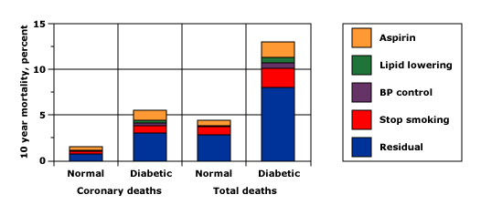
Risk Reduction of Various Interventions - 1993
Calculated effects of different interventions on coronary and total deaths in 1000 normal and 1000 men with type 2 diabetes aged 35 to 57 years without a history of myocardial infarction. Yudkin, JS, BMJ 1993; 306:1313
Notes:
Calculated effects of different interventions on coronary and total deaths in 1000 normal and 1000 men with type 2 diabetes aged 35 to 57 years without a history of myocardial infarction. Although risk was reduced by the therapeutic interventions (particularly cessation of smoking), there was a residual three to four fold increase in mortality in the diabetic men, which was apparently incorrectly thought to be due to simply the effects of hyperglycemia or hyperinsulinemia. Data from Yudkin, JS, BMJ 1993; 306:1313.

Slide 53
Conclusion Errors…
The residual risk of “MRFIT” is due to high sugars
Lowering sugar eliminates the risk

Slide 54
Value of Intensive Glycemic Control - 1998
3867 Type 2 DM followed 10 years
Conventional Control Diet alone A1C 7.9% | vs |  | Intensive Control Diet + Sulfa or Insulin A1C 7%
Less weight gain |  | No difference in agent eff.
Less hypoglycemia |  | 12% less laser photocoag of retinae
 |  | No sig difference in deaths
Conclusion: Tight control of DM2 doesn’t affect mortality (or help much).
UKPDS 33, Lancet 1998
Notes:
BACKGROUND: Improved blood-glucose control decreases the progression of diabetic microvascular disease, but the effect on macrovascular complications is unknown. There is concern that sulphonylureas may increase cardiovascular mortality in patients with type 2 diabetes and that high insulin concentrations may enhance atheroma formation. We compared the effects of intensive blood-glucose control with either sulphonylurea or insulin and conventional treatment on the risk of microvascular and macrovascular complications in patients with type 2 diabetes in a randomised controlled trial. METHODS: 3867 newly diagnosed patients with type 2 diabetes, median age 54 years (IQR 48-60 years), who after 3 months' diet treatment had a mean of two fasting plasma glucose (FPG) concentrations of 6.1-15.0 mmol/L were randomly assigned intensive policy with a sulphonylurea (chlorpropamide, glibenclamide, or glipizide) or with insulin, or conventional policy with diet. The aim in the intensive group was FPG less than 6 mmol/L. In the conventional group, the aim was the best achievable FPG with diet alone; drugs were added only if there were hyperglycaemic symptoms or FPG greater than 15 mmol/L. Three aggregate endpoints were used to assess differences between conventional and intensive treatment: any diabetes-related endpoint (sudden death, death from hyperglycaemia or hypoglycaemia, fatal or non-fatal myocardial infarction, angina, heart failure, stroke, renal failure, amputation [of at least one digit], vitreous haemorrhage, retinopathy requiring photocoagulation, blindness in one eye, or cataract extraction); diabetes-related death (death from myocardial infarction, stroke, peripheral vascular disease, renal disease, hyperglycaemia or hypoglycaemia, and sudden death); all-cause mortality. Single clinical endpoints and surrogate subclinical endpoints were also assessed. All analyses were by intention to treat and frequency of hypoglycaemia was also analysed by actual therapy. FINDINGS: Over 10 years, haemoglobin A1c (HbA1c) was 7.0% (6.2-8.2) in the intensive group compared with 7.9% (6.9-8.8) in the conventional group--an 11% reduction. There was no difference in HbA1c among agents in the intensive group. Compared with the conventional group, the risk in the intensive group was 12% lower (95% CI 1-21, p=0.029) for any diabetes-related endpoint; 10% lower (-11 to 27, p=0.34) for any diabetes-related death; and 6% lower (-10 to 20, p=0.44) for all-cause mortality. Most of the risk reduction in the any diabetes-related aggregate endpoint was due to a 25% risk reduction (7-40, p=0.0099) in microvascular endpoints, including the need for retinal photocoagulation. There was no difference for any of the three aggregate endpoints between the three intensive agents (chlorpropamide, glibenclamide, or insulin). Patients in the intensive group had more hypoglycaemic episodes than those in the conventional group on both types of analysis (both p<0.0001). The rates of major hypoglycaemic episodes per year were 0.7% with conventional treatment, 1.0% with chlorpropamide, 1.4% with glibenclamide, and 1.8% with insulin. Weight gain was significantly higher in the intensive group (mean 2.9 kg) than in the conventional group (p<0.001), and patients assigned insulin had a greater gain in weight (4.0 kg) than those assigned chlorpropamide (2.6 kg) or glibenclamide (1.7 kg). INTERPRETATION: Intensive blood-glucose control by either sulphonylureas or insulin substantially decreases the risk of microvascular complications, but not macrovascular disease, in patients with type 2 diabetes.

Slide 55
ADVANCE - 2008
Is Tight Control Good?
215 centers, 20 countries
11,140 pts DM2 randomized to “tight” A1C 6.5% or standard A1C to 7.3%; f/u 5 years
Age > 55, Vascular disease or risk
Less macroalbuminuria (9.4% vs 10.9%)
More hypoglycemia (2.7% vs 1.5%)
No difference in CV death, nonfatal MI, stroke.
The ADVANCE Collaborative Group. INTENSIVE BLOOD GLUCOSE CONTROL AND VASCULAR OUTCOMES IN PATIENTS WITH TYPE 2 DIABETES. N Engl J Med 358(24):2560, June 12, 2008

Slide 56
ACCORD - 2008
The End of Tight Control?
No significant different in MI or stroke
Intensive treatment caused
  Increased all-cause mortality 5% vs 4% (P=NS)
  More Hypoglycemia 16.2% vs 5.1%
  More Weight gain > 10 kg 27.8% vs 14.1%
The Action to Control Cardiovascular Risk in Diabetes (ACCORD) Study Group . The EFFECTS OF INTENSIVE GLUCOSE LOWERING IN TYPE 2 DIABETES. N Engl J Med 358(24):2545, June 12, 2008

Slide 57
Rational Obesity Associated DM2 CV Risk Reduction:
Smoking Cessation
Weight loss, Mediterranean Diet, exercise
BP normalization
ASA (males)
Glycemic control of minor benefit – use for symptoms unless well resourced
Statin (not lipid lowering)
No self testing - wasteful unless on varying dose insulin

Slide 58
World Health Organization/ Health Action International (VII) – Cost of Meds Expressed in Days of Wages

Slide 59
Cost Effective Care of DM2 in LIC
One medication decreases mortality* = Metformin
Goal – Order of highest to lowest priority
  Reduce cardiac risk (see prior slide)
  Treat the poor to reduce symptoms not A1C
  Retinal monitoring if affordable/treatment available
  Treat microalbuminuria with ACE if affordable
  Lower fasting glucose as income allows
  *Till Empagliflozin
  Zinman, NEJM, Sept 2015.

Slide 60
Case 3: 60 year old Togolese DM2
60 yo man with type 2 diabetes mellitus. He lives with his son, a subsistence farmer, but is himself inactive. Exam significant for obesity otherwise normal. You would
Advise weight loss, exercise, and 1 aspirin per day
“a” and add Metformin 2000 mg daily
Check a creatinine and do “b” if < 1.7 (or so)
Do “c” and check his cholesterol and add a statin to control his LDL < 100
Do “d” and also add an ACE in case and recommend home glucose monitoring

Slide 61
Case 4: The Pregnant Pakistani Woman
A healthy 30 yo G2P1, an uncomplicated prior pregnancy delivered by untrained TBA in her home presents for prenatal care to your rural hospital at 12 weeks GA. You would
Recommend monthly visits increasing to every 2 weeks at term with hospital delivery
Recommend she simply again deliver at home with the TBA
Recommend care at the maternity in town
Recommend TT2, iron/folate, insecticide treated bednet use, IPTp, a prenatal visit in each trimester with a midwife or physician and delivery with the midwife.

Slide 62
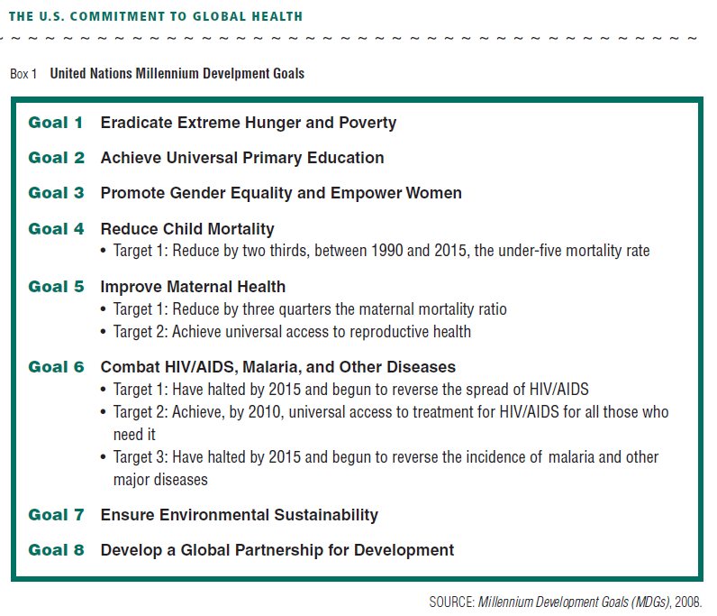
Why Be Involved
Institute of Medicine. The U.S. Commitment to Global Health: Recommendations for the New Administration Committee on the U.S. Commitment to Global Health. 2009.

Slide 63
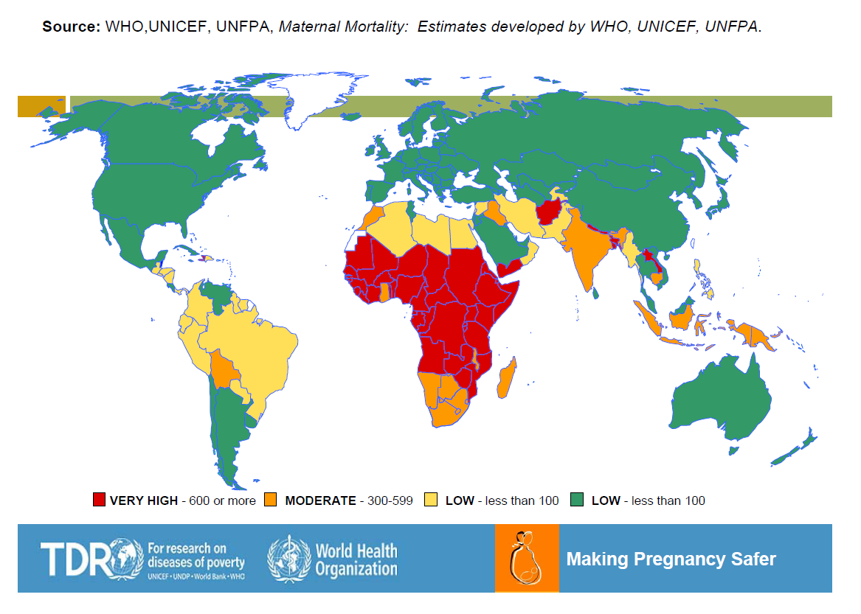
per 100,000
live births

Slide 64

29
Notes:
Much work remains!

Slide 65
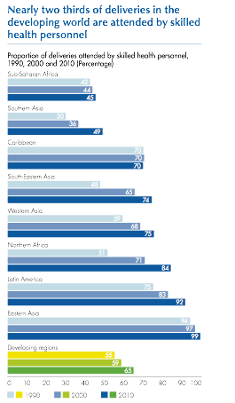
29

Slide 66
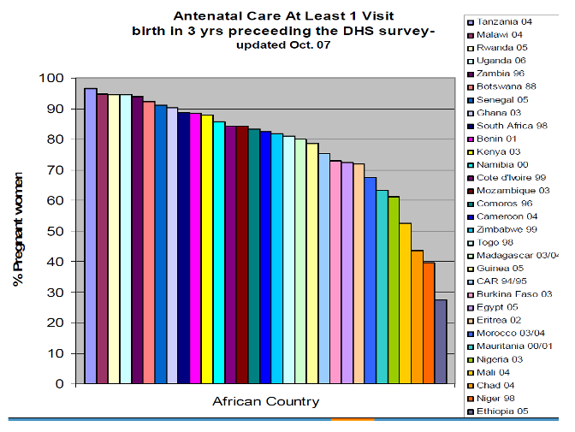
Inadequate Prenatal Care

Slide 67
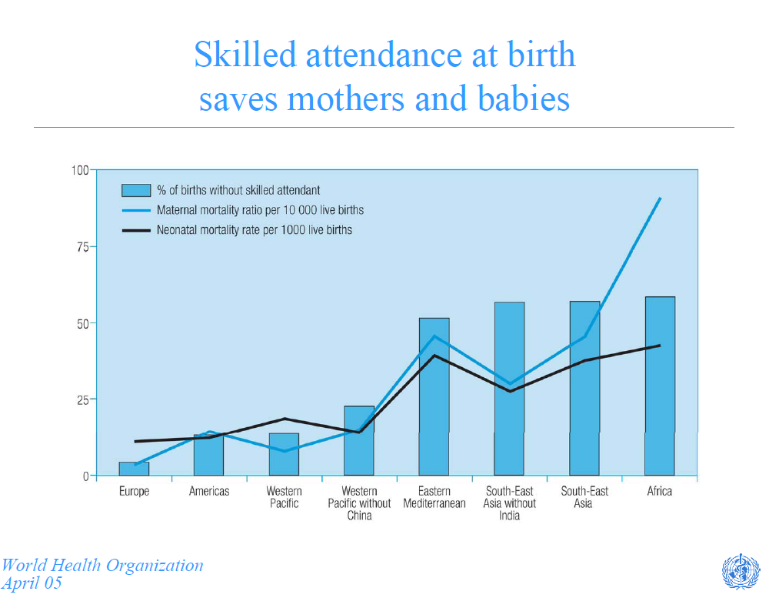

Slide 68
Good Maternity Care
Requires at least 1 visit per trimester
Interventions
  Iron/Folate
  Fansidar malaria treatment/prophylaxis
  IT Bed nets
  Tetanus immunization - TT2
  Advise location of delivery
Delivery by Midwife/Family Medicine/OB - a trained professional.

Slide 69
Case 4: The Pregnant Pakistani Woman
A healthy 30 yo G2P1, an uncomplicated prior pregnancy delivered by untrained TBA in her home presents for prenatal care to your rural hospital at 12 weeks GA. You would
Recommend monthly visits increasing to every 2 weeks at term with hospital delivery
Recommend she simply again deliver at home with the TBA
Recommend care at the maternity in town
Recommend TT2, iron/folate, insecticide treated bednet use, IPTp, a prenatal visit in each trimester with a midwife or physician and delivery with the midwife.

Slide 70
C. Section is highly cost effective
Jha et al, Health Policy and Planning, 1998

Slide 71
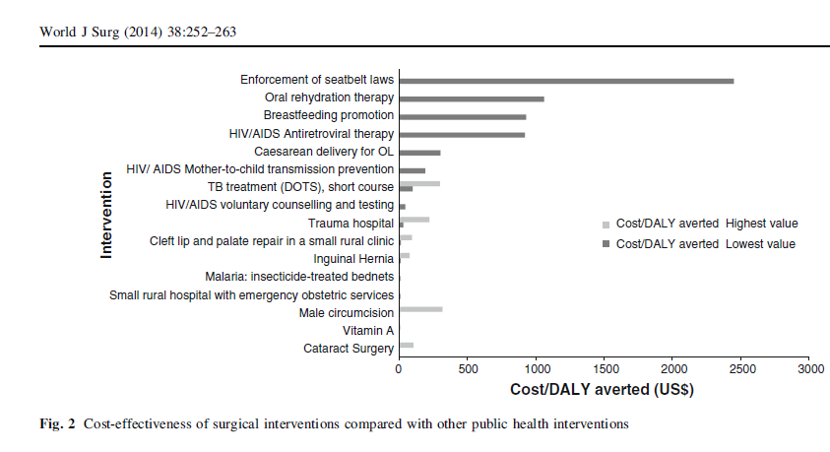
Essential Surgery is Highly Cost-Effective
= Surgeries
Grimes, World J Surg, 2014

Slide 72
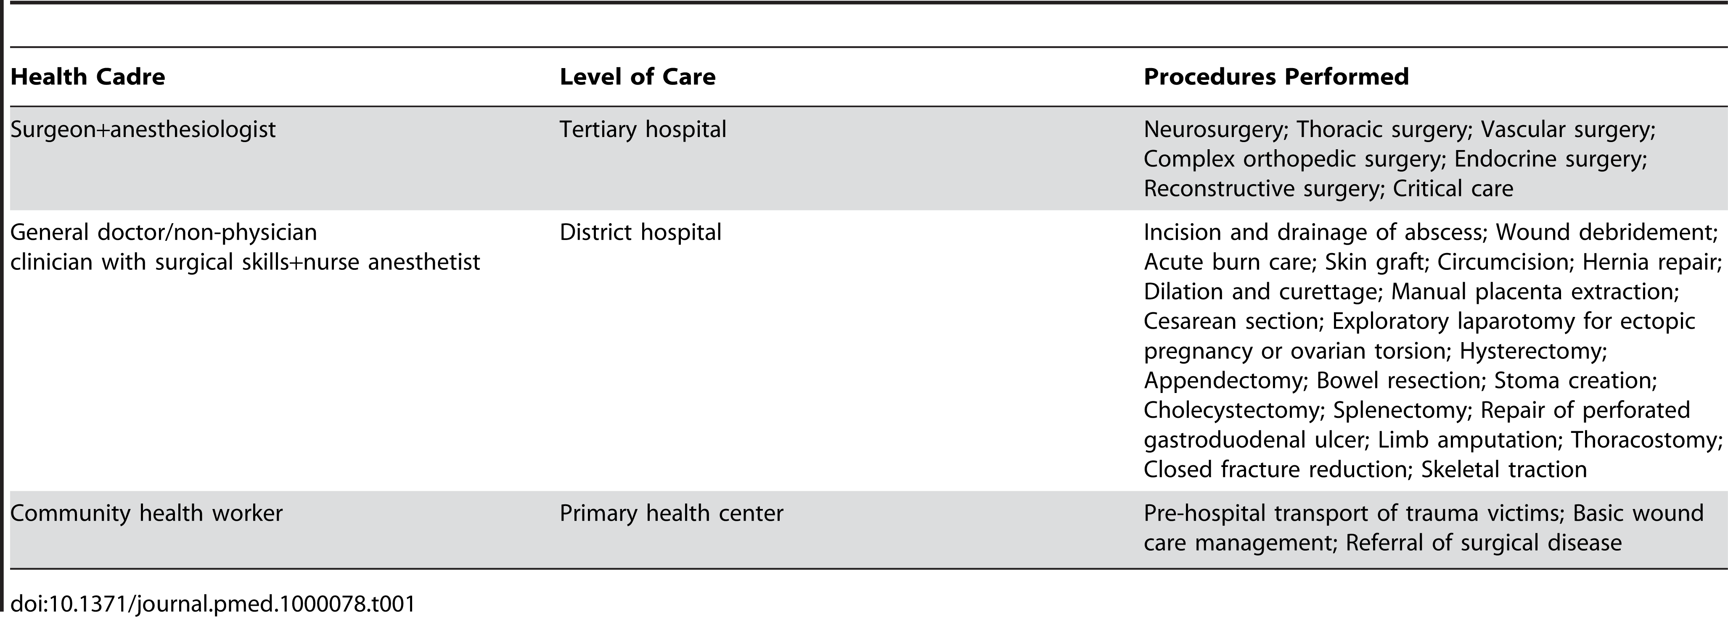
Surgical Task Shifting (or Sharing)
What Family Docs should be able to do
72
Chu et al. PLoS Medicine 2009

Slide 73

Surgical Task Shifting/Sharing With Surgeons
“most of the surgery is presently being
done by generalists with no surgical qualifications, without
anesthesiology support and under difficult conditions… This situation will not
change rapidly if the ‘‘cornerstone to improving surgical
care in rural Africa’’ is the training of general surgeons in
5-year surgical residencies.
73
Merry, World J Surg, 2011

Slide 74
What about cancer screening?
Screening for Cervical Ca is cost effective in LIC:
  Screening women once…at age 35 years, with …visual inspection of the cervix with acetic acid or DNA testing for HPV in cervical cell samples, reduced the lifetime risk of cancer by …25 to 36 percent, and cost less than $500 per year of life saved.
  Relative cancer risk declined by an additional 40 percent with two screenings (at 35 and 40 years of age), resulting in a cost per year of life saved that was less than each country's per capita gross domestic product
Goldie, NEJM, 2005

Slide 75
Other Cancer Screening?
Not colon (cost effective in US but not LMIC)
Not breast (hardly cost effective in US)
Not prostate (not effective even in US)
Not liver – need to prevent with treatment of Hep B/C.

Slide 76
Highly Cost Effective Care = Prevention
Lifestyle/public health
  Latrines
  Hand washing Infections
  Clean water NTD’s,
  Insecticide treated bed nets
  Vaccinations
  Smoking cessation
  Weight loss
  Exercise DM2, HTN, CAD
  Mediterranean Diet
  Aspirin
76

Slide 77
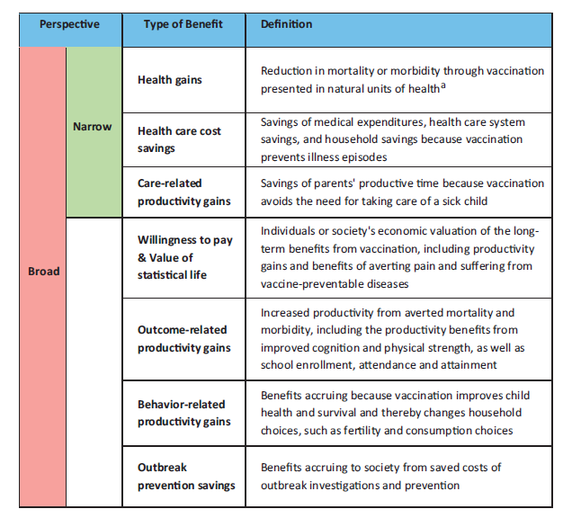
Economic Benefits of Prevention Framework of Vaccinations
Ozawa S, Vaccine, 2012

Slide 78

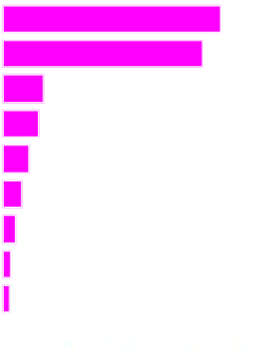
Primary Health Care:
Getting to the root of the problem
Leading Causes of Death¹
Actual Causes of Death²
Heart Disease
Tobacco
Cancer
Poor diet/
lack of exercise³
Stroke
Alcohol
Chronic lower
respiratory disease
Infectious agents
Unintentional Injuries
Pollutants/toxins
Diabetes
Firearms
Sexual behavior
Pneumonia/influenza
Alzheimer’s disease
Motor vehicles
Kidney Disease
Illicit drug use
Percentage (of all deaths)
Percentage (of all deaths)
¹ National Vital Statistics Reports, Vol. 53, No. 15, February 28, 2005.
² Adapted from McGinnis Foege, updated by Mokdad et. al., 2000.
³ JAMA, April 20, 2005—Vol 293, No. 15, pg 1861.
78

Slide 79
Cost-Effective Health Care
Caring for people in resource limited setting
  Less tests, technology, meds; just the essentials
  Less specialists
  Less physician driven – lifestyle/public health primary
  Avoid futility
Person centered, coordinated, comprehensive care by an accessible primary care provider
Tribute to Barbara Starfield, MD

Slide 80
Cost Effectiveness: Diagnosis
Limited labs Choose at most 1 or 2
Limited imaging Use rarely
Careful exam Yet efficient
Rare specialists Textbooks or Virtual Consults
80

Slide 81
Syndromic Diagnoses
Empiric Rx: WHO IMCI
(Integrated Management of Childhood Illness)
Cough (and fever)
Increased respiratory rate
  ≥60 if age < 2 mos.
  ≥50 if age 2-12 mos.
  ≥40 if age 12 mos. to 5 years
Lower chest retractions
(Hypoxia, crackles, percussed
dullness rather than CXR)
= Pneumonia
81
Notes:
IMCI – WHO algorithms for community health workers
Pneumonia recognized by clinical signs – sufficient to begin antibiotics
Associated with grunting respirations, pulmonary crackles
CXR usually not necessary
Pneumonia is usually due to S. pneumoniae or H. influenza and treatment with amoxicillin or cotrimoxazole is typically given.

Slide 82
E.g.
Evidence Based
Cancer Screening Recs for Thailand (MIC) 2014:
Screening guidelines based on country income
Chalkidou, K., P. Marquez, et al. (2014). "Evidence-informed frameworks for cost-effective cancer care and prevention in low, middle, and high-income countries." The Lancet. Oncology 15(3): e119-131.

Slide 83
Cost Effectiveness: Treatment
  Balance NNTB / NNTH Mental Math
  ($ care delivery value chain/DALY)
  Efficient treatment of chronic disease
  Essential meds No fru-fru
  Avoid futility End of life care
83

Slide 84
Cost Effective Care
Treatment
  Efficient treatment of chronic disease
    Pills if treatment saves 1 year of disability adjusted life for < 3 x per capita household income
84

Slide 85
Cost Effective Care: Treatment
Treatment
  Essential meds and meds only when essential
    No treatment for URI’s, most OM, conjunctivitis, sinusitis, acute bronchitis (since NNT > NNH).
    I & D not antibiotic for abscess
    No expensive junk
85

Slide 86
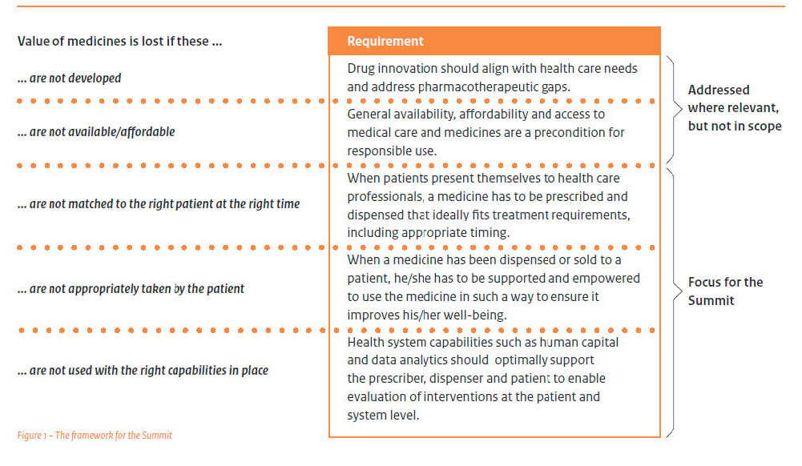
The Benefits of Responsible Use of Medicines. Setting Policies for Better and Cost-effective Healthcare.
Ministers Summit, Amsterdam, the Netherlands.
3 October 2012,

Slide 87

WHO Essential Medication List
WHO Department of Essential Medicines and Health Products
Find updated list here: http://www.who.int/medicines/en/
Buy essential meds from IDA:
  http://www.ida.nl/

Slide 88
Cost Effective Care
Treatment
  Task Sharing/Shifting - Increase access and lower costs
    HIV/AIDS
    Essential surgery
  Avoid futility - intensive care of terminal patients
    Helping patients/families face death
    Dying with Hope – hospice, chaplains, pastors, community
88

Slide 89

So, how should I decide who to treat?
Mental math – estimate ratio of benefit to cost/harm in light of resources
National treatment guidelines http://apps.who.int/medicinedocs/en/cl/CL9.1/clmd,50.html
Ask your national colleague (and accept their approach as best)

Slide 90


So, how should I decide?
Carry expert advice with you in your pocket!:
  Oxford Handbook of TM
  Handbook of Medicine in Developing Countries – Palmer and Wolf
Buy: www.talcuk.org

Slide 91
Medical Missionaries Behaving Well In A LIC
Follow MOH treatment protocols
Work cost effectively by screening for and treating diseases at high risk for adverse patient oriented outcomes that matter when cost : benefit is reasonable.
Focus on community transformation to prevent and treat diseases by working on the root problem rather than patching it with pills when possible .

Slide 92
Learning Objectives
Treat chronic diseases in resource-limited settings in a rational, cost-effective way.
Follow an income-based diagnosis and treatment protocol for hypertension, type 1 and 2 diabetes, maternity care, surgery, cancer screening, and acute care.
Design treatment protocols based on guiding principles of cost-effectiveness.

Slide 93
Select Bibliography
WHO and World Economic Forum, “From Burden to ‘Best Buys’”, 2009
Christopher Murray’s bibliography…
Rhatigan et al. Applying the Care Delivery Value Chain: HIV/AIDS Care in Resource Poor Setttings. Harvard Business School working paper, 2009
Ministers Summit: The Benefits of Responsible Use of Medicines: Setting Priorities for Better and Cost-Effective Healthcare. Amsterdam, 3 Oct 2012.
WHO-Choice ((CHOosing Interventions that are Cost-Effective): http://www.who.int/choice/cost-effectiveness/en/
One Health Tool software – http://www.who.int/choice/onehealthtool/en/
(See slides for other references)

Slide 94
Questions & Discussion merry.stephen@mayo.edu

