Slide 1


Cross-Cultural Communication in Medical Contexts
Mark Topazian, M.D.

Slide 2


Slide 3


Slide 4


Slide 5


Slide 6


Slide 7

www.entrepeneur.com

Slide 8
Why does good cross-cultural communication matter?
Professional influence
Spiritual influence

Slide 9
Why does good cross-cultural communication matter?
Good outcomes

Slide 10
Why does good cross-cultural communication matter?
Good outcomes
Professional influence

Slide 11
Why does good cross-cultural communication matter?
Good outcomes
Professional influence
Spiritual influence

Slide 12
What is “culture”?

Slide 13
The shared social behavior, institutions, and norms of a group of people
A way of life
The sum of normal expectations
Thomas Berger, Desert Rose Consultancy

Slide 14
The shared social behavior, institutions, and norms of a group of people
A way of life
The sum of normal expectations
Thomas Berger, Desert Rose Consultancy

Slide 15
The shared social behavior, institutions, and norms of a group of people
A way of life
The sum of normal expectations
Thomas Berger, Desert Rose Consultancy

Slide 16

You visit a hospital in a resource-limited setting to teach a new method. When you arrive at the site, your hosts tell you that the equipment you need isn’t functioning.

Slide 17
How would you react?
- Express surprise and frustration
- Ask how long the equipment’s been broken
- Offer to try to fix the equipment yourself
- Suggest going out for coffee
- Reschedule your return flight home

Slide 18
When things don’t make sense . . .
Confusion
Discomfort
Irritation
Anger
Judgement

Slide 19


Slide 20
When things don’t make sense . . .
Confusion
Discomfort
Irritation
Anger
Judgement
Observe
Be curious
Ask
Apologize
Learn
Thomas Berger, Desert Rose Consultancy

Slide 21

https://geographyeducation.org/2015/03/10/
these-amazing-maps-show-the-true-diversity-of-africa/

Slide 22

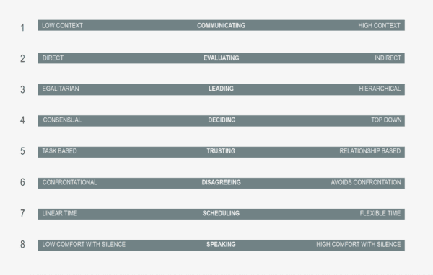

Slide 23

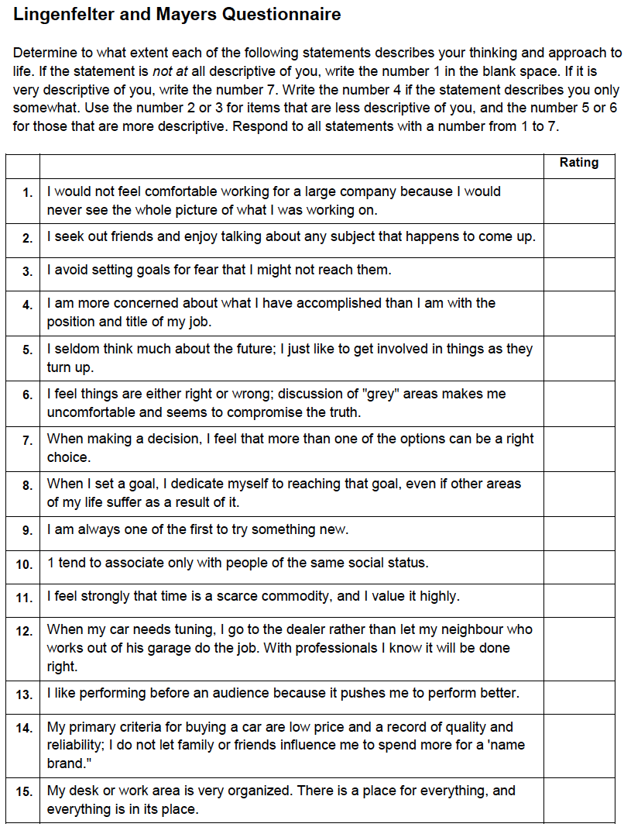

Slide 24

High Context
Communication vs.
Low Context
Communication
https://www.craiyon.com/en/image/WKpn1hPcTyeiErQQAwO0Yw

Slide 25
Low context communication is:
- Precise
- Explicit
- Clear
- Understood at face value
- Repetitious
https://www.craiyon.com/en/image/WKpn1hPcTyeiErQQAwO0Yw

Slide 26
High context communication is:
- Nuanced
- Message is implied, not stated
- Body language
- Tone of voice
- Listener must read between the lines
https://www.craiyon.com/en/image/WKpn1hPcTyeiErQQAwO0Yw

Slide 27
Low context communication is:
- Precise
- Explicit
- Clear
- Understood at face value
- Repetitious
https://www.craiyon.com/en/image/WKpn1hPcTyeiErQQAwO0Yw
Notes:
OK, so let’s imagine we are from a high-context communication background, and we’re interacting with an American visitor who is doing low-context communication: spelling everything out, stating the obvious, repeating themselves. What are you thinking?
How could the American do better?
- questions

Slide 28
High context communication is:
- Nuanced
- Message is implied, not stated
- Body language
- Tone of voice
- Listener must read between the lines
https://www.craiyon.com/en/image/WKpn1hPcTyeiErQQAwO0Yw
Notes:
Now let’s imaging that you, the American, are with a colleague from a high-context background, who is practicing high-context communication. How might you react? - you might be mystified
- you might miss the point completely
- Me: my trainee is making ineffectual attempts
How could you helpfully react?
- questions
- posture of a learner
- “I’m missing something” “could you explain? I’m having a hard time understanding”

Slide 29
When things don’t make sense . . .
Confusion
Discomfort
Irritation
Anger
Judgement
Observe
Be curious
Ask
Apologize
Learn
Thomas Berger, Desert Rose Consultancy

Slide 30

Egalitarian
Leadership vs.
Hierarchical
Leadership
https://www.craiyon.com/en/image/DYR_jmFTSCi-oBl1-9ZBpQ

Slide 31
Egalitarian
Leaders are:
- Seen as equals
- Challenged
- Disagreement is healthy
- Evidence matters
Decisions are made by building agreement
https://www.craiyon.com/en/image/DYR_jmFTSCi-oBl1-9ZBpQ

Slide 32
Hierarchical
Leaders are:
- Respected
- Deferred to
- Not questioned directly
- Expertise matters
- Experience matters
Decisions are made by the leader
https://www.craiyon.com/en/image/DYR_jmFTSCi-oBl1-9ZBpQ

Slide 33
Egalitarian Leaders Hierarchical Leaders
Speak First
Invite questions and comments
Facilitators

Slide 34
Egalitarian Leaders Hierarchical Leaders
Speak last
Listen
Affirm others
Make decisions
Speak First
Invite questions and comments
Facilitators
Thomas Berger, Desert Rose Consultancy

Slide 35
Egalitarian
Leaders are:
- Seen as equals
- Challenged
- Disagreement is healthy
- Evidence matters
Decisions are made by building agreement
https://www.craiyon.com/en/image/DYR_jmFTSCi-oBl1-9ZBpQ
Notes:
OK, so let’s say you’re an American visitor from an egalitarian culture and you’re listening to the senior surgeon/physician/nurse talk about something clinical with their team, and you realize they’re wrong – they don’t know the latest research, which has seriously changed the clinical approach to the problem. What are you likely to do/say? How will the people around you, from a hierarchical culture, react? How will your senior colleague feel? What could you do differently?

Slide 36
Hierarchical
Leaders are:
- Respected
- Deferred to
- Not questioned directly
- Expertise matters
- Experience matters
Decisions are made by the leader
https://www.craiyon.com/en/image/DYR_jmFTSCi-oBl1-9ZBpQ
Notes:
OK, imagine you’re from a Hierarchical cultural background, and you’re listening to the American visitor who’s talking about a patient’s presentation, and you realize that the American is completely off base because they don’t know the common diagnoses in your setting. How are you going to react?
How could you approach the situation differently?

Slide 37

Task-based Trust vs.
Relationship-based Trust

Slide 38
Task-based Trust:
- Cognitive
- Built through work and collaboration
- Based on reliability
Feedback focuses on performance

Slide 39
Relationship-based Trust:
- Affective (from the heart)
- Built by sharing life together
- Based on mutual liking
Feedback avoids shame

Slide 40
Task-based Trust:
- Cognitive
- Built through work and collaboration
- Based on reliability
Feedback focuses on performance
Notes:
Me in the ICU with a patient with low potassium, not reported by the resident
How did I respond? How should I respond?

Slide 41
Relationship-based Trust:
- Affective (from the heart)
- Built by sharing life together
- Based on mutual liking
Feedback avoids shame
Notes:
OK, so now let’s think about that same colleague, who is from a relationship-based background, and gave me the wrong information on rounds. Why did they do that? How might they be thinking about me?
Never say “no” (avoid shaming others)
Affirm others (I have high standards, and will coach you because I know you can achieve them”)
Never say “no” (avoid shaming others)
Affirm others (I have high standards, and will coach you because I know you can achieve them”)

Slide 42
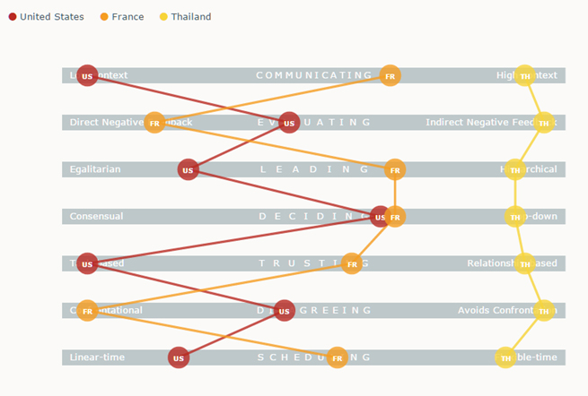
https://www.blackspotradish.com/wp/2022/02/the-culture-map-a-book-review/

Slide 43
You visit a hospital in a resource-limited setting to teach a new method. When you arrive at the site, your hosts tell you that the equipment you need isn’t functioning.

Slide 44
How would you react?
- Express surprise and frustration
- Ask how long the equipment’s been broken
- Offer to try to fix the equipment yourself
- Suggest going out for coffee
- Reschedule your return flight home

Slide 46
When things don’t make sense . . .
Confusion
Discomfort
Irritation
Anger
Judgement
Observe
Be curious
Ask
Apologize
Learn
Thomas Berger, Desert Rose Consultancy

Slide 47

Becoming a third-culture person
https://www.craiyon.com/en/image/Yg5VeF8RTJCnpvqOeK2Exw

Slide 48
Becoming a third-culture person
Observe
Be curious
Ask
Apologize
Learn
https://www.craiyon.com/en/image/Yg5VeF8RTJCnpvqOeK2Exw

Slide 49

Third culture at its best

Slide 50
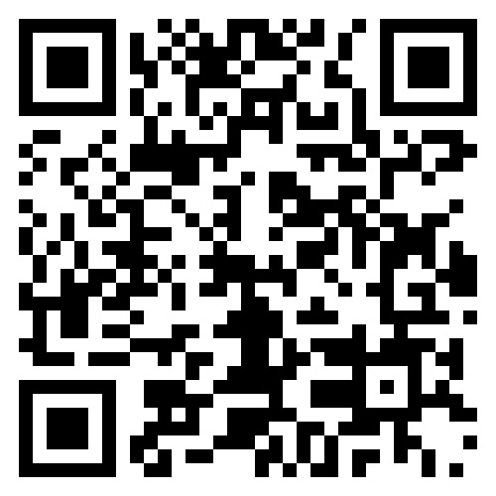

Slide 51

Observe
Be curious
Ask
Apologize
Learn
Mark Topazian
topazian@gmail.com

