Slide 1
Families in Mission:
Preparing to Thrive

Slide 2




John and Rachel Wind
Clara Anne (8), Chloe (7), Christin (5), Charis (1)

Slide 3
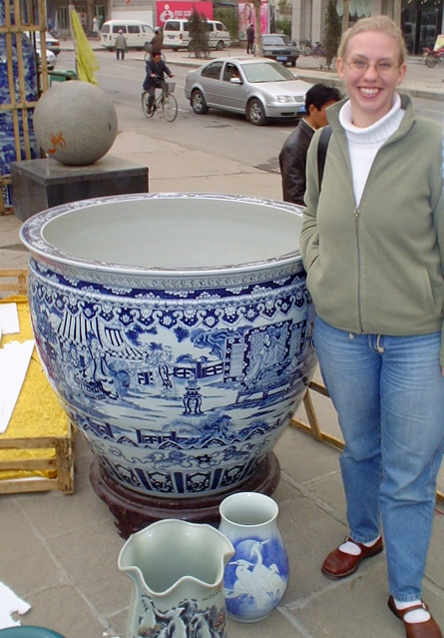

January 2004

Slide 4
Is it possible for your marriage and family to thrive on the mission field? How?

Slide 5
Our Primary Audience
Married couples (or singles who hope to be married someday) who are called to, preparing for, or already involved in cross-cultural medical missions.

Slide 6
Our Primary Goal
To identify 15 key elements of a family action plan for thriving on the mission field so that you might set aside time to develop prayerfully your own family action plan.

Slide 7
Communication

Slide 8
Expectations

Slide 9

1. Confirming a Shared Call

Slide 10
2. Agreeing on Clear Priorities
Abiding in Christ
  Jesus says: “I am the vine; you are the branches. Whoever abides in me and I in him, he it is that bears much fruit, for apart from me you can do nothing.” John 15:5
Ministering to Family
  “The saying is trustworthy: If anyone aspires to the office of overseer . . . he must manage his own household well, with all dignity keeping his children submissive, for if someone does not know how to manage his own household, how will he care for God's church?” 1 Timothy 3:1,4-5
Ministering to Church and to Society

Slide 11

3. Establishing Individual Spiritual Habits

Slide 12

4. Establishing Family
Spiritual Habits

Slide 13
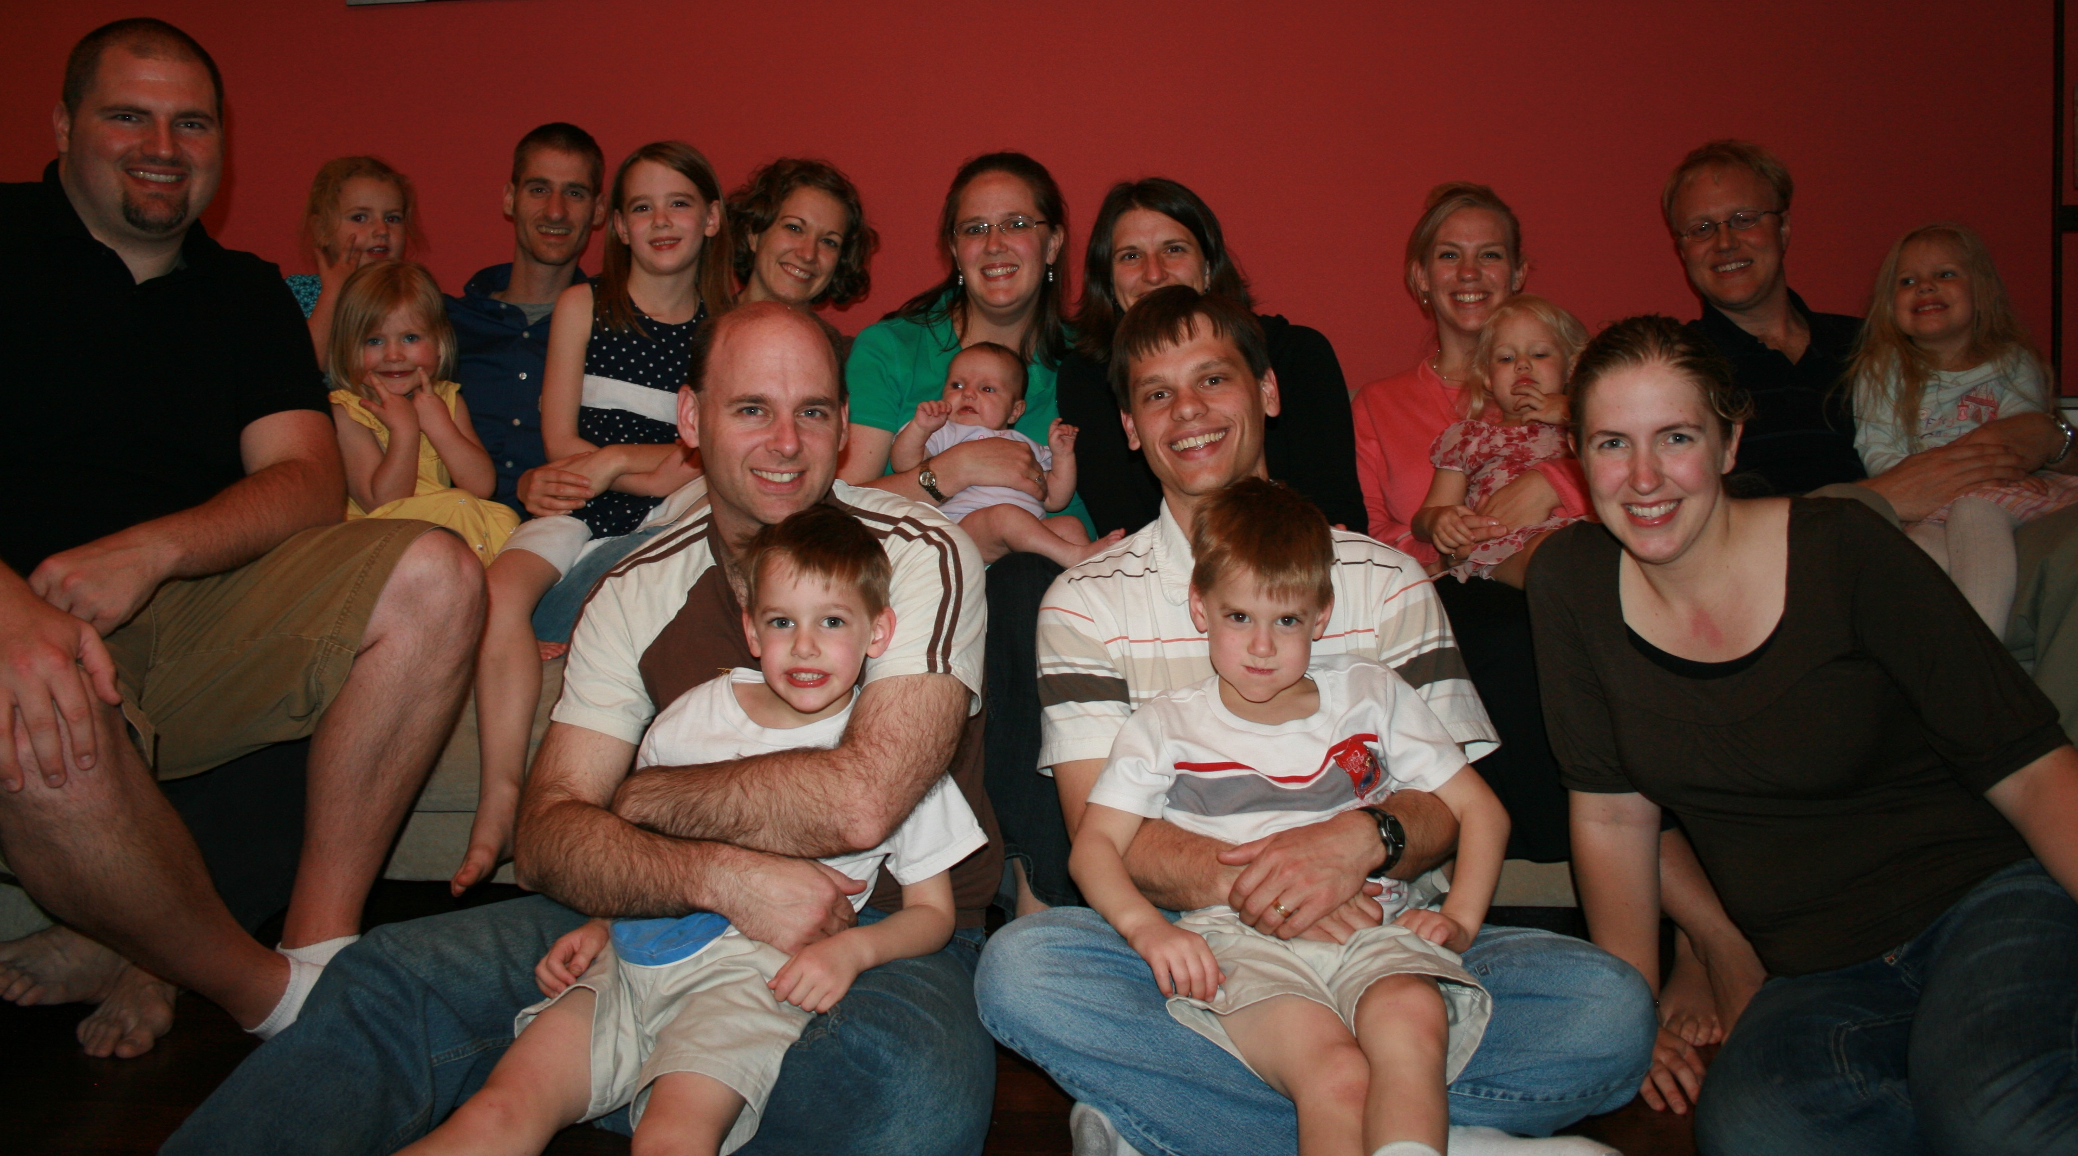
5. Establishing Community
Spiritual Habits

Slide 14

6. Developing
Good Communication Habits

Slide 15
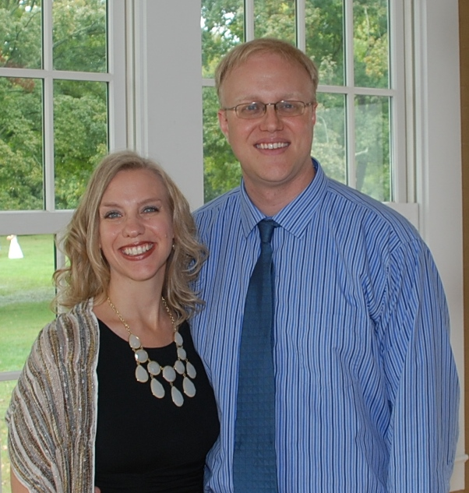
7. Developing Good Conflict Management Habits

Slide 16
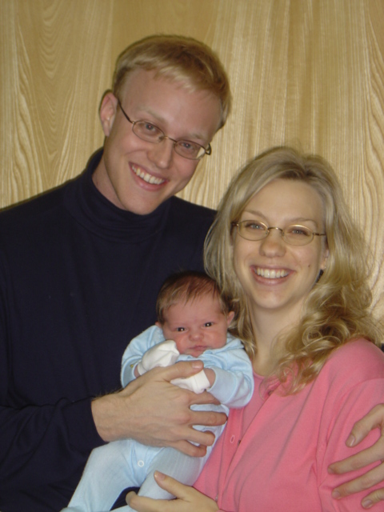
8.
Clarifying Roles

Slide 17
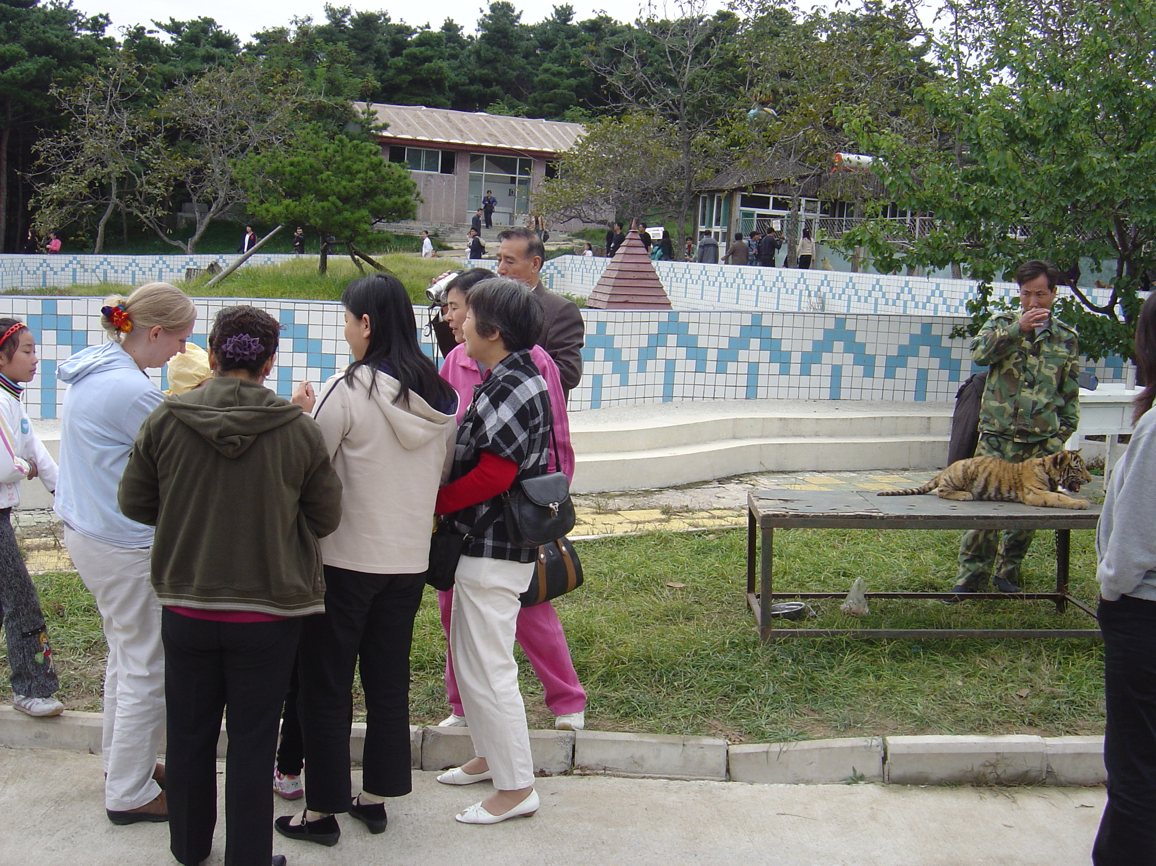
9. Maintaining Healthy Home Environment

Slide 18

10. Managing
Children’s Schooling

Slide 19
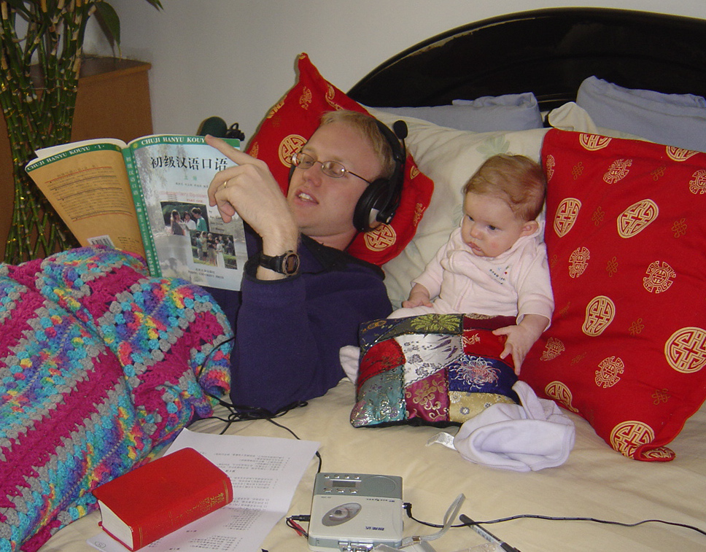
11.
Strategizing for
Language Learning

Slide 20
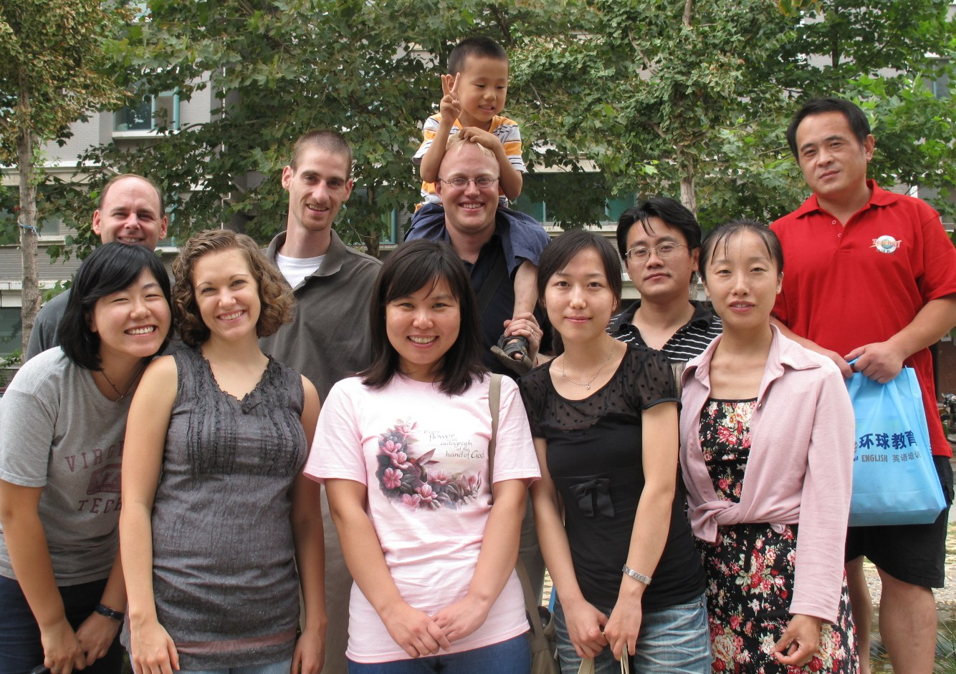
12. Clarifying
Work Responsibilities

Slide 21
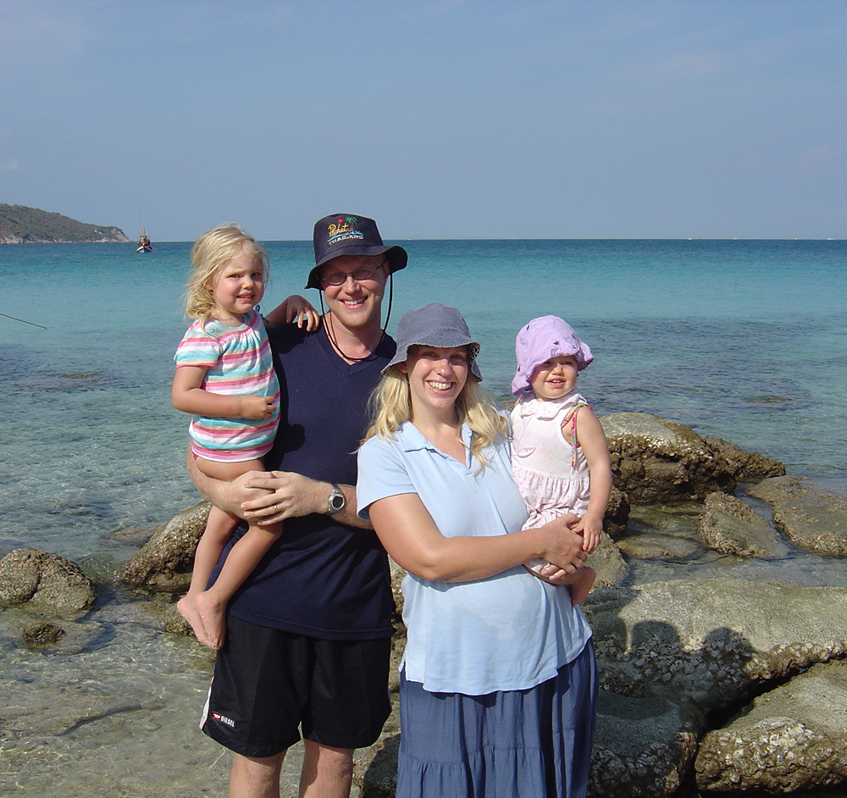
13. Committing to Rest/Vacation

Slide 22

14. Coping with Culture Stress

Slide 23
15. Addressing any additional unresolved or challenging issues in your marriage/family

Slide 24
Questions?

Slide 25
MedicalMissionsMentoring.com

