Slide 1
Not So Subtle Asian Traits & the Challenge of Medical Missions for Asian Americans, Part 2
Small Group Discussion

Slide 2

Our Family & Story

Slide 3
What is your parents’ favorite Bible verse?
“Children, obey your parents in the Lord, for this is right” –Ephesians 6:1

Slide 4
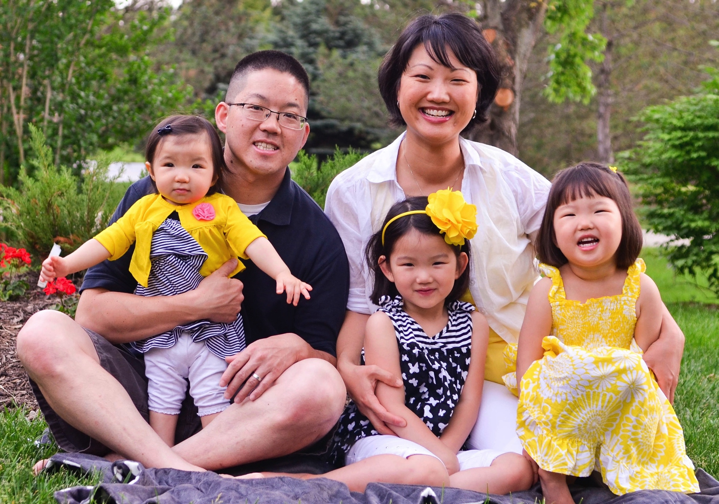

Slide 5
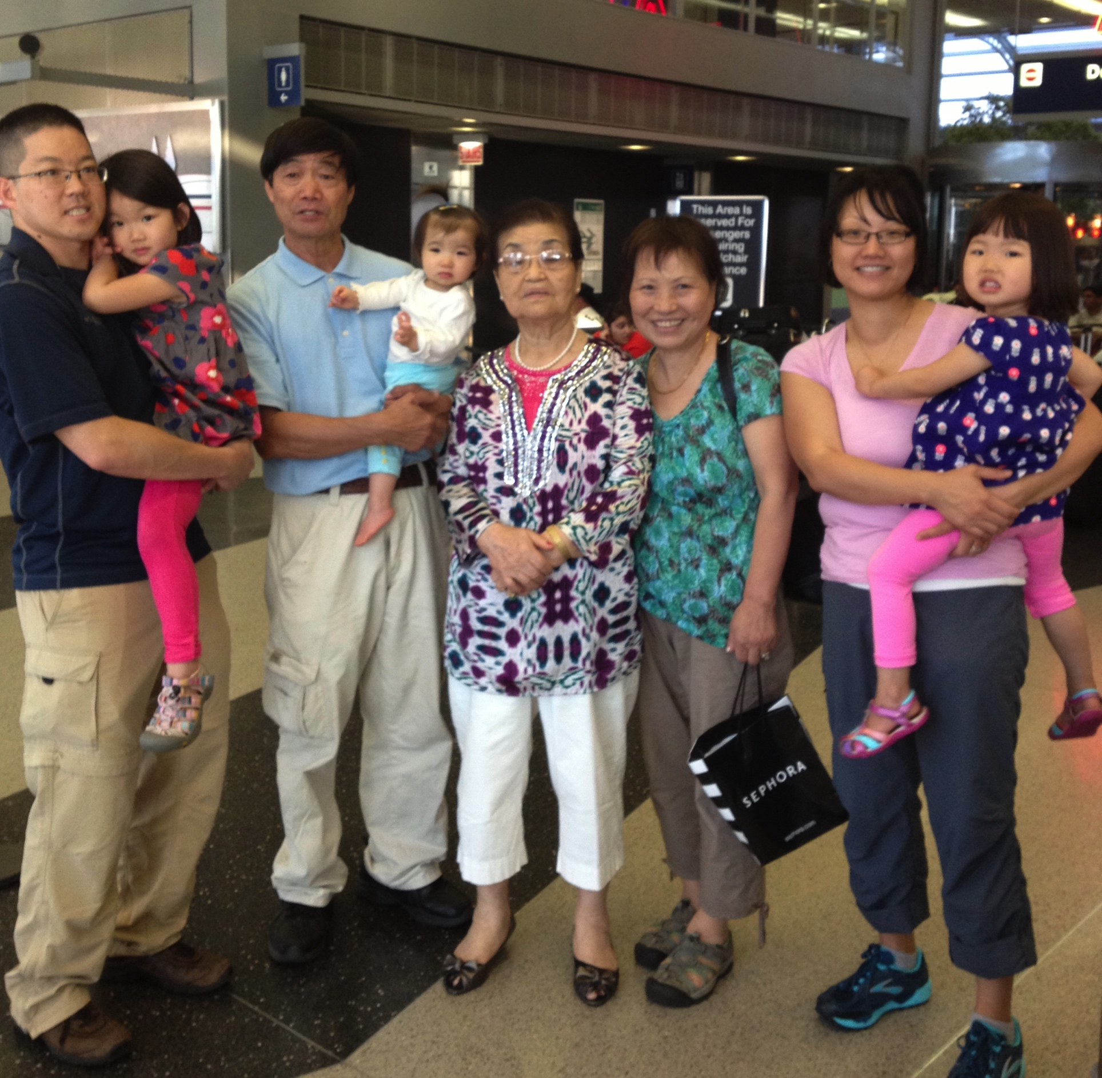
Notes:
Picture of us with both sets of in laws

Slide 6
Objection #1:
You are abandoning your family
“Anyone who does not provide for their relatives, and especially for your own household, has denied the faith and is worse than an unbeliever.” 1 Timothy 5:8

Slide 7
Objection #1:
You are abandoning your family
Points of Discussion:
  Is it wrong to go overseas when your parents are depending on you, especially financially?
  Do you personally struggle with this even if your parents do not?
  What are some ways that a couple moving overseas can reassure their extended family?

Slide 8
Objection #2:
Your kids will not be (fill in the blank).
Points of Discussion:
  What advice would you give to a couple to reassure their parents who are concerned about the future of their grandchildren?
  Specifically, what could be said about education, extra-curricular activities, and potential missed opportunities?

Slide 9
Objection #3:
You are not being safe
Point of Discussion:
  What advice would you give to a couple to reassure their parents who are concerned for their safety?
  Is there a place or time to discuss the notion of biblical safety versus worldly safety?

Slide 10
Objection #4:
You are beggars.

Slide 11
Objection #4:
You are beggars.
Point of discussion:
  What advice could you give to someone in this situation to reassure their parents?
  Do your own feeling on the discomfort of support-raising conflict with answering this viewpoint?
  Is there Biblical support for this issue?

Slide 12
Lessons Learned
Watch for pride
Honor the sacrifice
Try to address fears
Be willing to lose some battles

Slide 13
Questions? Comments? Concerns?
  Burt and Sandy Lee
    burton.w.lee@gmail.com, slee00220@gmail.com
  David and Lara Narita
    naritads@gmail.com
  Dave and Jenny Kim
    david.kim@sim.org, jenny.kim@sim.org
  Rich Bae
    rsbae@alumni.princeton.edu
  Kendrick Lau
    kendrick.lau@sim.org
  Cedrick Cheung
    cedricwendy@psmail.net
  Keith and Minhee So
    thesos@psmail.net

