Slide 1
FROM KalamazoO TO KATHMANDO
Making the LEAP from training to missions

Slide 2
DISCLAIMERS
My background is nursing
I have served with Mercy Ships and Samaritan’s Purse and I am currently on the board of the Christian Health Service Corps
My focus and passion is international missions
Missionaries are human

Slide 3
Lessons
Education
Advice
Prayer, Priorities and Promises

Slide 4
Lessons
http://vimeo.com/50702502
http://www.youtube.com/watch?list=PL90F7B1991F2B95FF&feature=player_embedded&v=4B7PphAYB10#!

Slide 5
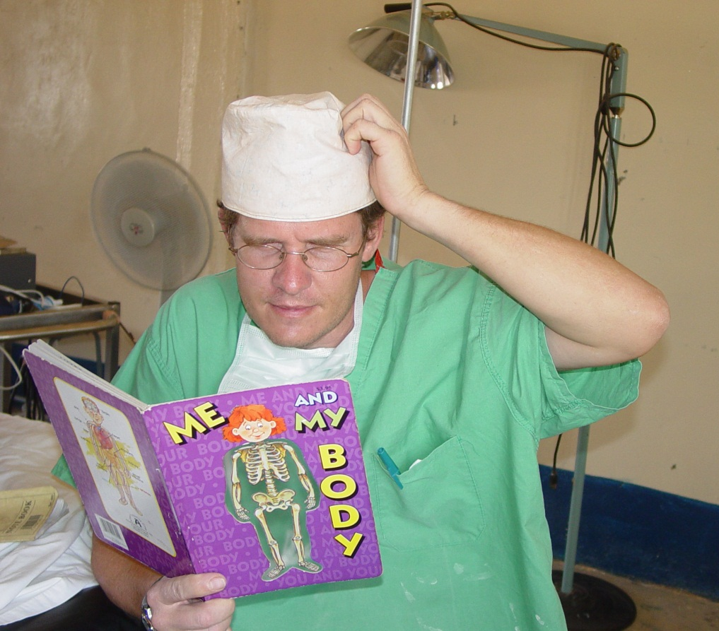
Medical Education
Develop strong assessment skills
Tropical Medicine Course
Goragas, Liverpool, West Virginia, etc.
Broad training
Community Health Evangelism (www.chenetwork.org)

Slide 6
Non-Medical Education
Management, business, leadership
Language
Culture
Ethics (Mark 6:30-32)
CMDA’s Orientation to Medical Missions Conference

Slide 7
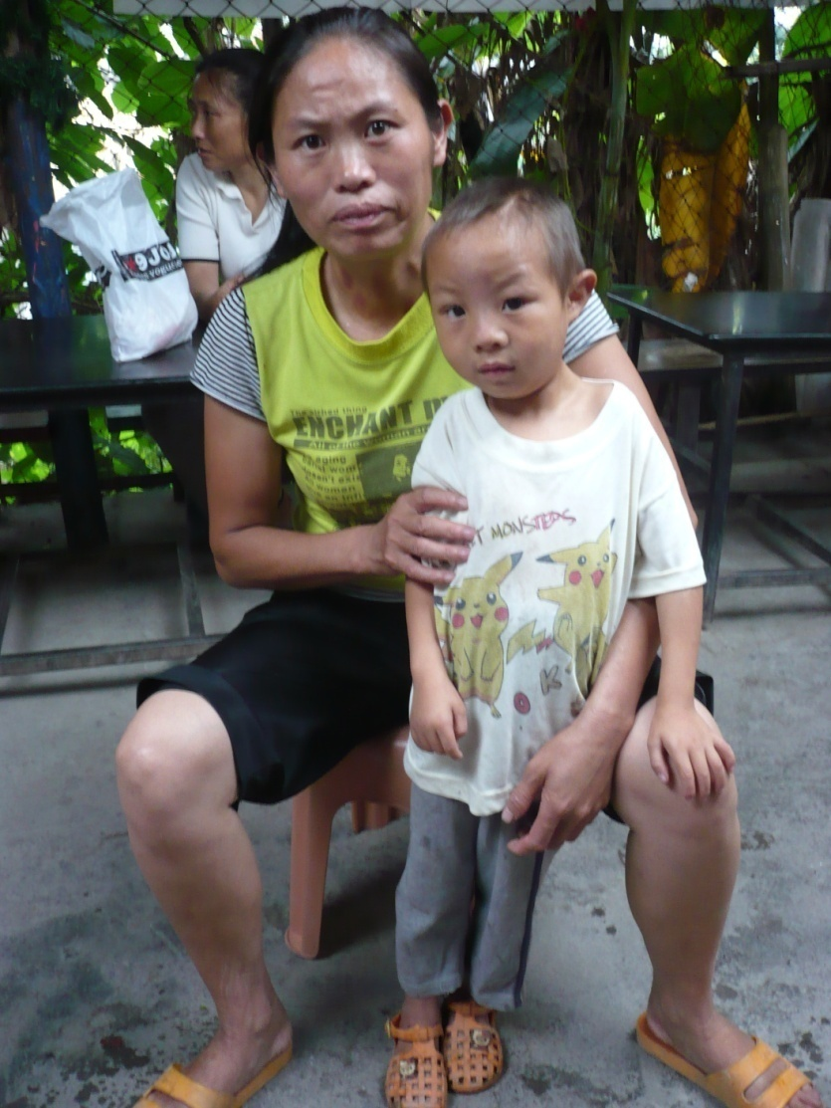
Educational Opportunities
Mission organizations: AIM, C&MA, HCJB, Pioneers, SIM, TEAM, etc.
World Medical Mission (www.samaritanspurse.org/wmm)
Global Health Outreach (GHO) (www.cmda.org)
Summer Medical Institute (www.esperanzahealthcenter.org/opportunities/summer-medical-institute)
INMED (http://inmed.us/)

Slide 8
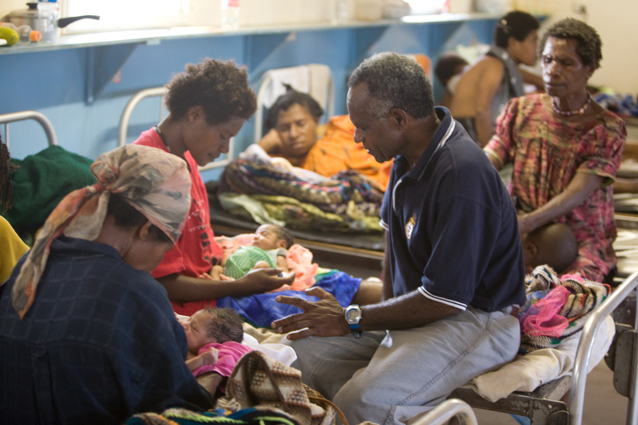
Biblical Education
University or Seminary
Gordon Conwell (http://my.gordonconwell.edu/dimensions)
Moody, etc
Perspectives Course (www.perspectives.org)
Evangelism and discipleship
Saline Solution (www.cmda.org)
METS (www.gomets.org)

Slide 9
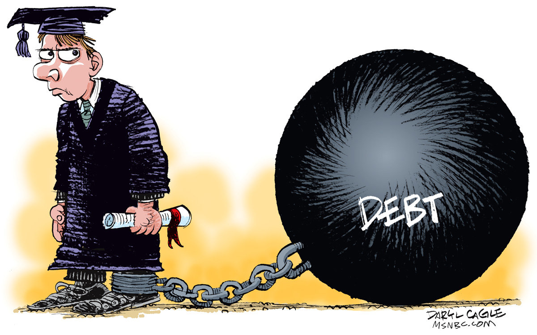
Finances
Live missionally
Get a job, moonlight
Project MedSend (www.medsend.org)
Gov’t programs
Income Based Repayment (IBR)
College Cost Reduction Act (CCRA) 2007

Slide 10
Advice
Current and former medical missionaries
Mentor
Church – pastor staff
Mission organizations

Slide 11
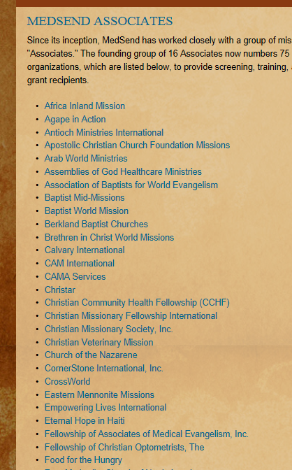
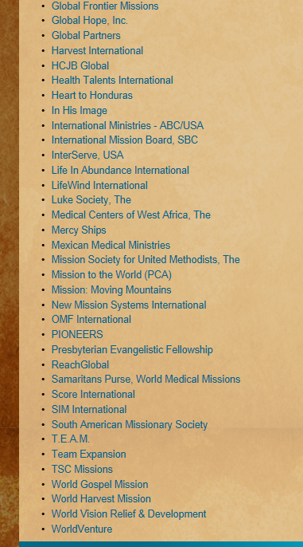

Slide 12
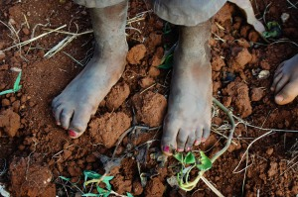
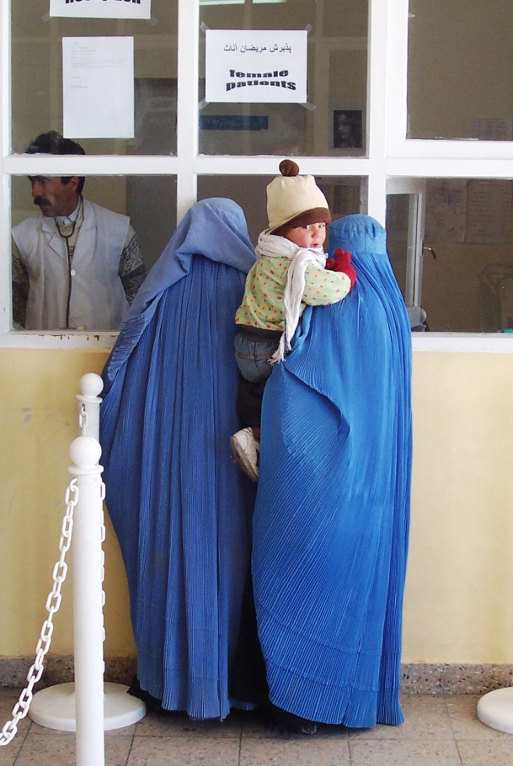
Prayer, Priorities and Promises
If God is for us, who can be against us? He who did not spare his own Son, but gave him up for us all—how will he not also, along with him, graciously give us all things? Romans 8:31-32
“Truly I tell you,” Jesus replied, “no one who has left home or brothers or sisters or mother or father or children or fields for me and the gospel will fail to receive a hundred times as much in this present age: homes, brothers, sisters, mothers, children and fields—along with persecutions—and in the age to come eternal life.
Mark 10:29-30

Slide 13
Lessons
Education
Advice
Prayer, Priorities and Promises

Slide 14
www.medicalmissions.com
Scott Reichenbach
reichenbach.scott@gmail.com

