Slide 1
Creating curriculum from your clinical conundrum
Jeffrey J. Thompson, MD FACEP FAAEM
SUNY at Buffalo/Myungsung Medical College
GMHC 2025

Slide 2
Disclosures
None

Slide 3


outline
Conduct a needs assessment
Develop a curriculum
Engage stakeholders
Measure success
Your thoughts, ideas, and experiences

Slide 4
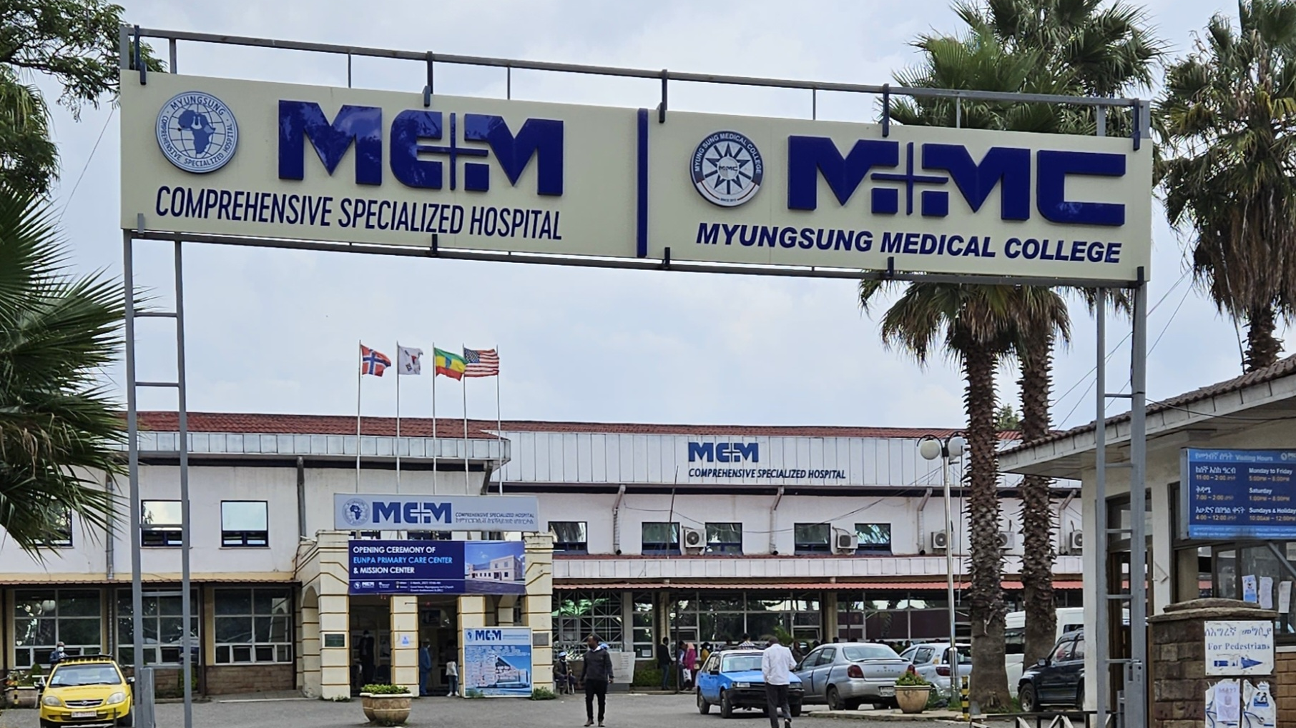

Slide 5
Curriculum development steps
Needs Assessment
Prioritizing Content
Goals and Objectives
Selecting Educational Strategies
Implementation
Evaluation
Schneiderhan J, Guetterman TC, Dobson ML. Curriculum development: a how to primer. Family Medicine and Community Health. 2019 Mar 8;7(2):e000046.

Slide 6
Curriculum development steps
Needs Assessment
Prioritizing Content
Goals and Objectives
Selecting Educational Strategies
Implementation
Evaluation
Problem Identification and General Needs Assessment
Targeted Needs Assessment
Goals and Objectives
Educational Strategies
Implementation
Evaluation and Feedback
Schneiderhan J, Guetterman TC, Dobson ML. Curriculum development: a how to primer. Family Medicine and Community Health. 2019 Mar 8;7(2):e000046.
Thomas PA, Kern DE, Hughes MT, Tackett SA, Chen BY, editors. Curriculum development for medical education: a six-step approach. JHU press; 2022 Aug 30.

Slide 7



Be on the lookout

Slide 8

Needs assessment
Alroumi F, Belcher A. The needs assessment: an educator’s first step. Academic Medicine. 2024 Aug 1;99(8):934.

Slide 9
Emergency Medicine Core Training Program (EMCTP)
Emergency Room GPs
Interns
Nurses
Clinical year medical students
Surgery residents

Slide 10


Goals and objectives

Slide 11
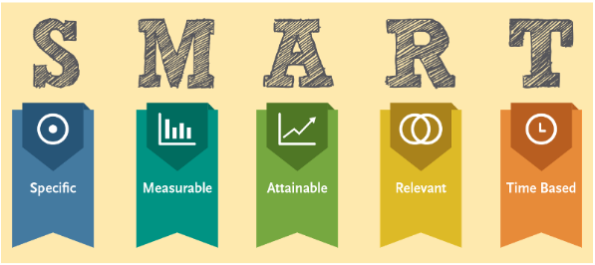

Slide 12
EMCTP Goals
Resuscitation
ECG Interpretation
Trauma Management

Slide 13

Educational strategies
Lectures
Procedure workshops
Simulation exercises

Slide 14

Engage stakeholders
Learners
Institution
Patients

Slide 15
Engage stakeholders
Royston AP. Stakeholder Perspectives on Undergraduate Medical Education: Using a Systems Thinking Approach to Explore Interests in Curriculum Composition. J Med Educ Curric Dev. 2025 May 9

Slide 16

Implementation
Weekly Lectures
BLS/ACLS
ECG Bootcamp
Procedure workshops
Disaster workshop

Slide 17

Formal vs informal
Formal vs Informal
Kirkpatrick model
Formal:
CIPP
Logic
Kirkpatrick
Phillips
Ullah H, Huma S, Yasin G, Ashraf M, Tahir-Ud-Din Q, Shabana H, Sarfraz J. Curriculum and program evaluation in medical education: a short systematic literature review. Ann Med Surg (Lond). 2024 Aug 30;86(10):5988-5994. doi: 10.1097/MS9.0000000000002518. PMID: 39359811; PMCID: PMC11444604.

Slide 18
Formal vs informal
Formal vs Informal
Kirkpatrick model
Informal
Observation
Conversation
Long-term ROI

Slide 19
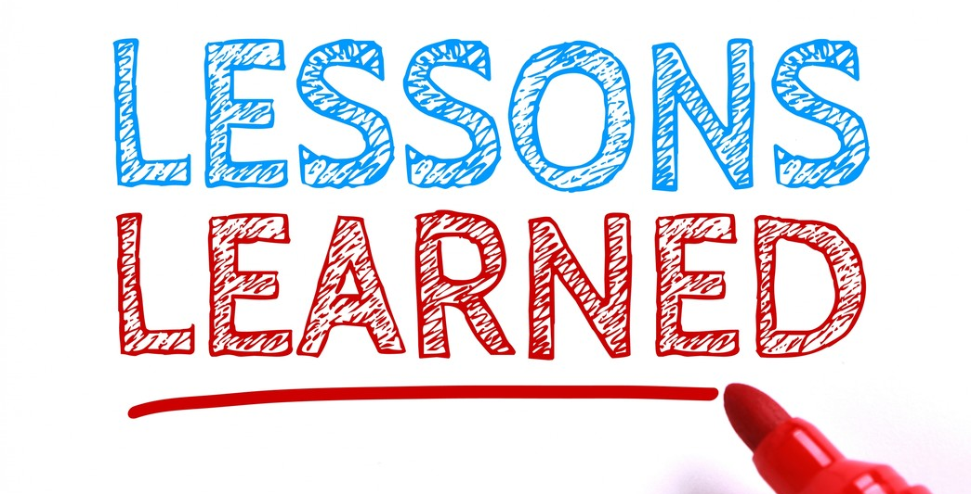

Slide 20


Slide 21
