Slide 1
Healthcare Education Missions:
Cultural Competence
Critical Thinking

Slide 2
Objectives
Understand how critical thinking and cultural competence relate to each other in a global educational setting
Use the strengths and weaknesses of rote memory and critical thinking to encourage student participation in the educational experience
Be able to use these educational approaches in a culturally sensitive way to make our healthcare education relevant and actionable in a global setting.

Slide 3
Plans for this Session
Cultural Competence/Cultural Awareness/Sensitivity – Maggie Tarpley
Introduction to Critical Thinking – Shari Falkenheimer
Personal Experiences in Healthcare Education – Panelists
  Healthcare Education Mission: Cultural Competence and Critical Thinking – Rachel and Eric McLaughlin
  Sarah Kent – Family Medicine residency training in a creative access nation
  Starting a new residency in an established medical school in Botswana – John Tarpley
  Discussion with panelists and audience

Slide 5


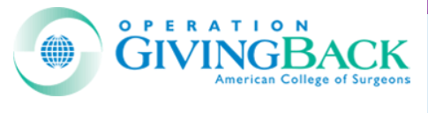

Cultural Competence/Cultural Awareness/Sensitivity

Slide 6
Competence vs Sensitivity and Awareness
Reaching cultural competence takes a long time and is achieved by few persons who come from outside the culture and stay for brief periods.
All of us can be sensitive and aware if we engage a new culture with humility (our knowledge is quite limited) and show respect for each person we meet

Slide 7
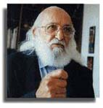
Paulo Freire
Paulo Freire (1921–1997) was an educator.
Paulo Freire was not a North American. He was Brazilian.
He taught that learning was partnership, not just a one-way information transfer.
Pedagogy of the Oppressed. (Translated from the original 1968 Portuguese MS). New York: Continuum, 1970.
http://www.unomaha.edu/~pto/paulo.htm

Slide 8
Culturally sensitive medical volunteer relationships are partnerships—not just one-way transfers of skills

Slide 9
Cultural awareness starts with a “sense of a perceived need”.
If one is not culturally sensitive in SF, Boston, DC, LA, Chicago, Dallas, or Nashville, likely they will not be culturally sensitive in Asia, Africa, Europe, or the other Americas.

Slide 10
Four Degrees of Cultural Awareness
“My way is the only way.”
“I know their way, but my way is better.”
“My way and their way.”
“Our way.”
“Admit you don’t know. Suspend Judgements. Empathy.
Systematically check your assumptions.
Become comfortable with ambiguity.
Celebrate diversity.”
www.culturosity.com/pdfs/What%20is%20Cultural%20Awareness.pdf, Accessed 14 Aug 19

Slide 11
Nurturing a Culture of Respect
For patients
For families
For colleagues
For staff

Slide 12
Each culture is unique.
Similar appearances (e.g., Chinese, Japanese, and Korean) do not mean cultural similarity
Sharing a language (e.g., English-speaking East Asia Indians, British, Nigerians, Americans) does not mean cultural similarity
Sharing a nationality (e.g., New Yorkers, Hawaiians, Texans) does not mean cultural similarity
Sharing a religion does not mean cultural similarity

Slide 13
Comparing Cultural Norms and Values
Aspects of Culture
Sense of self and space
Communication and language
Dress and appearance
Food and eating habits
Time and time consciousness
Gardenswartz L., Rowe A. Managing Diversity: A Complete Desk Reference and Planning Guide. New York and San Diego: Irwin/Pfeiffer & Co., 1993, p. 386-387

Slide 14
Issues of Cultural Sensitivity
Spirituality and religious issues
Communication and interpersonal relationship styles including word choice, voice tone and volume, eye contact, and proper titles
End-of-life situations
Delivering bad news
Clothing, hair styles, and body adornment
Gender issues and consideration of appropriate male/female interaction
Age, respect, and seniority
Discipline, correction, and training methods
Informal and social interactions
Individualism and equality

Slide 15
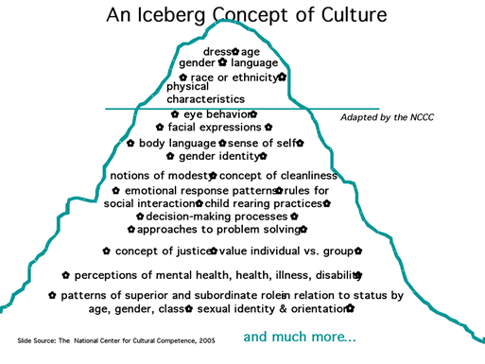
https://cultureandhealth.wordpress.com/2010/12/23/iceberg-concept-of-culture/, Accessed 14 June 2019
https://cultureandhealth.wordpress.com/2010/12/23/

Slide 16
Cultivating Cultural Humility
A lifelong commitment to self-evaluation and self-critique
Redressing power imbalances
Developing mutually beneficial partnerships with communities on behalf of individuals and defined populations
Tervalon M, Murray-Garcia J. Cultural humility versus cultural competence: a critical distinction in defining physician training outcomes in multicultural education.
Journal of Health Care for the Poor and Underserved 9: 117-124, 1998

Slide 17
Some Suggestions to Promote
Cultural Awareness/Sensitivity for Vanderbilt Residents Heading to Kenya for a Surgical Elective
Be respectful; practice good manners.
Use titles when speaking to individuals: Ms., Mrs., Mr., Dr., Ma’am, Sir.
Remember: you are a guest.
Greet. Ask about their family.
When in doubt, ask.
Do not assume someone heard or comprehended what you said.
Dress appropriately.
Try local food—it’s quite good.
Make a Kenyan friend.

Slide 18
Two useful articles related to host perceptions of volunteers

Slide 19
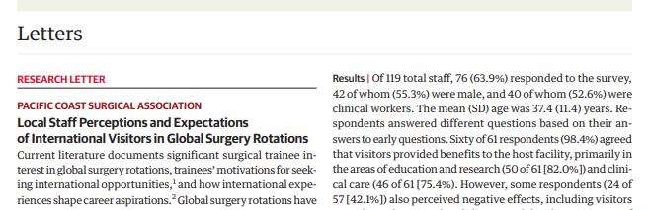
Local Staff Perceptions and Expectations of International Visitors in Global Surgery Rotations
Mulenga M, Rhodes Z, Wren SM, Parikh PP. JAMA Surgery. In press. 2021
76/119 staff (64%) Responded

Slide 20
Discussion
In this single-site study, local staff felt that visitors were beneficial to their facility in providing research and education opportunities and increasing clinical care capacity. (60/61)
However, more than 40% perceived a negative effect with visitors imposing their medical care concepts onto local practices. (24/57)
Mulenga M, Rhodes Z, Wren SM, Parikh PP. JAMA Surgery. In press. 2021

Slide 21
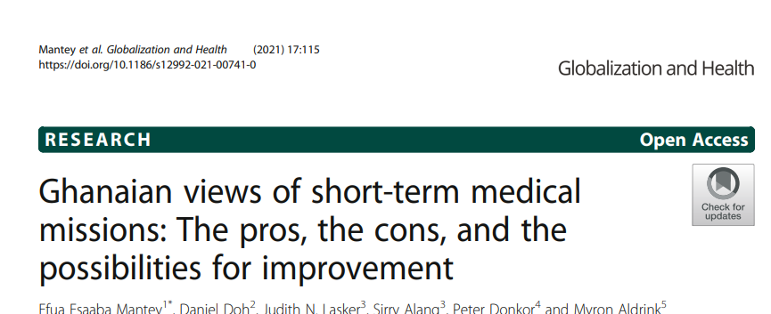
Globalization and Health (2021) 17:115
https://globalizationandhealth.biomedcentral.com/track/pdf/10.1186/s12992-021-00741-0.pdf

Slide 22
Cultural insensitivity was significant issue
Not understanding local customs and culture
Treating local health professionals as less knowledgeable than volunteers—even about local diseases
Language difficulties
Lack of respect for governmental regulations required to practice medicine short term

Slide 23
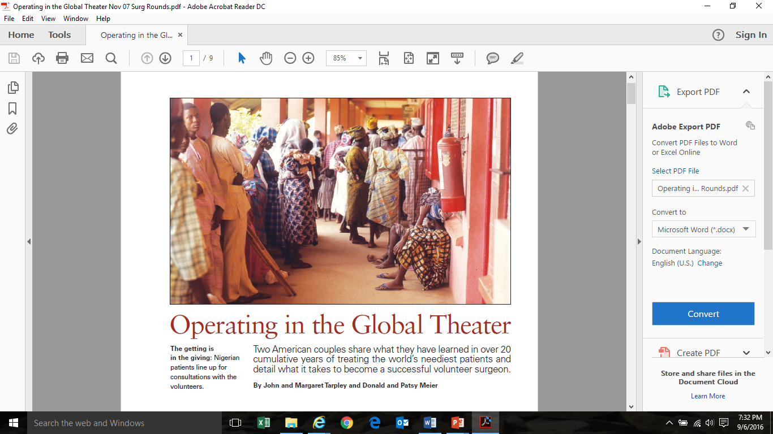
https://www.mdmag.com/journals/surgical-rounds/2007/2007-11/2007-11_02,
Accessed 30 Sept 19

Slide 24
Suggestions from Operating in the Global Theater i
Avoid criticism of the hospital, the living accommodations, the food, the climate, the political situation.
Maintain a good attitude and remember why you embarked on the humanitarian/volunteerism outing in the first place. (cf. Steve Covey)
Avoid making comparisons publicly or stating: “In Nashville this patient would not have expired.” You are not in Nashville.

Slide 25
Suggestions from
Operating in the Global Theater ii
Do not discuss trip expenses or how much this outing is costing you.
Mention or introduce suggestions for improvements collaboratively and gradually.
See yourself as a temporary substitute; the host is the coach. If you are covering for the host, resist the temptation to rewrite the “playbook”.
Ask permission before photographing.

Slide 26

Universality of the Golden Rule*
“Do Not Do to Others What You Do Not Want Done to Yourself”
Confucius
*http://www.pflaum.com/goldrule/newgrpost.pdf
(25 May 2005)--used by permission

Slide 27
The R Words
Relationships
Respect

Slide 28
Margaret.tarpley@vanderbilt.edu

