Slide 1
Using Stories for Community Health and Development in Oral Cultures
Tim Brown
visionSynergy -- T4 Global -- International Orality Network

Slide 2
What are these?
Notes:
Oral learners are more event-oriented and concrete-oriented. We from book cultures often think abstractly. This is a circle. No, it’s a pizza!

Slide 3
Which item doesn’t belong?

Slide 4
Which item doesn’t belong?

Slide 5
Notes:
We need to radically RETHINK how we do mission work in oral cultures.
Okay, let’s have some fun. Here are a couple of exercises for us.

Slide 6
Three approaches
Teach them to read
“Oralize” literate teaching/
Audio recordings/films
Start fresh –
Orality

Slide 7
Communication/Learning Styles Literate/Book and Oral/Traditional
Lecture
Outline
Summarize
Divide into parts
Study/Reference
Individual
Abstract
Knowledge
Repetition
Narrative
Events
Stories, drama, music
Participation
Community/Discussion
Concrete
Experience
Notes:
We often do teaching and preaching based on single verses of the Bible, or take a bunch of verses from different chapters and books of the Bible and relate them to a topic.
In oral cultures, it’s much better to use the stories of the Bible. 75% of the Bible is narrative – it’s stories!

Slide 8
Keys for Working in Oral Cultures
Understand Oral Cultures
Native Language/Mother Tongue
Oral arts:
Story
Music
Drama
Discussion and dialogue

Slide 9
So how does this work?

Slide 10
So how does this work?
Identify a topic(s)
Community health and social issues
Collect information
Identify what needs to be remembered/recalled
Develop a story/narrative that is:
Scientifically Accurate
Culturally Appropriate
Clearly communicates

Slide 11
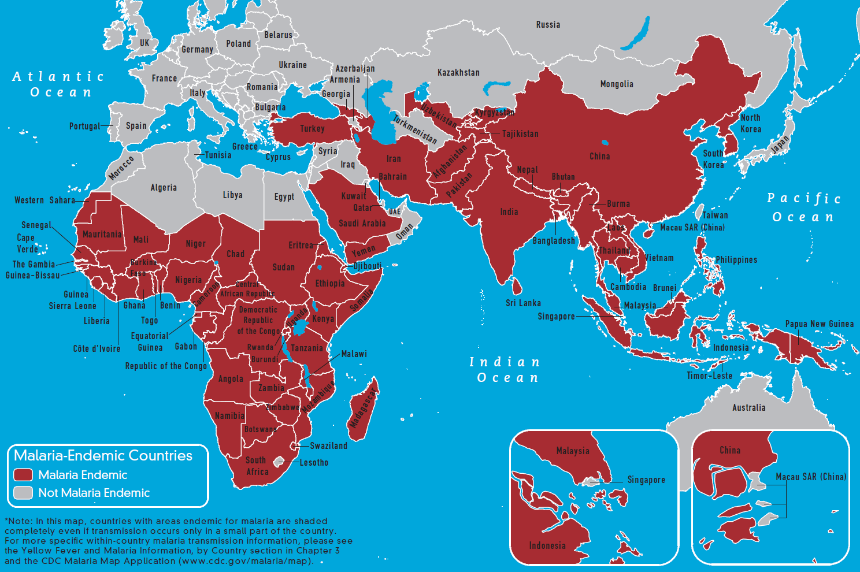

Slide 12
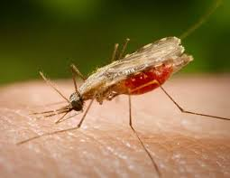

Slide 13
An Example
Malaria
Symptoms
Treatment
Prevention

Slide 15
For more information:
Susie Brown
International Orality Network
Oral Arts/Women
susie.brown@cox.net
Tim Brown
visionSynergy
tbrown@visionsynergy.net

