Slide 1
Effective Sending:
How to Craft a Career and Lifestyle
to Maximize Global Missions from Home
Jason Dykstra, MD
GMHC 2020

Slide 2
What Do I Mean by Effective Sending?
A strategic lifestyle of sending Christians and support wherever in the world both will maximize the impact of Christ’s Body
In other words, Effective Sending IS long-term missions!
-Active (learning/improving), not reactive (sporadic/emotional)
-Proven (research-based), not subjective (circumstantial/redundant)
-Biblical (countercultural), not historical (familiar/status quo)

Slide 3
Why Learn How to Effectively Send?
Reason 1: It’s really, really effective!
-A doctor’s career in the US has the average isolated impact of saving ~3 lives (Source: Doing Good Better).
-A doctor’s career in the poorest nations has the average isolated impact of saving ~300 lives (Source: Doing Good Better).
-An effectively sending doctor’s career in the US has the average isolated impact of saving ~3000 lives (Source: The Life You Can Save).

Slide 4
Why Learn How to Effectively Send?
Reason 2: 9,998 out of 10,000 evangelicals don’t end up doing full-time missions outside their home country (Source: Missionary Portal).
-This includes missions conference attendees!
-We must always teach to go - the need is great! But we must also prepare for what is, not what might be - the need and impact are even greater!

Slide 5
Why Learn How to Effectively Send?
Reason 2: 9,998 out of 10,000 evangelicals don’t end up doing full-time missions outside their home country (Source: Missionary Portal).
-This huge majority isn’t trained to effectively send.
So in daily practice, this has created a “Go or Stay,” “Missionary or non-missionary” mentality, not a “Go or Send” mentality.
-Missions rarely becomes more than a B-team sending occasional prayer, teams, or money to the A-team. Not ONE team consistently coordinated in priorities and action.

Slide 6
Why Learn How to Effectively Send?
Reason 3: This disconnect of the B-Team inevitably leads this majority to prioritize the inward and local, not the outward and global.
-In daily practice, we act like many self-sustaining independent bodies, not the ONE global interdependent Body of Christ.
-And if we’re honest, we’ve allowed our culture’s in-group mentality and selfishness to keep things that way.

Slide 7
Why Learn How to Effectively Send?
Reason 4: This has absolutely devastated this ONE worldwide Church we have, as well as the missions it does. Don’t believe me?
-Only 6% of US donations go toward people living outside the US (Source: Giving USA).
-Only 10% of the average US church’s budget goes to missions, and only 5% outside the US (Source: Christianity Today).
-You can save over 2000 lives in the poorest nations for the same cost as saving 1 life in the US (Sources: Duke University, FDA, USDOT).

Slide 8
Why Learn How to Effectively Send?
Reason 4: This has absolutely devastated this ONE worldwide Church we have, as well as the missions it does. Still don’t believe me?
-97% of Christian donations are spent on Christians, who are typically the wealthiest in the world (Source: ROI Ministry).
-For every $100,000 dollars a Christian earns, only $1 goes toward unreached people groups (Source: Missionary Portal).
-And this trickle of support is typically spent on initiatives chosen by circumstantial or relational connections, not on the initiatives with the most research-proven impact-per-dollar.

Slide 9
Why Learn How to Effectively Send?
Reason 5: The enemy’s long-laid plan is succeeding and Jesus’ Body is greatly suffering.
-The vast majority of Christians don’t go to do missions.
-The vast majority of their resources don’t go toward missions.
-The resources that do don’t have the greatest impact on missions.
-The poor example this sets leads non-Christians to disparage missions.
Effective sending reverses ALL of this! So how do we do it?

Slide 10
How Do I Effectively Send?
Identify as the member (CELL) of the global Body that you ARE!

Slide 11
How Do I Effectively Send?
Identify as the member (CELL) of the global Body that you ARE!
-Claim God’s words about your global role (Commit them to memory).
-Envision yourself within your global role.
-Lament the cost of not playing a global role.
-Live your global role with education, advocacy, money, and time.

Slide 12
How to Effectively Send: Claim/Commit
Repeatedly read and recite God’s perspective on sending support.
-God prioritizes tithing/giving where the need is greatest.
Leviticus 27:30
A tithe of everything from the land, whether grain from the soil or fruit from the trees, belongs to the Lord.
Deuteronomy 14:28-29
Bring all the tithes of that year’s produce and store it in your towns, so that the Levites (who have no allotment or inheritance of their own) and the foreigners, the fatherless and the widows who live in your towns may come and eat and be satisfied, and so that the Lord your God may bless you in all the work of your hands.

Slide 13
How to Effectively Send: Claim/Commit
Repeatedly read and recite God’s perspective on sending support.
-God prioritizes tithing/giving where the need is greatest.
Acts 4:32-35
All the believers were one in heart and mind. No one claimed that any of their possessions was their own, but they shared everything they had. With great power the apostles continued to testify to the resurrection of the Lord Jesus. And God’s grace was so powerfully at work in them all that there were no needy persons among them. For from time to time those who owned land or houses sold them, brought the money from the sales and put it at the apostles’ feet, and it was distributed to anyone who had need.
Romans 15:25-27
I am on my way to Jerusalem in the service of the Lord’s people there. For Macedonia and Achaia were pleased to make a contribution for the poor among the Lord’s people in Jerusalem. They were pleased to do it, and indeed they owe it to them. For if the Gentiles have shared in the Jews’ spiritual blessings, they owe it to the Jews to share with them their material blessings.

Slide 14
How to Effectively Send: Claim/Commit
Repeatedly read and recite God’s perspective on sending support.
-God prioritizes tithing/giving where the need is greatest.
Matthew 25:34-40
The King will say to those on his right, “Come, you who are blessed by my Father; take your inheritance…for I was hungry and you gave me something to eat, I was thirsty and you gave me something to drink, I was a stranger and you invited me in”…Truly I tell you, whatever you did for one of the least of these brothers and sisters of mine, you did for me.
1 Corinthians 12:24-26
But God has put the body together, giving greater honor to the parts that lacked it, so that there should be no division in the body, but that its parts should have equal concern for each other. If one part suffers, every part suffers with it; if one part is honored, every part rejoices with it.
Which verse most memorably reminds you
to live like a cell in Christ’s global Body?

Slide 15
How Do I Effectively Send?
Identify as the member (CELL) of the global Body that you ARE!
-Claim God’s words about your global role (Commit them to memory).
-Envision yourself within your global role.
-Lament the cost of not playing a global role.
-Live your global role with education, advocacy, money, and time.

Slide 16
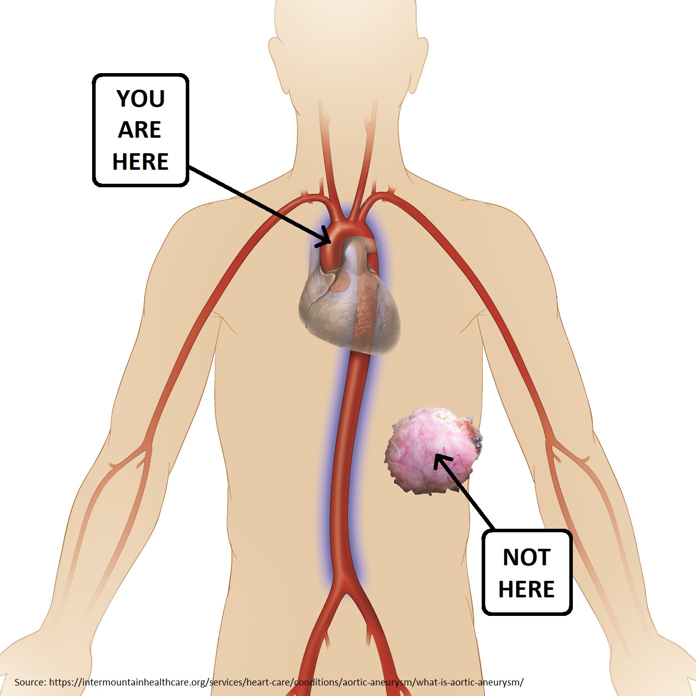
How to Effectively Send: Envision
Keep recalling images or
scenarios where you
play a global role.
-Healthy members
of a global body
act like aortas,
not cancers.

Slide 17
How to Effectively Send: Envision
Keep recalling images or
scenarios where you
play a global role.
-What picture or situation
most memorably reminds
you to live as a cell in
Christ’s global Body?

Slide 18
How Do I Effectively Send?
Identify as the member (CELL) of the global Body that you ARE!
-Claim God’s words about your global role (Commit them to memory).
-Envision yourself within your global role.
-Lament the cost of not playing a global role.
-Live your global role with your education, advocacy, money, and time.

Slide 19
How to Effectively Send: Lament
Never celebrate the benefits of staying without counting the cost.
-41% of humans remain unreached today. If every evangelical gave 0.1% more, we’d be able to support enough missionaries to reach every unreached people group (Source: Missionary Portal).
-An average US Christian choosing to tithe toward unreached people groups, via the most research-proven initiatives, would have ~10,000x the evangelistic impact.

Slide 20
How to Effectively Send: Lament
Never celebrate the benefits of staying without counting the cost.
-An average US Christian choosing to tithe toward healthcare amongst the world’s least served, via the most research-proven initiatives, would have ~8,000x the healthcare impact.
-Before choosing to effectively send, I was leaving 1000s more people – of the world’s least reached – without Jesus, without discipleship, and without life-giving healthcare. However many benefits staying without effective sending gave me, I couldn’t even begin to justify the cost. And I couldn’t forget the cost either.

Slide 21
How Do I Effectively Send?
Identify as the member (CELL) of the global Body that you ARE!
-Claim God’s words about your global role (Commit them to memory).
-Envision yourself within your global role.
-Lament the cost of not playing a global role.
-Live your global role with education, advocacy, money, and time.

Slide 22
How to Effectively Send: Live!
Enjoy celebrating the benefits of effective sending! Create a lifestyle maximizing the impact of your…
-Education
-Advocacy
-Money
-Time
In the global Body, specialty education and donating money are the roles Americans are best-equipped to play.

Slide 23
How to Live as a Sender: Education
Strategically learn how and when to use your skillset to maximize impact…
-Visit www.80000hours.org to learn about the highest-impact careers.
-Focus short-term trips on crisis relief, providing a chronically unavailable skill, or training natives to replace you.
-Be a uniquely-skilled consultant for missionaries abroad.

Slide 24
How to Live as a Sender: Advocacy
Strategically publicize high-impact missions/charity initiatives…
-Regularly ask high-impact groups how to pray for them and expectantly ask how God is answering those prayers.
-Ask them what types of publicity, social media, or fundraising efforts would most benefit them, given your situation.
-Value your audience’s cares, causes, and creativity.
-Consider a Bless BIG Impact Trip: A COVID-safe, flexible experience designed specifically to maximize your impact for a cause God created you to love!
Email info@blessbig.org to learn more.

Slide 25
How to Live as a Sender: Money
Strategically give to exponentially increase the impact of the support you send…
-Familiarity, resulting emotional ties, and selfishness – with advertising exploiting all 3 – are the largest obstacles to benefiting Christ’s global Body…at great cost to many. Beware an in-group bias!
-Instead, train yourself to use more objective criteria to guide your giving, bouncing that benefit/cost ratio high as the heavens!
1. Impact Evidence - What actual outcomes did the aid improve (versus aid given)?
2. Financial Efficiency - What % is spent on those in need?
3. Financial Transparency - Is vital information being hidden?
4. Relative Need - Who else is providing similar aid to the same population?

Slide 26
How to Live as a Sender: Money
Strategically give to exponentially increase the impact of the support you send…
-Sound too overwhelming? Websites like blessbig.org do all the work for you.
-For example, Bless BIG combines the research evaluating all 4 criteria by 15 premier charity evaluators (e.g. ROI Ministry, Ministry Watch, ECFA, Give Well, Charity Navigator, Guidestar, etc.). You pick a cause; they list which charities give your money the highest research-proven impact-per-dollar for the most unreached and underserved!
-When selecting individual missionaries, use the same 4 criteria (if they use similar high-impact approaches where relative need is highest).

Slide 27
How to Live as a Sender: Money
Why am I prioritizing impact so much?
-Because it makes sense, because Jesus prioritizes impact, and because we’re cells in his global Body – of equal value to and with equal concern for each other.
Matthew 25:14-30
The man who had received five bags of gold brought the other five. “Master,” he said, “you entrusted me with five bags of gold. See, I have gained five more.” His master replied, “Well done, good and faithful servant! You have been faithful with a few things; I will put you in charge of many things. Come and share your master’s happiness!”
1 Corinthians 12:21, 25-26
The eye cannot say to the hand, “I don’t need you!” And the head cannot say to the feet, “I don’t need you!”…its parts should have equal concern for each other. If one part suffers, every part suffers with it; if one part is honored, every part rejoices with it.

Slide 28
How to Live as a Sender: Money
But my local community or personal connections will be abandoned!
-The Head of our Body is Jesus, and it is he to whom we must give account, not a local community member.
-Remember, 94% of US giving goes to Americans, and 95% of the average US church’s budget goes to its own members and community. So whenever God leads you to give to the globally unreached and underserved, you’re not favoring your global neighbor over your local one. You’re slightly but significantly reducing the devastating bias against your global neighbor!
-Let the 95% keep covering your local neighbors, while joining the 5% providing the highest proven impact-per-dollar for your global neighbors!

Slide 29
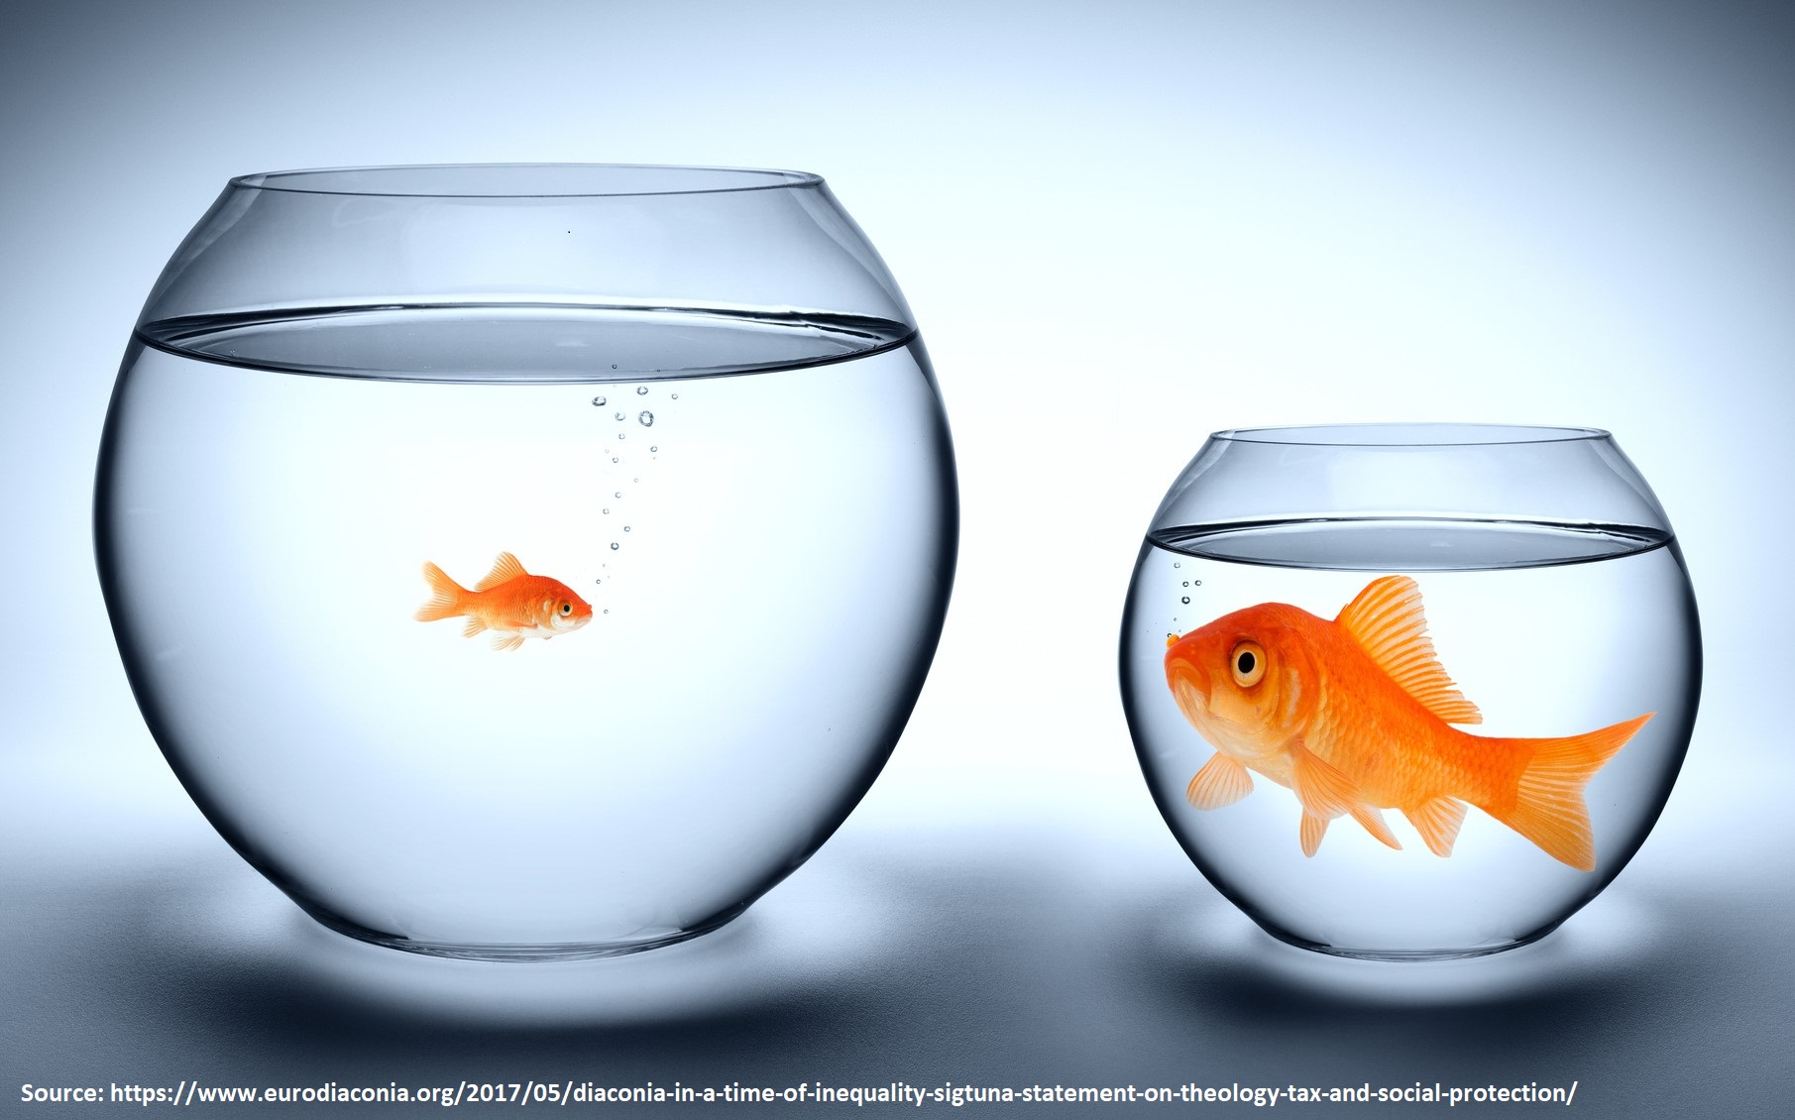
How to Live as a Sender: Money
But my local community
or personal connections
will be abandoned
(not likely)!
-Besides, your education, advocacy, and time are usually more impactful resources to use locally anyway. So favor everyone, just with the best resource!

Slide 30
How to Live as a Sender: Time
Strategically budget your time toward where it’s the most impactful resource and away from where it’s not…
-“Give time to those around you; that’s what empathy is for.
But give cash to the world’s lesser served; you’ll heal 10,000 more!”
-Use time for education and advocacy – important for sending both domestic and global support – but heed the recipients’ input!
-Most importantly, ensure God isn’t calling you to use your time to GO. Senders are part of ONE A-team, not a default B-team.

Slide 31
Right Now: How Will I Effectively Send?
Identify as the member (CELL) of the global Body that you ARE!
-Claim God’s words about your global role (Commit them to memory).
-Envision yourself within your global role.
-Lament the cost of not playing a global role.
-Live your global role with education, advocacy, money, and time.

Slide 32
Right Now: How Will I Effectively Send?
Claim God’s words about your global role (Commit one to memory!)
-Deut. 14:28-29: The tithe is centrally gathered for all paid ministry workers and those in greatest need.
-1 Cor. 12:24-26: We are all cells in Christ’s Body and must care for each other equally.
-Acts 4:32: Since all we have is Christ’s, his Body’s excess must meet his Body’s needs.
-Rom. 15:26-27: This balance applies globally, not just locally.

Slide 33
Right Now: How Will I Effectively Send?
Envision yourself
within your global role.
(Mentally imprint the image
best reminding you
of your global role.)

Slide 34
Right Now: How Will I Effectively Send?
Lament the cost of not playing a global role (Which lamentation is most compelling?).
-An average US Christian has ~8,000x less healthcare impact on the world’s least served than an effective sender does.
-An average US Christian has ~10,000x less evangelistic impact on the world’s least reached than an effective sender does.
-For every $100,000 dollars a Christian earns, only $1 goes toward unreached people groups.
-41% of humans remain unreached today, and effective sending could easily provide the financial means to reach them all.

Slide 35
Right Now: How Will I Effectively Send?
Live your global role with education, advocacy, money, and time.
-Education: Visit www.80000hours.org, read Doing Good Better (MacAskill), or email jason.dykstra.md@gmail.com for an Effective Sending Timeline personalized for your situation…or just to connect further!
-Advocacy: Email info@blessbig.org to learn more about
Bless BIG Impact Trips.
-Money: Partner with role model CELLs and their high-impact charities at www.blessbig.org.
-Time: GO, and if God makes you an Effective Sender instead…
“Give time to those around you; that’s what empathy is for.
But give cash to the world’s lesser served; you’ll heal 10,000 more!”

