Slide 1
Global Missions Health Conference Find Where You Belong November, 2013
Working with Universities, Governments &
National Healthcare

Slide 2
Working with Universities, Governments & National Healthcare
Panelists
Matthew Koh, MD, is a general surgeon from Singapore. He is President of MSI Professional Services, serving in southwest China.
James D. Smith, MD, Professor Emeritus of Otolaryngology, Oregon Health & Science University. Chairman of the Medical Education International (MEI) Advisory Council.
Daniel Tolan, MD, lived full time in Kenya from 1989 to 2002. He and Cindy are missionaries with World Gospel Mission, now working in missionary recruitment and retention and with Christian Medical Dental Associations (CMDA).
Neil O. Thompson, MD, Panel Moderator. Served as missionary surgeon at Manorom Christian Hospital in Central Thailand from 1978-2001. He is now Medical Mission Advocate with OMF International.

Slide 3
Opportunities to use Medical Education as an Outreach in Medical Universities Worldwide
James D. Smith, MD
Professor Emeritus
Oregon Health & Science University

Slide 4
Objectives
Participants will be introduced to the worldwide need for current medical education training which can be used as a mission outreach in both short term and long term settings.
Participants will be able to prepare for and find opportunities to work in Medical Universities worldwide and use this as a forum to serve the Lord

Slide 5
Personal Journey
Academic Otolaryngology – OHSU
Sabbaticals
Visiting Professor – National U. of Singapore
Full time - 2 ½ years
Part time – for the past 14 years

Slide 6
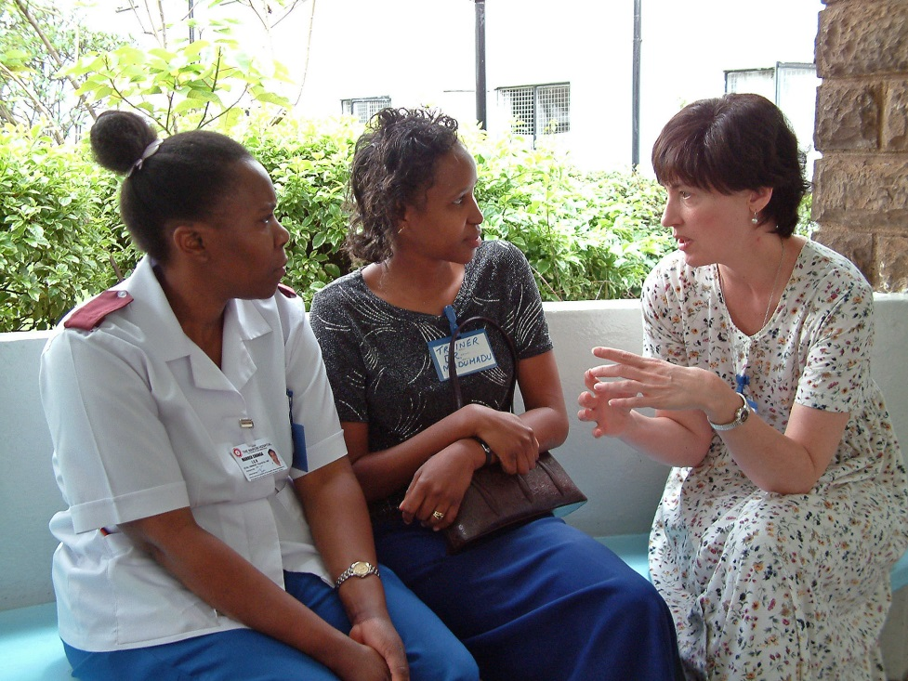
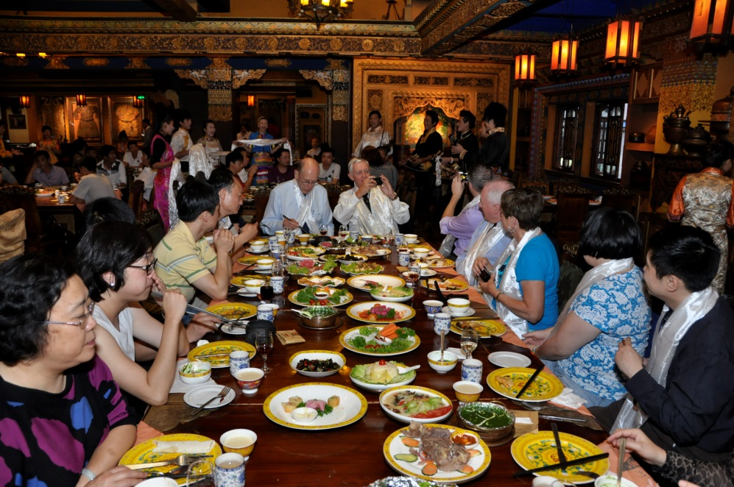
The Key
The key to having an opportunity to share your faith in other cultures is to develop genuine and caring relationships
How can we do this?

Slide 7
The Key To Successful Short Term Teams
Teaching and Training
Transfer of skills
Repeat trips – necessary to develop relationships

Slide 8
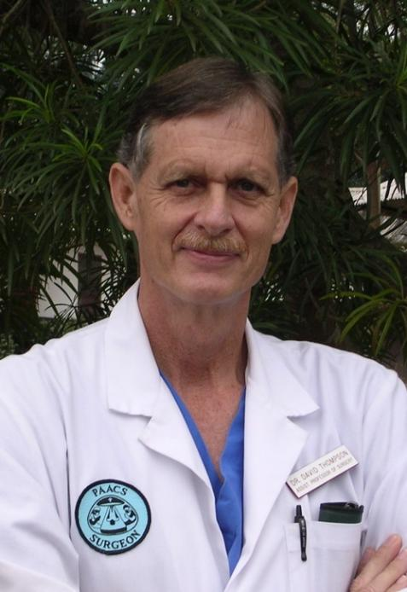
The Key To a Successful Long Term Career
Get to know the culture
Develop long term relationships
Be a role model
As a teacher
The way you treat patients
Clinical

Slide 9
Opportunities
Medical Schools
Christian – Zambia, Burundi, Cameroon, Ethiopia
Secular - Kazakhstan
Residency Training
PAACS, Family and Internal Medicine
Secular – Jim Jewell
Faculty Development
China – Loh Cheng
Zambia – Cheryl Snyder

Slide 10
Preparation
“To be a good teacher one needs to love their subject and love their students”
Prepare career with a view of being a teacher
Take education courses
Plan to take a faculty position in a training program

Slide 11
But What Can I Do?
Influence medical students clinically and spiritually
A role model as an excellent teacher
A role model for treating patients with care and respect

Slide 12
What Should be Our Motive?
Our overriding reason is to show the love of Christ
I Peter 3:15 – Always be prepared to give an answer to everyone who asks you to give the reason for the hope that you have. But do this with gentleness and respect.

Slide 13
Campbell, A, Sullivan, M, Sherman, R. Magee, W: The Medial Mission and Modern Cultural Competency Training. American College of Surgeons Vol. 212, No. 1, Jan 2011: 124-129
Ethics for International Medicine: A practical guide for aid workers in developing countries. Anji E. Wall
When Helping Hurts. Steve Corbett and Brian Fikkert

Slide 14
Developing World Health Systems. “Where and how do I fit as a medical missionary?”
Daniel Tolan
2013
Daniel.tolan@cmda.org

Slide 15
1. Do I really need to be part of the National Health System as a medical missionary? 2. Are there Christians (organizations) in health-care in my country? 3. Is there a Biblical basis or mandate to us as Christians?
Notes:
There are a number of good questions we need to ask ourselves. One in particular is “How important is it really to fit into the system? Another good question is as a Christian where will you look for your support as a believer in health-care in your country of practice?

Slide 16
…from the Chair Medical Board and Dean of a Medical School in Kenya…
who had been educated in Christian schools
who was a member of a good church and attended regularly
who was working with several mission hospitals on an educational project..
Notes:
To answer the first question of how important this is…listen to the words of Dean Otsyula from Moi University Medical School in Kenya.

Slide 17
From the Dean…
“I do not see how this will work very easily. There is lack of trust on your part directed toward us. You do not show interest in being part of us or of this country’s system. We are good people but we do not know each other.”
Notes:
Read the statement.
The Dean’s comments are like a dagger to the heart of medical missions and too often they ring loud and true of missions and medical missionaries.
It is too easy to get into our busy cocoon and be isolated from those around those – those we came to serve.

Slide 18
Objectives
Understand the basic design of The Ministry of Health.
Identify the critical offices you need to be familiar with.
Understand the value of, and our Biblical mandate for, faith-based cooperation/collaboration with governmental and private sectors.
Notes:
Read the objectives above.
This is what I hope you gain from time together.

Slide 19
Why should this be of interest to me?
What does God say?
Is there a Biblical basis?
Notes:
Well, you might be asking yourself, “Why should this interest me?”
Attitude of - “Really, I am going to tell people about God not to cooperate or get involved in politics, government offices and red tape!”
Well the Bible address this quite clearly in both the old and new testaments. So just briefly…

Slide 20
Our Biblical mandate and principles
Government is God's institution
Genesis 9:1-7 – civil government began
Exodus 20-22 – patterns established
Daniel 2:20-21 – God changes rulers
Romans 13:1 - ordains civil powers
Notes:
Civil government exists and functions by God's command, not because men created a social contract.
Civil government began in Genesis 9:1-7, when God instructed Noah after the flood.
Exodus 20-22, God through Moses gives a specific pattern for civil government.
Daniel 2:20-21, God removes and sets up new rulers and Proverbs 21:1, he turns a ruler's heart.
Romans 13:1, He ordains civil powers.
Clearly, government is not a secular institution but a God-ordained institution.

Slide 21
Biblical principles and mandate
God directs His institutions
Exodus 21-22 address crimes such as murder, manslaughter, slavery, kidnapping, abortion, infanticide, robbery
Leviticus 13, 20 public health laws
Deuteronomy 17-22 power of courts for standards, conduct and punishment
Exodus 18 and 1 Tim 3 qualifications of leadership in church and civil government
Notes:
Exodus 21-22 addresses manslaughter, premeditated murder, assault, kidnapping (and slavery), abortion, infanticide, property crimes, criminal negligence, assaulting parents, robbery and bestiality.
Leviticus 13, 20 and other passages address such issues as public health laws and issues of sexuality.
In Deuteronomy 17-22 regarding violation of a court order, perjury, malicious accusations, building codes (no regulatory scheme, it just sets the standards for responsible conduct and punishes wrongs), juvenile delinquency and rape.
God also gives qualifications for leadership, both in the church (1 Timothy 3:1-7) and in civil government (Exodus 18:21).

Slide 22
Biblical Principles and Mandate
Secularizing government is an affront to a Holy God
Romans 13:3-4 civil leaders are "ministers of God“
Daniel 2, Psalm 75:6-7, Esther 4:14 the reality of sovereign appointments
1 Kings 3:16-27, Proverbs 3:5-6 Wisdom comes from dependency not our own understanding
Notes:
Another principal is that we should not secularize government.
Romans 13 leaders are to be thought of as ministers to us.
We must understand the reality of sovereign appointments. A civil leader serves at God's pleasure! "...He (God) removes and sets up kings..." (Daniel 2:21). "For promotion comes neither from the east, west, or south. (Psalm 75:6-7). God places people in leadership for His specific purposes -- for His benefit, not theirs! "... for such a time as this?" (Esther 4:14.)
Understanding man's tendency to compromise, we also recognize the principle of DEPENDENCY. Recall Solomon and the baby (1 Kings 3:16- 27). "...lean not unto thine own understanding" (see Proverbs 3:5-6).

Slide 23
Health Care Services in most countries can be divided conveniently into three official sub-sectors.
Public
Voluntary ( Non Governmental Organizations - abbreviated NGOs)
Private
Notes:
In most developing countries Health Care Services can be conveniently divided into three sector or divisions. We will briefly look at these three subsectors.

Slide 24
Public sub-sector
Government owned health services and other parastatals. (A parastatal being a company or agency owned or controlled wholly or partly by the government.)
Notes:
Read the above.
Most of the developing world the majority of health services will be provided through the government. This is the largest division for most of the world countries. In US this would be County health services, Veteran Affairs hospitals, etc.

Slide 25
Voluntary sub-sector
Health activities of what are popularly known as Non Governmental Organisations or NGOs. Examples:
Faith-based health services
The Red Cross
WHO
Doctors Without Borders
NGOs can be as small as a handful of staff to literally hundreds.
Notes:
Read above
This is usually where you and I as missionaries – you would work for what would be considered a Nongovernmental Organization if you work for a faith based organization that is registered in the country.

Slide 26
Private sub-sector
Also referred to as the “private for profit sectors”
private health facilities
health professionals in private practices
Notes:
In the United States this is by far and away the largest division. We are mostly small independent organizations spread out over the country. But in much of the world this is smaller although the balance can be quite dynamic.

Slide 27
4th group
An unofficial sub sector comprising of institutions and providers over which the MOH has no control, i.e. traditional medicine consisting of herbalists, bone setters, spiritual healers and other practitioners.
Notes:
The 4th group … read above.
This is a growing group in terms of numbers and influence of which we will talk about later in the conference.

Slide 28
What is a Ministry of Health?
Government body charged with establishing national policies, guidelines and standards for all health services
Manages the govt. (public) health services
Notes:
Basically there are two functions for the Ministry of Health. A ministry simply means a department of the national government.
(Read the two functions above)

Slide 29
What (who) do I need to know?
Licensing body
Department of Clinical and Community Services
Department of Planning and Development
Notes:
So who do you need to know?
At the national level and the local level who you need to know is different.

Slide 30
Who is responsible for your license?
One national office for your profession
Usually falls under the Ministry of Health Clinical Services - Licensing Body (examples):
Medical and Dental Practitioners Board
National Board of Nursing
Board of Clinical Officers
Register with this body even if it is not required
Seek to know someone on the board
Similar function to State Medical Board (USA)

Slide 31
Department of Clinical and Community Services
Dept of National Disease Control
Ex: TB, AIDS, Leprosy, etc.
Dept of Community/Public Health
Ex: Immunizations, sanitation, etc.
Dept of Clinical Services
Ex: Pharmacy formulary, standards, CME, etc.
Organize CME for your local community health staff
Know these offices at your local level

Slide 32
Department of Planning and Development
Ministry of Health will have or will be part of the following two sections at a local level:
District Health Management board
District Development board

Slide 33
District Health Management Team
Community Health officer
Clinical Services officer – usually the chief medical officer in the district
Department of Water and Sanitation
Planning and Development officer
Others?
One or two health facility representatives
Try to have someone from your team on this committee!

Slide 34
Public, NGO, Private collaboration(?)
Often at war with each other
Poor testimony and witness
Collaboration benefits those we are called to serve
Part of our calling is to serve those in authority over us
Collaboration will eventually benefit your ministry in one way or another

Slide 35
NGOs Temptations:
To Be Self Sufficient - (Self Reliant)
To Be Spectacular
(Celebrity Mentality)
To Be Powerful (In Charge)

Slide 36
Christian Medical Fellowship
Part of the International Christian Medical and Dental Association www.ICMDA.net
Contact ICMDA to learn about CMF in your country
Join the National CMF
Join or organize a local chapter

Slide 37
Activities of CMF
National meeting – do you best to attend even for part of the meeting!
Local chapter meetings – be part of a local chapter. Do not hold meetings just at your place of ministry but take turns
CME – offer to the community health personnel

Slide 38
Christian Health Association of ?
Links together all Faith-based ministry within a country
Important to:
represent you to government bodies
obtaining funding/grants
procuring drugs and supplies at large volume discounts
teaching and training

Slide 39
To help you be a team member…
Obtain country health profile from WHO
Visit multi-sectorial efforts in your area
Ex: water, sanitation, education
Become a member of district boards related to health
Obtain a copy of the “Health Sector Act (Reform Act) for your country
Obtain essential drug list for your country from both the Ministry of Health and WHO
Base your project’s formulary on this document

Slide 40
New missionary needs to do…
Before you go…
Research the WHO website on your country (such as the country health profile)
After you arrive…
(in the first 2 months) Visit and register with national board that oversees your profession
(within 3 months) Take one day … Identify and visit two local offices to do with health/development. Ask, “how can I help you meet your goals?” (Ex. local public health office, Educational officer)

Slide 41
Missions HealthCare Ministries
Take home message: We need to do a better job at serving our country’s Ministry of Health (fitting in).
We need to develop more relationships locally with individuals
There is strength in unity and cooperation

Slide 42
Working with Universities, Governments & National Healthcare
Panelists
Matthew Koh, MD, is a general surgeon from Singapore. He is President of MSI Professional Services, serving in southwest China.
James D. Smith, MD, Professor Emeritus of Otolaryngology, Oregon Health & Science University. Chairman of the Medical Education International (MEI) Advisory Council.
Daniel Tolan, MD, lived full time in Kenya from 1989 to 2002. He and Cindy are missionaries with World Gospel Mission, now working in missionary recruitment and retention and with Christian Medical Dental Associations (CMDA).
Neil O. Thompson, MD, Panel Moderator. Served as missionary surgeon at Manorom Christian Hospital in Central Thailand from 1978-2001. He is now Medical Mission Advocate with OMF International.

