Slide 1
Understanding Worldviews:
Buddhist & Confucian
Neil O. Thompson, MD
Matthew Koh, MD
Global Missions Health Conference
Louisville, KY
7 November 2015
Notes:
1
Welcome to “Understanding WVs: Buddhist & Confucian”. We’re about to take you on a trip to the Orient.

Slide 2
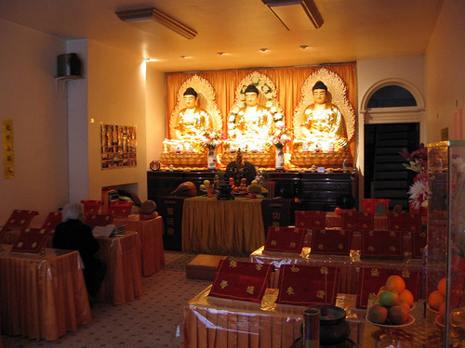
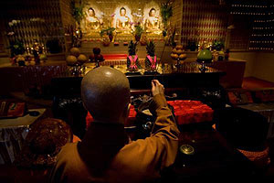
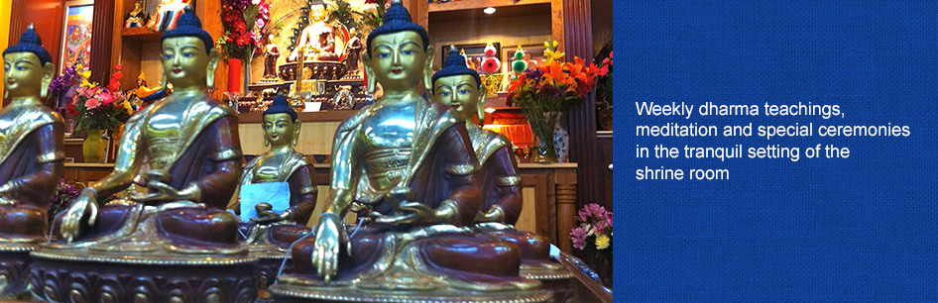
Notes:
There are > 2400 Buddhist temples in the US! Here are temples in Philadelphia, Denver and—not too far from here—Louisville!

Slide 3
Understanding Worldviews:
Buddhist & Confucian
“The God who made the world and everything in it is the Lord of heaven and earth and does not live in temples built by human hands.” —Acts 17.24
Neil O. Thompson, MD
Matthew Koh, MD
Global Missions Health Conference
Louisville, KY
7 November 2015
Notes:
3
For our struggle is not against flesh and blood, but against the rulers, against the authorities, against the powers of this dark world and against the spiritual forces of evil in the heavenly realms. —Ephesians 6.12
The light shines in the darkness, and the darkness has not overcome it. —John 1.5

Slide 4
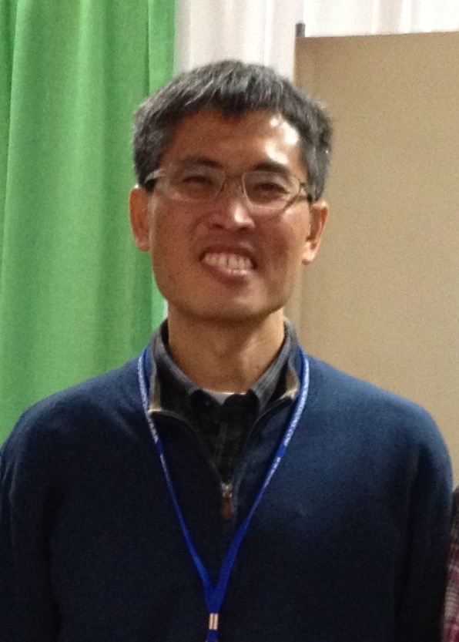

Slide 5
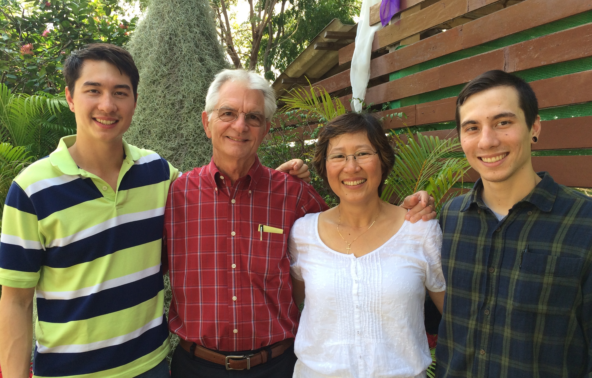
Kevin, Neil, Wannee & Nathan

Slide 6
Outline
Introduction: Worldview—What is it?
Understanding Buddhism
Philosophy
Practice
Understanding Confucianism
Philosophy
Practice
Summary
Response

Slide 7
What is Worldview?
A worldview (or vision of life) is a framework or set of fundamental beliefs through which we view the world and our calling and future in it.…
Notes:
A worldview is a commitment, a fundamental orientation of the heart, that can be expressed as a story or in a set of presuppositions (assumptions which may be true, partially true or entirely false) that we hold (consciously or subconsciously, consistently or inconsistently) about the basic constitution of reality, and that provides the foundation on which we live and move and have our being. — UND, p. 20, working definition of book

Slide 8
What kinds of questions does “Worldview” ask?
What is the nature of the world around us?
What is a human being?
Where do we come from?
What happens to a person at death?
What is the meaning of human history?
What is the nature of the world around us?
What is the nature of the world around us?
Notes:
What is the nature of the world around us? Created or evolved, orderly or chaotic, subjective or objective?
What is a human being? Where do we come from? To this we might answer: a highly complex machine, a sleeping god, a person made in the image of God, a naked ape.
What happens to a person at death? Here we might reply: personal extinction, or transformation to a higher state, or reincarnation.
How do we know what is right and wrong? Because of a God who is good, or what feels good?
What is the meaning of human history? To fulfill the purposes of God, or it’s meaningless?

Slide 9
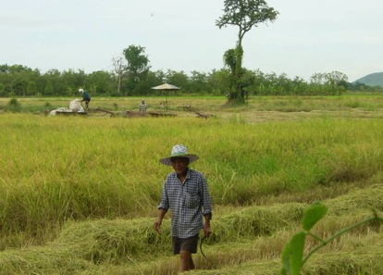
Meet Mr. Riap
Notes:
I first met Mr. Riap when I went to Thailand as a medical student on a short-term trip over 40 years ago. He grew up in Hanka, Chainat, about 100 miles north of Bangkok—among the vast rice plains of Central Thailand. His father was a rice farmer. Riap became a teacher.

Slide 10
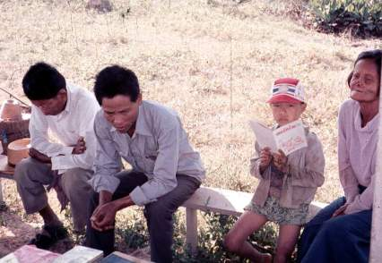
Meet Mr. Riap
Rural Clinic, Central Thailand
Notes:
But one day he found a numb spot on his arm, and then later on it became painful. He and his family were frightened. The monks at the Buddhist temple tried to help, but their expensive poultices did not help. His family loved him, but they felt they had no alternative than to put you out of the house.

Slide 11
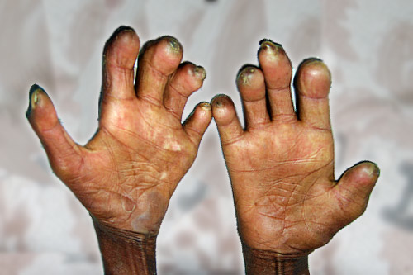
Mr. Riap’s Hands
Notes:
In a few years, his hands became deformed and he could hardly feel or grip anything. He was desperate, knowing he was facing life as a social outcast and begging. There were no local hospitals or clinics in the area. But then a friend told him of this new clinic run by foreigners…
Let’s look at Buddhism…

Slide 12
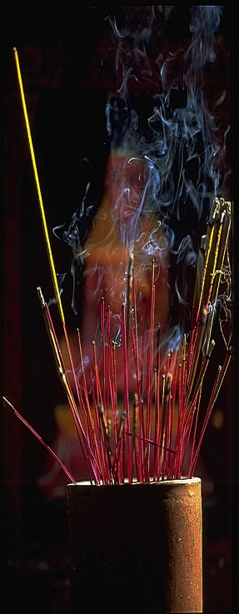
Outline
Introduction: Worldview—What is it?
Understanding Buddhism
Philosophy
Practice
Understanding Confucianism
Philosophy
Practice
Summary
Response
Notes:
This is what we’ll be looking at today.

Slide 13
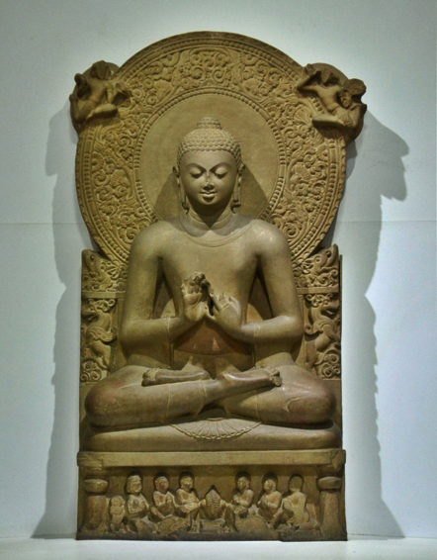
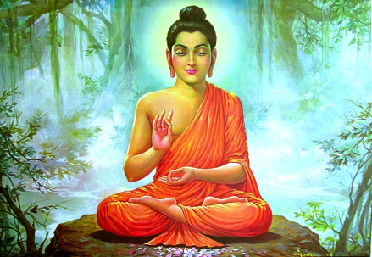
Understanding Buddhism
Siddharta Gautama,
563-483 BC
Notes:
Siddharta Gautama, 563-483 BC (~ time of Jewish exile) was born into a life of wealth and privilege, in NE India/ Nepal. Having seen nothing of suffering and pain in his protected surroundings, he went out on a chariot ride one day and ”encountered the realities of old age, sickness and death for the first time”. He was so moved that at the age of 29 he moved out of his father’s house, exchanged his clothes for a beggar’s and went out into the world to search for the cause of human suffering and the way to liberation. He remained in turmoil as he learned that neither extreme wealth nor extreme poverty helped him break the cycle of birth, suffering, death and rebirth. He decided to take “the middle way”, which became a central tenant of Buddhism. He ate enough food and water to survive, continued to meditate and on the 49th day of enlightenment he became known as The Buddha, the “Enlightened One”. He traveled throughout India and taught for 45 years, before dying at the age of 80.

Slide 14
Buddhism in Thailand: The Philosophy
  Four Noble Truths →
  The Noble Eightfold Path →
  “The Middle Way” →
  “Enlightenment”

Slide 15
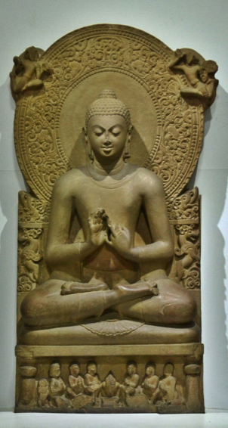
The Four Noble Truths
Life leads to suffering.
Suffering is caused by desire, craving.
Extinguish desire.
Follow the eightfold path…
—The first teaching of Gautama Buddha after attaining Nirvana: the “essence” of Buddhism.
Notes:
Another way of putting it: Life is suffering; man is born to suffer; can’t change your fate; must depend on yourself

Slide 16

The Noble Eightfold Path
Correct View
Correct Intention
Correct Speech
Correct Action
Correct Livelihood
Correct Effort
Correct Mindfulness
Correct Concentration
Notes:
Wisdom (Prajñā • Paññā)/ Insight
1 Right view. 2 Right intention, Ethical conduct (Śīla)/ Morality. 3 Right speech. 4 Right action. 5 Right livelihood, Mental discipline (Samādhi), concentration, meditation. 6 Right effort, 7 Right mindfulness. 8 Right concentration.
Along with (with the Five Commandments)
Where add the “Five Commandments”?
Don’t kill living things.
Don’t steal.
Don’t commit adultery
Don’t lie.
Don’t get drunk.

Slide 17
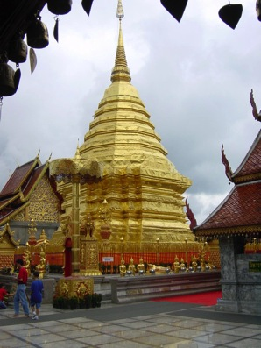
The Middle Way
Moderation, away from the extremes of self-indulgence and self-mortification
The middle ground between “all things exist or do not exist”
Avoid extremes of permanence and nihilism, existence and nothingness.
—Said to have been discovered by Gautama Buddha prior to his enlightenment.

Slide 18
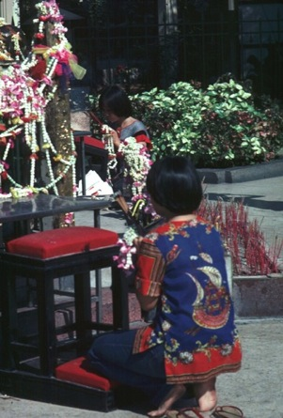
Nirvana: Enlightenment
Awakening =
Understanding =
Knowledge…
  Of past lives
  Of the working of karma and reincarnation
  Of the Four Noble Truths
  … that all this is true →
What the Buddha attained
Notes:
This is the Buddhist view of the crowing achievement of life.
How does this work out in practice?

Slide 19
Buddhism: The Practice
NIRVANA
REINCARNATION
MERIT
KARMA
Notes:
NIRVANA: Enlightenment—End of the Cycle
SAMSURA- Reincarnation—Cycle from the previous birth
KARMA—Fate determined by past actions
MERIT—Accumulation of Good or Bad Deeds: the life of a Buddhist!
Giving rice to monk in morning
Bowing at a spirit house or shrine
Lighting joss sticks
Dedicating a son to a temple
Setting animals free
Donating money, etc to temple

Slide 20
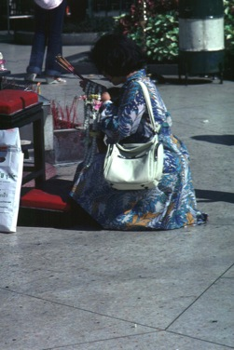
Buddhism: The Practice
What does “Making Merit” look like?
  “Karma (from the Sanskrit, ‘action, work’) in Buddhism is the force that drives the cycle of suffering and rebirth (samsara) for each being.” This is called ‘making merit’.
  To break the hold of karma (fate) and reincarnation…
Notes:
In Theravada Buddhism there can be no divine salvation or forgiveness for one’s karma, since it is a purely impersonal process that is a part of the makeup of the universe.
Buddhism: Karma, in Wikipedia

Slide 21
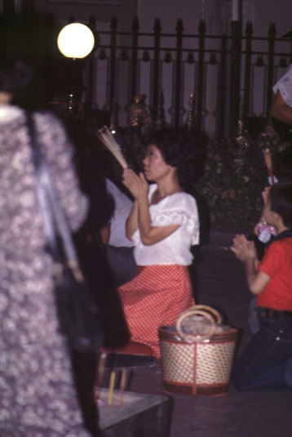
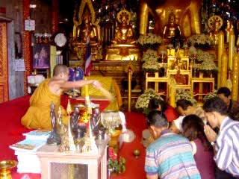
Buddhism: Making Merit
Notes:
Making merit, in its many forms: lighting joss sticks and worshiping at a Hindu shrine (in Bangkok, Thailand). Visiting a monk at a local temple (ChiengMai, Thailand).

Slide 22
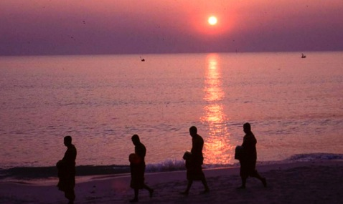
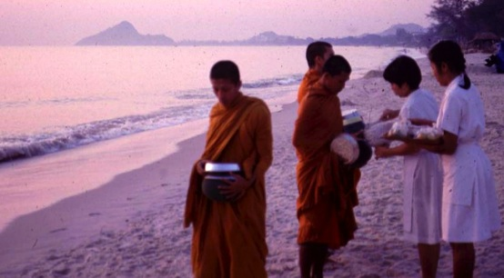
Buddhism: Making Merit
Notes:
Giving rice to monks at sunrise (at Hua Hin, Thailand).

Slide 23
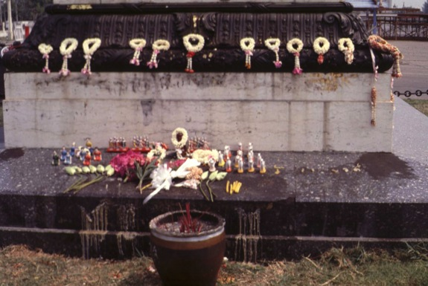
Buddhism: Making Merit
Notes:
Making merit, in its many forms

Slide 24
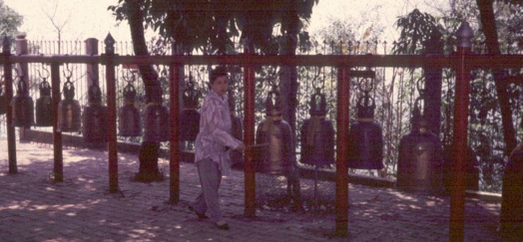
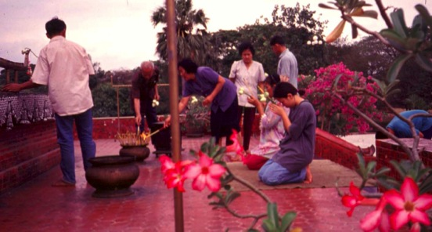
Buddhism: Making Merit
Notes:
Making merit, in its many forms: beating prayer drums, lighting joss sticks.

Slide 25
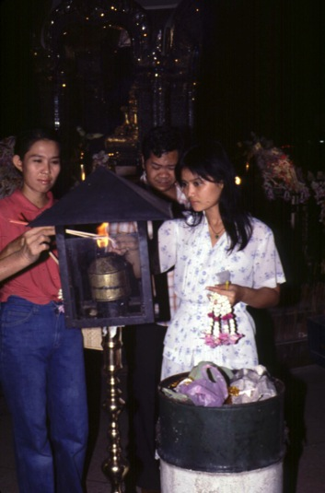
Buddhism: Making Merit
Notes:
Making merit, in its many forms

Slide 26
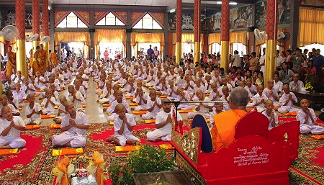
Instruction of Novices
The novices and their parents “make merit”.
Notes:
When a boy enters the temple, both he and his parents “make merit”.

Slide 27
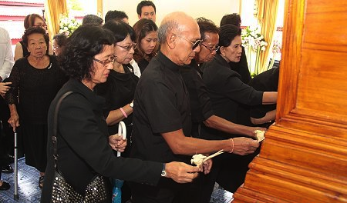
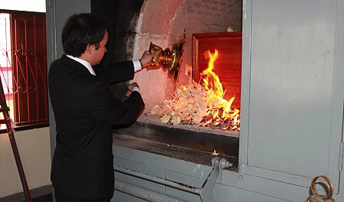
Thai Funeral

Slide 28
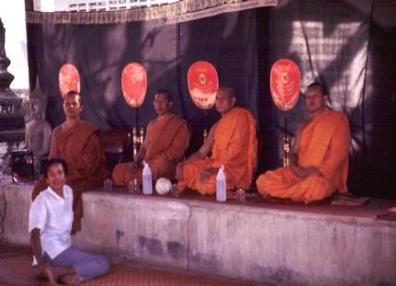
Thai Funeral
He’s gone and won’t be back.
He sleeps and won’t wake up.
There is no resurrection.
There is no escape.
Notes:
At Buddhist funerals, monks were chant while holding orange colored fans that say:
He’s gone and won’t come back.
He sleeps and he won’t wake up.
There is no resurrection.
There is no escape.
Summary: There is no such thing as “hope” in the Christian sense!

Slide 29
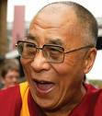
Buddhism: Making Merit
“We must take direct responsibility for our own spiritual lives, and rely upon nobody and nothing…
If another being were able to save us, surely he would have already done so? It is time, therefore, that we
help ourselves.”
Notes:
Buddhism: the most elaborate “self-help” philosophy.

Slide 30
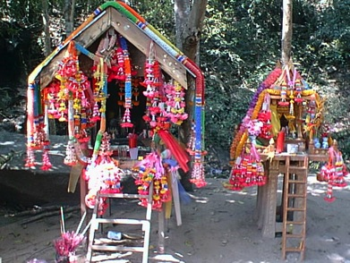
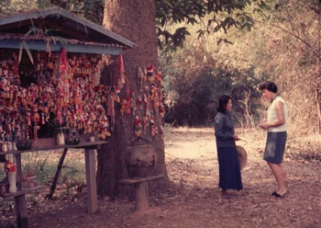
Syncretism in Buddhism:
Animism
Notes:
Animism: Spirit houses
Syncretism: Hinduism, Animism, Ancestor Worship, Shamanism

Slide 31
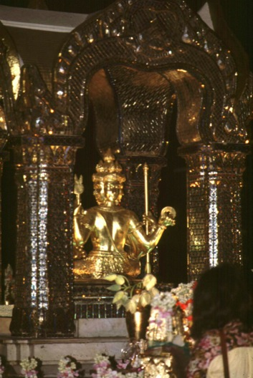
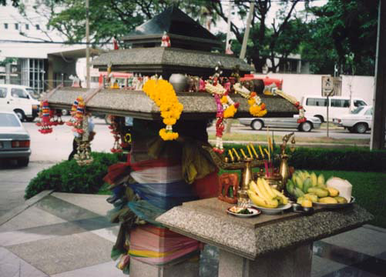
Syncretism in Buddhism:
Hinduism, Animism, Ancestor Worship
Notes:
Syncretism: Hinduism, Animism, Secular Hedonism

Slide 32
Buddhism in Thailand: The Results
  Loyalty to king, country, religion and family is a non-negotiable value.
  Becoming a Christian is seen as disloyal, like being a traitor.
  Therefore, it is very difficult for a Thai to become a Christian.
  Thai Funeral: Fatalism → Hopelessness and Despair
  And yet, after centuries of proclamation of the Gospel, only 0.5% of Thai people are Christians.

Slide 33

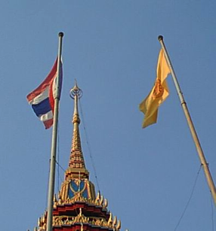
Buddhism in Thailand: Summary
  “To be Thai is to be Buddhist.”
  Buddhism is growing worldwide.
  The Challenge Today
  Then what can you do?
Notes:
It is very difficult for a Thai to become a Christian because loyalty to religion, king, country and family is a core value.
Becoming a Christian (therefore, disloyal) is like being a traitor.
Summary: After centuries of proclamation of the Gospel, only 0.5% of Thai people are Christians. “To be Thai is to be Buddhist.” Burmese, Cambodian, Vietnamese, Tibetan, Mongol, Japanese, Taiwanese.

Slide 34
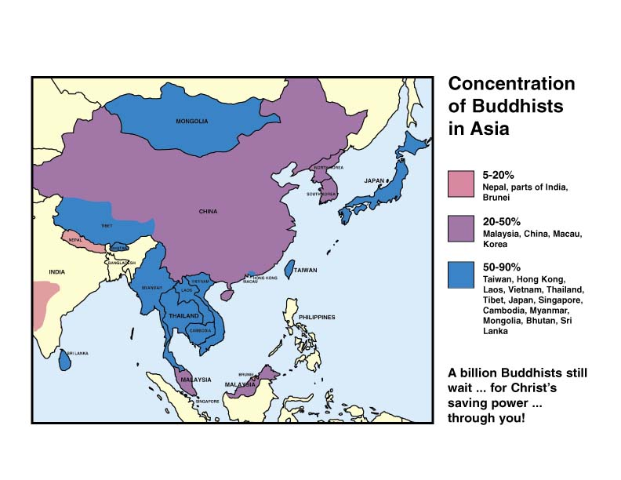

Slide 35
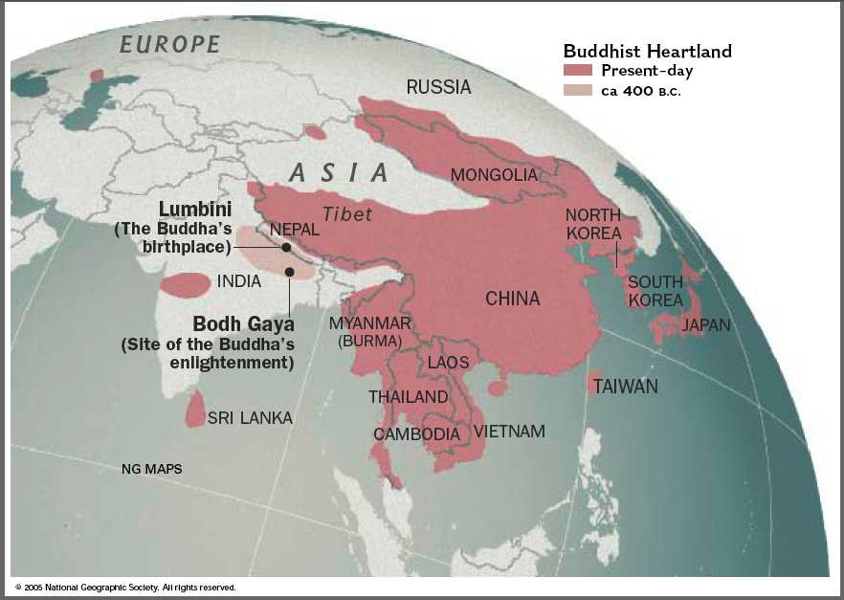
Notes:
This is the part of the world we’ll be focusing on today. But, remember that Buddhism is the most rapidly growing religion in Australia. And, the US has the 11th highest population of Buddhists in the world!

Slide 36
Outline
Introduction: Worldview—What is it?
Understanding Buddhism
Philosophy
Practice
Understanding Confucianism
Philosophy
Practice
Summary
Response
Notes:
Dr. Matthew Koh: Understanding Confucianism

Slide 37
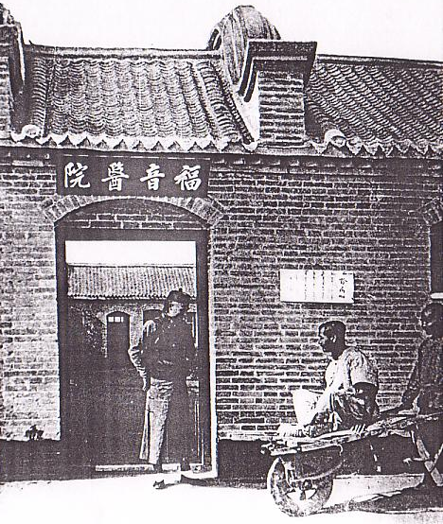
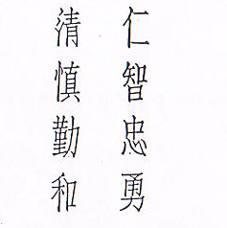
The Influence of Confucian Work Ethic as it relates to Professional Mission in PRC
Notes:
Benevolence, knowledge, loyalty, courage, honesty, prudence, diligence and harmony

Slide 38
Nature and Purpose of Study
Tentmaking theology
Asian Theology - Theology of Work
Pastoral care of tentmakers
Missionary Praxis in PRC

Slide 39
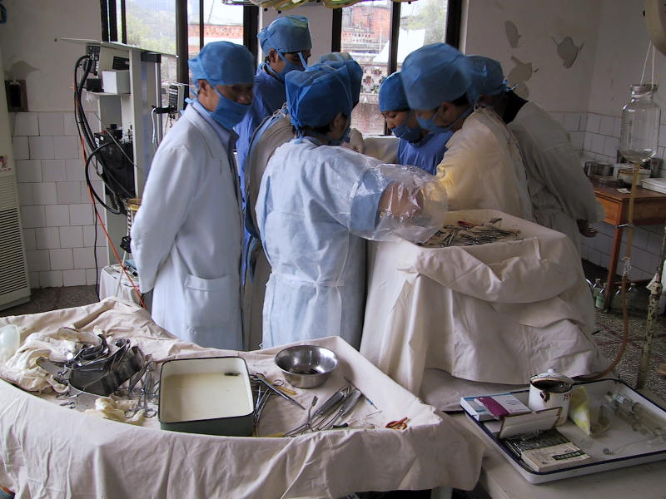
A Personal Pilgrimage

Slide 40
Outline
(II) Confucian Work Ethic
(III) Tentmaking and Professional Services / Mission
(IV) Implication of Confucian Ethic for Professional Mission
(V) Work of Tentmaking – Conclusions?
  Work as it Relates to a Theology of Evangelism, Conversion and the Church

Slide 41
(II) Confucian Work Ethic – A Survey
  Basis for Analysing Confucian Work Ethic
  Confucian View of Vocation
  Social Stratification in Traditional China
Notes:
According to the scholar Xie Fuya (1892-1992), the Hebrews are a people of faith, while the Greeks and other Westerners are people of knowing, but the Chinese are a people of action. "For more than 1800 years, the West has used the method of knowledge to prove the faith, and has created a glorious, illuminating Christian theology. Yet, in our manifesting faith in action, we should be able to create a Chinese Christian civilization."[1]
Jia Yuming (1880-1964) went a step further by integrating knowledge and action. "What I believe is what I know; what I know is what I believe and also what I do. With actual experience I will know what I believe and do what I know."[2]
[1] "Christianity and Culture", and "A Collection of Christian Thoughts in My Late Years."
[2] The Study of Theology.

Slide 42
Key Confucian Values
  Work ethic;
  Respect for community and authority;
  Tradition of paternalistic government;
  Emphasis on education;
  Merit-based advancement.

Slide 43
A Detailed Code of Interpersonal Behaviour
Justice and righteousness should mark the relations between sovereign and subject
Proper rapport between father and son
Separation of function of husband and wife
Younger gives precedence to elder
Faith and trust to reign in relationships between friends

Slide 44
Search for truth
“He who fully realises the truth in the morning may die without regrets in the evening.”
“gain control of yourself, and then you can manage your family, rule the nation, and bring peace to the world.”
Analects

Slide 45
The Ideal Man
self-reflection
self-restraint
good-heartedness
responsibility
filial piety
decorum,
honesty
sincerity
humility
moderation
thrift
self-reliance
respect for tradition and elders
need to be in harmony with nature.

Slide 46
Contemporary Expression of Confucian Work Ethic
Chinese Term | Type of Work | Meaning
Shih-ye | General term used for ‘white collar’ workers. Includes businesses, professionals as opposed to labourers. | A Career. The Concept of ‘a career’ only applies for those in this category. Note: shih is derived from word for ‘gentry’
Nung-ye | Farming and husbandry. | This initially tends to be family based; it gradually took a broader communal form in meaning.
Kung-ye | Manual work and industries | Tends to apply to a community rather than individuals.
Shang-ye | Businesses, trading | The idea of exchange is a key concept, hence how communities or individuals relate.

Slide 47
(II) Confucian Work Ethic – A Survey (continued)
Motivation for Education and for Work
‘forever occupy your thoughts with education.’
The Wisdom of Confucius.
Preference for Types of Work
Lao-li and Lao-sin

Slide 48
(III) Tentmaking and Professional Services / Mission
Differing Philosophies on Tentmaking
Work of Tentmaking
The Identity of a Tentmaker
Crisis of the Tentmaker’s Identity
Crisis of Chinese Identity

Slide 49
Crisis of the Tentmaker’s Identity
Type | 1 | 2 | 3 | 4 | 5
Call and Self Identity | Missionary Calling | Missionary Calling | Professional Calling | Professional Calling | Professional Calling
Sense of Vocation | Reach a People No Professional skills or no sense of calling to use such skills, so seek a way to reach people without using professional skills | Reach a People with the gospel And use their professional skills to hep reach a people IF their skills can be used If not, find another way | Serve in their profession And use their professional skills to hep reach a people IF their skills can be used If not, find another place | Serve in their profession Witness where ever they end up Ended up in East Asia | Serve in their profession Witness where ever they end up Remained at home
Relation to Agency | Missionary | Tentmaker | Tentmaker | Partner | Supporter
Problems | Can’t get into CANs | Regard ‘3’ as uncommitted, unfocused, lacking zeal | Regard ‘2’ as unprofessional, lacking integrity | No sense of mission calling (yet!)

Slide 50
(IV) Implication of Confucian Ethic for Professional Mission
Western Mission and a Chinese Biblical Theology of Work
Confucius Ethic and Protestant Ethic
Gentry and Professionalism
Notes:
But the other thing I want to say about that theology is that fundamentalism is not a good thing for present day China. And yet, on the grass roots level, the Chinese church is a fundamentalist church. I have had extensive discussion with theologians and students in Nanjing about the local churches they are preparing to enter and that some of them are already ministering in. When they describe the local churches (and I'm including and emphasizing the churches of the China Christian Council), they are describing churches that continue to bear the marks of American Protestant fundamentalism, which was basically "Christ against culture."
This view emphasizes individual conversion. It emphasizes cultivating those characteristics, virtues and traits that will allow us to go to heaven some day; but it doesn't cultivate those attitudes and values that will motivate us to take seriously the work of contributing to the larger culture in positive ways and cooperating with people in the larger culture with whom we disagree on spiritual and religious matters.
Christianity and Culture: A Challenge for the New China [07-01-03]
Dr. Richard J. Mouw, President, Fuller Theological Seminary

Slide 51
(IV) Implication of Confucian Ethic for Professional Mission
The Crises of Love and Jen
Work Done in Love
Crises of faith and Hope
Work Done also in Faith and Hope
Notes:
‘Asian (Chinese) Christians must learn to read and understand the Bible from within their own contexts, short of dualistic and enlightenment presuppositions’.[1] Chinese Christianity carries the baggage from these presuppositions in the understanding of faith, love, and righteousness. On top of these presuppositions, Chinese Christians are compounded with a Confucian tradition of humanism. Values of love and righteousness become defined and interpreted in a moralistic, legalistic basis. Chinese contextual theology wrestles to grasp love and righteousness[2] from the revelation of Jesus, the ‘God who is for humanity and the Man who is for God’[3]. Chinese culture’s implicit social paradigm of humanity must become subject under the revelatory authority of Scripture. By the grace of God, God works in love, we see the Word made flesh. Christ is the hope for all authentic human life. The gracious encounter of Christ with the Confucian Chinese results in the shift of the core of his identity that is now in Christ. From this identity, we can respond to the command to love God and love neighbour, only by which work can be done authentically in love.
[1] Hwa Yung. Mangoes or Bananas, p224
[2] Note that the Chinese bible’s translation for righteousness as used in Romans 1:16, 17 is the same word of yi (righteousness) in Confucian ethics.
[3] Adapted from Ray Anderson, Practical Theology, p 175. ‘Asian (Chinese) Christians must learn to read and understand the Bible from within their own contexts, short of dualistic and enlightenment presuppositions’.[1] Chinese Christianity carries the baggage from these presuppositions in the understanding of faith, love, and righteousness. On top of these presuppositions, Chinese Christians are compounded with a Confucian tradition of humanism. Values of love and righteousness become defined and interpreted in a moralistic, legalistic basis. Chinese contextual theology wrestles to grasp love and righteousness[2] from the revelation of Jesus, the ‘God who is for humanity and the Man who is for God’[3]. Chinese culture’s implicit social paradigm of humanity must become subject under the revelatory authority of Scripture. By the grace of God, God works in love, we see the Word made flesh. Christ is the hope for all authentic human life. The gracious encounter of Christ with the Confucian Chinese results in the shift of the core of his identity that is now in Christ. From this identity, we can respond to the command to love God and love neighbour, only by which work can be done authentically in love.
[1] Hwa Yung. Mangoes or Bananas, p224
[2] Note that the Chinese bible’s translation for righteousness as used in Romans 1:16, 17 is the same word of yi (righteousness) in Confucian ethics.
‘Asian (Chinese) Christians must learn to read and understand the Bible from within their own contexts, short of dualistic and enlightenment presuppositions’.[1] Chinese Christianity carries the baggage from these presuppositions in the understanding of faith, love, and righteousness. On top of these presuppositions, Chinese Christians are compounded with a Confucian tradition of humanism. Values of love and righteousness become defined and interpreted in a moralistic, legalistic basis. Chinese contextual theology wrestles to grasp love and righteousness[2] from the revelation of Jesus, the ‘God who is for humanity and the Man who is for God’[3]. Chinese culture’s implicit social paradigm of humanity must become subject under the revelatory authority of Scripture. By the grace of God, God works in love, we see the Word made flesh. Christ is the hope for all authentic human life. The gracious encounter of Christ with the Confucian Chinese results in the shift of the core of his identity that is now in Christ. From this identity, we can respond to the command to love God and love neighbour, only by which work can be done authentically in love.
[1] Hwa Yung. Mangoes or Bananas, p224
[2] Note that the Chinese bible’s translation for righteousness as used in Romans 1:16, 17 is the same word of yi (righteousness) in Confucian ethics.
[3] Adapted from Ray Anderson, Practical Theology, p 175.

Slide 52
(V) Work of Tentmaking – What Conclusions?
Work of Tentmaking in PRC - How it Serves Towards Articulating a Chinese Theology of Evangelism, Conversion and Church

Slide 53
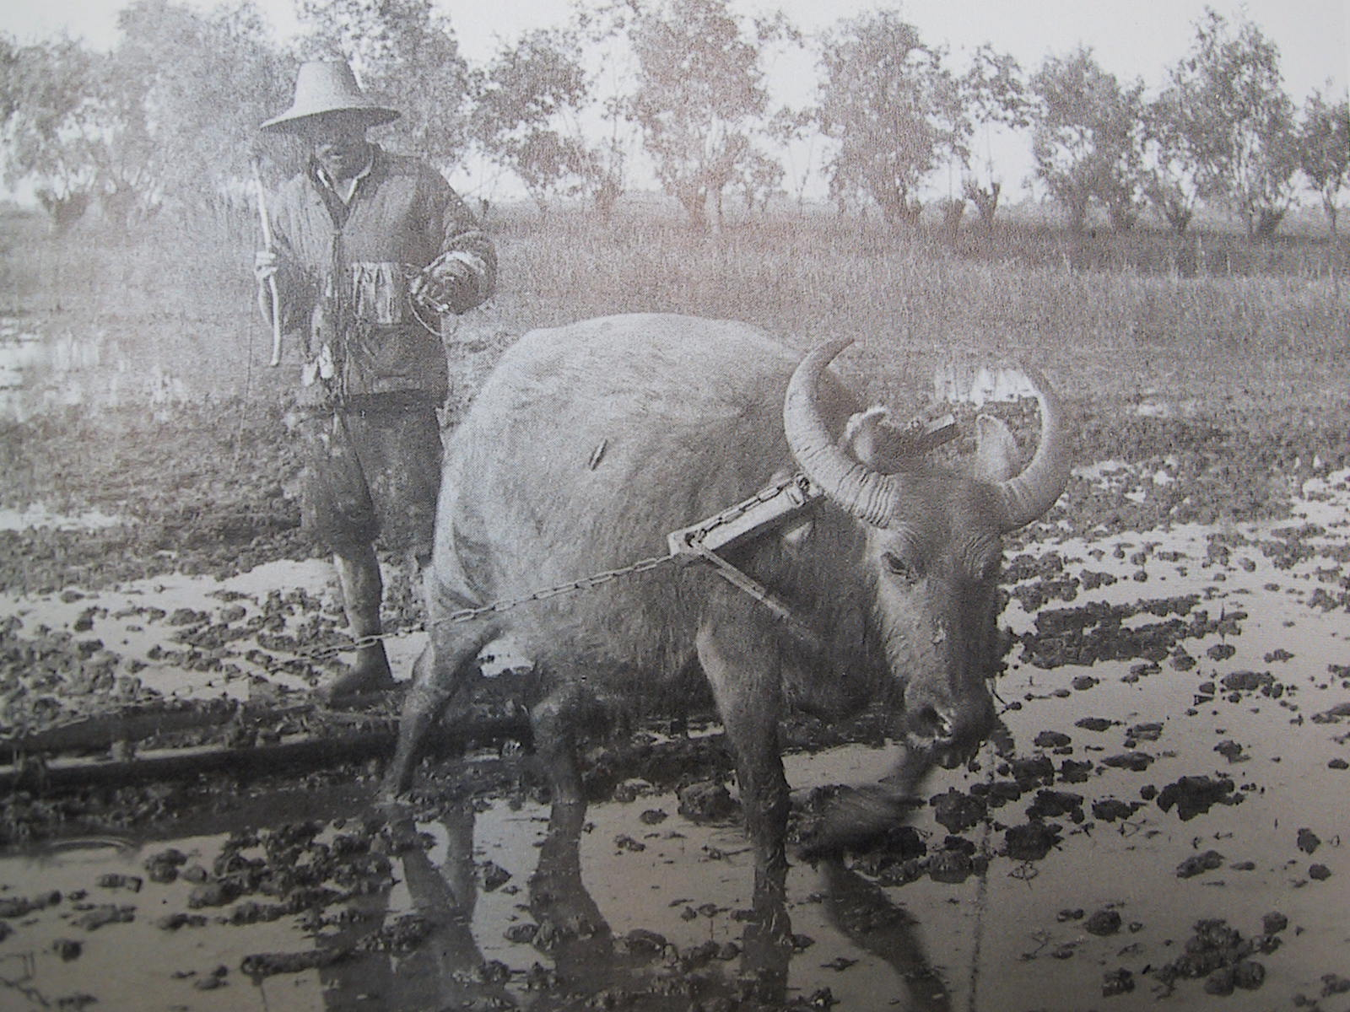
(V) Work of Tentmaking – What Conclusions?
Work as it Relates to a Theology of Evangelism

Slide 54
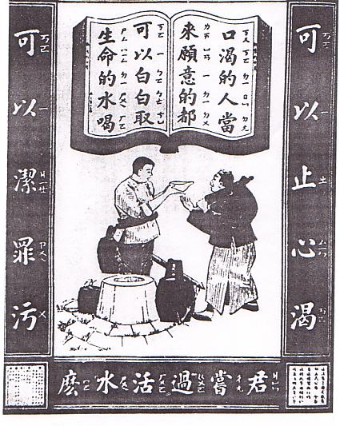
(V) Work of Tentmaking – What Conclusions?
Work as it Relates to a Theology of Evangelism
Work as it Relates to a Theology of Conversion

Slide 55
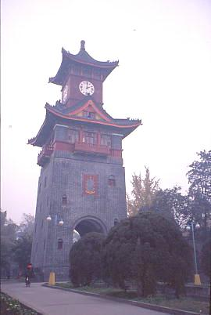
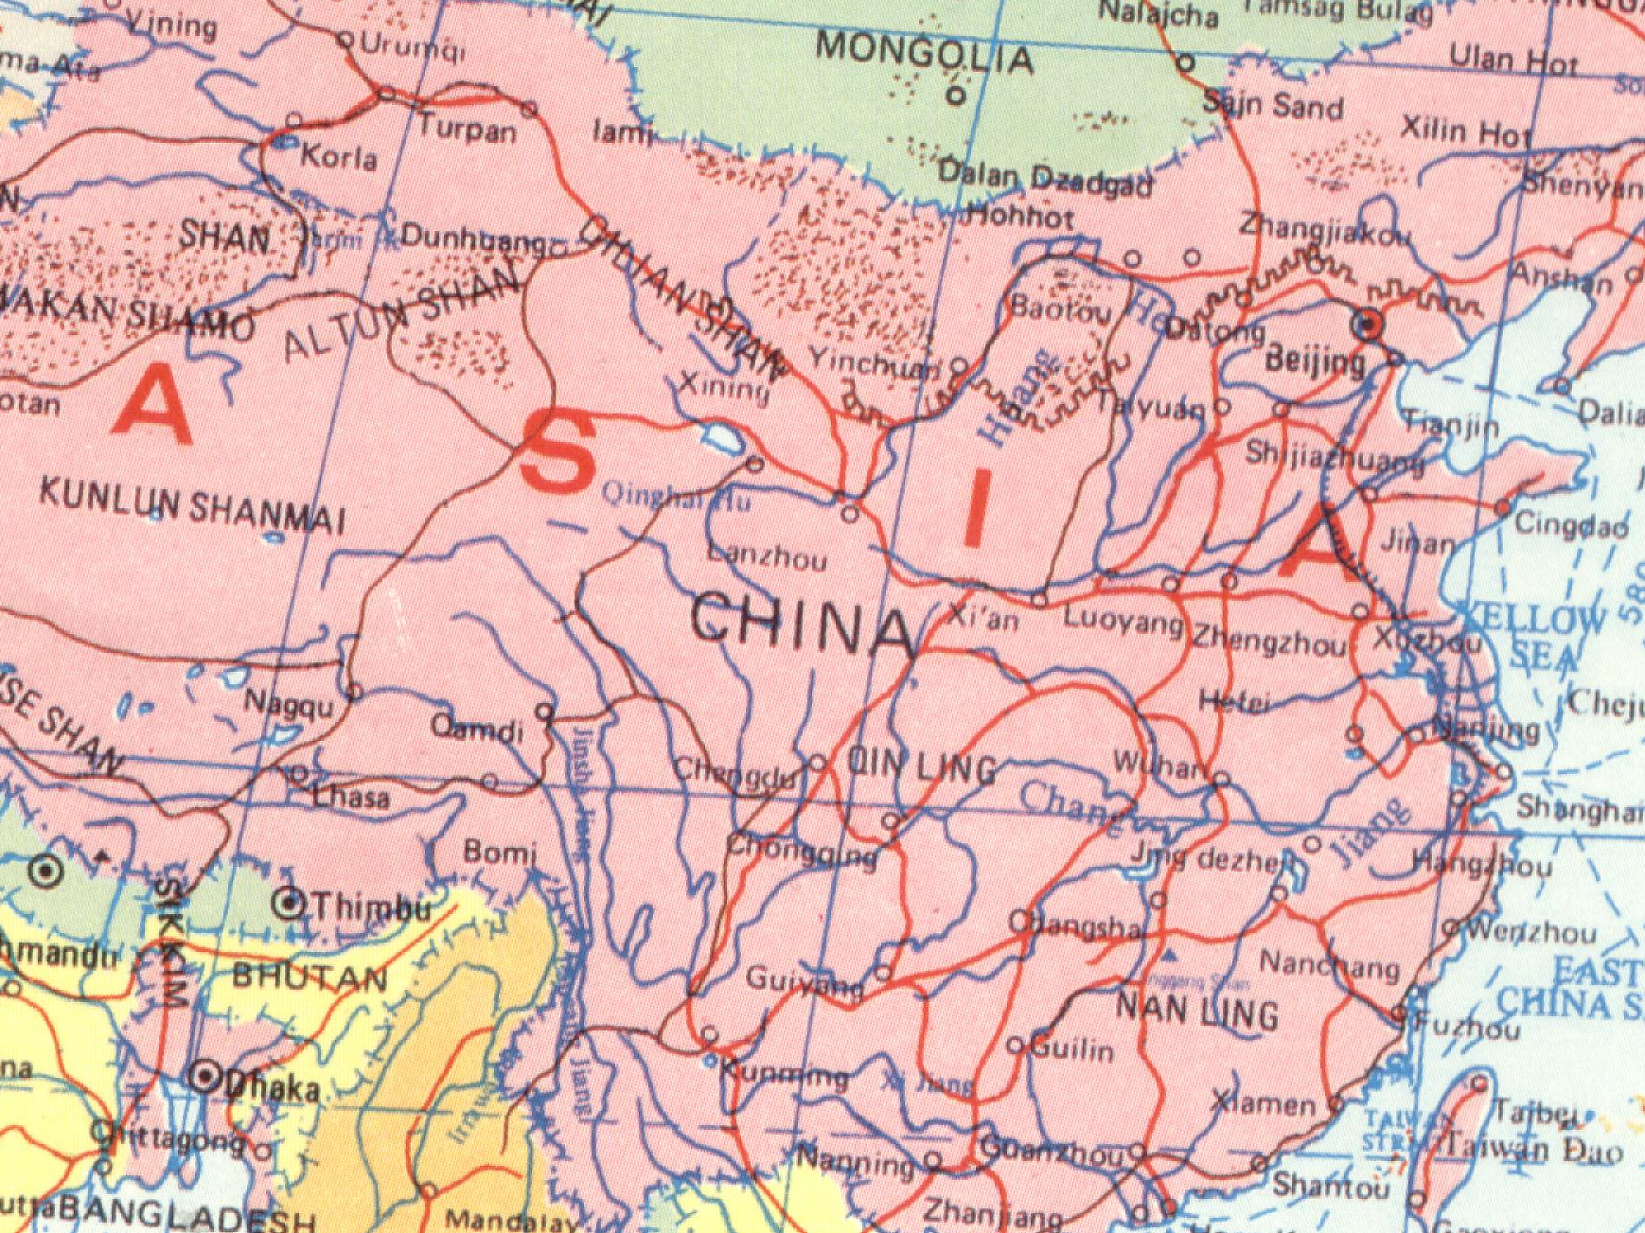
(V) Work of Tentmaking – What Conclusions?
Work as it Relates to a Theology of Evangelism
Work as it Relates to a Theology of Conversion
Work as it Relates to a Theology of the Church

Slide 56
Outline
Introduction: Worldview—What is it?
Understanding Buddhism
Philosophy
Practice
Understanding Confucianism
Philosophy
Practice
Summary
Response
Notes:
Thank you, David.

Slide 57
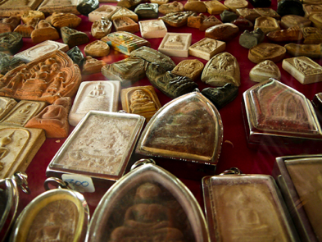
Summary
What have you learned about Buddhism and Confucianism?
What is attractive to you in Buddhism and Confucianism?
Spiritual voids, usually filled by the spirit world, shrines, charms and amulets.

Slide 58
Summary
“Since Buddhism denies the existence of God, Christian theism is an incomprehensible illusion to the Buddhist mind. In fact, Buddhism cannot think of a ‘god’ to whom it can refer to as Creator, Lord, Savior…” Buddha is thought to be superior to all gods.
Notes:
M. S. Vasanthakumor

Slide 59
Outline
Introduction: Worldview—What is it?
Understanding Buddhism
Philosophy
Practice
Understanding Confucianism
Philosophy
Practice
Summary
Response
Notes:
Dr. David Leung…

Slide 60
Response: What can we do?
Prayer, especially in times of social and economic upheaval (e.g., China & Mongolia).
Note: quoting John 3.16 does not usually work in a Buddhist context.
Use “suffering” as a starting point.
Use Ecclesiastes as a starting point.
The “humility” approach (Thai “meekness”)
Long term relationships… The “rest of the story”
Notes:
This takes us back to Uncle Riap, as most of us at Manorom Christian Hospital in Central Thailand knew him. Here’s “The Rest of the Story”!

Slide 61
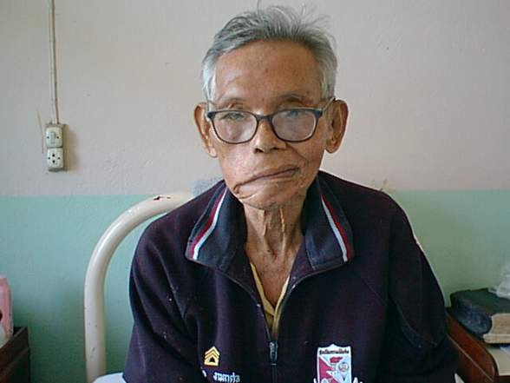
Uncle Riap: The Rest of the Story

Slide 62
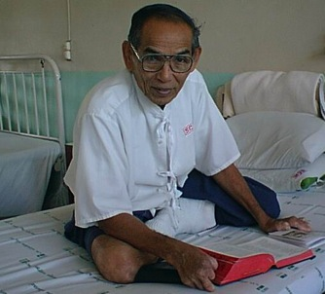
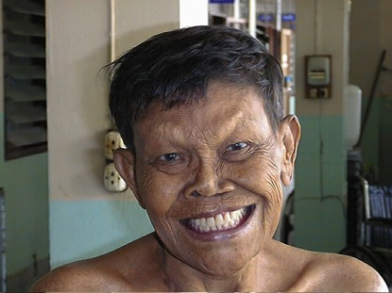
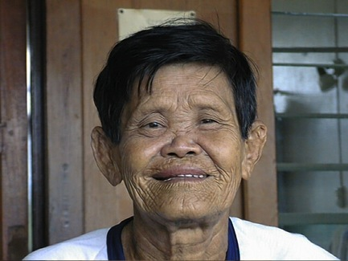
Fellowship with other Christians

Slide 63
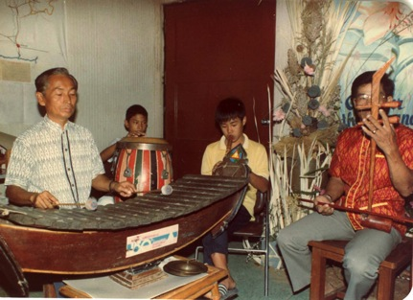
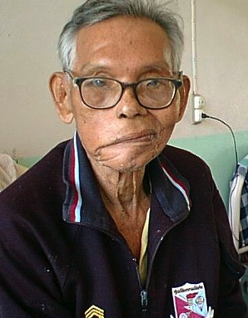
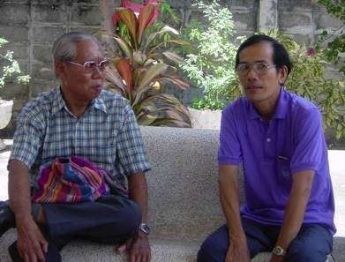
The Rest of the Story
The Gift of Music: Indigenous Thai Worship

Slide 64







The Rest of the Story
Music: Indigenous Thai Worship
Notes:
Buddhism had nothing to offer Uncle Riap. Jesus offered him a new faith, a new life and a new hope.

Slide 65
Prayer for Buddhists
“The God who made the world and everything in it is the Lord of heaven and earth and does not live in temples built by human hands.” —Acts 17.24
For rulers of Buddhist countries and people groups
That grace and truth may become clear (John 1.14)
For missionaries to communicate clearly; for mobilization of many new workers for Buddhist peoples (Matt. 9.38)
For God to prepare hearts to understand the Gospel and to know Him
That Buddhist background believers will remain strong in face of ridicule and opposition
Notes:
“The God who made the world and everything in it is the Lord of heaven and earth and does not live in temples built by human hands.” —Acts 17.24

Slide 66
Questions
Notes:
“The God who made the world and everything in it is the Lord of heaven and earth and does not live in temples built by human hands.” —Acts 17.24

Slide 67
Bibliography: Buddhism
A Christian’s Pocket Guide to Buddhism, Alex Smith, Christian Focus Publications, 2009
More Than Skin Deep, Margaret Armitage, OMF Books, 1988
Peoples of the Buddhist World, Paul Hattaway, Piquant Editions, 2004
Theology in the Context of World Christianity, Timothy Tennant, Zondervan, 2007
The Universe Next Door, A Basic Worldview Catalog, James W. Sire, 2009, 5th Edition.
http://en.wikipedia.org/wiki/Buddhism_in_Thailand
http://en.wikipedia.org/wiki/Buddhism
Notes:
Understanding Confucianism

Slide 68
Understanding Worldviews:
Buddhist & Confucian
Neil O. Thompson, MD
Matthew Koh, MD
Global Missions Health Conference
Louisville, KY
7 November 2015
Notes:
68

