Slide 1
Gait Training For the Non-Physical Therapist
From Non-weight bearing to full functional training

Slide 2
Educational Objectives
Identify the proper gait and weight bearing patterns for specific needs for patients.
Identify the progression of weight bearing.
Identify the proper use of assistive devices.
Identify the progression to advanced levels of weight bearing with balance and functional training techniques.

Slide 3
Rick Schurman PT Cert MDT
Graduate of Northwestern University- Programs in Physical Therapy
Credentialed in the McKenzie Method of Mechanical Diagnosis and Therapy.
Working for 39 year of practice primarily in out-patient orthopedic practice including owning a private practice for 25 years.
Specialty Coordinator for Physical Therapy for Global Health Outreach (GHO) since 2004.
Serves on the Advisory Council for Global Health Outreach
Veteran of 13 short term GHO trips to the Dominican Republic

Slide 4
Disclosure
I have no potential financial gain from this presentation and have no stock if any companies mentioned in this presentation.

Slide 5
Practical session for non-therapists
Intended to help you think through basic and progressive walking or gait training for proper protection of patients in recovery from lower extremity or neurological dysfunction.
Intended for the non-therapist medical professional or person working in a medical location as a practical application of progressive ambulation for the patient.

Slide 6
Terms
Gait – a walking pattern or officially it is the movement of the limbs of animals including humans during locomotion over a solid surface.
Ambulation- the process of moving- mostly referred to as walking.
Non-weight bearing – No weight applied for the involved foot or leg.
Partial weight bearing –
Toe- touch or touch down weight bearing- The weight of the leg is taken off the hip and lower back with just the toe or part of the foot touching the ground – not intended to have weight going through that extremity.
Percentage of weight bearing or weighed- The indications might include partial weight allowed on the extremity and this might be an estimate or the patient actually uses a scale to determine the amount allowed.

Slide 7
Terms ( cont.)
Weight bearing as tolerated. – there is no limit of the weight applied except that it should not cause pain. This is commonly used in the early application of weight on the foot.
Full weight bearing- no limits of weight and the expectation is the patient should be able to progressively load the foot and decrease the use of assistive devices.
Assistive devices –
Canes- Straight , Small based quad cane , large based quad cane
Crutches – Lofstrand ( forearm), Axillary
Walkers- Rolling ( 4 and 2 wheels), Non-rolling

Slide 8
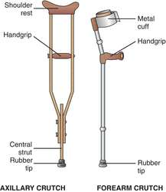
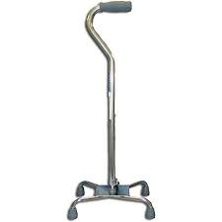
Assistive Devices

Slide 9
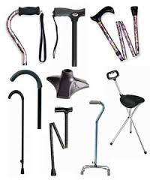
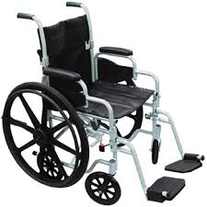
Assistive Devices

Slide 10
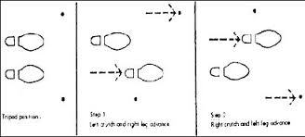
Gait Terminology
Four Point gait pattern – the safest and the slowest- used with crutches or canes- You are favoring both sides.
There are 3 of 4 points of the gait on the ground at one time.
Typical pattern verbal commands would be “ left crutch , right foot , right crutch
Left foot “ Only one point( crutch or foot ) moving at a time.

Slide 11
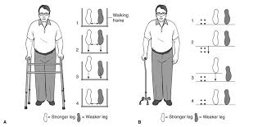
Gait terminology
3 Point Gait – with the use of one crutch/cane/walker. You are favoring one side
The cane or crutch is used in the hand opposite of the involved lower extremity.
Verbal command “Right crutch(cane/walker) , left foot , right foot”
You have only three points on the round with this pattern.

Slide 12
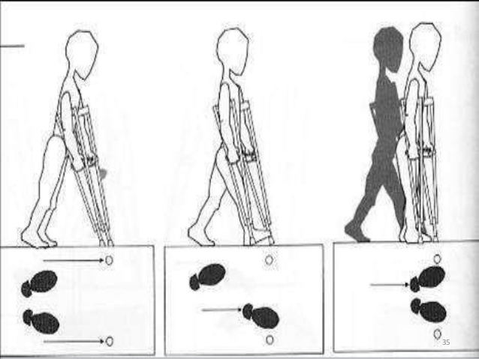
Gait Terminology
3 point gait continued.
The crutches or canes are used as one point and move together
Verbal Command “ crutches, right foot , left foot” - in this case the right foot would be the involved foot.

Slide 13
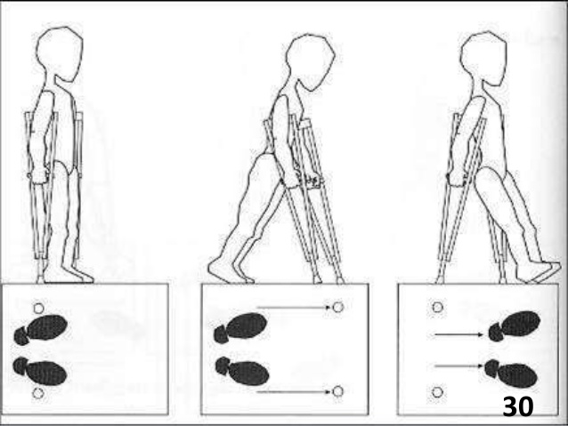
Gait Terminology
Two Point Gait
The assistive device is one and the other point is one/both foot/feet.

Slide 14
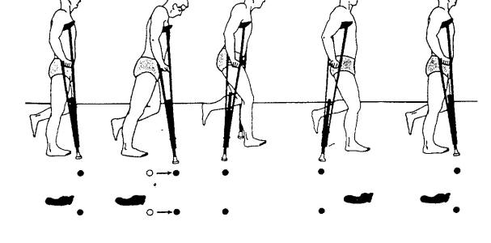
Gait Terminology
Two Point gait continued

Slide 15
Fitting Assistive Devices- Walker/Cane
Walkers
With the patient standing straight up and the arm resting at the side of the body the handle of the walker should be at the wrist of the patient.
Canes
Same as walkers

Slide 16
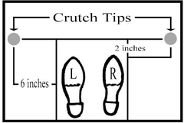
Fitting Assistive Devices- Crutches
With the tip in the position below the crutch should come up under the axilla ( arm pit) to a level of 3 finger widths distance under the axilla with the shoulder relaxed. The upper pad should rest against the ribs. Hand grip should allow the elbow to be bent 15-20*. Weight should be on the hands.

Slide 17
Walking stairs

Slide 18
Walking Stairs/Ramps
Stairs
Up with the good and down with the bad
The crutches go with the bad.
Use a railing when available.
Ramps
Going up – lean into the ramp
Going down – lean back

Slide 19
Gait after a Stroke
Assess the active motion and strength of the affected leg.
If there is adequate strength to lift the leg and contract the muscles and move the joints then you can move to weight bearing.
Begin with Standing holding on to a stable object (counter or table)
Use a belt around the waist to assist the patient as needed.
Assess the ability to bear weight while you stand on the good side of the patient using the gait belt.
Look for weight shifting ability and stability of the knee and ankle.
The cane goes in the hand opposite to the affected side.

Slide 20
Gait after a Stroke
A three point gait is needed with the command of “ cane, affected leg and then the non-affected leg”
You should stand on the non-affected side so you can steady the patient on the good side.
Commonly a larger base gait is used for stability and for the cane to stand on its own.

Slide 21
Progressive Gait Rehab
Gait- proper weight bearing , weight shifting including strength and coordination
Walking a straight line , sideways and forward/ backwards , up and down stairs and ramps and hills.
Balance- forward and sideways and backward
Lunging and balance reach
Level and un-level surfaces
Running and Coordination
Jog, Trot, run, sprint
Dynamic activities – moving on the feet with the hands busy.

Slide 22
Walking drills
Walking in tandem
One foot directly in front of another
Stepping forward/ sideways over objects
Walking sideways
Carioca/Karioka- cross over sideways walking/running
Progression can include increasing speed, distance, varying position, loading through the upper body.

Slide 23
Static Balance

Slide 24
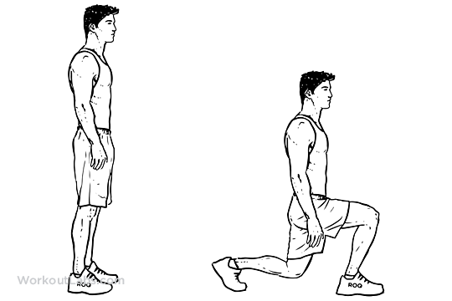
Lunging
Can do this forward ,sideway and backwards
Advance as tolerated by increasing – distance-speed- angle- loading - reaching

Slide 25
Lunge Matrix

Slide 26
Lunging with Upper Body Movements

Slide 27
Dynamic-Balance Reach

Slide 28
Conclusion
In a setting where there is no formal therapy or rehab some of these principles may be applicable for use in bringing a patient back to a higher level of function.
Remember- all progression and activities must be safe and appropriate for the age of the patient, their disability and pain levels. The patient can feel some residual muscle soreness but no increasing pain symptoms. Cause no harm.

Slide 29
Thank you
Questions???
Rick Schurman PT Cert MDT
rick.schurman@gmail.com

