Slide 1
Treating Mechanical Spinal pain for the Non-Physical Therapist

Slide 2
Educational Objectives
Identify a patient with mechanical spinal pain
Identify those patient who might respond to Mechanical Diagnosis and Therapy
Identify the type of program the patient shoulder be given to the patient for application at home.
Identify the process of taking a patient to complete resolution of symptoms with exercise and postural correction.

Slide 3
Rick Schurman PT Cert MDT
Graduate of Northwestern University- Programs in Physical Therapy
Credentialed in the McKenzie Method of Mechanical Diagnosis and Therapy.
Working for 39 year of practice primarily in out-patient orthopedic practice including owning a private practice for 25 years.
Specialty Coordinator for Physical Therapy for Global Health Outreach (GHO) since 2004.
Serves on the Advisory Council for Global Health Outreach
Veteran of 13 short term GHO trips to the Dominican Republic

Slide 4
Disclosure
I have no interest in or possible financial gain from anything mentioned in this presentation.

Slide 5
Mechanical Pain
Mechanical pain- what is it?
  It can be constant or intermittent
  It changes with movement or postural( positional) changes
  Can be referred or radiating
  Can be short or long term
  Likely will have a direction of preference
  Can improve with repetitive motion in the right direction.
  May cause local muscle pain or spasm from the joint issues.
What it is not- Inflammatory, Infectious, Disease process.

Slide 6
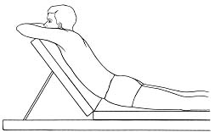
Robin McKenzie and Mr. Smith
“ Chance finding” by Robin McKenzie- Mr. Smith

Slide 7
Mechanical Diagnosis and Therapy
Principles of MDT
  History and exam
  Direction of preference
  Response to repetitive exercises
  Centralization/Peripheralization response
  End range motion
  Postural Training
  Education for long term control of symptoms.
  Teaching Model is the Intervertebral Disc

Slide 8
History- What are we looking for?
Injury or spontaneous onset.
Position of injury or cause
Tolerance presently for positions , activities and the time of day
Pain that will move toward or a way from the spine. (Centralization/peripheralization)
Tell the patient that we are looking for a pain pattern that will allow us to treat the pain with exercise.
Red flags – yellow flags- green flags.
Better – Worse

Slide 9
Effect of Posture

Slide 10
Spinal Anatomy

Slide 11
Spinal Anatomy

Slide 12
Spinal Anatomy

Slide 13
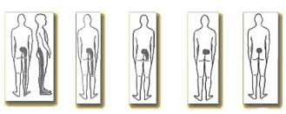
Where do I feel the pain?

Slide 14
Lumbar Spine
Most common as an injury or onset of pain in flexion ( Forward bending or sitting)
Maybe felt in the Lower back, buttock(s) or down the leg.
Usually worse with sitting and bending or leaning forward and lifting.
Morning symptoms are common- may improve with time up.
For people under 50-55 there is usually a direction of preference of extension
May do better with prone ( on stomach) laying exercises ( press ups) than standing ( standing back bends)
You need to respect the tightness ( barrier)
No pain increase- tightness on and off – no worse.

Slide 15
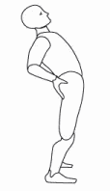
Lumbar Program- Standing Back Bends

Slide 16
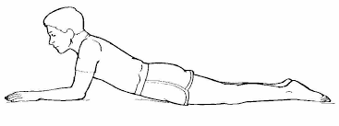
Lumbar -Prone to Prone on Elbows

Slide 17
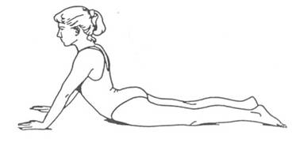
Lumbar-Press ups

Slide 18
Unilateral or one-sided pain
Can be in the lower back to the foot.
Can be tingling ,numbness or pain.
If advanced can cause weakness, loss of reflex and loss of feeling in the leg.
If in the back of the leg often referred to as Sciatica.
Sometimes requires a unilateral exercise for centralize the symptoms before you go into extension.
Standing side glides- with the painful side away from the wall
Laying down flexion rotation- lay on painful side.
The unilateral exercise should be done prior the extension

Slide 19
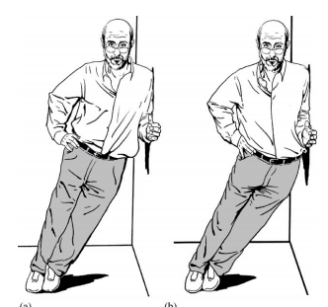
Lumbar-Standing Side Glide- for Right side Symptoms

Slide 20
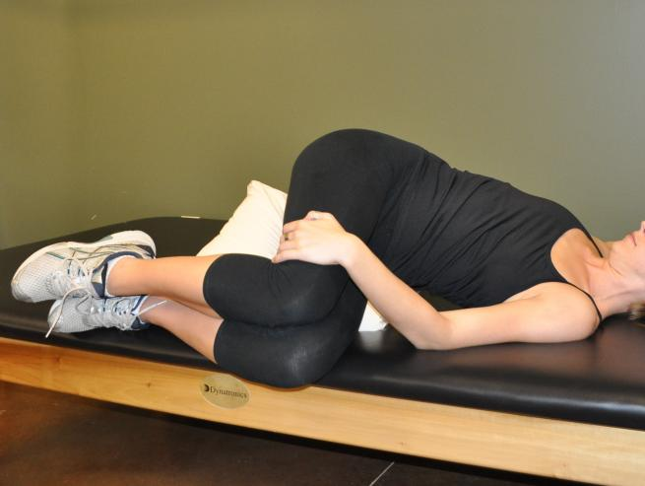
Lumbar - Flexion –Rotation for Left sided pain

Slide 21
Cervical Spine
Commonly a result of head forward positioning
Can be felt in the neck, shoulder, upper back , mid-back, down the arm and sometimes in the chest.
Symptoms related to lower cervical flexion.
Upper cervical headaches are commonly caused by extension ( backward) positioning of the head and tightness in the muscles under the back of the skull.
Can be very chronic and accepted as a part of life.
May cause muscle spasms and tenderness in the neck.
Posture management and exercise are critical parts of the program.

Slide 22
Cervical Spine- Postural Correction
Commonly a result of sustained head forward posturing.

Slide 23
Cervical Exercises # 1 - Retraction

Slide 24
Cervical Exercise # 2 – Retraction with Overpressure

Slide 25
Cervical Exercise # 3 – Assisted Extension

Slide 26
Cervical Exercise # 4 – Extension with Overpressure

Slide 27
Thoracic Spine
It is common that the pain in this region is coming from the cervical spine.
It is common to be associated with a head forward posture.
It is common that there develop muscle tenderness in the mid-back area.
The exercises are more limited due to the loss of flexibility and the ribs.
Common to have lost of extension flexibility due to prolonged head forward positioning.

Slide 28
Thoracic exercise- extension

Slide 29
Principles of Exercise
Frequency- Up to hourly- to combat the forces of life ( Not time consuming)
Repetition -10 per session
End range motion- the goal
Tightness on / tightness off and no worse.
Centralization/ peripheralization
We are altering the mechanics of the disc – not just stretching
We are working in the direction of preference.
New pains- soreness

Slide 30
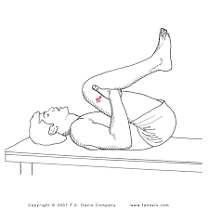
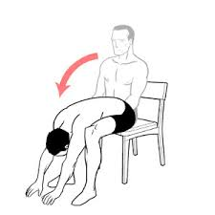
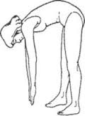
Lumbar Flexion Indications
In the older lumbar patient there may have a flexion direction of preference. Spinal Stenosis is more common and will respond to flexion exercises. These patients are worse with standing and walking and sometimes have to sit to relieve their symptoms. Get relief when sitting. This flexion direction of preference is uncommon in people under 50 unless there has been a hyperextension injury.

Slide 31
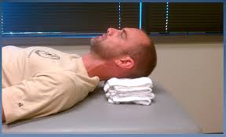
Cervical Unloading-Supine on Towels
In the cervical spine if the pain is acute the patient may benefit from lying on the back ( supine) and having a head forward position using towels under the head.

Slide 32
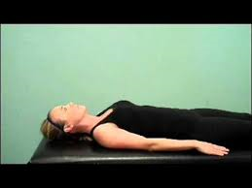
Cervical Unloading-Progression to Flat Supine In the progression of unloaded exercises cervical retraction is done in this position to the point to tightness and progressively stretch out the tightness to full flexibility.

Slide 33
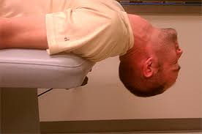
Extension Over the Bed ( Cervical)
The end range cervical extension can also be arranged with gravity assisted exercises over the bed. This is unloaded motion controlled by the hand( not shown). Same principles apply as the sitting exercises.

Slide 34
Review
Mechanical pain is treaded successfully with repetitive, end range motion when combined with postural correction and education.
Patients can be empowered to treat themselves with the proper home program
Patients can control their pain long term
Mechanical pain has specific characteristics – Centralization, response to repetitive exercise, reduction with postural correction and proper body mechanics.
Mechanical pain must be treated mechanically to be successfully abolished.

Slide 35
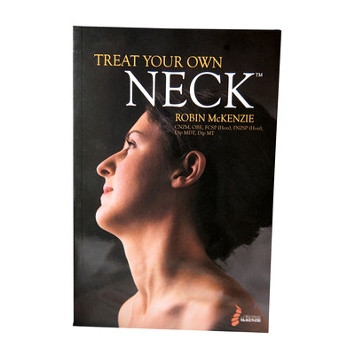
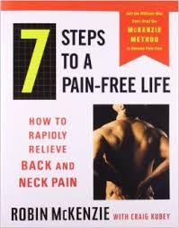

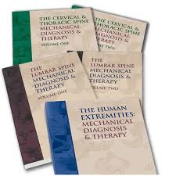
Tools

Slide 36
Thank You
Questions???
Rick Schurman PT Cert MDT
Rick.schurman@gmail.com
www.mckenziemdt.org
www.cmda.org > missions

