Slide 1
Unintended Consequences in the Ebola Epidemic Rick Sacra, MD SIM Missionary/ELWA Hospital, Liberia

Slide 2
Objectives:
1. Understand ways that attempts to help (as in intervening in the Ebola Crisis) can have unintended consequences.
2. Understand problems caused by cultural misunderstandings, relationship problems, or economic problems.
3. Describe why long term Christian missions are in a good position to avoid or to understand and compensate for unintended consequences.

Slide 3
TAKE IT HOME!
I’ll be satisfied as long as you leave with:
You WILL get it wrong the first time…
We all do!
Good Relationships
and
Willingness to Change Course
will help you succeed

Slide 4
5 Major Learning Opportunities:
1. Finding the right Triage Protocol
2. Giving financial incentives to Ebola Treatment Unit workers
3. Health System Collapse
4. Violent Reactions to Interventions by Missionaries and Aid Workers
5. Efforts to Provide Services Disempower Communities

Slide 5
1. Triage Protocol
Original Plan: Train Liberian health care workers and hospitals on Patient Triage using the Protocol developed in previous epidemics

Slide 6
Ebola Triage Protocol (WHO) (somewhat simplified)
History of Contact? Yes/No
NO
YES
Fever + 3 other symptoms?
Fever?
NO
YES
NO
YES
Watch Case
Suspected Case
No Case
Suspected Case

Slide 7
1. Triage Protocol
Original Plan: Train Liberian health care workers and hospitals on Patient Triage using the Protocol developed in previous epidemics
Unanticipated Consequence: The protocol missed cases of Ebola, due to 2 factors:
1. Inability to get an accurate Hx of contact
2. Complex cases (Pregnancy, HIV, infants, Comorbidities, Elderly)

Slide 8
Ebola Triage Protocol (ELWA)
Fever or any other symptom?
Any Ebola Contact History?
NO
YES
No Case
Suspected Case
Continue Observation
Test (PCR) and Wear Full PPE

Slide 9
2. Economic Factors (Salaries)
Original Plan (by Ministry of Health): Pay Ebola Treatment Unit (ETU) workers special hazard pay, to encourage workers to sign up

Slide 11
2. Economic Factors (Salaries)
Original Plan (by Ministry of Health): Pay Ebola Treatment Unit (ETU) workers special hazard pay, to encourage workers to sign up
Unanticipated Consequences: Ebola risk for health care workers is equal in the hospital or emergency room as the ETU.
Other nurses requesting bonus pay, and many staying home from work, contributing to health system collapse

Slide 13
3. Health System Collapse
Original Idea: If we set up ETUs, and care for Ebola patients well, death rate will drop.
(No special intervention needed for hospitals)
Unintended Consequence: A Chain Reaction:
Health care workers contract Ebola (>200 in Liberia); Hospitals close for disinfection; Workers stay home 21 days; cycle repeats. High pay for ETU staff is disincentive for hospitals. (Major facilities in Liberia, Sierra Leone NOT fully open)

Slide 14
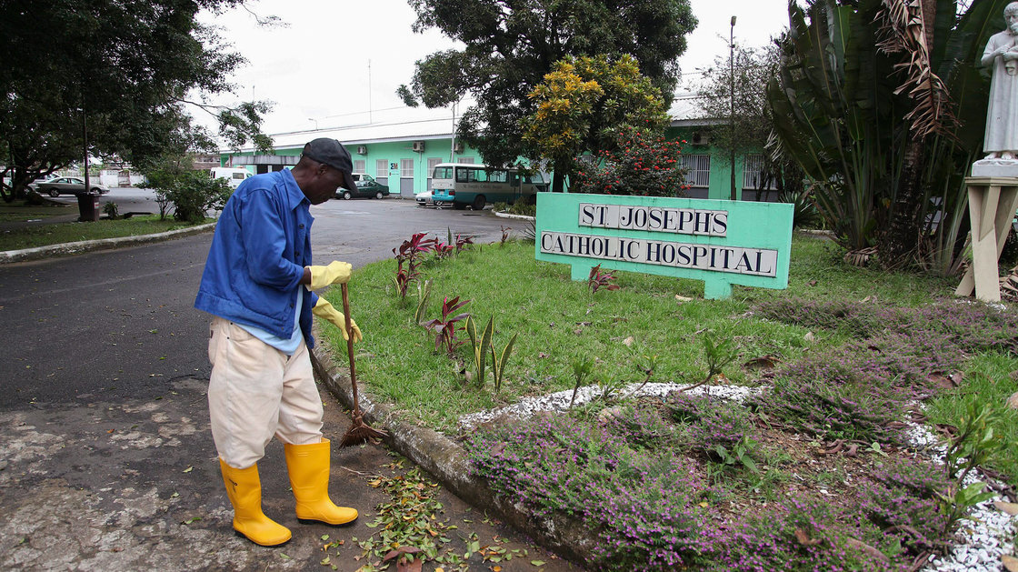

Slide 15
4. Violent Reactions
Original Plan: Teams enter villages and towns to remove dead bodies, pick up sick patients, or carry out community education.

Slide 17
4. Violent Reactions
Original Plan: Teams enter villages and towns to remove dead bodies, pick up sick patients, or carry out community education.
Unintended consequences:
In several cases, suspicion, ignorance, or lack of trust have lead to violence and even death in these encounters
Long term relationships helpful

Slide 18
5. Disempowered Communities
Original Plan (By Government of Liberia):
A central “Hot Line” run by an Ebola Crisis Team to allow people to call for dead body pick-up or Ambulance service will reduce the risk of spread

Slide 19
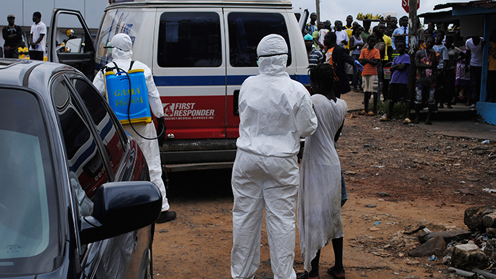

Slide 20
5. Disempowered Communities
Original Plan (By Government of Liberia):
A central “Hot Line” run by an Ebola Crisis Team to allow people to call for dead body pick-up or Ambulance service will reduce the risk of spread
Unintended Consequence:
Ambulance/Burial teams overwhelmed by load;
Since the communities have been told to look up to central government structures to meet their needs, they become passive and resentful

Slide 21
Conclusions:
Always look out for the UNINTENDED CONSEQUENCES of actions that you take, and be willing to reverse course or adjust
PRAY and remain open to the Holy Spirit!
Relationships are key—Tap into long term partners.

