Slide 1
Long Term Preparation
Mentors and Resources for Long Term Medical Missions
Neil O. Thompson, MD FACS
Medical Mission Advocate
OMF International (U.S)

Slide 2
Mentors in Missions
Frank Smith, M.D.
GHMC, 2012

Slide 3
Outline
Watch and pray for mentors
Find them in the flesh, in history, and in books
Few for many seasons, not one for all
Yet, there is one for all seasons
My story

Slide 5
Here is the tragic fact:
Only about one out of hundred “missionary decisions” results in actual career mission service. Why? There is no one to nurture, guide and equip them to complete the process. In other words, the [potential] workers are plentiful but the mobilizers are few!

Slide 6
Notes:
My story

Slide 7
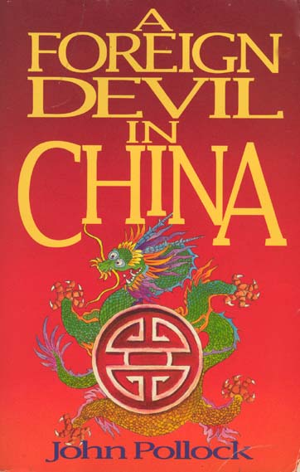
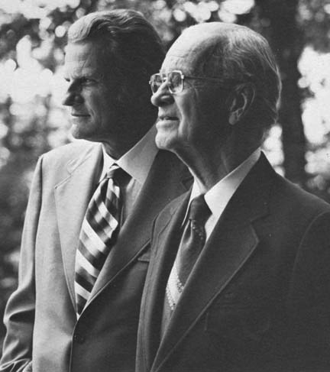

Slide 10
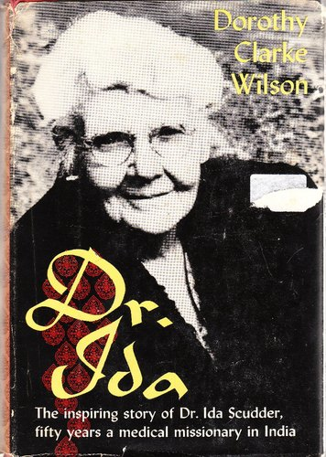
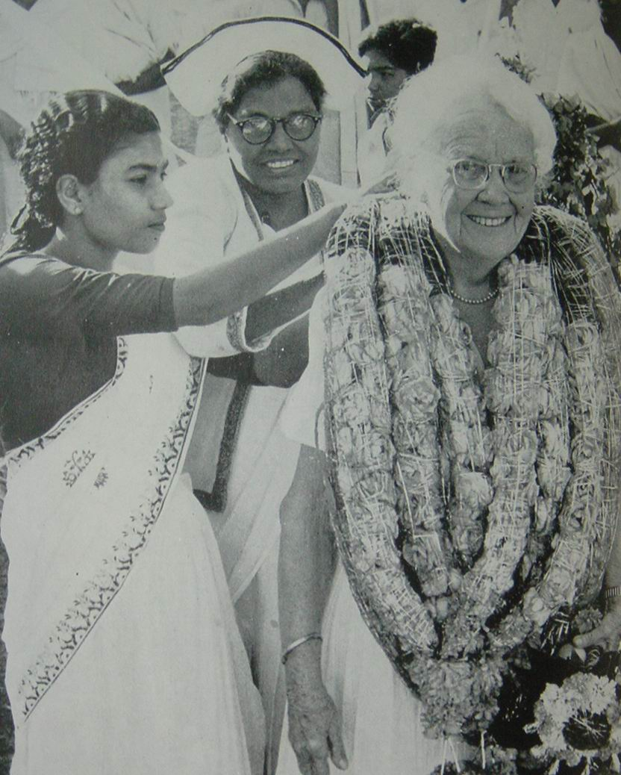

Slide 11
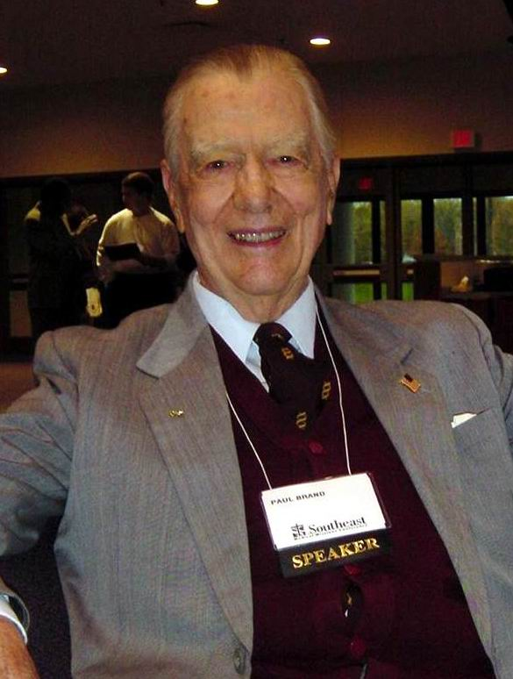
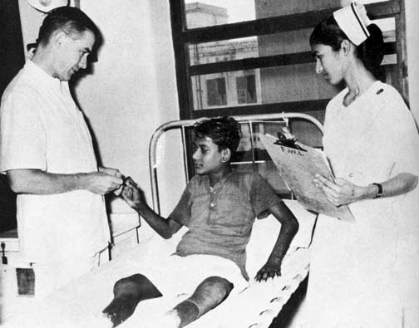

Slide 12
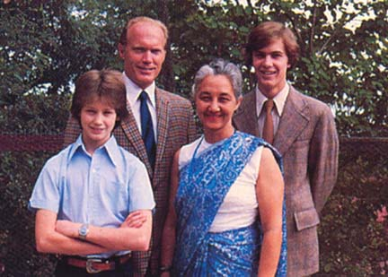

Slide 14
Notes:
In his book, On Being a Missionary, Dr. Thomas Hale says, “Medical missions, whether domestic or foreign, is the most useful, fulfilling, and challenging career open to any Christian health professional.” (p. 275)

Slide 15
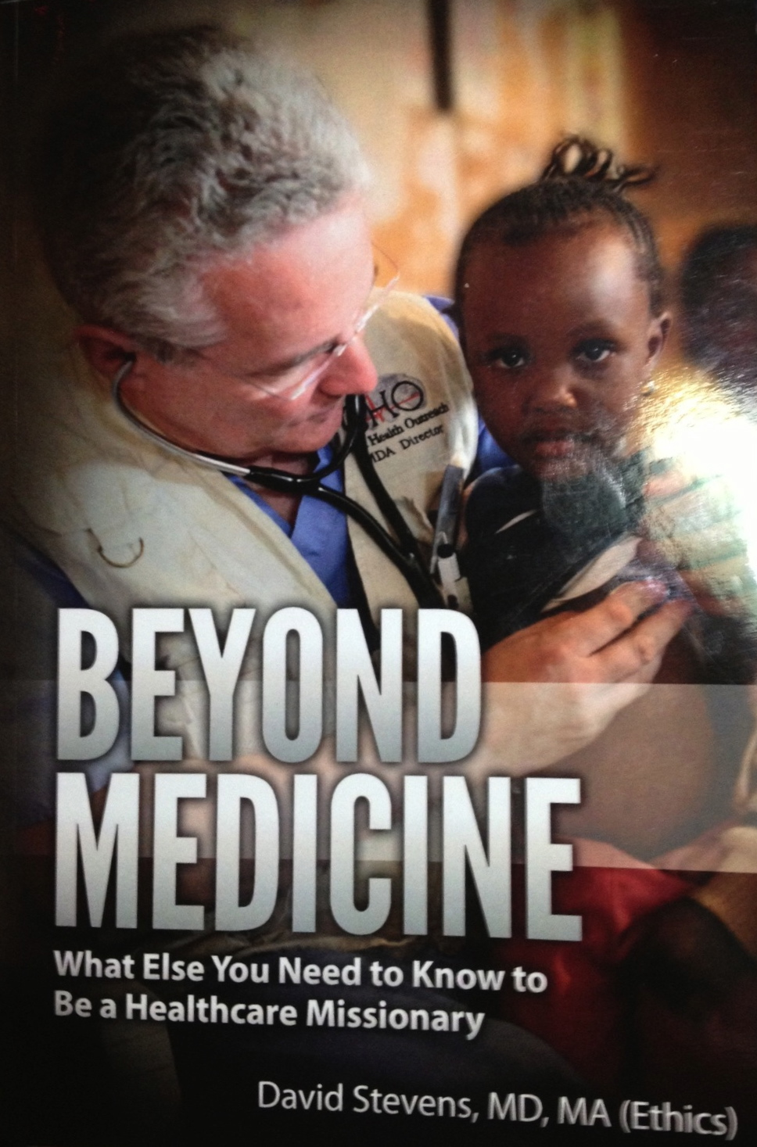

Slide 16
