Slide 1
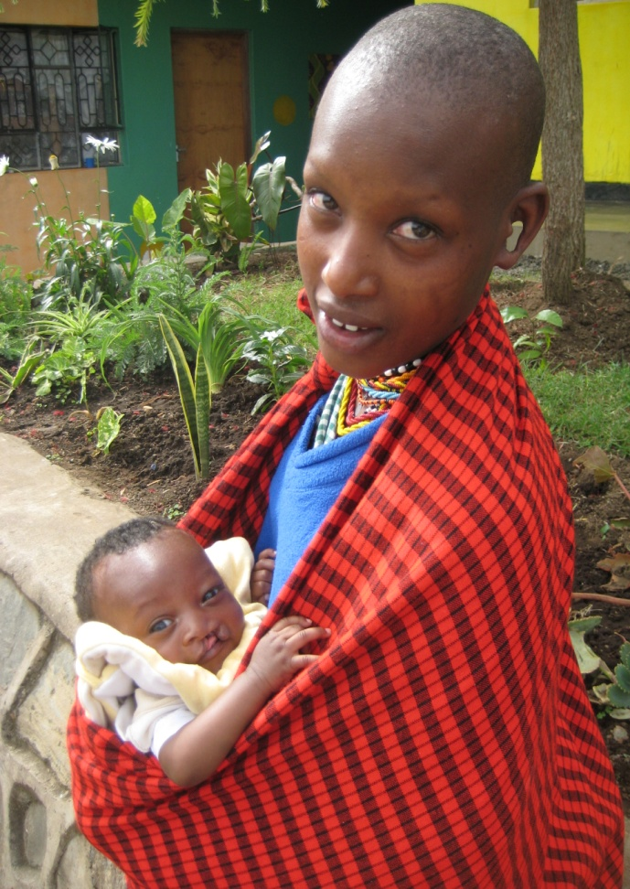
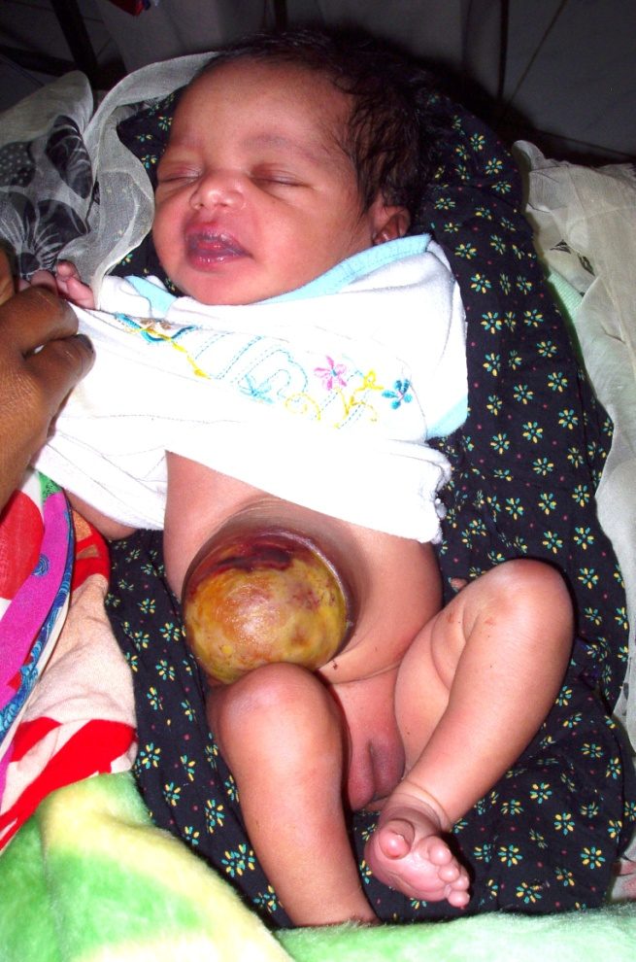
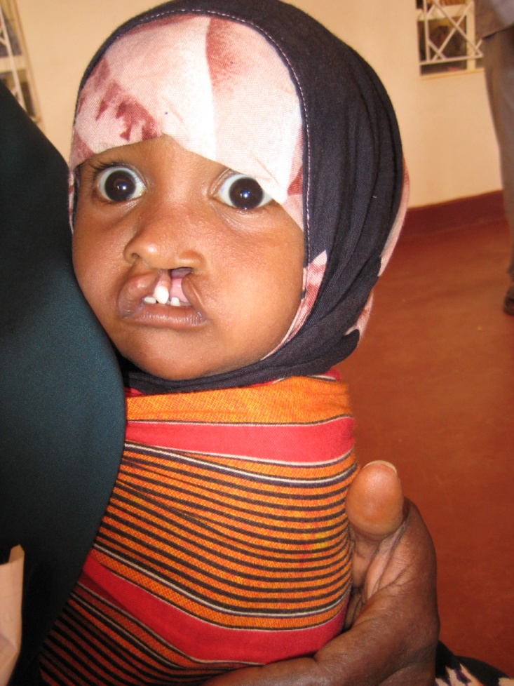
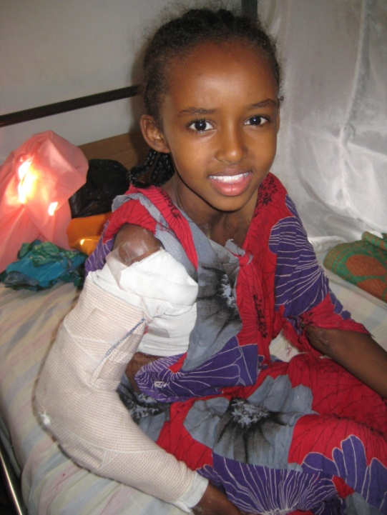
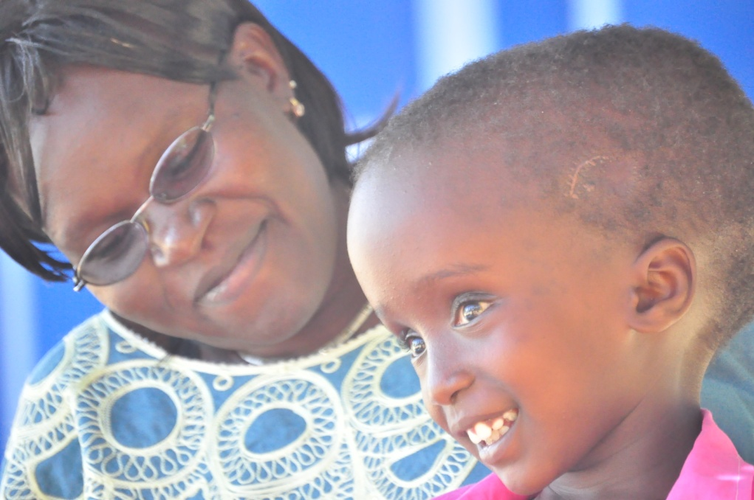
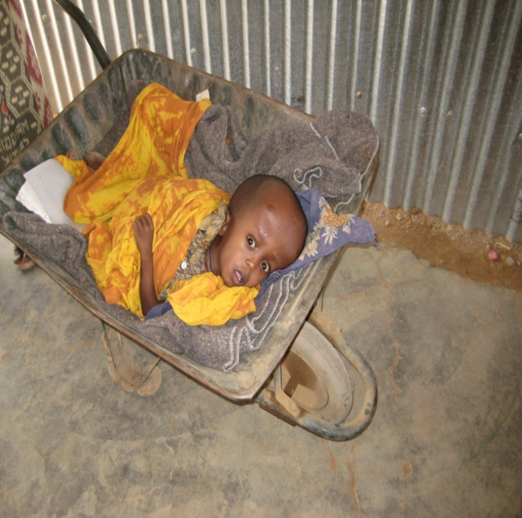
C
H
I
L
D
R
E
N

Slide 2
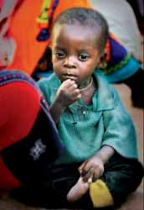
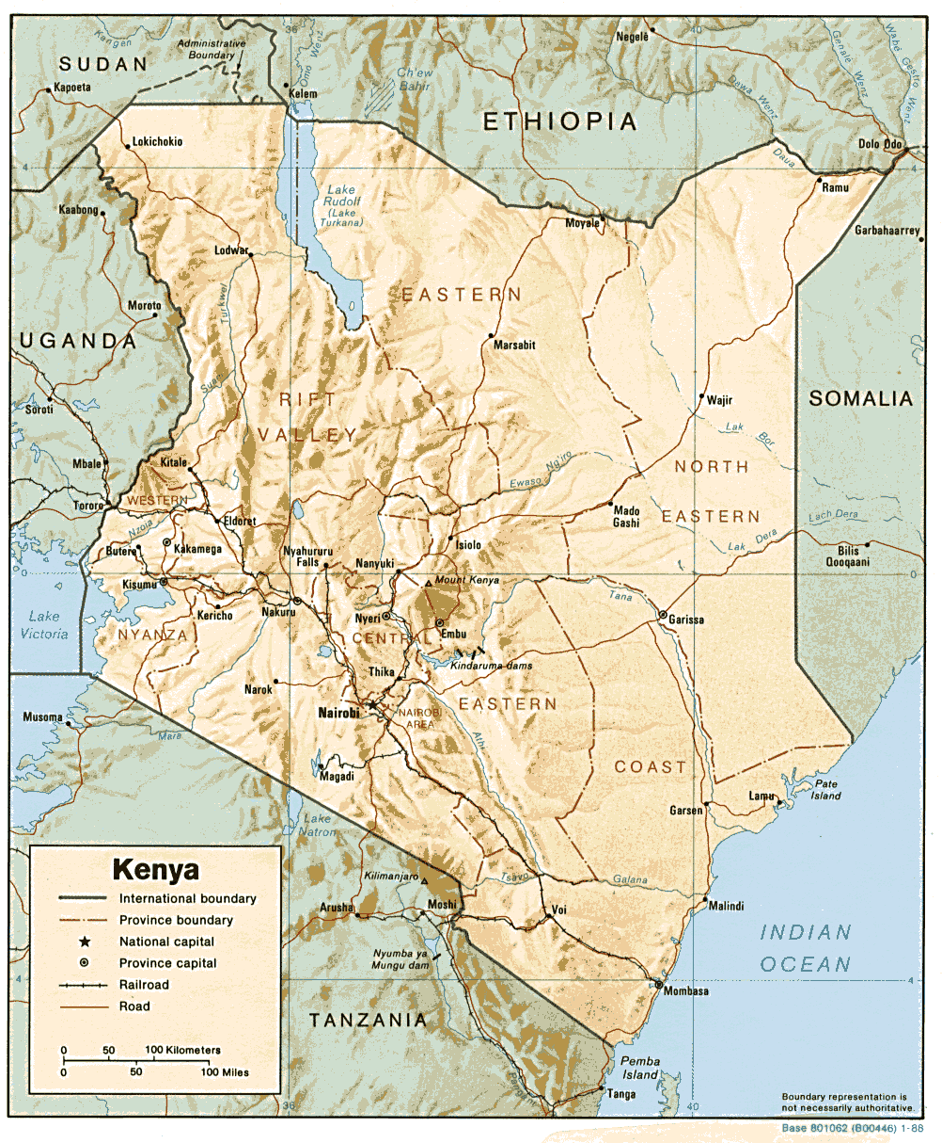
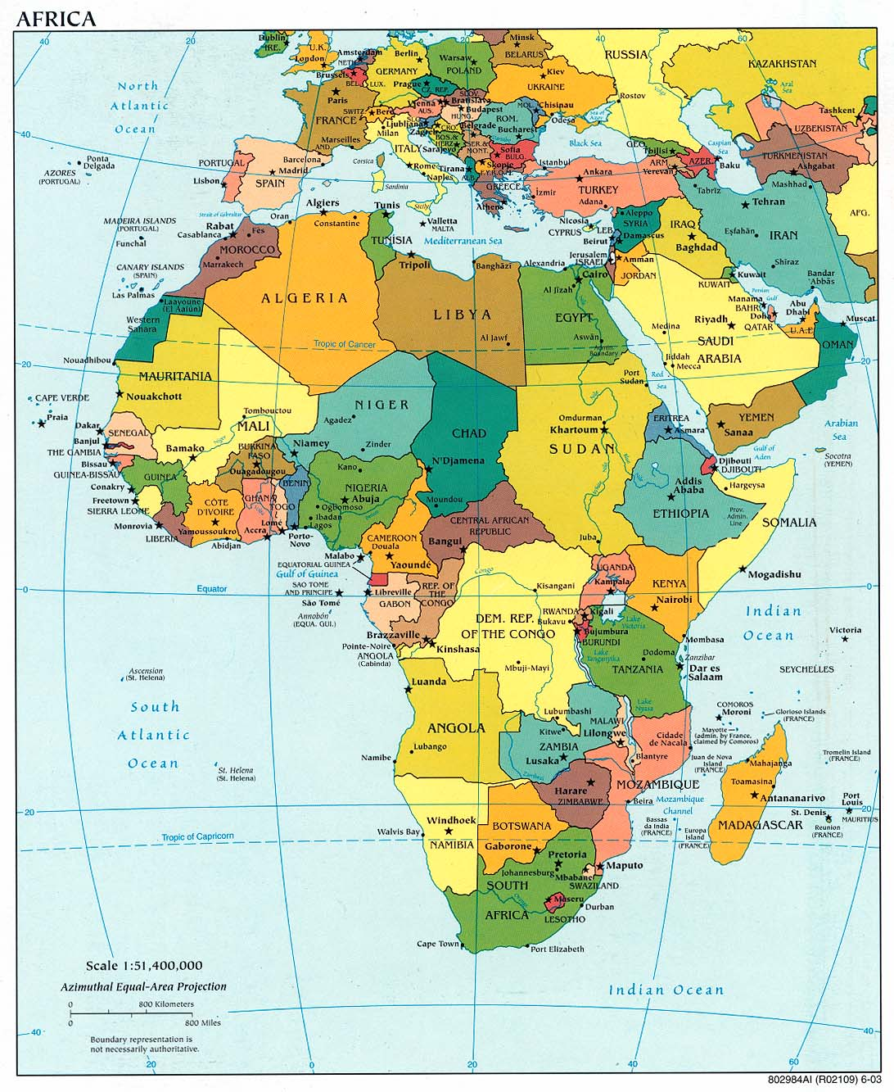
Disabled Children in Africa: 28 years o surgical progress…
Richard S. Bransford,
MD, FACS
1975 Sorrento Drive
Boone, NC 28607
rbransford@gmail.com

Slide 3
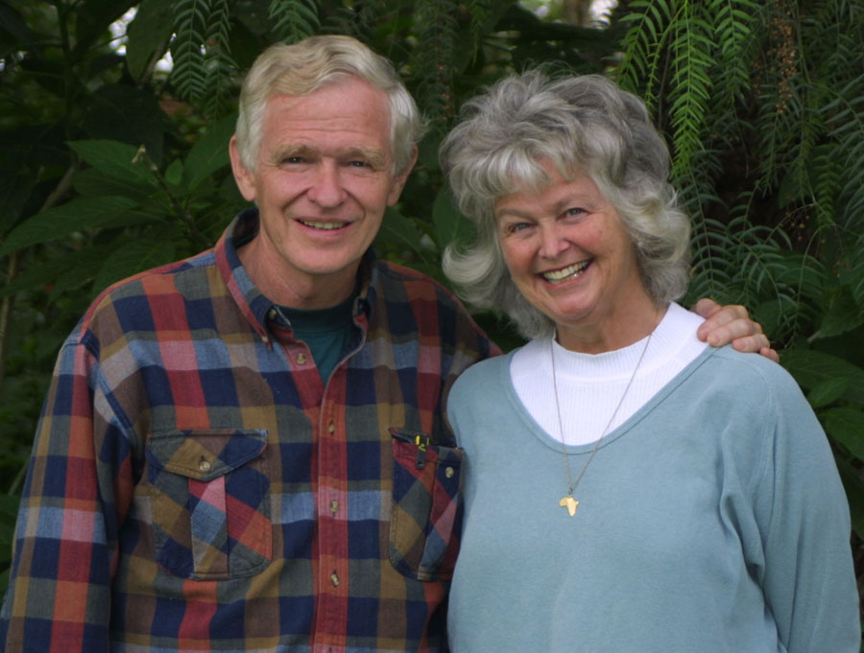
Observation:
Nothing happens by chance in the lives of those wanting to please God!

Slide 4
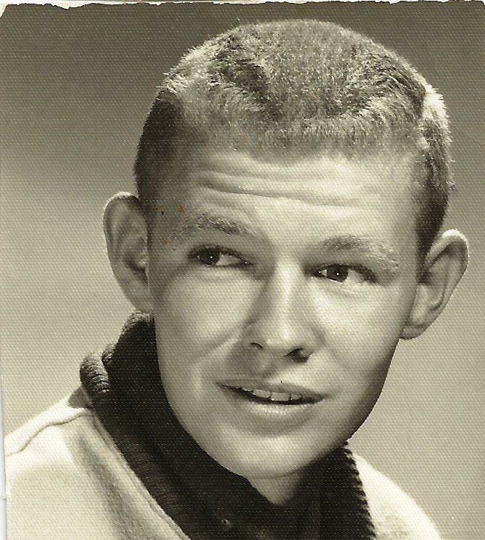
However, if I had gotten what I thought I wanted as a teenager, I would have been:
  The 3rd baseman for the Los Angeles Angels

Slide 5
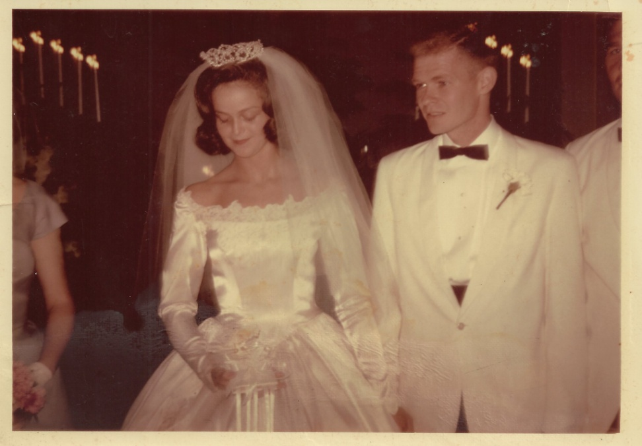
1953 – Saved
1964 – Met Millie
1965 – Married

Slide 6
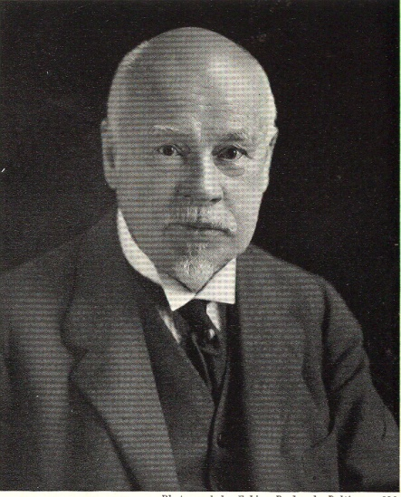
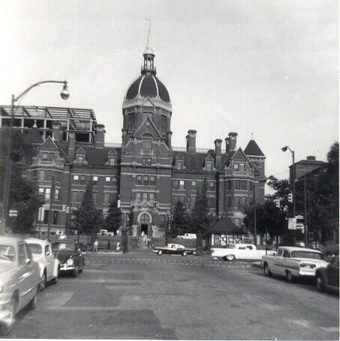
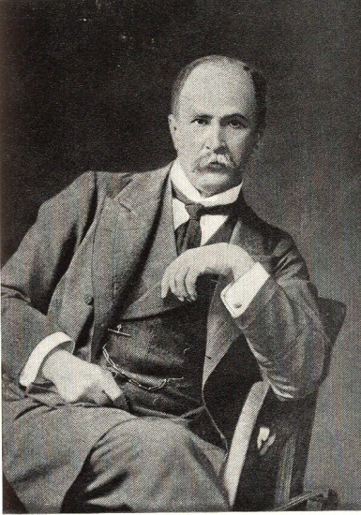
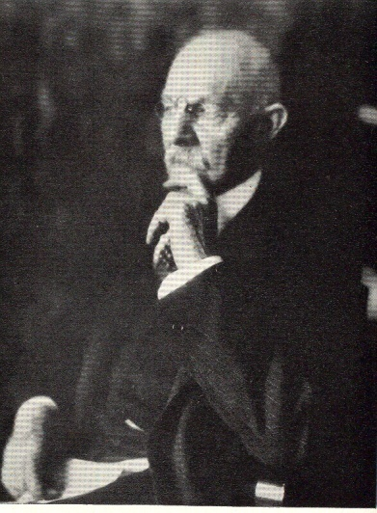
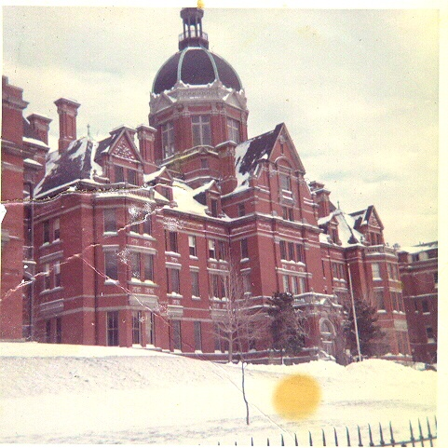
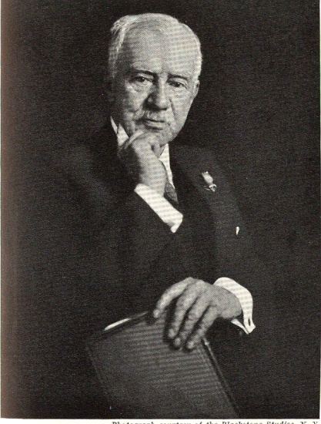
Johns Hopkins Hospital
Compton College, UCLA, Johns Hopkins
William H. Welch
William Osler
William S. Halsted
Howard Kelly

Slide 7
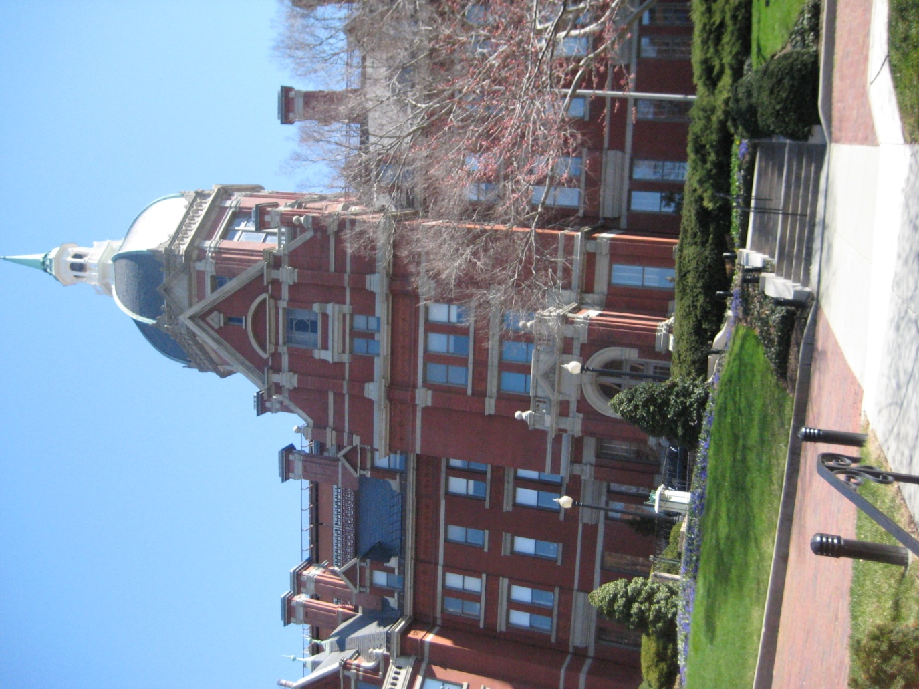
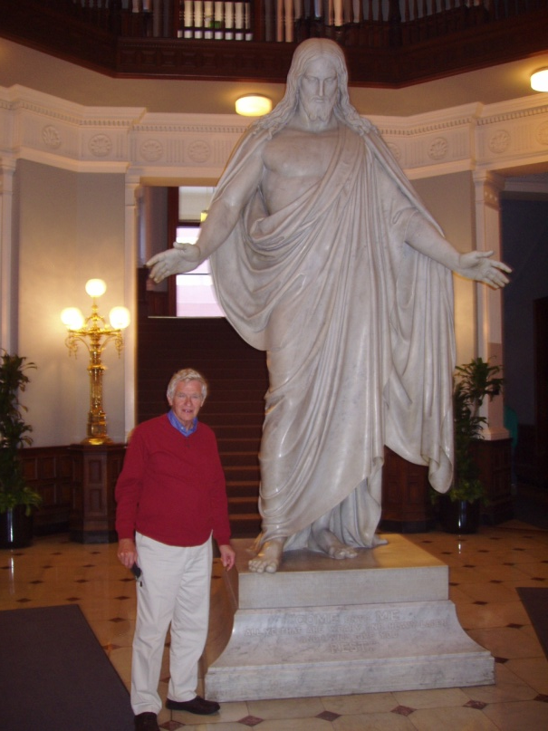
1966 – Africa
1967 – Finished medical school
1972 – Africa, then U.S. Air Force

Slide 8
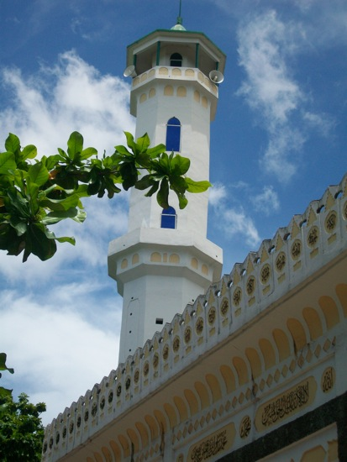
1976 – Creative Access Nation in Africa with
ONE Christian for 350,000 people; only surgeon

Slide 9
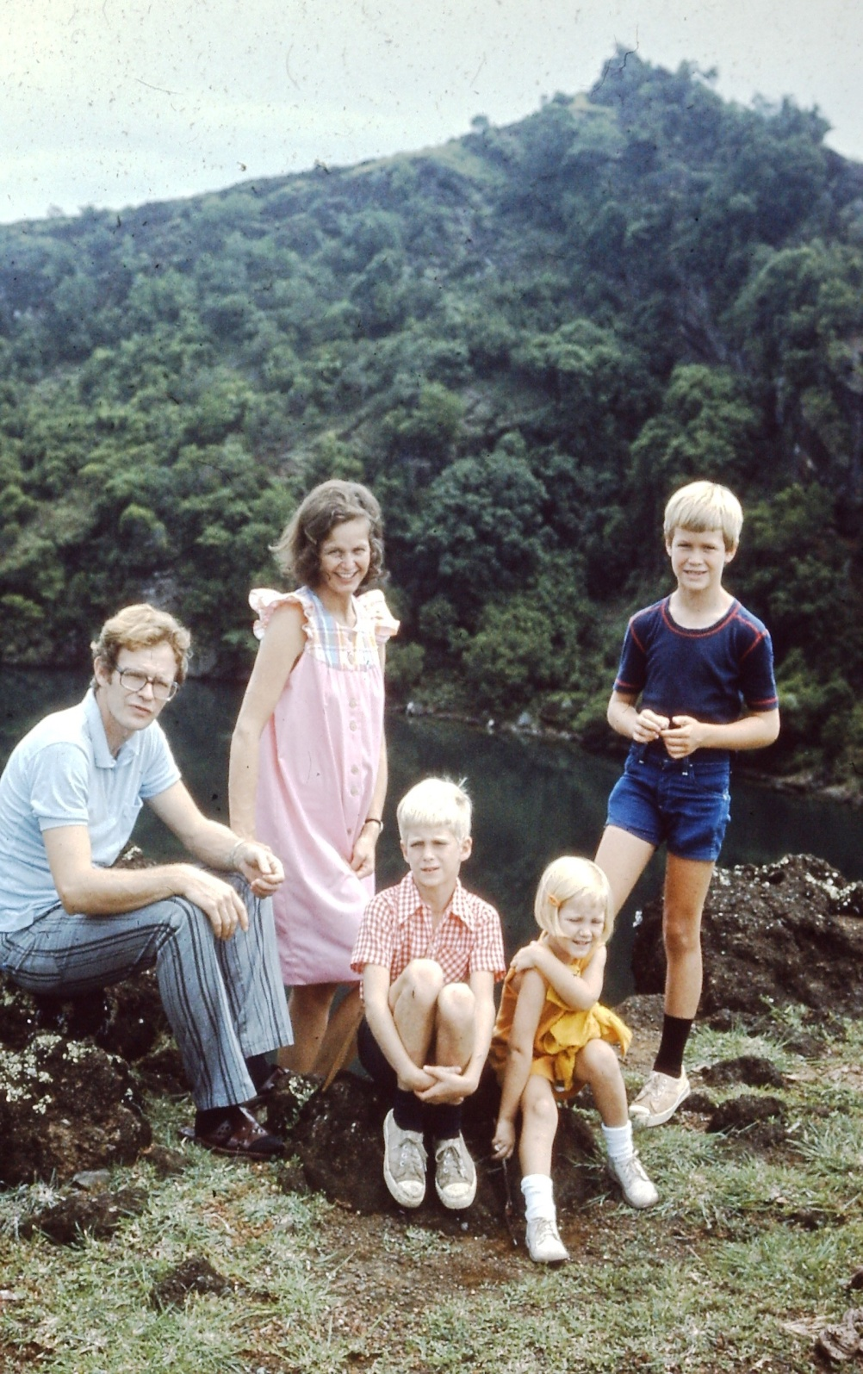
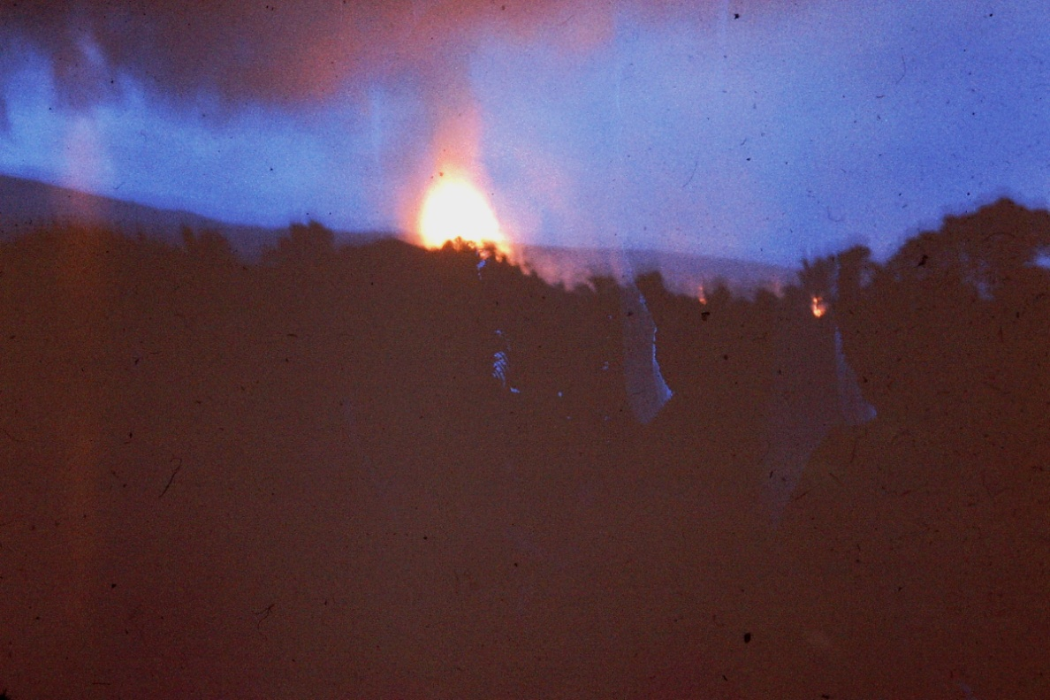
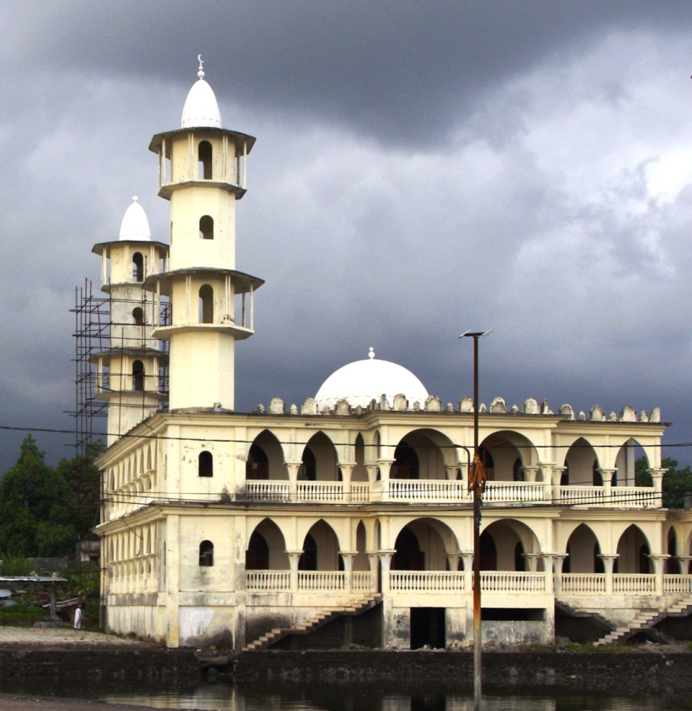
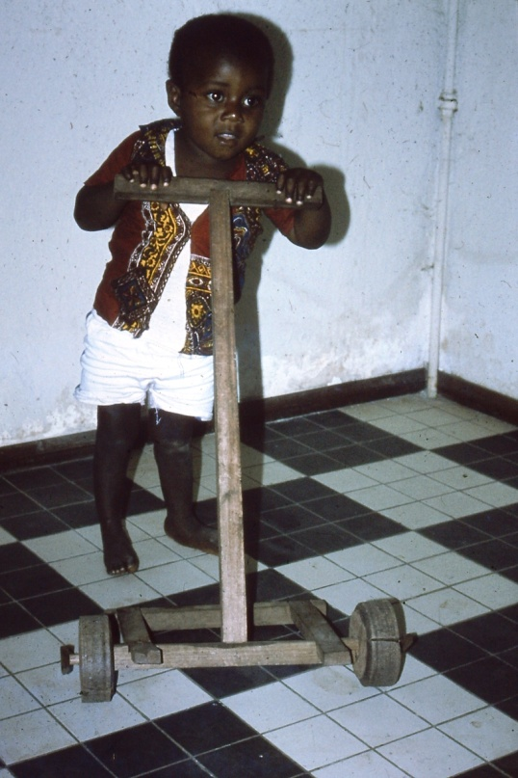

Slide 10
Secret Dreams
*Yes, to be the third baseman.
*To be a Chief of Surgery, and be brilliant
*To be an AOA member

Slide 11
To my great surprise
-I did become the Chief of Surgery and Chief of Obstetrics and Gynecology at the E M Hospital, a 350 bed hospital in a creative access nation.
-In 2011 I did become an honorary AOA member.

Slide 12
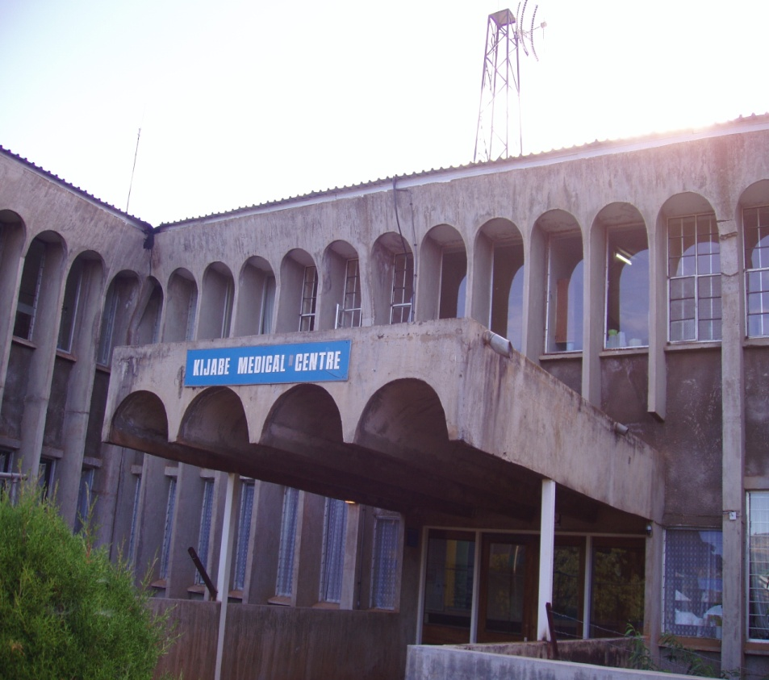
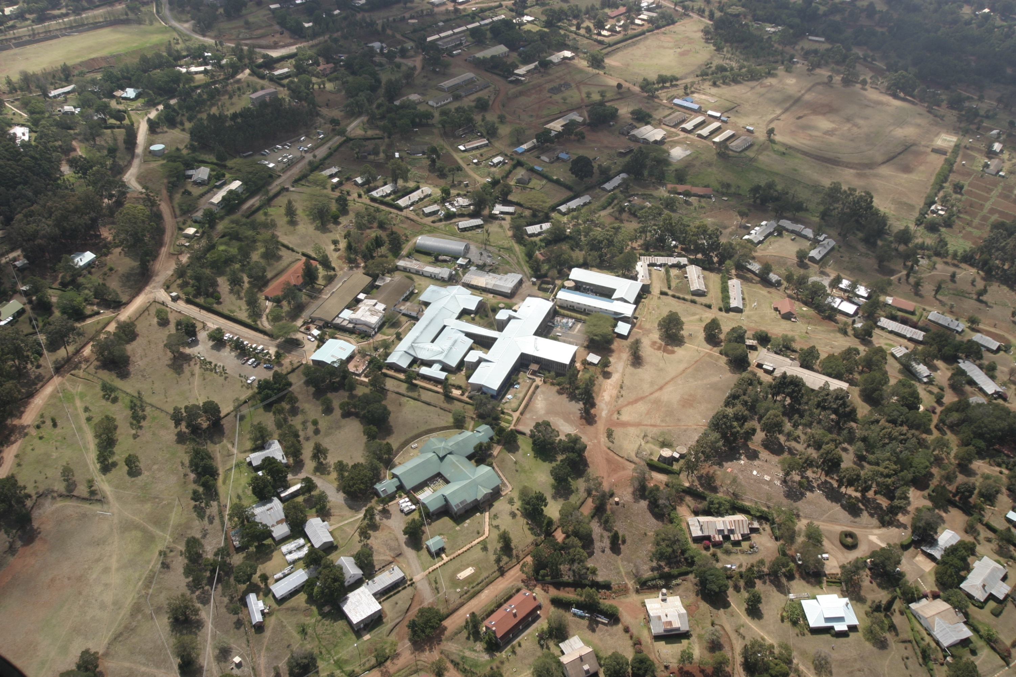
January, 1978 – Expelled from this CAN and went to Kijabe (33 years)

Slide 13
USA+China+
Western Europe+India+
Argentina
AFRICA

Slide 14
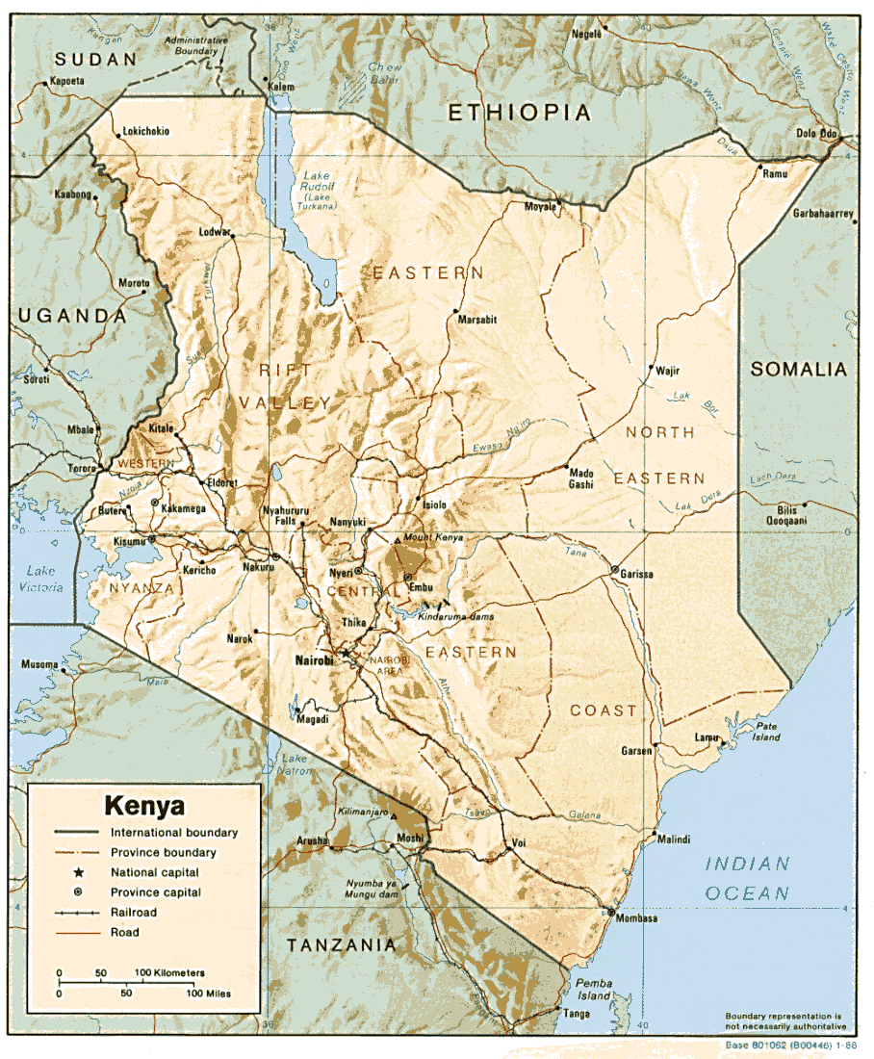
KENYA

Slide 15

Kijabe Hospital
May 9th, 2006

Slide 16
Today I am talking to medical people I do not know, and who do not know me.
1. What unique role are you now playing for God’s kingdom?
2. In your imagination, what innovative way might God use the rest of your life, even our of your “comfort zone”?
3. And, what won’t get done without you?

Slide 17
And…
*What is your definition of “success”?
*Is success a new home, new cars, a new career, and a six figure salary?
*Is success receiving the recognition that you have never had?
*Where does God fit into your definition of “success”?

Slide 18
Bob Pierce
“Lord, I give you license to interfere in my life and plans at any time, in any way, at any cost to me.”
Notes:
Interfere in: my life?
my plans?
at any time?
at any cost to me?
Can YOU tell the Lord this too?

Slide 19
Founder of World Vision and Samaritan’s Purse
“Let my heart be broken with the things that break the heart of God.”
Notes:
Bob Pierce was quoted as saying this in his biography by Franklin Graham. The final line in red is a costly prayer. Don’t pray it lightly and without considering the cost.
Is the picture getting any clearer?

Slide 20
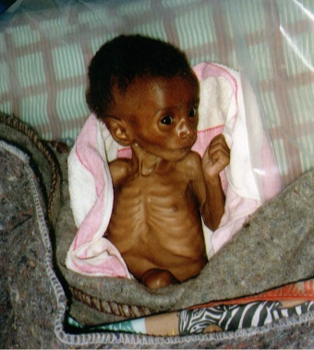
UNICEF
Highest Ranking
“Under 5 Mortality”
#1 – Sierra Leone
#2 – Niger
#3 – Angola
#4 – Afghanistan
#5 – Liberia In fact, 35 of the worst 40
#6 – Mali are in Africa!
#7 – Somalia
#8 – Guinea-Bissau
#9 – Democratic Republic of Congo
#10- Zambia
Notes:
Doctors per 100,000 people
#1 Sierra Leone 7.3
#2 Niger 3.5
#3 Angola 7.7
#4 Afghanistan 11
#5 Liberia 2.3
#6 Mali 4.7
#7 Somalia 4.0
#8 Guinea-Bissau 16.6
#9 DRC 6.9
#10 Zambia 6.9
vs.
U.K. 164
USA 279
Canada 229
France 303

Slide 21
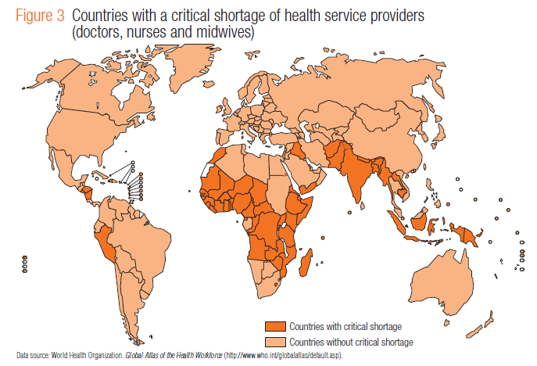

Slide 22
POVERTY
1.3 billion people live on less than $1 per day. – World Bank
Thirty-four thousand children die every day of hunger and preventable disease.
Seventeen million people die every year from infectious and parasitic diseases that we know how to prevent.

Slide 23
World Bank’s Development Report
  Infant mortality rates are nine times higher in the low-income countries than in the developed world.
  This is true for most of Africa.

Slide 24
AFRICA
COUNTRY | GNP (INCOME PER YEAR) | % OF USA
KENYA | $340 | 1.1%
UGANDA | $330 | 1%
TANZANIA | $210 | 0.7%
MOZAMBIQUE | $140 | 0.5%
RWANDA | $210 | 0.7%
CONGO (DRC) | $110 | 0.4%
SUDAN | $290 | 0.9%

Slide 25
What was Kijabe Medical Centre like in 1966 when I first came as a medical student?
55 beds, if the front door was closed to traffic and beds were put down both sides of the hall and in the X-ray unit.
The delivery room was a closet
Possibly 50 operations per month
A handful of missionary nurses and no legal national nurses
AND, 1 ¼ doctors!

Slide 26
Kijabe Hospital-2009
285 bed general hospital
9,049 operations
>112,000 outpatient visits
~11,000 admissions
~2,000 deliveries
Notes:
Our operating room is the second busiest in Kenya.
Our pathology department provides service for over 50 hospitals throughout Africa.

Slide 27
In 2010 there were:
*3 general surgeons + 2 general surgical residents
*4 orthopedists + 4 orthopedic residents
*2 obstetricians
*3 pediatric surgeons + 3 pediatric surgery fellows
*1 pediatric neurosurgeon + 1 fellow
*1 plastic surgeon
*1 ENT surgeon
*Also there are 8 operating rooms instead of 2.
Plus much-needed FP’s, internist, pediatricians, pathologist, etc

Slide 28
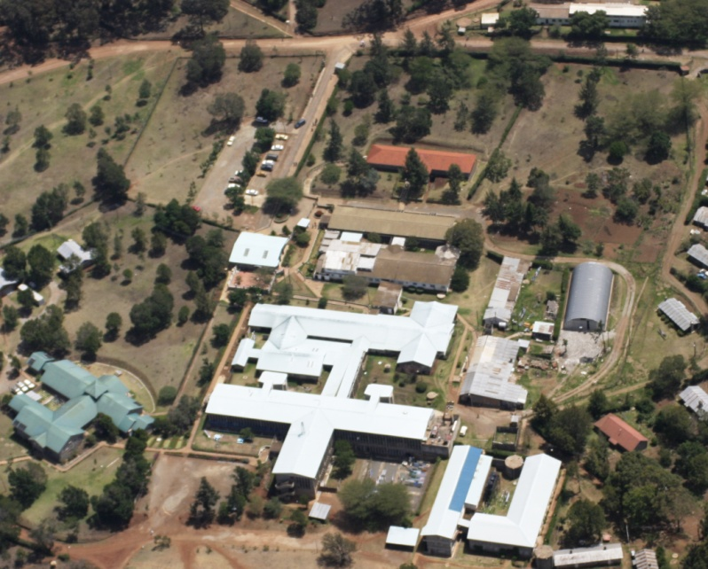
Kijabe Hospital---the training programs have expanded:
1977 - Enrolled nurses
2011 - Interns
Family practitioners
Registered nurses
Orthopedic surgeons
General surgeons
Pediatric surgeons
Pediatric neurosurgeons

Slide 29
How did God get us from 1966 to the present, AND why?

Slide 30
Let me give you my “one sided” version…
At first I was a happy general surgeon doing a variety of surgery

Slide 31
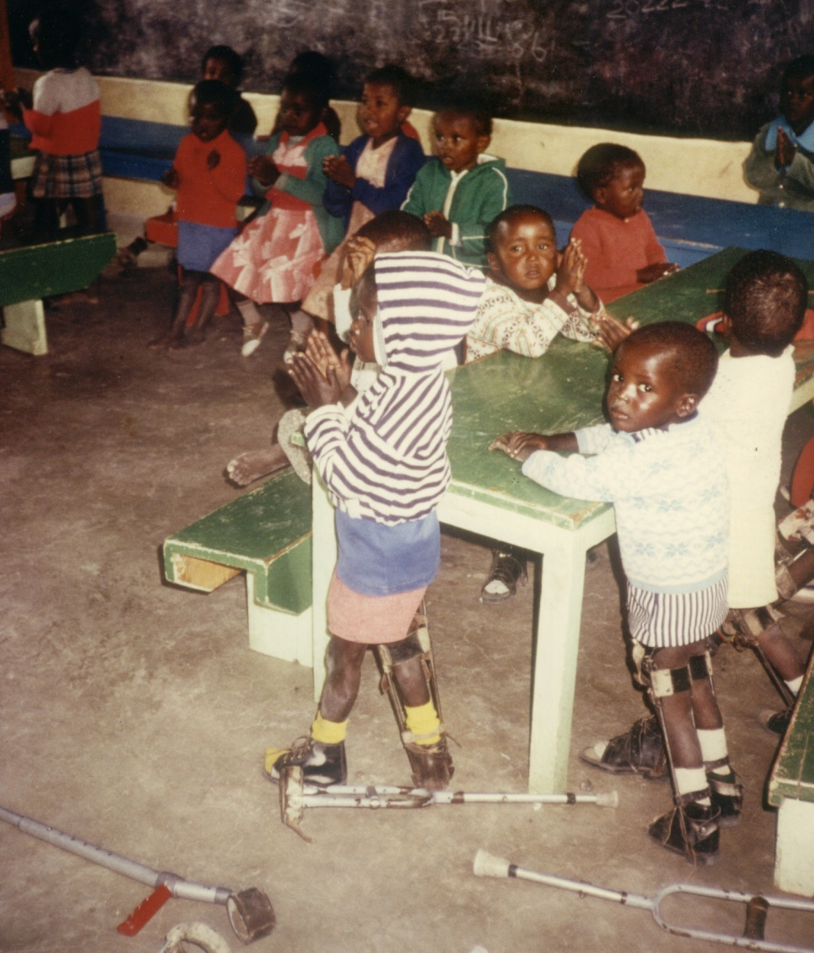
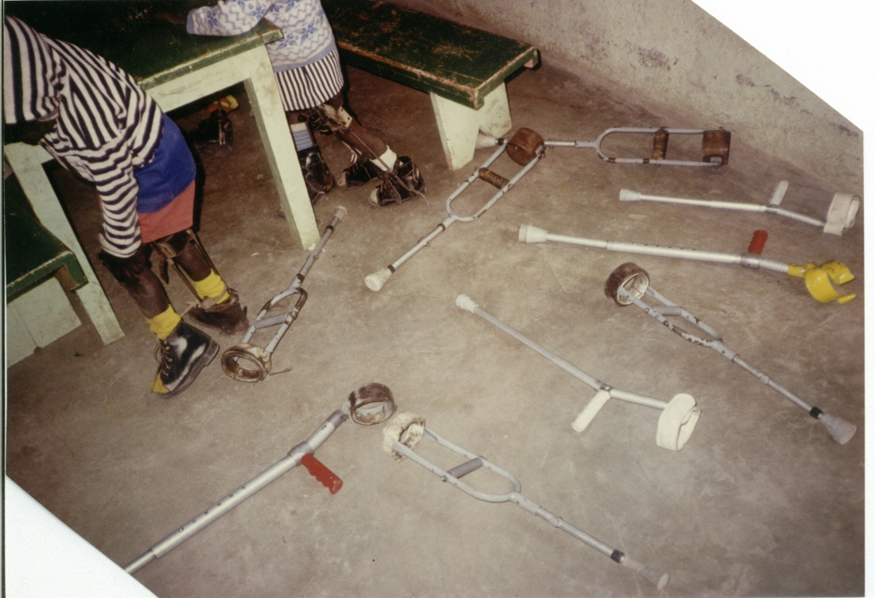
Kajiado 1982
Me? A “casual” visit to Kajiado that changed my life
Can you
help us?
Notes:
Let me digress a bit with some personal history. The above children were seen on my very first visit to a home for disabled children in about 1982.
I was an American-trained general surgeon when a Scottish nurse asked me to help her with crippled kids.
I knew nearly nothing about orthopedics, neurosurgery, plastic surgery, or rehab.
Yet, the Lord was kind. Soon we began doing little things.
God used this untrained general surgeon to perform 2079 operations on 1014 children with polio over a ten year period. Often I did this by the “skin of my teeth” and the help of Almighty God---and with a book at my side.

Slide 32
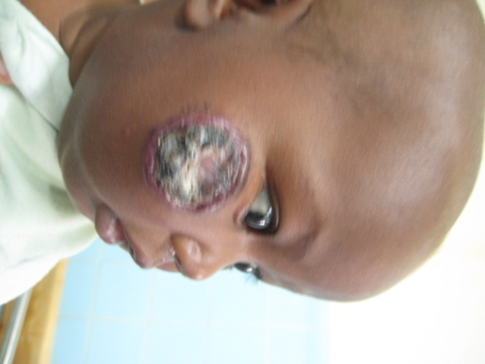
1982
An explanation…
1. There was nearly no care for the disabled in Kenya, especially for the poor.
2. My personal care for the disabled was begun recognizing that I had no previous experience, and I had huge limitations.
3. Visiting surgeons, surgical books, an evolving experience, and mistakes, were my main teachers.
Notes:
E-mail service also provided a lot of help. I did spend three weeks in a rehab hospital in Korea in 1987.

Slide 33
We began…
Polio
Club feet I was totally unprepared!
Cleft lips
Burn contractures
Hypospadias, etc.
“Anything worth doing is worth doing poorly.”

Slide 34
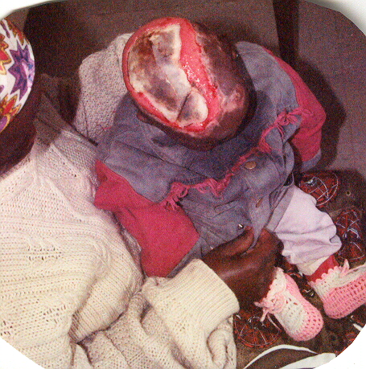
JUST
DO YOUR BEST

Slide 35
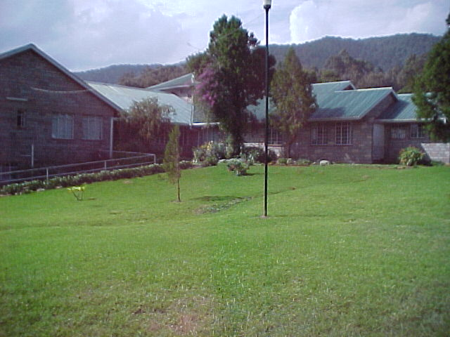
1998
Bethany Crippled Children’s Centre
11998
Notes:
Between about 1982 and 1998 God was birthing a vision for a rehab center for disabled children. The work with disabled children had begun within Kijabe Medical in 1982. BCCC was opened in 1998 adjacent to Kijabe Hospital.
Once I called the late Dr. Paul Brand asking him for his thoughts. After sharing the idea, he commented that he thought “there is nothing like it in Africa.”
Childbirth is not easy, and birthing Bethany was also not easy. However, the blessings over the years have been wonderful.
No one could ever give me anything equal to the friendships of many little disfigured children.
Their touch, their handshakes, and their smiles are worth untold millions. I am so thankful.

Slide 36
Concentration
Rehab orthopedics
Plastic surgery for burns
Intermittent cleft lip teams
Early training in orthopedics
Later: an orthopedic residency

Slide 37
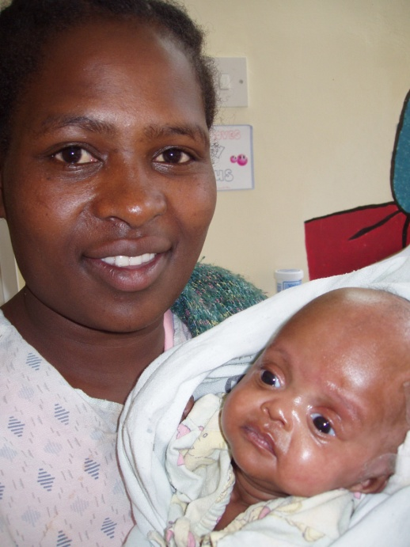
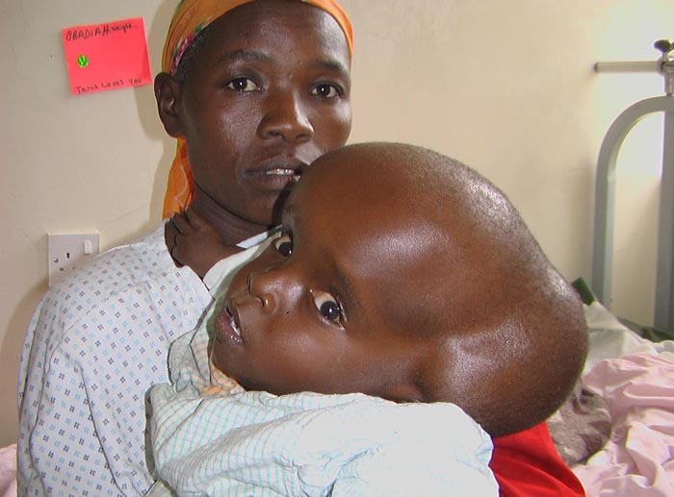
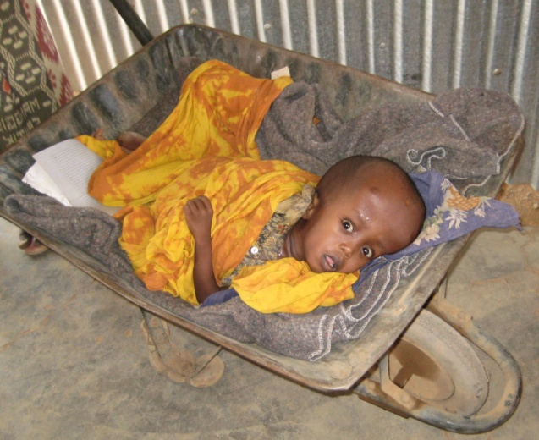
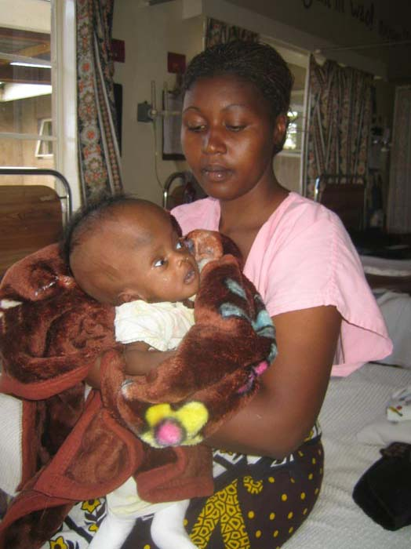
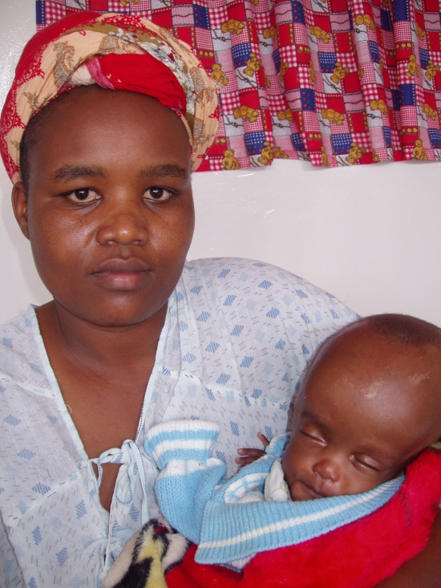
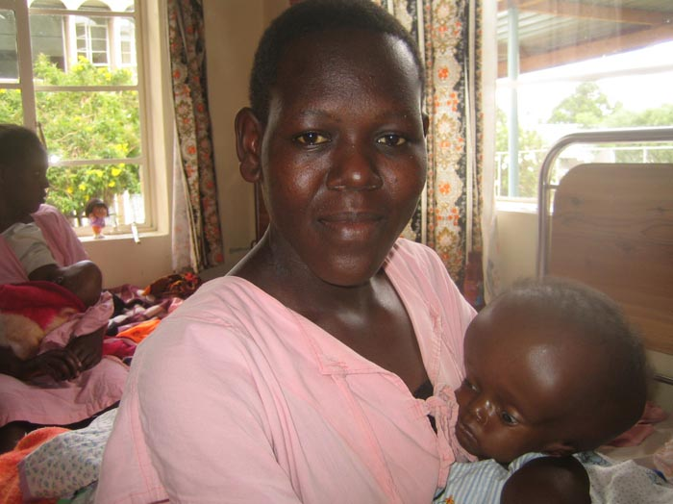

Slide 38
An accident, orchestrated, or providence?
1998 – The work with disabled children was moved from Kijabe Hospital to the newly built Bethany Crippled Children’s Centre – 30 beds
2004 –Due to unexpected growth in the number of children coming with HC and SB, this part of the work was moved to Kijabe Hospital where it became known as BethanyKids at Kijabe Hospital

Slide 39
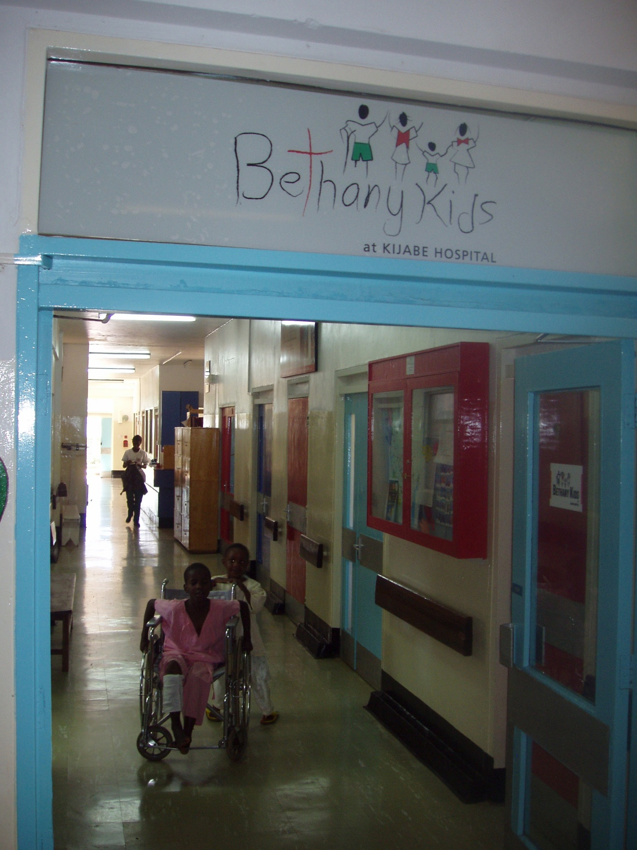
2004
BETHANY KIDS
AT
KIJABE
HOSPITAL
(36+18+13 beds)

Slide 40
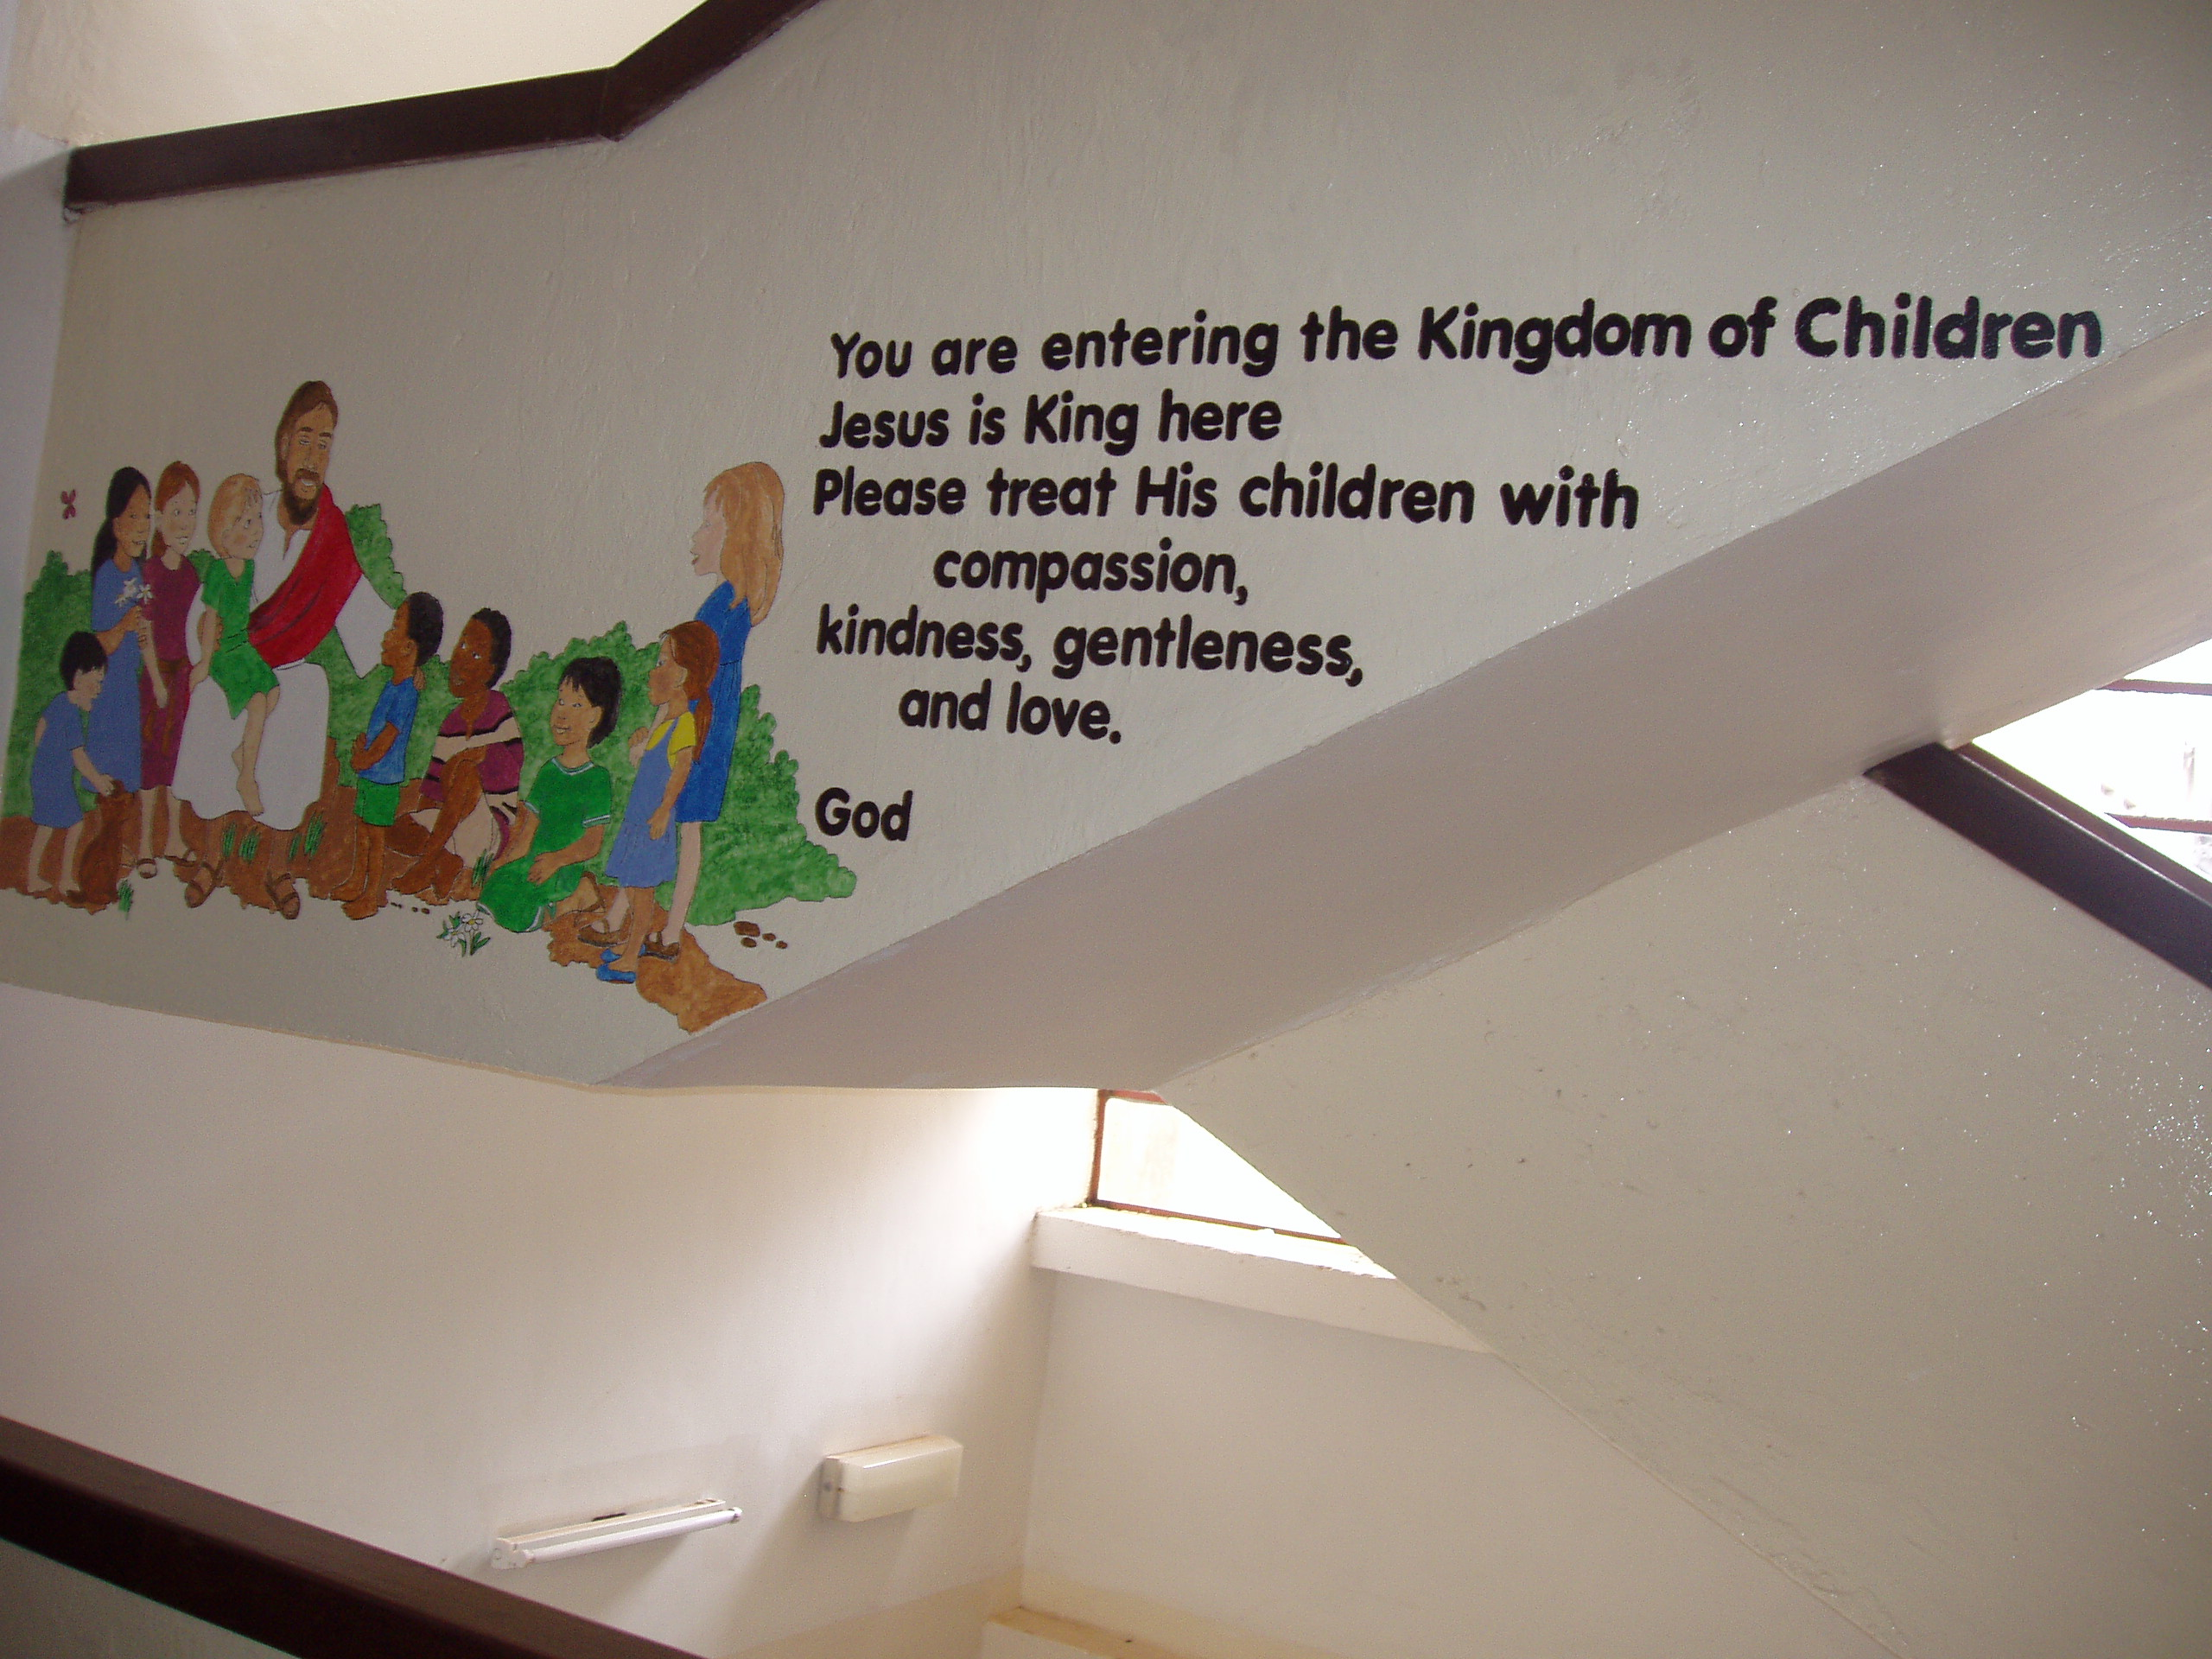
Our staff developed a good attitude toward sick children.

Slide 41
Concentration
Pediatric neurosurgery
Pediatric surgery
Pediatric urology
Pediatric plastic reconstructive
Training of PAACS general surgery residents
Fellowships in pediatric surgery and pediatric neurosurgery

Slide 42

And, the number of children arriving with hydrocephalus grew.

Slide 44
Hydrocephalus and Spina Bifida
1997 – 7 shunts for hydrocephalus and 8 spina bifida closures
2011 – 792 shunts, and related procedures, for hydrocephalus and 299 spina bifida closures
Yearly an estimated 45,000 new cases of hydrocephalus occur in Sub Saharan Africa (Warf)

Slide 45
Notes:
This was a very narrow neurosurgical practice I admit.

Slide 46
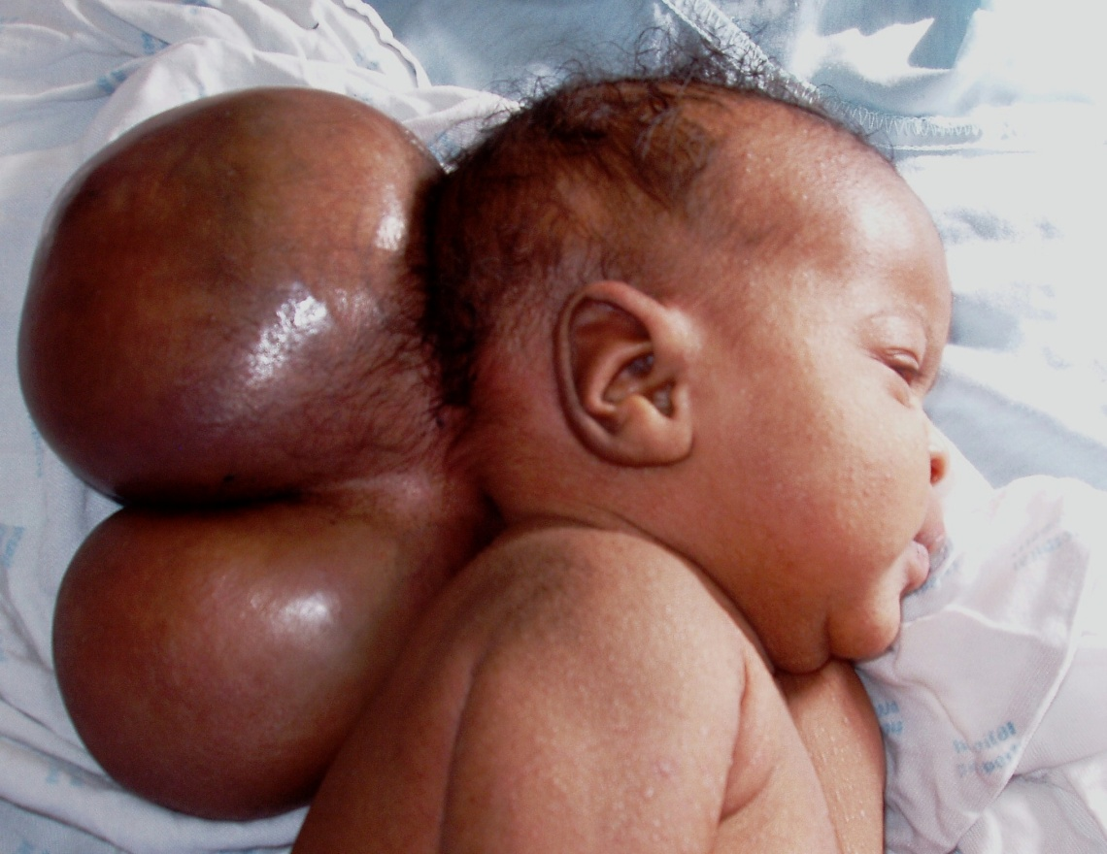
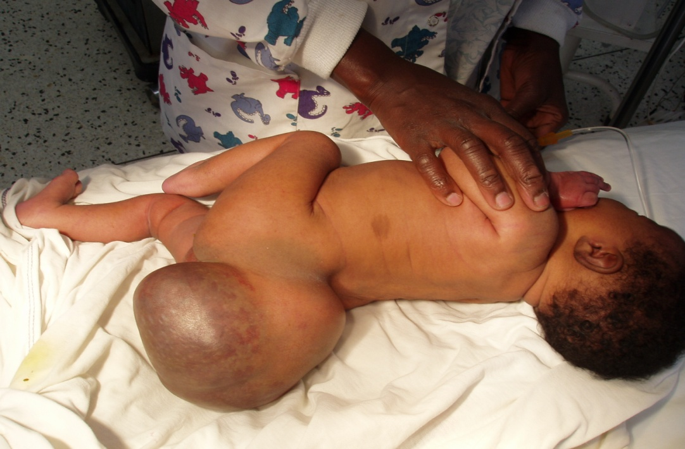
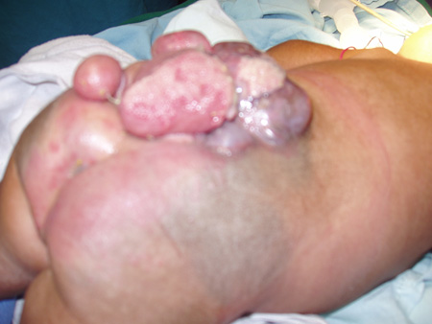
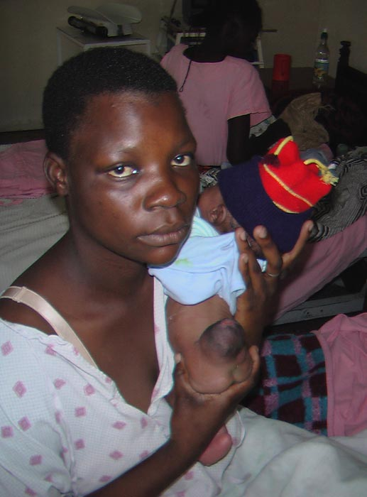

Slide 47
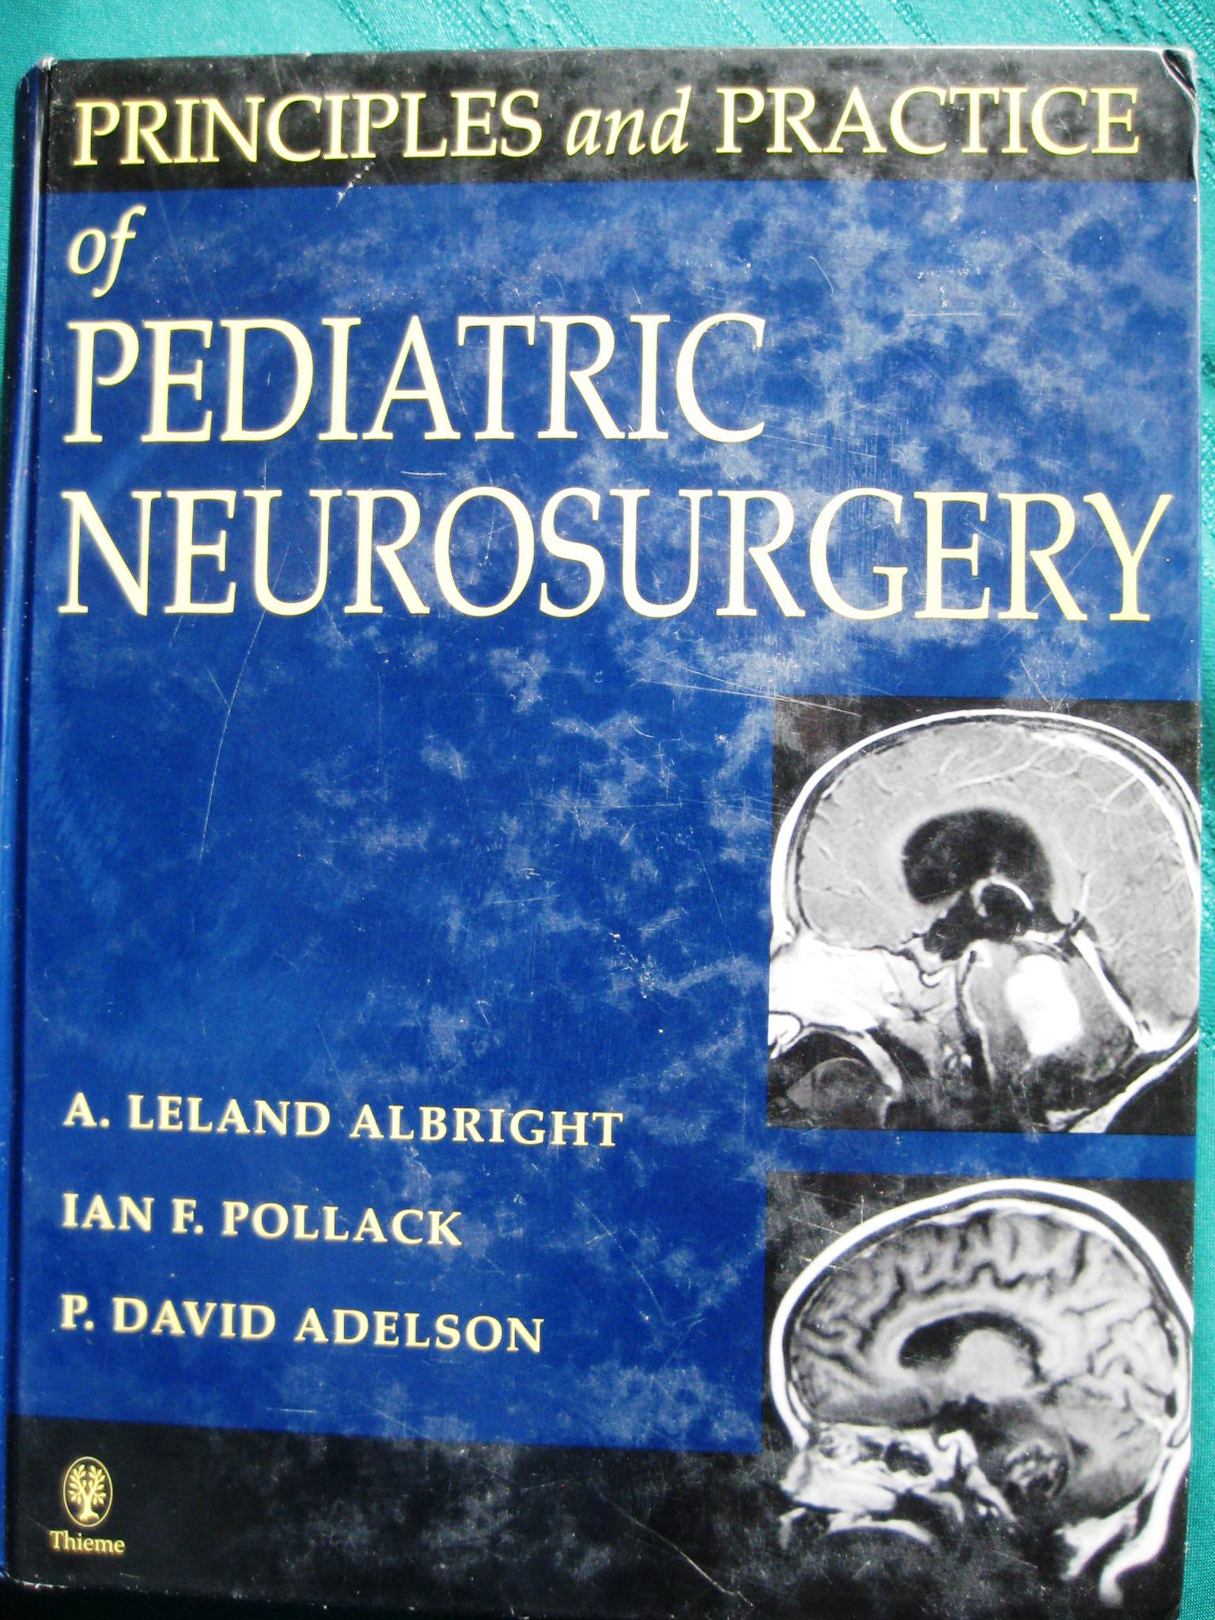
I couldn’t find the book!

Slide 48
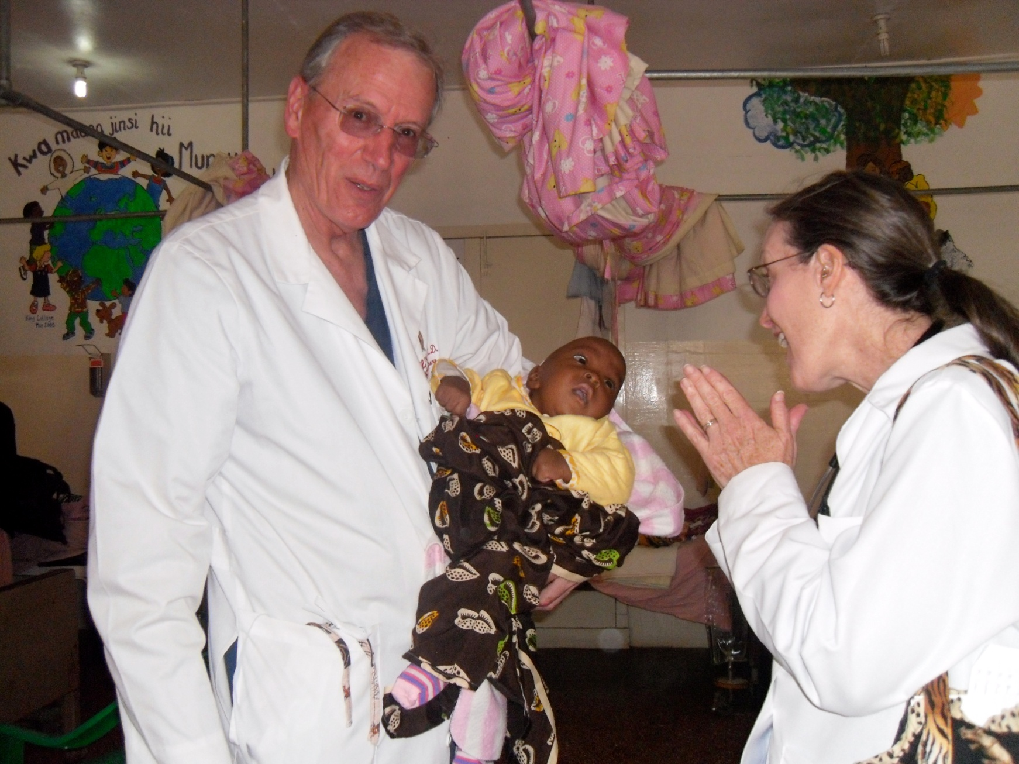
Dr. and Mrs. Leland Albright- a casual visit in 2002

Slide 49

Let me tell you about a few disabled young people-friends:
Gladys
Daisy
Francesca
Rebecca
Baby John

Slide 50


Slide 51
Patients had come from:
*Senegal
*Sierra Leone
*Guinea
*Sudan
*Somalia
*Ethiopia
*Somaliland
*Uganda
*Burundi
*Tanzania
*Comoro
Islands
*Mozambique
*DRC
*Liberia
Notes:
Map of Africa

Slide 52

Why?

Slide 53

Why?
1. There was, and is,
nearly no care
available for the disabled in Africa.
2. AND, most of the disabled are just too poor to be able to access care, if it were available.

Slide 54
“NO HOSPITAL OF THIS KIND BETWEEN
CAIRO
AND
CAPE TOWN!”

Slide 55
Disabled
-3-10% of those in the developing world
-ONE BILLION people in Africa,
i.e 30-100,000,000 disabled
-Disabled includes those with club feet, polio, cleft lips/palates, burn contractures, hypospadias, hydrocephalus, spina bifida, seizures, blind, CP, etc.

Slide 56
What are the possible spiritual implications of working with the disabled?
BKKH opened in 2004
Saved:
2010 ~5,000
2011~7,000
Think of what this could mean for AFRICA!
In 2006 Mercy suggested that we train “disciplers”. Now, 2012, there are >300 DISCIPLERS.

Slide 57


D
I
S
C
I
P
L
E
R
S
MERCY
+
2010 - ~5,000 new believers

Slide 58
$3.84

Slide 59
Coincidence?
Coincidence?
Accident?
Providence?
Obedience?

Slide 60


1982

Slide 61


U
N
R
E
A
C
H
E
D
B
O
N
I

Slide 62




Famine
Northeastern Kenya
1992
Notes:
In 1992 Northeastern Kenya was in the midst of a severe famine. Somalis stormed across the border in search of food and a means to stay alive.
Graves were everywhere!
These were the selfsame Somalis for whom the Christian world had been praying for decades---decades!
I stood on a pile of rocks all one morning seeing starving, sick kids. What an OPPORTUNITY!
Their arrival was not the answer to our prayers that we had anticipated, but they were here. While the Christians looked on counting the cost and fearing the Muslims, the secular world rushed to their aid. Oh, the opportunities missed!

Slide 63

“THE WORLD HAS SENT ITS PEOPLE, BUT THE CHRISTIANS HAVE NOT COME!”

Slide 64
I returned from Mandera to go on a family vacation at the Coast
1st time in a hotel
1st time with access to a phone
Josh 9 months and with us 3 months
Jon and Susie 15

Slide 65

2nd day
= phone call

Slide 66
My comments to David Stevens about going to Somalia with Samaritan’s Purse:
1. I could not go without the permission of our hospital director. DONE!
2. Who would take my place? WMM has someone to fill your place at Kijabe.
3. I need to talk to Millie and my 15 year old twins.

Slide 67
JON
“Dad, you’ve got to go! This is what we have been praying for!

Slide 68




SOMALIA
1993
Notes:
HOWEVER, in December, 1992, David Stephens, on behalf of World Medical Missions, called me at a hotel in Mombasa, and asked me if I would be willing to join SP in Somalia as their medical director. I said that I would have to ask the medical director at Kijabe Medical Centre and my family. Dave responded that he already had his permission from the medical director. When I presented this “opportunity” to my 15 year old twins, Jon said, “Dad, you must go! This is what we have been praying for.”
American troops had landed in Somalia in December, 1992. Thanks to Samaritan’s Purse and other godly organizations, the opportunities within Somalia were not fully missed.
Compassion, with carefully chosen words, was used of the Lord. Many, many, many died, but God also used us and did something to our hearts and the hearts of some Somalis.

Slide 69

Mogadishu

Slide 70


Slide 71

M
O
G
A
D
I
S
H
U

Slide 72
SOMALIA
1993
Notes:
HOWEVER, in December, 1992, David Stephens, on behalf of World Medical Missions, called me at a hotel in Mombasa, and asked me if I would be willing to join SP in Somalia as their medical director. I said that I would have to ask the medical director at Kijabe Medical Centre and my family. Dave responded that he already had his permission from the medical director. When I presented this “opportunity” to my 15 year old twins, Jon said, “Dad, you must go! This is what we have been praying for.”
American troops had landed in Somalia in December, 1992. Thanks to Samaritan’s Purse and other godly organizations, the opportunities within Somalia were not fully missed.
Compassion, with carefully chosen words, was used of the Lord. Many, many, many died, but God also used us and did something to our hearts and the hearts of some Somalis.

Slide 73

A
H
M
E
D

Slide 74




R
W
A
N
D
A
1994
Musehe
Uemana
Sweet Pea
Pillow case kids
Notes:
April, 1994, came and the massacre in Rwanda. 800,000 people were slain in 100 days while most of the world looked on.
SP was able to enter to provide compassionate care through the rebel faction. My daughter Bethany and I went to Rwanda. Bethany remained on through the summer, and she handed many of her little orphans and unaccompanied minors “across the chasm of death into the hands of our loving Heavenly Father”---as she wrote in her journal.
Many tears were shed. Bethany grew. God too did a work in her heart---and mine too.
What I am trying to say is that God presents a MULTITUDE OF OPPORTUNITIES ALLOWING US TO USE OUR MEDICAL SKILLS TO BRING PEOPLE TO JESUS CHRIST!

Slide 75



800,000 killed
in
100
days!
Genocide

Slide 76


Uemana - Kigali

Slide 77



Slide 78


1996
Southern
Sudan
Notes:
Crippled children, training programs, a medical school….
Finally, let me share with you something of what has excited my soul since 1996.
Sudan! Southern Sudan and its people and needs have become a real passion for me.
I was invited by Safe Harbor to help them medically on a relief-evangelistic trip into Southern Sudan in 1996. My two daughters went along to help with the immunization program and in whatever way that they could help.

Slide 79



Slide 80

SUDAN - 1996

Slide 81
Faith
She was 10 months old and weighed 8 pounds.
Her mother and one sibling were dead, and her father was a SPLA soldier.
She was “dying” when Bethany saw her at the distant clinic.
Faith was brought back to camp where we cared for her until we departed; she left Sudan with us.
Faith had an interesting border crossing---Kate.

Slide 82

THE JESUS FILM

Slide 83
1996 to 1998
1996 –return trip to Nyamlel with Safe Harbor
1998 – Kakuma Refugee Camp-97,000 Sudanese

Slide 84

Flight from Kakuma Refugee Camp---home for over 97,000 refugees

Slide 85


Storm over NFD
Emergency Landing

Slide 86
1998 – Tonj-Starvation---flight out
1998- Lui, an introduction to Samaritan’s Purse’s work in Sudan

Slide 87

Mundri County International Airport

Slide 88


LUI GATE
&
CHAPEL

Slide 89


Sudan:
“STATE OF THE ART?”
Notes:
Dr. Warren Cooper in Lui, Sudan

Slide 90




Slide 91

1999 – Land mines on air strip and road; Millie teaching women

Slide 92

2000
-Repeat trips to Lui
-Ebola***
-The bombing of Lui

Slide 93

ADVOCACY
Notes:
Part of what came from my visits to Sudan was a sense of responsibility. This responsibility seemed to dictate that I do what I could do to change the course of history in Sudan.

Slide 94




Sudan - as seen in the Holocaust Museum & in person!
Notes:
The Holocaust Museum in Washington, DC, had an exhibit about the plight of Southern Sudan, and these pictures were in the museum.
On the front of the museum is a quote by President Dwight Eisenhower that, “never again will the world….fail to act in time to prevent this terrible crime of genocide…” Kosovo and Rwanda have come and gone; many have stood watching and assigning blame. Few have intervened.
In Southern Sudan over 2 million people have died, and most of these have been Southerners. It is likely that the cost will become even greater within the next year. Will our sophisticated world once again stand watching while thousands of innocent men, women and children die?

Slide 95



Washington DC
2000
2001
2002
2003
Arlington Cemetery
Notes:
I have visited Washington on behalf of the people of Southern Sudan and disabled children for the last four years.
I do not know if I have had any effect, but I can tell God that I have done what I could do.
Possibly, just possibly, I will be able to help the disabled within Southern Sudan commencing next year.

Slide 96
In 2003 I visited Washington again to represent two groups:
The disabled of Africa and
The people of Southern Sudan.
(The civil war had already gone on for over 20 years.)

Slide 97
Among my appointments was a visit with the head of USAID.

Slide 98
WASHINGTON, DC
OCTOBER 20TH, 2003
“I believe that a peace agreement will be signed in Sudan!”
“Would you consider caring for the needs of the disabled of ALL of Southern Sudan?”
“Would you consider helping to begin a medical school for Southern Sudan?”
“And, do you know which is the fastest growing church in the world? It is the church in Sudan!”

Slide 99
Unfortunately I did not yet feel adequate to accept these challenges.
Do I regret my decisions?
Yes! I really did not trust God enough at that time.

Slide 100
Coincidence?
Coincidence?
Accident?
Providence?
Obedience?

Slide 101

Closed Country
2006
Notes:
Lastly God has opened a door to allow some of our team to enter a “closed country” where we train medical and nursing students, do bedside teaching, and operate on patients from four different countries. My work with disabled children is unavailable to most in nearly all of those countries.

Slide 102
June, 2006
“I have never met a Christian!”

Slide 103







REMEMBER
Anisa:
“I just want to feed myself!”

Slide 104





A
Presence

Slide 105


*Presence *Teaching
*Medical Care *“Sharing”

Slide 106








Slide 107




REMEMBER
Don’t forget why you have come!

Slide 108
But realize…
We are often just preparing the soil.
Our fruit may come much later, possibly after we are dead.
Communication with many is minimal---often just a smile or a touch.
It may be dangerous for us, and for any new believer.
God will be glorified, IF we are obedient.

Slide 109
If I had achieved my earlier dreams of being a baseball player, what might have happened?
1. Thousands of disabled children, e.g. polio, club feet, cleft lips, burn contractures, hydrocephalus, spina bifida, and other congenital and acquired abnormalities, might not have received medical care, or He would have found another person.
2. In 2010 Mercy and her “disciplers” would not have seen nearly 5,000 people give their lives to Jesus Christ.

Slide 110

A DREAM THAT BEGAN IN THE 1980’S AND STILL IS NOT COMPLETE

Slide 111
Realize the accomplishments He has allowed!
UPG’s: Boni, Wolof, Somali, Okiek, Daruma,
Comorians, Mwani,
Didinga,
Disabled

Slide 112
My unfulfilled dreams…
Dadaab and Kakuma Refugee Camps
~ 35-45 more African countries
“Remedial” training program for rehab workers
6,955 UPG

Slide 113







DADAAB
REFUGEE
CAMP

Slide 114


Slide 115




Slide 116

His story is yet another example of how the concept
of
a supreme God
has existed for
centuries in hundreds of cultures
throughout the world.

Slide 117

A supreme God has existed forever, and He has bestowed on each of His children unique gifts and a unique plan to glorify Himself.
AN
ETERNAL PURPOSE
IN
THEIR BEING
by
Dick Bransford

Slide 118
WHAT IS YOUR GIMMICK?
What gifting has God given you, OR will help you develop?

Slide 119
Many of us began with few natural talents.

Slide 120
Many of us were not naturally good students.
Some of us have even failed!

Slide 121
BUT
Has not an Almighty,
All-knowing God prepared each of us?

Slide 122
What if you were to tell God,
“Change my life in any way you would like, so that I might best be able to touch the world for you.”

Slide 123


Slide 124
I want to be “successful”, in
God’s eyes!

