Slide 1

Disability:
Displaying the Works of God through
Wholistic Development

Slide 2
God is sovereign over disability.

Slide 3
Exodus 4:11
Then the Lord said to him, “Who has made man's mouth? Who makes him mute, or deaf, or seeing, or blind? Is it not I, the Lord?

Slide 4
2 Corinthians 12:7-10
So to keep me from becoming conceited because of the surpassing greatness of the revelations, a thorn was given me in the flesh, a messenger of Satan to harass me, to keep me from becoming conceited. Three times I pleaded with the Lord about this, that it should leave me. But he said to me, “My grace is sufficient for you, for my power is made perfect in weakness.” Therefore I will boast all the more gladly of my weaknesses, so that the power of Christ may rest upon me. For the sake of Christ, then, I am content with weaknesses, insults, hardships, persecutions, and calamities. For when I am weak, then I am strong.

Slide 5
Isaiah 45:6b-7
I am the Lord, and there is no other. I form the light and create the darkness, I make well-being and create calamity, I am the Lord, who does all these things.

Slide 6
Jeremiah 32:42
“For thus says the Lord: Just as I have brought all this great disaster upon this people, so I will bring upon them all the good that I promise them.

Slide 7
Then why?
What is the purpose of disability in God’s economy?

Slide 8
John 9:1-3
As he passed by, he saw a man blind from birth. And his disciples asked him, “Rabbi, who sinned, this man or his parents, that he was born blind?” Jesus answered, “It was not that this man sinned, or his parents, but that the works of God might be displayed in him.

Slide 9
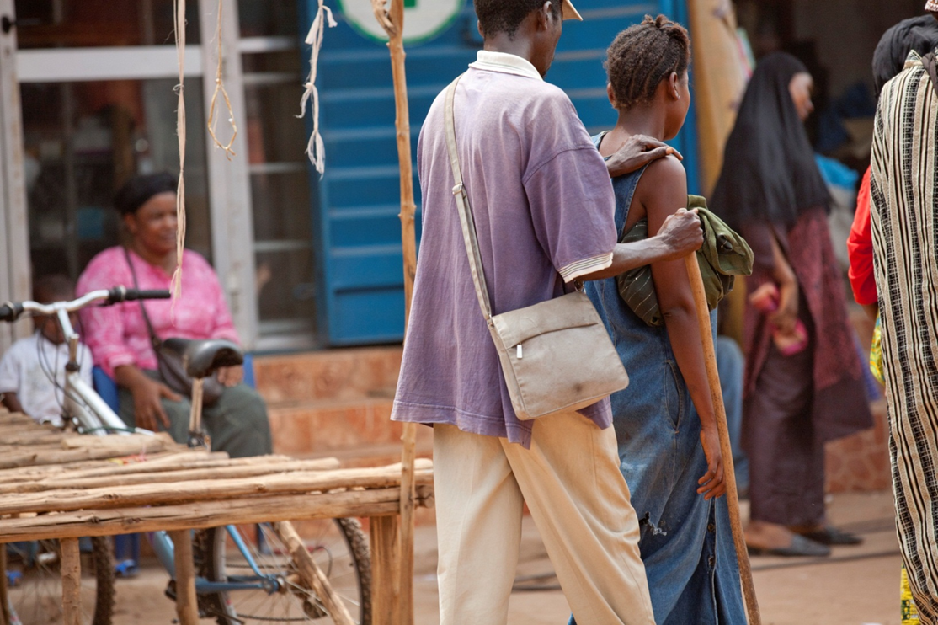

Slide 10
God’s Glory and his Works…
Displayed in the healing of the disability?
  Or in the suffering?

Slide 11
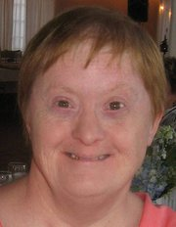
Robin Hiser

Slide 12
How is God glorified and made manifest in suffering?

Slide 13
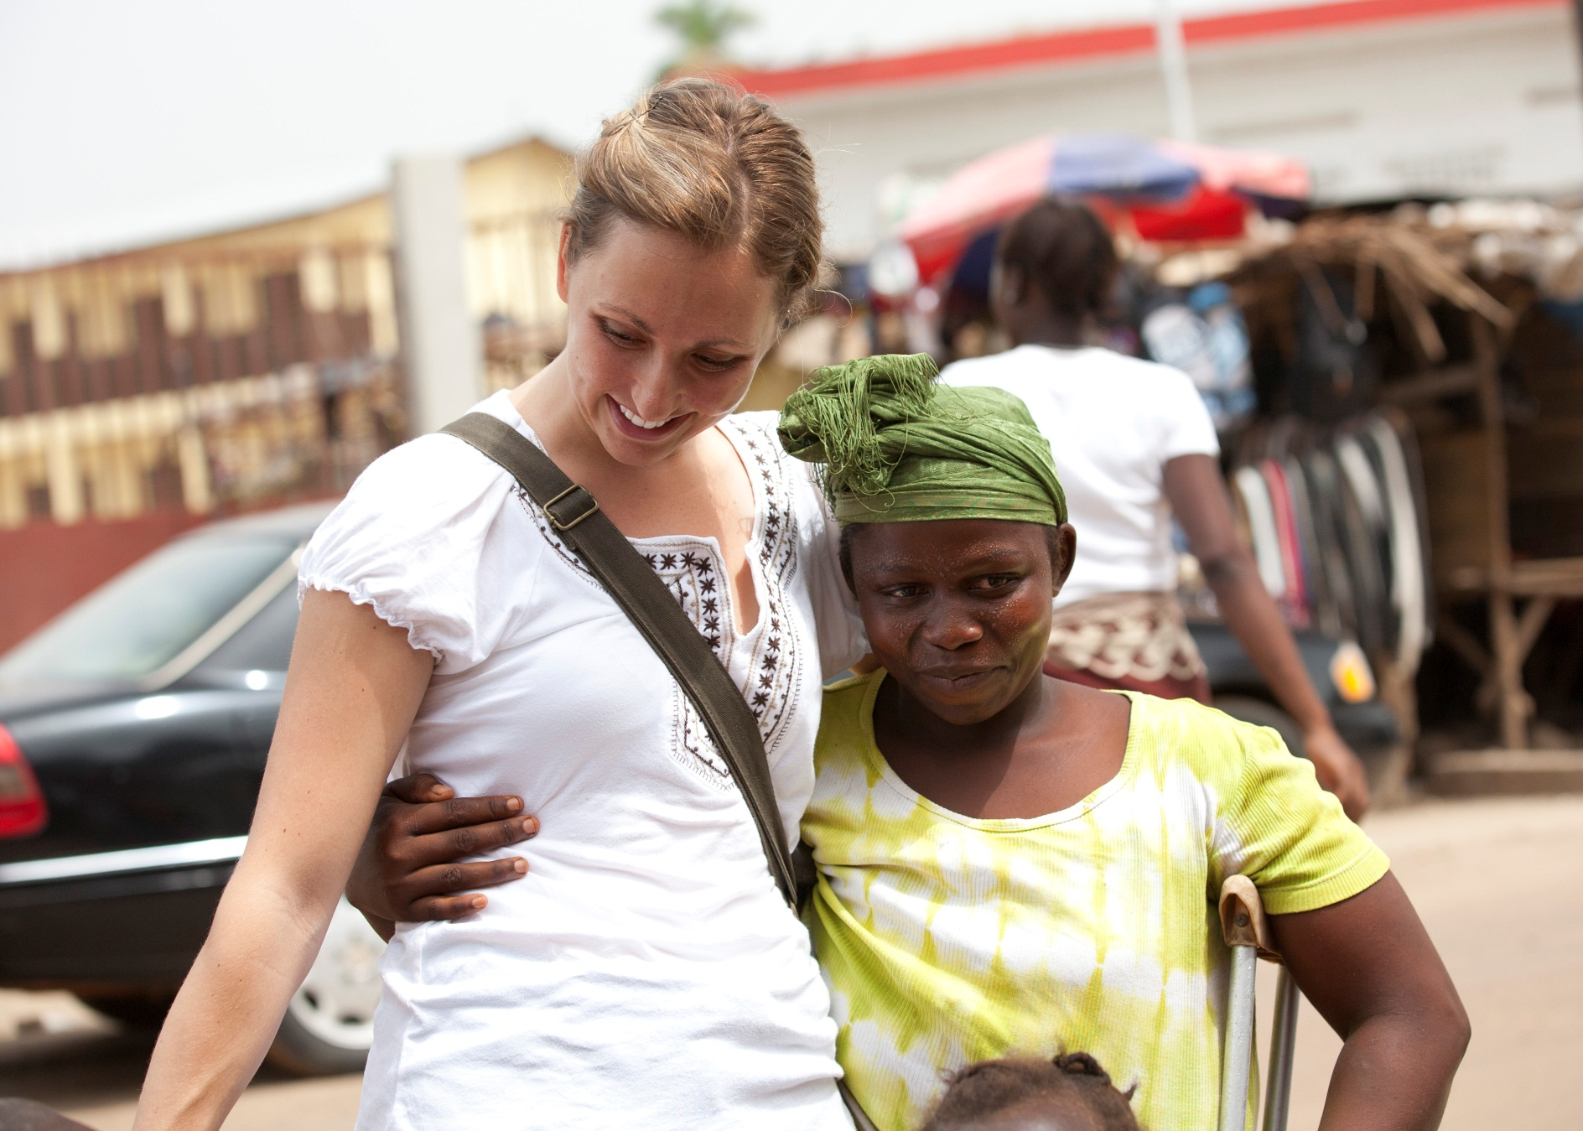

Slide 14
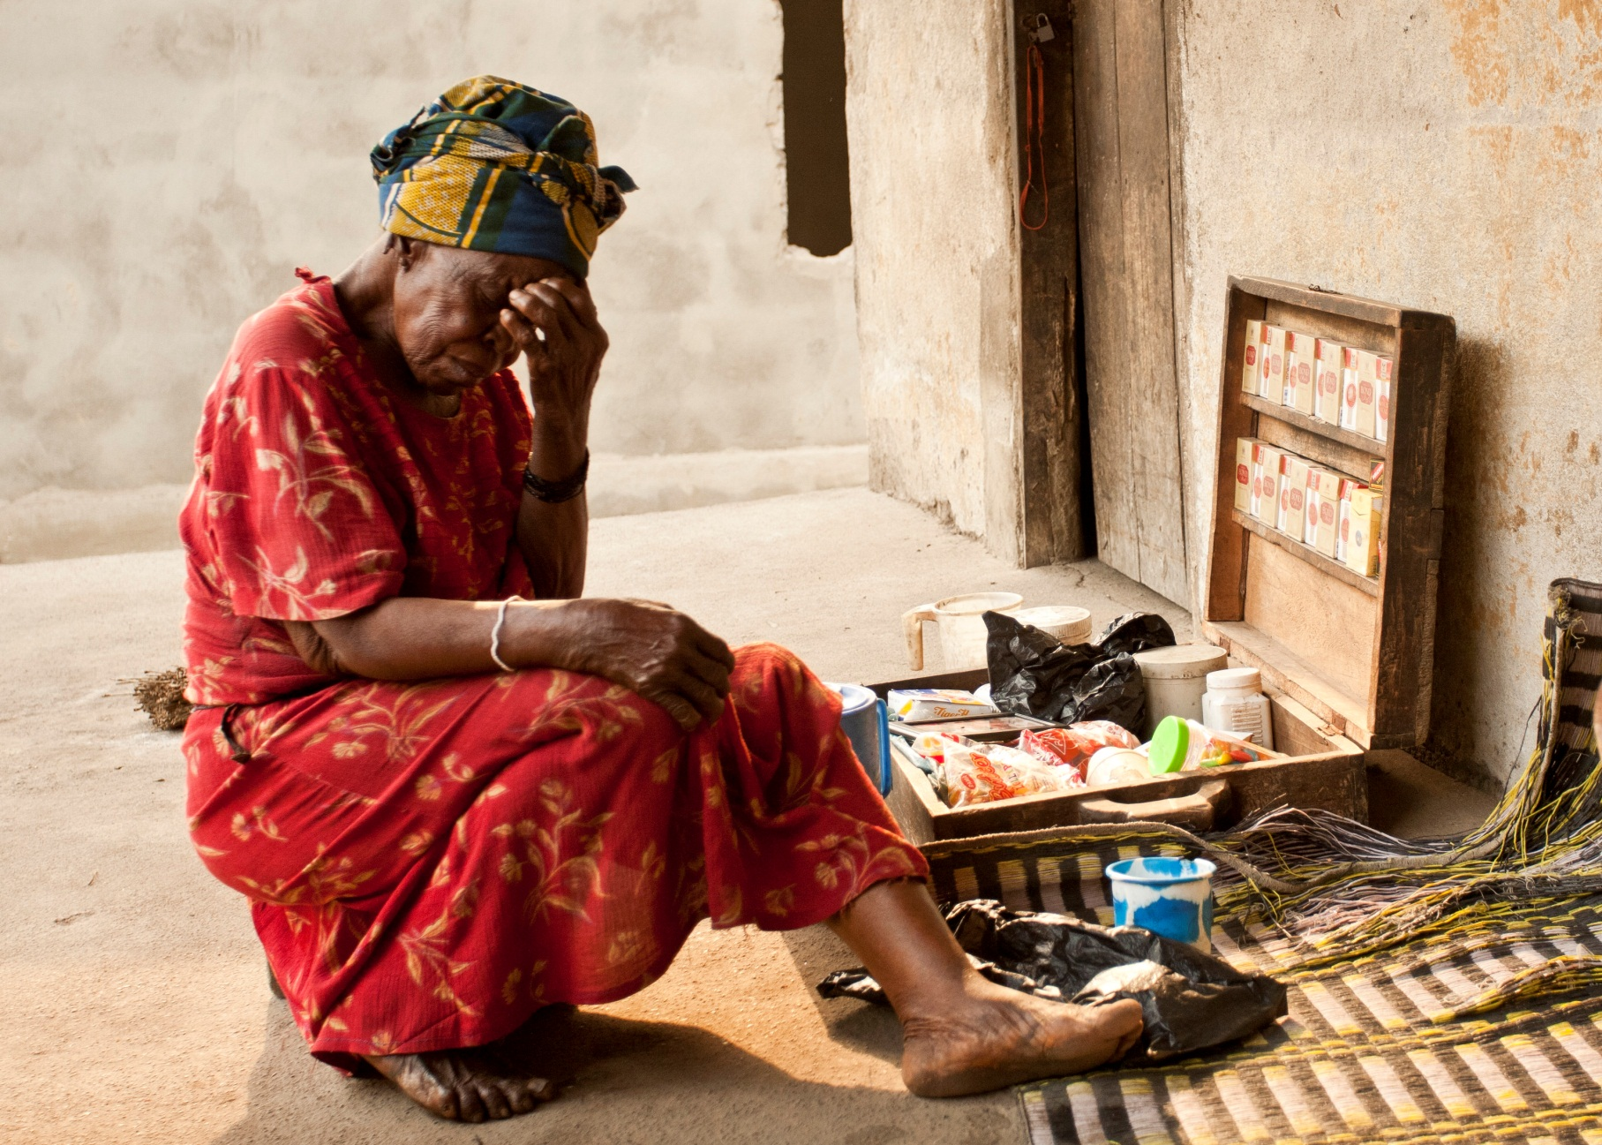

Slide 15
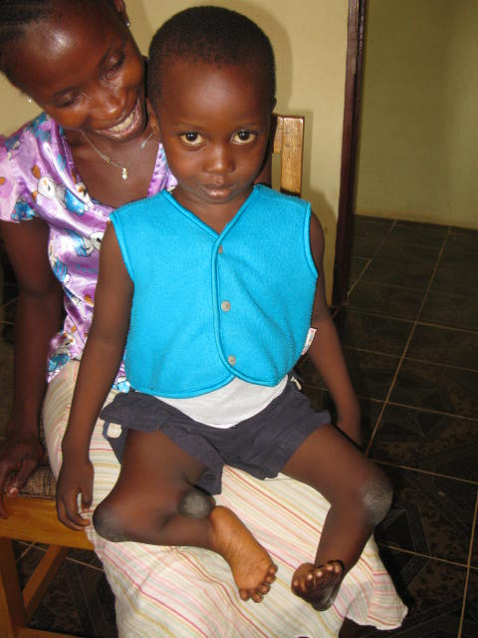

Slide 16
God displaying His glory in Suffering
I Peter 4:19
Therefore let those who suffer according to God's will entrust their souls to a faithful Creator while doing good.
2 Corinthians 12:9
He said to me, “My grace is sufficient for you, for my power is made perfect in weakness.” Therefore I will boast all the more gladly of my weaknesses, so that the power of Christ may rest upon me.
I Corinthians 1:26-29
For consider your calling, brothers: not many of you were wise according to worldly standards, not many were powerful, not many were of noble birth. But God chose what is foolish in the world to shame the wise; God chose what is weak in the world to shame the strong; God chose what is low and despised in the world, even things that are not, to bring to nothing things that are, so that no human being might boast in the presence of God.

Slide 17
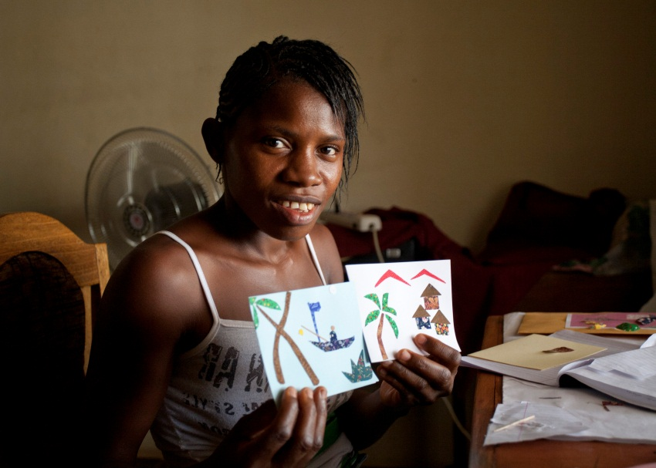
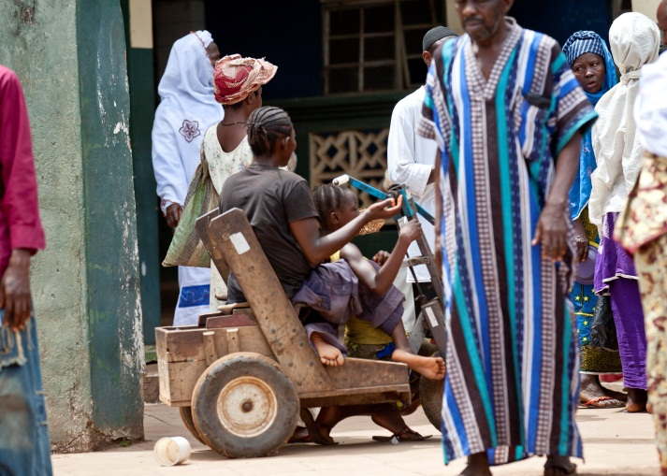
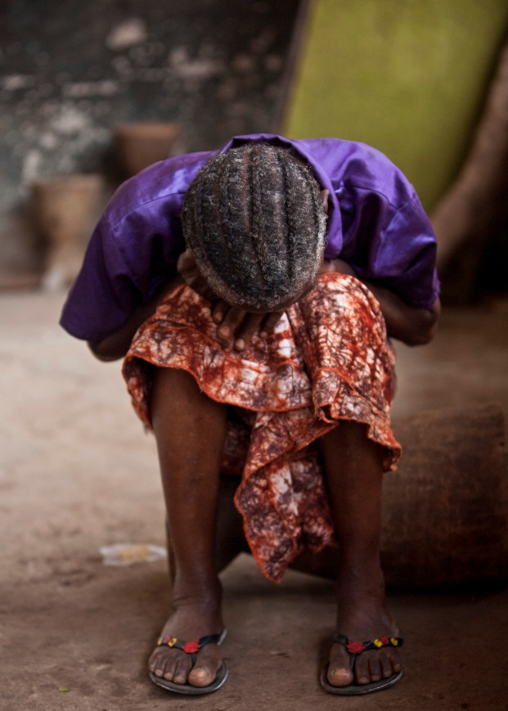
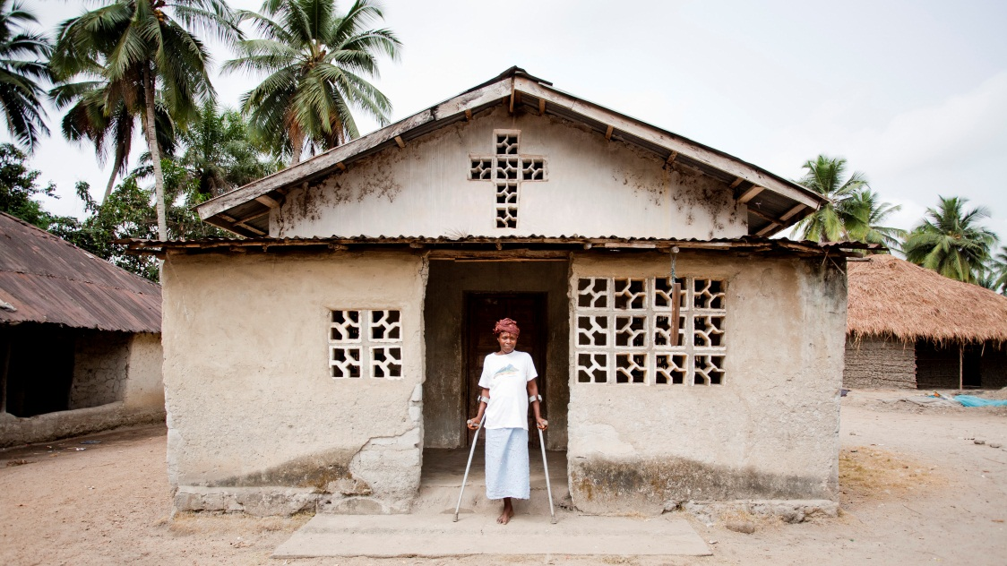
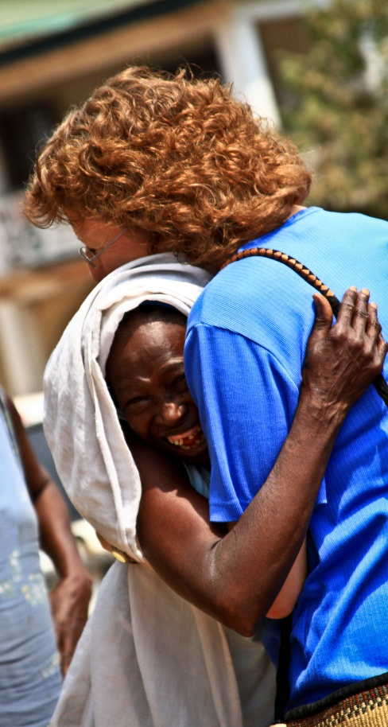
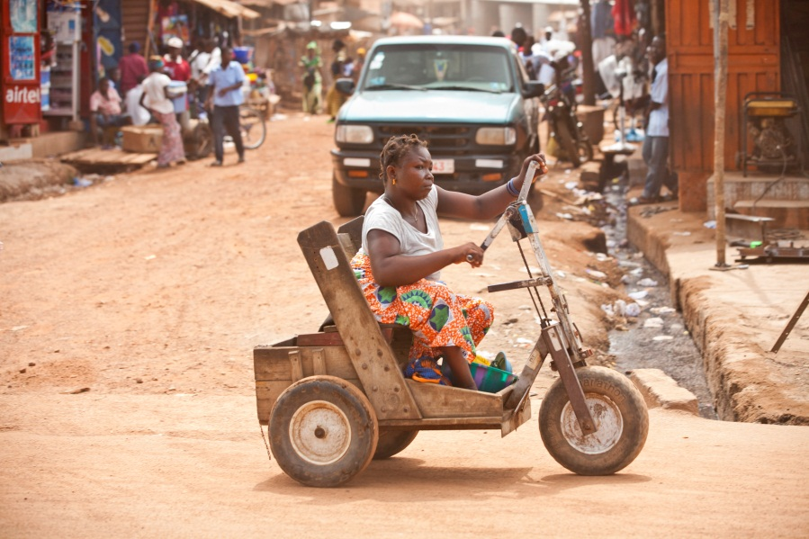
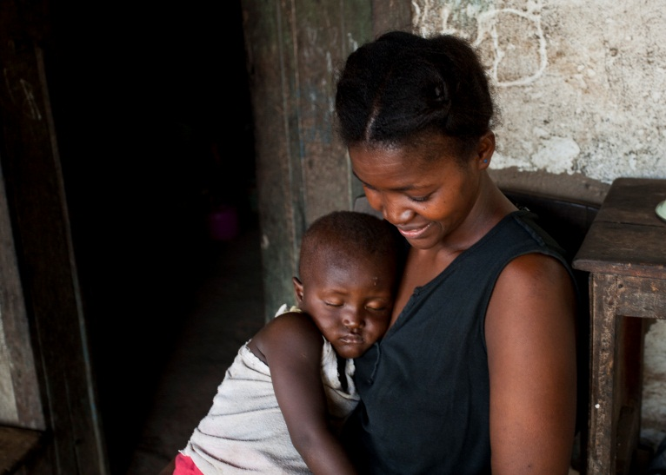

Slide 18
Four relationships broken by the fall:

Slide 19
Four relationships broken by the fall:
1. Man and God – Gen. 3:8-9

Slide 20
Four relationships broken by the fall:
1. Man and God – Gen. 3:8-9
2. Man and Self – Gen. 3:7, 10

Slide 21
Four relationships broken by the fall:
1. Man and God – Gen. 3:8-9
2. Man and Self – Gen. 3:7, 10
3. Man and Others – Gen. 3:7, 12, 16

Slide 22
Four relationships broken by the fall:
1. Man and God – Gen. 3:8-9
2. Man and Self – Gen. 3:7, 10
3. Man and Others – Gen. 3:7, 12, 16
4. Man and Creation – Gen. 3:17-19

Slide 23
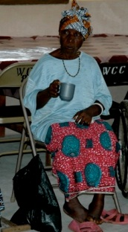
Ya Yeabu

Slide 24
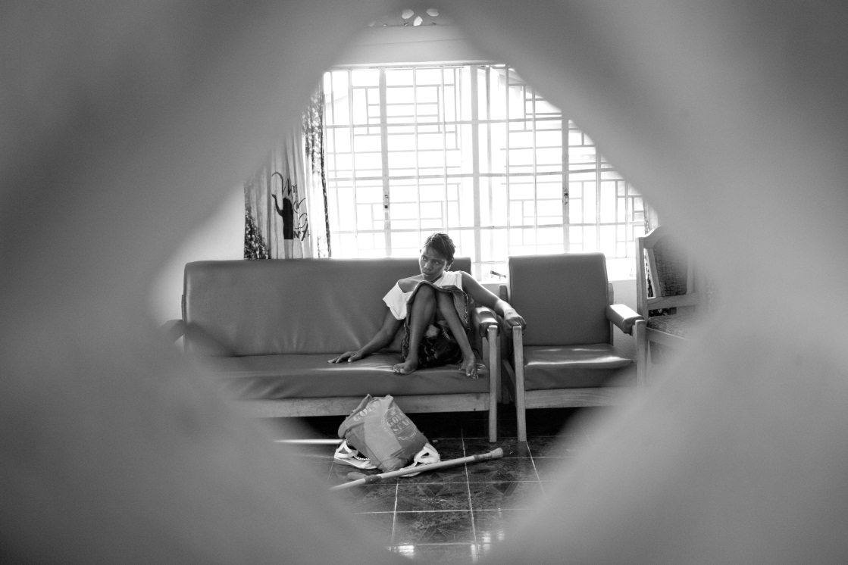
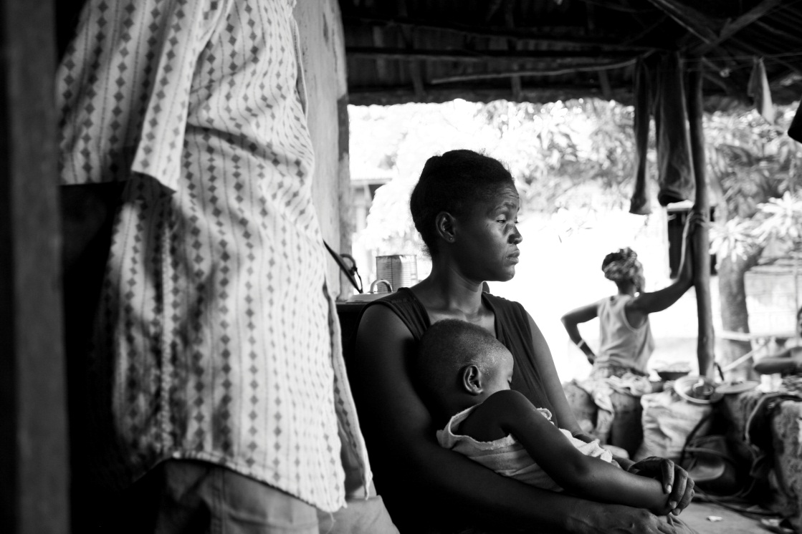
Much of the brokenness in the lives of PWDs is related to the broken society in which they live.

Slide 25

Because an “unknown” blind beggar is special to God, we must have compassion for him individually. This compassion must be visible in specific acts of mercy, but our compassion for him must go deep enough to create a society that can see that a blind man is a special person. He should not have to live a hand-to-mouth, insecure existence until one day he falls sick, becomes too weak to beg, and rots by the roadside to be eaten by beasts, birds and worms. A society that cannot see the intrinsic value of a blind beggar is blind to truth. Its blindness needs to be exposed so that it can be transformed into a humane and compassionate community.
~ Vishal Mangalwadi, “Truth and Transformation: A Manifesto for Ailing Nations”

Slide 26
Jesus – Our Ministry Example
Matt. 4:23-24
Matt. 8:1-4
Matt. 8:5-10
Matt. 9:1-7
Matt.9:27-30
Matt. 9:32-33
Matt. 10:1
Matt. 10:8
Matt. 11:4-6
Matt. 12:9-13
Matt. 12:22
Matt. 15:30-31
Matt. 17:14-18
Matt. 20:30-34
Matt. 26:6-7
Mk. 1:40-45
Mk. 2:3-12
Mk. 3:1-6
Mk. 7:32-37
Mk. 8:22-26
Mk. 9:17-29
Mk. 10:46-52
Mk. 14:3
Lk. 1:20-23, 61-64
Lk. 5:12-14
Lk. 5:18-26
Lk. 6:6-11
Lk. 7:21-23
Lk. 11:14
Lk. 13:10-17
Lk. 14:2-6
Lk. 14:12-14
Lk. 14:21
Lk. 17:11-19
Lk. 18:35-43
Jn. 5:2-17
Jn. 9:1-41
Acts 3:1-10
Acts 5:12-16
Acts 8:7
Acts 9:8-19
Acts 9:32-34
Acts 14:8-10

Slide 27
Jesus Defines Himself
Luke 7:22
And he answered them, “Go and tell John what you have seen and heard: the blind receive their sight, the lame walk, lepers are cleansed, and the deaf hear; the dead are raised up, the poor have good news preached to them.”

Slide 28
What about you?
What are the implications for YOUR ministry, as you follow in His footsteps?

Slide 29
