Slide 1
Faith and Therapy: Unveiling a Pedagogical Model for Aligning Biblical Theology and Counseling Theories
Dr. Andrew R. Wichterman
Dr. Selin Philip
Dr. Rebecca Taylor
Colorado Christian University
Christian Association For Psychological Studies, March 23rd, 2024

Slide 2
Agenda
A Creative Minority
Model as Filter and Application
Modified Meta-Narrative as Framework
Conceptual Foundation Integration
Technical Integration
Steps for Beginning Therapists

Slide 3
A Creative Minority
Borrowing from the Jews

Slide 4
A Creative Minority
Rabbi Jonathan Sacks
  Strengthening internal communities through expressions of faith
  Mediating between the host society and other cultures
  Becoming influential leaders in thought and science, thereby shaping host cultures.
Christian Students and Professionals as a Creative Minority
  The profession aims for Christian ideals, but overlooks their source
  Psychology operates without a clear model of congruency to foster personal congruence.

Slide 5
A Creative Minority
Goal of Christian Counseling/Psychology programs:
  Develop clinically sound professionals
  Cultivate emotionally and spiritually mature saints
  Impact all around them for the kingdom of Christ
  Imagine an army of alumni deep in the Word, connected to the Holy Spirit, and in love with Jesus that the mental health profession sees revival.

Slide 6
A Creative Minority
How to achieve this revival?
  A model steeped in scriptural truths:
    Foundation
    Framework
    Programs prioritizing relationship with Jesus

Slide 7
The Model as Filter
A Common Starting Point

Slide 8
How should this model function?
We seek to develop a “starting model”
We seek to develop a starting point from which all theory can be tested and filtered through the lens of scripture.

Slide 9
Modified Meta-Narrative as Foundation and Framework
Foundation and Framework

Slide 10
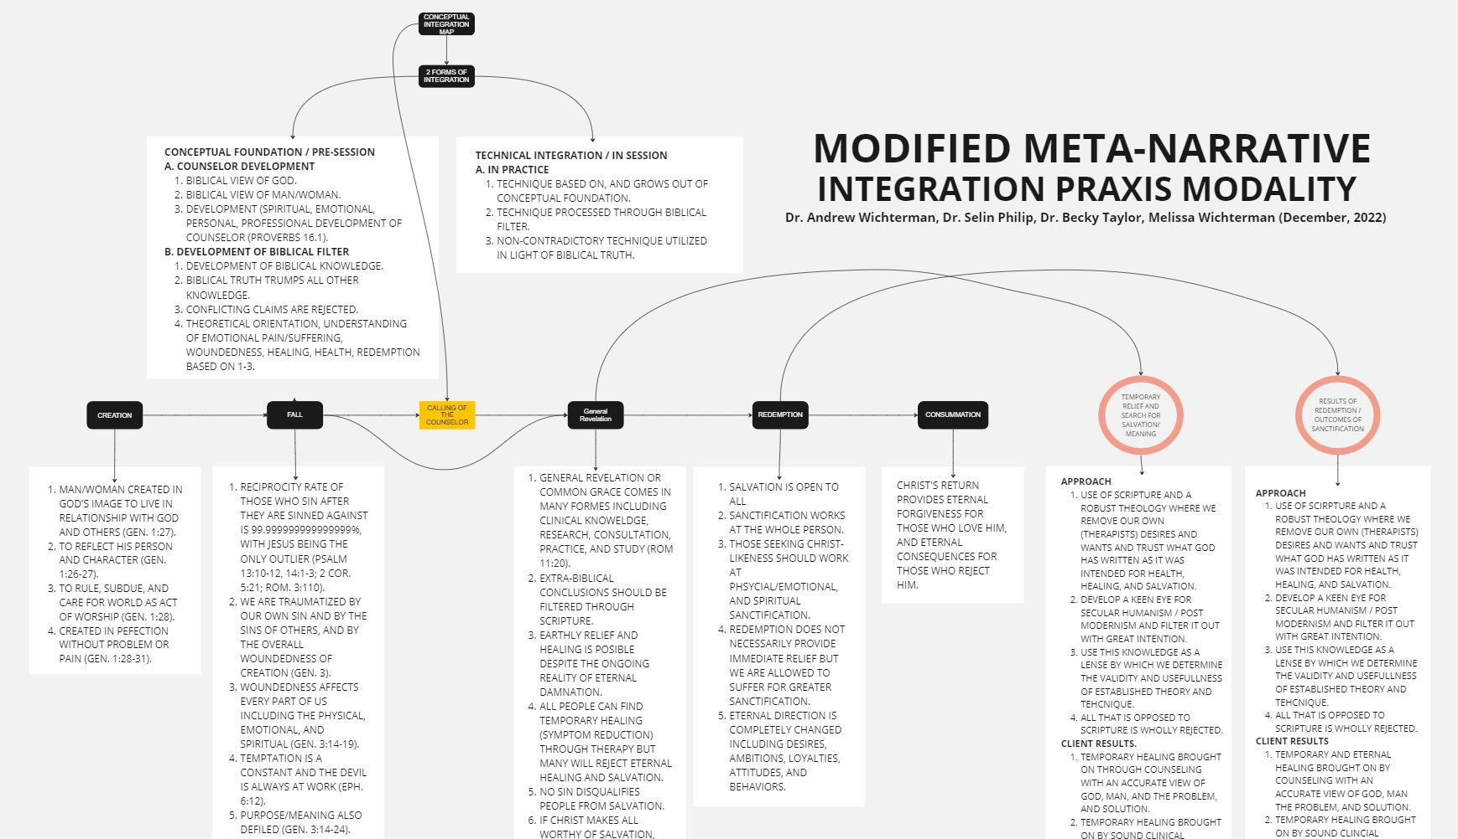
Modified Meta-Narrative

Slide 11
Creation
Man/Woman created in God’s image to live in relationship with God (Gensis 1:27).
To reflect His person and character (Genesis 1:26-27)
To rule, subdue, and care for the world as an act of worship (Gen 1:28).
Created in perfection without problem or pain (Genesis 1:28-31).

Slide 12
Fall
Reciprocity rate of those who sin before and after they are sinned against is 99.999999999999999%, Jesus is the only outlier (PSALM 13:10-12, 14:1-3; 2 COR. 5:21; ROM. 3:110).
We are traumatized by our own sin and by the sin of others, and by the overall woundedness of creation (GEN. 3).
Woundedness affects every part of us including the physical, emotional, and spiritual (GEN. 3:14-19).
Temptation is a constant and the Devil and Demons are always at work (EPH. 6:12).
Purpose and meaning is also defiled (GEN. 3:14-24).
Sin’s consequences (Including mental illness) are justified/affirmed by society.

Slide 13
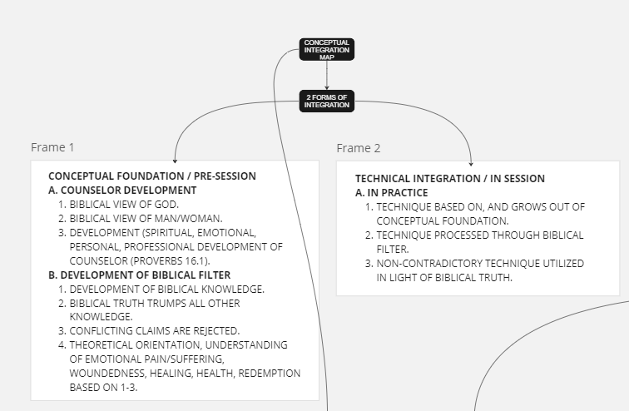
Calling of the Counselor
.

Slide 14
General Revelation
General Revelation (Common Grace comes in many forms including clinical knowledge, research, consultation, practice and study (Romans 11:20).
Extra-Biblical conclusions should be filtered through scripture.
Earthly relief and healing is possible despite the ongoing reality of eternal damnation.
All people can find temporary healing (symptom reduction) through therapy, but many will reject eternal healing and salvation.
No sin disqualifies people from salvation.
If Christ’s sacrifice makes all worthy of salvation, all are worthy of competent and caring therapy.

Slide 15
Redemption
Salvation is available to all.
Sanctification works in the whole person.
Those seeking Christ-likeness should work at physical/emotional, and spiritual sanctification.
Redemption does not necessarily provide immediate relief, but we are allowed to suffer for greater sanctification.
Eternal direction is completely changed including desires, ambitions, loyalties, attitudes, and behaviors.

Slide 16
Consummation
Christ’s return is immanent and provides eternal forgiveness for those who love him, and eternal consequences for those who reject Him.

Slide 17
Temporary Relief and search for Salvation / Meaning
APPROACH
Use of scripture and a robust theology where the therapist removes their own desires & wants + trusts what God has written as it was intended for health, healing , and salvation.
Develop a keen eye for Secular Humanism/Post Modernism and filter it with great intention.
Use the knowledge as a lens through which we determine the validity and usefulness of establishing theory and technique.
All that is opposed to scripture is wholly rejected.

Slide 18
Temporary Relief and search for Salvation / Meaning
CLIENT RESULTS
Temporary healing brought on through counseling with an accurate view of God, humanity, their problem, and God’s solution.
Temporary healing brought on by a sound clinical understanding and teaching, filtered through a sound understanding of Scripture.

Slide 19
Results of redemption / Outcomes of sanctification
APPROACH
Use of scripture and a robust theology where the therapist removes their own desires and wants and trusts what God has written as it was intended for health, healing , and salvation.
Develop a keen eye for Secular Humanism/Post Modernism and filter it with great intention.
Use the knowledge as a lens through which we determine the validity and usefulness of establishing theory and technique.
All that is opposed to scripture is wholly rejected.

Slide 20
Results of redemption / Outcomes of sanctification
CLIENT RESULTS
Temporary healing brought on through counseling with an accurate view of God, humanity, their problem, and God’s solution.
Temporary healing brought on by a sound clinical understanding and teaching, filtered through a mature understanding of scripture.
  As a result:
    Clients grow in Christ-likeness.
    Clients develop a non-anxious presence and calm as they mature in Christ (Sayers, 2022).
    Clients practice the spiritual disciplines as techniques, grow closer to the
    Triune God and grow more emotionally regulated in the process.

Slide 21
Steps for Beginning Therapists
Providing Practical Steps for Students

Slide 22
Selected References
Jones, S., L. & Butman, R. E. ( 2011). Modern psychotherapies: A comprehensive Christian appraisal. IVP Academic
McMinn, M. R. (1996). Psychology, theology, and spirituality in counseling. Tyndale House Publishers
Narramore, C. (2000). The psychology of counseling. Zondervan
Sacks, J. (2014, January). On creative minorities. First Things. https://www.firstthings.com/article /2014/01/on-creative-minorities
Sayers, M. (2016). Disappearing church: From cultural relevance to gospel resilience. Moody Press
Tan, S-Y. (2022). Counseling and psychotherapy: A Christian perspective. Baker Academic

Slide 23
Questions
Dr. Andrew R. Wichterman, Ph.D., LPC, NCC
(269) 274-2028
awichterman@ccu.edu
Dr. Selin Philip, Ph.D., LPC, NCC
(215) 589-3994
sphilip@ccu.edu
Dr. Rebecca Taylor, Ed.D., LPC, CEDS
(719) 352-8875
rtaylor@ccu.edu

