Slide 1

The righteous will thrive like a green leaf.
- Proverbs 11:28
https://www.goodhousekeeping.com/home/gardening/g2681/plant-leaves/

Slide 2
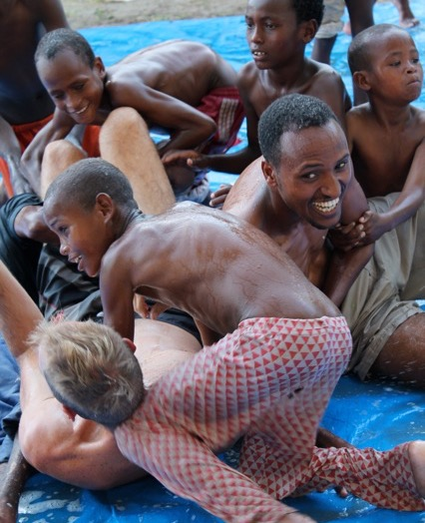
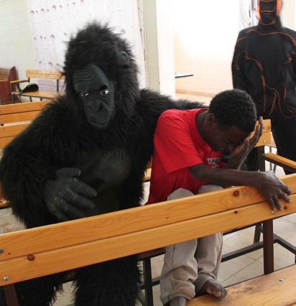
Notes:
Jack: Embrace the people, culture and language
Doesn’t get hot and bothered when people are late. He understands that in the culture events matter more than time.
Jill: Fell in love with the people. “Turn people’s weak sides away from you – focus on and appreciate people’s strengths” Learned to understand that when people she was working with told her what they thought she wanted to hear, it was because in their culture relationship matters more than task.
I’ve known medical missionaries who’ve never reconciled themselves to key elements of their host culture, who’ve never fallen in love with the people they work among
Pearl #1: embrace

Slide 3
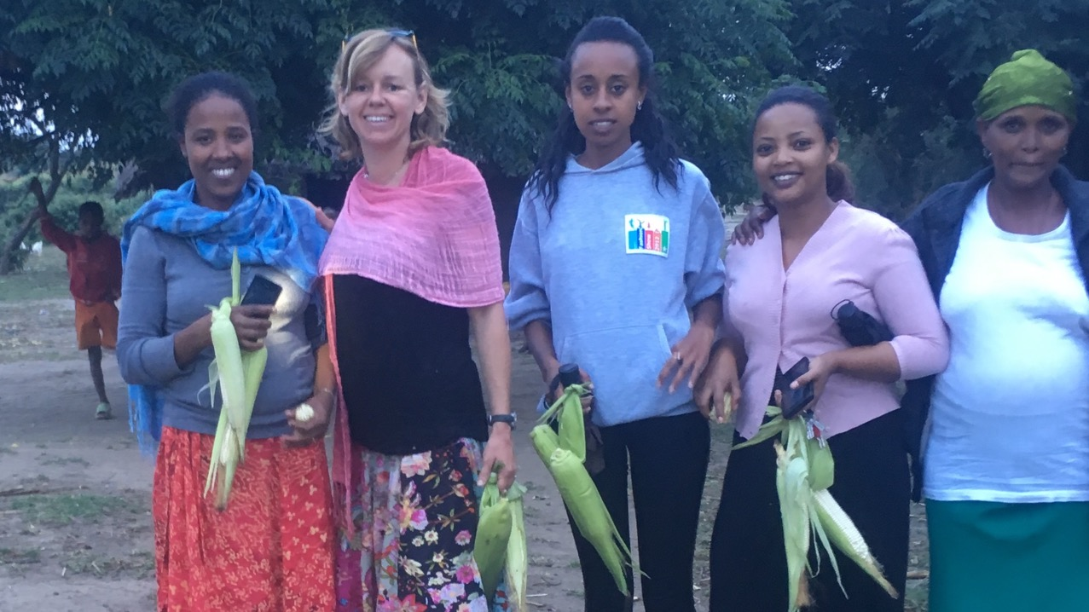
Notes:
Jack: Embrace the people, culture and language
Doesn’t get hot and bothered when people are late. He understands that in the culture events matter more than time.
Jill: Fell in love with the people. “Turn people’s weak sides away from you – focus on and appreciate people’s strengths” Learned to understand that when people she was working with told her what they thought she wanted to hear, it was because in their culture relationship matters more than task.
I’ve known medical missionaries who’ve never reconciled themselves to key elements of their host culture, who’ve never fallen in love with the people they work among
Pearl #1: embrace

Slide 4
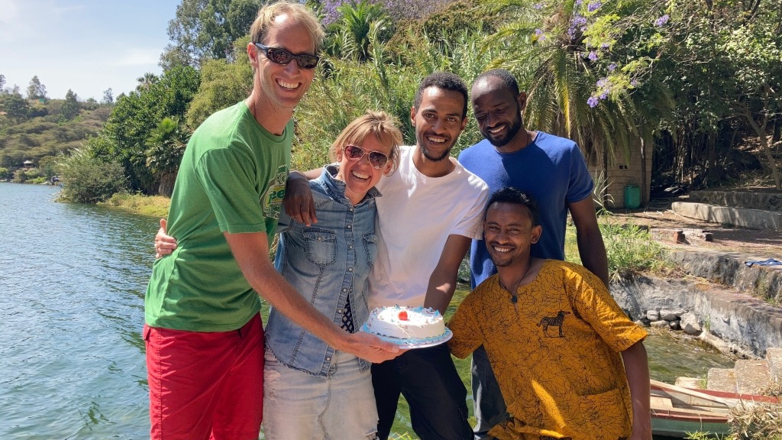
Notes:
The rest of the story: abrupt end to ministry
Are they thriving?

Slide 5
Principle #1
“Embrace the people, language and culture”
Notes:
The rest of the story: abrupt end to ministry
Are they thriving?

Slide 6
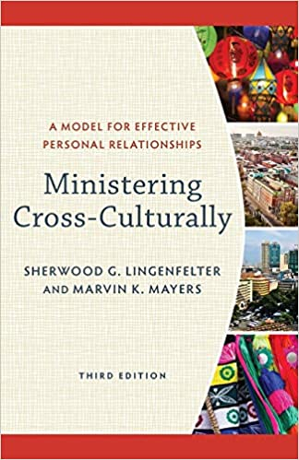



Slide 7
Notes:
The rest of the story: abrupt end to ministry
Are they thriving?

Slide 8
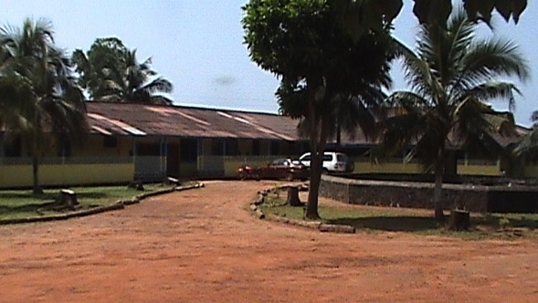

https://www.pinterest.com/pin/633248397596682454/
Notes:
Case study “Anna” – knowing your passion and living it out; finding your sweet spot
In her country of service, everybody seems to know her
Embraced the culture, language and people
Got tremendous satisfaction from providing excellent care and having good outcomes
Synthesis of science and faith. What I learned from her
A passion for training the next generation and the ability to raise financial support to do so
Thriving spiritual ministry at her hospital
Always somewhat prone to illness. Bouts of severe malaria and sepsis.
Some years in she developed disabling symptoms: cloudy sensorium, inability to concentrate. She stopped seeing patients and teaching residents. After over a year and a million-dollar workup she was diagnosed with depression.
Is this thriving, or thriving gone wrong?

Slide 9
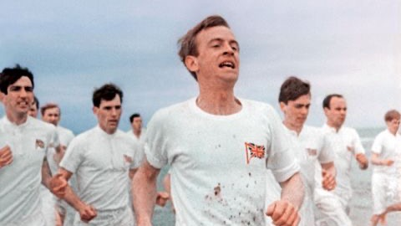
Principle #2
“Realize your God-given passion”
https://www.runnersworld.com/runners-stories/a21566047/in-chariots-of-fire-they-ran/
Notes:
“liddle”
Realizing your giftedness
Pursuing your passion
Being who God made you, doing what you were made for
Pearl #2: Engage your God-given passion

Slide 10

Principle #3
“Integrate your faith and your practice”

Slide 11


SALINE
PROCESSTM
Notes:
The mission of Faith Prescriptions is to equip Christian healthcare professionals to communicate the love of Christ, in word and in deed, to our patients, students and colleagues. What does this look like each day as we practice? How does the love of Christ motivate us to do our very best for our patients? How can we encourage our patients to confide in us regarding their spiritual needs? How do we verbally communicate the power of the Gospel with sensitivity and respect?

Slide 12
https://www.pinterest.com/pin/633248397596682454/
Notes:
Case study “Anna” – knowing your passion and living it out; finding your sweet spot
In her country of service, everybody seems to know her
Embraced the culture, language and people
Got tremendous satisfaction from providing excellent care and having good outcomes
Synthesis of science and faith. What I learned from her
A passion for training the next generation and the ability to raise financial support to do so
Thriving spiritual ministry at her hospital
Always somewhat prone to illness. Bouts of severe malaria and sepsis.
Some years in she developed disabling symptoms: cloudy sensorium, inability to concentrate. She stopped seeing patients and teaching residents. After over a year and a million-dollar workup she was diagnosed with depression.
Is this thriving, or thriving gone wrong?

Slide 13

Notes:
Default concept from the culture around us: comfort and control
In contradistinction, the Bible offers us the concept of shalom, peace broadly construed.
Housing doesn’t meet your expectations - if thriving is all about comfort you’ve got an insurmountable problem
Your neighbor’s child-rearing philosophy is different than yours, and when your kids play together it doesn’t always go well – if thriving is all about comfort you’ve got an insurmountable problem

Slide 14
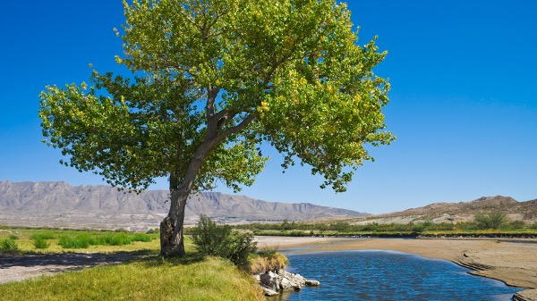
https://www.biblegateway.com/blog/2018/10/how-to-live-the-bible-how-will-our-lives-be-better-if-we-understand-the-bible/
Notes:
The Bible uses plants and trees as metaphors to depict thriving.

Slide 15
Blessed is the one who trusts in the Lord, whose confidence is in him. They will be like a tree planted by the water that sends out its roots by the stream. It does not fear when heat comes; its leaves are always green. It has no worries in a year of drought and never fails to bear fruit.
Jeremiah 17:7-8
https://www.biblegateway.com/blog/2018/10/how-to-live-the-bible-how-will-our-lives-be-better-if-we-understand-the-bible/
Notes:
Thriving is the state of being “blessed.” The word can mean favored, satisfied. Genesis 1:22: God blessed them and said, be fruitful. The result of thriving: fruit. The thriving person is fruitful.
Thriving is most apparent in people during stressful times.
The unseen source of thriving is the stream.
This passage mentions fruitfulness as the result of thriving. It also gives us a picture of what thriving looks like when heat comes: the pressure is on, things are getting uncomfortable, and you’re thinking “I can’t stand the heat, maybe I should get out of the kitchen”: the thriving person isn’t fearful when the pressure is on. It also shows us what thriving looks like when drought comes: thirsty times, dry times, tough times. The thriving person doesn’t worry in the dry times. all of us experience heat and drought – and thriving is not the absence of these difficulties. The thriving person doesn’t fear, has no worries, and is still fruitful in season.
Staying green and bearing fruit.
In John 15, Jesus puts it this way: I am the vine; you are the branches. If you remain in me and I in you, you will bear much fruit
- John 15:5

Slide 16
Blessed is the one who trusts in the Lord, whose confidence is in him. They will be like a tree planted by the water that sends out its roots by the stream. It does not fear when heat comes; its leaves are always green. It has no worries in a year of drought and never fails to bear fruit.
Jeremiah 17:7-8
https://www.biblegateway.com/blog/2018/10/how-to-live-the-bible-how-will-our-lives-be-better-if-we-understand-the-bible/
Notes:
Thriving is the state of being “blessed.” The word can mean favored, satisfied. Genesis 1:22: God blessed them and said, be fruitful. The result of thriving: fruit. The thriving person is fruitful.
Thriving is most apparent in people during stressful times.
The unseen source of thriving is the stream.
This passage mentions fruitfulness as the result of thriving. It also gives us a picture of what thriving looks like when heat comes: the pressure is on, things are getting uncomfortable, and you’re thinking “I can’t stand the heat, maybe I should get out of the kitchen”: the thriving person isn’t fearful when the pressure is on. It also shows us what thriving looks like when drought comes: thirsty times, dry times, tough times. The thriving person doesn’t worry in the dry times. all of us experience heat and drought – and thriving is not the absence of these difficulties. The thriving person doesn’t fear, has no worries, and is still fruitful in season.
Staying green and bearing fruit.
In John 15, Jesus puts it this way: I am the vine; you are the branches. If you remain in me and I in you, you will bear much fruit
- John 15:5

Slide 17
Blessed is the one who trusts in the Lord, whose confidence is in him. They will be like a tree planted by the water that sends out its roots by the stream. It does not fear when heat comes; its leaves are always green. It has no worries in a year of drought and never fails to bear fruit.
Jeremiah 17:7-8
https://www.biblegateway.com/blog/2018/10/how-to-live-the-bible-how-will-our-lives-be-better-if-we-understand-the-bible/
Notes:
Thriving is the state of being “blessed.” The word can mean favored, satisfied. Genesis 1:22: God blessed them and said, be fruitful. The result of thriving: fruit. The thriving person is fruitful.
Thriving is most apparent in people during stressful times.
The unseen source of thriving is the stream.
This passage mentions fruitfulness as the result of thriving. It also gives us a picture of what thriving looks like when heat comes: the pressure is on, things are getting uncomfortable, and you’re thinking “I can’t stand the heat, maybe I should get out of the kitchen”: the thriving person isn’t fearful when the pressure is on. It also shows us what thriving looks like when drought comes: thirsty times, dry times, tough times. The thriving person doesn’t worry in the dry times. all of us experience heat and drought – and thriving is not the absence of these difficulties. The thriving person doesn’t fear, has no worries, and is still fruitful in season.
Staying green and bearing fruit.
In John 15, Jesus puts it this way: I am the vine; you are the branches. If you remain in me and I in you, you will bear much fruit
- John 15:5

Slide 18
Blessed is the one who trusts in the Lord, whose confidence is in him. They will be like a tree planted by the water that sends out its roots by the stream. It does not fear when heat comes; its leaves are always green. It has no worries in a year of drought and never fails to bear fruit.
Jeremiah 17:7-8
https://www.biblegateway.com/blog/2018/10/how-to-live-the-bible-how-will-our-lives-be-better-if-we-understand-the-bible/
Notes:
Thriving is the state of being “blessed.” The word can mean favored, satisfied. Genesis 1:22: God blessed them and said, be fruitful. The result of thriving: fruit. The thriving person is fruitful.
Thriving is most apparent in people during stressful times.
The unseen source of thriving is the stream.
This passage mentions fruitfulness as the result of thriving. It also gives us a picture of what thriving looks like when heat comes: the pressure is on, things are getting uncomfortable, and you’re thinking “I can’t stand the heat, maybe I should get out of the kitchen”: the thriving person isn’t fearful when the pressure is on. It also shows us what thriving looks like when drought comes: thirsty times, dry times, tough times. The thriving person doesn’t worry in the dry times. all of us experience heat and drought – and thriving is not the absence of these difficulties. The thriving person doesn’t fear, has no worries, and is still fruitful in season.
Staying green and bearing fruit.
In John 15, Jesus puts it this way: I am the vine; you are the branches. If you remain in me and I in you, you will bear much fruit
- John 15:5

Slide 19
Blessed is the one who trusts in the Lord, whose confidence is in him. They will be like a tree planted by the water that sends out its roots by the stream. It does not fear when heat comes; its leaves are always green. It has no worries in a year of drought and never fails to bear fruit.
Jeremiah 17:7-8
https://www.biblegateway.com/blog/2018/10/how-to-live-the-bible-how-will-our-lives-be-better-if-we-understand-the-bible/
Notes:
Difficulties are not the opposite of thriving. We all go through difficult times. In John 15 Jesus talks about thriving using the metaphor of a vine and its branches, and he says that we should expect difficulties. He calls difficulties “pruning,” and he says the purpose of difficult times is to make us even more fruitful.
This passage from Jeremiah suggests that difficulties reveal whether we are thriving or not – whether our roots are drawing from the stream that never runs dry.

Slide 20
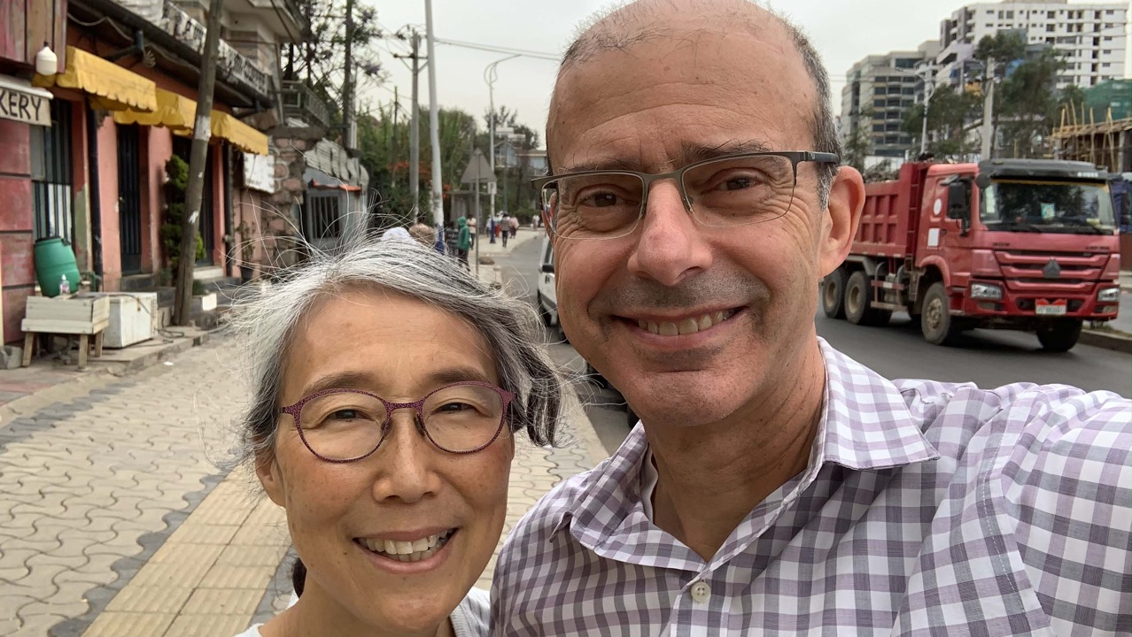
Notes:
My wife Janet and I are only in our third year of long-term cross-cultural work. When we arrived in the place where we now live, one of the first things I did was to apply for a medical license
Fortunately, God had prepared me. Two years earlier a dear friend had asked me to study Galatians with him. What I learned from that study was that I didn’t really believe the gospel. I knew and subscribed to it up here, but down here it wasn’t a reality in my life. My self-identity was caught up in my professional identity, and the affirmation I got from my colleagues, my team and my patients. I had way too positive a view of myself. What I learned from Galatians is that I’m hopeless, I’m a house on fire, and Jesus rescued me and continues to rescue me. Not only that, he made me a child of God. That’s a status I don’t deserve, can’t earn, can’t justify, but incredibly its who I am.
If I had moved to Africa knowing myself primarily as a highly skilled healthcare professional, as God’s gift to the people we moved among, I might have packed it up 6 months into my struggle to get a medical license. Yet I found myself curiously unworried about getting a license. I went to language school, explored the city, learned about the culture, and experienced the necessity of meditating on God’s word as a luxury.

Slide 21
Principle #4
Grasp the Gospel
Notes:
My wife Janet and I are only in our third year of long-term cross-cultural work. When we arrived in the place where we now live, one of the first things I did was to apply for a medical license
Fortunately, God had prepared me. Two years earlier a dear friend had asked me to study Galatians with him. What I learned from that study was that I didn’t really believe the gospel. I knew and subscribed to it up here, but down here it wasn’t a reality in my life. My self-identity was caught up in my professional identity, and the affirmation I got from my colleagues, my team and my patients. I had way too positive a view of myself. What I learned from Galatians is that I’m hopeless, I’m a house on fire, and Jesus rescued me and continues to rescue me. Not only that, he made me a child of God. That’s a status I don’t deserve, can’t earn, can’t justify, but incredibly its who I am.
If I had moved to Africa knowing myself primarily as a highly skilled healthcare professional, as God’s gift to the people we moved among, I might have packed it up 6 months into my struggle to get a medical license. Yet I found myself curiously unworried about getting a license. I went to language school, explored the city, learned about the culture, and experienced the necessity of meditating on God’s word as a luxury.

Slide 22
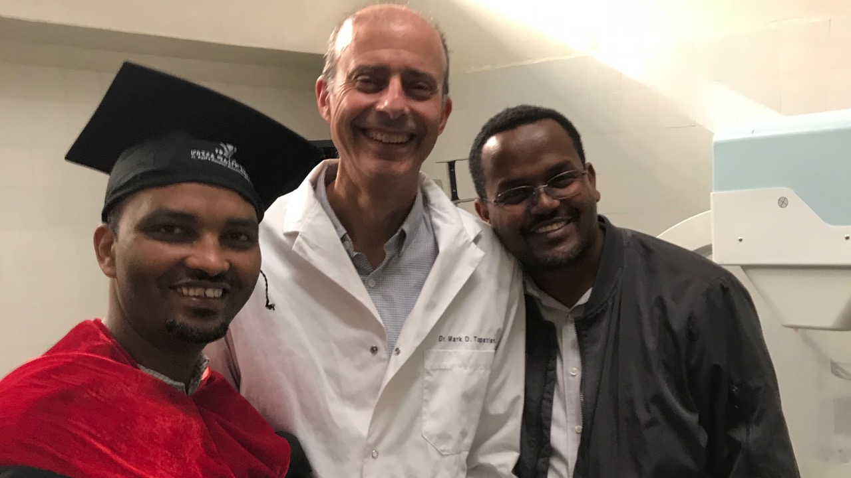
Notes:
What about me?
I did ultimately get a medical license, and I teach at large public and mission hospitals in the city where I live. I have friends, students and colleagues that I share life, work and faith with.
A couple of years before we moved to Africa, a friend invited me to study Galatians with him. I came to realize that my joy and self-identity were often based in being a doctor and being a provider. Those were streams my roots were close to – streams that sometimes run dry.
I learned from Galatians that the good news is not that I am a skilled physician or that I can take care of my family. The good news is that I was a house on fire, and Jesus rescued me. Not only that, he made me a child of God. That’s who I am.
That’s the stream that doesn’t run dry. For me these days it feels luxurious to spend time meditating on scripture. It feels like a luxury, but it’s a necessity.
If you want to study these themes from Galatians yourself, I suggest the “Sonship” curriculum available from New Growth Press , or Tim Keller’s sermons on Galatians, available through the Word in Life podcast.

Slide 23




Slide 24
Notes:
The rest of the story: abrupt end to ministry
Are they thriving?

Slide 25
“Make yourself smaller and you will be happier”
Notes:
The rest of the story: abrupt end to ministry
Are they thriving?

Slide 26
https://www.pinterest.com/pin/633248397596682454/
Notes:
Case study “Anna” – knowing your passion and living it out; finding your sweet spot
In her country of service, everybody seems to know her
Embraced the culture, language and people
Got tremendous satisfaction from providing excellent care and having good outcomes
Synthesis of science and faith. What I learned from her
A passion for training the next generation and the ability to raise financial support to do so
Thriving spiritual ministry at her hospital
Always somewhat prone to illness. Bouts of severe malaria and sepsis.
Some years in she developed disabling symptoms: cloudy sensorium, inability to concentrate. She stopped seeing patients and teaching residents. After over a year and a million-dollar workup she was diagnosed with depression.
Is this thriving, or thriving gone wrong?

Slide 27
Principle #5
“Accept your weakness”
https://www.pinterest.com/pin/633248397596682454/
Notes:
Case study “Anna” – knowing your passion and living it out; finding your sweet spot
In her country of service, everybody seems to know her
Embraced the culture, language and people
Got tremendous satisfaction from providing excellent care and having good outcomes
Synthesis of science and faith. What I learned from her
A passion for training the next generation and the ability to raise financial support to do so
Thriving spiritual ministry at her hospital
Always somewhat prone to illness. Bouts of severe malaria and sepsis.
Some years in she developed disabling symptoms: cloudy sensorium, inability to concentrate. She stopped seeing patients and teaching residents. After over a year and a million-dollar workup she was diagnosed with depression.
Is this thriving, or thriving gone wrong?

Slide 28
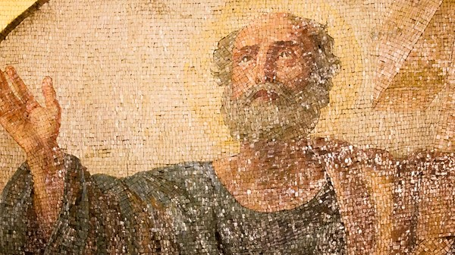
https://www.christianitytoday.com/history/issues/issue-47/apostle-paul-and-his-times-christian-history-timeline.html

Slide 29
Principle #6
“Tend your roots”
https://www.pinterest.com/pin/633248397596682454/
Notes:
Case study “Anna” – knowing your passion and living it out; finding your sweet spot
In her country of service, everybody seems to know her
Embraced the culture, language and people
Got tremendous satisfaction from providing excellent care and having good outcomes
Synthesis of science and faith. What I learned from her
A passion for training the next generation and the ability to raise financial support to do so
Thriving spiritual ministry at her hospital
Always somewhat prone to illness. Bouts of severe malaria and sepsis.
Some years in she developed disabling symptoms: cloudy sensorium, inability to concentrate. She stopped seeing patients and teaching residents. After over a year and a million-dollar workup she was diagnosed with depression.
Is this thriving, or thriving gone wrong?

Slide 30
https://www.biblegateway.com/blog/2018/10/how-to-live-the-bible-how-will-our-lives-be-better-if-we-understand-the-bible/
Notes:
The Bible uses plants and trees as metaphors to depict thriving as fruitfulness.

Slide 31
#1: Embrace the people, language and culture
#2: Realize your God-given passion
#3: Integrate your faith and your practice
#4: Grasp the gospel
#5: Accept your weakness
#6: Tend your roots
In what ways are you thriving/not thriving now?
What is God saying to you about thriving?
https://www.biblegateway.com/blog/2018/10/how-to-live-the-bible-how-will-our-lives-be-better-if-we-understand-the-bible/
Notes:
The Bible uses plants and trees as metaphors to depict thriving as fruitfulness.

Slide 32
mark.topazian@sim.org
https://www.biblegateway.com/blog/2018/10/how-to-live-the-bible-how-will-our-lives-be-better-if-we-understand-the-bible/
Notes:
The Bible uses plants and trees as metaphors to depict thriving as fruitfulness.

