Slide 1
GMHC – Preparing for and working in a Therapy Clinic – Short Term
Rick Schurman PT Cert MDT

Slide 2

Rick Schurman PT Cert MDT
Graduate of Northwestern University Physical Therapy program-
Experience in out-patient orthopedics, private practice, industrial medicine and athletic training.
Credentialed in the McKenzie Mechanical Diagnosis and Therapy since 1999
Volunteer with Global Health Outreach since 2004 as the PT Specialty Coordinator and member of the GHO Advisory Council
Experience: 12 GHO trips to the Dominican Republic.

Slide 3
Declaration- No conflict of Interest
I have no financial involvement or ownership in any of the products or systems mentioned in this presentation

Slide 4
Problem
There is a shortage of Physical and Occupational Therapists to go on short term medical missions trips to serve patients in the treatment of musculoskeletal disorders and rehabilitation.

Slide 5
Objectives
1) Identify the needed equipment and supplies for a therapy clinic on a short term missions trip
2) Identify the obstacles for the clinic to function properly and efficiently
3) Identify a time table for preparations for a short term trip with a therapy clinic
4) Identify the ways to prepare therapy supplies and equipment for transport on a short term trip
5) Identify the most effective approach for treating patients on a short term trip with limited time for each patient visit.
6) Identify the dynamics of working in a short term clinic

Slide 6
Objectives
Participants will be presented with:
  Ideas and options for securing and transporting therapy supplies and equipment
  Expectations of working in multi-disciplinary clinic on a short term trip
  Working conditions and patient types.
  Identifying differing types of trips and specific needs for each trip

Slide 7
Questions to answer first
Choosing an organization
  Doctrinal statement – Do you in general agree with the organizations belief system
  Evangelistic approach- Is there a strong component of the trip that will be sharing the gospel
  Clinic model- How is the therapist used in the way the clinic is run.

Slide 8
Three components to consider.
Will this clinic model allow me to practice my specialty to benefit as many patients as possible?
Is there a strong plan for sharing the gospel that is the most efficient in time spent?
Is there a strong partnership with a local church or ministry that allows for spiritual and medical follow up?

Slide 9
Role of the Therapist
The therapist is to be part of the team of leaders to take responsibility for musculo-skeletal and neurological disorders
The therapist organizes the team for those taking therapy supplies and equipment.
The therapy equipment includes wheelchairs, crutches, walkers and canes. Supplies includes all other therapy items ( braces, bands, exercise tools)
The therapist’s responsibilities will depend on the number of therapists on the team and their experience

Slide 10
Role of the Physical or Occupational Therapist
To determine with the Team Leader the way the therapist(s) will be utilized on the trip and in the clinic
Take into account the country , culture and location of the clinic.
Determine with the team leader and medical director how the therapists will function ( with or without referral)

Slide 11
Pre-trip Assistance
Organize the team to take PT Equipment and supplies
  Work with team members who are not already taking medicine, dental equipment or other supplies
    Counsel on how to secure the equipment locally
    Counsel on how to prepare the item for travel
    Discuss the best way to approach local airline reps
    It is best to start 3-4 months ahead of the trip date

Slide 12
Pre- Trip -PT Equipment
Determine with the Team Leader what items can be taken on the trip by
  Discussing with host group
  Considering the logistics of transporting the items in country
  Considering the specific needs for the target group being treated.

Slide 13
Securing Therapy supplies and equipment
Wheelchairs-
  most often can be found at local nursing homes and hospitals/Word of mouth/social media
  Wrapped to protect for shipping
  Check on as a second checked bag
  Should be in good working order with arm rests and leg rests
  Look for a variety of sizes- Peds to Full Adult

Slide 14
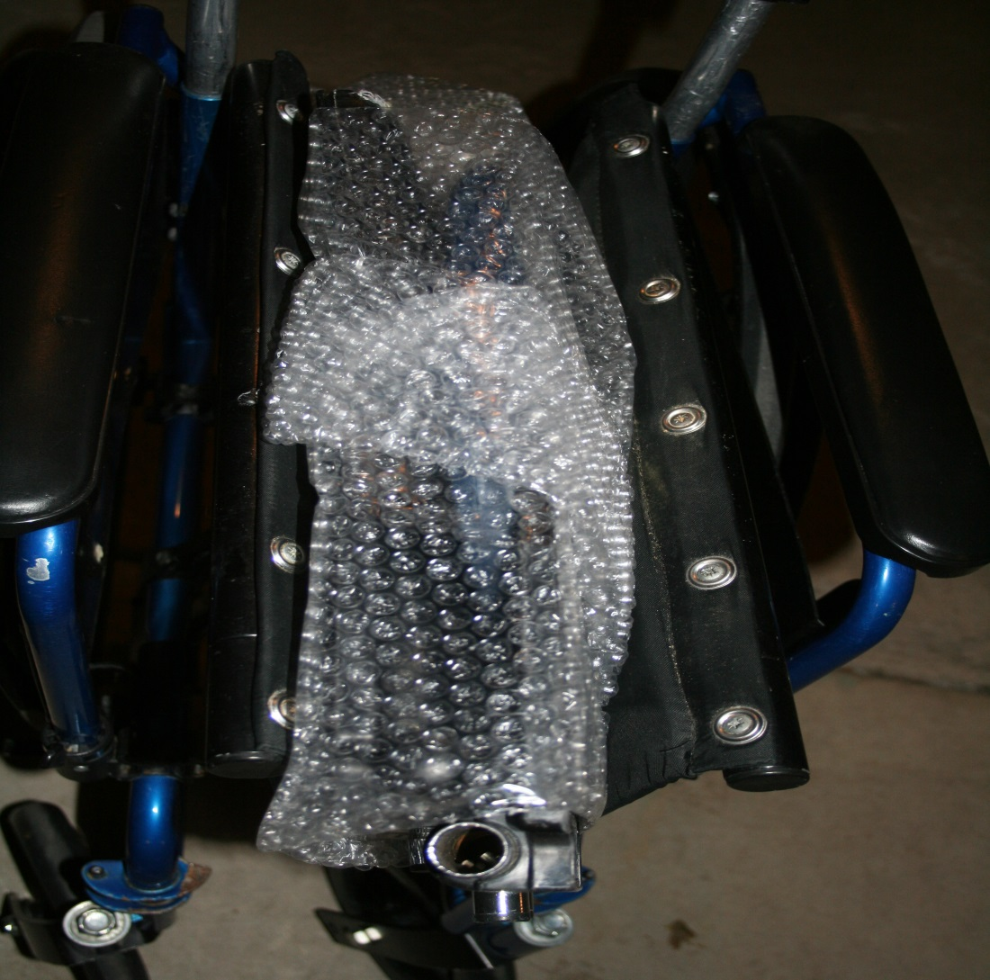
Wrapping a Wheelchair-leg rest in the seat

Slide 15
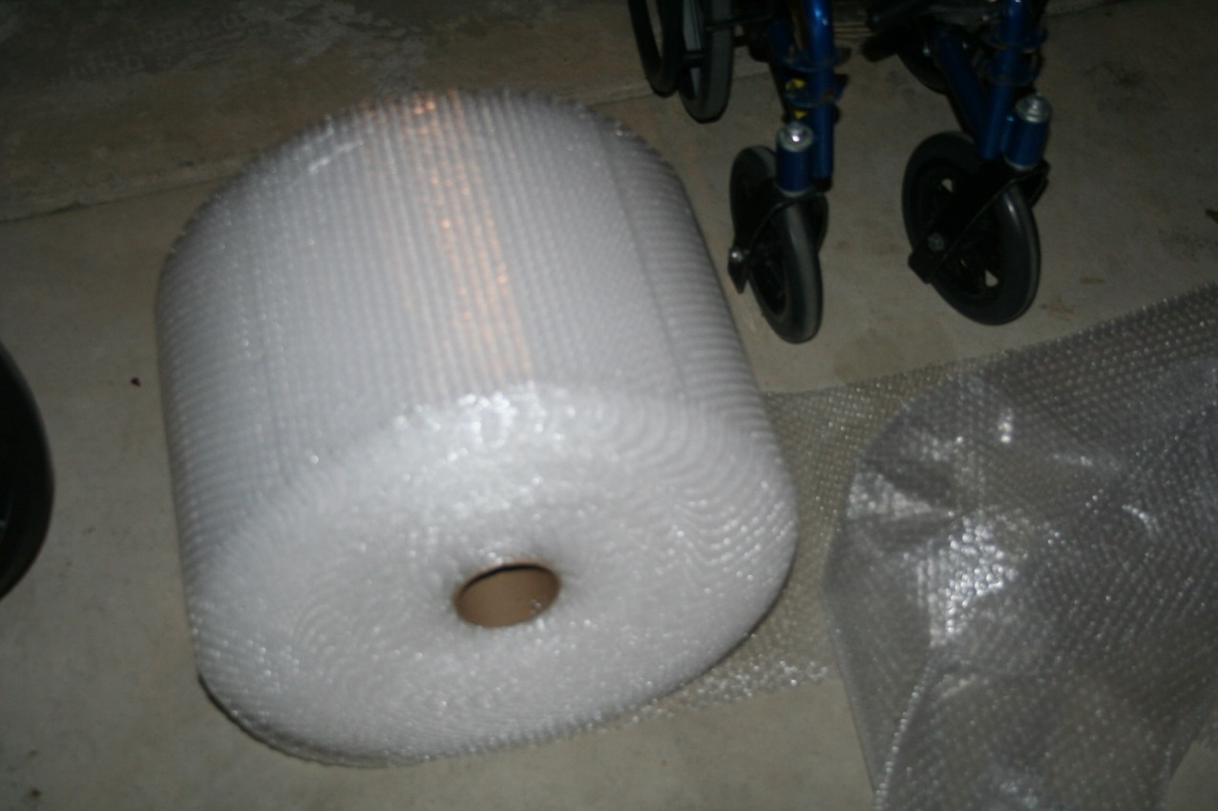
Wrapping a wheelchair- bubble wrap

Slide 16
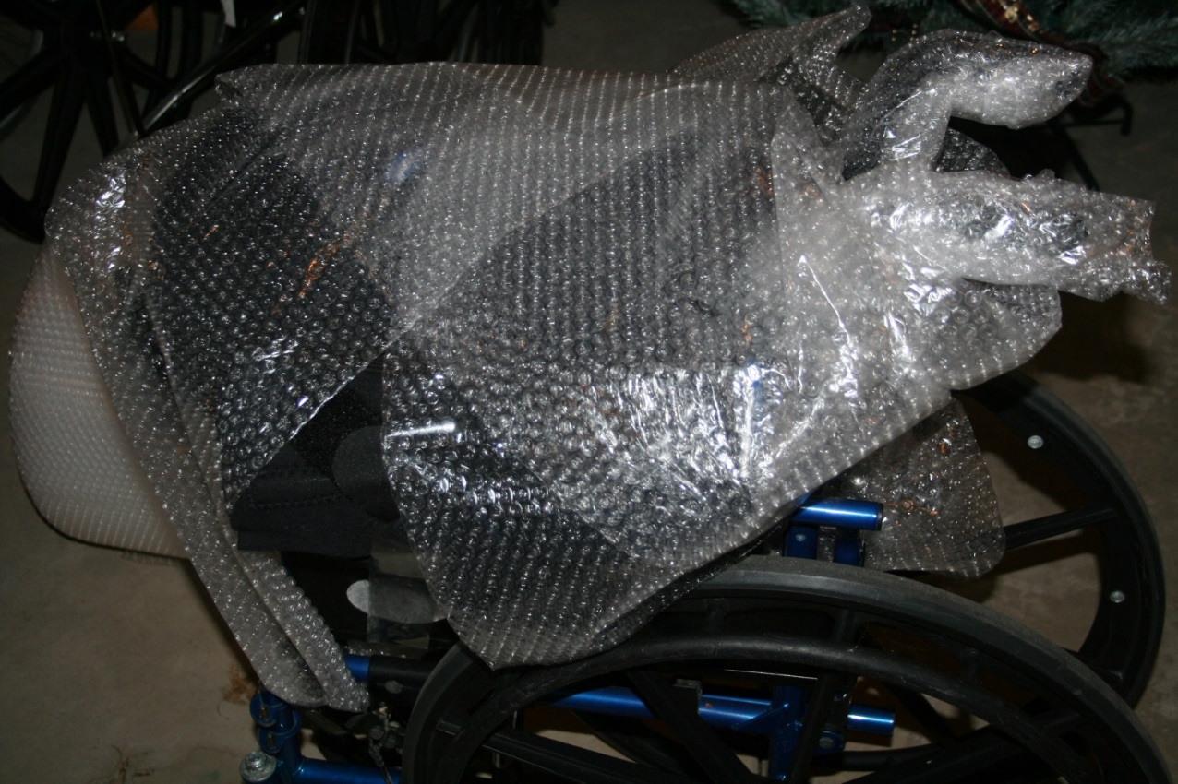
Wrapping a wheelchair -Cover everything except the wheels

Slide 17
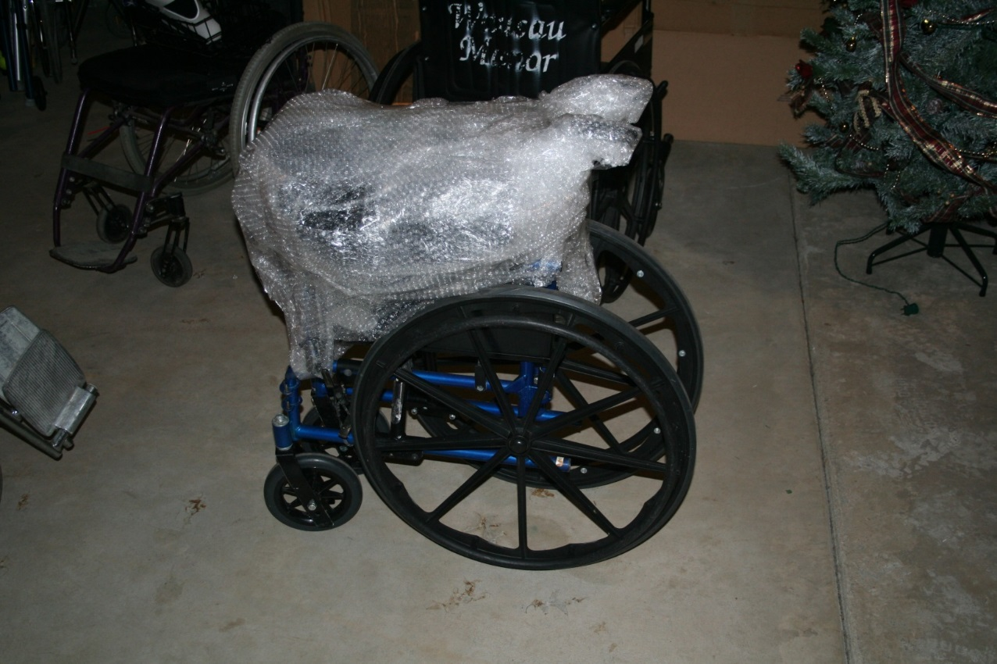
Wrapping a wheelchair-

Slide 18
Wheelchair – step by step

Slide 19
Walkers
Secure also from nursing homes, hospitals and individuals
Preferably folding with or without wheels.
Usually can get 5 wrapped together for a checked bag.
Other types of walkers limit your number (rolling with a seat or non-folding)

Slide 20
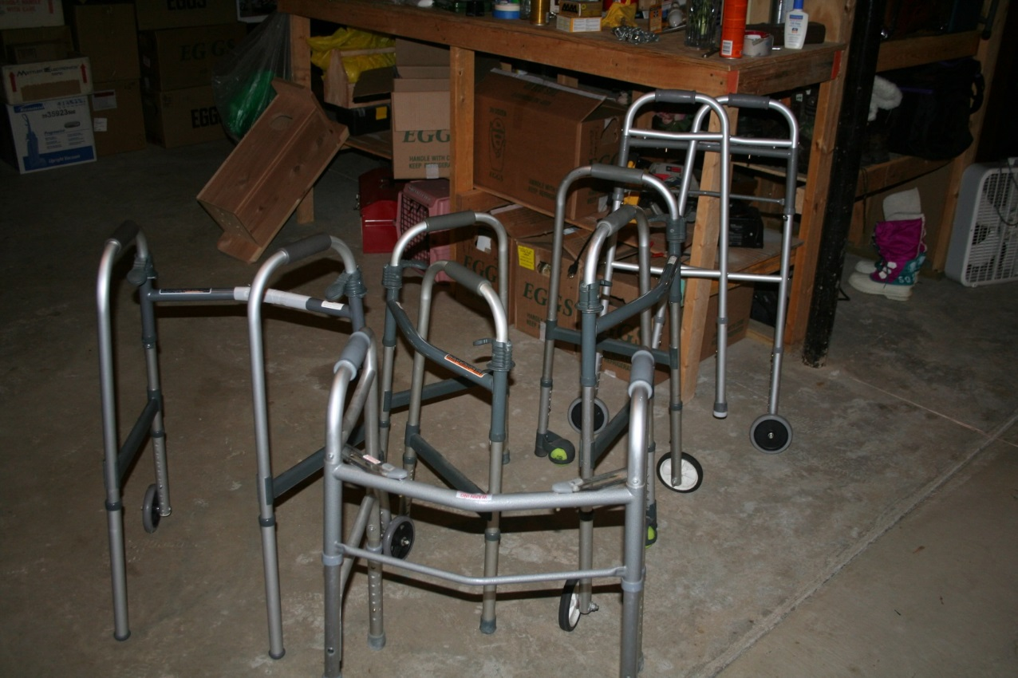
Wrapping Walkers

Slide 21
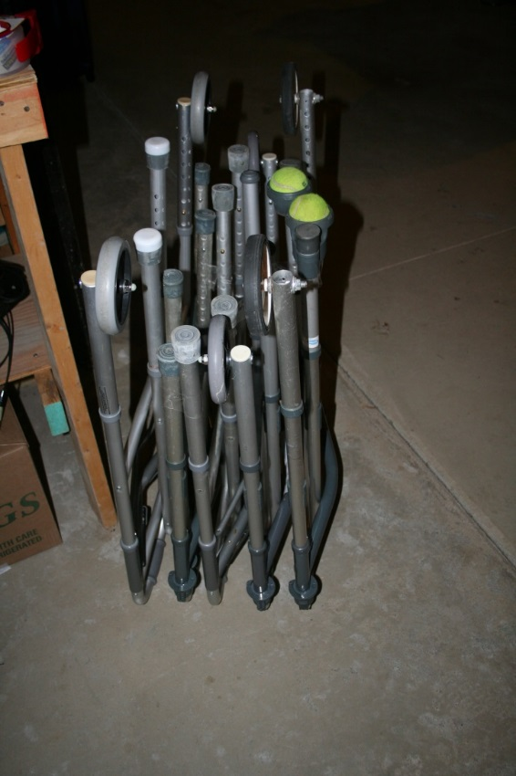
Wrapping Walkers

Slide 22
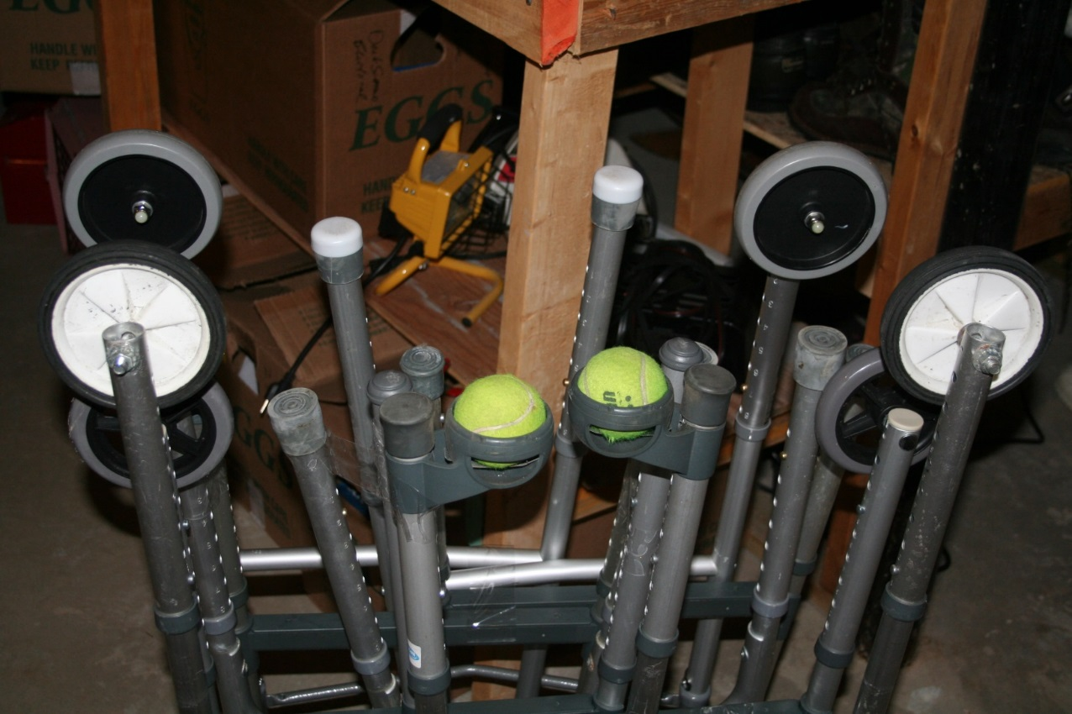
Wrapping walkers

Slide 23
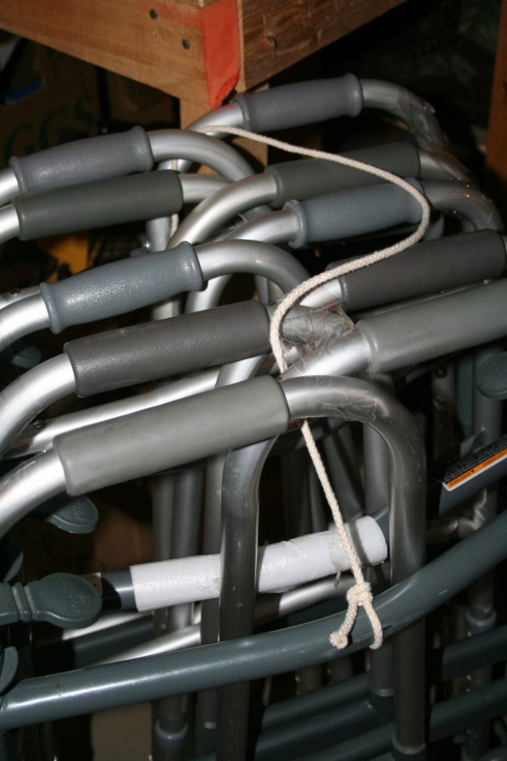
Wrapping walkers

Slide 24
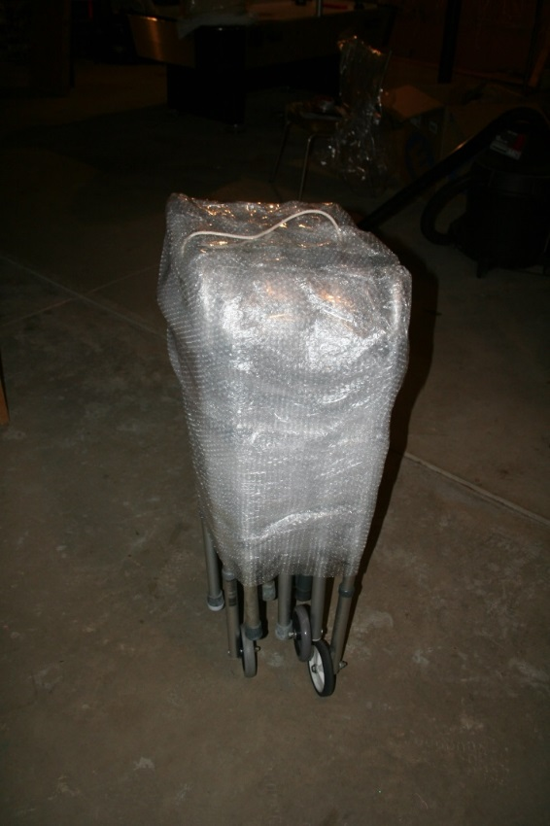
Wrapping walkers

Slide 25
Walkers- step by step
Wrapping walkers for a missions trip
Supplies: 4-5 folding walkers, bubble wrap, clear packaging tape.
Obtain 4-5 walkers that fold completely
Find the two tallest that have wheels and will be the outsides of the finished product
Extend the legs with wheels to the tallest position
Shorten the other legs on those two and the other walkers to the shortest position
Invert one of the outside walkers and stand on the handles.
Position one of the other walkers inverted next to it and tape the two together.
Place another shorter walker next to the two that are taped and then tape it to the others.
Continue this until you get to the last walker ( the other taller one) so that you have all the 5 next to each other and that they are taped to each other. As you add each walker you can tape it to the next one and also run some tape through to the other to secure the 5 together.
Turn the walkers up on their legs. You should have the 4 wheels in the corners of the unit now.
Get a piece of rope about 30 inches long and tie it the rope securely to the two outside walkers part way down. Make sure you have enough to use the rope as a handle after the bubble wrap is in place
Lay a strip of bubble wrap over the top that reaches down the sides.
Wrap the rest of the walkers with bubble wrap ( 2-3 thicknesses) down to the top of the walker legs
Cover generously with the packaging tape.
If you would like you could tape a cane or two in the walkers as you are putting them together

Slide 26
Crutches , canes and other items.
Crutches and canes are often donated from similar sources or from people who are aware that you have a need-can be transported in a golf bag or wrapped in bubble wrap.
Through church or work email, social media and other ways of communicating your up coming trip and the needed items.
Durable medical goods- companies that supply clinics and hospitals often have programs of giving items for benevolent works.
Linens- old sheets, towels and pillowcases.

Slide 27
Other Therapy Supplies
Instructional sheets-
Thera-band and other exercise equipment
Braces – wrist , knee and ankle are most common- CAM walkers
Overhead pulleys
Gait belts
Duct tape, small tool kit, razor blade knives

Slide 28
Personal items for the clinic
Hand Disinfectant
Fan and extension cord
Crystal light
Frogg Toggs
Scrubs and closed toed shoes
Snacks – energy bars

Slide 29
On site -Lead Physical Therapist
Assist with management and issuing of the therapy equipment and supplies
  Working with local pastors and doctors to do post-trip management of the equipment
  Prioritize the issuing of items to the most needy
  Will be responsible for organizing and leading other therapists in the clinic
  Responsible for the mentoring of students and for new therapist experiences for all parts of the trip.

Slide 30
Onsite- Physical Therapist
Communicate with clinic providers regarding therapy services.
Work with the team leader and medical director to problem solve during the operation of the clinic.
When possible reach out in country medical providers to assist in the treatment of musculo-skeletal and rehab patients.

Slide 31
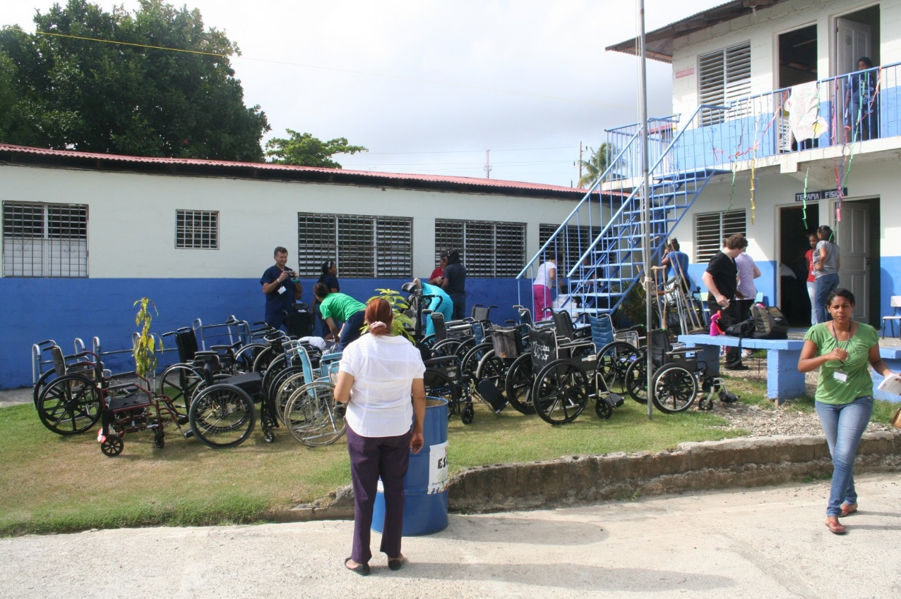
On site clinic

Slide 32
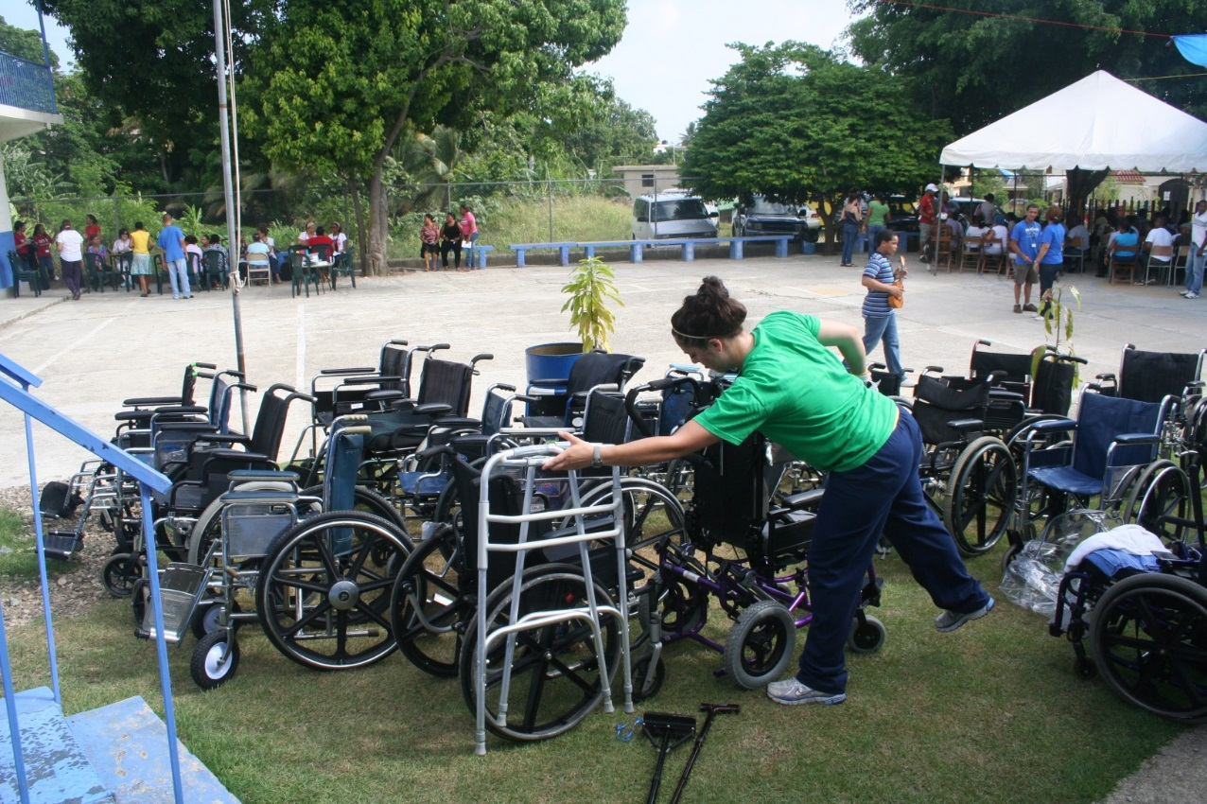
Donated Wheelchairs

Slide 33
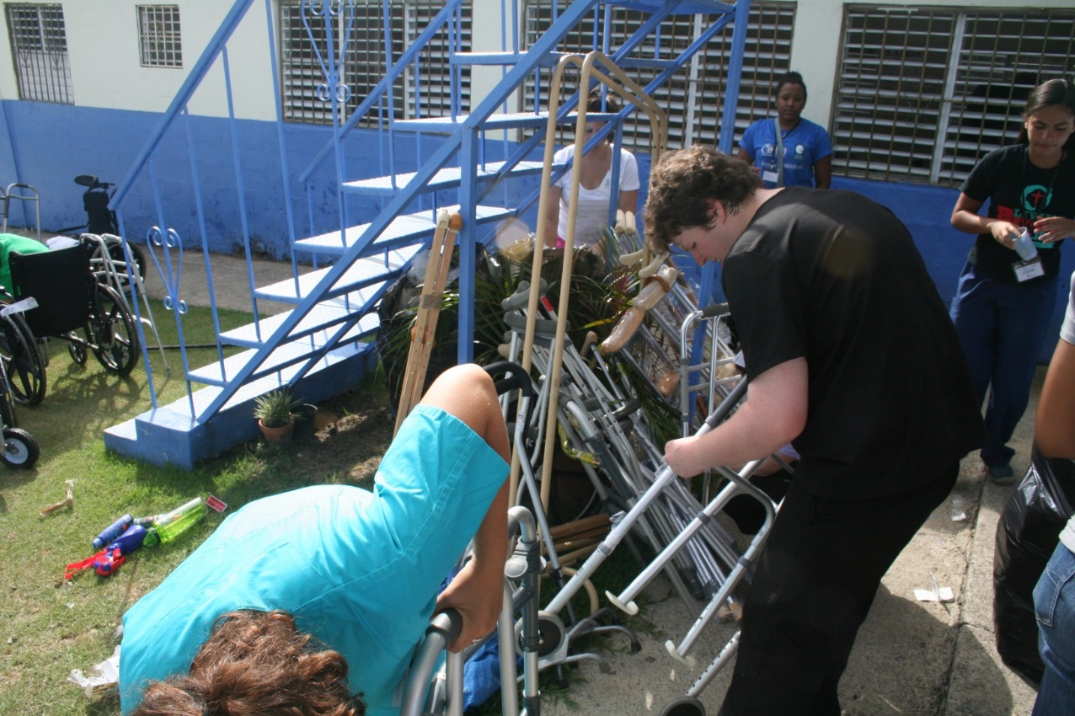
Donated Assistive Devices

Slide 34
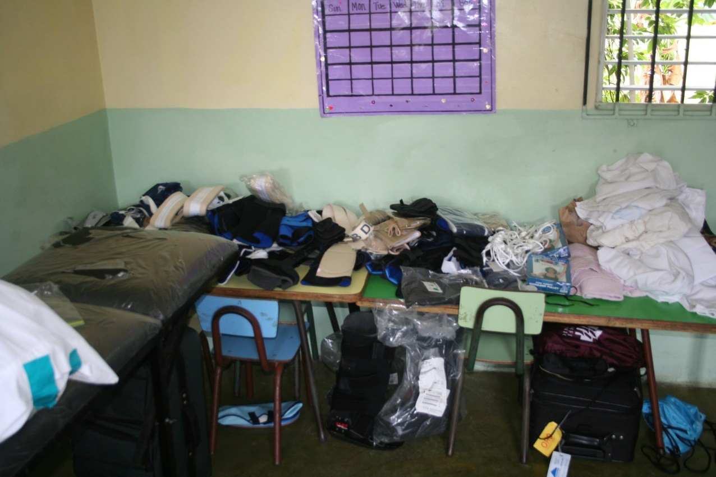
Donated Therapy Supplies

Slide 35
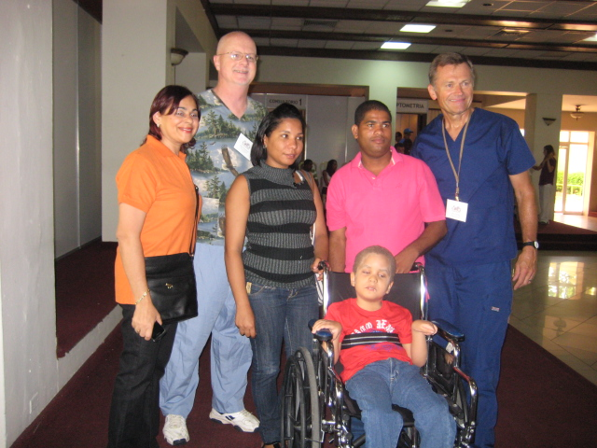
Wheelchair Ministry

Slide 36
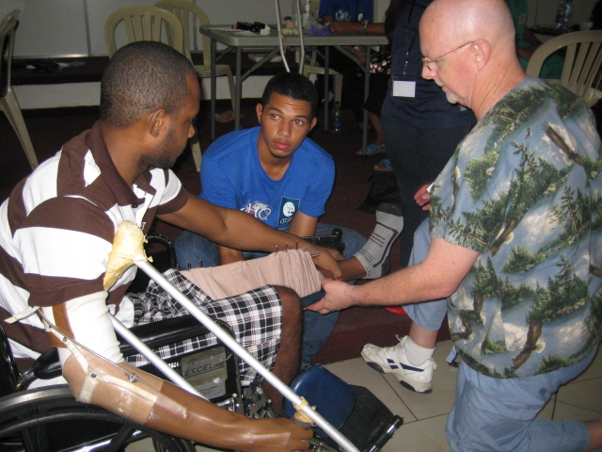
Wheelchairs

Slide 37
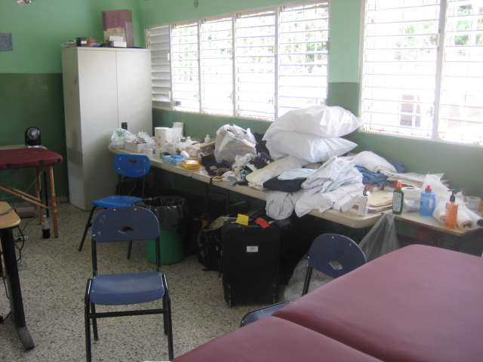
Clinic Supplies

Slide 38
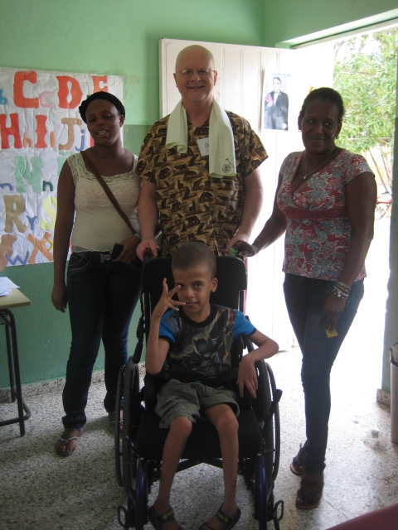

Slide 39
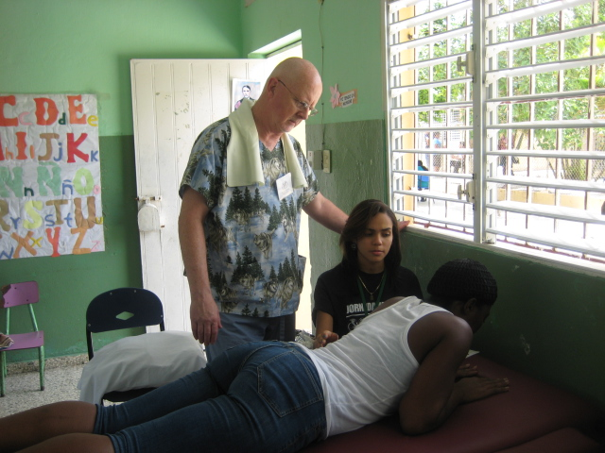
Treating through a Translator

Slide 40
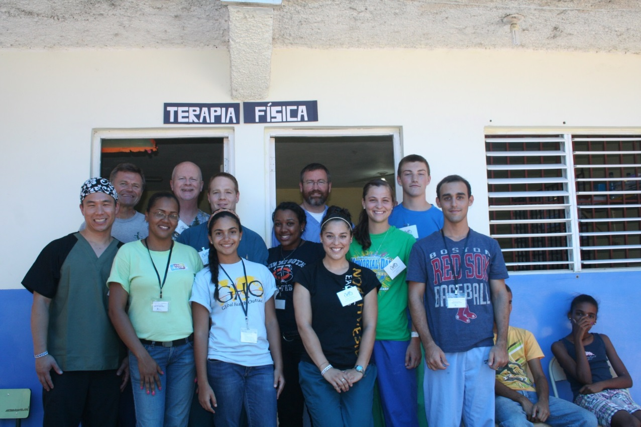
Clinic Team

Slide 41
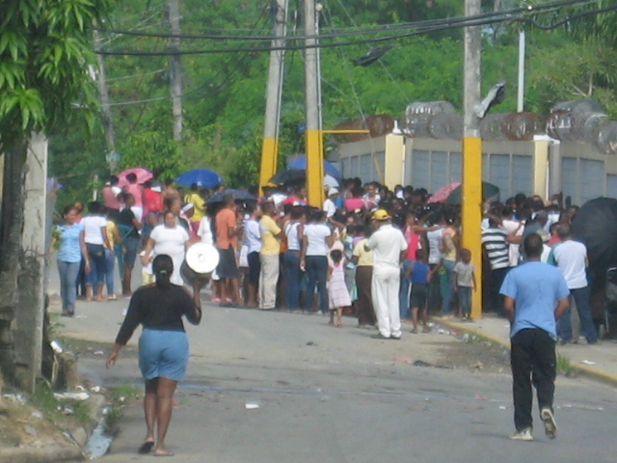
Clinic Schedule

Slide 42
Appropriate Use of Therapy
Treatment of musculo-skeletal and neurological disorders with therapeutic exercise, manual therapy and functional rehabilitation
Educate patients regarding the long term management of their condition.
Train patients family members regarding the proper home programs and use of equipment

Slide 43
Appropriate use of Therapy
Types of patients that you might see on a short-term medical relief trip
  Musculo-skeletal conditions- spinal and extremity
  Neurological- Stroke, Parkinson’s, Spinal cord,
  Pediatrics- Cerebral Palsy, Developmental delay, Spina Bifida
  Wound care- Amputees-
  Unusual cases

Slide 44
Post-trip Responsibilities
Seek feedback from therapists, team leaders, medical directors and other team members to enhance the effectiveness of future trips.
Communicate with the Organizations leadership regarding suggestions and experiences for improving therapist experience.
Be available for future consultations regarding the effective follow up of in-country patients (email, social media, teleconferencing if available)
Encourage team to read post trip devotions for reentry back to life and work at home.

Slide 45
Potential Barriers
Lack of understanding by the team leadership to understand how the PT fits into the trip and team.
Lack of resources by the host group for handling the therapy equipment and supplies.
The Therapists lack of experience and confidence in fulfilling the responsibilities of the therapist
Lack of willingness on behalf of the team members to assist in the securing of equipment and supplies.

Slide 46
Barriers cont.
Location and type of medical clinic
Lack of understanding of the needs of potential patients before the trip.

Slide 47
Conclusion
The need is significant and therapists on short term trips can offer permanent help for patients.
Donated therapy supplies and equipment are readily accessible
Therapists serve an important part of a short term medical trip being the expert for treatment of musculo-skeletal disorders
The earlier you start the better.

Slide 48
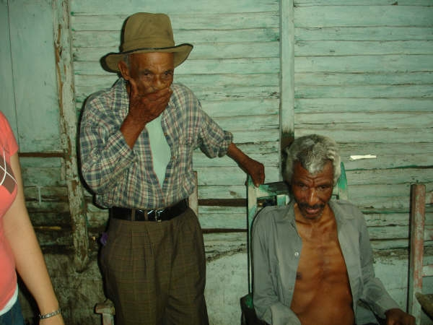
Stories

Slide 49
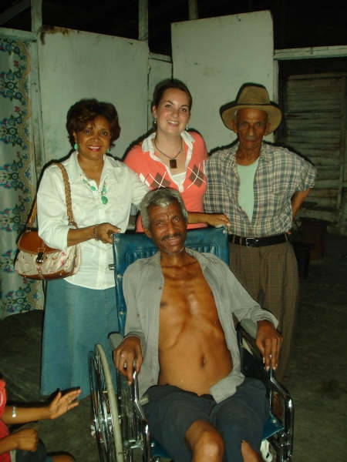
Stories

Slide 50
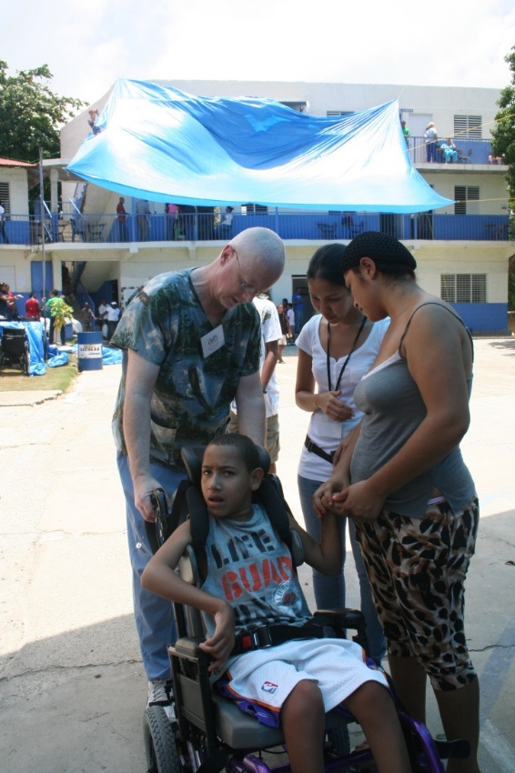
Puerto Plata DR 2012

Slide 51
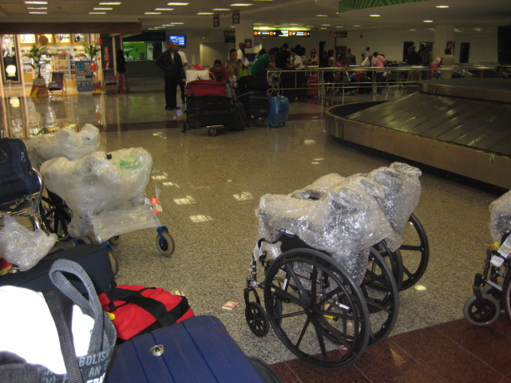
DR 2013

Slide 52
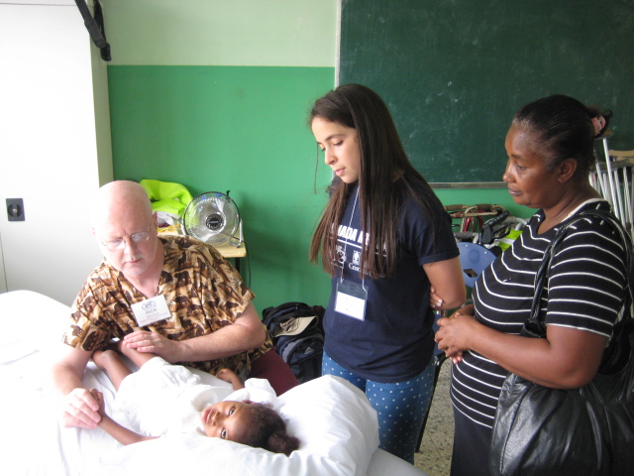
DR 2015

Slide 53
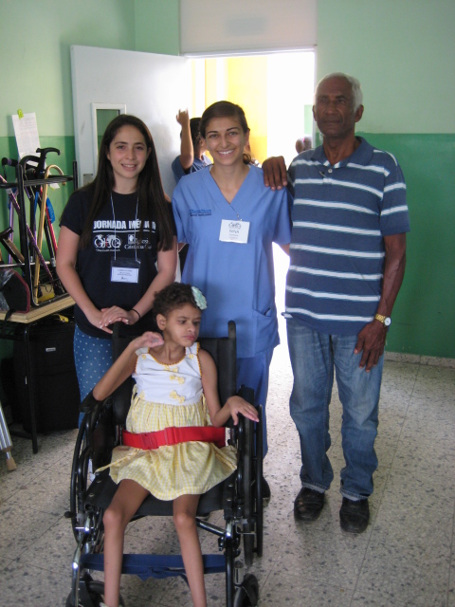
DR 2015

Slide 54
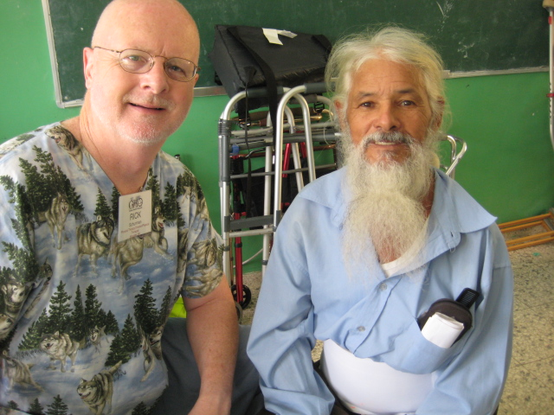
DR 2015

Slide 55
Thank you.
Questions??
Comments!!!
Rick Schurman PT Cert MDT
rick.schurman@gmail.com
920-627-7633

