Slide 1
Get Emotionally Healed: A training course
4 Proven Biblical Keys You Can Use

Slide 2

INTRODUCTION
Personal
HAI
Our journey to apply Isaiah 61
Breakout Session Objectives
Summary
What Next

Slide 3
Hope Alive Initiatives
Vision: Hope Alive Initiatives restores hope, though wholistic empowerment, to individuals, churches and Christian organizations.
Mission: To come alongside like-minded partners to facilitate healthy, mental, emotional and spiritual growth through Scripture and the power of the Holy Spirit.

Slide 4

Our journey to apply Isaiah 61
Began in 2005
6 categories Jesus has anointed us to help: the poor, the brokenhearted, the prisoners and captives, those who are mourning, those who have despair and those clothed with shame and disgrace

Slide 5

Breakout Session Objectives
Receive emotional healing
Minister emotional healing to others.
This Photo by Unknown Author is licensed under CC BY-NC-ND

Slide 6

Key #1: Make Peace with God and Yourself
This covers the area of guilt. Guilt is a legal term.
When you violate your conscience, guilt is the result.
Unresolved guilt can lead to: depression, anxiety, paranoia, low self image.
Solution: Confess and repent of your sinful personal choices.
This Photo by Unknown Author is licensed under CC BY-NC-ND

Slide 7

Key #2: Make Peace with Others
Through forgiveness,
Ephesians 4:32
Be kind and compassionate to one another, forgiving each other, just as in Christ God forgave you.
List down people you need to forgive.
Then forgive them.
Remember forgiveness is a choice, not a feeling
This Photo by Unknown Author is licensed under CC BY-SA-NC

Slide 8

Key #3: Guard Your Emotions
There are times your mind will come under the attack of dark forces.
It can affect you emotionally, physically and spiritually.
Do not be passive
Submit to God and resist the dark forces verbally,
James 4:7
Submit yourselves, then, to God. Resist the devil, and he will flee from you.
Choose to focus on health emotions – Philippians 4:8,
Finally, brethren, whatsoever things are true, whatsoever things are honest, whatsoever things are just, whatsoever things are pure, whatsoever things are lovely, whatsoever things are of good report; if there be any virtue, and if there be any praise, think on these things.
This Photo by Unknown Author is licensed under CC BY-NC-ND

Slide 9
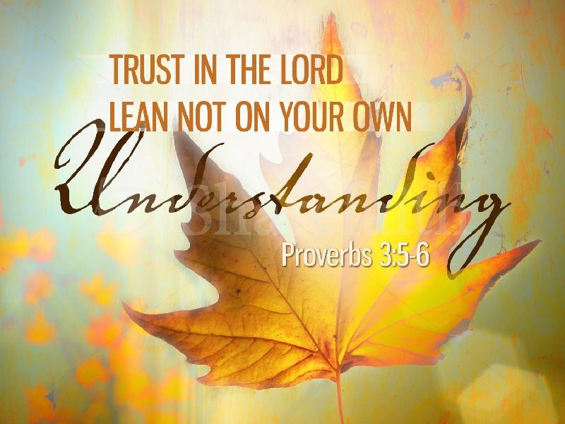
Key #4: Trust God
God will sometimes allow us go through difficult times: physically, spiritually and emotionally.
For a greater good.
Like Job: to test why do he serves God. God restored twice after testing.
Like Paul: to humble us. God gave grace to him after prayer.
This Photo by Unknown Author is licensed under CC BY-ND

Slide 10

Summary
It will take a lifetime to practice the 4 keys. Master them well.
Will help you to stay open to receive emotional healing.
And minister emotional healing to others.
This Photo by Unknown Author is licensed under CC BY-SA

Slide 11
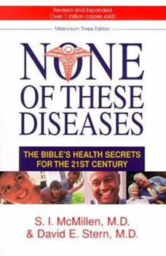
What Next? Recommended resources
None of These Diseases by S.I. McMillen, MD & David E. Stern, MD

Slide 12

What Next? Recommended resources
Get Emotionally Healed by Francis Bukachi,
Offer – until 11:30pm, November 30th 2023 – 100% off:
https://payhip.com/b/SE94k
Coupon code: B 8 S Y B K 2 4 B P

Slide 13
What Next? Recommended resources
If you are interested to host an emotional healing course in your area:
1. Sign up
2. Send an email to: pamandfrancis@gmail.com

