Slide 1
How to Effectively Share Our Faith While Providing Healthcare
Walt Larimore, MD
Family Physician and Author
Colorado Springs, Colorado
Christian Medical & Dental Associations’
2018 Remedy Medical Missions Conference
First Baptist Church Orlando
Friday, March 23, 2018

Slide 2
CME Disclosure
I have no significant financial interest or other relationship with any of the commercial product(s) and/or services discussed in this presentation or with any of the supporters of this activity.

Slide 3
CME Objectives
Upon completion of the presentation, the participant should be able to:
Be cognizant of the national guidelines recommending spiritual interventions as a core component of quality patient care,
Describe one or more evidence-based reasons to provide spiritual interventions in clinical care, and
Begin practicing spiritual interventions.

Slide 4
Acknowledgement

Slide 5
Acknowledgement
GRACE PRESCRIPTIONS
Incorporating Spiritual Care in Practice
Walt Larimore, MD, & William C. Peel, DMin
www.CMDA.org/Grace Prescriptions

Slide 6
Becoming an Everyday Missionary
Jesus is already doing everything necessary to make our participation in His mission simple. All we have to do is reorient our minds and ask Jesus:
What are You up to today in the lives of my patients?
How would You have me join You in Your work with those patients You bring into my life each day?

Slide 7
Practices for Everyday Missionaries
Hear from Jesus
The practice of hearing from Jesus all about spending daily time in His Word and praying without ceasing.
Blessed is the one … whose delight is in the law of the Lord, and who meditates on his law day and night. (Psalm 1:1-2, NIV)

Slide 8
Practices for Everyday Missionaries
Hear from Jesus
Pray without ceasing, in everything give thanks; for this is the will of God in Christ Jesus for you. (1 Thessalonians 5:16-18, NIV)
“I am the vine; you are the branches. If you remain in me and I in you, you will bear much fruit; apart from me you can do nothing.” (John 15:5, NIV)

Slide 9
Practices for Everyday Missionaries
Seek first the Kingdom of God
The practice of seeking first the Kingdom of God is simply being on the lookout for what God is already showing us every day in the midst of our daily routines.
But seek first his kingdom and his righteousness, and all these things will be given to you as well. (Matthew 6:33, NIV)

Slide 10
Practices for Everyday Missionaries
Hang with and talk to people
The practice of intentionally seeking relationships and conversing with the pre-believers He brings into your life.
“The Son of Man came eating and drinking, and they say, ‘Here is a … friend of tax collectors and sinners.’ But wisdom is proved right by her deeds.” (Matthew 11:19, NIV)

Slide 11
Practices for Everyday Missionaries
Do good
The practice of meeting needs in the name of Jesus, empowered by the Holy Spirit, to make the Kingdom and grace of God a little more real to people He brings into our lives.
“Not all of us can do great things, but we can all do small things with great love.” Mother Teresa

Slide 12
Practices for Everyday Missionaries
Do good
For we are God’s handiwork, created in Christ Jesus to do good works, which God prepared in advance for us to do. (Ephesians 2:10, NIV)

Slide 13
Practices for Everyday Missionaries
Minister with prayer
The practice of prayer is not so much about getting the words right as it is about inviting our King into the needs, troubles, and distress of those with whom we interact.
Do not be anxious about anything, but in every situation, by prayer and petition, with thanks-giving, present your requests to God. (Phil 4:6)

Slide 14
Practices for Everyday Missionaries
Hear from Jesus
Seek first the Kingdom of God
Hang with and talk to people
Do good
Minister through prayer

Slide 15
Everyday Healthcare Missionaries
Research is rapidly accumulating from thousands of studies that demonstrates a strong link between spirituality and/or religious involvement and health.
As a result, healthcare professionals are searching for ways to apply the recommendations from these studies to patient care.
Notes:
That’s why we say these interventions are all predicated upon respect for a patient and his/her autonomy, sensitivity to the patient’s desires and needs, and only after obtaining the patient’s permission.

Slide 16
Everyday Healthcare Missionaries
Harold Koenig, M.D.
“Religion, Spirituality, and Health: The Research and Clinical Implications” (Review Article)
International Scholarly Research Network: ISRN Psychiatry. 2012. Article ID 28730.
tinyurl.com/pr4xo7z.

Slide 17
Everyday Healthcare Missionaries
Harold G. Koenig, Dana E. King, and Verna B. Carson. Handbook of Religion and Health, 2nd ed. New York: Oxford University Press, 2012.

Slide 18
Practices for Everyday Missionaries
in Healthcare

Slide 19
1) Hear from Jesus
What is God’s will for you?
Rejoice always, pray without ceasing, in everything give thanks; for this is the will of God in Christ Jesus for you. (1 Thessalonians 5:16-18, NIV)

Slide 20
1) Hear from Jesus
Therefore, pray for yourself and for your patients before you start your day, on your way to work, before you see each patient, and throughout your day.

Slide 21
2) Seek first the Kingdom of God
God Grants Us a Tremendous Privilege
God has committed to us the message of reconciliation. We are therefore Christ’s ambassadors, as though God were making his appeal through us. (2 Corinthians 5:19-20, NIV)

Slide 22
2) Seek first the Kingdom of God
“In the medical profession, we do have a matchless, wonderful opportunity to meet people at times of their real need when they are ready to open up their hearts and expose their fears and worries and concerns.”
Paul Brand, MD

Slide 23
Spiritual Assessment
A correct spiritual diagnosis is critical before choosing a spiritual intervention.
Christian healthcare professionals should prayerfully consider the stage of a patient’s spiritual journey and what interventions are appropriate for that stage of spiritual development.
Larimore, WL, Peel, William C. Grace Prescriptions: Incorporating Spiritual Care Into Your Practice. Christian Medical and Dental Associations. 2015.

Slide 24
Spiritual Assessment
Evidence-based reasons for spiritual assessment:
Patient desire
Patient benefit
Enhances doctor-patient relationship
A standard in quality patient care
Identifies any religious struggle
Larimore W. Spiritual Assessment in Clinical Care. Part 1—The Basics. Today’s Christian Doctor 2015(Spring):46(1):22-26.

Slide 25
Spiritual Assessment
A spiritual history is a form of high-quality, evidence-based, whole person care.
A spiritual history is required by the Joint Commission for “patients cared for in hospitals or nursing homes, or by a home health agency.”
Koenig, HG. Spirituality in Patient Care. Why, How, When, and What. Second Edition, (Templeton Press, 2007):188–227.

Slide 26
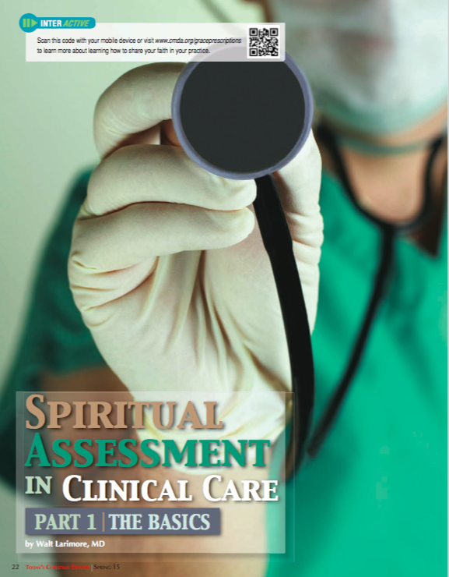
Spiritual Assessment
Walt Larimore, M.D.
Today’s Christian Doctor.
“Spiritual Assessment in Clinical Care: The Basics.” 2015(Spring):46(1):22-26.
CMDA.org/SpiritualAssessment tinyurl.com/j2a65zv

Slide 27
Basic Spiritual Assessment
Open (i.e., open the door to conversation)
May I ask your faith background?
Do you have a spiritual or faith preference?
Invite (i.e., Use a mnemonic spiritual assessment to invite the patient to discuss spiritual needs).
Saguil A, Phelps K. The Spiritual Assessment. Am Fam Physician 2012(Sep 15);86(6):546-550.

Slide 28
Basic Spiritual Assessment
G = God
O = Others
D = Do
Larimore W. Spiritual Assessment in Clinical Care. Part 1—The Basics. Today’s Christian Doctor 2015(Spring):46(1):22-26.

Slide 29
Basic Spiritual Assessment
G = God:
May I ask your faith background?
Do you have a spiritual or faith preference?
Is God, spirituality, religion, or prayer important to you, or not?
Larimore W. Spiritual Assessment in Clinical Care. Part 1—The Basics. Today’s Christian Doctor 2015(Spring):46(1):22-26.

Slide 30
Basic Spiritual Assessment
O = Others:
Do you now or have you ever met with others in religious or spiritual community?
If so, how often?
How important is/was this to you?
Larimore W. Spiritual Assessment in Clinical Care. Part 1—The Basics. Today’s Christian Doctor 2015(Spring):46(1):22-26.

Slide 31
Basic Spiritual Assessment
D = Do:
What can I do to help you incorporate your faith into your medical care?
Do you need to see a chaplain, pastor, or priest?
Do you need any religious materials or resources?
May I pray with/for you? May I have others pray?
Larimore W. Spiritual Assessment in Clinical Care. Part 1—The Basics. Today’s Christian Doctor 2015(Spring):46(1):22-26.

Slide 32
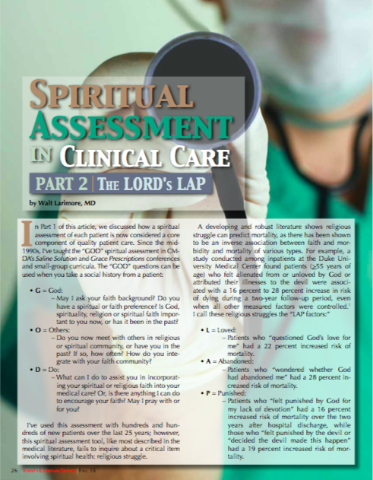
Advanced Spiritual Assessment
Walt Larimore, M.D.
Today’s Christian Doctor.
“Spiritual Assessment in Clinical Care: The LORD’s LAP.” 2015(Spring):46(3):26-29.
CMDA.org/SpiritualAssessment tinyurl.com/j2a65zv

Slide 33
3) Hang with and talk to people
What kind of spiritual conversations are you having with the patients Jesus brings into your life?
In “Grace Prescriptions” we have modules for various ways to “salt” and “light” your patient interactions with spiritual conversation in a way that’s wise.

Slide 34
A Word of Caution
“By respectfully exploring spiritual topics with patients who are open, we are much more likely to help than harm.”
Larimore et al. Annals of Behavioral Medicine 2002;24(1):69-73.

Slide 35
A Word of Caution
“Professional problems can occur when well-meaning physicians ‘faith-push’ a patient opposed to discussing religion …
“However, rather than ignoring faith completely with all patients, most of whom want to discuss it, physicians might ask a question to discern who would like to pursue it and who would rather not.”
Post. Mind/Body Medicine. 1996;2(1):44-8.

Slide 36
A Word of Caution
Spiritual interventions must follow these principles:
Respect for the patient
Sensitivity to the patient
Permission from the patient
Gostin, LO. Informed Consent, Cultural Sensitivity, and Respect for Persons. JAMA 1995;274(10):844-845.
Notes:
That’s why we say these interventions are all predicated upon respect for a patient and his/her autonomy, sensitivity to the patient’s desires and needs, and only after obtaining the patient’s permission.

Slide 37
A Word of Caution
The healthcare professional must always respect the patient’s rights to:
Autonomy in beliefs and practices
Confidentiality
Privacy
Gostin, LO. Informed Consent, Cultural Sensitivity, and Respect for Persons. JAMA 1995;274(10):844-845.
Notes:
But, even so, are there ethical concerns healthcare professionals must consider before utilizing spiritual interventions in clinical care? You bet!

Slide 38
A Word of Caution
Don’t be pushy,
BUT …
Don’t ignore!
Everyday Missionaries concentrate on conversation, not conversion.

Slide 39
4) Do good
“Ours is not the task of fixing the entire world at once, but of stretching out to mend the part of the world that is within our reach.” Clarissa Estes
These days, because words mean so little in our culture, as Winnie-the-Pooh said, “A little consideration, a little thought for others, makes all the difference.”

Slide 40
4) Do good
“It is important that people see Jesus in us before they hear about Jesus from us.” Greg Finke

Slide 41
4) Do good – Matthew 5:13, NIV
“You are the salt of the earth. But if the salt loses its saltiness, how can it be made salty again? It is no longer good for anything, except to be thrown out and trampled underfoot.”

Slide 42
4) Do good – Matthew 5:14-16, NIV
“You are the light of the world. A town built on a hill cannot be hidden. Neither do people light a lamp and put it under a bowl. Instead they put it on its stand, and it gives light to everyone in the house.
“In the same way, let your light shine before others, that they may see your good deeds and glorify your Father in heaven.”

Slide 43
4) Do good
LIGHT: Living the Good News
COMPETENCE – Doing good work
CHARACTER – Doing good work with integrity
COMPASSION – Doing good work w/ kindness
SALT: Speaking the Good News
COMMUNICATION – Missional conversation

Slide 44
4) Do good
LIGHT: Living the Good News
COMPETENCE – Doing good work
People don’t care if you are a good person until they know that you are a good worker.
If we want people to pay attention to our faith, we must first pay attention to our work.

Slide 45
4) Do good
We urge you, brothers and sisters, to … make it your ambition to lead a quiet life: You should mind your own business and work with your hands, just as we told you, so that your daily life may win the respect of outsiders. (1 Thessalonians 4:10-12, NIV)
Whatever you do, work at it with all your heart, as working for the Lord. (Colossians 3:23, NIV)

Slide 46
4) Do good
LIGHT: Living the Good News
CHARACTER – Demonstrating integrity
It's not enough to do good work, there must be something attractive about you personally.

Slide 47
4) Do good
Do everything without complaining or arguing, so that you may become blameless and pure, children of God without fault in a crooked and depraved generation, in which you shine like stars in the universe. (Philippians 2:14-15, NIV)

Slide 48
4) Do good
LIGHT: Living the Good News
COMPASSION – Doing good work with kindness
Each of you should look not only to your own interests, but also to the interests of others. (Philippians 2:4, NIV)
The fruit of the Spirit is love … kindness, goodness … gentleness … (Galatians 5:22, NIV).

Slide 49
4) Do good
SALT: Speaking the Good News
COMMUNICATION – Conversation that is missional
Jesus went … proclaiming the good news of the kingdom and healing.” (Matthew 4:23, NIV)
He sent them out to proclaim the kingdom of God and to heal the sick. (Luke 9:2, NIV)

Slide 50
4) Do good
When you have been hearing from Jesus, seeking first the Kingdom of God, hanging and talking with people, and doing good, people will start to know who you are and know they can trust you.
It won’t be at all unusual for people to begin asking spiritual questions.

Slide 51
4) Do good
A Remarkable Responsibility
Always be prepared to give an answer to everyone who asks you to give the reason for the hope that you have. But do this with gentleness and respect. (1 Peter 3:15 , NIV)
If your patients (friends, colleagues) are NOT asking about your faith … either you are SALT that is NOT flavorful or LIGHT that is NOT comforting.

Slide 52
5) Minister through prayer
Let us then approach the throne of grace with confidence, so that we may receive mercy and find grace to help us in our time of need. (Hebrews 4:16, NIV)
The prayer of a righteous person is powerful and effective. (James 5:16, NIV)

Slide 53
5) Minister through prayer
“Men may spurn our appeals, reject our message, oppose our arguments, despise our persons, but they are helpless against our prayers.” J. Sidlow Baxter

Slide 54
5) Minister through prayer
As we close out time with our patients, instead of just wishing them “good luck” or “good bye,” we can say something like, “I know this is a lot to be going through or to think about. But, before we end our time together, could I pray with you about this?”

Slide 55
5) Minister through prayer
Patients who say “yes” to prayer often assume that the praying will be done later. When they say “yes” I say, “May I pray with you right now?”
A prayer spoken out loud directly to God on behalf of my patient is a simple way to help them experience the reality of being in the presence of God.

Slide 56
5) Minister through prayer
Keep it short and keep it simple.
Don’t address God as if He doesn’t know what’s going on.
“Dear Lord, you know my patient has cancer. She’s scared. I invite you into our trouble. I ask you to help us trust you as you work out your plan for her life. Amen.”

Slide 57
5) Minister through prayer
“Satan dreads nothing but prayer. His one concern is to keep the saints from praying. He fears nothing from prayerless studies, prayerless work, prayerless religion. He laughs at our toil, he mocks our wisdom, but he trembles when we pray.” Samuel Chadwick

Slide 58
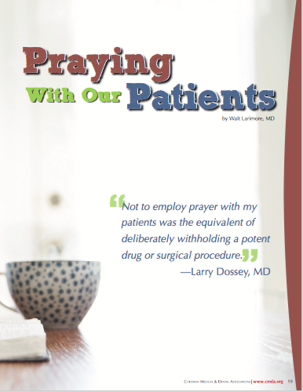
5) Minister through prayer
Walt Larimore, M.D.
“Praying with Our Patients” (Review Article)
Today's Christian Doctor. 2016(Fall);47(3):18-24.

Slide 59
5) Minister through prayer
As a Christian health professional, you have a powerful, healing resource not all health professionals know how to use … prayer.
Use it!
Wisely!

Slide 60
Everyday Healthcare Missionaries
Spiritual interventions allow us to practice high-quality, evidence-based, whole person care.
The Joint Commission “standard” includes not only the requirement for a spiritual assessment, but also requires that providers respect patients’ cultural and spiritual beliefs.
Koenig, HG. Spirituality in Patient Care. Why, How, When, and What. Second Edition, (Templeton Press, 2007):188–227.

Slide 61
Everyday Healthcare Missionaries
“The ability to identify and address patient spiritual needs has become an important clinical competency.”
“Assessing and integrating patient spirituality into the healthcare encounter can build trust and rapport, broadening the physician-patient relationship and increasing its effectiveness.”
Katz PS. ACP Internist 2012(Oct).
Saguil, A, Phelps, K. The Spiritual Assessment. American Family Physician. 2012(Sep 15);86(6):546-50.

Slide 62
Everyday Healthcare Missionaries
Do I have time for this?
Jesus commands us, “Therefore go and make disciples.” (Matthew 28:19, NIV)
The Greek participle translated “go” can be literally translated as “while going.”
Jesus is saying, “While going, make disciples.”

Slide 63
Everyday Healthcare Missionaries
Jesus isn’t saying, “Go,” as in, “Go find room in your hectic day to make disciples,” but rather, “While you are going through your hectic day, make disciples.”
You don’t have to find a way to come out of your hectic lifestyle in order to have a missional life, your hectic life can be your missional life.

Slide 64
Everyday Healthcare Missionaries
You don’t have to struggle to be missional. Rather, have a spiritually intentional lifestyle that is missional; overflow, not overwork.
Everyday healthcare missionaries can walk into their hectic schedules, filled with the Holy Spirit, leaving the hard work and the results to God.

Slide 65
Everyday Missional Community
You cannot do this alone.
You are NOT designed to.
You are part of the Body of Christ.
Find others who will join you in a missional community. Here are two suggestions, one basic and one advanced.

Slide 66
Basic Missional Community
Team up with one or more other believing healthcare professionals for 3, 6, 9 or 12 months to form a missional accountability group.
Be accountable to pray for each other daily, touch base at least weekly, and meet at least monthly.
Share with each other what God is doing as you become an Everyday Healthcare Missionary.
The Andrew Project: How to Develop a Burden for the Lost. The Truth Project.

Slide 67
Basic Missional Community
Each member of the group prayerfully selects 5 non-believing patients.
Each day, each member prays for three things:
God will open the patients’ hearts (receptivity)
God will open a door to share (opportunity)
God will open my mouth to share (boldness/courage)
The Andrew Project: How to Develop a Burden for the Lost. The Truth Project.

Slide 68
Basic Missional Community
Each month each member intentionally provides a note, gift, letter, book, phone contact with each of the patients they are praying for.
Each member looks for opportunities during this 3-12 month period to share their personal testimony or “hope story” with each of these patients.
The Andrew Project: How to Develop a Burden for the Lost. The Truth Project.

Slide 69
Basic Missional Community
At the end of this period, meet one last time with your missional community to share the fruit God has raised in and through each of you as Everyday Healthcare Missionaries.
The Andrew Project: How to Develop a Burden for the Lost. The Truth Project.

Slide 70
Advanced Missional Community
Consider building a Spiritual Care Team in your institution.
The two key members are a healthcare professional and a spiritual care coordinator (although many others can participate).
Harold G. Koenig. The Spiritual Care Team: Enabling the Practice of Whole Person Medicine. Religions 2014, 5(4), 1161-1174. tinyurl.com/patk4c5

Slide 71
Advanced Missional Community
This model is also being developed at Duke University’s Center for Spirituality, Theology, and Health for implementation in the Adventist Health System, the largest Protestant healthcare system in the United States.
Harold G. Koenig, Ted Hamilton, and Kathy Perno. Integrating Spirituality into Patient Care; Durham: Duke University’s Center for Spirituality, Theology and Health, Duke University Medical Center, 2014. tinyurl.com/p5hsr56

Slide 72
Advanced Missional Community
tinyurl.com/patk4c5

Slide 73
Advanced Missional Community
Larimore, Walt.
Efficient Care and Spiritual Care: Can You Do Both?
Today’s Christian Doctor. 2017(Fall):48(3):14-21.

Slide 74
Conclusion
“The research findings, a desire to provide high-quality care, and simple common sense, all underscore the need to integrate spirituality into patient care.”
Koenig. ISRN Psychiatry. 2012(Dec16):278730.
Notes:
Harold Koenig, MD, a psychiatrist at Duke writes:

Slide 75
Conclusion
“It is highly ethical for healthcare professionals and healthcare systems to assess their patients’ spiritual health and needs, and to provide indicated and desired spiritual interventions.”
Larimore et al. Annals of Behavioral Medicine 2002;24(1):69-73.

Slide 76
Conclusion
“At stake is the health and wellbeing of our patients and the satisfaction that we as healthcare providers experience in delivering care that addresses the whole person — body, mind, and spirit.”
Koenig. ISRN Psychiatry. 2012(Dec16):278730.
Notes:
Is spiritual care appropriate in healthcare? Is spiritual care important for our patients? You bet! Koenig instructs us:
TO BILL

Slide 77
Conclusion
Most of all, being intentional about spiritual interventions in healthcare allows us, as followers of Jesus to find out where our patients are in their spiritual journey and join the Holy Spirit in His work there as “EVERYDAY MISSIONARIES.”

Slide 78
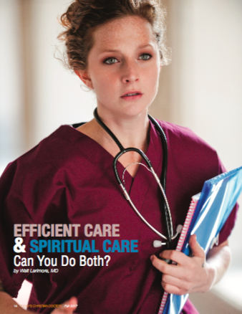
Where to find?

Slide 79
medicalmissions.com/events/remedy-2018

Slide 80
medicalmissions.com/events/remedy-2018/downloads

