Slide 1
The Zika Virus
Charles Mosler, PharmD, CGP, FASCP
Associate Professor of Pharmacy Practice
The University of Findlay
Global Missions Health Conference

Slide 2
Disclosures
I have no financial relationship to disclose.
I will not advocate for off-label use and/or investigational use in my presentation.

Slide 3
Objectives
Describe transmission of Zika
Describe the symptoms of a Zika patient
Review the current treatment of Zika
Discuss current research on Zika treatments and vaccines
Compare and contrast other viruses with Zika

Slide 4
History of Zika
First discovered in 1947 in a macaque monkey in Uganda
Zika is the name of the forest that the monkey was found in
Researchers were actually trying to find Yellow Fever virus in that area
No indication initially that Zika caused illness in humans
For the next 68 years almost no one heard of Zika

Slide 5
Epidemiology
Zika is a single-stranded RNA Flavivirus similar to dengue, yellow fever, West Nile and others
First known human infection of Zika was Nigeria in 1953
From 1953 to 2007 there were only 13 known naturally acquired human cases of Zika
2007 there were almost 5000 cases of Zika in one state of Micronesia
2013-14 estimated 32,000 in French Polynesia
Notes:
Micronesia – State of Yap 5000 of 6700 people were infected
French Polynesia – first cases of Guillian Barre syndrome associated with Zika

Slide 6
Epidemiology
First identified in the Americas in March 2015 in Brazil
By December 2015 there were an estimated 1.3 million cases of Zika in Brazil
Has continued to spread throughout the Americas since
Currently an estimated 60 countries and territories have autochthonous transmission of Zika

Slide 7
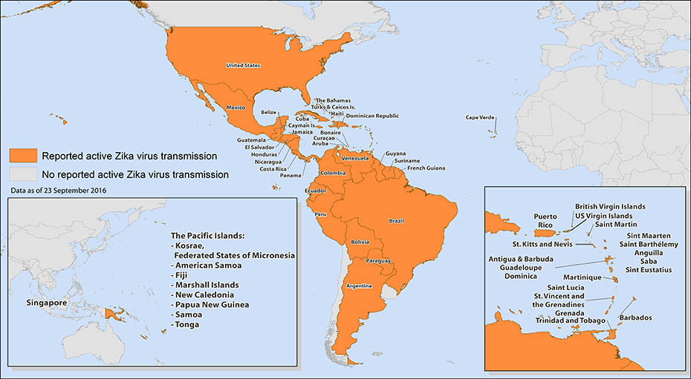
www.cdc.gov

Slide 8
Transmission
Mosquito
Jungle (sylvatic)
Suburban/Urban
Transmitted predominantly by mosquitoes that bite during the daytime and found widely in tropical and subtropical areas throughout the world

Slide 9
Petersen LR et al NEJM 2016; 374:1552-63.

Slide 10
www.cdc.gov

Slide 11
Transmission
Mother to Child
During pregnancy or time of birth
No reports of Zika transmission through breastfeeding
Sex
Passed from partner to partner prior to symptoms, while symptomatic or after symptoms end
Unknown how long can last in semen or vaginal fluids
Notes:
Possible to also be transmitted through blood transfusions, monkey bites and laboratory exposure
One documented case of a volunteer being infected after a subcutaneous injection of infected mouse brain suspension

Slide 12
Symptoms
Many are asymptomatic
Common symptoms:
Maculopapular rash (90%)
Arthralgia (65%)
Fever (65%)
Conjunctivitis (55%)
Myalgia (50%)
Headache (45%)
Notes:
As high as 80% of patients with Zika have no symptoms
Symptoms generally last less than 7 days

Slide 13
Symptoms
Rare Symptoms:
Guillian-Barré syndrome
Microcephaly
Other fetal brain defects
Vision abnormalities
Seizures
Hearing abnormalities
Slow development
Notes:
Abnormalities in up to 30% of pregnant women with Zika

Slide 14
Microcephaly
www.cdc.gov

Slide 15
Microcephaly
Still largely unknown what the risk is but it is now thought that Zika is at least partially responsible for many of the increased cases of microcephaly in countries afflicted with Zika
For some reason much higher percentage of microcephaly in Brazil
Much is still unknown

Slide 16
Comparison of Flavivirus Symptoms
 | Zika | Chikungunya | Dengue
Symptoms | 20% | 70% | 20-60%
Fever | < 101F | >101F | >101F
Headache | Yes | Yes | Severe
Rash | Yes | Yes | Yes
Conjunctivitis | Yes | No | No
Muscle/Joint Pain | Mild | Mild/Severe | Severe/Moderate
Other | Mild symptoms | Recovery may take weeks | Quite ill

Slide 17
Pregnancy and Travel
If pregnant not recommended to travel to a location with known Zika
If pregnant and you or partner do travel to Zika location then recommended to use protection or abstain from sex
If trying to become pregnant do not travel to a location with known Zika

Slide 18
Diagnosis
Large differential that includes other flaviviruses, malaria, GAS, measles, rubella and others
Preliminary diagnosis is largely based on symptoms and travel history/geographic location
Confirmatory diagnosis is typically based on a RT-PCR analysis of serum or saliva as well as detection of IgM antibodies to Zika from an ELISA test

Slide 19
Treatment
No antivirals are effective
Symptomatic relief
Rest
Fluids
Antipyretics
Analgesics
Notes:
Recommend to avoid ASA and NSAIDs until Dengue is ruled out to reduce risk of hemorrhage

Slide 20
Prevention
Avoid mosquito bites
Insect repellant
Long-sleeved shirts and pants
Nets
AC and/or screens
Avoid unprotected sexual contact with partners at risk of Zika
6 months for men with or at risk of Zika
2 months for women with or at risk of Zika

Slide 21
Control
Elimination of breeding sites
Use of larvicides
Use of insecticides
Genetically modified mosquitoes
Notes:
Mosquitoes that are dependent on tetracycline for survival or mosquitoes that lead to nonviable offsptring

Slide 22
Vaccines
Nothing available at this time
Early stage investigative trials
Licensed vaccine likely years away
Fortunately there are existing vaccines for other flaviviruses

Slide 23
Research
Antivirals
Vaccines
Mosquito control
Effects of Zika in pregnancy
Notes:
Looking for a broadspectrum antiviral against many flaviviruses

Slide 24
Zika in the Future
Likely to become endemic in this hemisphere
Hard to tell; explosion of Zika in last couple years is somewhat unprecedented
Largely depends on current research for vaccine and mosquito control

Slide 25
Case Review
A patient of yours and his wife are celebrating his retirement at age 65 by going on a trip to several Caribbean islands. They are asking your opinion as to what they should take with them or do special to help prevent them from getting the Zika virus. What would you recommend?

Slide 26
Case Review
A patient of yours and her husband are celebrating their 10 year anniversary with a trip to the Dominican Republic. She is really worried about getting pregnant and contracting Zika and is wondering what she should do. What do you recommend?

Slide 27
Case Review
A 38 year old male patient asks you if ibuprofen would be a good choice for him because he has an itchy rash, red eyes, a fever and muscle pain. After talking to him you find out that he returned 3 days ago from a business trip to Brazil. What do you recommend?

Slide 28
Selected References
Paixao ES, et al. History, epidemiology and clinical manifestations of Zika: a systematic review. Am J Public Health. 2016;106:606-612.
Petersen LR, et al. Zika Virus. NEJM. 2016;374:1552-1563.
Wikan N, et al. Zika virus: history of a newly emerging arbovirus. Lancet Infect Dis. 2016;16:e119-126.
Zika Virus, Centers for Disease Control, https://www.cdc.gov/zika/. Accessed 10/18/2016.
Zika Virus, World Health Organization, http://www.who.int/topics/zika/en/. Accessed 10/18/2016.

