Slide 1
Healthcare Education Mission: Cultural Competence and Critical Thinking
Family Medicine Residency in the Horn of Africa
Dr. Kate
GHMC
12 November 2021

Slide 2
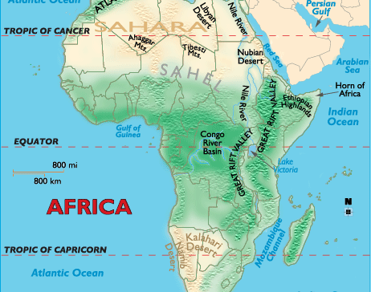
Hope Family Medicine
*Opened November 2012
*First class graduated November 2015
*34 Graduates / 32 in Horn of Africa

Slide 3
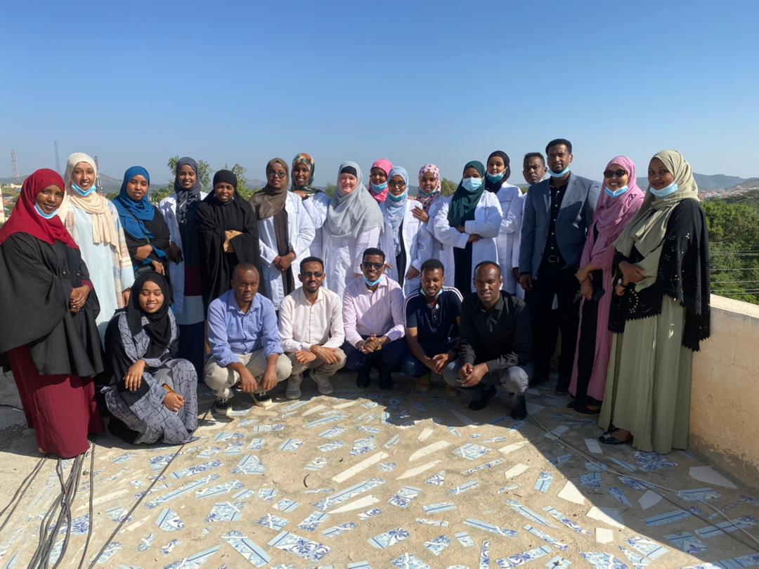
Residency Education
3 Year Training Program
Notes:
Values – patients first, respect, integrity, stewardship, sanctity of life, life long learning, excellence

Slide 4
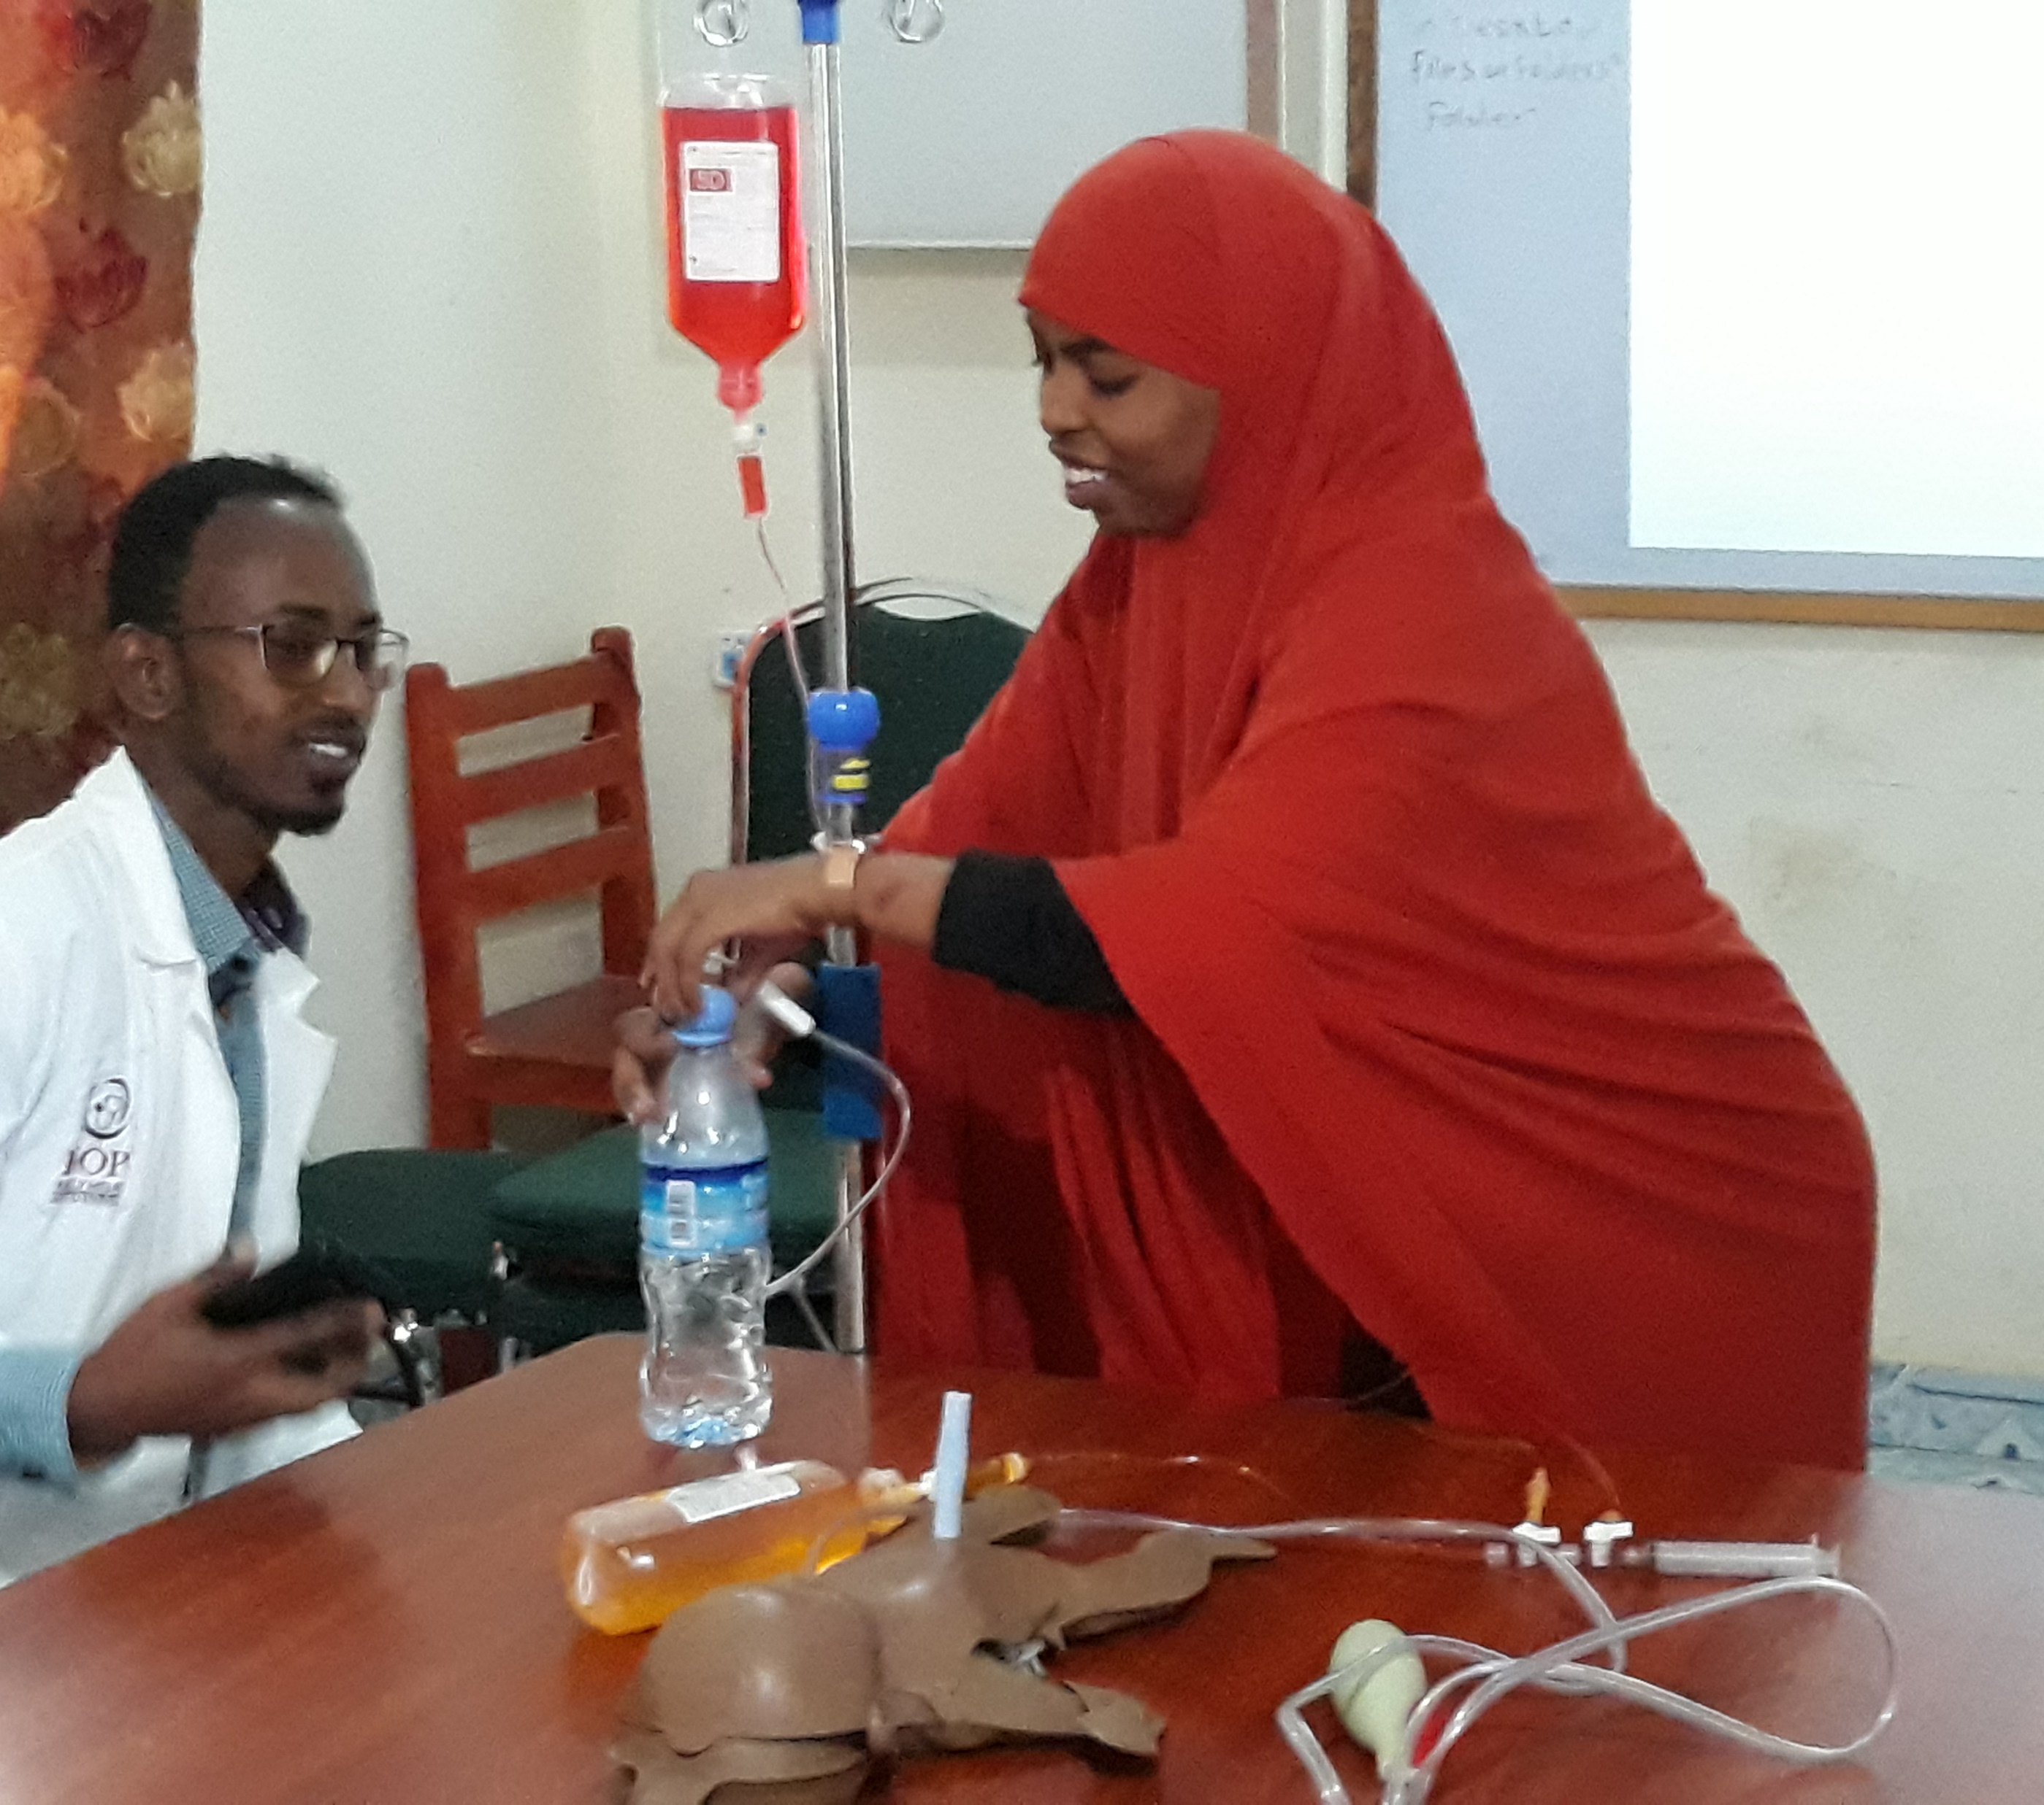
Residency Education
3 Year Training Program
Values Based Education
Notes:
Values – patients first, respect, integrity, stewardship, sanctity of life, life long learning, excellence

Slide 5
Residency Education
3 Year Training Program
Asking Good Questions
Values Based Education
Notes:
Values – patients first, respect, integrity, stewardship, sanctity of life, life long learning, excellence

Slide 6
Residency Education
3 Year Training Program
Self Evaluation and Reflection
Asking Good Questions
Values Based Education
Notes:
Values – patients first, respect, integrity, stewardship, sanctity of life, life long learning, excellence

Slide 7
Residency Education
3 Year Training Program
Critical Thinking
Self Evaluation and Reflection
Asking Good Questions
Values Based Education
Notes:
Values – patients first, respect, integrity, stewardship, sanctity of life, life long learning, excellence

Slide 8
Critical Thinking
Identify assumptions behind an argument
Recognize important relationships
Make correct references from data
Draw conclusions from the data provided
Interpret the merit of a conclusion based on the available information
Evaluate the credibility of a statement and its source
Make self corrections

Slide 9
Medical Education → To Proclamation?
3 Year Training Program → Life Happens

Slide 10
Medical Education → To Proclamation?
3 Year Training Program → Life Happens
Values Based Education → Common Basis of Agreement

Slide 11
Medical Education → To Proclamation?
3 Year Training Program → Life Happens
Values Based Education → Common Basis of Agreement
Asking Good Questions → Search for Truth

Slide 12
Medical Education → To Proclamation?
3 Year Training Program → Life Happens
Values Based Education → Common Basis of Agreement
Asking Good Questions → Search for Truth
Self Evaluation and Reflection → Initiate Internal Dialogue

Slide 13
Medical Education → To Proclamation?
3 Year Training Program → Life Happens
Values Based Education → Common Basis of Agreement
Asking Good Questions → Search for Truth
Self Evaluation and Reflection → Initiate Internal Dialogue
Critical Thinking → Apply Discovery of Truth to Personal Faith

Slide 14
Medical Education → To Proclamation?
3 Year Training Program → Life Happens
Values Based Education → Common Basis of Agreement
Asking Good Questions → Search for Truth
Self Evaluation and Reflection → Initiate Internal Dialogue
Critical Thinking → Apply Discovery of Truth to Personal Faith

Slide 15
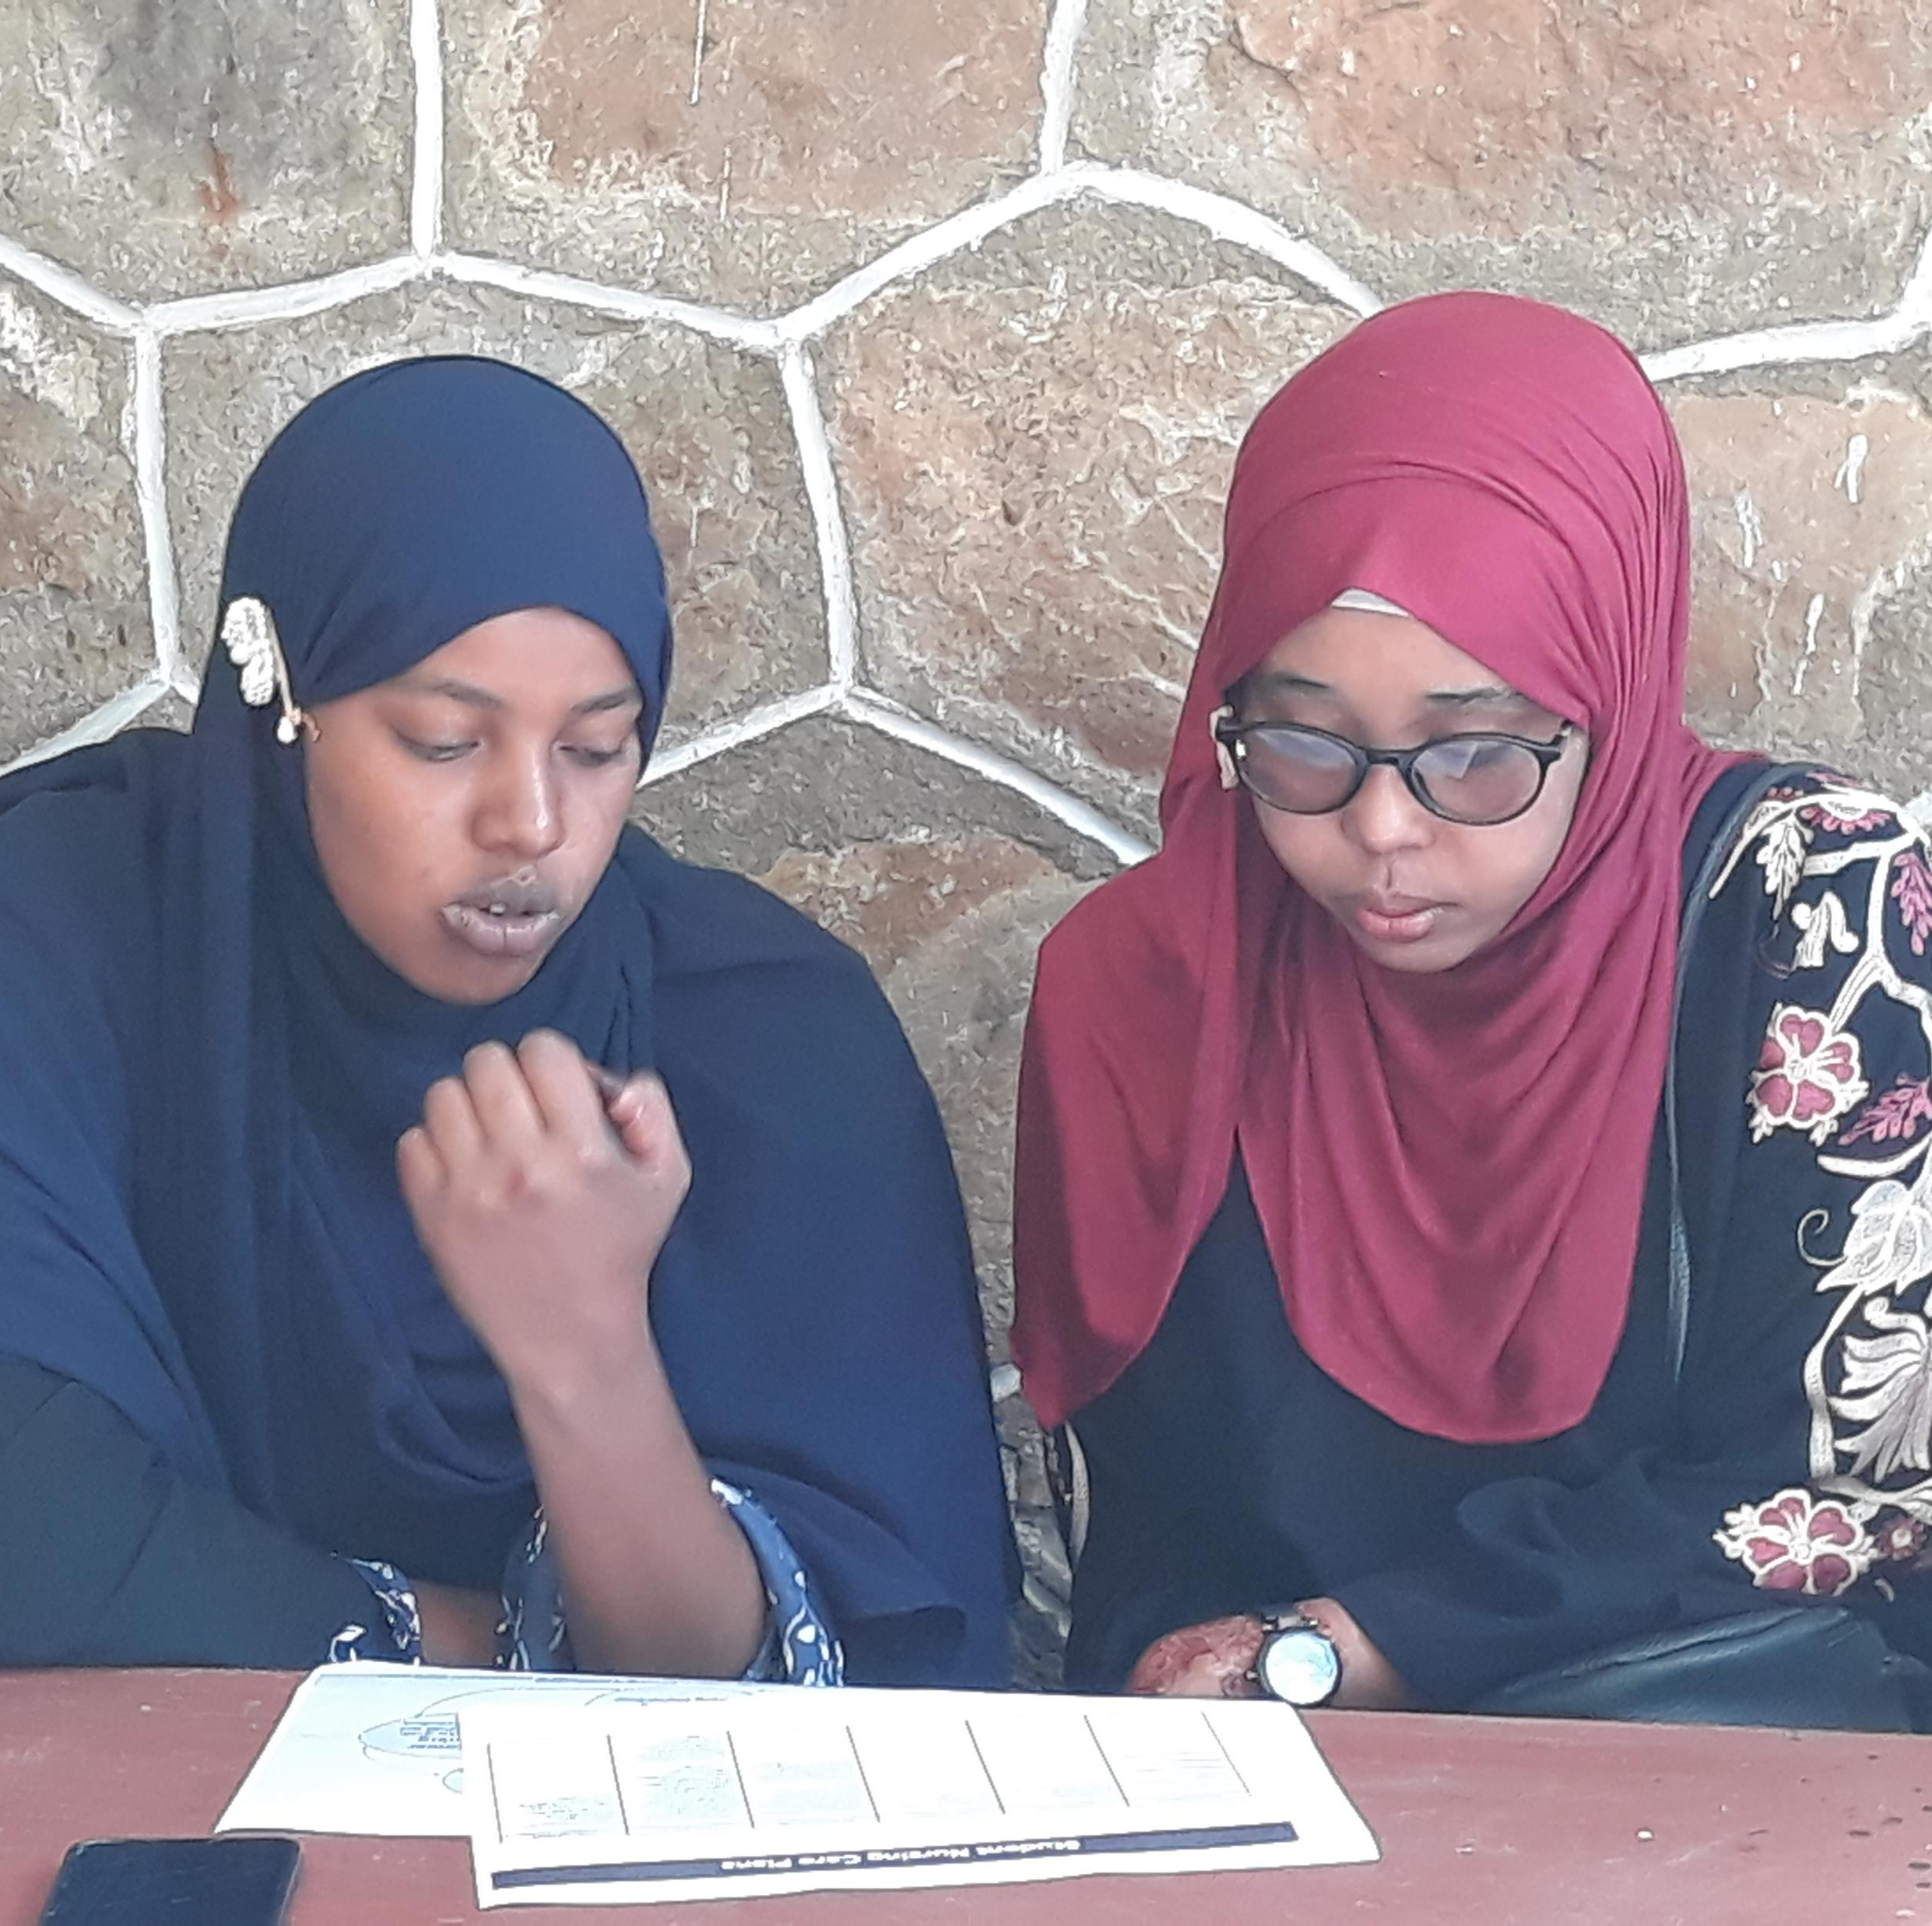
Questions?
drkthomas18@gmail.com

