Slide 1

What Patients Really Want:
Taking a Spiritual History
Bob Mason, MDiv
© 2020 Medical Strategic Network

Slide 2
Disclosure
We have nothing to disclose.
We do not have any relevant financial relationships with any commercial interests.
We do not intend to discuss off-labeled investigational uses of drugs or devices in my presentation.

Slide 3
Learning Objectives
Identify an ethical basis for whole person care
Discuss the principles for taking a spiritual history
Explain guidelines for the spiritual intervention of prayer and advance spiritual interventions

Slide 4

April’s Big Adventure

Slide 5
Professional Views
The majority (75%) of surveyed physicians agree that religion and spirituality is important to patients for coping and for giving them a positive state of mind
Curlin FA et al. Physicians’ Observations and Interpretations of the Influence of Religion and Spirituality on Health. Arch Intern Med. 2007;167:649-654

Slide 6
Patient Practices and Beliefs
71% of Americans claim to pray regularly (daily, weekly).
Data from the Pew Forum U.S. Religious Landscape Survey conducted 2014 among 35,000 in USA.

Slide 7
Surgical Patients Beliefs & Prefs
83% agreed or strongly agreed that surgeons should be aware of their patients' religiosity and spirituality.
63% concurred that surgeons should take a spiritual history.
64% indicated that their trust in their surgeon would increase if they did so.
-J Surg Educ. 2011 Jan-Feb;68(1):36-43

Slide 8
April’s Big Adventure…
Part 2

Slide 9
Teen Preferences
Most teens wanted their provider to ask them about their spiritual beliefs during some visits, especially when dealing with death/dying or chronic illness.
-J Relig Health. 2012 Jan 19

Slide 10
Patient Satisfaction
Patients who had discussions of religion & spiritual concerns:
More likely to rate their care at the highest…, regardless of whether or not they said they had desired such a discussion.
-J Gen Intern Med. 2011 Nov;26(11):1265-71

Slide 11
The Faith Factor:
Good Medicine for Patients?
“There is increasing evidence to support the inclusion of spiritual factors as an important component in the assessment and treatment of pain.”
Siddall, P. Spirituality: What is its role in Pain Medicine? Pain Medicine 2014

Slide 12
The Faith Factor
Good Medicine for Patients?
Religiousness is related to:
Significantly less depressive symptoms
better quality of life
less cognitive impairment
less perceived pain.
Clinicians should consider taking a spiritual history and ensuring that spiritual needs are addressed among older patients in rehabilitation settings.
-J Rehabil Med. 2011 Mar;43(4):316-22

Slide 13
A 2 year longitudinal study of hospitalized patients...
PATIENTS WHO:
wondered whether God had abandoned them
questioned Gods love for them
decided the devil made this happen
felt punished by God for their lack of devotion
→ 16%-28% higher mortality during a 2-year period following hospital discharge.
                Arch Int Medicine 2001

Slide 14

If you know something that
increased the
likelihood of dying by 20%,
would you intervene ??
Walt Larimore, MD
Grace Prescriptions 2014

Slide 15
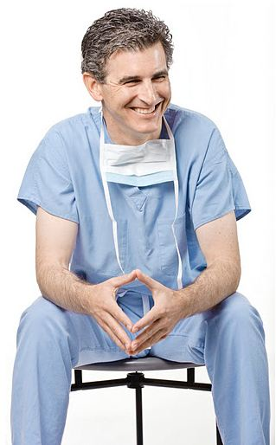
Discovering the Power of Whole Person Care
A Neurosurgeon’s Journey

Slide 16
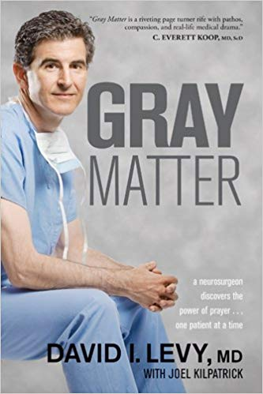

Slide 17
The Joint Commission
… the spirituality of patients should be respected, assessed and attended to in ways that are important to them.
Joint Commission on Accreditation of Healthcare Organizations.
JCAHO PE 1.1.5.1

Slide 18
Whole Person Care
Not being done?
230 patients with advanced cancer
72% said their spiritual needs were minimally or not all supported by the medical system.
J of Clinical Oncology, Balboni et al, 25:555-560

Slide 19
Whole Person Care
Costs of not being done?
EOL costs were higher when patients reported that their spiritual needs were inadequately supported
Overall - $4947 vs $2833, P = .03
Minorities - $6533 vs $2276, P = .02
High religious copers - $6344 vs $2431, P=.005
Cancer 2011; 117:5383–91

Slide 20

Whole Person Care
How?

Slide 21
Spiritual History Questions
With this illness, what keeps you going?
What is your source of strength?
Has any of this been scary/stressful for you?
How?
How has this illness affected the way you see
yourself?
How has this illness affected your
relationship with God?
5. What in your life is most meaningful to you?

Slide 22
Whole Person Care
Approach your patients with:
Permission
Respect
Sensitivity

Slide 23
AVOIDING harm
Permission & respect patients’ autonomy: 1 Pe 3:15
    “Always be prepared to give an answer to everyone who asks you to give the reason for the hope that you have. But do this with gentleness and respect”
Meet patient where they are. 1 Co 9:19
    ”To those not having the law I became like one not having the law… so as to win those not having the law. To the weak I became weak, to win the weak. I have become all things to all people so that by all possible means I might save some.”
Sensitivity to the Spirit: Act 16:6
  Paul tries to preach in Bithynia, but the Holy Spirit prevents him
Humility: Like Christ, come to serve, not be served. Ph 2:6-8, Mt 23:11
Notes:
Ph 2:6-8 Who, being in very nature^{[a]} God,
did not consider equality with God something to be used to his own advantage;
⁷ rather, he made himself nothing
by taking the very nature^{[b]} of a servant,
being made in human likeness.
⁸ And being found in appearance as a man,
he humbled himself
by becoming obedient to death—
even death on a cross!
Mth 23:8-11 “But you are not to be called ‘Rabbi,’ for you have one Teacher, and you are all brothers.⁹ And do not call anyone on earth ‘father,’ for you have one Father, and he is in heaven. ¹⁰ Nor are you to be called instructors, for you have one Instructor, the Messiah. ¹¹ The greatest among you will be your servant. ¹² For those who exalt themselves will be humbled, and those who humble themselves will be exalted.

Slide 24
Taking a SpHx?
Good Medicine for Provider?
Caring about the patient is also what gives joy and fulfillment to the practice of medicine & is why many of us chose this profession.
Its absence, especially in this pressured health care environment, can rapidly lead to dissatisfaction, emotional exhaustion, and burnout.
Practicing whole-person medicine is the best kind of care both for those who receive it and those who give it.
-So Med J 2004 Dec; 97 (12): 1194-1200

Slide 25
Whole Person Care
Negative Outcomes?
WPC vs Penicillin
N

Slide 26
Strategy for Asking Questions
Identify Spiritual Maturity
Identify Spiritual Needs
No Interest
Awareness of Brokenness
Recognize Spiritual Readiness
Mature Christian
Searching
Receptive

Slide 27
Based on Assessment
Option 1
Would it be helpful to you if we pray for you before we leave?

Slide 28
Praying with Patients
Concerns they have mentioned…
Medical team…
Healing…?
God’s presence and comfort…

Slide 29
Praying with Patients
Do not be anxious about anything, but in everything by prayer and supplication with thanksgiving let your requests be made known to God. And the peace of God, which surpasses all understanding, will guard your hearts and your minds in Christ Jesus.
Philippines 4:6-7 (ESV)

Slide 30
Strategy for Asking Questions
Identify Spiritual Maturity
Identify Spiritual Needs
No Interest
Awareness of Brokenness
Recognize Spiritual Readiness
Mature Christian
Searching
Receptive

Slide 31
Based on Assessment
Option 2
Many patients express a desire to know God better. Would you say that is true of you?

Slide 32
Based on Assessment
Option 2
When patients tell us they would like to know God better, we sometimes are able to take a few more minutes to explain how one can connect with God in a more meaningful way. We do that by reading through a four-point outline that explains from a biblical Christian perspective how one might have a more personal relationship with God. It takes about (3-10) minutes.

Slide 33
Based on Assessment
Option 2
Would it be helpful for you to read through this information together?

Slide 34
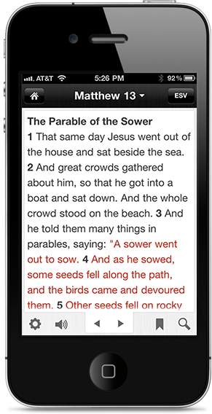



Sharing the Gospel
https://youtu.be/jkIwHhS7o-0

Slide 35
Based on Assessment
Option 2
If you get tired, uncomfortable or want to stop the visit, please tell us. We can leave at any time.” NOTE: Periodically ask the patient if they are comfortable and if they want to continue talking.

Slide 36
Nicole Story

Slide 37


Follow Up

Slide 38
Next Steps
Interest in the relationship between spirituality, religion, and clinical care has increased in the last 15 years, but clinicians need more concrete guidance about this topic.
-Chest. 2009 Jun;135(6):1634-42

Slide 39

METS Whole Person Care Conferences
Pre-Med/Pre-Pro Health Student Mission
Whole Person Care Preceptorship-Southern California
Whole Person Care Preceptorship SIM Africa Combo
Student Elective Rotations
MedSn.org

Slide 40
Bob Mason, MDiv
P.O. Box 2052
Redlands, CA 92373
909-335-9877
bob.mason@cru.org

