Slide 1
Education of Healthcare Personnel for Community Health Development
Grace Tazelaar MS, RN
Missions Director
Nurses Christian Fellowship

Slide 2
Health Care Needs & Resource Allocation
Rehab
Early Detection and Treatment
Health promotion and Disease Prevention
Rehab
Treatment and Early Detection
Disease Prevention & Health promotion
Healthcare Needs
Resource Allocation

Slide 3
Alma Ata Principles
Service at the closest point of contact (in the community, not in a distant hospital);
Prevention as well as curative clinical care;
Service by the lowest level provider, appropriate to the task;
A tiered system of health care, starting with the family and community at the household level, through the community-based clinic and on to primary, secondary and tertiary referral facilities;
Equity in service provision, with special emphasis on women.

Slide 4
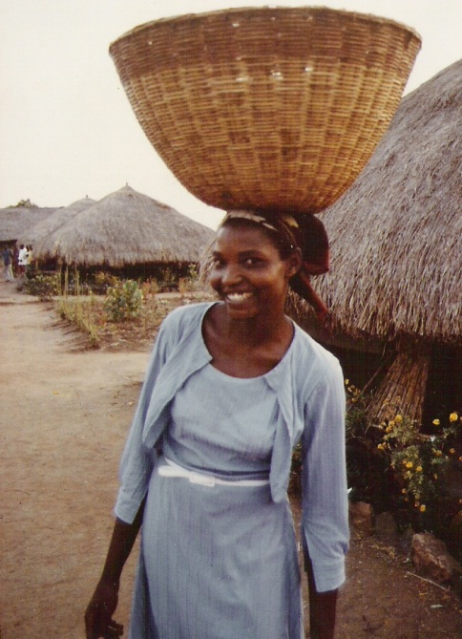
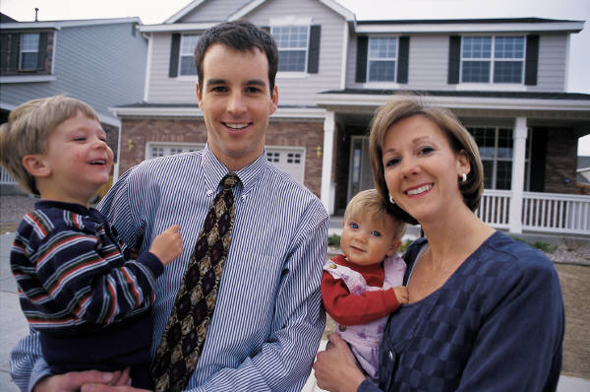
Location of Healthcare Services
In the home
Who provides the care
Parents
Children
Components of health
Nutrition
Hygiene
Safety
Loving relationships

Slide 5
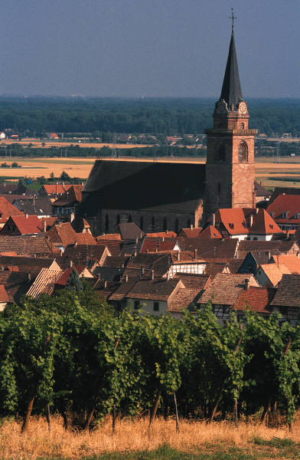
Location of Healthcare Services
In the community
In the church
Who
Social Workers
Police officers
Rescue personnel
Pharmacy
Teachers/Educators
Type of healthcare
First Aid
Emergency
Common illnesses
Who
Pastors
Faith Based nurses
Stephen ministers
Type of healthcare
Spiritual Care
Moral/Ethical teaching
Emotional care

Slide 6
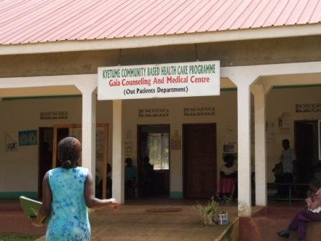
Location of Healthcare Services
In the clinic
Type of healthcare
Prevention
Health education
Immunizations
Early Detection
Health screenings
Curative
Simple diseases
Complex/
multisystem diseases
Who
Medical providers
Mid-level providers
Advanced Practice nurses
Physician Assistants
Certified nursing assistants
Licensed practical nurses
Professional nurses
Dentists
Pharmacists
Alternative health care providers

Slide 7
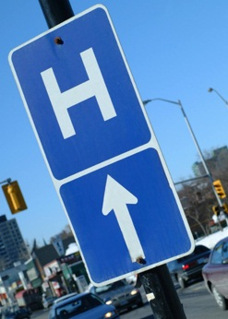
In the Hospital
Community/Health Center
Small healthcare facilities with limited services
Located in rural areas and small communities
Regional
Offer commonly required healthcare services
Serve a region
May have other smaller healthcare facilities that feed into their system
Tertiary Care
Large facility for high level care and research

Slide 8
Education
Purpose
Focus
Evaluation
Typ
e of
Location
healthcare
Community
1.
Promote
Learner
Changed
Primarily
Home
health
health
Prevention
Church
2.
Change
behavior
Office
health
behavior
Healthcare
1.
Educate
Knowledge
Professional
Primarily
Clinics
Professionals
competent
and
Standards
Curative
Hospitals
healthcare
Skills
of Practice
Universities
professionals
(required for
2.
Provide
professional
excellent
qualification)
healthcare to
the care
recipients

Slide 9
How Health Education is Different in the Community
Different content
Need only the essential information required to change health behavior
Need skills necessary to carry out behavior change

Slide 10
How Health Education is Different in the Community
Consider cultural influences
Values and Beliefs
Worldview
Practice
Notes:
We tend to teach as we were taught.

Slide 11
How Health Education is Different in the Community
Different teaching methodology
Pedagogy vs. Andragogy/Formal vs. Non-formal
Participatory learning
Problem Posing Starter
SHOWeD

Slide 12
SHOWeD
What did you See?
What was Happening?
Does that happen in Our community?
Why does this happen?
What can we Do about this?
Who? When? Where? How?

Slide 13
How Health Education is Different in the Community
Evaluation methods
Process
Outcome

Slide 14
Lessons learned in the community
The place of culture
Information does not lead to behavior change
To be sustainable the community must own the program
Evaluation needs to be part of the plan

Slide 15
Lessons learned in the community
A Biblical worldview provides a strong foundation
Humans are created in God’s image and therefore have dignity
God is Sovereign
God is a redeeming God
God calls and equips His people

Slide 16
The Future
Global Society
On line education
Smart phones

