Slide 2
CONFLICT
RESOLUTION
Notes:
My sister and brother-in-law arrived on the mission field in South America while I was still in medical school. By the time Jody and I were ready for service, they had finished their first term and were “experienced” missionaries. I can only remember one piece of advice he gave me as we prepared to head overseas, but it was jewel. He said, “Dave, your greatest blessings will come from your relationships with other missionaries. They will also be your greatest source of conflict and tension.” At that time, I thought all missionaries were super Christians who had received their heavenly haloes early!

Slide 3
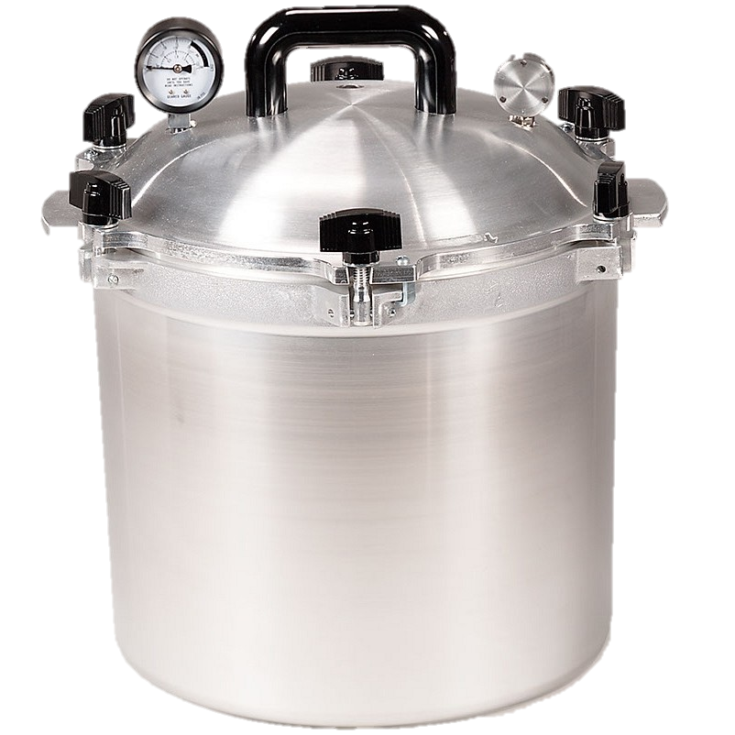
LIVING IN THE
PRESSURE
COOKER
Notes:
After arriving on the field, it didn’t take me long to learn the truth of my brother-in-law’s prophecy. In fact, the possibility of missionary conflict is amplified because you don’t get to choose your colleagues and you are forced to work, worship, play, and live in close proximity. The potential for problems compounds because you live in a high pressure environment where night call, patient loads, and administrative duties make you even more interdependent. For example, if someone goes on vacation or is not carrying the load, you are obligated to pick up extra duties.

Slide 4
DOCTOR
PASTOR
Notes:
Problems are further aggravated by the usual overdose of work, limited staff (if someone gets mad and leaves, you get to do that job until the mission finds someone else to replace them), and often a lack of pastoral care. It is a guaranteed recipe for resentment, anger, bitterness, and even the occasional knockdown, drag out fight. (I could share illustrative stories, but I won’t in order to protect the guilty!)

Slide 5
www.peacemaker.net
Notes:
I want to share some advice on conflict resolution drawn in part from one of CMDA’s grandchildren. We helped to birth the Christian Legal
Society many years ago, which later created and spun off Peacemaker Ministries. This ministry has now produced an incredible number of great resources on this topic that you can check out at www.peacemaker.net. I used their Christian mediation and arbitration services soon after taking the helm at CMDA in a difficult situation we had with another Christian organization. They did such a great job that we routinely use the group for mediation and arbitration in all of our contracts.

Slide 6
DEALING WITH
PERSONAL CONFLICT
CONFLICT BETWEEN OTHERS
PREVENTING CONFLICT
Notes:
Let’s start by learning how to deal with conflicts with others, move to helping others resolve conflict, and then talk about prophylaxis to reduce the incidence of future conflict. These principles are well worth the time to learn and practice as they can be applied to work, marriage, family, church, and friendship situations.

Slide 7
YOU AREN’T DOING
YOUR SHARE OF THE WORK!
IT’S YOUR FAULT HE IS WORKING SO MUCH!
YOU ARE A WORK-A-HOLIC!
Notes:
EX: Here is the situation. You have a colleague who is outgoing, personable, and loves people. He loves the traveling, meeting new people, and interacting with nationals. The problem is that he has trouble sticking with the grind of the heavy workload at your hospital. He is eager and ready to make clinic visits, take visiting staff out to the community, do a business trip, get involved on a variety of mission committees that require extensive time away, and accept enumerable preaching opportunities. When he is gone, he always seems to find a reason to extend the length of his time away.
At first you just picked up the extra load but then it became a source of irritation. You complained to your spouse about it. She threw some fuel on the fire by telling you that you were justified in being upset and she was tired of you having to do more than your share of the work. It was time away from her and the children.
After that your irritation embers burst into anger flames. A few sparks flew as you shared your “concern” via some sarcastic comments to others on the subject of his “lack of a good work ethic.” Unbeknown to you, some of those words travel back to him, lighting his fire. He retaliates by telling visiting staff about your workaholic personality that “doesn’t really care about people like he does.”
You learn of some of his comments and that throws even more gasoline to your fire. Your anger bursts into bitterness. Your communication becomes even shorter and more stilted when you talk to him. Your wives avoid each other. The other missionaries are picking sides. You begin to think the best thing might be to get out of this mess and return to the U.S.
If this isn’t your scenario, you probably have experienced something similar to it on this or another issue. You have gone down the road from irritation, to anger, to bitterness, to broken relationships, and even to a desire to punish someone.

Slide 8
What causes fights and quarrels among you? Don’t they come from your desires that battle within you? You want something but don’t get it. You kill and covet, but you cannot have what you want. You quarrel and fight. You do not have, because you do not ask God. When you ask, you do not receive, because you ask with wrong motives, that you may spend what you get on your pleasures.
James 4:1-3
Notes:
Where do you begin to get out of such a mess? First start with your own heart’s desires.
James 4:1-3 says,
“What causes fights and quarrels among you? Don’t they come from your desires that battle within you? You want something but don’t get it. You kill and covet, but you cannot have what you want. You quarrel and fight. You do not have, because you do not ask God. When you ask, you do not receive, because you ask with wrong motives, that you may spend what you get on your pleasures.” (NIV 1984).
The desires of our hearts are the wellspring of our conflicts. It usually bubbles up from a belief that our “rights” of justice and autonomy are not being recognized and respected. Sometimes that is the case, but either way the first step is to put you and your desires on the altar before trying to work through the conflict.

Slide 9
Notes:
Understanding the wellspring of your anger and bitterness is the first step to reconciliation as you first ask God to deal with you before you deal with others. The second stem is to ask God to cleanse your heart of bitterness and anger and give you a genuine love for the person you have the conflict with.
VERSE
EX: I remember when Dr. Steury and I were dealing with a difficult situation where someone had treated him very badly. He had every reason to be angry and upset, but he wasn’t. He told me the reason why. He said, “Dave, I’ve learned if I genuinely pray for God’s best for the person I’m having a problem with, it changes my attitude towards them. I don’t ask for God to change them. I ask God to overflow my heart with love for them.”

Slide 10
When they call us names, we say,
‘God bless you’ (MSG)
Corinthians 4:12
Notes:
Paul had learned this lesson and personally applied it. He said in 1 Corinthians 4:12, “When they call us names, we say, ‘God bless you’” (MSG).

Slide 11
Notes:
Christ summed up what we should do when we have conflict with someone in
READ THIS
Luke 6:27-28:
“To you who are ready for the truth, I say this: Love your enemies. Let them bring out the best in you, not the worst. When someone gives you a hard time, respond with the energies of prayer for that person” (MSG).

Slide 12
First we were loved, now we love. He loved us first. If anyone boasts, ‘I love God,’ and goes right on hating his brother or sister, thinking nothing of it, he is a liar. If he won’t love the person he can see, how can he love the God he can’t see? The command we have from Christ is blunt:
Loving God includes loving people.
You’ve got to love both
1 John 4:19-21
Notes:
In 1 John 4:19-21, John reiterates and tells us that loving those who have treated us badly is not an option to consider but a command to follow.
“...First we were loved, now we love. He loved us first. If anyone boasts, ‘I love God,’ and goes right on hating his brother or sister, thinking nothing of it, he is a liar. If he won’t love the person he can see, how can he love the God he can’t see? The command we have from Christ is blunt: Loving God includes loving people. You’ve got to love both” (MSG).
Wow! You just thought you were doing well if you could tolerate that person, but God set the standard. He loved us when we were unlovable. Because He loved us, we are not only commanded but also enabled to love the one who harmed us.

Slide 13
JUDGE NOT
Don’t pick on people, jump on their failures, criticize their faults—unless, of course, you want the same treatment. (MSG)
Luke 6:37
Notes:
The other thing we tend to do when we have a conflict is to judge the other person in thought, word, or deed. We criticize, talk behind their back, nitpick, gossip, and coerce them if we have the power to do so.
Christ cautions us about this in Luke 6:37, “Don’t pick on people, jump on their failures, criticize their faults—unless, of course, you want the same treatment” (MSG).
Note that this verse admits the person in question has failed and is at fault, but this admission doesn’t give us the right to step into God’s role as judge and jury to condemn them. Does that mean we should just ignore their actions?

Slide 14
CONTEMPT
Do you have the nerve to say, ‘Let me wash your face for you,’ when your own face is distorted by contempt? It’s this whole traveling road-show mentality all over again, playing a holier- than-thou part instead of just living your part. Wipe that ugly sneer off your own face, and you might be fit to offer a washcloth to your neighbor.
Matt. 7:4-5 (MSG)
Notes:
The Bible teaches that there is a right and wrong way to judge. We are commanded not to do it out of contempt, a sense of moral superiority, or bitterness. We may need to confront a situation but we must do so out of a pure motive of seeking that person’s good. One type of judging mentally condemns the person to punishment. The other type of judgment realistically sees the situation and tries to restore the relationship.
Check out this verse in Matthew 7:4-5:
“Do you have the nerve to say, ‘Let me wash your face for you,’ when your own face is distorted by contempt? It’s this whole traveling road-show mentality all over again, playing a holier- than-thou part instead of just living your part. Wipe that ugly sneer off your own face, and you might be fit to offer a washcloth to your neighbor” (MSG).

Slide 15
..If someone falls into sin, forgivingly restore him, saving your critical comments for yourself. You might be needing forgiveness before the day’s out.
Galatians 6:1 (MSG)
Be even-tempered, content with second place, quick to forgive an offense. Forgive as quickly and completely as the Master forgave you.
Colossians 3:13 (MSG)
Notes:
And then in Galatians 6:1 it says, “...If someone falls into sin, forgivingly restore him, saving your critical comments for yourself. You might be needing forgiveness before the day’s out” (MSG).
Which brings us to the last bit of soul surgery we need to submit to by our heavenly surgeon. We must unconditionally forgive the person who has wronged us, even before they ask for forgiveness.
Paul says it more explicitly in Colossians 3:13, “Be even-tempered, content with second place, quick to forgive an offense. Forgive as quickly and completely as the Master forgave you” (MSG).
The standard God set is complete and immediate forgiveness for the hurt someone has heaped on us whether they “deserve” it or not. We didn’t deserve God’s forgiveness but He freely forgave our sins.
Let me give you a practical word of advice at this point. You may need to have personal help in dealing with your anger, bitterness, or even rage. Find a friend you can be completely honest with. Tell that friend how you think and feel about the situation, not in a way to put the focus on the other person but in a way to empty your own heart. Ask them to pray for you that God will give you a generous, overflowing love for the person who offended you and flood your heart with forgiveness. Often just saying how you feel out loud has a wonderful therapeutic effect that can turn the tide as you pray with your friend.
When your attitudes and actions have had a Godly adjustment, thank Him and rejoice! This is the most important and hardest thing you need to do in dealing with conflict. You can’t control the other person so the only results you are responsible for in resolving the conflict is to get your heart healed and your mind mended to God’s way of thinking.

Slide 17
Smart people know how to hold their tongue; their grandeur is to forgive and forget. Proverbs 19:11 (MSG)
Is the offense seriously dishonoring God?
Has it permanently damaged a relationship? Is it seriously hurting other people?
Is it seriously hurting the offender himself?
Like Water Off A Duck’s Back:
Notes:
First, you need to “duck” some offenses, and I mean that in both senses of the word! There are some issues that you should avoid dealing with because they don’t rise to a level of importance that merits addressing. Ken Sande, the President of Peacemakers, recommends that offenses be overlooked if you can answer “No” to the following questions:
Is the offense seriously dishonoring God?
Has it permanently damaged a relationship? Is it seriously hurting other people?
Is it seriously hurting the offender himself?
If it is not a serious offense, imitate a duck and let it roll off your back like drops of water. This may mean ignoring a real offense – someone does not give you credit for the work you are doing, has imposed more than your share of the work on you, said something unkind about you to others, and the list goes on. It may or may not be a habitual pattern. Either way you have to decide whether you are going to get upset, take offense, and make an issue out of it.
After years of being in leadership over a wide variety of people, I’ve learned it is critical to know when and when not to duck. If the situation is affecting the ministry, damaging relationships, causing a poor testimony, or seriously damaging the perpetrator, it must be dealt with. If it is just irritating me, I need to do my duck imitation and forget it. “Smart people know how to hold their tongue; their grandeur is to forgive and forget” (Proverbs 19:11, MSG).

Slide 18
Notes:
in this same vein, you need to interpret other people’s actions in the best light. If you are already irritated or upset, it is easy to “interpret” every word or deed in the worst way. When this happens you filter each thing said or done for hidden motives and meanings. You become anaphylactic in the sense that the smallest imagined offense can set off a huge reaction. You are actively looking for evidence to support your forgone conclusion that this person is in error. Many conflicts would disappear if the person offended would just remove the CHIP from their shoulder and give the other person the benefit of the doubt.

Slide 19
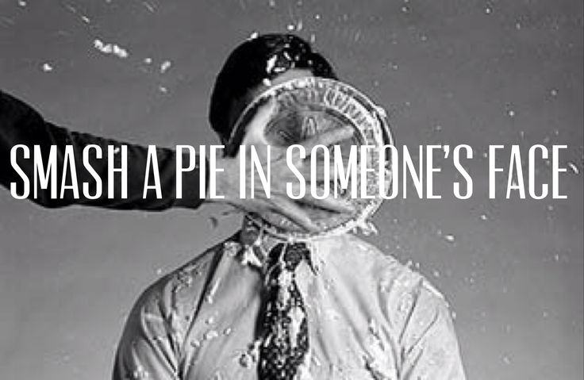
If your brother sins against you, go and show him his fault, just between the two of you...
Matt. 18:15
Notes:
If there has been a serious offense, make sure you are pursuing the right goal, the goal of restoration.
It is easy to take Matthew 18:15 out of context when it states, “If your brother sins against you, go and show him his fault, just between the two of you...” (NIV 1984).
I’ve seen people use this direction to “show him his fault” or to justify “getting into someone’s face” and telling them exactly what their problem is. That rarely, if ever, works.

Slide 20
Notes:
Winning your brother over does not mean hitting him over the head with a verbal 2x4! It means acting with gentleness, mercy, and good intent. You want to be winsome! The goal is to not only to renew your relationship but to make it better. If you go to a person to prove them wrong, there is little chance that restoration will take place.

Slide 21
PREPARATION IS ESSENTIAL
PRAY
James 1:5 - If you don’t know what you’re doing, pray to the Father. He loves to help
Romans 8:26 - If we don’t know how or what to pray, it doesn’t matter. He does our praying in and for us, making prayer out of our wordless sighs, our aching groans.
Ephesians 6:19 - “Don’t forget to pray for me. Pray that I’ll know what to say and have the courage to say it at the right time.
Notes:
Preparation is essential in making peace.
First of all pray for wisdom, humility, and a spirit of grace. It is difficult to know exactly what to say and how to communicate it with love. James 1:5 says, “If you don’t know what you’re doing, pray to the Father. He loves to help” (MSG).
Like you, I’ve been in conflicts that make it seem difficult, if not impossible, to pray or to know what to say to God. The stress and emotions run high. Still, pray as it commands in Romans 8:26, “If we don’t know how or what to pray, it doesn’t matter. He does our praying in and for us, making prayer out of our wordless sighs, our aching groans” (MSG).
You may need to find a friend or two who will pray for you. You don’t need to take out all the dirty laundry or even tell them whom you are going to talk to. Just let them know you are dealing with an interpersonal conflict. Like Paul in Ephesians 6:19, you can ask, “Don’t forget to pray for me. Pray that I’ll know what to say and have the courage to say it at the right time” (MSG).

Slide 22
REHEARSE!
Time?
Place?
TONE?
Notes:
Preparation is essential in making peace.
It is also helpful to plan what you are going to say to the person and even rehearse it in especially difficult situations. It is helpful to tell the person how their actions or words made you feel. They can argue about the facts or try to explain their motives but they can’t challenge the emotions you feel. Think about the person’s likely responses and think about how you will respond. Practice will help you learn how to better deal with the situation.
A good filter to put your rehearsal through is to ask yourself, “If this was turned around and this person was coming to me, how would I like to be spoken to? What would I want said?” Don’t forget to practice using the right tone. Just think of all the ways you can say, “I love you.” It can sound sincere and loving, sarcastic, frivolous, questioning, and even mean depending on the tone and inflection you use. Body language also conveys as much or more than the words you say. Pay attention and rehearse all forms of communication to make sure you are sending the right message. ]
It is critical to pick the right time and place to talk about the issue. Almost always, talking in private without distractions or interruptions is best. You can pick their ground, neutral ground or your ground. There are good reasons for each depending on the situation. Meeting on their ground puts the person more at ease and you control how long the discussion lasts before you decide to leave, but you can’t prevent interruptions or distractions. Your ground may be more threatening to the person you are dealing with but you can control the environment better. Often neutral ground works the best because neither party is boxed in. You could say something like, “Can you come by and have a cup of coffee? There is something I would like to talk to you about.”
Okay, you have dealt with your personal feelings before God, are prayed up, have practiced, and found the right place. You’ve approached this biblically, but it is still easy to worry and fret about what could happen, to be nervous, or even scared.

Slide 23
RELAX
Notes:
What about a written communication? It usually doesn’t work. It does not have tone, inflection, or body language so it can easily be misinterpreted. It also can easily be passed on to others or excerpted out of context. You can’t tailor it to how your words are being received as you can in a live conversation. A good principle to adhere to is to never use a letter or an email to deal with conflict. This type of conflicts requires a personal meeting or at least a phone call.
RELAX
Rest.
Rest in the knowledge that you are doing what God has told you to do and striving to please Him. God expects faithful obedience and rewards it, not our success at what he asks us to do.
Rest in the fact that the outcome is in His hands and you can’t control the other person’s reactions. Only God can change people.
Rest in the assurance that you aren’t dealing with this alone but God is with you.

Slide 24
CARRY OUT YOUR PLAN
MEDIATION
LISTEN
Answering before listening is both stupid and rude. (Pro. 18:13)
SPEAK WISLEY
Watch the way you talk. Say only what helps, each word a gift. (Eph. 4:29).
GET & GIVE FEEDBACK
A gentle response defuses anger, but a sharp tongue kindles a temper-fire. (Pro. 15:1)
MAY TAKE MORE THAN ONE COVERSATION
God’s servant must not be argumentative, but a gentle listener and a teacher who keeps cool, working firmly but patiently with those who refuse to obey. You never know how or when God might sober them up with a change of heart and a turning to the truth. (2 Tim. 2:24-25).
If he won’t listen, take one or two others along so that the presence of witnesses will keep things honest, and try again.
Matthew 18:16
Notes:
If the matter is serious and you are unable to get it resolved, you may need to seek a person or two to mediate between the two of you. Ideally, this should be someone both people respect and who has experience in resolving conflicts.
“If he won’t listen, take one or two others along so that the presence of witnesses will keep things honest, and try again” (Matthew 18:16, MSG).
These witnesses can help hold you both accountable, see beyond the rhetoric to the facts, and pray with you both.

Slide 25
Be gentle with one another, sensitive. Forgive one another as quickly and thoroughly as God in Christ forgave you. Eph. 4:32
Notes:
Reconciliation requires forgiveness. You need to forgive the person for what they have done to you.
“Be alert. If you see your friend going wrong, correct him. If he responds, forgive him” (Luke 17:3, MSG).
“Be gentle with one another, sensitive. Forgive one another as quickly and thoroughly as God in Christ forgave you” (Ephesians 4:32, MSG).
“Now is the time to forgive this man and help him back on his feet. If all you do is pour on the guilt, you could very well drown him in it” (2 Corinthians 2:7, MSG).
If necessary, you too need to ask for forgiveness for your wrong words, attitudes, thoughts, and actions. Make a conscious decision to be different in the future. Job gives us a great example of this when he said, “I admit I once lived by rumors of you; now I have it all firsthand from my own eyes and ears! I’m sorry—forgive me. I’ll never do that again, I promise! I’ll never again live on crusts of hearsay, crumbs of rumor” (Job 42:5-6, MSG).
Resolving conflict is hard work and sometimes it does not work despite the fact that you went about it in a biblical manner. What then?
Seek good advice from wise people regarding other approaches to try. If the person won’t approach the conflict from a biblical perspective, don’t step down to their level. Continue thinking and doing as God mandates. Their intransigence does not give you the right to act unrighteous. Continue to pray for them and God’s blessings on their lives. Treat them with the most powerful weapon of all, unconditional love.

Slide 26
CONFLICT PREVENTION
Notes:
How do you prevent conflicts or remedy them quickly?
Teaching everyone how to recognize and react to conflicts is essential. You may want to take these principles and share them with others or provide them with great resources for individual or group study.
2. Ken Sande’s book The Peacemaker is available at www.peacemaker.org. It is also available as an audio book and workbooks are available for small group studies. There are also resources for families and youth to help others resolve their conflicts.
I want to be a peacemaker. It is one of the key characteristics of good Christian leadership. I hope you too will pursue peace - it is worth the effort.

Slide 27
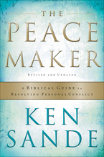
www.peacemaker.org
Notes:
How do you prevent conflicts or remedy them quickly? Teaching everyone how to recognize and react to conflicts is essential. You may want to take these principles and share them with others or provide them with great resources for individual or group study. Ken Sande’s book The Peacemaker is available at www.peacemaker.org. It is also available as an audio book and workbooks are available for small group studies. There are also resources for families and youth to help others resolve their conflicts.
I want to be a peacemaker. It is one of the key characteristics of good Christian leadership. I hope you too will pursue peace - it is worth the effort.

