Slide 1
Diarrhea or Baptism?
EMPOWERMENT
The Foundation of
Sustainable Health Improvement
al Sensitivity
in Medical Missions
W Michael Smith, MDiv, DMin

Slide 2
This session asserts that…
No single factor
enhances the likelihood of sustained improvement
in the health of a person, family or community
more than empowerment

Slide 3
EMPOWERMENT
Introduction
What does it mean?
Why is it important from a Christian perspective?
How does it relate to improving health?
How do we empower in health ministries?
How can we measure it?
Where can we learn more?

Slide 4
Personal path of learning
Only in the past decade
Colleagues/mentors
Luz Stella Losada – Masters in Health Professionals Education , Limburg University, The Netherlands
Jose Miguel DeAngulo - MD, MPH, Johns Hopkins
Julien Ake Ake – MD, Cardiologist, Cote D’Ivoire
Ndunge Kiiti – PhD, Houghton College, NY
Beyond a pathogenic model of health
Promoting “total health”
Holistic – a web of factors
Energy for change – empowerment

Slide 5
Research
How do NGOs define, operationalize and measure empowerment
Monique Hennink, Rollins School of Public Health, Emory University, Ndunge Kiiti, Houghton College, NY; Ravi Jayakaran, MAP International
Dr. Kiiti presented to conference of African Religious Health Assets Program (ARHAP) in Cape Town - 2009
Article in Development in Practice, “Defining Empowerment: Perspectives from International Development Organizations” - 2012
Notes:
Development in Practice
Publication details, including instructions for authors and
subscription information:
http://www.tandfonline.com/loi/cdip20
Defining empowerment: perspectives
from international development
organisations
Monique Hennink, Ndunge Kiiti, Mara Pillinger & Ravi Jayakaran
Available online: 28 Mar 2012

Slide 6
btw, If you want slides or articles…
GMHC Exhibit: Bread for the World - # 1203
Email: msmith@bread.org

Slide 7
Context - Encouraging Developments
The world seems more ready than ever to tackle the diseases of poverty
Foreign policy attention
Unprecedented billions available for health
33% decline in new AIDS infections since 2001 (UNAIDS 2013)
Surge of attention to Malaria & other neglected diseases
1990 – 2012 under-5 deaths declined from 12.6 to 6.6 million (Unicef – Trends in Child Mortality - 2013)

Slide 8
Yet remaining challenges…
Still almost 18,000 children under age five die every day (Unicef – Trends in Child Mortality - 2013)
All 16 countries with <5 mortality rate above 100 deaths per 1,000 live births are in Sub-Sahara Africa.
Globally, noncommunicable diseases - a major challenge in the 21st century. 63% of the 57 million deaths that occurred globally in 2008, were due to noncommunicable diseases (WHO, Global Action Plan for Prevention and Control of Noncommunicable Diseases, Feb. 2013)
Notes:
In USA 5.9 deaths per 1000 live births – compare to 2.59 in Singapore & 1.8 in Monaco – 50 countries better than US

Slide 9
Undermining Progress
“Concept Note” from the Africa Regional Faith-Based Coalition (March 2008) expressed concern that:
“…a dominant culture of service-provision, intervention and welfare is well-intentioned, but undermines the capacity of local communities to acknowledge concerns, and act on shared vision to respond to those behaviors that put them at risk. Technical and organizational capacity development is often valued over Human Capacity Development.
Human Capacity… describes the basic common human strengths for care through accompaniment and participation, change, hope, relational influence, and belonging. These are innate, but often suppressed and need support to be unveiled.”

Slide 10
A Call to Respect and Engage
Dr. Margaret Chan concluded her address to International
Federation of Red Cross and Red Crescent Societies –
Global Health and Care Forum 2008:
“Primary health care starts with people. Our common humanity compels us to respect people’s universal aspiration for a better life.
It compels us to respect the resilience and ingenuity of the human spirit, and the great capacity of individuals and communities to solve their own problems.”

Slide 11
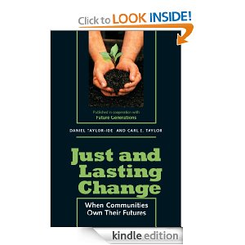
A movement under way
Theory and practice of empowerment
Not new – 1970s
Carl Taylor, MD, DPH, Founder of School of International Health at Bloomberg School of Public Health, Johns Hopkins
Influenced programs like:
- Jamkhed – India
- Chilimarca – Bolivia
- Kakamega - Kenya

Slide 12
Words, Meaning & Belief
Can we literally “empower” someone?
Maybe “self-empowerment”
Jesus’ examples:
Profound respect for their dignity – we are one with them
Touched lepers & blind
Spoke with unacceptable women
Ate with “sinners”
Invited them to do what they could & should do
“Take up your mat and walk”
“Go and show yourselves to the priest”
“Neither do I condemn you. Go and sin no more.”
“You unwrap him and let him go”
Notes:
Example - SUBSIDIZING

Slide 13
Changing what we believe
“Community-based” & Empowerment are beliefs first:
belief that local communities - especially those who have lived in chronic poverty - have the inherent strengths to author their own stories
- to rediscover their capacity to dream
- to learn to evaluate their situation
- to mobilize & organize the resources
- to take constructive steps to influence their world
- to evaluate and continue improving - to author their own stories

Slide 14
What is Empowerment?
The Dynamics of Power
Power = ability to act or produce an effect
“Empower” – some have & some don’t and that makes a difference in health outcomes
Story of Rakku - What are features of her disempowerment?

Slide 15
Empowerment as Outcome
AGENCY – foundation of empowerment
What a person is free to do and able to do and achieve in pursuit of whatever goals or values he or she regards as important. (Amartya Sen, 1985, and Ibrahim and Alkire, 2007)
Empowerment increases AGENCY
Notes:
Academics – Agency is foundational – empowerment is expanding / increasing agency

Slide 16
Empowerment defined
“A state where people can make choices and take actions on their own behalf with self-confidence, from a position of economic, political and social strength.” (NGO, 2008)
“Communities taking ownership of and including themselves in the efforts to solve their problems and better their own lifestyles.” (NGO, 2008)
Notes:
Academics – Agency is foundational – empowerment is expanding / increasing agency

Slide 17
Opposite of empowered ?
To be coerced
oppressed
passive
without hope
Notes:
Academics – Agency is foundational – empowerment is expanding / increasing agency

Slide 18
Empowerment as Process (nonlinear)
Rooted in Community
Key to sustainable improvement in health is “... not technical breakthroughs but changing behavior at the community level .” JALC, p. 17
Multiple dimensions and dynamics – 3-way partnership
Bottom-up actions by people
Top-down policies from government
Outside-in contribution of ideas and skills - outside experts JALC, p. 12
No easy path
“We stress that empowerment is context-specific and highly reversible, and deeply nonlinear.” (NGO, 2008)

Slide 19
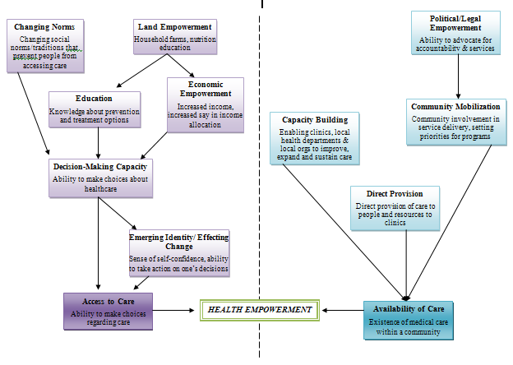
Complex Path to Health Empowerment
ARHAP, 15
Notes:
Total self-reliance not required – rare.

Slide 20
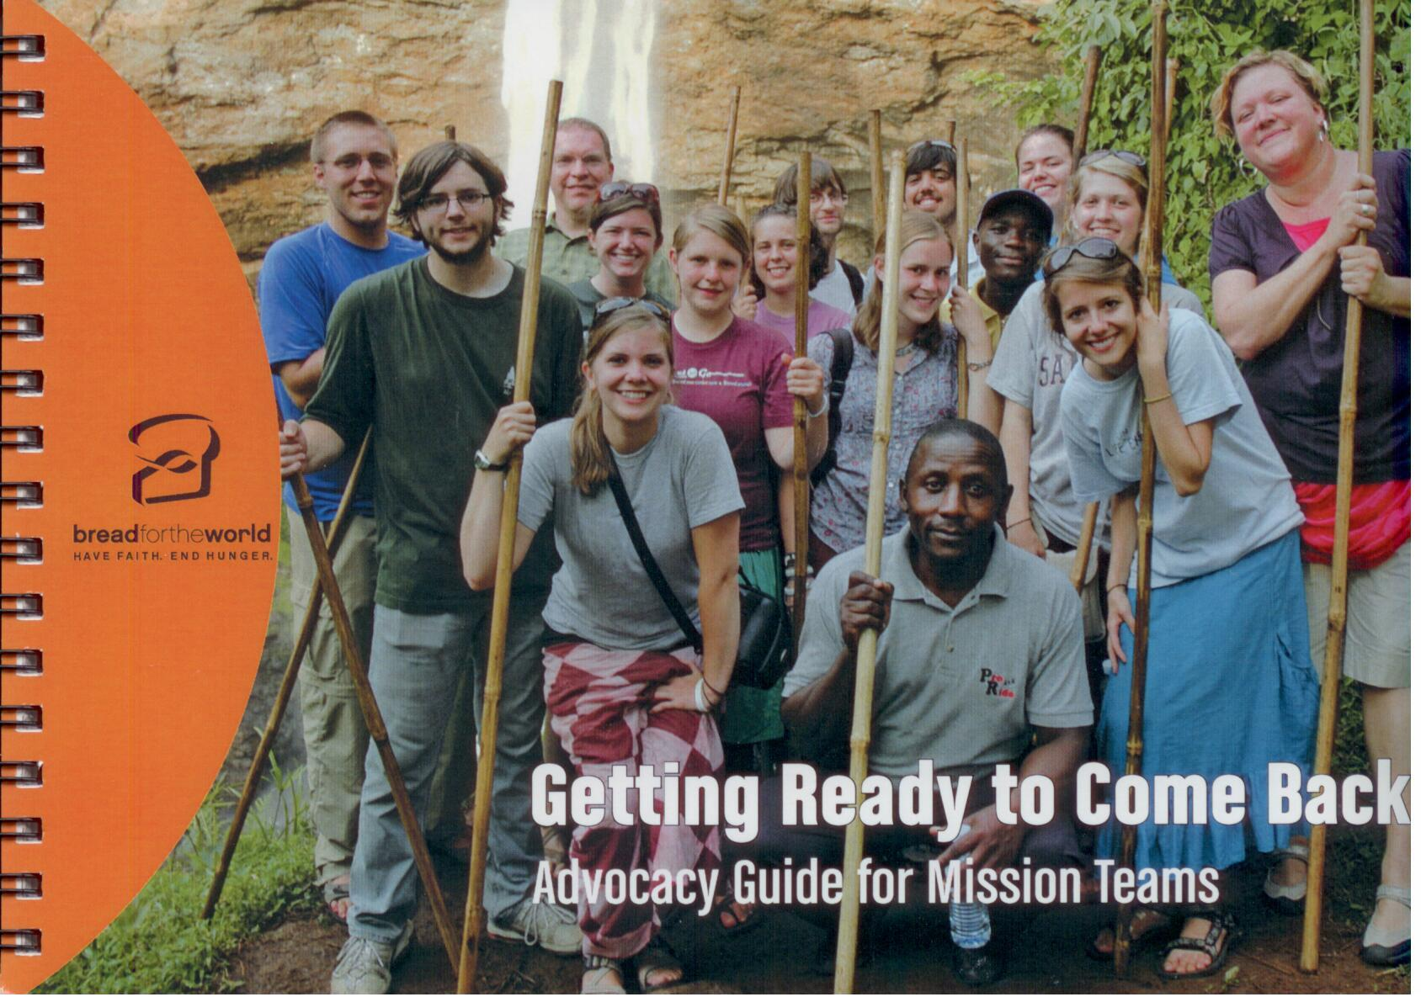
Eyes for structural/policy barriers
Exhibit
# 1203
Notes:
Total self-reliance not required – rare.

Slide 21
Role of outsiders
WHO article, February 2006, "What is the evidence on effectiveness of empowerment to improve health?", explained:
“Advocates or external change agents may catalyze actions or help create spaces for people to learn,
but sustainability and empowerment occur only as people create their own momentum, gain their own skills, and advocate for their own changes.”

Slide 22
Implications for us
Changing OUR behavior
Relinquish control Gently and more quickly than we are comfortable
Outside resources sometimes erode empowerment
- Examples?
- Aim to mobilize community energy – can’t buy or coerce
Notes:
Example – SUBSIDIZING tuition for Chilimarca & Visiting docs who unintentionally undercut livelihood & sustainable care of local HCP.

Slide 23
Creating space for Empowerment
“Opportunity Structure”
In your personal development, who believed in you?
Saw you
Recognized your potential
Challenged, pushed, stretched you
Expected more of you
Made space for you to grow – sometimes by not doing, not advising, not stepping in
Taught & mentored
Encouraged you to learn through failures and tough spots

Slide 24
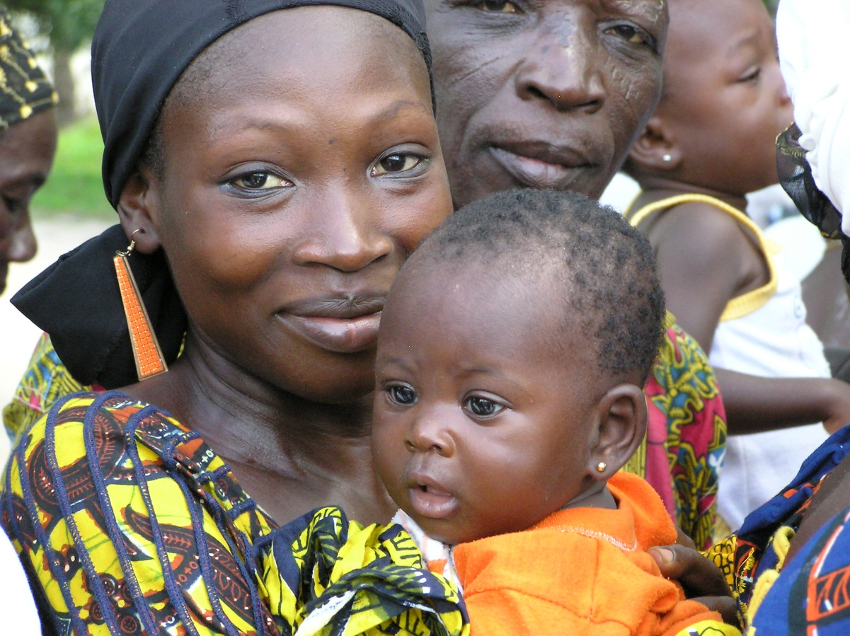
The fuel for Empowerment
Hope and Confidence
Hope is foundation of change (Paulo Freire, Pedagogy of the Oppressed)
Indicators of Confidence
self-confidence and self-efficacy to set and achieve goals
ability to make informed decisions that are recognized and respected
belief in own ability to take action to effect change based on own goals
(Hennink et al, p. 206)
Notes:
Freire – People begin to get involved when they have hope that their actions will make a difference
Example – Breast feeding & confidence
Women lacked self-worth, thinking that their breast milk was not good enough or bad for the baby. We were then able to address the issue and plan programme priorities around these beliefs/inaccuracies, instilling in the mothers the confidence to take control of their feeding practices and envision healthy futures for their babies. We improved the mothers’ capacity to believe in themselves and thus act on these new beliefs.
Communities that are skeptical about their potential may endure, accommodate, or pretend, but they will not develop.” JALC – 33

Slide 25
Most important health workers
Child Survival revolution in 2nd half of 20th century historic reduction of child mortality worldwide.
One of most important consequences “…realization that the most important health workers in the world are not physicians or surgeons but mothers.”
Related reduction in deaths from diarrheal disease
- Oral Rehydration Therapies
- When Family Health Workers resisted, mothers used it

Slide 26
Experiental learning / transformation
Not by “telling” - - Deep knowing
Action-Reflection
Asset Based Community Development
Appreciative Inquiry
What can we do to facilitate that learning?
Notes:
Freire – People begin to get involved when they have hope that their actions will make a difference
Example – Breast feeding & confidence
Women lacked self-worth, thinking that their breast milk was not good enough or bad for the baby. We were then able to address the issue and plan programme priorities around these beliefs/inaccuracies, instilling in the mothers the confidence to take control of their feeding practices and envision healthy futures for their babies. We improved the mothers’ capacity to believe in themselves and thus act on these new beliefs.
Communities that are skeptical about their potential may endure, accommodate, or pretend, but they will not develop.” JALC – 33

Slide 27
Respecting local context & priorities
Each community has social construct
order, change processes, cohesiveness, predictability
Owners or Passive Recipients
Your goats first??
Notes:
In each community a social construct has evolved, providing order, change processes, cohesiveness, predictability.
Interventions that fail to recognize and respect the local reality may encourage local people to be passive recipients of charity rather than owners of their future.

Slide 28
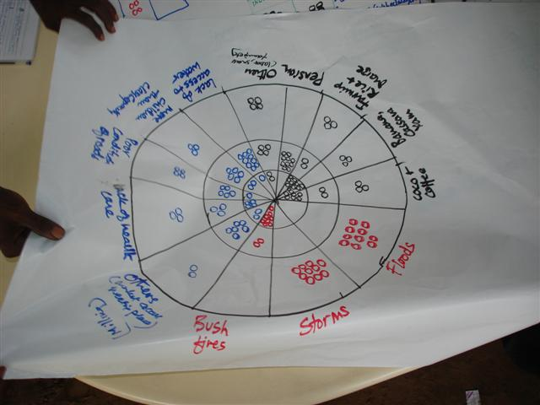
Capacity for complex analysis
Ravi Jayakaran’s
10 Seed Process
Learning how communities see themselves
Notes:
Example – Breast feeding & confidence
Women lacked self-worth, thinking that their breast milk was not good enough or bad for the baby. We were then able to address the issue and plan programme priorities around these beliefs/inaccuracies, instilling in the mothers the confidence to take control of their feeding practices and envision healthy futures for their babies. We improved the mothers’ capacity to believe in themselves and thus act on these new beliefs.

Slide 29
Barriers to empowerment
What barriers have you encountered?
Time
Lack long-term partnerships with locals
Training in facilitating
Skills are curative, specialized, focused
How engage governments?
The domination system
Jesus called them together and said, “You know that the rulers of the Gentiles lord it over them, and their high officials exercise authority over them. Not so with you. Instead, whoever wants to become great among you must be your minister, and whoever wants to be first must be your servant- just as the Son of Man did not come to be served, but to serve, and to give his life as a ransom for many.” (Matthew 20:25-28)
Challenging the leadership paradigm

Slide 30
Facilitators – not fixers:
A sample annual community process
BUILDING CAPACITY:
Create or re-create a coordinating committee
Identify past successes – base for future.
Study successes and visit other communities. Adapt what’s worked for others. Send the workers.
CHOOSING A VISION:
Evaluate the situation objectively. A community-specific database. Problem and resources, specific skills.
Discuss source of problems, explore possible solutions, decide which problems most urgent. Then draft a work plan that assigns jobs and functions to all.
TAKING ACTION
Involve as many as possible. Start projects that will be popular. Build momentum.
Monitor momentum and identify gaps in action to make corrections. Try, evaluate, adapt, improve.
JALC, p. 20ff

Slide 31
But you’re short-term & outsider !
What can you do?
What approaches have you made or seen?

Slide 32
Empowerment Opportunity | Strategy
Understand host community’s sense of need and priority – rather than focus only on the team’s agenda. | Via pre-trip visit or through local host Recruit your team accordingly Require pre-trip training for all participants
Work with local health services; government, mission, private. | Identify them Communicate in advance Meet on-site
Avoid undermining sustainability of health care by ignoring or displacing local health professionals. | Consult them in planning your trip. Meet early - personal relationship Invite them to work alongside you Mutual learning a part of your mission
Model attention to long-term care and utilization of international standards | WHO protocols, record base-line measurement of children for follow-up by local health care staff or by future mission teams

Slide 33
Plan for Empowerment
MAP’s Project Planning Tool (PPT) requires each project plan to foster self-empowerment
Psychological Aspects – Self-esteem, resilience, development of a vision for the future, etc.
Community Involvement – In project design, implementation and evaluation
Capacity to Act – Ongoing development of relevant and appropriate knowledge, skills and tools
Community Ownership & Local Resources; & linking to other systems and resources.
Notes:
Total self-reliance not required – rare.

Slide 34
Measuring - Indicators
Difficult to measure – even for large NGOs
Five Indicators of Empowerment
Identity: Self-esteem, self-worth, sense of control and of community
Ideas: Ability to envision, educate others, communicate vision & process
Implementation: Goal setting, planning, knowledge, skills, tools needed
Influence: Institutional relationships, advocacy, effecting change
Impact: Ability to monitor and evaluate progress
Notes:
Evidence-based

Slide 35
Resources and Best Practices
Alkire, S. (2007). Measuring Agency: Issues and Possibilities. Indian Journal of Human Development, 1(1), 169-175.
Chambers, R. (1983). Rural Development: Putting the Last First. Essex: Longman Scientific & Technical, Group.
Chambers, R. (1997). Whose Reality Counts?: Putting the First Last. London: Intermediate Technology Publications.
Hennink, M.; Kiiti, N; Pillinger, Jayakaran, R; Smith, M; “Defining empowerment: perspectives from international development organisations”, Development in Practice, March 28, 2012
Taylor, Carl E. and Taylor-Ide, Daniel, Just and Lasting Change: When Communities Own their Futures, Baltimore: Johns Hopkins Press, 2002.
“What is the evidence on effectiveness of empowerment to improve health?” Feb. 2006 http://www.euro.who.int/__data/assets/pdf_file/0010/74656/E88086.pdf
Notes:
Last one has 257 bibliography entries

Slide 36
Resources and Best Practices
Seager, G., When Healthcare Hurts: An Evidence Based Guide for Best Practices in Global Health Initiatives, Bloomington, IN: Author House, 2012
Sen, A. (1985). Well-Being, Agency and Freedom: The Dewey Lectures. Journal of Philosophy, 82(4): 169-221.
Freire, Paulo. Pedagogy of the Oppressed. New York: Continuum, 2007
CHE – Community Health Evangelism - http://www.chenetwork.org/
MAP – Medical Assistance Programs International – www.map.org
What others do you know?
Media resources (books, videos, courses, etc.)?
Programs & practitioners to learn from?
Notes:
Last one has 257 bibliography entries

Slide 37
Empowerment:
Loving God and our Neighbors
What we do in our health ministries
And the ways we do it
Will cultivate empowerment or disempowerment.
May God’s Spirit give us eyes and ears to perceive,
And hearts open to receive the people to whom God sends us
as equal sisters and brothers
with amazing capacity to love, learn, teach and serve.
And may we together experience the wonder of God’s transforming and empowering work in all of our lives.

