Slide 1
Critical Thinking in Healthcare: What is It?
Sharon A. (“Shari”) Falkenheimer
MD, MPH, MA (Bioethics), PhD
Christian Medical & Dental Associations

Slide 2
Overview
The need for critical thinking
What critical thinking is and is not
Critical thinking is similar to the scientific method
Critical thinking is biblical!
Knowledge vs. understanding/application
Case study:
  Novice
  Mid-level critical thinker
  Highly experienced critical thinker.

Slide 3
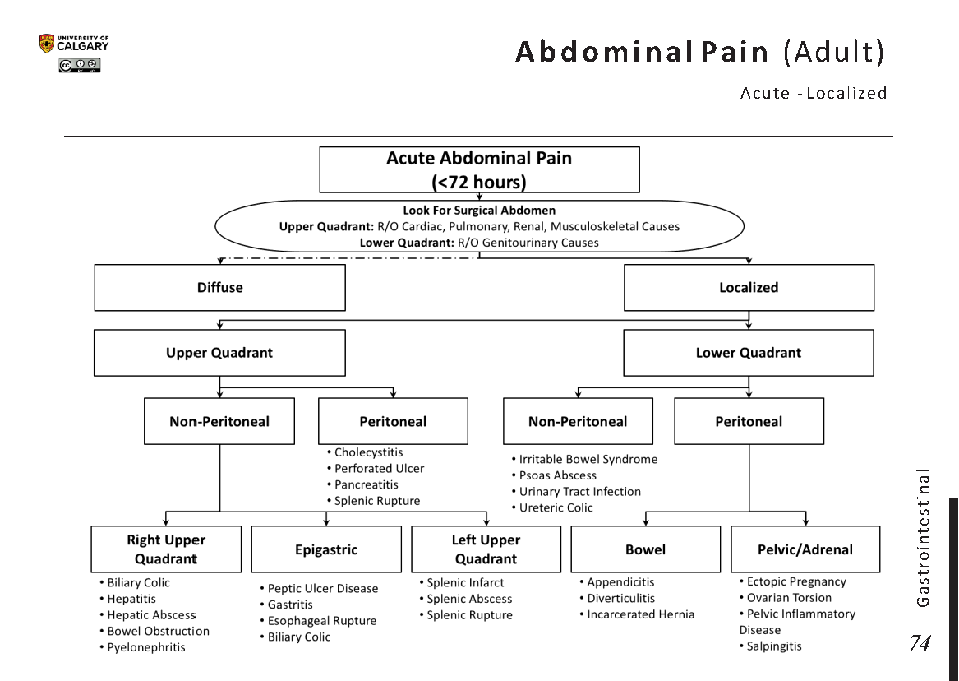
Internet https://www.grepmed.com/images/8095/
pain-algorithm-diagnosis-localized-abdominal;
accessed 1/29/2021

Slide 4
Algorithms – Pro and Con
Pros
  Simple and helpful for typical presentations of illness
  Help novice practitioners get from symptoms to diagnosis or experienced practitioners to identify rare or unfamiliar diseases
  Often lead to correct diagnosis and therapy
Cons
  Not helpful when symptoms don’t fit the algorithm
  Discourage and can constrain independent and creative thinking
Groopman, Jerome. How Doctors Think, p. 5

Slide 5
Evidence-Based Medicine
“Statistics cannot substitute for the human being before you; statistics embody averages, not individuals.”
What do you do when you can’t find evidence or an algorithm which fits the situation?
Groopman, Jerome. How Doctors Think, p.6.

Slide 6
How can critical thinking can help students in the health professions?
Understand the subjects better
Identify better/alternate options for diagnosis and treatment
Better clinical decision making
Avoid or decrease medical/clinical errors
Develops confidence
Get higher grades
Succeed in one’s career.
Better able to work in resource limited settings
Preparation for life-long learning
May bring innovation through creativity
May bring faster promotion and advancement
Zayapragassarazan, Zayabalaradjane, Vikas Menon, SitanshuSekar Kar, and Gitanjali
Batmanabane. “Understanding Critical Thinking to Create Better Doctors, JOURNAL
OF ADVANCES IN MEDICAL EDUCATION AND RESEARCH 1, no. 3 (2016): 9–13.

Slide 7
Critical Thinking Can Save Lives!
Doctors are expected to take effective decisions in well defined and ill defined medical emergencies. However, when they face undefined medical emergencies they are unable to take effective clinical decisions and that leads to untoward incidents. One among the many reasons for this is a lack of critical thinking skills among doctors.
Zayapragassarazan et al, “Understanding Critical Thinking to Create Better Doctors.”
JOURNAL OF ADVANCES IN MEDICAL EDUCATION AND RESEARCH 1, 3
(December 2016): 9–13.

Slide 8
Demand for Critical Thinking
“mentions of critical thinking in job postings have doubled since 2009” and that in single week in October 2014, a job search site had “more than 21,000 health-care and 6,700 management postings [that] contained some reference to the skill.”
*Korn, Melissa quoted in Nazaryan, Alexander, You're 100 Percent
Wrong About Critical Thinking," Newsweek, 8/14/2015

Slide 9
Critical Thinking is NOT
Critical theory
Criticizing others
Being able to think in a critical situation

Slide 10
Diagnosis Based on Rote Learning
“I could make the correct diagnosis, but I couldn’t tell you how or why I made it” – physician trained in a culture which emphasized memorization but discouraged critical thinking
Not all illnesses fit the standard pattern of the disease
If we don’t know why a diagnosis is correct, we won’t know when it is wrong!

Slide 11
What is Critical Thinking?
The ability and willingness to assess claims and make objective judgments on the basis of well-supported reasons. It is the ability to look for flaws in arguments and resist claims that have no supporting evidence. It also fosters the ability to ... generate possible explanations for findings, think of implications, and apply new knowledge to … problems.
Critical thinking involves asking good questions
Zayapragassarazan et al. “Understanding Critical Thinking to Create Better Doctors.” JOURNAL OF ADVANCES IN MEDICAL EDUCATION AND RESEARCH 1, no. 3 (December 2016): 9–13.

Slide 12
Prerequisite to Critical Thinking: Knowledge
People cannot think critically about topics for which they have little knowledge.*
Thinking critically involves comparing and contrasting and synthesizing what one has learned. And a great deal of knowledge is necessary before one can begin to reflect on its meaning and look for alternative explanations.”**
* BMJ 2017;357:j2234, Critical Thinking in medical education: When and How?
***Ravitch, Diane, quoted in Nazaryan, Alexander, You're 100 Percent Wrong About Critical Thinking," Newsweek, 8/14/2015

Slide 13
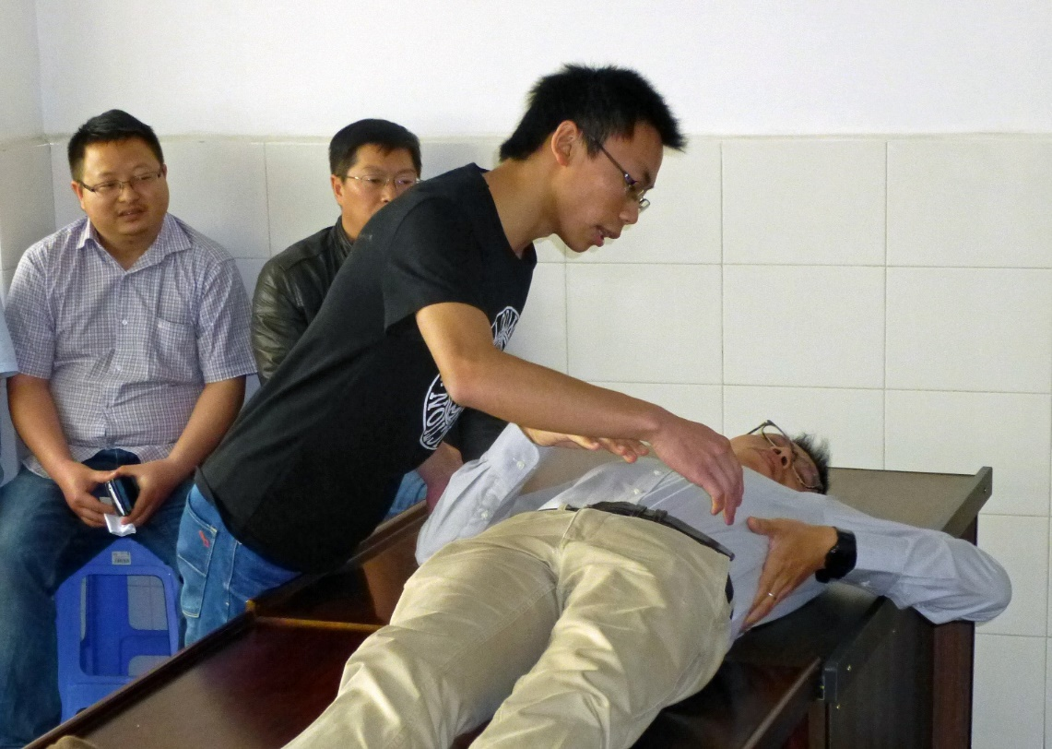
Critical Thinking is Similar to the Scientific Method
Observation
Analysis
Interpretation
Evaluation
Problem solving
Decision making
Explanation
Courtesy of Dr. James Smith, Emeritus Professor of ENT, Oregon Health Sciences University, Portland, Oregon, USA

Slide 14
Critical Thinking is Biblical!
Be transformed by the renewal of your mind (Romans 1:2)
Paul’s Character modelled:*
Intellectual humility: Willingness to admit what you don’t know
Intellectual integrity: Continual evaluation of your own thinking, holding yourself to the same standards you hold others, and willingness to admit when your thinking may be flawed
Intellectual courage: Awareness of the need to face and fairly address ideas, beliefs, or viewpoints to which you have negative feelings and to which you haven’t given serious hearing.
Intellectual empathy: A conscious effort to understand others by putting your own feelings aside and imagining yourself in their place.
* “What Does Critical Thinking Look Like?”, Tenwek Hospital, Bomet, Kenya, 2005

Slide 15
Novice Thinking Compared with Expert Thinking
Knowledge Based
Understanding Based
Knowledge = facts. Rely heavily on resources (protocols, preceptors)
Need clear cut rules
Lack experience from doing
Tend to act before assessing
Unsure what to do if situation differs from previous learning
Understand knowledge and can apply it to different situations
Rules a guide which can be adapted
Experienced in doing
Assess before acting
Uses knowledge/experience to adapt to new situations
Adapted from “What Does Critical Thinking Look Like?”,
Tenwek Hospital, Bomet, Kenya, 2005

Slide 16
Kinds of Questions to Ask
What does it mean (lab values etc.)?
What else do you need to know?”
Why would that happen?
What do you think you should do?
What do you think might happen if you did that?
Why am I doing this?
Why would that happen?
What is the benefit to the patient in the end?
How are you going to evaluate your nursing diagnoses?
Are the medications being effective?
How did it (medication, treatment etc.) affect the patient?”
Adapted from “What Does Critical Thinking Look Like?”,
Tenwek Hospital, Bomet, Kenya, 2005

Slide 17
Questions To Help You
Think Critically
What else could it be?
Is there anything that does anything not fit my diagnosis?
Could there be more than one process at work?
Groopman, Jerome MD, FACP, and Pamela Hartzband, MD, FACP,
Thinking about our thinking as physicians, ACP Hospitalist, Oct 2011.

Slide 18
Case Study
16-year-old, sexually active high school student
Previously in good health
This morning noticed a sudden sharp pain in her abdomen which is worse in the right lower quadrant and getting worse
No recent injury or any pain like this before
Mild nausea but no vomiting or diarrhea.
What is the diagnosis?
Papp et a; “Milestones of Critical Thinking: A Developmental Model for Medicine
and Nursing.” Academic Medicine 89, no. 5 (May 2014): 1–6.

Slide 19
Novice Thinkers
This sounds like appendicitis!

Slide 20
Critical Thinker
This could be appendicitis, but I need to consider other possibilities and organs in the lower quadrants. Prioritize action by ruling out most critical possibilities such as appendicitis, ectopic pregnancy, pelvic inflammatory disease, and ovarian torsion. Consider rare conditions if still no diagnosis found.

