Slide 1
Diarrhea or Baptism?
Understanding Worldview
Tools for Healthcare Missions
W. Michael Smith, MDiv, Dmin

Slide 2
Wherever you go…
You take your worldview
Others have a different worldview
Meaningful change rearranges worldview
Beginning with the missionary’s

Slide 3
Diarrhea or Baptism?
What is a Worldview?
“…a few basic assumptions about the nature of reality… that shape our thinking” Paul Von Ward: http://www.vonward.com/selfassessmenttools.html
“…the basic way of interpreting things and events
that shapes our whole concept of reality - -
what is good, what is important, what is sacred, what is real.”
Adapted from Carol Hill http://asa3.org/ASA/education/views/index.html

Slide 4
Whimsical but helpful example from Maasai
What Categories these fit?
virus deer
man cow
lion tree germ
god rock bush
angel whale dog
demon woman

Slide 5
Seeing the World Differently
man
whale
lion
woman
cow
dog
deer
bush
germs
virus
demon
God
angel
Things that rule over
Things that produce (cow = bride price)
Things not owned by anybody but used by everybody
Things you can’t see that can kill you

Slide 6
Who has a Worldview?
Cross-Cultural Sensitivity
Cultures?
Nations?
Ethnic groups?
Individuals?

Slide 7
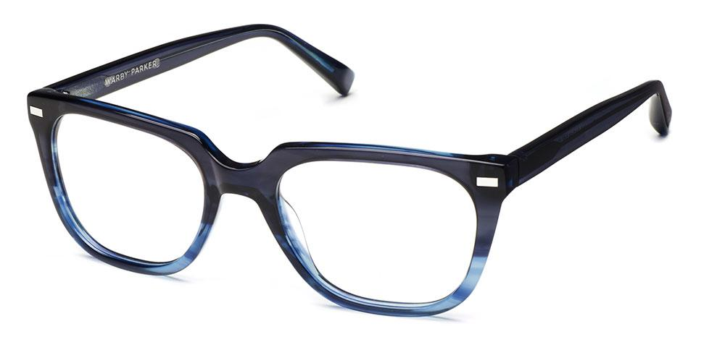
Where does our Worldview come from?
Born with it? Learn it?
Lenses “ground” by the world we live in
that become prescriptive – shaping what we see & do
Notes:
Healing the consequences of evil & brokenness

Slide 8
Forces shaping a worldview
ASSUMPTIONS ASSUMPTIONS PERSPECTIVES PERSPECTIVES
from from
YOUR PERSONAL
CULTURE EXPERIENCE
Words
& Actions
Values
Worldview

Slide 9
Hidden in Plain Sight
Examples?
Domination/equality
Abundance/scarcity
Agency/passivity
Implicit / Assumed – this is how things are
Hidden power – psychological, spiritual, relational, physical

Slide 10
The influence of our worldview
Words
& Actions
Values
Worldview

Slide 11
Worldview = Bedrock of our Living
Cross-Cultural Sensitivity
Cross-Cultural Sensitivity
NOT concerned with the “electives” in our lives
Fundamental sense of what is real
Belief at the deepest level

Slide 12
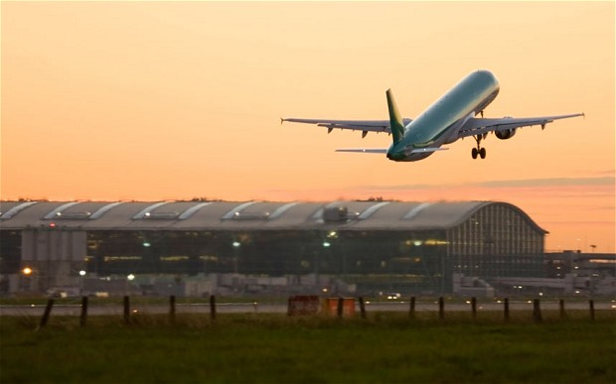
Belief that we stake our lives on
We DO live according to what we believe is real
Locus of deepest & most important living, healing, conversion
Notes:
Healing the consequences of evil & brokenness

Slide 13
How discover my own worldview?
Pay attention to my behaviors: Learn from points of conflict
Cross-cultural simulation learning exercises Bafa Bafa: http://www.nyu.edu/classes/persell/aIntroNSF/LessonPlans/BAFABAFALesson%20Plan.htm
Structured self-assessment - http://www.vonward.com/selfassessmenttools.html Google for others
Committed community – mutual learning together

Slide 14
Worldview Collision
In the Early Church
Most pivotal development in Christian history
Without it, we wouldn’t be here
Acts 10

Slide 15
Jesus does Worldview
Examples:
Bartimaeus, blind man, “Jesus, Son of David, have mercy on me.” Jesus calls him & asks, “What do you want me to do for you?” (Mark 10:46-52)
Zacchaeus, wealthy chief tax collector, after Jesus visited his home, “I give half my possessions to the poor, and repay 4x anyone I’ve cheated.” (Luke 19: 1-10)
Teachers, Pharisees, a crowd & a woman caught in adultery. Whoever is without sin, throw the first stone. Neither do I condemn you. Go & leave your sin. (John 8:1-11)

Slide 16
My Ministry Right Now
REQUIRED A CHANGE IN WORLDVIEW
A Collective Christian Voice
Building public and political will to end hunger

Slide 17
End physical hunger?
Influence political decisions?
“Surely not Lord,” that’s a morally good thing to pursue,
but its not the work of the Gospel
But then I “fell into a trance on the rooftop…”

Slide 18
My Worldview: “That’s not Gospel Work!”
Three key tenets of my worldview (what’s real)
were the lenses through which I read scripture & life
Individualistic: The Gospel is most concerned with me and other individuals being saved.
Fragmented Creation & Salvation: (Dualistic) Spirit is good, material is bad: Thus focus of ministry is to help others receive, in Christ the forgiveness that cleanses sins, so that we are acceptable to God and have hope of eternal life for our souls, i.e., are saved.
Domination: Destined to be poor. Bad character, culture, habits. Content

Slide 19
Pivotal story # 1 – opening my eyes
A card left in the restroom asked: “Do you know where you will spend eternity?”
Folks on the sidewalk didn’t know where they’d spend the night
Our Christian culture has us ask,
“Which is more important?”
Notes:
But along the way, growing unease
Fed by study, mentors, and
Deeper acquaintance with suffering…

Slide 20
The 2nd story
Several years ago, a District Health Commissioner in Kenya approached to approve a new health project asked:
How will your work be different than the missionaries before you?
They built clinics - They are in disrepair
They converted my people - They still live in poverty & disease
Notes:
But along the way, growing unease
Fed by study, mentors, and
Deeper acquaintance with suffering…

Slide 21
Seeing Jesus again – for the first time
Jesus’ mission – in his own words: “He went to Nazareth, where he had been brought up, and on the Sabbath day he went into the synagogue, as was his custom. And he stood up to read. The scroll of the prophet Isaiah was handed to him.
Unrolling it, he found the place where it is written: "The Spirit of the Lord is on me, because he has anointed me to preach good news to the poor. He has sent me to proclaim freedom for the prisoners and recovery of sight for the blind, to release the oppressed, to proclaim the year of the Lord's favor." Then he rolled up the scroll, gave it back to the attendant and sat down.
The eyes of everyone in the synagogue were fastened on him, and he began by saying to them, "Today this scripture is fulfilled in your hearing.“
Luke 4:16-21 (quoting Isaiah 61)
Notes:
But along the way, growing unease
Fed by study, mentors, and
Deeper acquaintance with suffering…

Slide 22
Didn’t he mean spiritually blind, poor ?
But, when Jesus was asked by John’s disciples if he was “the one…”, he answered:
“Go and tell John what you have seen and heard:
the blind receive their sight,
the lame walk,
the lepers are cleansed,
the deaf hear,
the dead are raised,
the poor have good news brought to them.”
(Matthew 11:5 and Luke 7:22)
Notes:
But along the way, growing unease
Fed by study, mentors, and
Deeper acquaintance with suffering…

Slide 23
Jesus’ scriptures were law & prophets
His worldview & ministry were shaped by the spirit of Isaiah 58:
6 "Is not this the kind of fasting I have chosen: to loose the chains of injustice and untie the cords of the yoke, to set the oppressed free and break every yoke?
7 Is it not to share your food with the hungry and to provide the poor wanderer with shelter-- when you see the naked, to clothe him, and not to turn away from your own flesh and blood?
8 Then your light will break forth like the dawn, and your healing will quickly appear; then your righteousness will go before you, and the glory of the LORD will be your rear guard.
Notes:
But along the way, growing unease
Fed by study, mentors, and
Deeper acquaintance with suffering…

Slide 24
Jesus taught his disciples to pray…
Your kingdom come,
your will be done on earth as it is in heaven.
Notes:
But along the way, growing unease
Fed by study, mentors, and
Deeper acquaintance with suffering…

Slide 25
The beatitudes
Blessed are those who hunger and thirst for δικαιοσύνη, for they will be filled.
Blessed are those who are persecuted because of δικαιοσύνη, for theirs is the kingdom of heaven.
Matt. 5: 6 & 10
Notes:
But along the way, growing unease
Fed by study, mentors, and
Deeper acquaintance with suffering…

Slide 26
“I now realize…” that ending injustice that leaves 29,000
children dying before their 5th birthday – every day
Is neither the fruit of the gospel
nor a means to preaching the gospel
It is the work of the gospel
(What I don’t mean by this…)
Notes:
But along the way, growing unease
Fed by study, mentors, and
Deeper acquaintance with suffering…

Slide 27
My worldview was born again
In August, 2010, the invitation came to work with Bread for the World.
“So when I was sent for,
I came without raising any objection.”
(Peter, Acts 10:29)
Notes:
But along the way, growing unease
Fed by study, mentors, and
Deeper acquaintance with suffering…

Slide 28
My prayer for you…
May you have the courage (like Peter) to listen and follow God’s call,
especially when it challenges your worldview.
A conditioning for ministry practice:
Regularly, prayerfully reread the gospels
What does Jesus say is the good news?
What does Jesus say about his purpose?
What does Jesus do in his ministry?
What does he teach his followers to do?

Slide 30
Want slides?
Michael Smith
Bread for the World
HAVE FAITH END HUNGER
GMHC Exhibit – 2307
msmith@bread.org
www.bread.org
Notes:
But along the way, growing unease
Fed by study, mentors, and
Deeper acquaintance with suffering…

