Slide 1
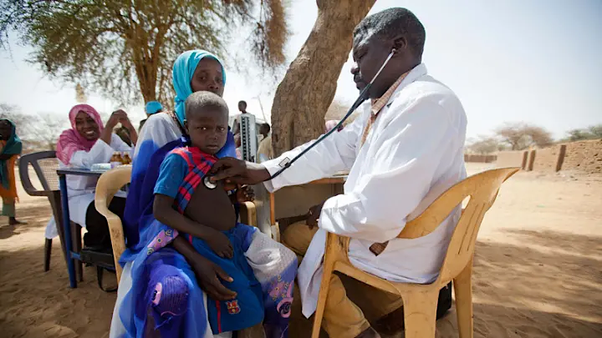
The Effective Use of CHWs in LMICs
Cathy Hoelzer, MPH, PA
Notes:
What is a Community Health Worker? A Community Health Worker (CHW) is a frontline public health provider—typically a trusted local community member or volunteer—who bridges the gap between underserved populations and formal primary health care systems.
While we’ll specifically addressing the use of CHW in LMICs, it is good to know that they are being used globally to help cover the gaps in the global healthcare shortage.
I first started working with CHWs in Africa and was involved in training and overseeing their work for a decade.

Slide 2

Objectives
Define Universal Health Care
Summarize the global health worker shortage
Define CHW roles and responsibilities in LMICs
Review evidence on CHW program effectiveness
Explore how short- and long-term medical missionaries can support CHW training
Notes:
Have you used or trained CHWs before? If so, where? What were your experiences?
What do you think is the most important step in starting a CHW program?
What are your thoughts on using CHWs in clinical practice? Pros vs. Cons?

Slide 3
Universal Health Care
Universal health coverage (UHC) means that all people have access to the full range of quality health services they need, when and where they need them, without financial hardship. (WHO)
Primary health care (PHC) is the most effective and cost-efficient way to get there. (WHO)
Community Health Workers are essential to help meet this need.
Notes:
UHC covers the full continuum of essential health services, from health promotion to prevention, treatment, rehabilitation and palliative care.
UHC means we need enough people to provide the care!

Slide 4
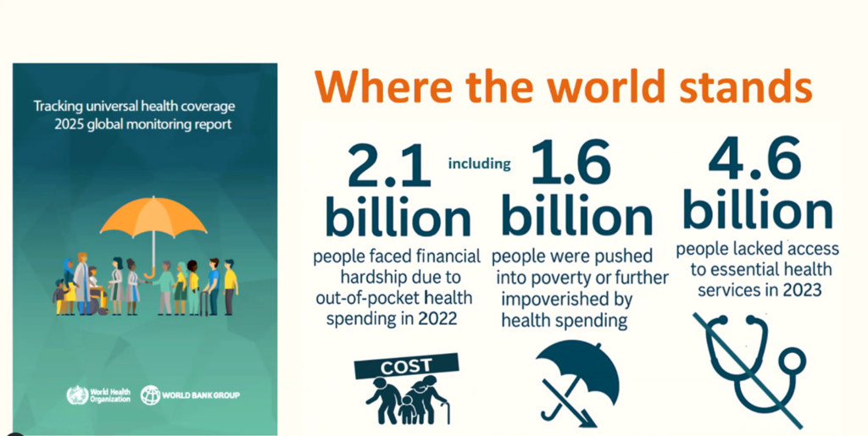
Why we need Universal Health Care

Slide 5
How will we achieve UHC without enough health workers?
WHO estimates a projected shortfall of 11 million health workers by 2030, mostly in low- and lower-middle-income countries.
Notes:
Perhaps CHWs can help meet this need?

Slide 6
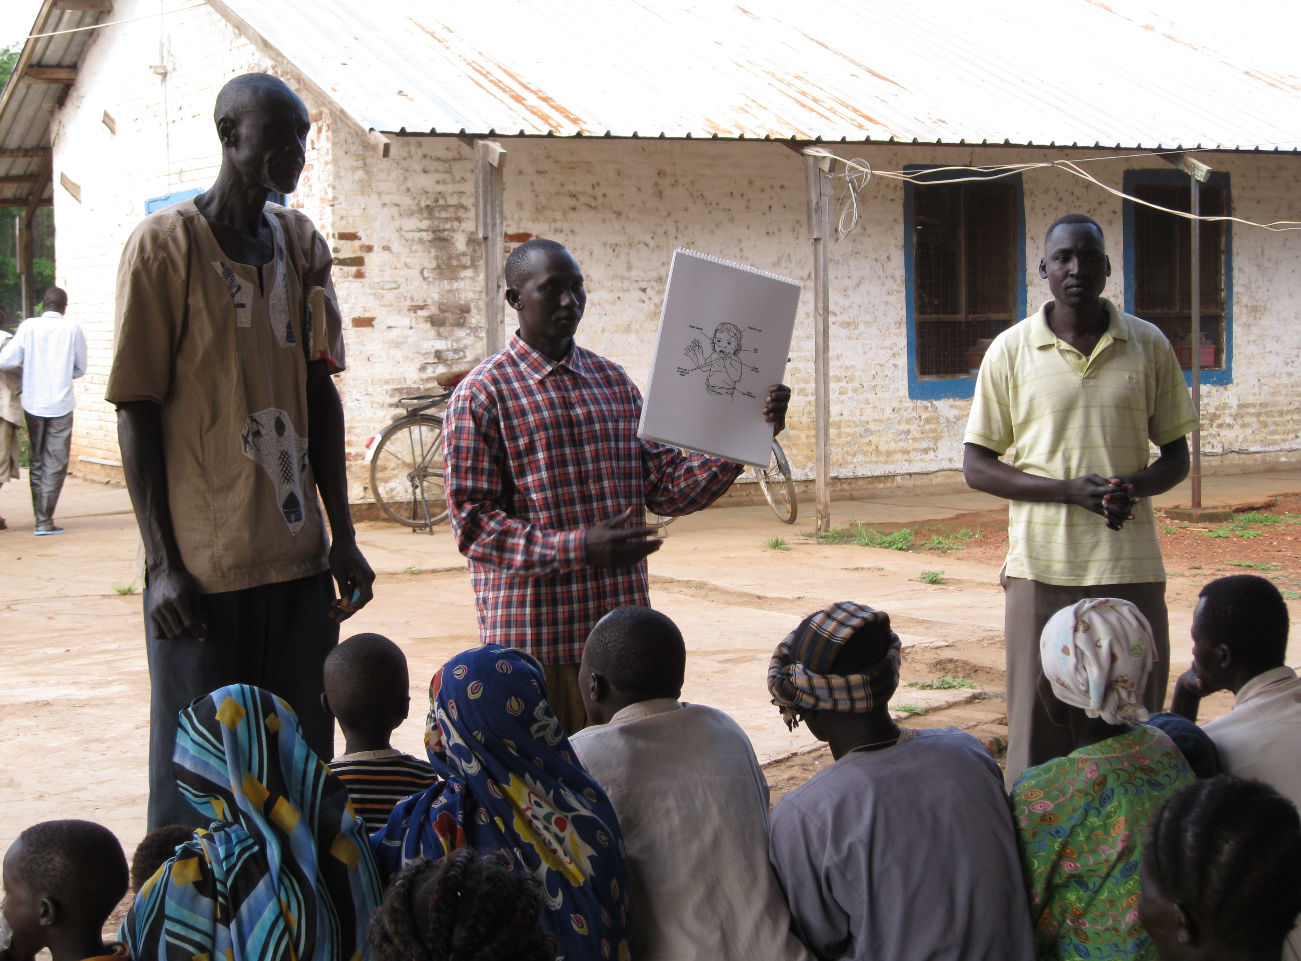
We need CHWs!
But what can they do?
Notes:
We need CHWs to help meet healthcare shortages.
First thought that comes to mind? What do you think is happening in the photo?

Slide 7
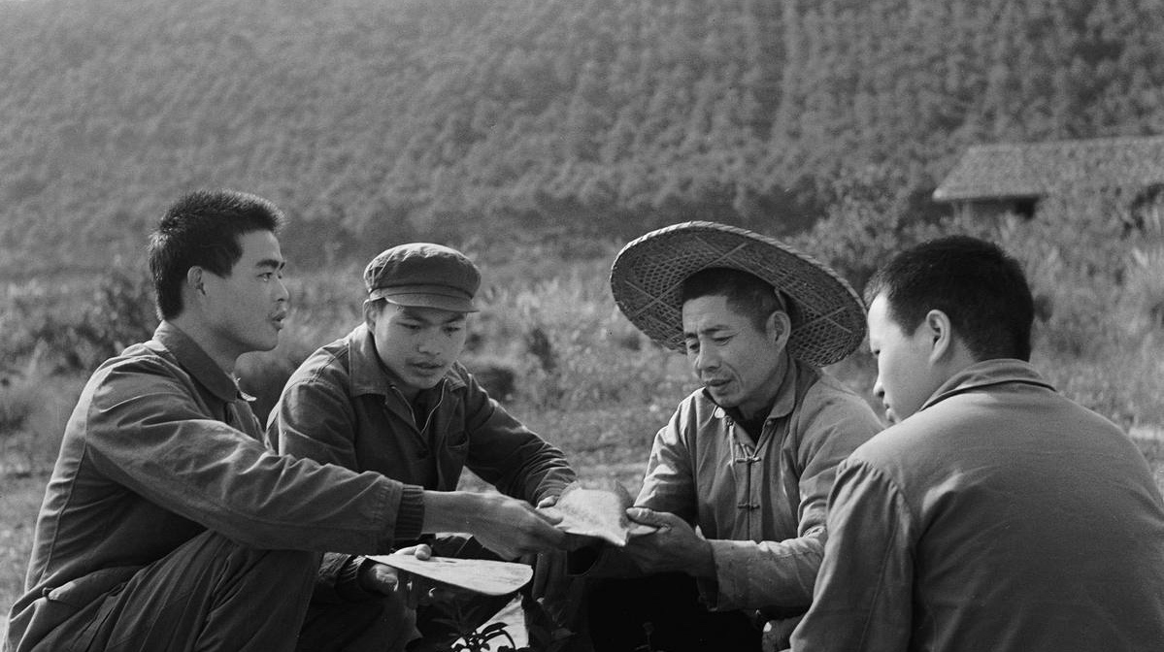
Evolution of Community Health Workers
1920s
Local farmers in China: Barefoot Doctor Program
↓
1950s–60s
Community-based health worker program spread to other poor nations
↓
1978
CHWs recognized as part of primary health care at the Alma Ata Declaration
↓
1980s–90s
National programs — successes and failures
↓
2000s
Evidence-based expansion
↓
Today
CHWs increasingly integrated into health systems--Ethiopia
Overall evolution:
From volunteers/local helpers → trained community health workers → essential members of health systems
Notes:
The "Barefoot Doctor" model was born in the 1920s.
Dr. John B. Grant of the Rockefeller Foundation and Chinese community development specialist Jimmy Yen trained local farmers.
Workers were taught to:
Record births and deaths
Vaccinate against disease
Provide health education
Teach communities about clean water and wells
By 1972 there were one million Barefoot Doctors serving 800 million people in rural China! Since the 1980s, this model has evolved into a more professionalized system, with village doctors now responsible for essential public health services such as health record maintenance, health education, infectious disease control, and chronic disease management (5).
1978 The Alma-Ata Declaration
WHO and UNICEF sponsored the International Conference on Primary Health Care.
The Alma-Ata Declaration promoted "Health for All."
CHWs were recognized as important providers of primary health care.
Community participation and decentralized health services became central principles.
2000s: Evidence Drives Renewed Interest
Research increasingly demonstrated the value of community-based interventions, particularly in:
Maternal health
Child health
Disease prevention
Reaching underserved populations
CHWs became increasingly important in efforts to achieve the Millennium Development Goals (MDGs), particularly:
MDG 4: Reduce child mortality
MDG 5: Improve maternal health
Key shift: Interest in CHWs was increasingly supported by evidence of impact, not just theory.
A major example of CHWs at scale
Ethiopia launched its Health Extension Worker program in 2004.
Approximately 38,000 CHWs were trained within five years.
The program aimed to reach every household with basic health services.
The program helped Ethiopia achieve the child health MDG.

Slide 8
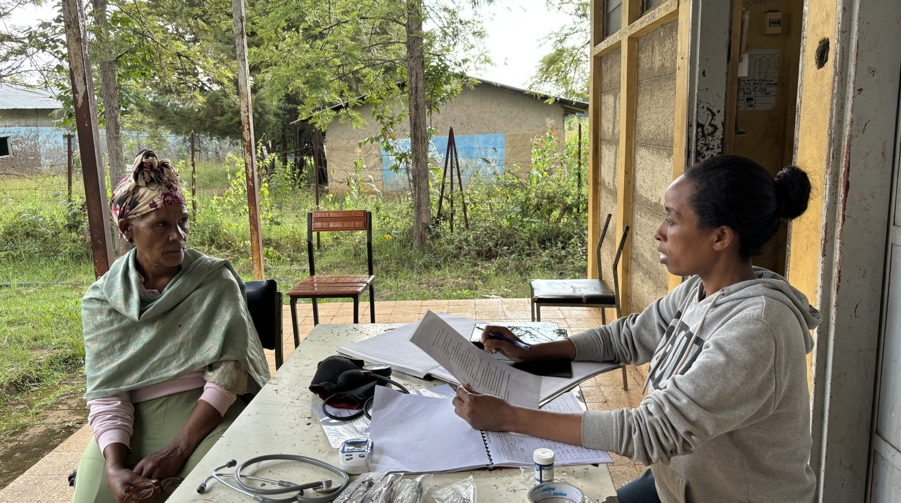
CHWs can meet needs where there is no doctor
Or nurse, or midwife, or dentist….
Notes:
We are in the middle of a global healthcare shortage that needs practical solutions. I think well-trained, government-backed, and recognized CHWs can be the answer.
In the photo is an Ehtiopian CHW. Ethiopia has more than 40,000 community health workers (known nationally as health extension workers) scaled across the country. Their CHW program connects rural and remote communities to quality primary care, which has played a key role in improving maternal and child health outcomes.

Slide 9
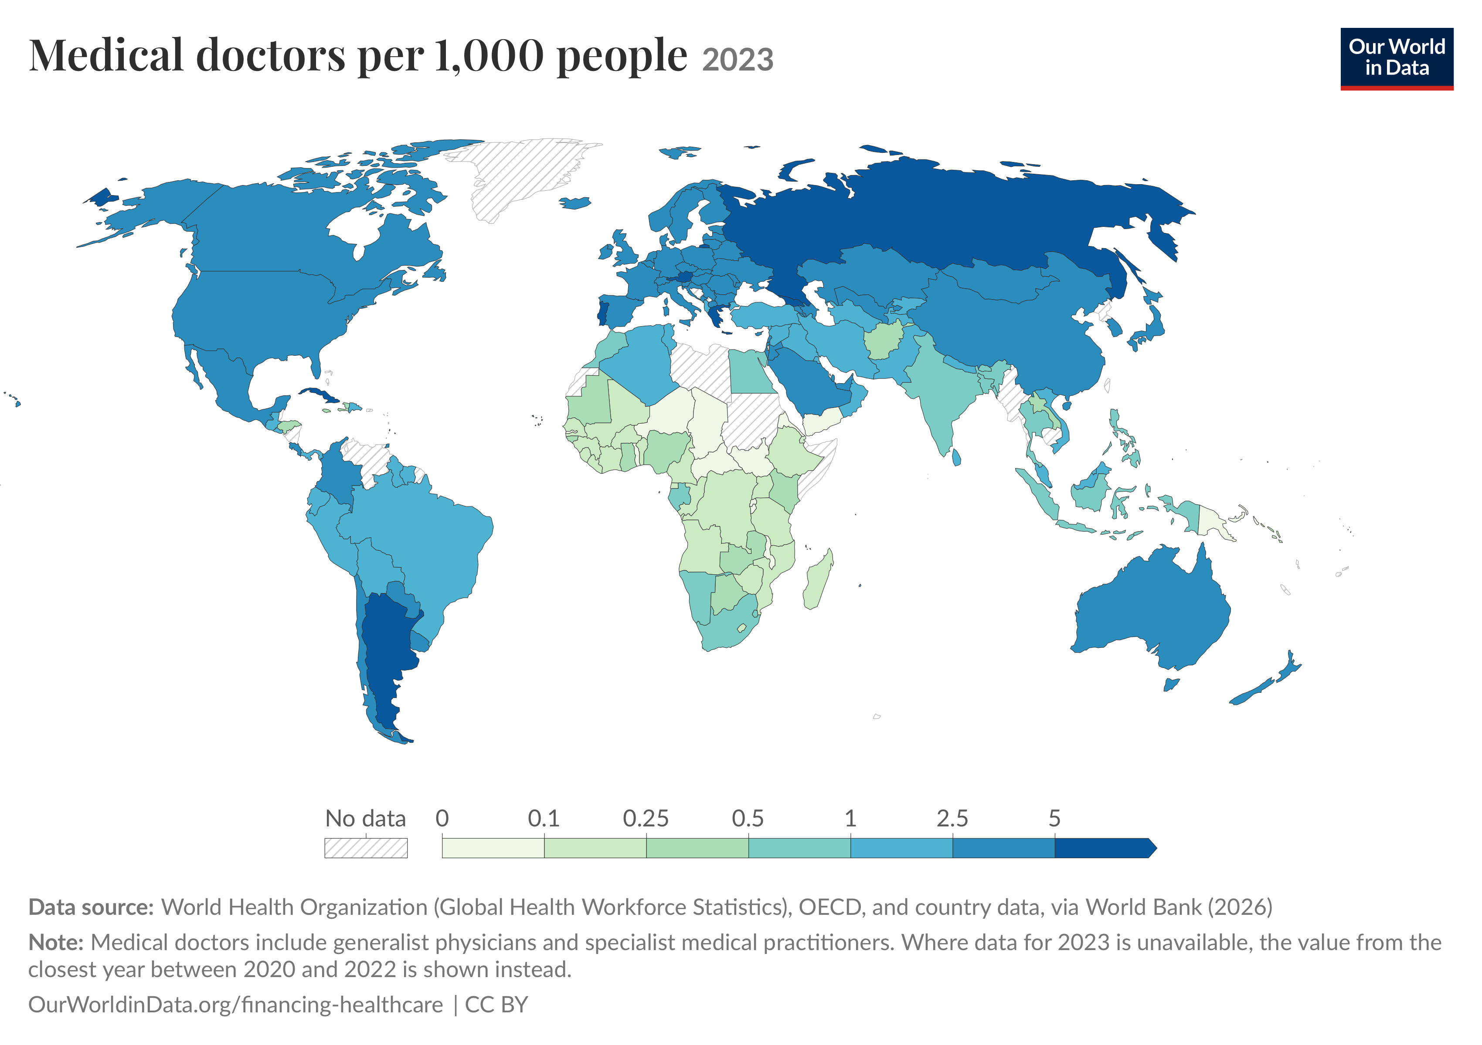
Notes:
According to research, there are 2.3 health workers per 1000 population in Africa and 4.3 per 1000 population in Southeast Asia. A maldistribution of these health workers often exists with a higher concentration of health workers in urban areas compared with rural regions where large proportions of the population reside. This poor distribution and shortage of health professionals has led some countries to rely on trained community health workers (CHWs), who take on specific tasks for the prevention and management of diseases.

Slide 10
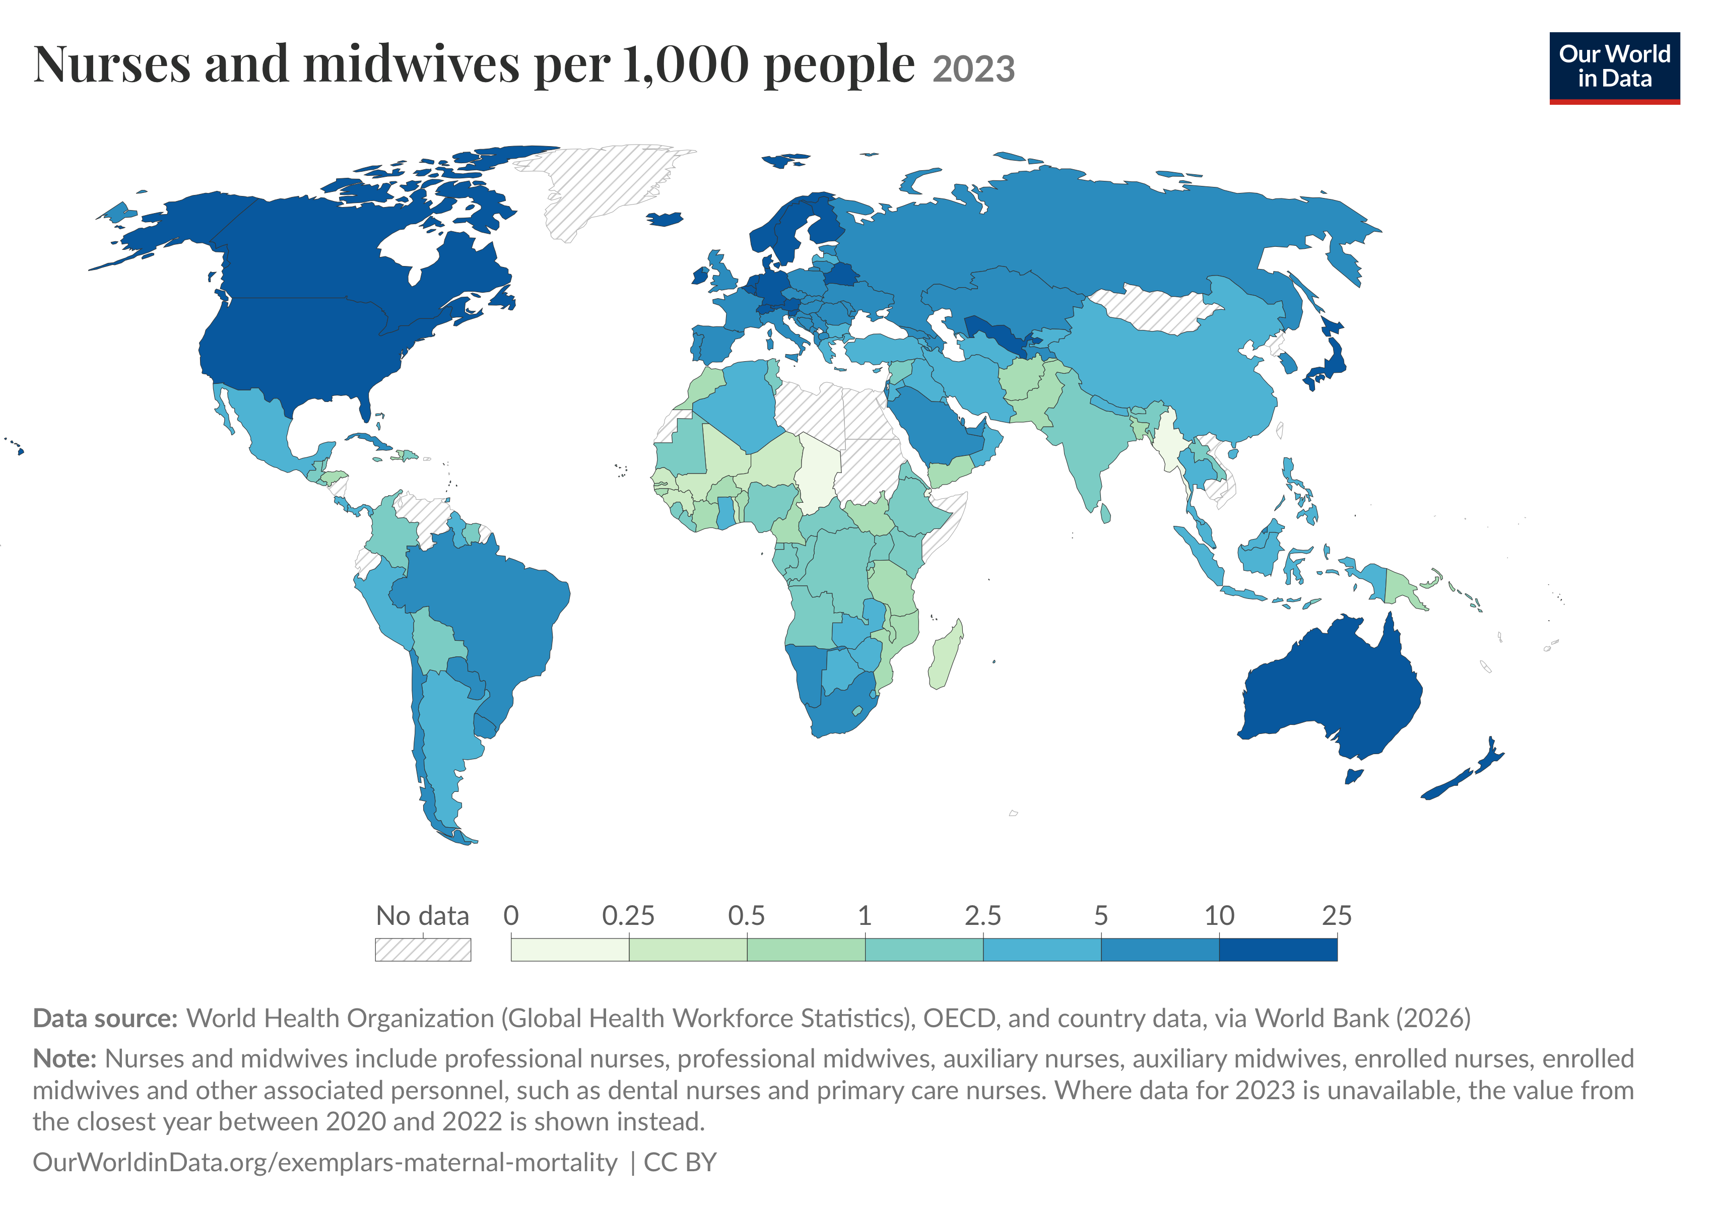

Slide 11
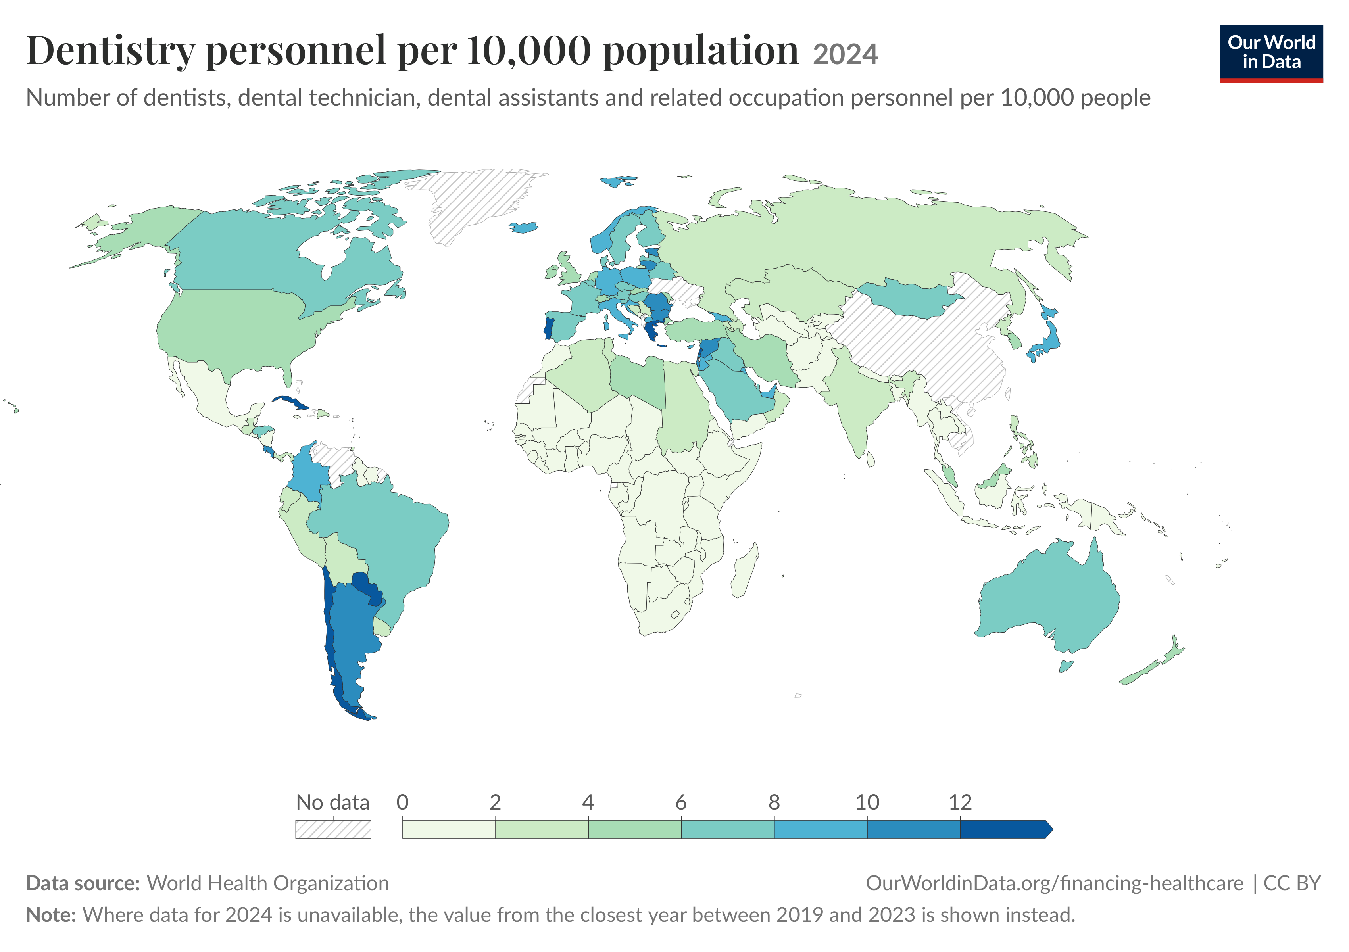

Slide 12
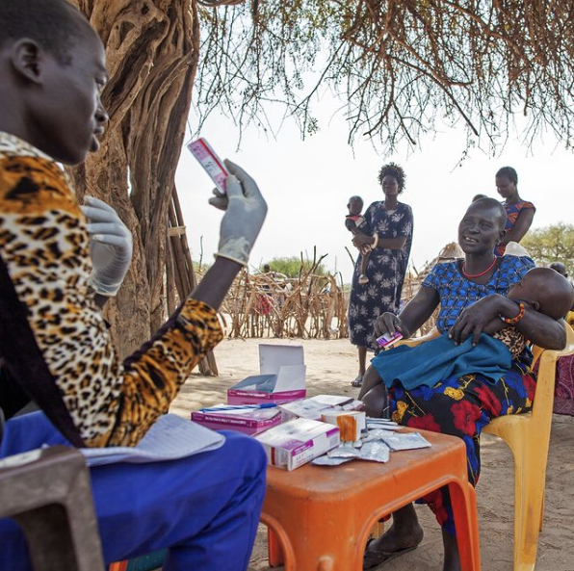
Community Health Workers: Building Trust, Delivering Care
Community members who help connect people with health services.
They work directly in communities, often reaching people with limited access to traditional health care services.
Notes:
CHWs are known to the people they are serving.
They speak the language and understand the culture and norms.
For example, in Doro during the rainy season, it was impossible for people to cross the river to get to the clinic. We had trained TBAs in that village who could be attended to if they couldn't deliver in the clinic.

Slide 13
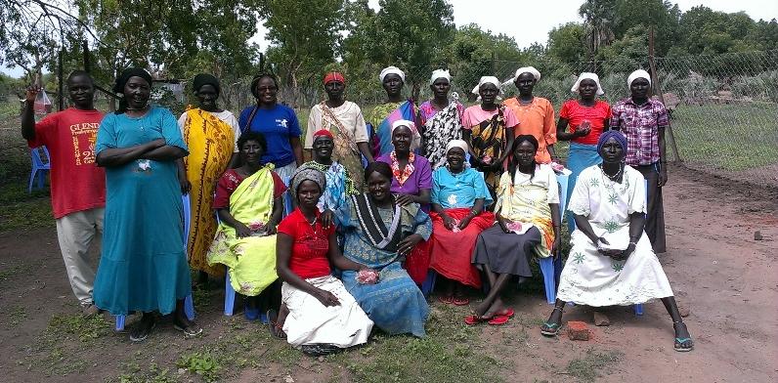
Traditional Birth Attendants
TBAs are trained regularly in Doro, South Sudan. They are incorporated into the SIM
Maternity program.
Notes:
Although I won’t be discussing TBAs in this lecture, this is another cadre of community health worker that may exist where you are working or may work. They are traditionally found in areas that lack professional health care services. This is true in South Sudan, where there are few to no doctors or nurse midwives except in large cities. They are critical for women who have no access to health care and if well-trained, save the lives of women and children.

Slide 14
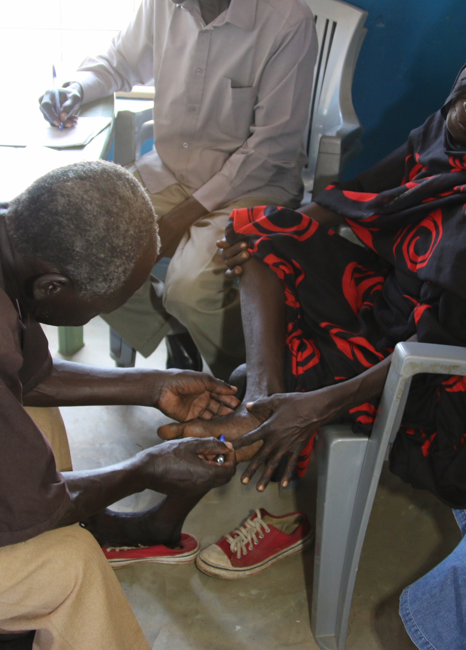
CHWs Role in Disease Identification, Prevention, Treatment
Role of Community Health Workers (CHWs)
Health Promotion & Disease Prevention – Educate communities on healthy practices.
Community-Based Diagnosis & Treatment – Identify and manage illnesses locally.
Maternal & Child Health Services – Support prenatal care, immunizations, and nutrition. (TBAs)
Chronic Disease Management – Assist with conditions like diabetes and hypertension.
Household-Level Care – Provide basic healthcare and monitor patient well-being.
Referral Facilitation – Connect patients to formal healthcare facilities.
Improving Healthcare Access – Support marginalized populations facing barriers (distance, cost, stigma).
Hassan, Saidu & Azike, Chidimma & Okoye, Nelyn & Adindu, Kelechi. (2024). Assessing the Impact of Community Health Workforce on the Efficiency and Accessibility of Healthcare Delivery. Archives of Current Research International. 24. 10.9734/acri/2024/v24i10918.
Notes:
When I was in Sudan, our CHWs were well trained and functioned more as nurses. They saw patients, diagnosed, and treated common PHC diseases. For more complex cases, they referred the patients to COs, NPs, or PAs. They were also involved in daily health education for waiting patients. Visited communities to care for leprosy and malnutrition and referred people in their community who needed specialized healthcare.
We also trained TBAs who could deliver and refer women to the clinic for birth control or if they felt the pregnancy was high risk. On top of this, we had CHWs who worked in the leprosy department doing follow-ups and prescribing the meds. Other CHWs worked in our nutrition program diagnosing malnutrition and caring for them in our inpatient program. Our clinical CHWs eventually learned to deliver babies, do IVs, and manage severe malaria cases. Other health volunteers were trained in diagnosing onchocerciasis and referring suspected cases to the clinic.

Slide 15
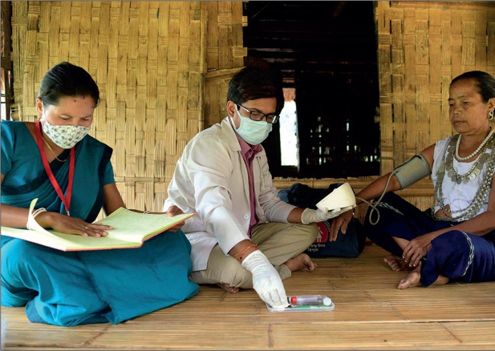
CHWs can help meet the need
There are more than 4.7 million CHWs in 100 countries.
70% of CHWs are women.
Half of those in low- and middle-income countries are unsalaried.
If they are not in the healthcare system, we should include them in the clinic and ensure they are paid fairly and supervised well.
Notes:
4.7 million CHWs in 100 countries. There are probably more but we lack the data.
CHWs must be part of the healthcare system and receive a salary, be regularly supervised, receive supplies, value and recognize them in the vital role they play.

Slide 16
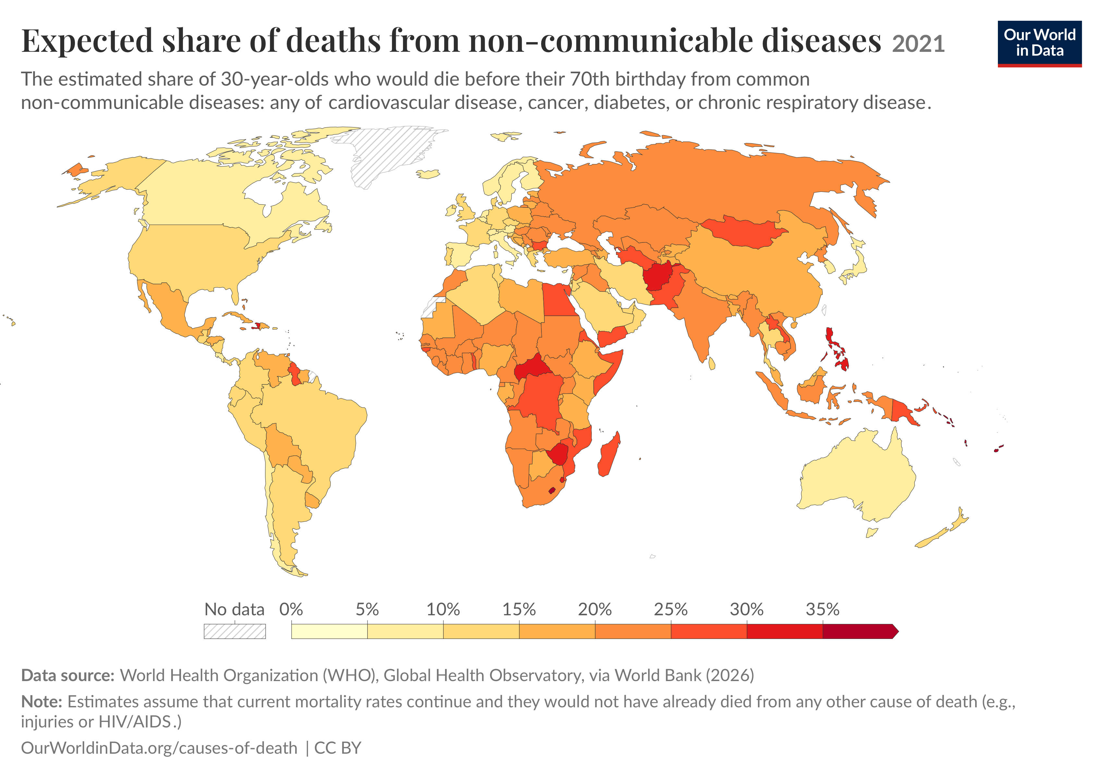
Should we expand their scope?
Notes:
For many years, communicable and tropical diseases outnumbered NCDs. However, these days, non-communicable diseases are the leading cause of death and disability globally.
LMICs are disproportionately impacted, representing 73% of non-communicable disease deaths.

Slide 17
We Must
Train CHWs to Help Combat NCDs in LMICs
Support early detection through screening and monitoring (e.g., BP, glucose)
Help patients manage chronic conditions through follow-up and medication adherence
Reduce the burden on clinics by delivering care at the community level
Promote healthy behaviors and lifestyle changes
Notes:
With proper training and support, CHWs can extend the reach of health systems and improve outcomes for people living with NCDs in resource-limited settings.
Preventive care is crucial—and community health workers serve as health educators and advocates in their communities.
Even more, to keep the CHWs from tackling diseases from a vertical approach, they should be looking at the health of the family unit and community as a whole. They can address unhealthy lifestyles that can be contributing to the development of NCDs.

Slide 18
Train CHWs Spiritually
Integrate faith into their health education training through the Community Health Evangelism/Education method.
  Community Health Evangelism (CHE) is a proven ministry strategy that seamlessly integrates evangelism, discipleship, and church planting with community health and development. (https://chenetwork.org/learn-the-strategy/what-is-che/)
Train clinic-based CHWs in the Saline Process
  The Saline Process Equips and mobilizes Christian healthcare workers as witnesses of the love and reality of Jesus at the bedsides and in the clinics where they work. (https://ihsglobal.org/salineprocess)
Notes:
We all know the saying: What good does it do if we send a healthy person to hell? We must address the spiritual health of our patients as well, and CHWs are well-situated to do this. They don’t need a translator, nor do they need to learn a culture. They just need to know how to share their faith.
I trained my Onchocerciasis team to find cases and refer them to the clinic. But they were also trained to share the Gospel while on outreach in the refugee camp. They were equipped with Audio Story Tellers and picture books that helped them share the truth of Jesus.
My CHWs and Clinic Chaplains were trained in the Saline Solution, which I had adapted for the context in which we operated. It helped the CHWs integrate their faith into their patient encounters.

Slide 19
Effectiveness of CHW Programs
Evidence Based Outcomes
Notes:
I want to show you some key findings from a few studies that evaluated the effectiveness of CHW programs in LMICs

Slide 20
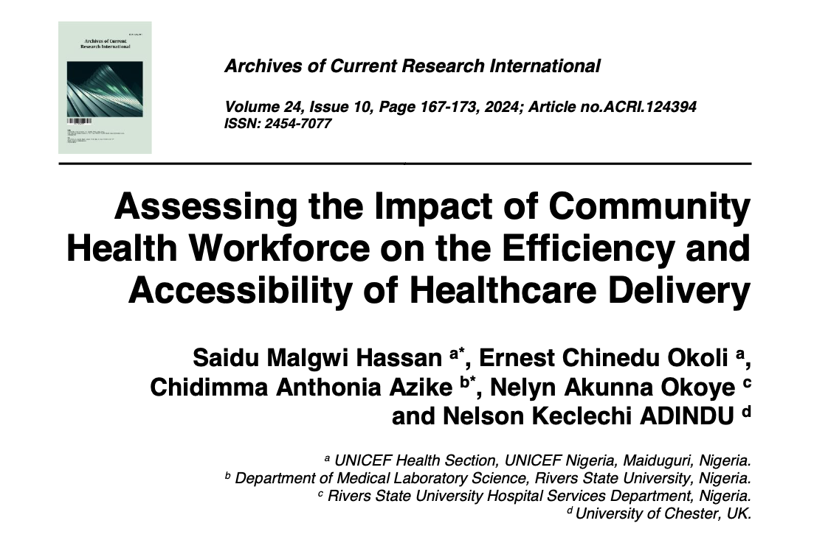

Slide 21
Key Findings
CHWs improve access to healthcare by bridging the gap between healthcare facilities and people who live in remote areas.
They make the health system more efficient by handling appropriate basic and preventive services.
Can improve the quality of care and health equity because they are based in communities they serve.
Biggest weakness is the sustainability of CHW programs.
The authors argue that investment and political support are essential, along with integration with formal healthcare services.
Hassan, Saidu Malgwi, Ernest Chinedu Okoli, Chidimma Anthonia Azike, Nelyn Akunna Okoye, and Nelson Keclechi ADINDU. 2024. “Assessing the Impact of Community Health Workforce on the Efficiency and Accessibility of Healthcare Delivery”. Archives of Current Research International 24 (10):167-73. https://doi.org/10.9734/acri/2024/v24i10918.
Notes:
Sustainability issues:
Insufficient training
Inadequate compensation
Poor integration with the formal healthcare system
Insufficient ongoing support
Simply putting community health workers into villages isn't enough. They need training, supervision, supplies, referral systems, compensation, and organizational support.
Community health workers can extend the reach of a health system dramatically, especially in rural areas, but they should not be viewed as a cheap substitute for professional healthcare. They work best as part of a supported, integrated system that connects community-level care with clinics, hospitals, supplies, supervision, and referral services.

Slide 22
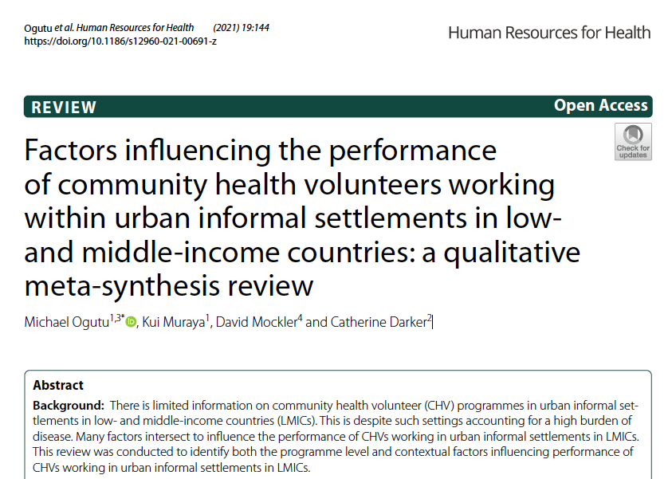
Notes:
We often consider CHWs to only work in rural areas; however, they are also needed in urban informal settlements (slums). For example, consider Kiburu slums in Kenya where 1 million people live in horrible conditions. Then there is India, Pakistan, Indonesia, China...the megacities are growing as more people leave rural areas for the city in search of jobs and opportunities.

Slide 23
Key Findings
Motivational Factors: CHVs are driven by intrinsic (altruism, community respect) and extrinsic (financial incentives, career progression) motivations.
Training & Capacity Building: Ongoing training and skill development are crucial for CHV effectiveness and retention.
Supervision & Support: Regular feedback, mentorship, and supportive supervision enhance CHV performance.
Workload & Burnout: High caseloads, lack of resources, and emotional strain contributed to fatigue and attrition.
Community Engagement: Trust and collaboration with community members improve CHV impact.
Policy & Institutional Support: Clear policies, financial backing, and integration into health systems are necessary for sustainability.
Ogutu, M., Muraya, K., Mockler, D., & Darker, C. (2024). Factors influencing the performance of community health volunteers working within urban informal settlements in low- and middle-income countries: A qualitative meta-synthesis review. BMC Public Health.
Notes:
This study looked at Community Health Volunteers in Urban settings.
They were motivated by feeling honored and receiving financial incentives and the opportunity to grow in their career.
Those who received training were more effective and tended to stay in their position.
Performance increased through regular supervision and support.
Too much work, not enough resources, and the emotional difficulties they faced every day led to burn out and attrition.
Their impact increased when the community was engaged.
Government backing is key for successful use of CHVs (CHWs).

Slide 24
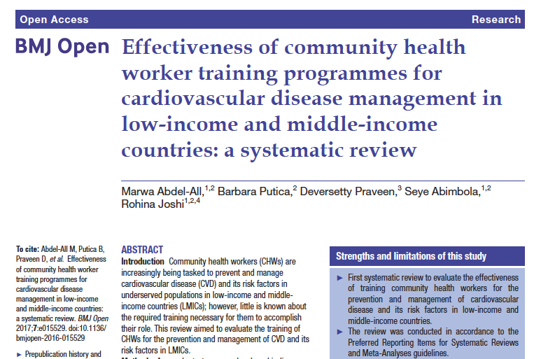
Notes:
Most health systems in LMICs are unprepared to manage the increasing burden of CVDs as their health systems are often focused on infectious diseases and maternal and child health, rather than chronic diseases. This review aimed to evaluate the training of CHWs for the prevention and management of CVD and its risk factors in LMICs.

Slide 25
Key Findings
CHWs can be effectively trained in CVD prevention and management but the review found that language differences between trainers and CHWs can be a barrier to effective training.
All 8 studies showed improved knowledge after training.
Some knowledge was retained 6 months later.
Multiple training methods were effective, including classroom, interactive, and e-learning.
Supports task shifting to address shortages of health professionals.
Effectiveness varies by context and training model.
Evidence remains limited: 6 of 8 studies were low quality.
More research is needed on long-term outcomes and cost-effectiveness.
Abdel-All, M., Putica, B., Praveen, D., Abimbola, S., & Joshi, R. (2024). Effectiveness of community health worker training programmes for cardiovascular disease management in low-income and middle-income countries: A systematic review. BMJ Global Health.
Notes:
CHW Training Resulted In:
Better patient outcomes. Better BP and cholesterol control and overall CV health improvement.
Communities increased in their health literacy rates through health education.
Patients better monitored and linked to health systems more effectively.
Why is this crucial? For example, it's much better to keep a patient from having a stroke or suffering a massive cardiac arrest. Once they get to this point, they become much more of a burden on the health system, and their illness can lead to more poverty if they lose the ability to work.
Bottom line: The evidence suggests that community health workers can be successfully trained to contribute to cardiovascular disease prevention and management, particularly by improving their knowledge and skills. However, the evidence was limited and generally low quality, so more rigorous research is needed to determine which training approaches work best, in which settings, and whether they are cost-effective.

Slide 26
Key Components of Effective CHW Programs
  Community participation & trust
  Appropriate training
  Ongoing supervision
  Fair compensation & incentives
  Supplies and logistical support
  Integration with the formal health system
  Strong political commitment
  Sustainable financing
  Monitoring, evaluation & quality improvement
Source: https://chwcentral.org/chapter-2-lessons-learned-from-viewing-the-history-of-large-scale-chw-programs/
Notes:
Which one of the factors listed do you think are most difficult to implement or achieve?
Financial:
LIC: $43 annual spent on health (6.6% OF GDP)
LMICs: $132 (5.3% OF GDP)
UMIC: $540 (6.5% OF GDP)
HIC: $3731 and some nations exceed $13000 annually!
BUT, there are high out of pocket expenses in lower income nations. Some can exceed 50% of total health expenditure, which leads to severe financial hardship. For example, in Jordan, the families have to buy the meds and supplies needed for their family member.
WHO estimates that low and LMIC countries face a massive investment gap to achieve basic UHC. About $34 per person more per year.

Slide 27
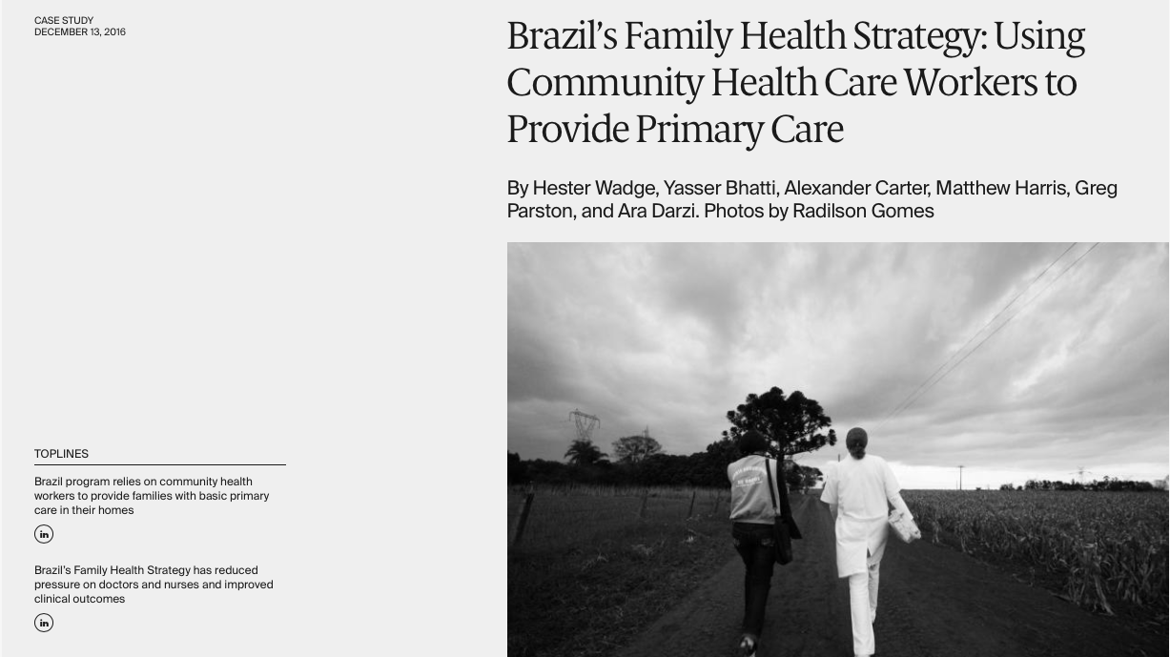
https://www.commonwealthfund.org/publications/case-study/2016/dec/brazils-family-health-strategy-using-community-health-care-workers
Notes:
This is a fascinating look into Brazil’s very successful CHW program, called Family Health Services. Brazil has successfully trained and integrated 400,000 CHWs into their formal healthcare system. Brazil spends between USD $50 and $100 per person annually to fund the entire Family Health Strategy.

Slide 28
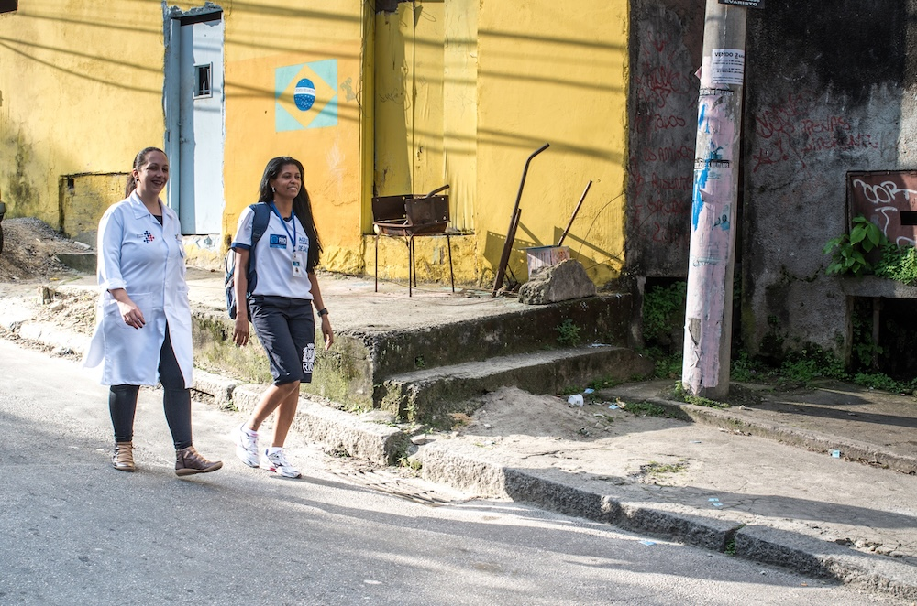
Impact of Brazil’s Family Health Strategy (FHS)
Improved population health
More accurate mortality data
Reduced mortality across age groups
10% increase in FHS coverage → 4.5% decrease in infant mortality
Better preventive care
Breastfeeding rates increased
Immunization coverage approached 100%
Greater access to medications and routine care
Greater health equity
Reduced inequality in health-care utilization
Strongest benefits among the poorest, women, and urban residents
Improved access & satisfaction
More likely to have a regular source of care
More doctor and dentist visits
Greater satisfaction with care
Reduced hospitalizations
Fewer avoidable hospitalizations for chronic and primary care–sensitive conditions
Broader social benefits
Reduced fertility
Increased school enrollment
Increased labor-force participation
https://www.commonwealthfund.org/publications/case-study/2016/dec/brazils-family-health-strategy-using-community-health-care-workers

Slide 29
Discussion
How can we best support CHW programs in the LMICs in which we may work?
How would it differ between FT and ST medical missionaries?
Notes:
Full-time medical missionaries can:
Develop a CHW program in conjunction with the MoH if they don’t have one. Cite Iraq example.
Develop a training program for CHWs in conjunction with the communities' expressed needs.
Supervise CHWs during outreach in the community or in the clinic.
Advocate for CHWs through meetings with the MoH to develop a fully integrated CHW program.
Short-term medical missionaries can:
Provide specialized training to CHWs.
Attend CHW outreaches in the community to observe (if they know the language.)

Slide 30
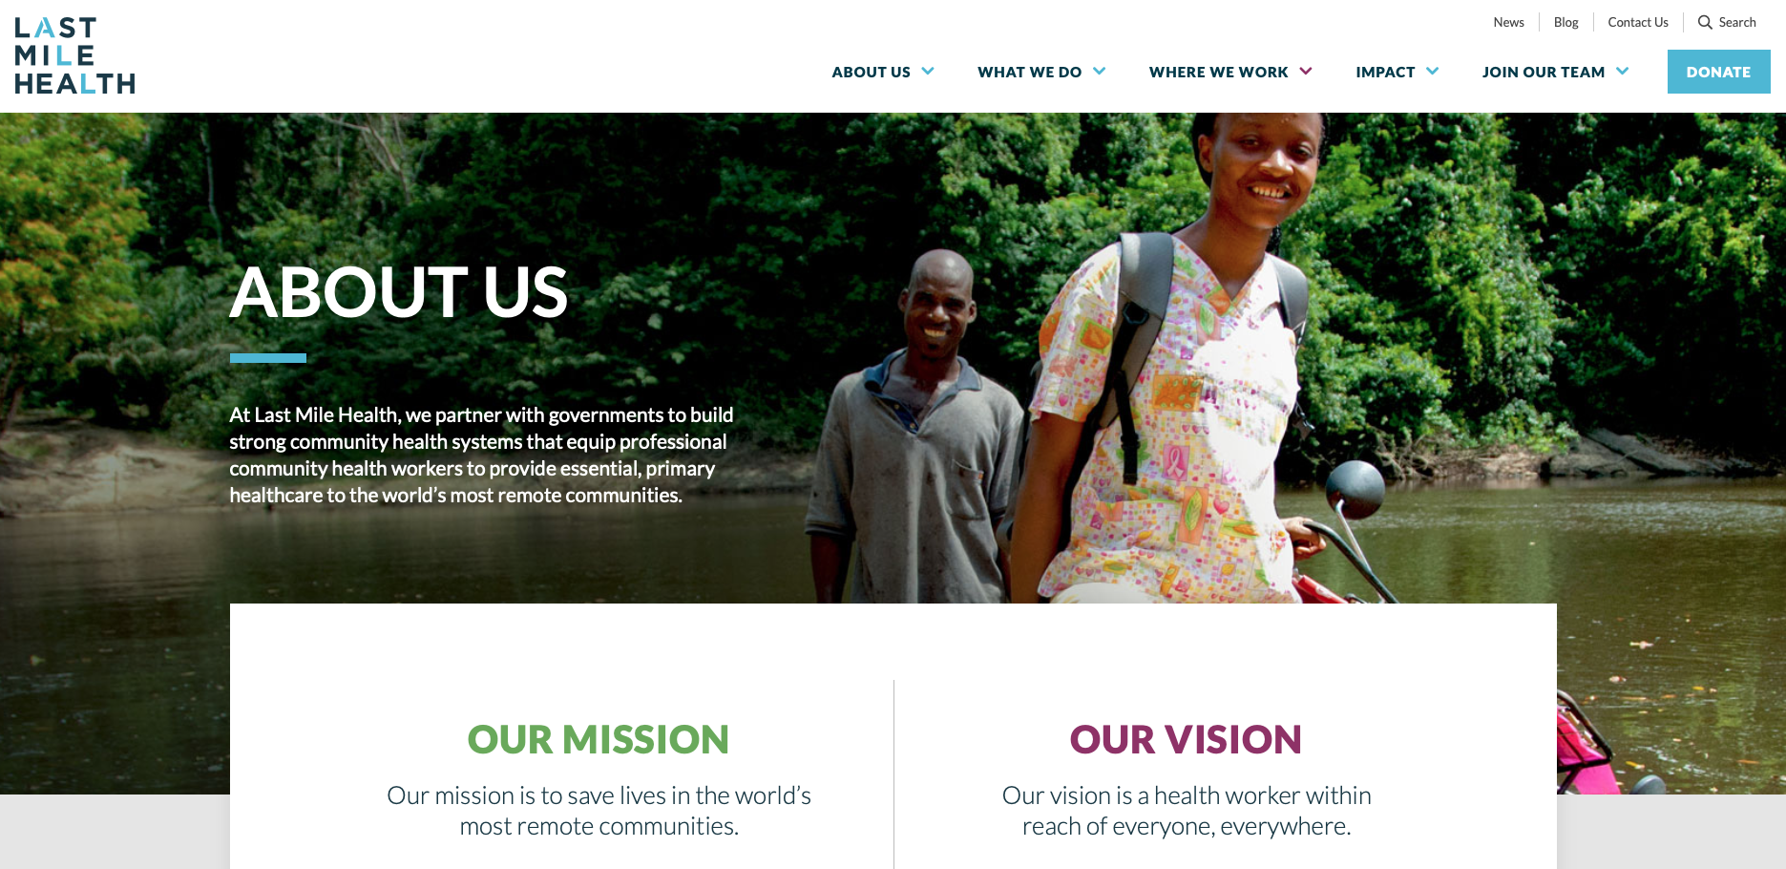
https://lastmilehealth.org
Notes:
I want to encourage you to look at this website. This organization is doing a great work in several nations in Africa in conjunction with the government.

Slide 31
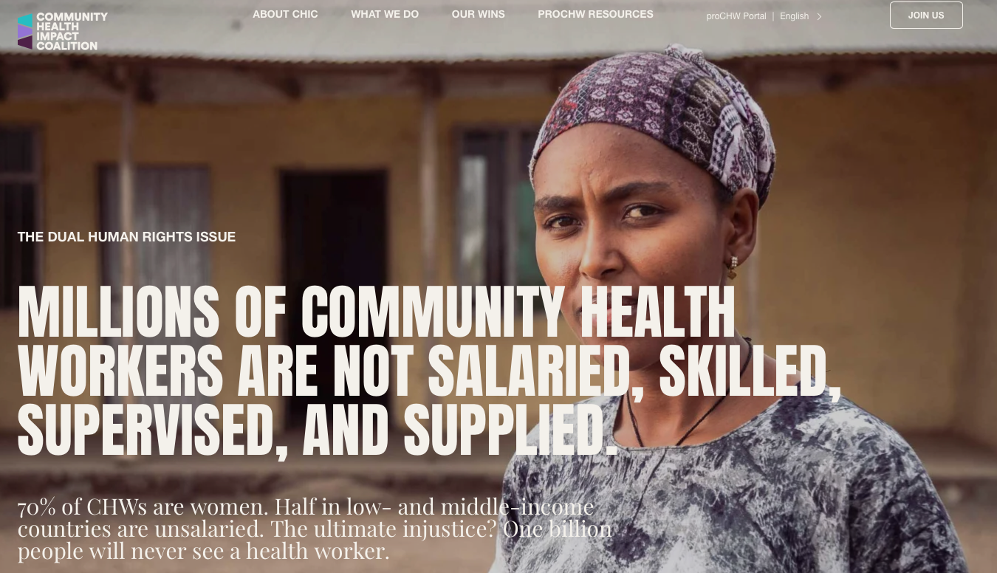
https://joinchic.org
Notes:
A great resource for advocating on behalf of CHWs.
Community Health Impact Coalition is making professional community health workers (proCHWs) the norm worldwide by changing guidelines, funding, and policy.

Slide 32
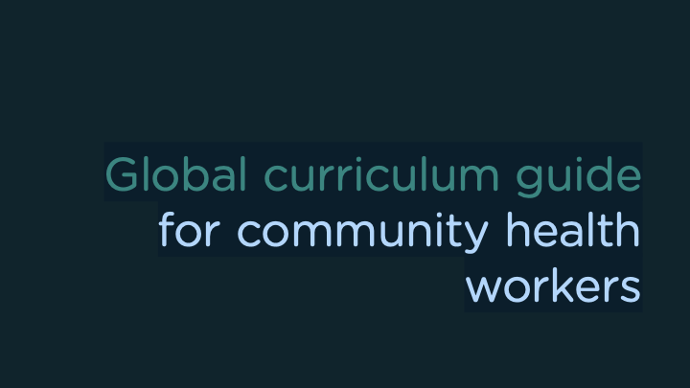
https://www.who.int/publications/i/item/9789240118065
Notes:
This is a great tool to help you develop a comprehensive CHW training course. This CHW curriculum guide should be adapted to the needs of different countries, health systems, programmes and contexts.

Slide 33
Questions?

Slide 34
Resources
Scott, K., Beckham, S.W., Gross, M. et al. What do we know about community-based health worker programs? A systematic review of existing reviews on community health workers. Hum Resour Health 16, 39 (2018). https://doi.org/10.1186/s12960-018-0304-x
WHO guideline on health policy and system support to optimize community health worker programmes. Geneva: World Health Organization; 2018. Licence: CC BY-NC-SA 3.0 IGO.
Community Health Impact Coalition: https://joinchic.org
Jeet G, Thakur JS, Prinja S, Singh M (2017) Community health workers for non-communicable diseases prevention and control in developing countries: Evidence and implications. PLoS ONE 12(7): e0180640. https://doi.org/10.1371/journal.pone.0180640
Free Course: Health For All Through Primary Health Care: https://www.coursera.org/learn/health-for-all?msockid=1ac4aca1b1f36fab01afb896b0da6e4e#modules
Harvard Course: Strengthening Community Health Worker Programs: https://harvardonline.harvard.edu/course/strengthening-community-health-worker-programs

