Slide 1


Compassionate Care: Welcoming the Nations to Memphis
Speaker: Dr. Audrey VanWylen

Slide 2

Purpose of Workshop
To describe how a faith-based federally qualified health care center (FQHC) in Memphis, TN partnered with resettlement organizations to provide domestic medical screenings and a medical home for those recently arrived. The vision and our clinic operations will be described as well as time to network and think about how any place of medical care might welcome refugees.

Slide 3
Workshop Objectives
1. Learn how a clinic can be welcoming to patients that are refugees.
2. Describe operational challenges of expanding capacity to see patients that are refugees and some solutions.
3. Analyze your medical care setting and determine next steps for being a welcoming place for refugees.

Slide 4
Audrey VanWylen, MD
Specialty: Family Medicine
Work: Christ Community Health Services (CCHS) – 12 years (9/2013 – present)
Current work:
  Refugee Health Lead Clinician
  HIV Lead Clinician - AAHIVM credentialed HIV specialist
  Christ Community Family Medicine Residency – Program Director
  Physician and IM resident preceptor at CCHS Frayser Clinic
Current Life
  I live in Memphis TN with my husband Peter (married 14 years as of Wednesday) and my children (Isaac – 10, Austin – 8, Isla -5), a dog and fish and occasionally jumping spiders.
  I enjoy in no particular order: camping, gardening, baseball, coffee dates, planning fun trips, celebrating things big and small.

Slide 5
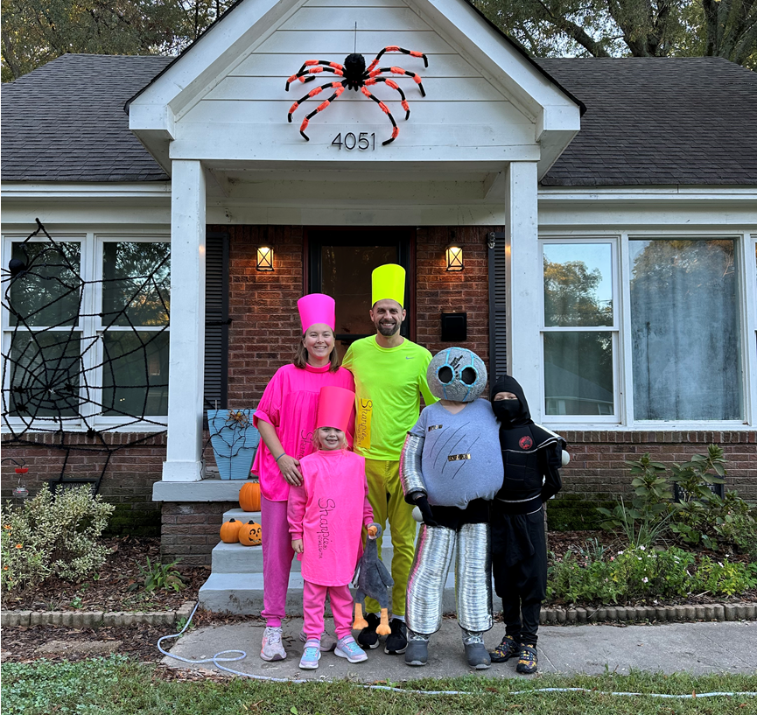
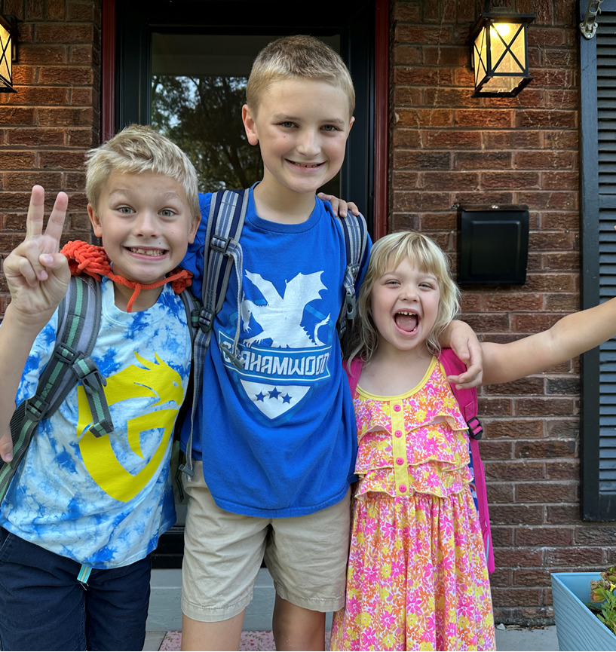
Disclosures
None

Slide 6
Prayer
Do not mistreat foreigners living in your country, but treat them just as you treat your own citizens. Love foreigners as you love yourselves, because you were foreigners one time in Egypt. I am the Lord your God. Leviticus 19: 33-34 (NCV)
And the Lord spoke his word to Zechariah again, saying, “ This is what the Lord All-Powerful says: ‘Do what is right and true. Be kind and merciful to each other. Don’t hurt widows and orphans, foreigners or the poor; don’t even think of doing evil to somebody else.’” Zechariah 7: 8-10 (NCV)
Keep on loving each other as brothers and sisters. Remember to welcome strangers, because some who have done this have welcomed angels without knowing it. Hebrews 13: 1-2 (NCV)

Slide 7
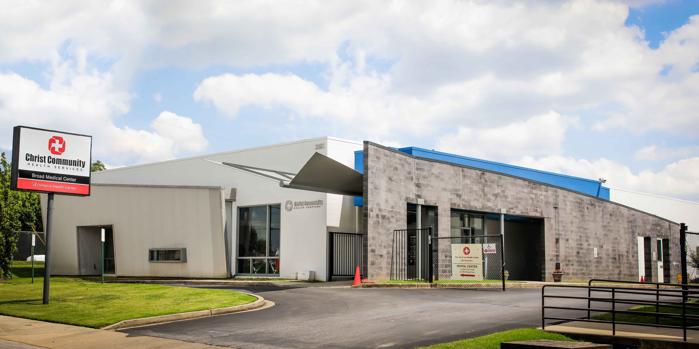
Environment of Care

Slide 8
CCHS was born out of the faithfulness of 4 doctors Rick Donlon, David Pepperman, Karen Miller, and Steven Besh who started the first clinic in 1995 on South Third street with a mission of providing high quality healthcare to the underserved in the context of distinctively Christian service recognizing that Jesus Christ is the true healer of individuals and their communities and the source of our ability to
Recently celebrated its 30th anniversary.
Federally Qualified Heath Center and Patient Centered Medical Home

Slide 9
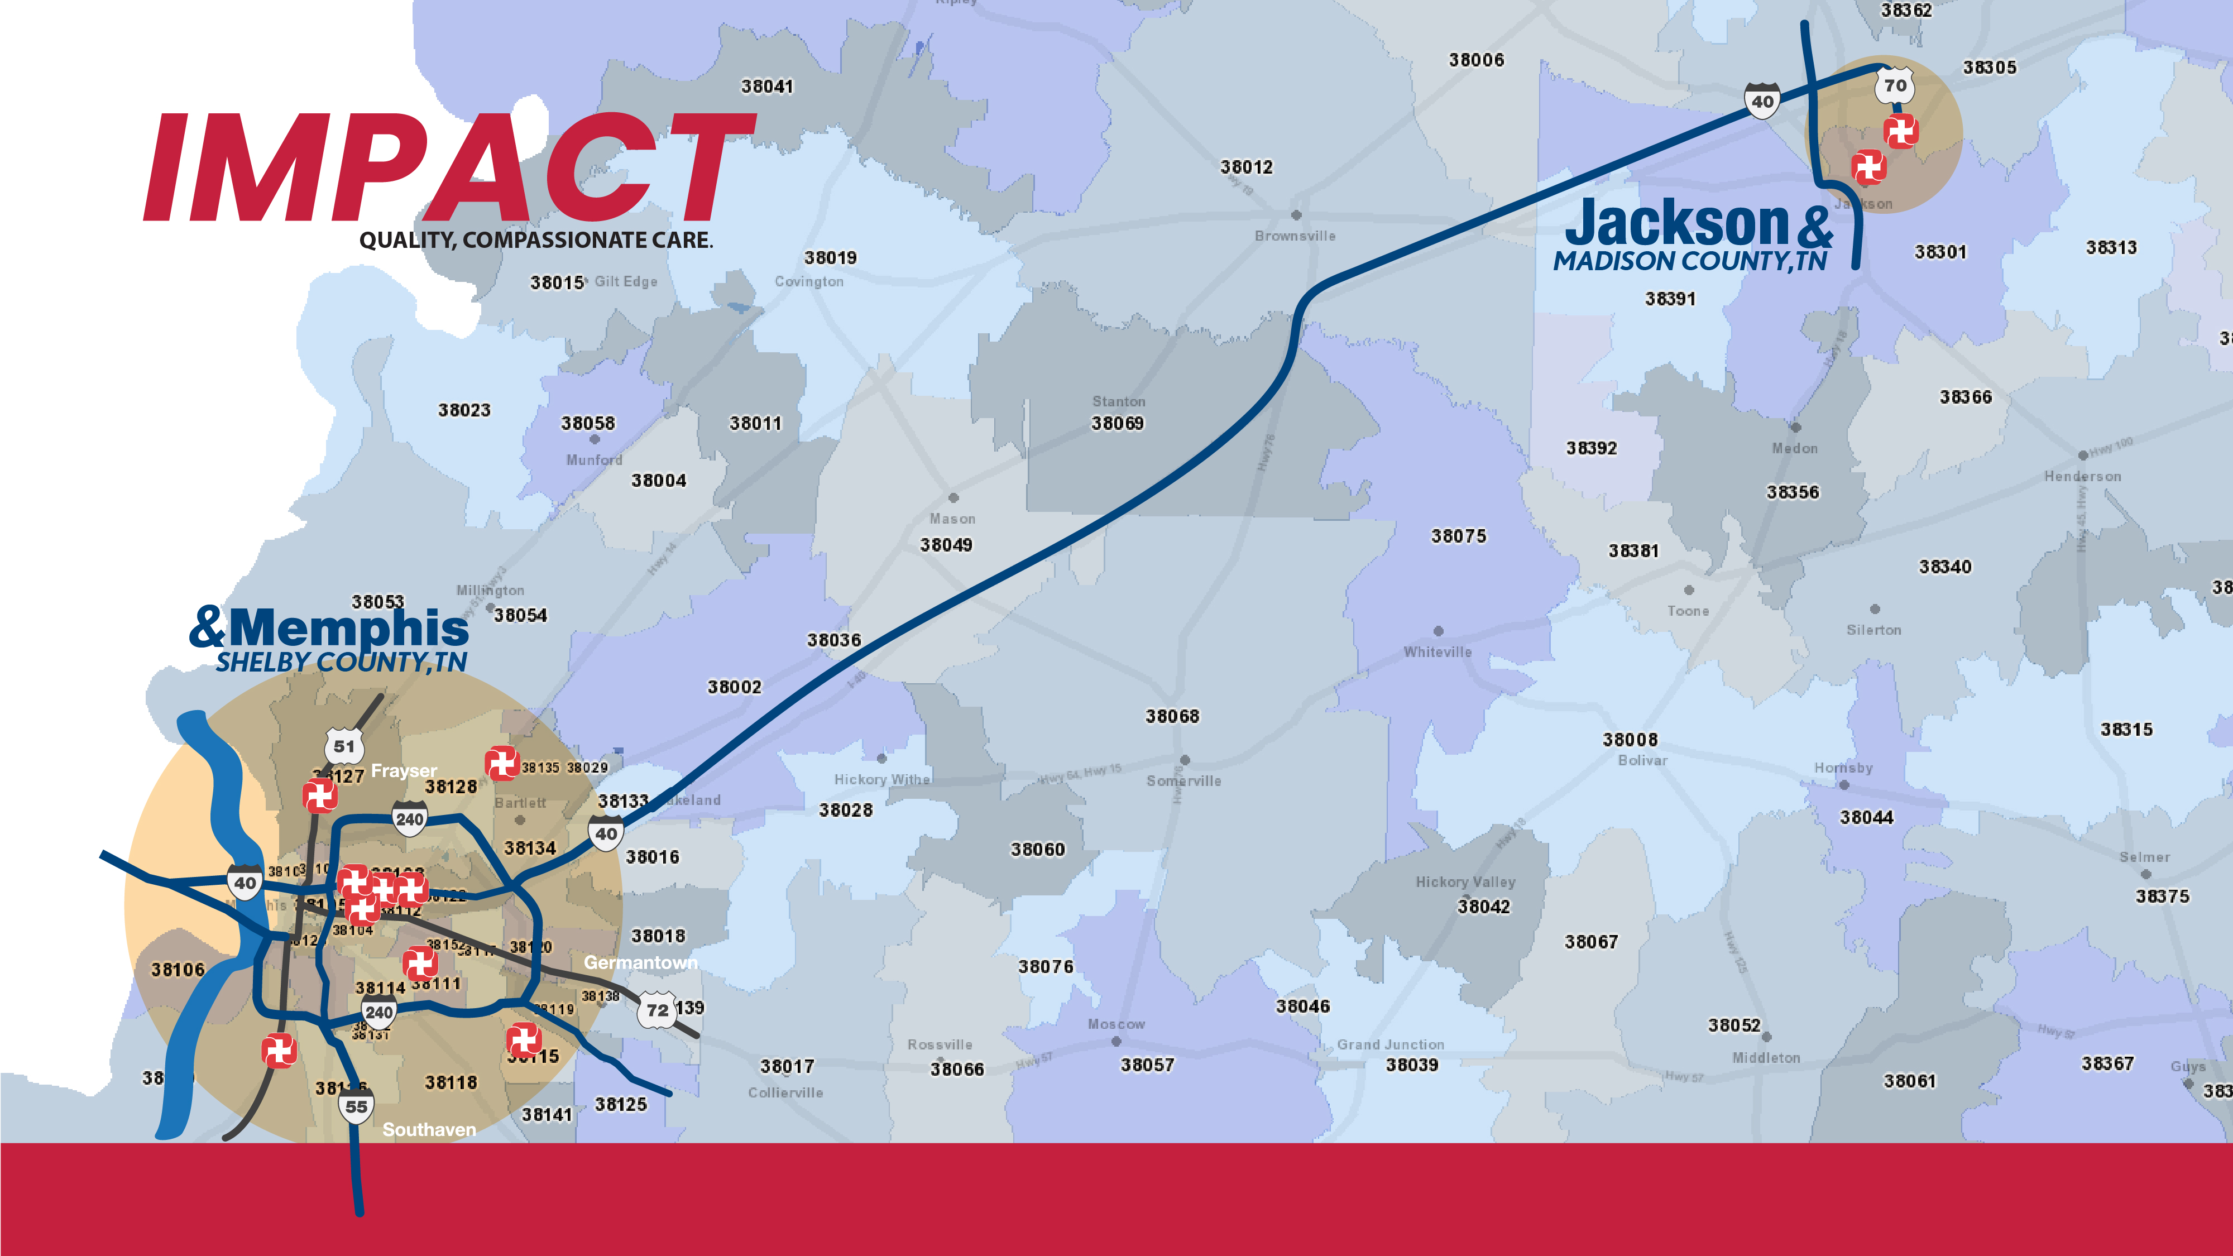
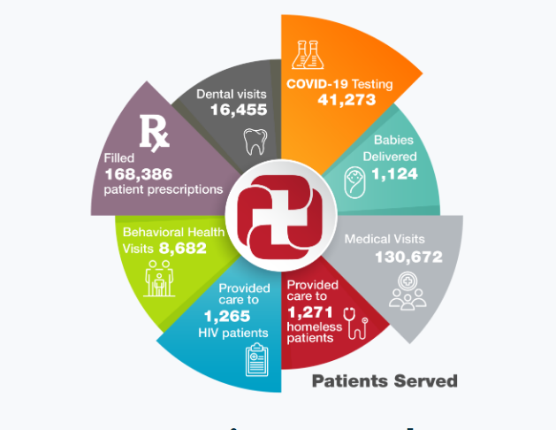
Christ community health services

Slide 10
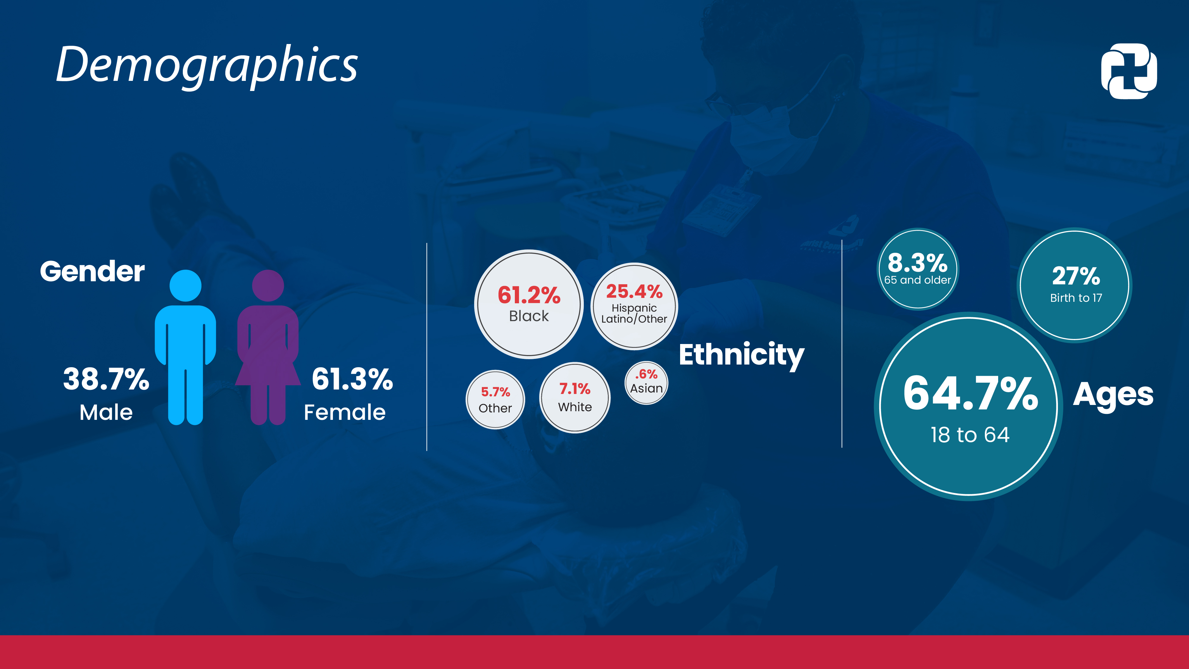
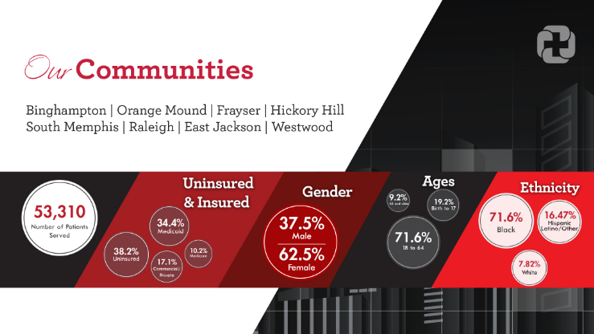

Slide 11
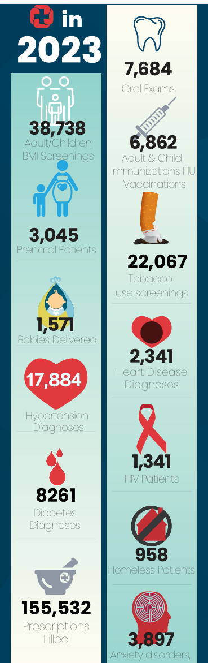
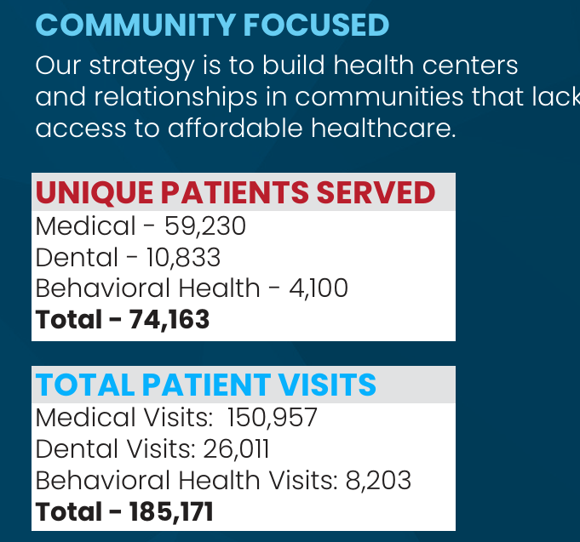

Slide 12

WELCOMING THE NATIONS

Slide 13
History
CCHS first partnered with the Tennessee Health Department July 1st, 2007 to provide domestic screening medical physicals
In 2008 when Tennessee opted out of overseeing refugee resettlement, Catholic Charities stepped up and created the Tennessee Office of Refugees (TOR)
TOR subcontracts with us as a partner clinic to provide the domestic health refugee medical screening exam.

Slide 14
Who qualifies for services?
Refugees
Asylees
Special Immigrant Visa Holders
Cubans/Haitians Entrants
Amerasians
Human Trafficking Victims
Humanitarian Parolees (ex: Afghanistan, Ukraine)

Slide 15
Resettlement Partners
World Relief Memphis/Bethany Christian Services
World Relief Memphis
  They opened their office in Memphis in 2012 and were the sole resettlement agency in Memphis until 2023.
  They welcome the refugees and then get us the necessary paperwork to schedule the exams.
  We meet monthly to coordinate our services
  They provide the initial services for the first 30-90 days including housing, essential furnishings, food, clothing, community/cultural orientation, and employment services.
  worldrelief.org/memphis/
Bethany Christian Services
  Began resettling refugees June 2023 due to increased demand for resettlement. Ended for all practical purposes 2025.
  Had the Resettlement & Placement grant but not some of the supportive services

Slide 16
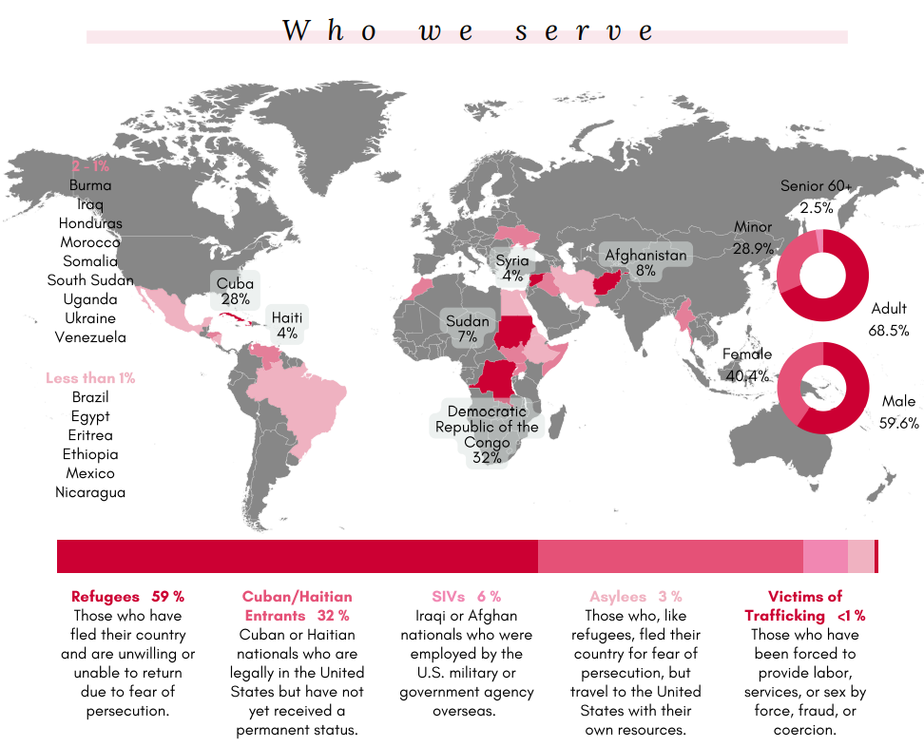
https://tnrefugees.org/wp-content/uploads/2022/05/2021-Year-in-Review.pdf

Slide 17
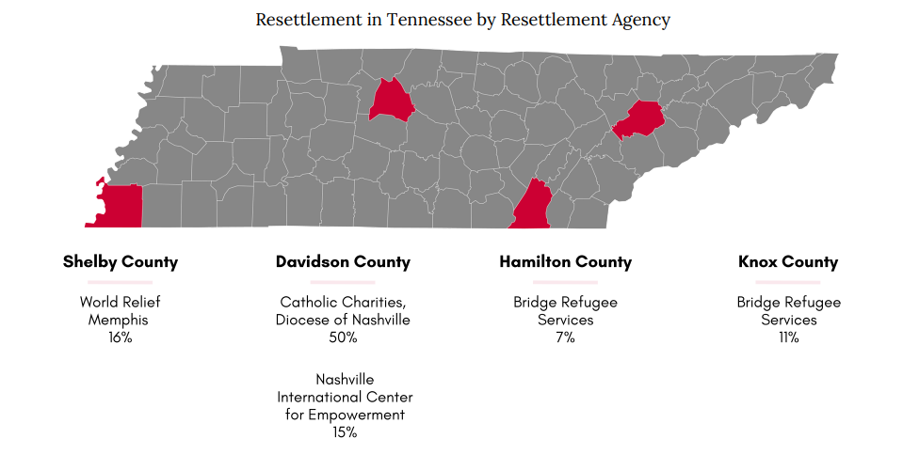
2024 19.6%
2024 12.4%
2024 13.2%
https://tnrefugees.org/wp-content/uploads/2022/05/2021-Year-in-Review.pdf

Slide 18
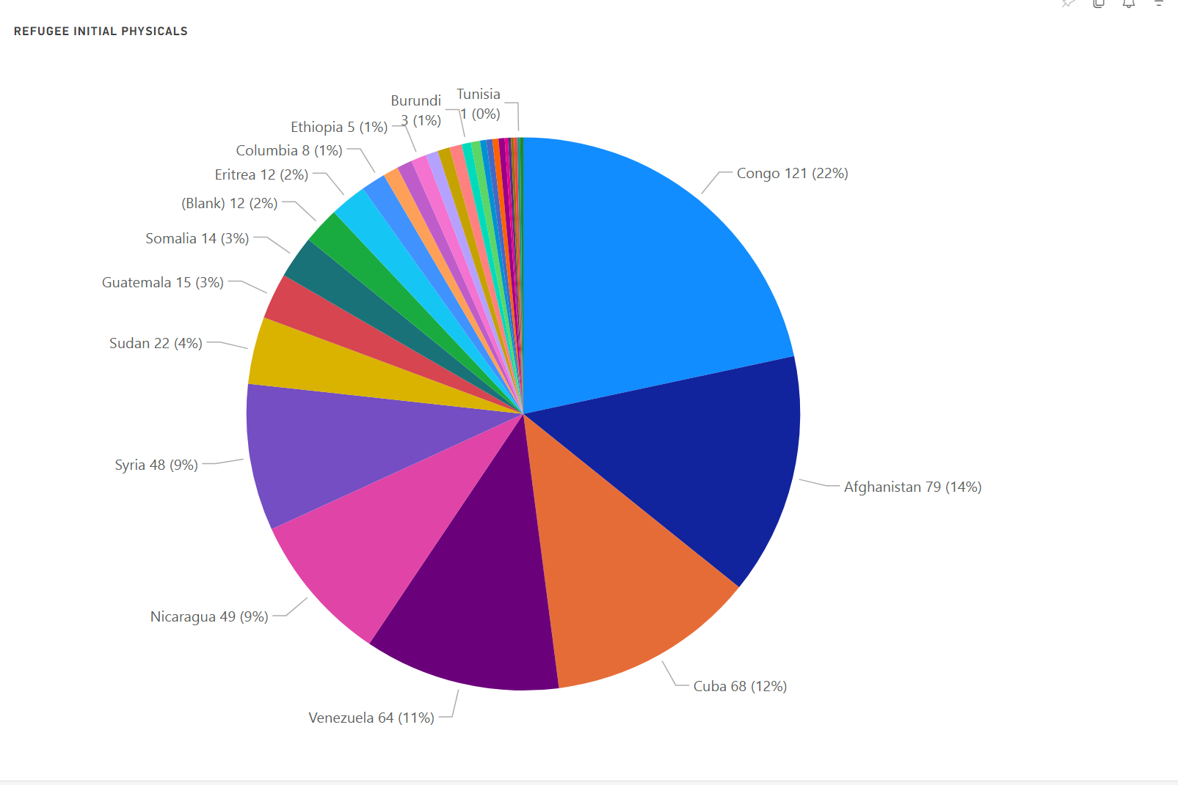

Slide 19
Domestic Health Refugee
Medical Screening
U.S. Domestic Medical Examination
Empiric parasite treatment
Lab testing (communicable diseases, etc.)
Treatment for or linked to care for chronic medical conditions
Basic mental health evaluation
Vaccinations
Interpretation services always provided free of charge

Slide 20
Health Goals for Refugees
Flourishing in Memphis
Access to Primary Care Services and Specialty Services
Always having interpreter for communication
Linking into care for wellness exams (different from refugee physical)
Refugee women’s health
Pediatric Care
Mental Health Care
Goal of being able to navigate their medical services and insurances
NO MATTER WHAT….They can come to CCHS.

Slide 21
What Makes a Clinic Welcoming?
Communication
  Access to interpreters in person or virtual at all stations of a medical visit.
  Written materials in the patient’s language
Time
  Allowance for increased triage and visit time
Personnel
  Welcoming staff
  Hiring staff from the refugee community
  Provider education
    Common medical issues from country of origin
    Common ways their culture interacts with medical beliefs
Location
  Decrease transportation barriers

Slide 22
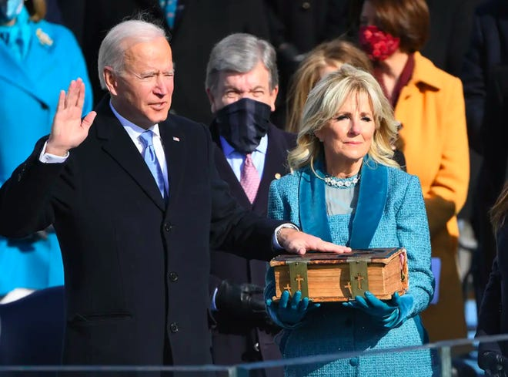
The Need
Picture from USA Today
President Biden Elected 2020

Slide 23
Situation 2020
We saw a total of 13 refugee physicals in all of the 2020 year (Oct 2019 – Sept 2020)
Infrastructure had atrophied due to lack of use.
We needed to prepare for the increased numbers.

Slide 24

Preparation
Lead given 4 hours/week x 2 months of admin time
Meetings with key clinic team members
  Front staff/Clinic manager
  Nursing/MA
  Providers
Meetings with community partner
  World Relief: Started monthly meetings, exchanged new information (personnel, procedures, documents)
Designed a weekly Refugee Clinic and received approval from C suite
  Wrote the clinic protocols for scheduling, clinic flow
Training
  Clinic staff on process and refugee pathway with a goal of increasing compassion
  Providers on domestic medical screening exam with lunch sessions. Made providing them opt-in.

Slide 25

Result
Successful ramp up without any clinic disruption
2020 – 13 exams
2021 – 53 exams
2022 – 205 exams
Feeling pretty good about our improved relationships and well oiled machine.

Slide 26

Capacity Crisis
Summer 2023 Tennessee Office of Refugees opened a new resettlement agency in Memphis and Resettlement and Placement project unprecedented numbers of arrivals

Slide 27
Adding a new resettlement agency
Challenges:
  No notice that refugees had arrived and needed to be scheduled.
  No common expectations of the process
  Unclear who was in charge.
Opportunities:
  More refugees would be able to be settled prior to the 2024 election.
Reality:
  The increase of refugees from World Relief as well as adding a new resettlement agency caused the number of arrivals to exceed our capacity.

Slide 28

We needed help…
WR was being asked to resettle 300 people in the 2024 year and BCS 110 people in 2024 for a total of 410 people (refugees only).
Immediately increased number per shift from 5 to 6 and doubled the number of clinics starting October 2023.
Still falling behind. Usually we saw refugees within the first 30 days of their arrival as asked but we were often at 90 days or beyond.
By February 2024 it was often 120 days to see patients given over 200 arrived in 4 months.

Slide 29
Ideas that didn’t work for us…but might work for you.
Hiring an RN part-time to do physicals under supervision and help with administrative duties.
Training up another CCHS clinic to be able to help perform physicals.
  School based health
  Homeless clinic sat empty on Fridays
Reached out to the Global Health Track director at University of Tennessee to see if their residents could help.
Tried to recruit a college intern to help with scheduling
Was unable to schedule more refugee clinics at the current CCHS clinic
> 1 day/week.

Slide 30
Ideas that did work
Add some Saturday clinics.
Trained new providers at CCHS to do refugee clinic while waiting to be credentialed with insurance companies.
Recruited another group in town (ShotRx) to help with vaccinations.
This led to them contracting with TOR to do physicals.
We trained their CEO, staff, provider in the process and they shadowed our clinic multiple times. Stayed in touch throughout the process.
Overall
  2023 – 265 screenings
  2024 – 417 screenings

Slide 31
Resettling Partnerships
Overcommunicate
  Raised the red flag in October
  Raised the white flag in January
Met weekly at times when needed to keep updated
Used church networks for unmet needs
Be gracious
Wrote letters of support when they were being pressured to accept more arrivals (beyond their capacity).

Slide 32

Questions? Announcement:
Dinner opportunity to continue discussions around welcoming refugees.

Slide 33

Workgroups
Please form groups of 3-5 people

Slide 34
Define
Define what you do or what services you offer.
Does what you do currently intersect with non-US born people groups?
  Why or why not?
Do you/your organization want to be more welcoming to refugees?
  Pros and Cons

Slide 35
Ask
Where are the people groups/individuals you wish to serve/learn from?
Who are the resettlement agencies in your area?
Who is already doing good work?
Who is your team?
What is your current process?
What are your opportunities for improvement?

Slide 36
Plan
Where does the needs in our refugee communities intersect with your passions/mission/services?
Where are you in the process? What is your next step?
  Information Gathering Stage
  Task Acquired
  Logistics/Data
  Pilot/Trial
  Reassess/Retrain
  Steady state

Slide 37
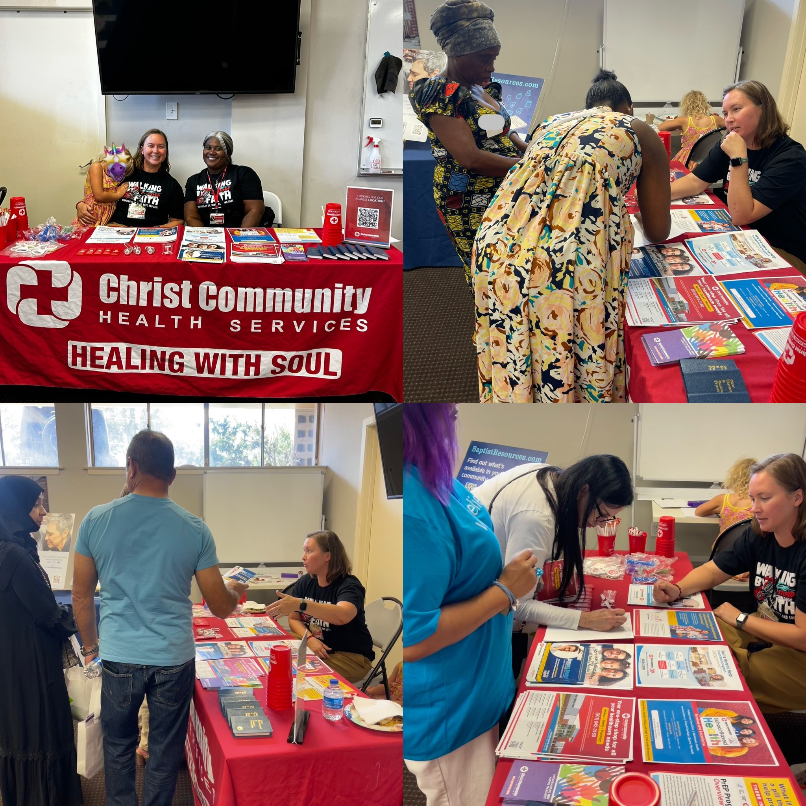
Thank you!!

Slide 38
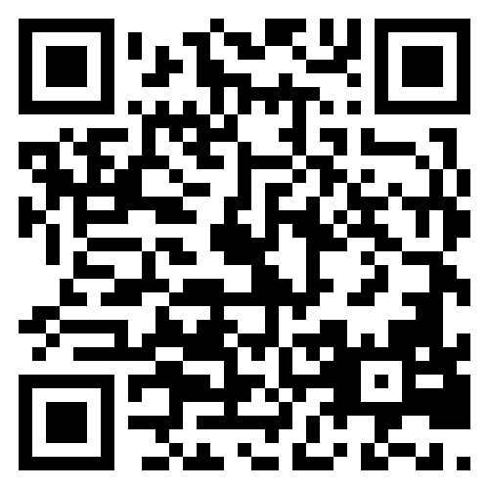
Evaluation

