Slide 1

Family Medicine Training
From Local to Global
Rebekah Zechariah
Christian Medical College
Vellore, India
GMHC 2025

Slide 2
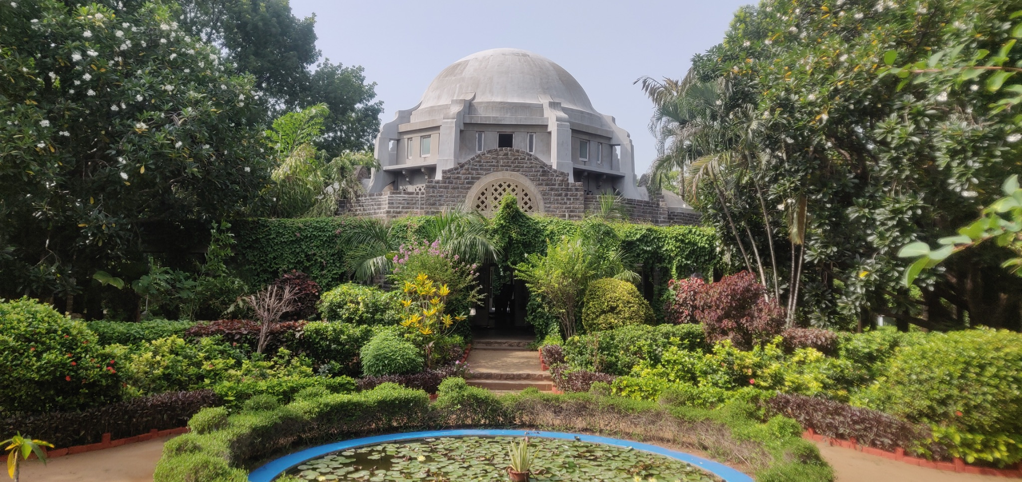
Christian Medical College & Hospital Vellore
Est. 1900

Slide 3
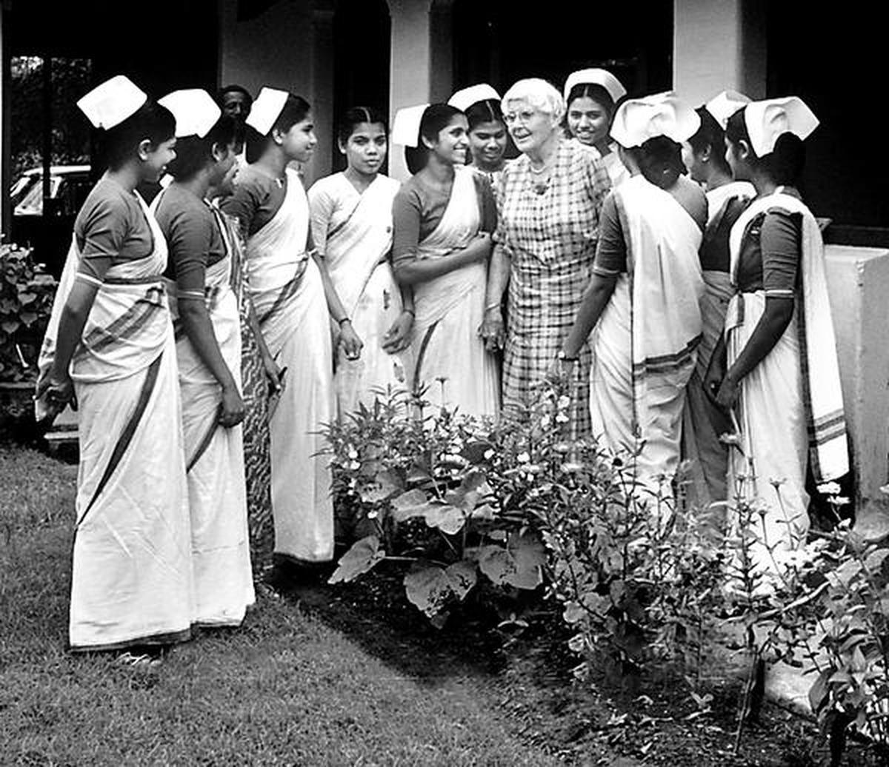
Dr. Ida Sophia Scudder
Founder

Slide 4
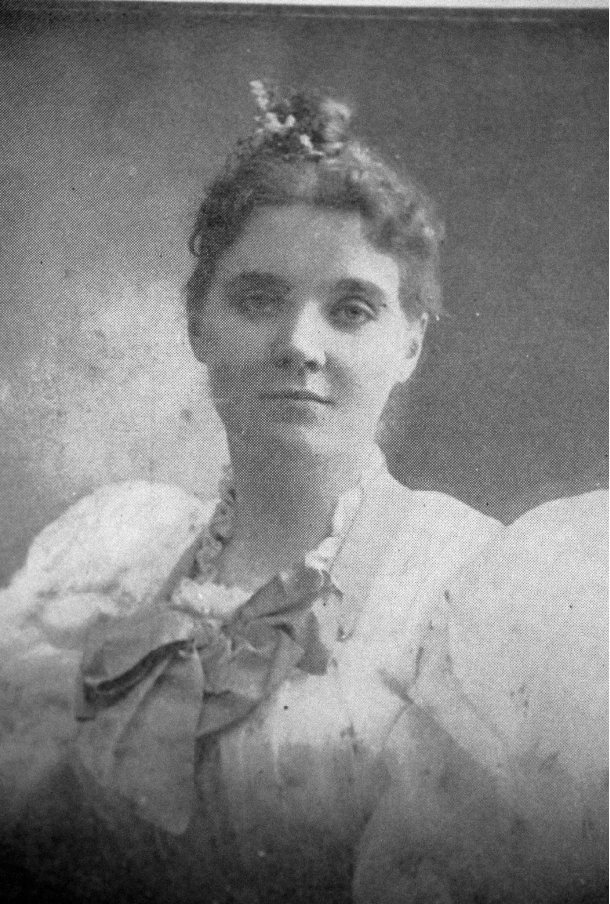
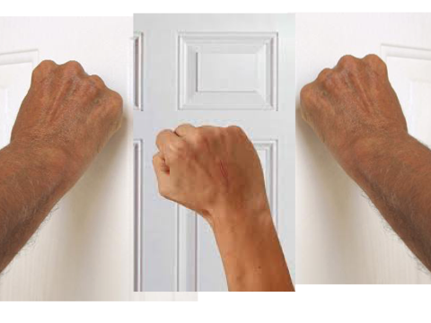
The Three Knocks

Slide 5
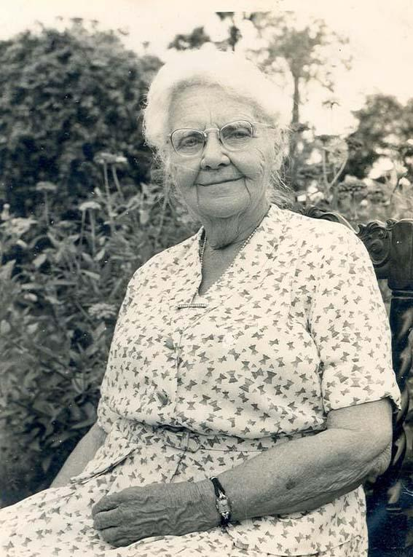
A Single Woman...
Listened
Dreamed
Acted on it

Slide 6
Some Staggering Figures
73%
27%
80%
Urban Population
Urban Doctors
Rural Population
20%
Rural Doctors

Slide 7
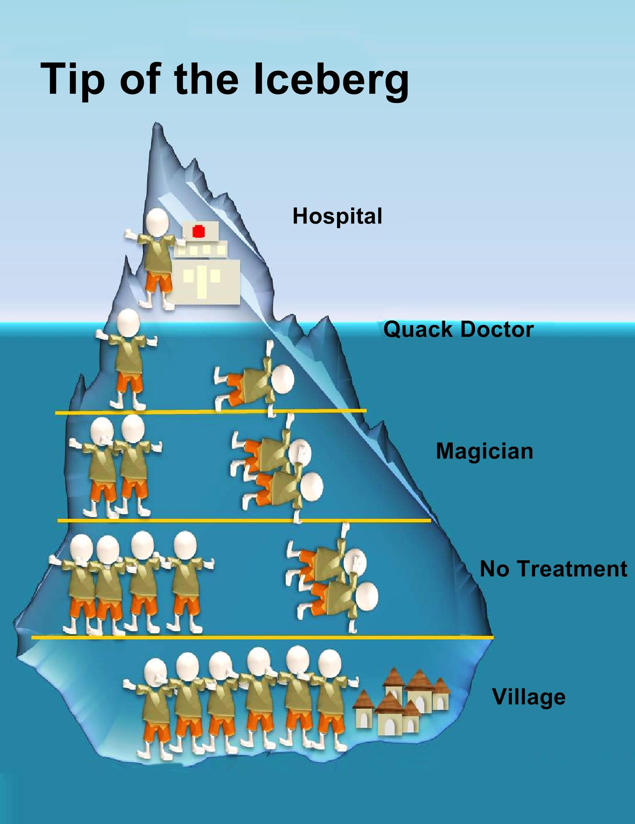
The Reality

Slide 8
Distance Education @ CMC

Slide 9
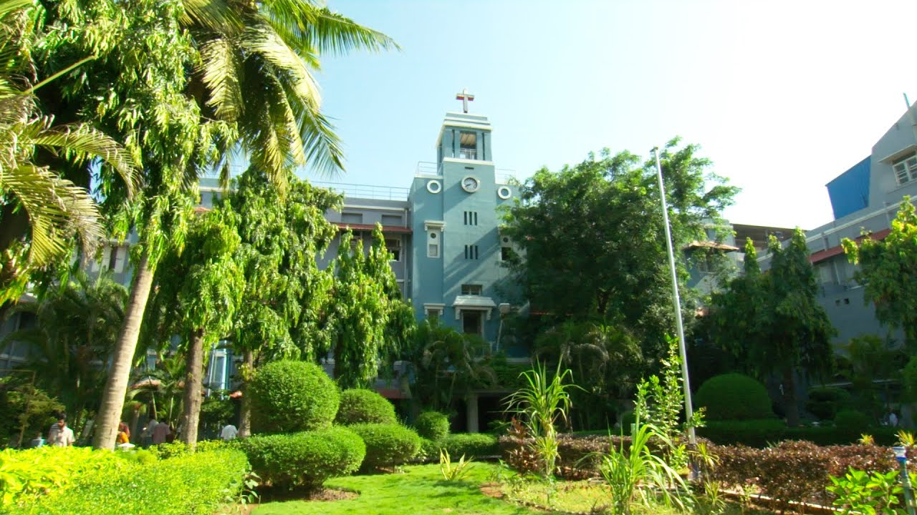
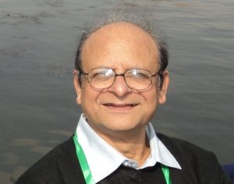
Distance Education Unit
Since 2004
Dr. Vinod Shah

Slide 10
Take the education to them rather than have healthcare professionals leave their service areas.

Slide 11


Face to Face
Online Learning
Blended Learning

Slide 12
Courses offered | Target group | Max No: of students per year | Total number trained (Upto 2021/22)
Family Medicine courses (PGDFM/MMed) | For General Practitioners | 300 | 3451
 | For Government doctors – TNHSP & NRHM | 20 | 254
Distance Fellowship in Diabetes Management (DFID) | For Post Graduate Physicians and Family Physicians | 75 | 1004
Community Lay-leaders Health Training Certificate (CLHTC) Program | Christian NGO workers based in very remote areas of the country. | 250 | 1712
Post Graduate Diploma in Geriatric medicine (PGDG) | For practicing general practitioners | 50 | 164
Post Graduate Diploma in Mental Health (PGDMH) | For practicing general practitioners and graduates | 30 pairs | 73 pairs
Certificate in General Dentistry (CGD) | For dentists | 16 | 53

Slide 13
Courses offered | Target group | Max No: of students per year | Total number trained (Upto 2020)
International Post Graduate Diploma in Family Medicine (I-PGDFM) | For General Practitioners | 50 | 67
Post Graduate Diploma in Rehabilitation Medicine | For Post Graduate Physicians and Family Physicians | 20 pairs | 11 pairs
Post Graduate Diploma in Lifestyle Medicine (PGDLM) | For practicing general practitioners | 20 pairs | Launched in Oct 2023
Certificate in Community Mental Health (CCMH) | For community volunteers | 20
Community Health Promoters Certificate Course (CHPC) | For community volunteers | 200

Slide 14

Focus on Primary Care
To become a more confident practitioner who is able to
“Refer less & Resolve more”

Slide 15
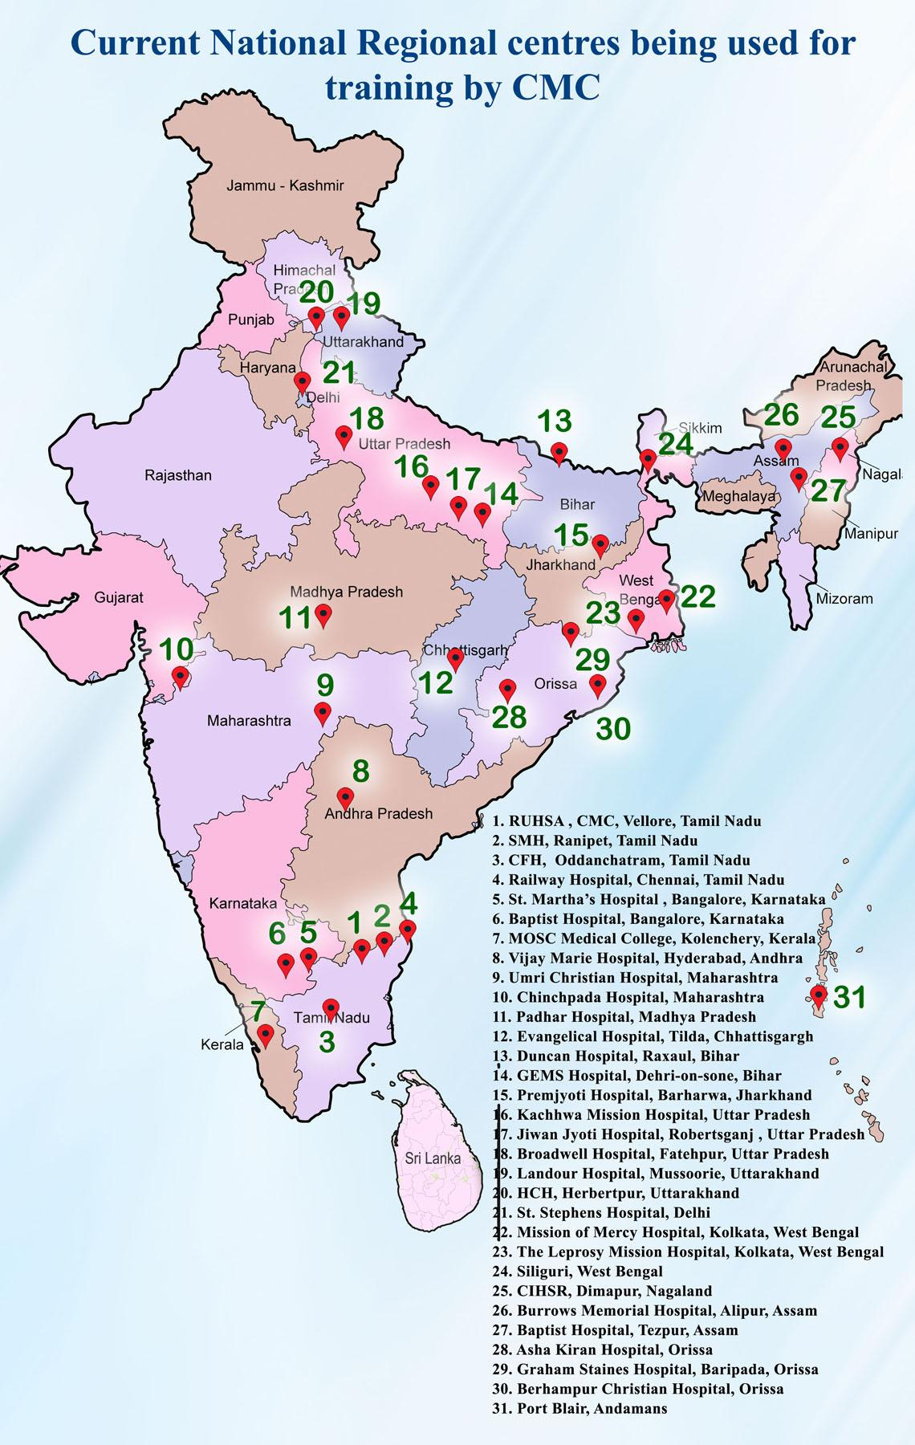
The Decentralized Approach
Regional Training Centres

Slide 16
Family Medicine as a Global Need

Slide 17



The International Program
International Post Graduate Diploma in Family Medicine
(I-PGDFM)

Slide 18
Diploma of Family Medicine (I-PGDFM)
Joint project between ICMDA, CMC Vellore and Loma Linda University
Launched on 4 May 2020 in the middle of the COVID Pandemic
Two year blended-learning course leading to international postgraduate diploma in Family Medicine (I-PGDFM)
Course is taught online with 15 online modules and 100 topics
Contact sessions held in six international centers
Six cohorts so far (50 learners per cohort)

Slide 19
TO TRAIN AND CERTIFY DOCTORS WITH POST-GRADUATE TRAINING IN FAMILY MEDICINE IN THE DEVELOPING WORLD AND EQUIP THEM PROFESSIONALLY AND SPIRITUALLY TO SERVE THEIR COUNTRY AND THE POOR
The Aim

Slide 20



ROLES
ICMDA – All course coordination
Registration/ payment of fees
Contact center planning
CMC – Course development, delivery & Faculty development
LLU – Accreditation

Slide 21
DESIGNED TO HONE DISTINCT FAMILY PHYSICIAN ATTITUDES, SKILLS AND KNOWLEDGE THAT QUALIFY THE PHYSICIAN TO PROVIDE CONTINUING, COMPREHENSIVE MEDICAL AND PREVENTIVE CARE TO PATIENTS, FAMILIES AND THEIR COMMUNITIES.
THE 'REFER LESS, RESOLVE MORE' MOTTO OF THE COURSE, SHARING HISTORICAL ROOTS TO FAMILY PRACTICE IS A STEP TOWARDS A COST EFFECTIVE, PATIENT CENTERED, PROBLEM ORIENTED, EVIDENCE BASED, GLOBAL HEALTH CARE DELIVERY SYSTEM.
Two year blended learning curriculum

Slide 22
Vital for the training be relevant.
Not just with regards to the course material but making it relevant to the health system in the region.
Global Contextualization

Slide 23
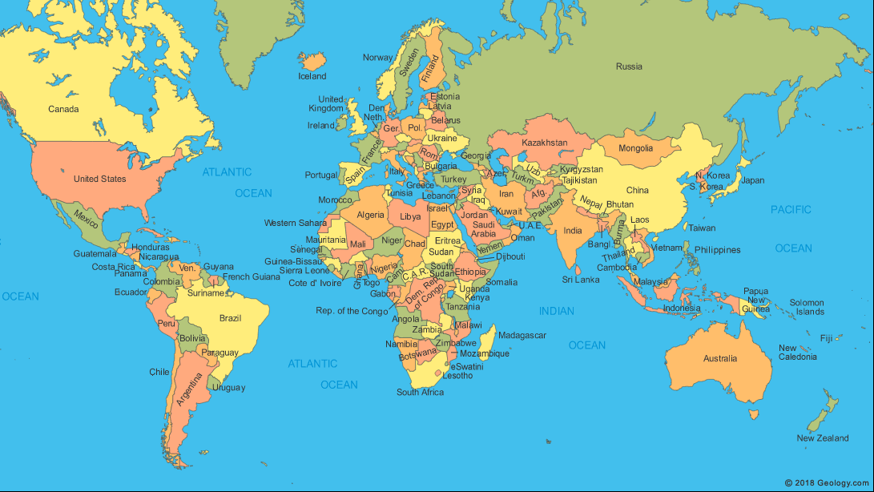
ENGLISH – EGYPT; NIGERIA; UGANDA; CAMBODIA; INDIA; PAKISTAN
TOGO/DRC (FRANCOPHONE);
KYRGYZSTAN/UZBEKISTAN (RUSSIAN);
HONDURAS (SPANISH)
This Photo by Unknown Author is licensed under CC BY-NC-ND

Slide 24
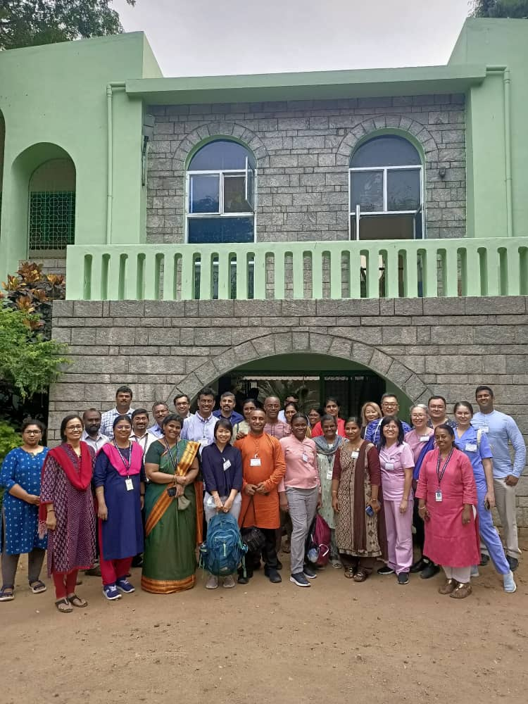
VELLORE

Slide 25
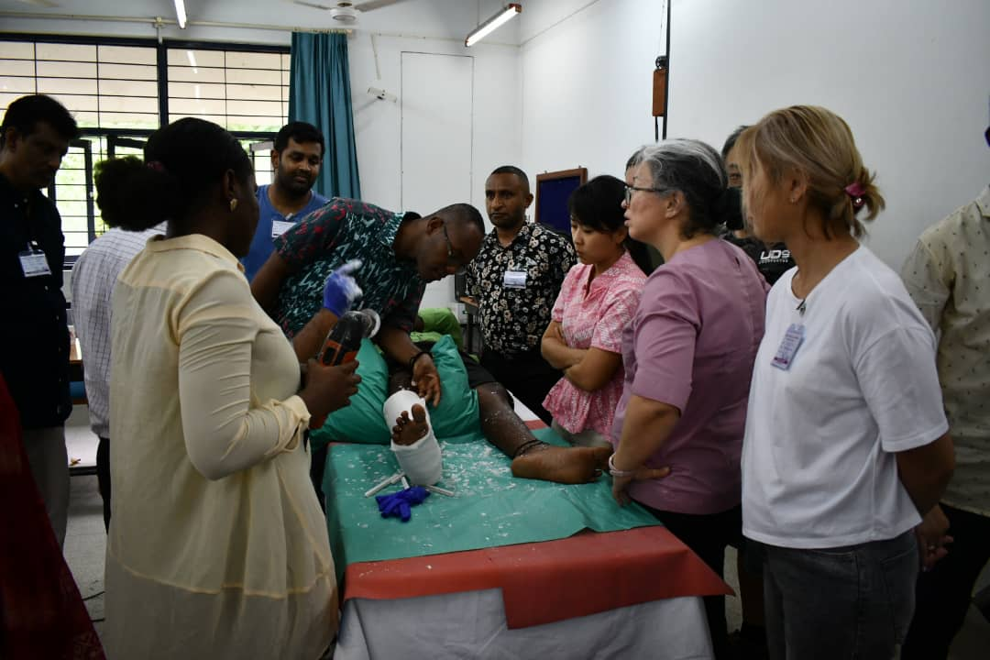
Hands-on Skills

Slide 26
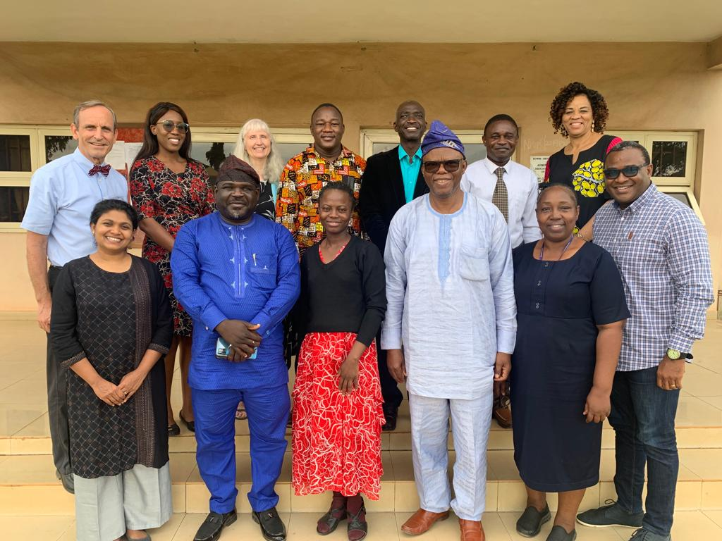
NIGERIA

Slide 27
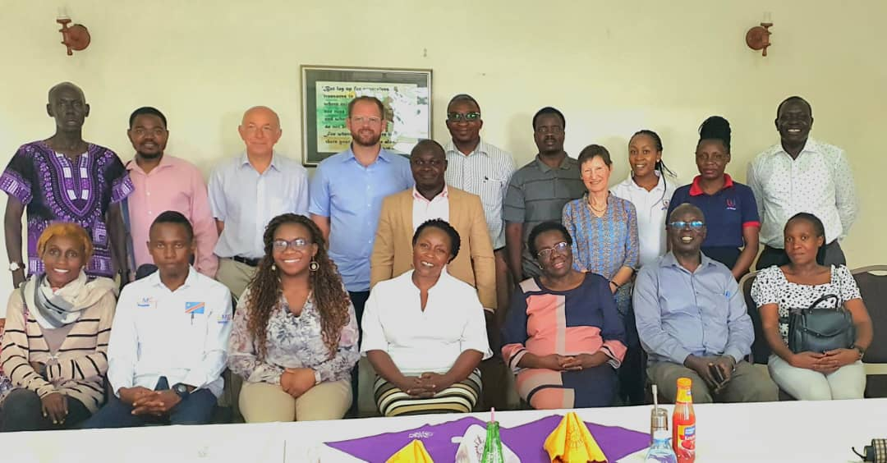
UGANDA

Slide 28
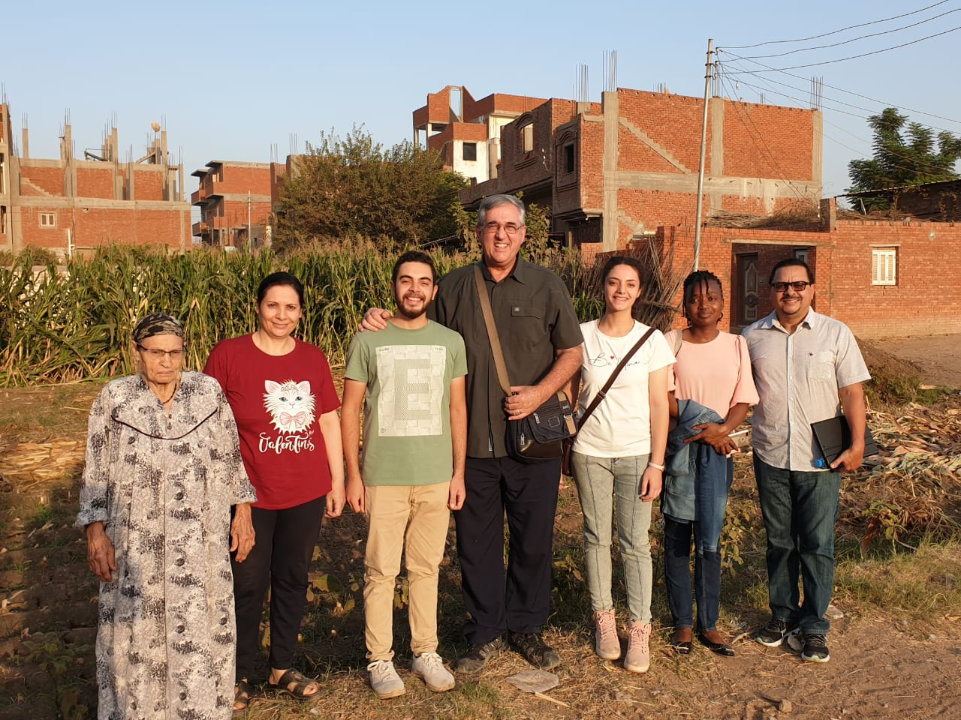
EGYPT

Slide 29
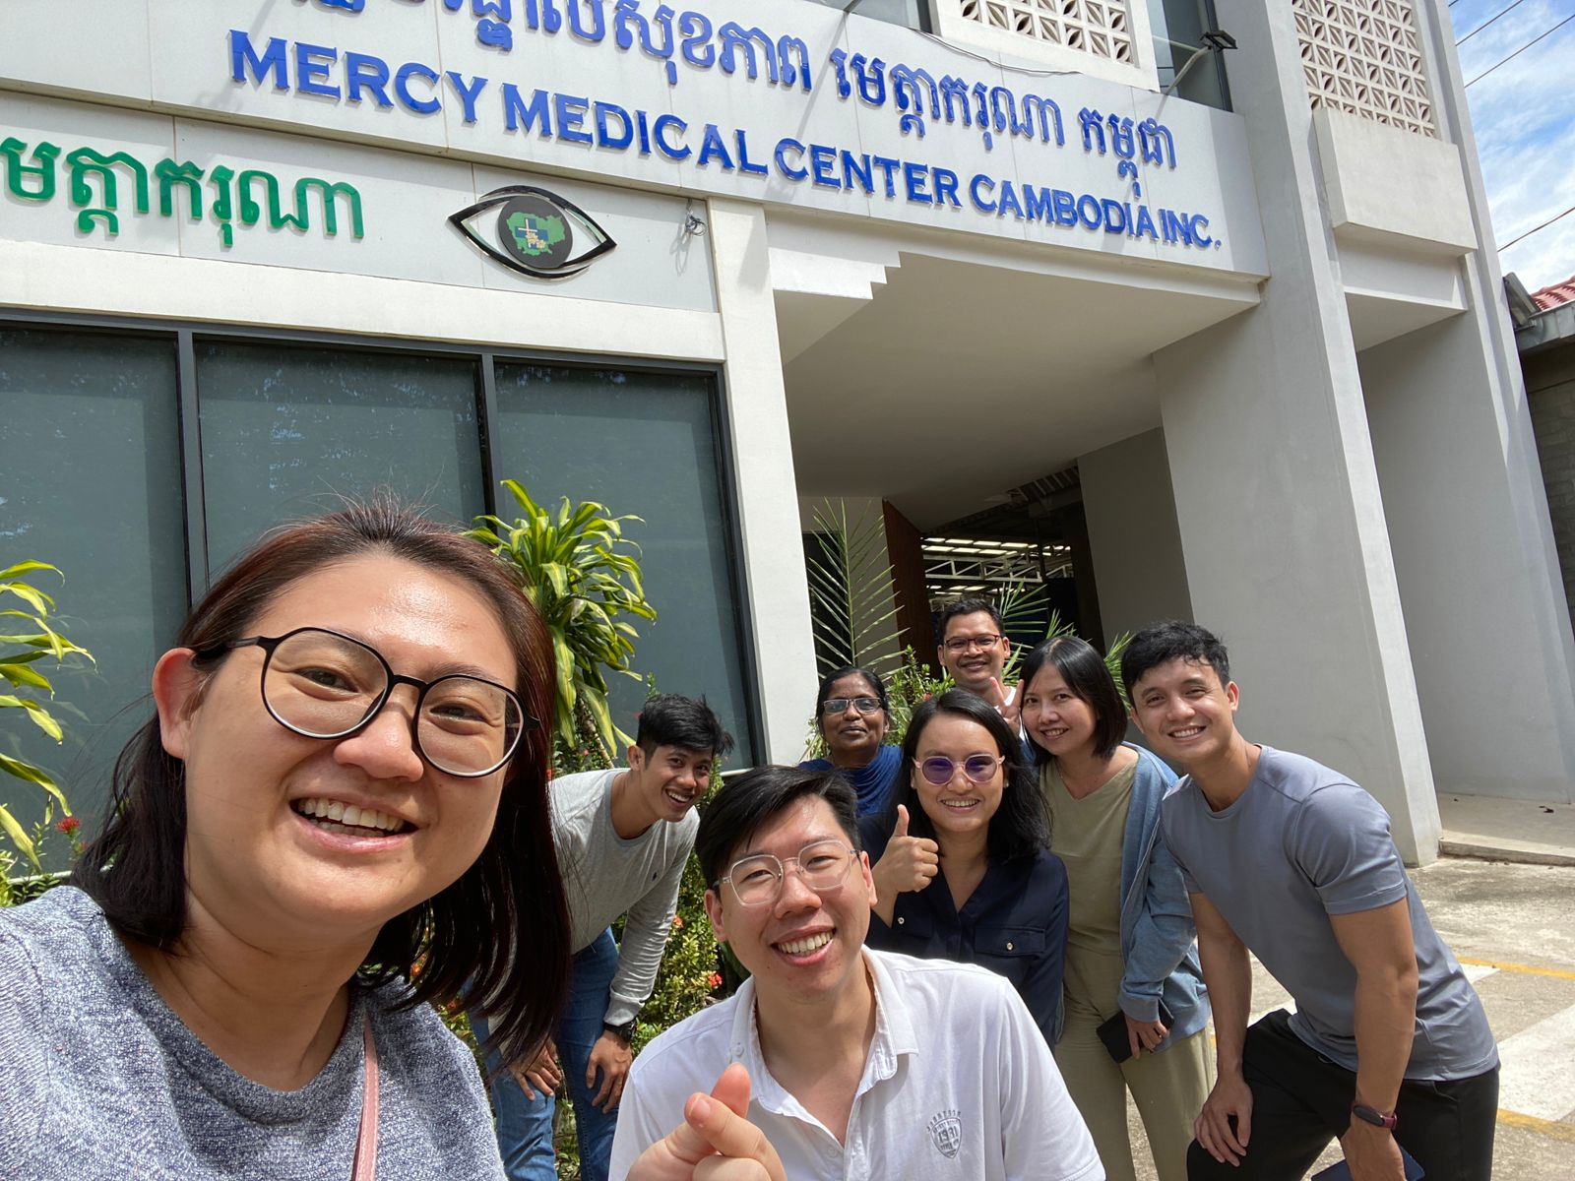
CAMBODIA

Slide 30
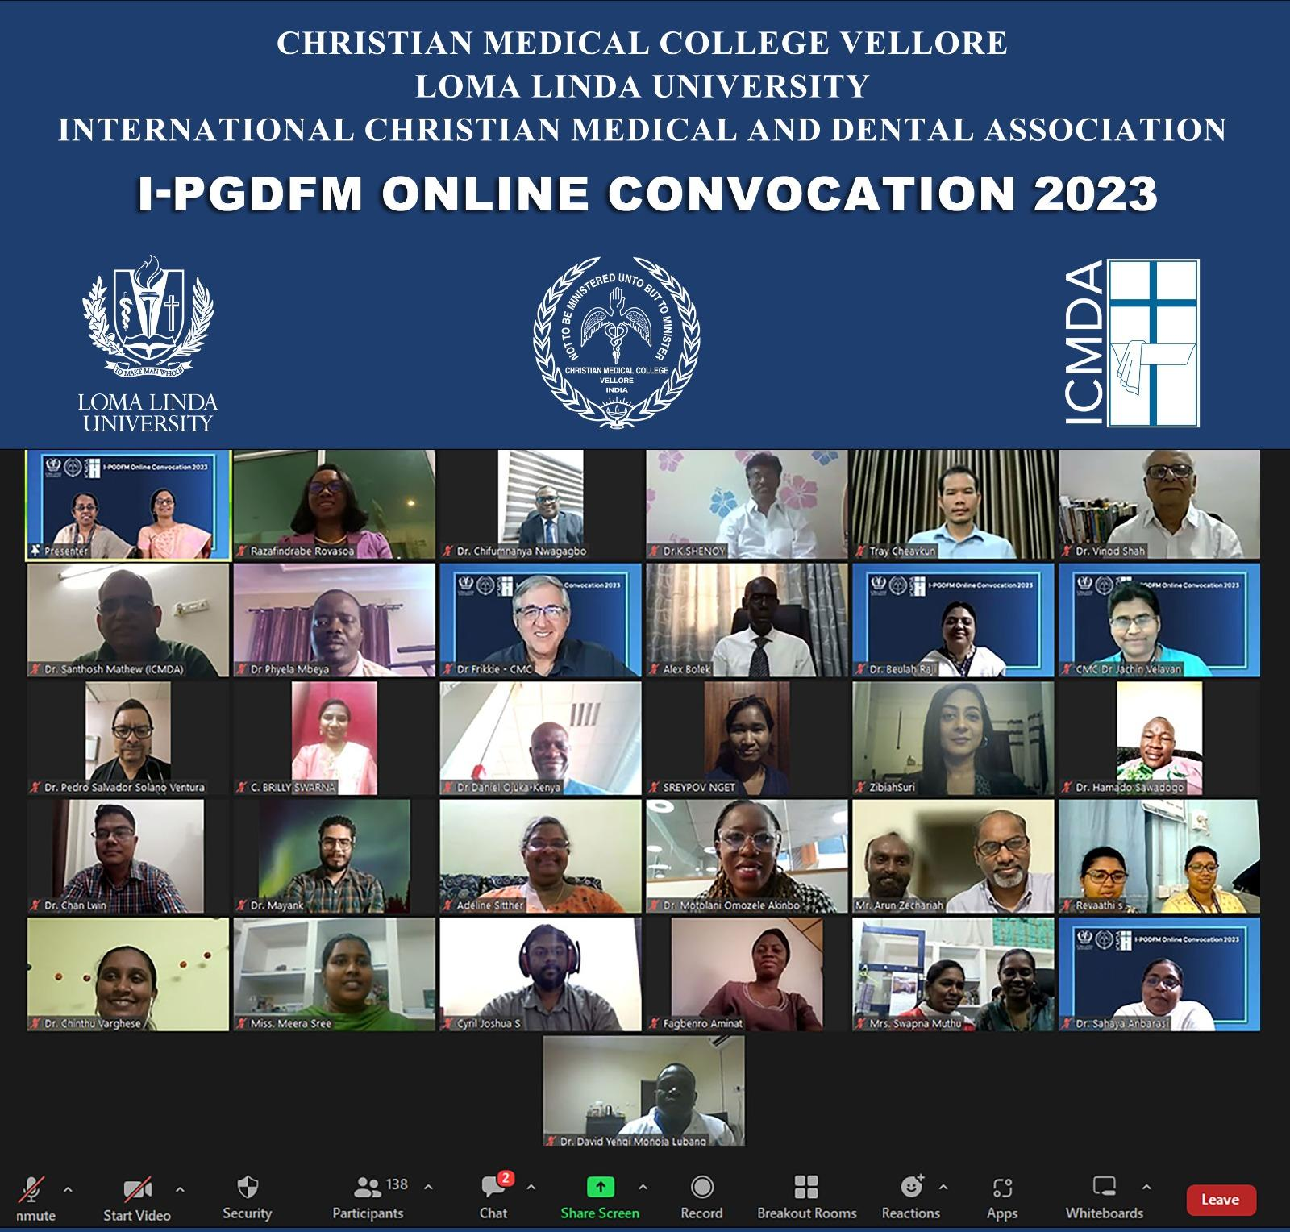
Our First Graduating Class!!
25 Graduates
13 Countries

Slide 31

Every learner is precious!
3000 doctors trained so far in India alone
343 doctors trained globally representing over 75 countries!

Slide 32
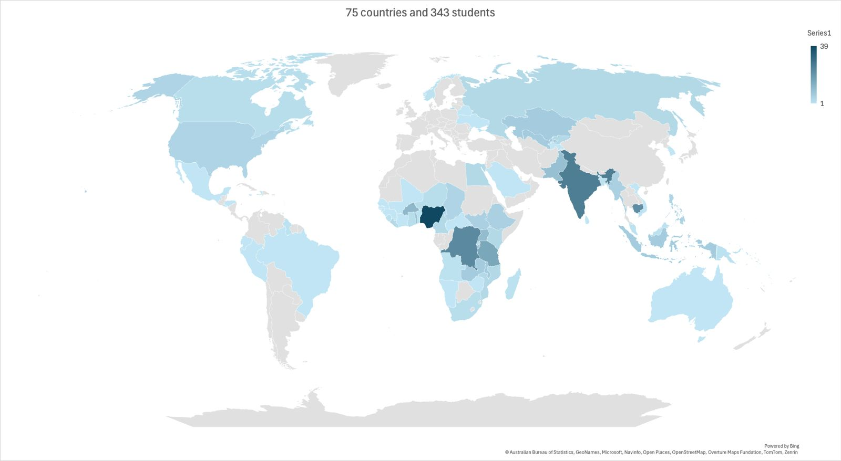

Slide 33
Stories from across the Globe

Slide 34
“This has broadened my perspective of Family Medicine from disease … to person!”
“This training helped me realise the significant work that can be done by ONE multicompetent and dedicated Family Physician”
“This course has made me know the importance of primary care in the healthcare system”
“I am now able to give more time to listen to my patients”
“The knowledge and skills I have acquired have made me a confident person”
“Took learning to a newer horizon”
“Not to be served but to serve others”
Notes:
Graduation Testimonies

Slide 35
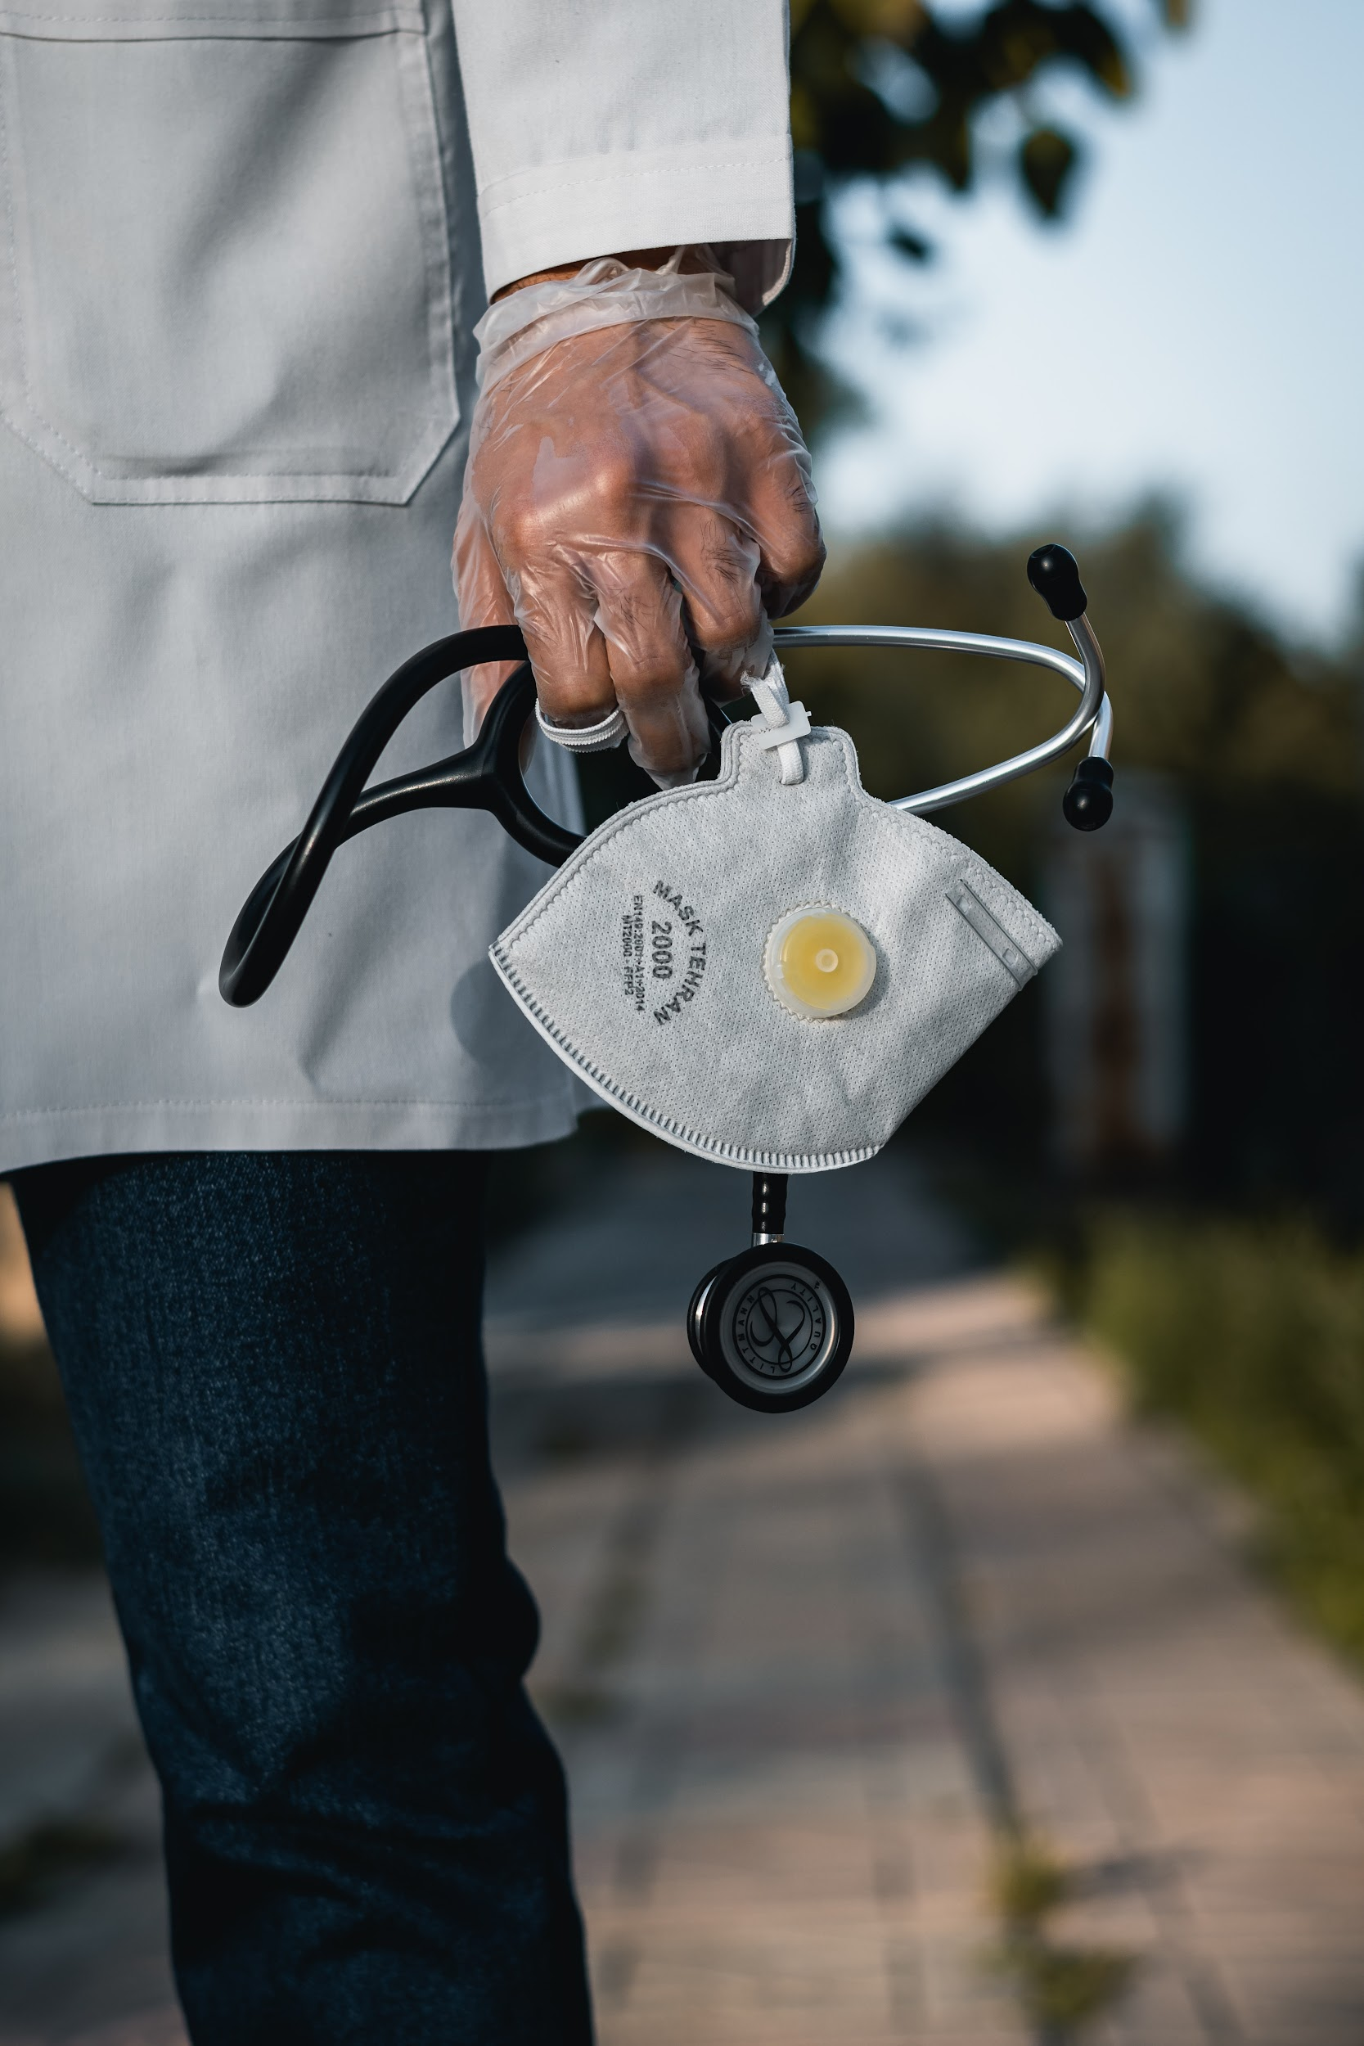
A Confident Practitioner

Slide 36
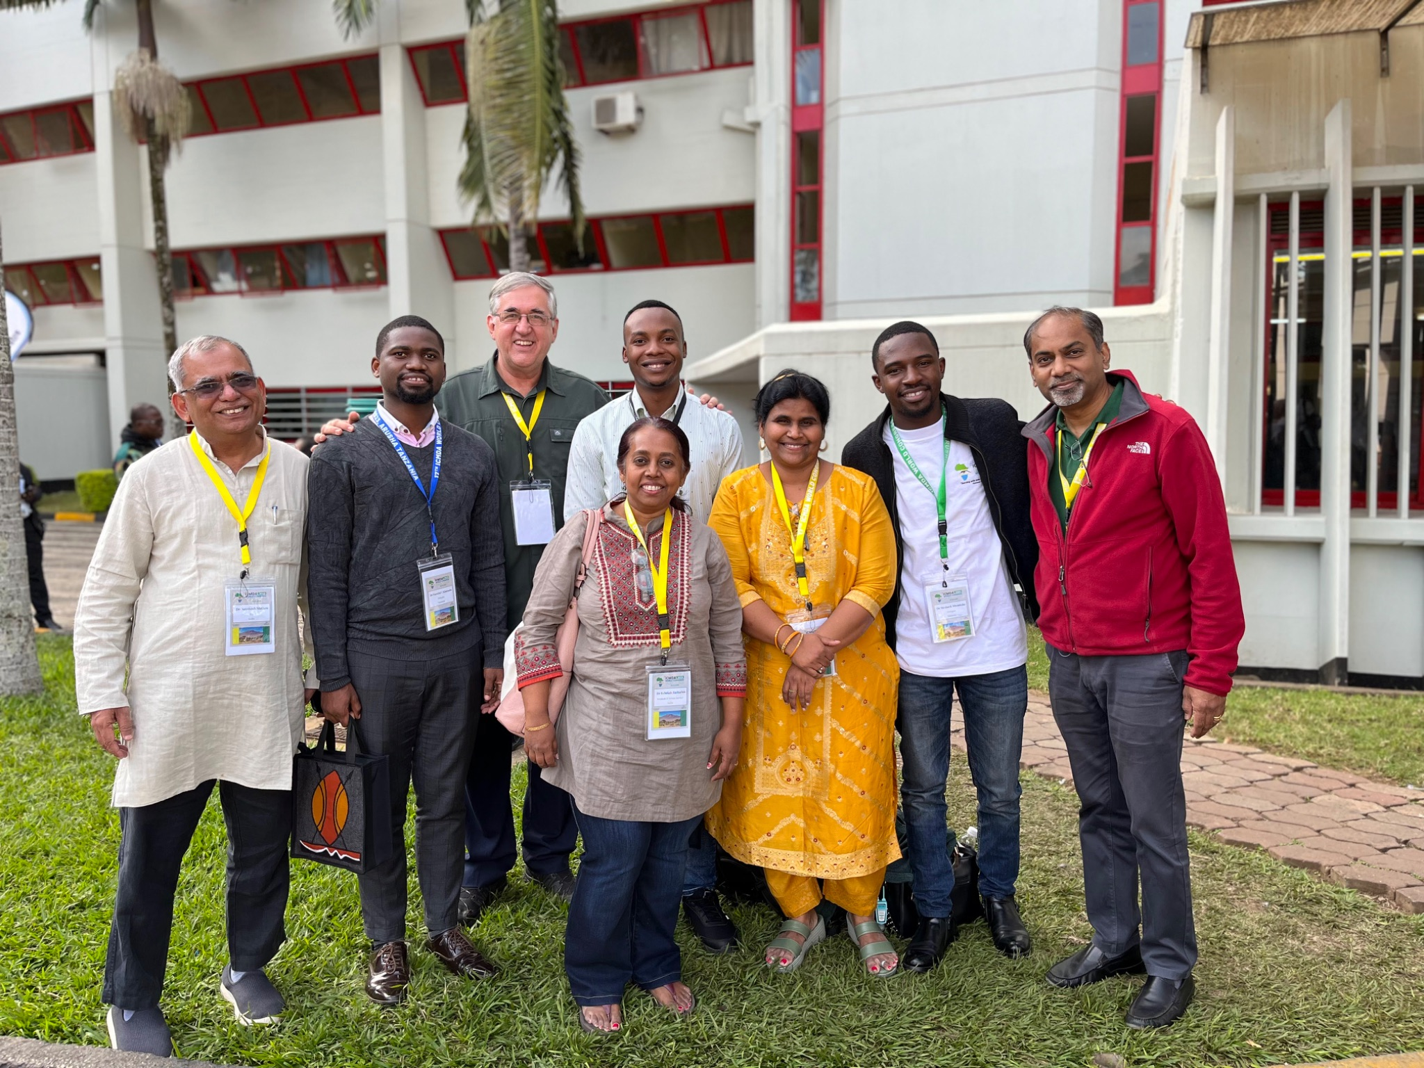
Arusha
Tanzania

Slide 37
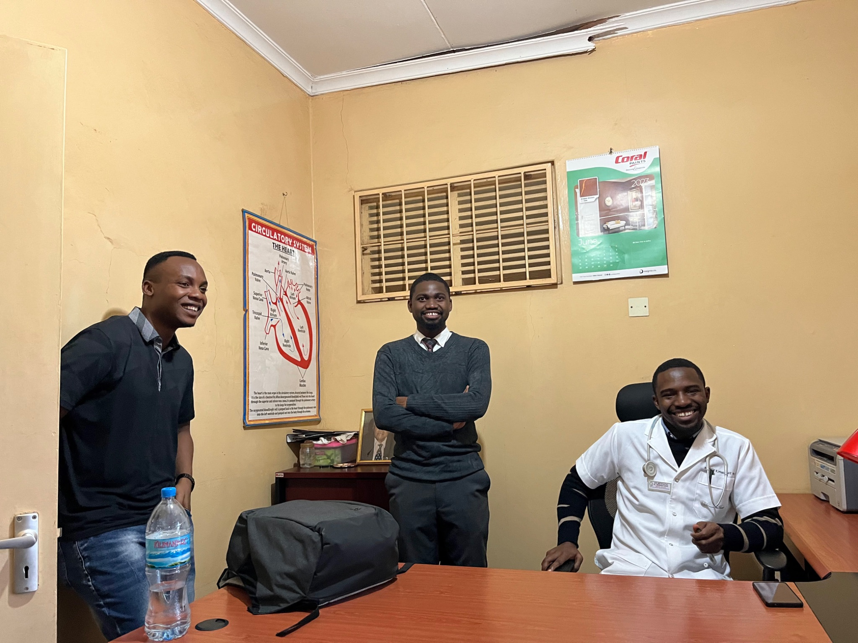
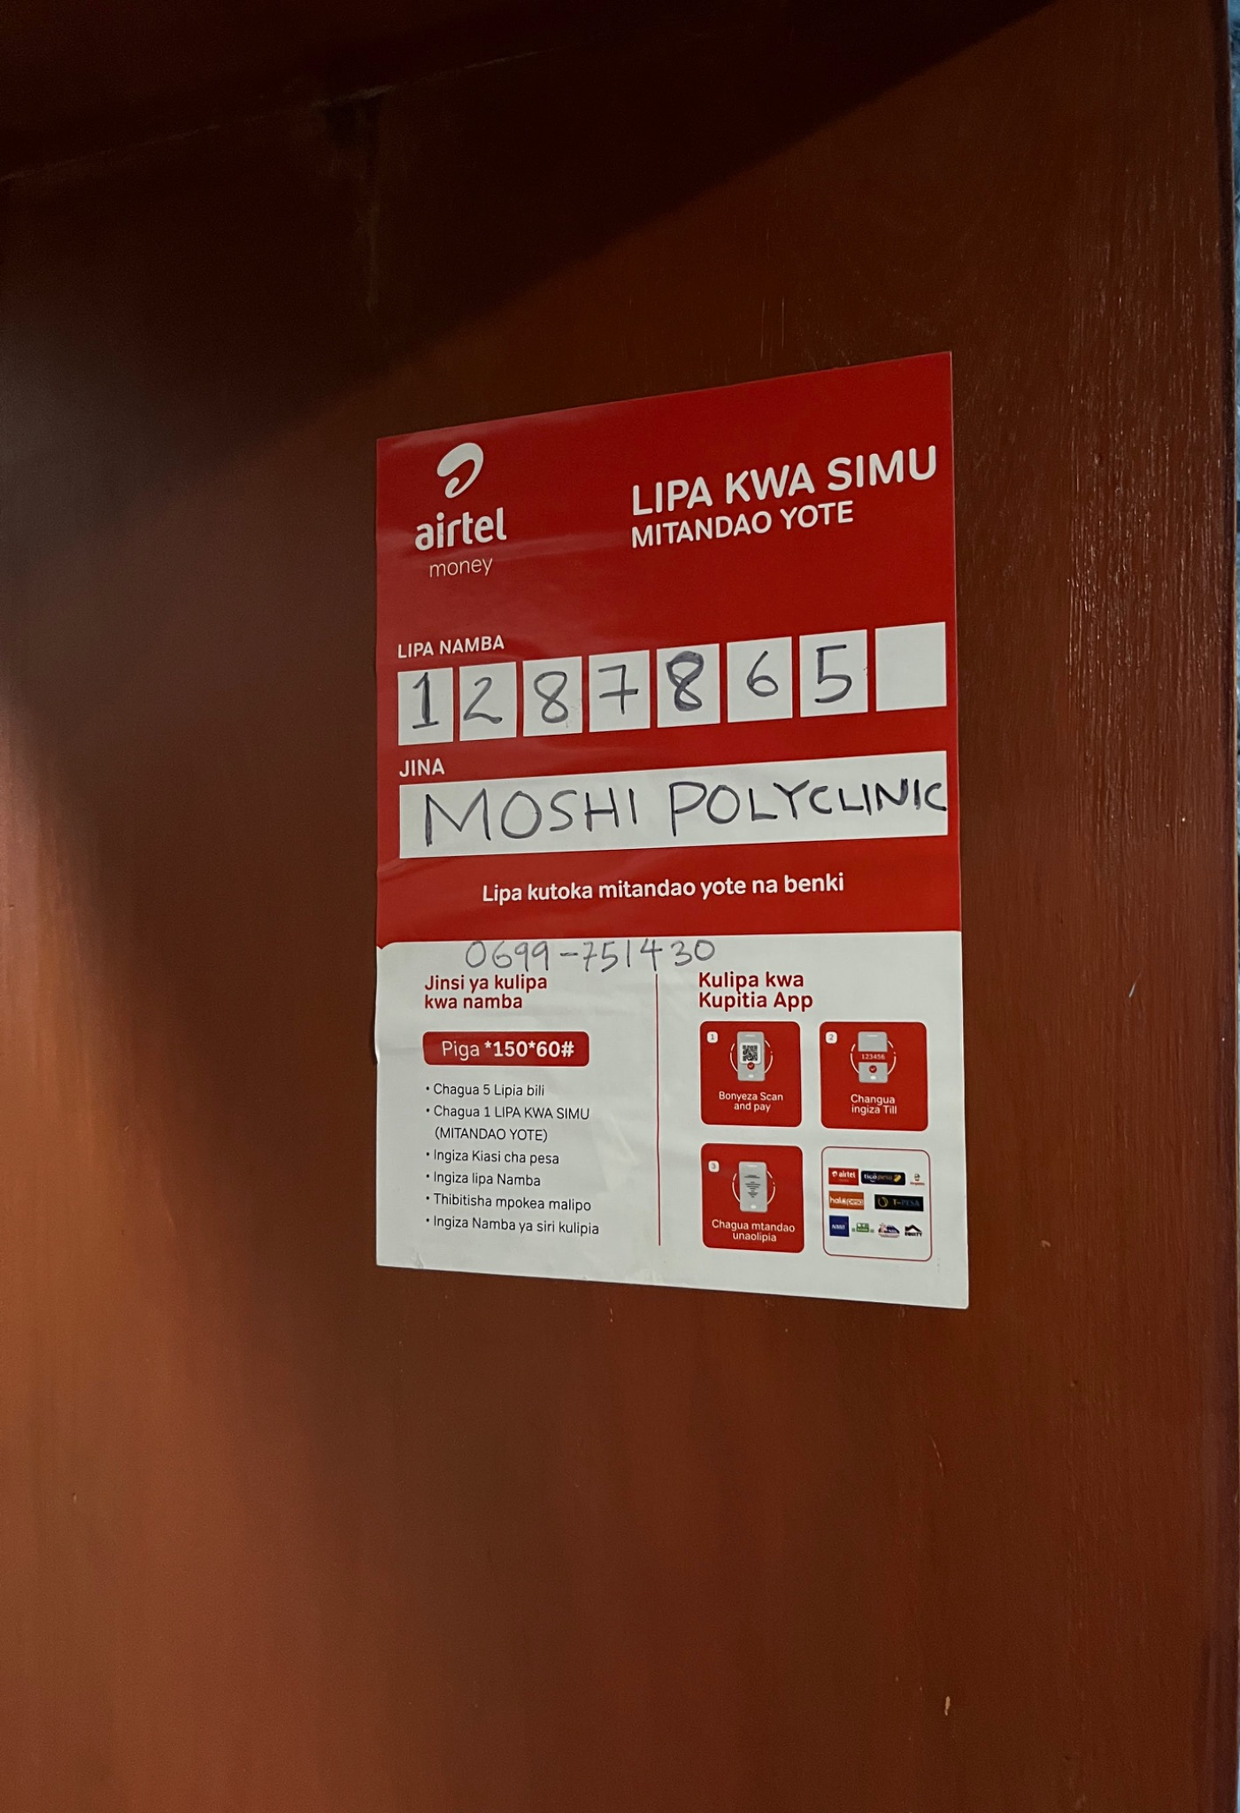
Moshi Clinic, Tanzania

Slide 38
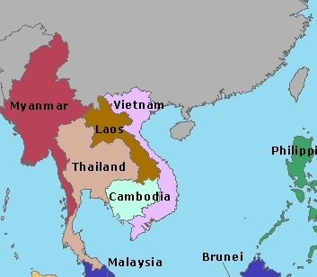
Serving across the border

Slide 39
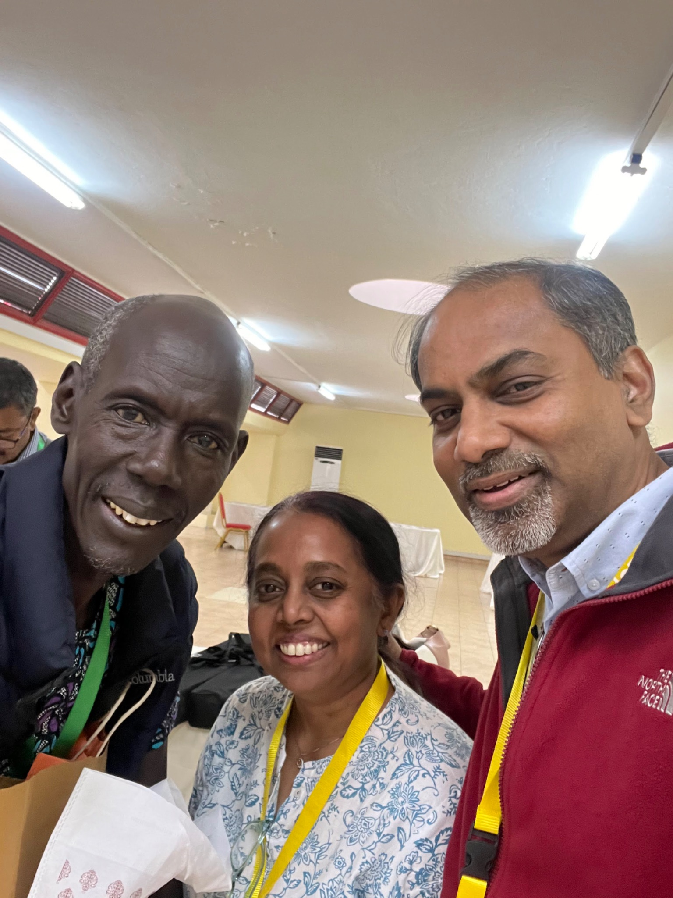
South Sudan

Slide 40
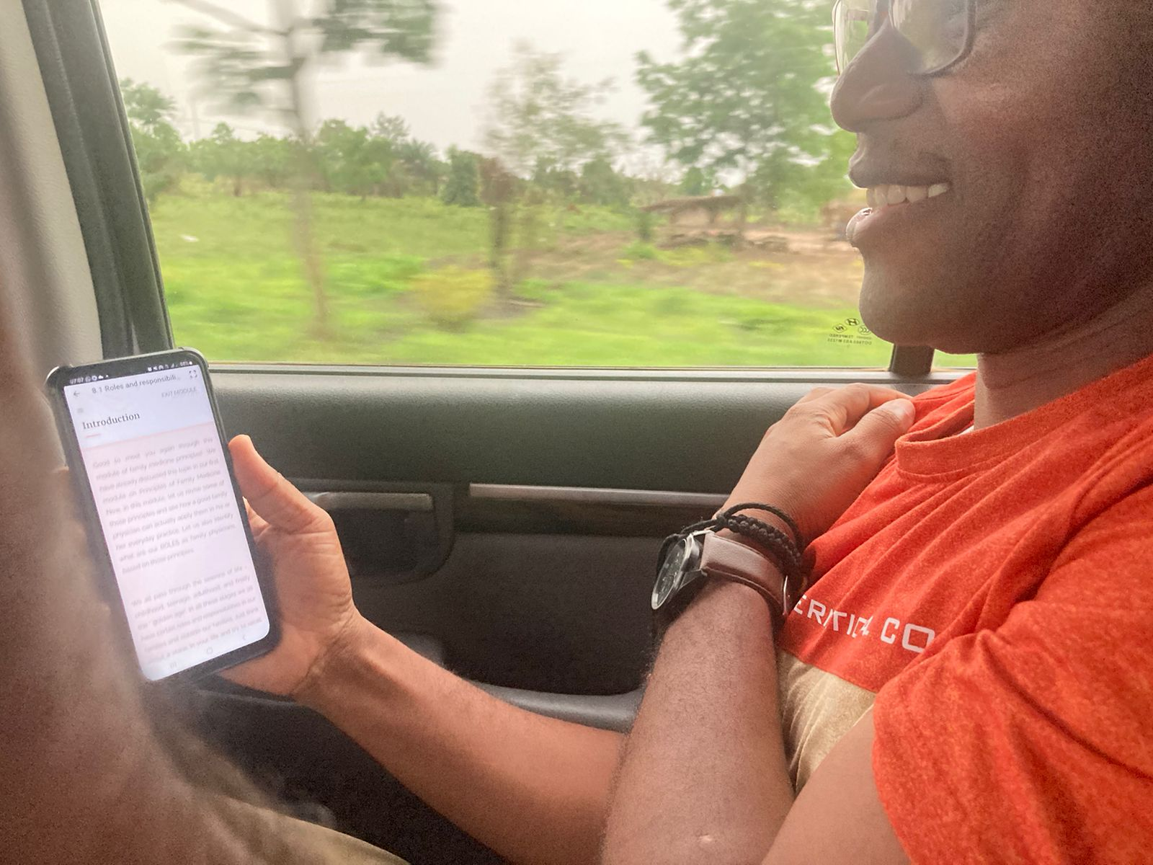
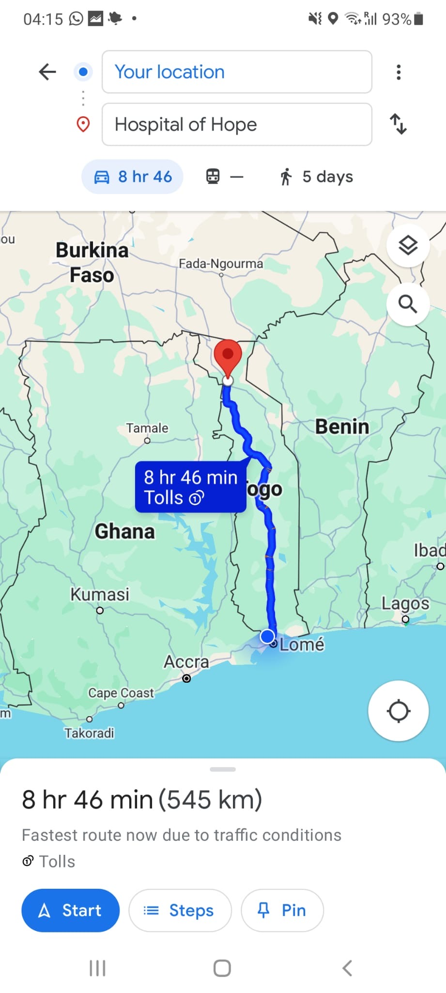
From Lome to Mango, Togo

Slide 41
Expanding the Reach

Slide 42
LANGUAGE COHORTS
TOGO/DRC (FRENCH);
KYRGYZSTAN/UZBEKISTAN (RUSSIAN);
HONDURAS (SPANISH)
This Photo by Unknown Author is licensed under CC BY-NC-ND

Slide 43
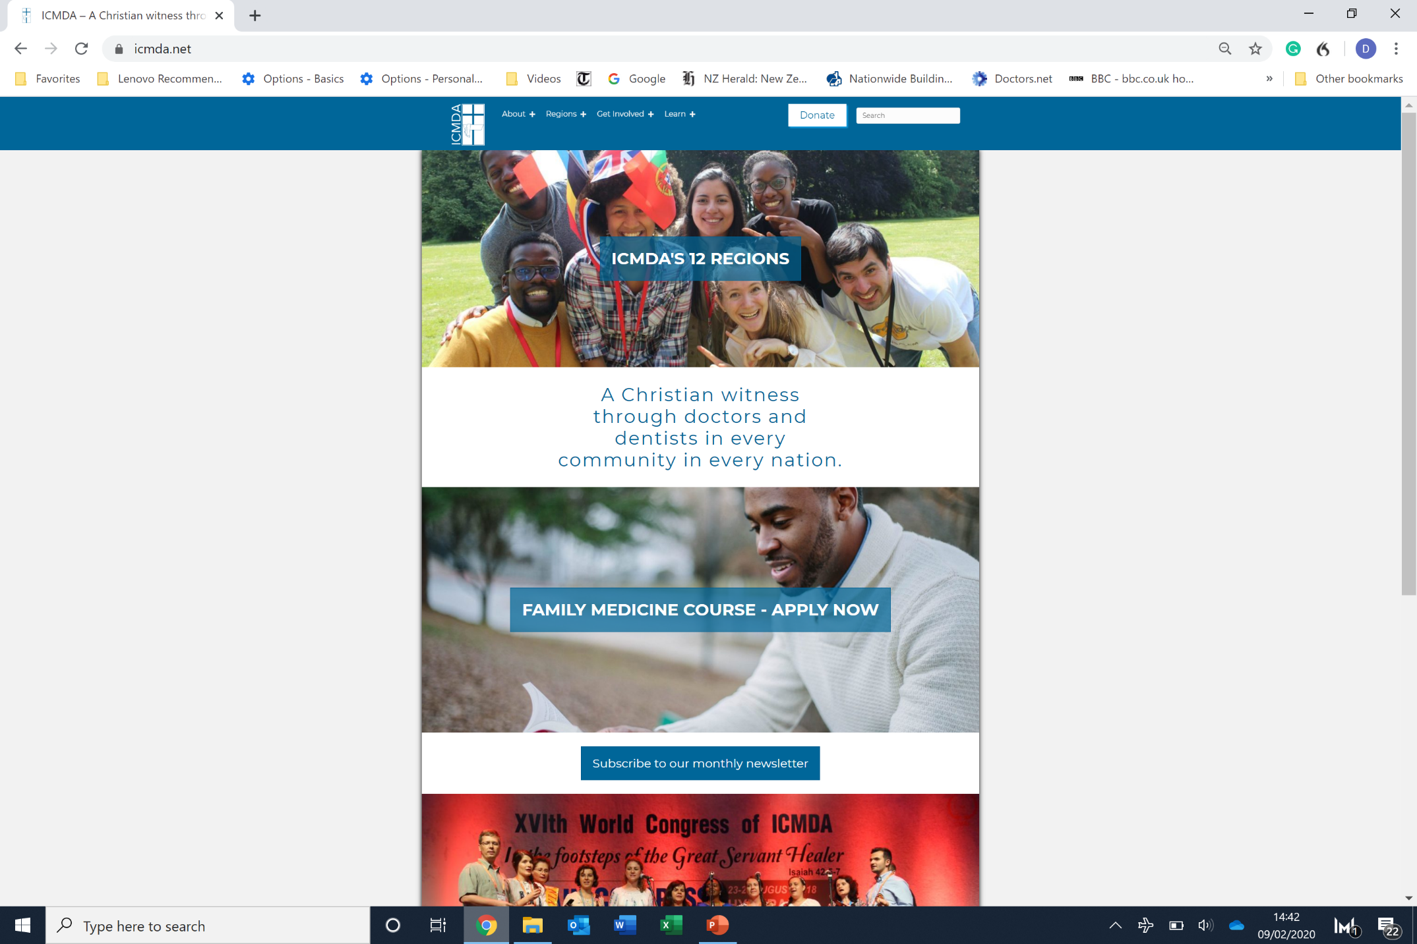
International Postgraduate Diploma in Family Medicine

Slide 44
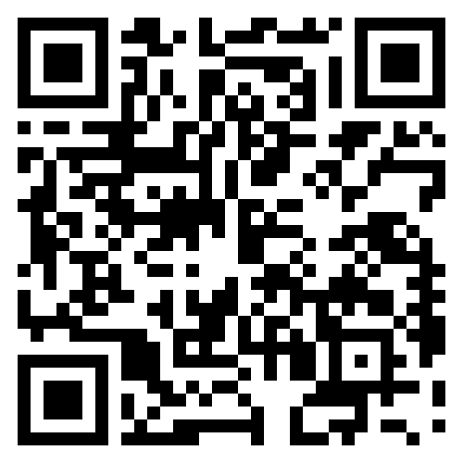
GMHC
Evaluations

