Slide 1


Connecting Your Faith & Your Healthcare Career Together
Helena Torres, PharmD, LCMHCA
medsn.org
© 2024 Medical Strategic Network

Slide 2

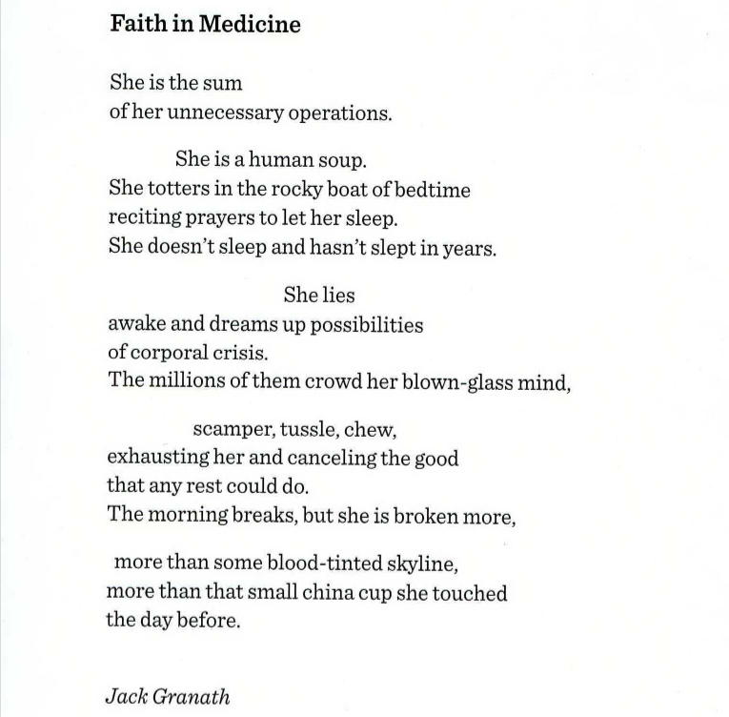
Notes:
This poem is the experience of many in healthcare today. They feel like they exist only as problems to be fixed, errors to be corrected, and are known only by their flaws.

Slide 3

Disclosures

Slide 4
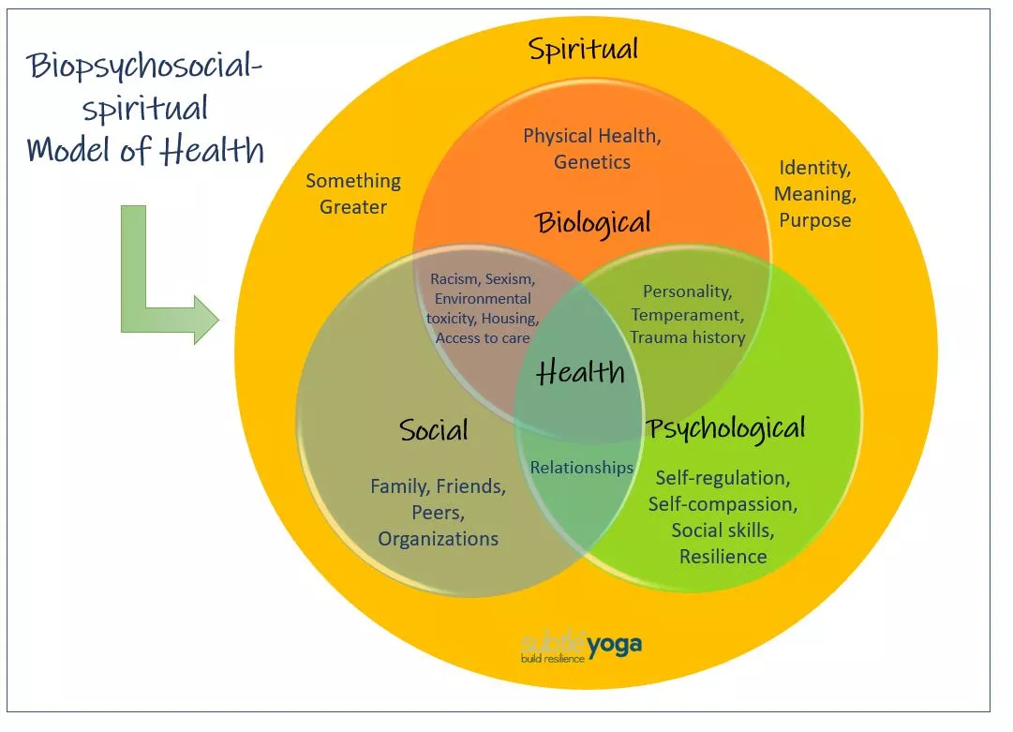
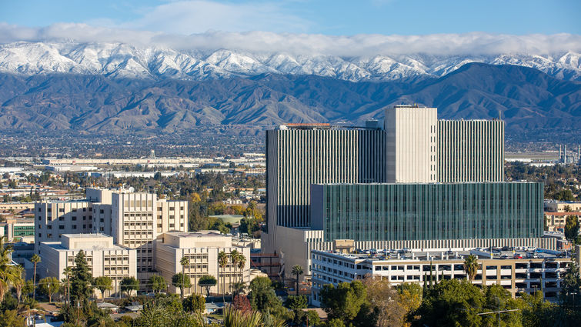
Notes:
Story of client with Addison’s

Slide 5
A bit of perspective…
Notes:
There was a study published in 2023 that reported 53.7% of patients reported poor patient-centered care. And it was higher among public hospitals (66.3%) than private hospitals (40.3%).

Slide 6
Response
Things You Like?
Things You Don’t Like?
Concerns?
Questions?

Slide 7
Patient Views
“Spiritual care is frequently desired by patients in serious illness as part of medical care, with estimates ranging from 50% to 96% of patients wanting spiritual care.”
“Spiritual needs are infrequently addressed in medical care of seriously ill patients, with patient-reported spiritual care from medical teams ranging from 9% to 51%.”
Balboni et al. Spirituality in Serious Illness and Health. JAMA. 2022.
Notes:
Big discrepancy here from what patient’s desire and what they receive

Slide 8
Response
Things You Like?
Things You Don’t Like?
Concerns?
Questions?

Slide 9

Appropriate Whole Person Care
How?

Slide 10
Spiritual History Questions
With this illness, what keeps you going?
What is your source of strength?
Has any of this been scary/stressful for you?
How?
How has this illness affected the way you see
yourself?
How has this illness affected the way you view and interact with God?
5. What in your life is most meaningful to you?

Slide 11
Practice!

Slide 12
Response
Things You Like?
Things You Don’t Like?
Concerns?
Questions?

Slide 13


No Interest
Mature Christian
Searching
Receptive

Slide 14
1 Thessalonians 4:9-12
'We don't have to write you about the need to love each other. God has taught you to do this, ''and you already have shown your love for all his people in Macedonia. But, my dear friends, we ask you to do even more. ''Try your best to live quietly, to mind your own business, and to work hard, just as we taught you to do. '' Then you will be respected by people who are not followers of the Lord, and you won't have to depend on anyone. '
Notes:
Be about the work God has given you

Slide 15
“My Father is always at His work to this very day, and I, too, am working…
I tell you the truth, the Son can do nothing by Himself,
He can do only what he sees His Father doing,
Because whatever the Father does the Son also does.
For the Father loves the Son and shows him all He does.
John 5:17, 19-20

Slide 16

Whole Person Care
How?

Slide 17
Whole Person Care
Approach your patients with:
Permission
Respect
Sensitivity

Slide 18
Spiritual Interventions
NOT a covert way of proselytizing
Goal: know loved, precious, forgiven, self-worth
Objectives:
  Past: experience forgiveness
  Present: self-worth, love, acceptance and achievement
  Future: courage and hope
Initial therapy—words of encouragement
  Validate
  Neutralize self-judgment and self-condemnation

Slide 19
Spiritual Interventions
Encouragement

Slide 20
Spiritual Interventions
Encouragement
Come to me, all who labor and are heavy laden, and I will give you rest. Take my yoke upon you, and learn from me; for I am gentle and lowly in heart, and you will find rest for your souls. For my yoke is easy, and my burden is light.
Matthew 11:28-30

Slide 21
Spiritual Interventions
Encouragement
Prayer
Empathy
Connection
Notes:
Would it be helpful to you if I prayed for you
Feeling guilty

Slide 22
No Interest
Mature Christian
Searching
Receptive

Slide 23

Using the SpHx Interview and
Diagnostic/Transition
Questions
Notes:
[Imagine walking down the corridor at your office]
If you pay attention to your work, people will pay attention to your faith.
Note the relationship here. Actions and attitudes precede words.
You will have the opportunity. Now how will you go about seizing that opportunity?

Slide 24
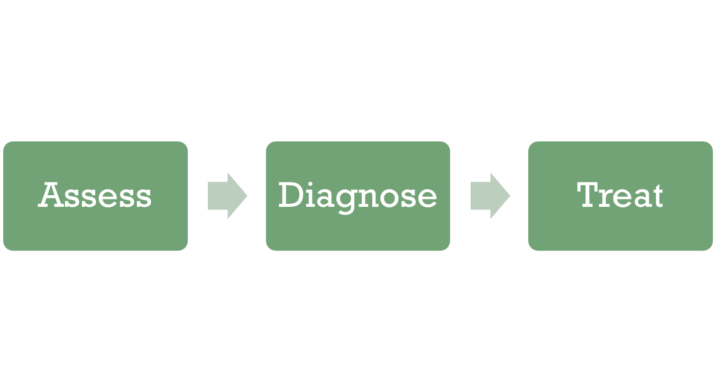
Assessing Spiritual Needs

Slide 25
Addressing Spiritual Needs
When patients tell me they would like to know God better, I’m sometimes able to take a few more minutes to explain from Christian perspective how one can connect with God in a more meaningful way. It takes about 5 minutes.

Slide 26
Bridging to the Gospel
Would it be helpful to you to read through this information?
If you get tired, uncomfortable or want to stop the visit, please tell me. I can stop at any time.

Slide 27
Response
Things You Like?
Things You Don’t Like?
Concerns?
Questions?

Slide 28
Taking a SpHx?
Good Medicine for Provider?
Caring about the patient is also what gives joy and fulfillment to the practice of medicine & is why many of us chose this profession.
Its absence, especially in this pressured health care environment, can rapidly lead to dissatisfaction, emotional exhaustion, and burnout.
Practicing whole-person medicine is the best kind of care both for those who receive it and those who give it.
-So Med J 2004 Dec; 97 (12): 1194-1200

Slide 29
Heart & Intentionality
Pray!
  For opportunities, for boldness, and for your patients
Be sensitive to the patients and to the Holy Spirit
Let God lead
Listen to the patient!
Remember why we’re doing this!
Keep doing it!

Slide 30
Next Steps
Interest in the relationship between spirituality, religion, and clinical care has increased in the last 15 years, but clinicians need more concrete guidance about this topic.
-Chest. 2009 Jun;135(6):1634-42

Slide 31
Q & A

Slide 32
Helena Torres, PharmD, LCMHCA
Medical Strategic Network
P.O. Box 2052
Redlands, CA 92373
httorpe7@gmail.com

