Slide 1
Malaria prevention in Expatriates and Missionaries
How to avoid
How to diagnose
How to treat
Gregory Juckett, MD, MPH
Professor Emeritus,
West Virginia University School of Medicine
No conflicts of interest

Slide 2

Malaria prevention Objectives
Discuss what’s happening with malaria.
Be able to determine if there is malaria risk at your destination and the likely species involved.
List common non-pharmacologic anti-malarial strategies
Discuss malaria prophylaxis for short and long-term travelers.
Discuss self diagnosis and self treatment for uncomplicated malaria

Slide 3
What’s happening with Malaria?
Quarter of the worlds population remains at risk, mostly poor in the global south. Africa has by far the highest malaria mortality.
Malaria remains a serious threat to children under 5 and to pregnant women
Malaria was being reduced or eliminated in many parts of the world (e.g. Sri Lanka in 2016) but Covid interrupted control efforts in 2020. Tthere are 84 endemic countries.
Mortality is very slowly dropping due to successful bed net and public health initiatives: , 245 million cases and 625,000 deaths in 2020, 247 million cases and 619,000 deaths in 2021, WHO World Malaria Report 2022
Pesticide resistant and new urban adapted mosquito species (Anopheles stephensii) threaten to undo this progress.
A new R21/Matrix M malaria vaccine developed in Oxford has been approved for prevention of malaria in young children with 3 initial doses and a one year booster giving 80% protection. This improved vaccine will replace the older RTS,S vaccine which was 40-50% effective. No vaccine for adult travelers.

Slide 4
Malaria
Parasitic infection transmitted by Anopheles mosquitoes which are active at night.
5 species of Plasmodium cause human malaria:
P. falciparum, vivax, ovale, malariae, knowlesii
Most malaria in the world is due to P. falciparum
and P. vivax
95% of malarial deaths are due to P. falciparum
Relapsing Malaria: 2 species (P. vivax and ovale) may persist in liver for upwards of 30 years causing episodic recurrences, P. malariae may also persist for years in blood with few symptoms.

Slide 5
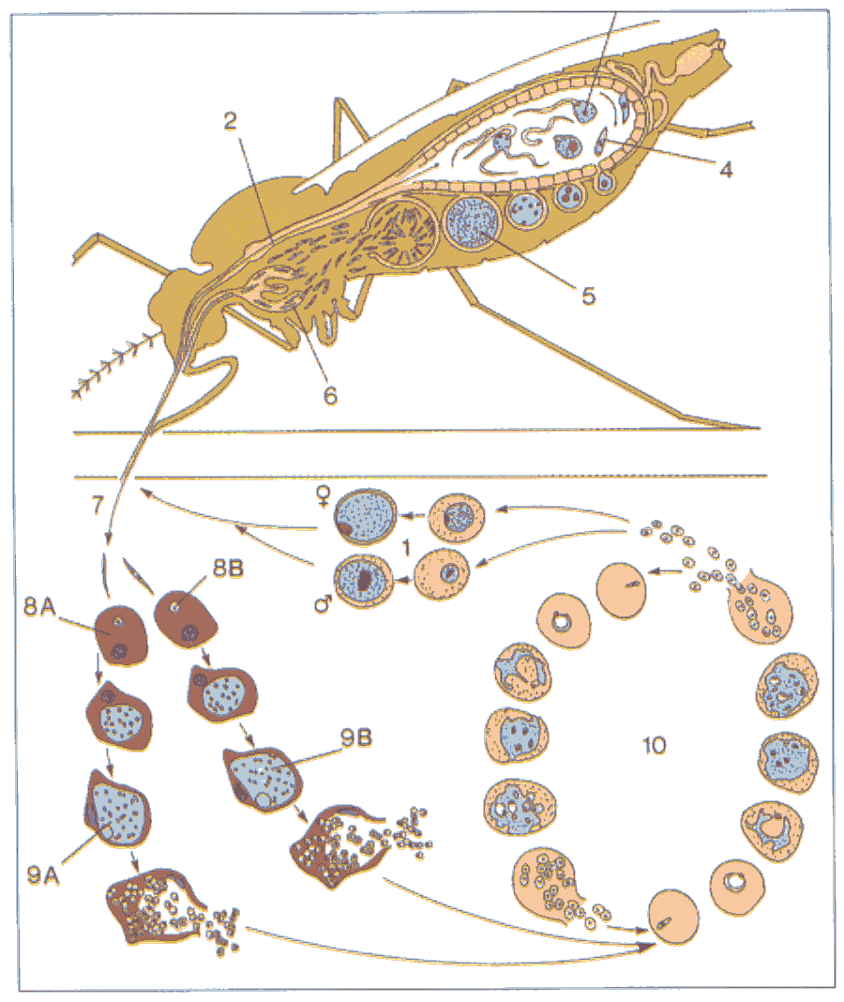
Malaria Life Cycle: Plasmodium sexual stage in mosquito
Genus Anopheles
Evening-feeders
Silent Fliers
Attracted to dark colors, CO2 and feet
Sporozoites injected into human host
Gametocytes
Merozoites
Trophozoites in RBCs
Merozoites from hepatocytes

Slide 6
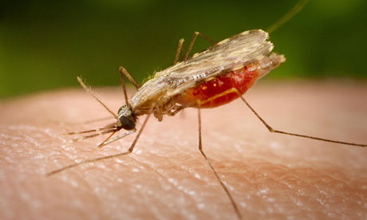
VECTOR: Anopheles Mosquito

Slide 7
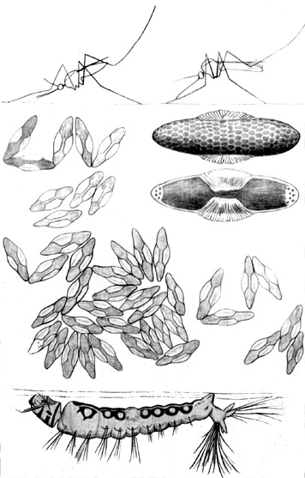
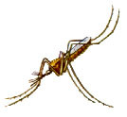


Anopheles mosquito
Resting posture: tilted head down
Silent flier: “stealth mozzie” without significant buzz
Non-Anopheles: Aedes
Horizontal resting position
Characteristic “whine”
Anopheline eggs have individual floats, not together in a raft
Eggs w/ individual floats
Anopheles Mosquito Lifecycle
Anopheles larvae rest in horizontal position at water surface
Non-Anopheles larvae hang down from water surface
Horizonal larvae

Slide 8
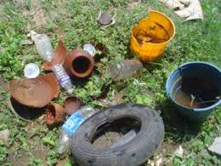
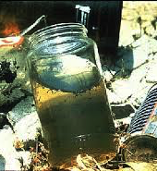
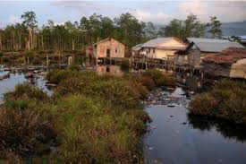
Stop malaria at its source: Eliminate Breeding Grounds

Slide 9
Anopheles stephensi: a new Threat to urban areas
A. gambiae (the classic African vector), A coluzzii, A funestis, and A arabiensis all predominate in rural areas
Anopheles stephensi from south Asia became associated in 2012 with urban malaria outbreaks in Ethiopia and Sudan and is now spreading to many African cities.
This mosquito’s range included Asia, Arabia, and the horn of Africa but it promises to be a major future vector in many African cities. It is “urban adapted.”
A stephensi can thrive in cities and needs minimal water to reproduce. 40% of Africans live in urban centers which have been less vulnerable until now. Urban malaria threat!!
This species bites both indoors and outdoors and is very resistant to several classes of insecticides.
In short, it is a super mosquito!

Slide 10
5 Human Malaria Species
Plasmodium falciparum — ~40+% (most dangerous), tropical distribution (esp. Africa), chloroquine resistance wide spread outside of Central America and Hispaniola
Plasmodium vivax – ~50% world malaria, temperate (liver phase hypnozoite adaptation) and also tropical, some chloroquine resistance in PNG and Indonesia which is spreading; recurrent attacks (must treat blood + liver phase)
P. ovale – W. Africa and spotty elsewhere, recurrent infections like P. vivax (can infect African blacks, P. vivax can’t)
P. malariae– spotty, mildest, oldest (infects other primates as well as humans), persists in blood (but not liver) x years
P. knowlesii —primate malaria in SE Asia, spreading to humans, clinically similar to and usually confused with P. falciparum

Slide 11
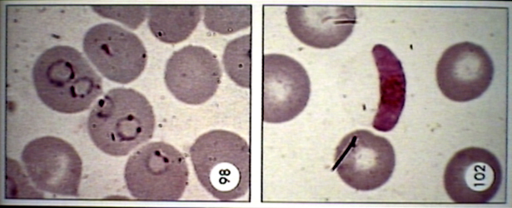
Plasmodium falciparum morphology
Thin Smear
Multiple ring-form trophozoites per RBC good indicator of P. falciparum
Sickle-shaped gametocyte confirms diagnosis (when visible)

Slide 12
P. falciparum
Multiple rings (trophozoites) per RBC characteristic
All ages of RBCs affected so heavy parasitemia much more likely (RBCs of average size and age)
Maurer’s dots seen on red cells(comma-shaped)
Schizonts (red cells about to split open) have 8-24 merozoites
Sickle-shaped (“falciform”) gametocytes, hence the specific name
Termed “Malignant Tertian” Malaria with q48h fever periodicity
Knob formation on red cell membrane causes cells to clump up and block capillaries
RBC sequestration (blockage from irregular RBCs) triggers often fatal complications in brain and kidney (cerebral malaria and blackwater fever)

Slide 13
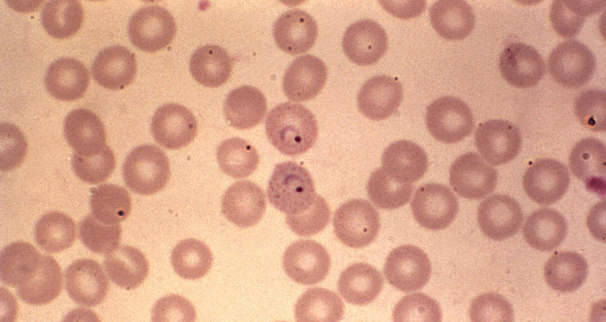
P vivax

Slide 14
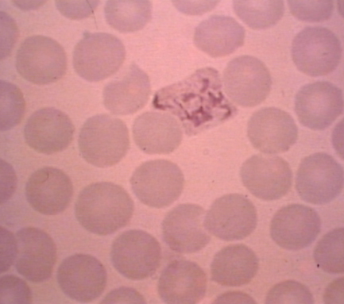
P. vivax
Benign Tertian Malaria involves larger younger erythrocytes (reticulocytes), fewer RBCs infected so less severe
Single “signet” rings of trophozoite -- one-third of RBC diameter
Amoeboid trophozoites also may be seen
Schuffner’s dots visible
12-24 merozoites (16 average)
African blacks are resistant to
P vivax as their RBCs tend to
lack the Duffy Antigen,
necessary for infection.
Vivax persists in liver (hypnozoites)
so it can relapse after treatment unless primaquine is given

Slide 15
Classic Malaria Symptoms
Prodrome: flu-like including HA, fever, malaise, myalgias –resembles flu at first.
Paroxysms of rigor (shaking chills) followed by high fever (coinciding with RBC rupture, merozoite release), sweating and headache
Periodicity of fever often absent initially (early quotidian or daily fever)– only later does fever become tertian (q48h) or quartan (q72h) so periodicity is not very useful clinically and it is dangerous to wait for it to develop! Latin terms related to 12 h day/night cycle, rather than hours.
Nausea, occasional jaundice (due to hemolysis), delirium
Splenomegaly and Anemia very common signs

Slide 16
FALCIPARUM MALARIA complications
Typical symptoms resemble flu at first then develop into tertian (q 48h) fever/rigors, severe headaches, myalgias/arthralgias
Atypical symptoms include –cough/dyspnea, diarrhea, vomiting (often confusing clinician)
P falciparum complications
  Cerebral malaria – altered level of consciousness, seizures
  Black water fever—dark urine due to hemolyzed blood, can lead to renal failure
  Pulmonary edema—acute shortness of breath
  Algid malaria—circulatory shock with hypothermia
  Severe anemia
  Stillbirth
  Death

Slide 17
P. Falciparum KEY Summary
Causes more significant disease, higher fatality rate
Infects RBCs of all ages (indiscriminate)
High parasitemia (potentially >5% of RBCs), causing massive hemolysis
RBC sequestration/clogging (due to knobs on RBCs)causing capillary obstruction, especially in brain and kidneys with high risk of fatality if untreated
Causes cerebral malaria, algid malaria, black water fever
More profound hypoglycemia/lactic acidosis
Resistant to chloroquine (CRPF) outside of Central America
Predominant species in tropical Africa, lowland tropics elsewhere, not well adapted to temperate or mountainous areas where Vivax thrives.

Slide 18
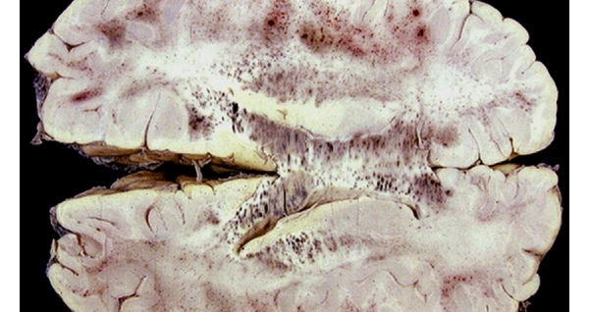
This is your Brain on malaria: capillary occlusion in P. falciparum

Slide 19
Questions to Ask before going
Is there significant malaria risk where I’m going? What type is present: falciparum (highest risk), vivax, or both?
Is this risk year-round or seasonal? Seasonal prophylaxis option
What can I do to protect myself from mosquitoes? (Non-pharm)
Will I need short or long-term prophylaxis? (Pharmacologic)
What prophylactic agent is suitable for my area? Is there drug resistance? e.g. mefloquine resistance in SE Asia
Will I be near a medical facility for rapid diagnosis of fever?
If not (more than 24 h away),will I have access to rapid diagnostic testing (RDT) and self treatment medication?
What are my colleagues using? Often nothing!
Can I develop malaria resistance like the natives?
No, you shouldn’t even try since it may risk your life!

Slide 20
Determining your risk
Sub-Saharan Africa (West>East) and Oceania (PNG, Solomon Islands) pose greatest risk of P falciparum
Moderate risk in India (mixed vivax and falciparum)
Moderate to low risk in Central and South America and East Asia
Night time exposure is key (day trips into malaria regions pose minimal risk if out by dusk)
Seasonal exposure-malaria risk tends to peak towards end of rainy season (stagnant pools of water)
Check with CDC.gov or CDC Yellow Book 2024
SHORELAND’S TRAVAX (subscription fee) for specific malaria maps (www.travax.com)
Malaria Atlas Project malariaatlas.org

Slide 21
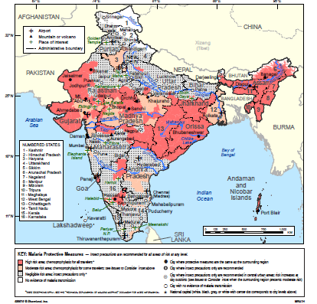
India TRAVAX Map: risk stratification by region and season
North > South Risk
Minimal risk in city hotels—some Mumbai concern
Risk peaks during and following Monsoon season

Slide 22
What Works for Malaria Prevention?
Permethrin Treated Bednets to protect children under 5 and pregnant women (the most vulnerable population of all)
Vector Control: draining or treating nearby mosquito breeding sites
Indoor Residual Spraying (pyrethrins, DDT)/sleeping inside home
Wear full sleeve protective clothing
Window screens
Insect Repellants: personal (DEET), clothing/nets/curtains (Pyrethrins)
Chemo-prophylaxis: 1. treatment of migrants from high risk areas to prevent malaria introduction/reduce transmission and 2. malaria prophylaxis of non-immune migrants/travelers
Intermittent prophylaxis of high-risk native groups: children and pregnant women use sulfadoxine-pyrimethamine (SP) e.g. PMC or perennial malaria chemoprophylaxis in children
R21 vaccine replacing RTS/PATH Malaria Vaccine (Mosquirix) for children
Cheap and available ACT first-line treatment in home (Coartem)
Bohemia Project 2022 now giving ivermectin,an endectoside, for mosquito control to populations and livestock in Mozambique and Kenya
Bohemia stands for Broad One Health Endectocide-based Malaria Intervention in Africa (bohemiaconsortium.org), funded by IS Global. Ivermectin given 400 micrograms/kg once a month x 3 months during the rainy season

Slide 23
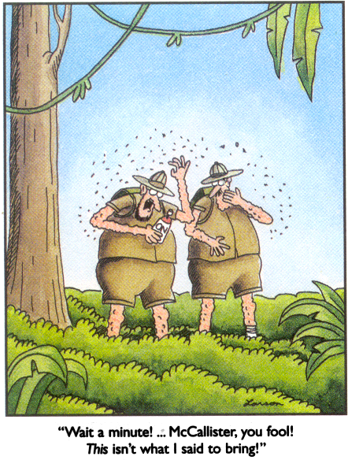
Bring the Right Insect Repellent!
DEET 35% SR (keep < 50%)
Picaridin 20%

Slide 24
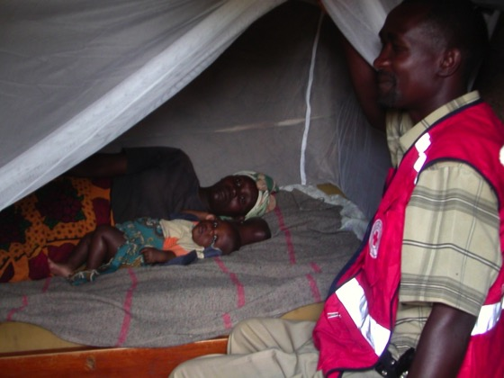
MALARIA prevention
Insecticide Treated Bed nets
Use them properly

Slide 25
Diagnosing MALARIA
Clinical suspicion based on history and symptoms—flu-like illness after travel to risk area, a good travel history essential
Blood Smears: Thick (+/- malaria) and Thin (best for species ID)
Point of care testing (chromatography)most practical e.g. Binax Now
Must consider meningitis (LP for persistent HA), pneumonia, influenza in differential diagnosis
Don’t wait for periodic fever to develop as it is a later sign
Ideally take blood smear when febrile and repeat negative smears if suspicion high

Slide 26
Rapid Diagnostic Tests for Malaria
Immuno-chromographic tests using lateral flow technique: cards, dipsticks, cassettes
Detects parasite antigens produced during their growth in RBCs
HRP2 (Histidine Rich Protein2) and/or pLDH (parasite lactate dehydrogenase) typical
ID Falciparum (HRP and pLDH) and vivax (pLDH) or all species (aldolase/pLDL)
Sensitivity 84-99.5%, Specificity 81-99.5%
Once positive, tests tend to stay positive for several weeks so rapid tests are of no use in following patient course (use blood smears)
Affordable

Slide 27
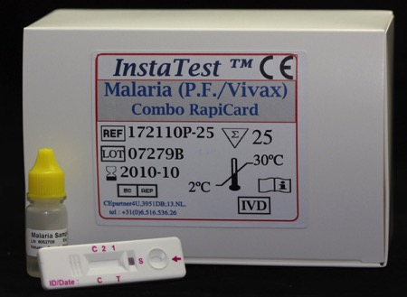
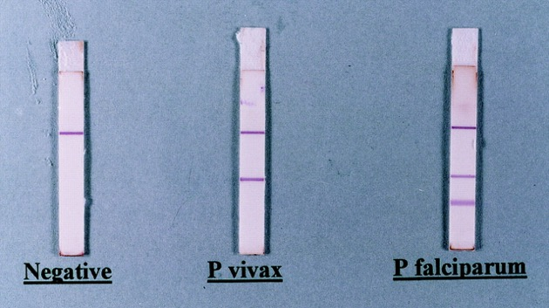
Point of care testing

Slide 28
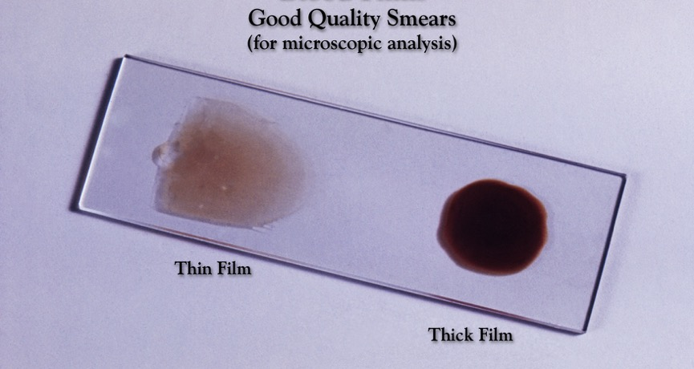
Thin and Thick smears

Slide 29
Common MALARIA medications
Chloroquine (PO, IV) not recommended outside Central America (Rx and Prophylaxis)
Quinine (PO, IV) with Doxycycline PO (7 days) older treatment as it’s harder to tolerate with an increased risk of hypoglycemia (especially given IV)
Atovaquone/proguanil (Malarone) – PO only for prophylaxis or treatment
Artemether/Lumefantrine (Coartem) – PO tablets and “dispersible” forms) for treatment
Artesunate (IV form of Artemisinin) approved by FDA 5/20 for treatment, but need to follow up with oral Doxycycline—Artesunate IV preferable to IV quinine for severe disease
Mefloquine (PO) –notorious for neuropsychiatric effects, high resistance in SE Asia, prophylaxis or treatment
Primaquine (po) 10d course for eradication of hypnozoites in liver to prevent later relapse (P vivax and ovale). Must treat liver as well as blood phase for these species. Testing for G6PD deficiency essential since primaquine can cause hemolysis if present. Usually for treatment to prevent vivax relapse, occasionally for vivax only prophylaxis
Tafenoquine (Krintafel) single po dose of 300 mg (two 150 mg tabs) approved by FDA in 2020, but 450 mg dose more effective for adults; alternative to primaquine for radical cure of P. vivax in patients >16 yrs, ideally overlapping with acute chloroquine therapy. Avoid in pregnancy and severe G6PD deficiency.
Future Treatment Option: Imatinib (Gleevec), a well tolerated CML drug, is 100% effective at clearing malaria in phase 2 trials by blocking erythrocyte tyrosine kinases( RBC enzyme) and preventing merozoite release. Not yet available for malaria treatment.

Slide 30
Prophylactic malaria Medications
Chloroquine phosphate 500 mg (300 mg base)- Once a week. Available in country. Wide spread resistance limits use to Central America and few other areas. Safe in pregnancy, avoid in epilepsy
Dose Start 1 week before, take weekly during exposure, and one q week x 4 weeks after
Doxycycline hyclate 100 mg- Every day. Sun sensitivity. Not for children <8 or pregnant women. Hard on stomach so take with plenty of water
Dose Start 1 day before, daily during exposure, and daily x 4 weeks after (compliance issues). Inexpensive.
Mefloquine 250 mg- Once a week. Screen carefully: Vivid dreams, Depression, Anxiety, Nightmares. Lowers seizure threshold. Safe for neonates and in pregnancy (category B for prophylaxis, not treatment) Dose Start 1 week before, weekly during exposure, and once a week for 4 weeks after, Don’t use in SE Asia (resistance) or with seizures or with known mental illness.
Atovaquone Proguanil 250/100 (Malarone)- Every day. Take with Fatty food. Safe for breast feeding and 5 kg infants. Start one day before exposure, daily during exposure and daily x 7 days after
Tafenoquine (Arakoda) 100 mg –Take loading dose of 2 tabs (200 mg) daily x3d before travel then 2 tabs once weekly during travel (starting one week after last pretravel dose), and 2 tabs once after travel (starting one week after last travel dose). Check for G6PD deficiency. NEW OPTION but expensive >$250 for 16 tabs
Primaquine phosphate 15 mg- 2 tabs (30 mg) every day x 2 weeks after travel to abort malaria in liver after long trips abroad. Not approved for routine prophylaxis but sometimes used for this outside of Africa (off label). Available in country. Best reserved for radical cure of Vivax and Ovale. Always check for G6PD deficiency before using. Tafenoquine (Krintafel brand) is a single 300 mg (150 mg tab x2) dose alternative to primaquine for radical cure of vivax.

Slide 31
What About mefloquine prophylaxis?
Weekly convenient malaria prophylaxis that is still a reasonable option for long-term expats in high risk areas.
Seldom my first choice due to 2013 black box warning stating that it can cause permanent neurologic and psychiatric damage. Military has almost stopped using it.
Avoid in SE Asia due to resistance problems
Avoid if there is a significant pre-existing psychiatric history (panic attacks, bipolar disorder, chronic depression) or seizures (lowers seizure threshold)
Its bad reputation for making people “crazy” is partly justified, but this drug often gets blamed for depression related to culture shock. Treatment doses (1250 mg in one day) often cause psych side effects.
Trial weekly dosing x 3 weeks prior to departure is good precaution. Most adverse reactions occur in this time frame. Safe for long term use if no side effects.
Take same day each week with food and glass of water.
Expect very vivid dreams. May cause dizziness, tinnitus, vestibular sx
Psychiatric symptoms may include severe anxiety, mistrust, insomnia, hallucinations, psychosis (hypervitaminosis A hypothesis) but these eventually resolve after the drug is stopped. Long half life (2-4 weeks).

Slide 32
Malaria prophylaxis in pregnancy
Delay or avoid travel in pregnancy is first CDC recommendation
Also wait until newborn infant weighs enough for safe prophylaxis 5 kg (or else use an insecticide treated bed net over crib every night)
Chloroquine safe in pregnancy but only effective in Central America where there is no resistance.
Mefloquine remains the prophylactic drug of choice for chloroquine resistant areas despite concerns about psychiatric side effects.
Doxycycline is contraindicated (teratogenic effects after 4th month).
Tafenoquine and primaquine contraindicated due to inability to test fetus for G6PD deficiency.
Atovaquone-proguanil (Malarone) not yet recommended due to insufficient evidence for safety. Proguanil is a folate antagonist so high dose folic acid (5 mg/d) should be taken if it is the only available option.
Recommended malaria treatment: quinine and clindamycin in first trimester, artemether/lumefantrine may be used in 2nd and 3rd trimester,
Native prophylaxis: At least 2 doses of sulfadoxine-pyrimethamine used as prophylaxis starting after the 1st TM, with second dose at the beginning of the 3rd TM. Pyrimethamine is a folate antagonist so given with low dose folic acid 0.4 mg -- high doses of folate may interfere with efficacy

Slide 33
SELF TREATMENT OPTIONs for mild to Moderate malaria
Atovaquone-proguanil (Malarone) 250/100 mg 4 tablets daily x 3d (12 tabs over 3d period) but don’t use if already using Malarone for prophylaxis
Artemether-Lumefantrine (Coartem) 20/120 4 tabs at start and 4 more at 8, 24, 36, 48, and 60 hours (this translates to 4 tabs, repeat 4 tabs in 8 h, then 4 tabs twice a day x 2 more days or 24 tabs over 60 hours)
Mefloquine 250 mg self treatment (3 tabs in AM and 2 in PM) is likely to cause psychiatric symptoms and should only be used if nothing else available

Slide 34
MALARIA Treatment
Mild Malaria- Give Coartem or Malarone by mouth
Moderate Malaria- Give Artemisinin Combination Therapy e.g. ACT (Coartem: artemether with longer-acting lumefantrine) or older combination regimen of quinine-doxycycline
Severe Malaria - Give IV Artesunate (significantly better than IV Quinine) or if IV Quinine given run D10 to prevent hypoglycemia; Rectal artemether if IV not possible
Various hospitals have malaria protocols adapted for local case management

Slide 35
Coartem (ACT) Treatment Option: now approved in U.S. for rx(2009)and an alternative to Malarone
NOT USED FOR PROPHYLAXIS!
Artemether 20 mg and Lumefantrine (Benflumetrol) 120 mg combination (Novartis)
Coartem = Riamet (Europe) --now Coartem brand is available in US but costs more (about $150 for 24 tab)
Two Day Rx: 4 tabs @dx, repeat @ 8, 24, 48h (less resistant areas, recommended only for partially immune “native” patients)
Three Day Rx #24 tabs: 4 tabs @dx, then 4 tabs@8h then 4 tabs BID x 2d (resistant areas, non-immune patient or traveler)
>95% cure rates, no increased QT problems
Can be used in small children (5-10 kg)
Pregnancy Category C
Well-tolerated; good “standby” treatment for traveler

Slide 36
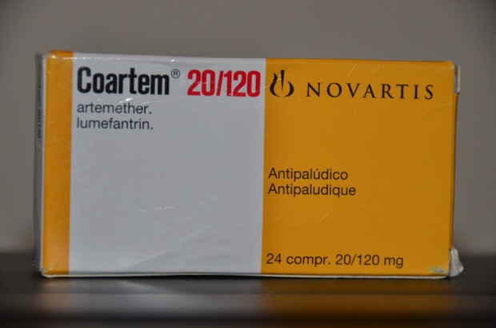

Slide 37
Atovaquone-proguanil 250/100 (Malarone)
Atovaquone is anti-parasitic used as alternative to Sulfa for Pneumocystis carinii pneumonia
Proguanil is an older British antimalarial with resistance problems when used alone.
Uncomplicated malaria treatment: 4 tablets a day x 3 days
Pediatric dose: ¼ adult strength
Prophylaxis: one tab daily starting one day prior to travel, daily during risk period, and daily x 7 days after exposure.
If malaria develops while using Malarone prophylaxis, it is recommended to use another drug for treatment
Atovaquone is Pregnancy Category C, not approved in pregnancy but not felt to be very harmful. Proguanil is a folate antagonist

Slide 38
Malaria in the Traveler
VFR (visiting friends and relatives) travelers and travelers to Africa at highest risk
Higher incidence of Cerebral Malaria due to lack of immunity
May be missed on initial blood smear- use capillary sample
May not exhibit classic cyclical fever pattern initially
Prophylaxis often not taken appropriately, and malaria symptoms may be masked by inadequate prophylaxis
Not acceptable to wait for smear/test results if malaria suspected, consider starting therapy ASAP while noting therapy always be stopped later when malaria ruled out.

Slide 39
Prevention and prophylaxis Summary
Minimize exposure (Use Repellents)
Reduce mosquito bites (Insecticide Treated Bed nets, Window screens)
Take Prophylaxis as directed when at risk
Consider Self Treatment if febrile and unable to get care in 24 hours

Slide 40
What Returning Travelers Should Know
Always give your doctor a travel history if you develop a febrile illness within a year of returning from a malarial area
Any febrile illness within 3 months of return could be life-threatening P. falciparum malaria and P. vivax malaria can (rarely) take as long as 1 year to manifest.
You will not be allowed to donate blood for 1year after returning from a visit to a malarious region
Residents of malarious regions (and those treated for malaria) are not allowed to donate blood for 3 years
Minimum incubation time for malaria is 1 week after being bitten by an infectious mosquito (P. falciparum)

Slide 41
The A,B,C,D of Malaria Prevention
A be Aware of malaria risk at your destination
B avoid being Bitten by mosquitoes
C take Chemoprophylaxis when appropriate
D immediately seek Diagnosis and treatment if fever develops even up to 1 year after exposure.

Slide 42
Immunity and immunization
Developing natural immunity to malaria is impractical
Native Immunity is species-specific and short-lived, often acquired at great risk and readily lost after time away from home.
Pregnancy lessens immunity
HIV/AIDS worsens malaria and vice versa
Sickle cell and Thalassemia provide some protection against severe malaria but no immunity
No effective malaria vaccine exists for travelers although a vaccine is in use for infants, children in high risk environments (R2/Matrix M vaccine replacing RTS,S/AS01 PATH for African children)

Slide 43
Bottom line Advice
Always consider the diagnosis of malaria (don’t wait for periodic fever to develop)
Don’t delay treatment while awaiting test results.
Falciparum can be rapidly fatal
Worse in children/pregnant women, comorbid conditions increase risk
Malaria recurrences possible years later
Take prophylaxis!
Carry POC Test and Coartem or Malarone for self treatment, use if febrile and more than 24 h from care
BRING SELF TREATMENT RX HOME WITH YOU (US docs often poor at diagnosing malaria even when given a travel history and it’s a lot cheaper to purchase overseas!)
Consider trying test dose of your antimalarial prophylaxis before you go to determine tolerability—especially important for mefloquine
Don’t get Malaria!!!

Slide 44
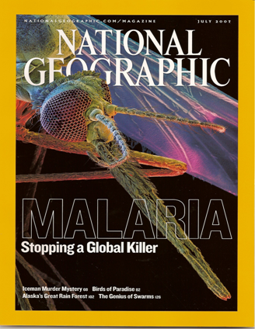
Words to Heed
“Some travelers prefer to acquire resistance to malaria rather than to take preventative tablets, or they twitter on about homeopathic cures for this killer disease. That’s their prerogative, but they have no place expounding his ill-informed drivel to others. Travelers to Africa cannot acquire any effective resistance to malaria, and those who don’t make use of prophylactic
drugs risk their life in a manner that is both foolish and unnecessary.”
Philip Briggs, “Uganda – The Bradt Travel Guide” 3rd edition. Bradt
Publication (UK) The Globe Pequot Press (USA), 1998

Slide 45

Malaria Resources
CDC Malaria Hotline 770-488-7788 (9-5 EST)or toll free 855-856-4713
CDC (after hours): 770-488-7100 : page the person on call for the CDC Malaria Branch
CDC Website http://www.cdc.gov/malaria
CDC Health Information for Internationffal Travel 2020 Yellow Book (information by country)
Trip Prep http://www.tripprep.com
WHO Guidelines for Malaria www.who.int

Slide 46
Malaria references
Management of Severe Malaria: A Practical Handbook 3rd Ed. World Health Organization apps.who.int
WHO World Malaria Report 2022
Trampuz A et al. Clinical Review: Severe Malaria. Critical Care 2003; 7(4): 315-323
Juckett G. Malaria Chemoprophylaxis and Insect Avoidance. In: Family Medicine Clinics. 2005; 7 (4): 653-673. Travel Medicine Edition, William Stauffer, ed. Saunders (Elsevier), Philadelphia
Bartoloni A, Zammarchi L. Clinical Aspects of Uncomplicated and Severe Malaria. Med J of Hematol and Inf Dis2012:4(1): e20112026M
The Ivermectin Roadmappers. A roadmap for the development of ivermectin as a complementary malaria vector control tool. Am J Trop Med Hyg 2020 Feb; 102(2 suppl)
Hombhanie F, Huang Q. Artemisinin-Naphthoquine Combination (ARCO): an overview of the progress. Pharmaceuticals 2010 Dec;;3(12): 3581-3593

Slide 47
Malaria STUDY Questions
Which type of malaria is associated with the highest morbidity/mortality? What environment is most suitable for this species?
Which two malaria species are known as benign tertian and require terminal treatment to prevent relapse?
What are the common symptoms of malaria?
What test can you use to diagnose malaria if away from medical care?
How can you protect yourself from mosquito bites?
What are two drug options are suitable to self treat mild to moderate malaria?
What can you use for malaria prevention in pregnancy?

Slide 48
Answers
Falciparum malaria, lowland tropics
P. vivax and ovale
Fever, headache, chills (rigors)
Rapid Diagnostic Test (RDT)
DEET repellents, long-sleeved shirts, Insecticide treated bed nets, window screens, indoor residual sprays
Malarone (atovaquone-proguanil) and Coartem (artemether-lumefantrin)
Mefloquine (Malarone category C)

