Slide 1

The Great Balancing Act:
Parenthood and Missions

Slide 2
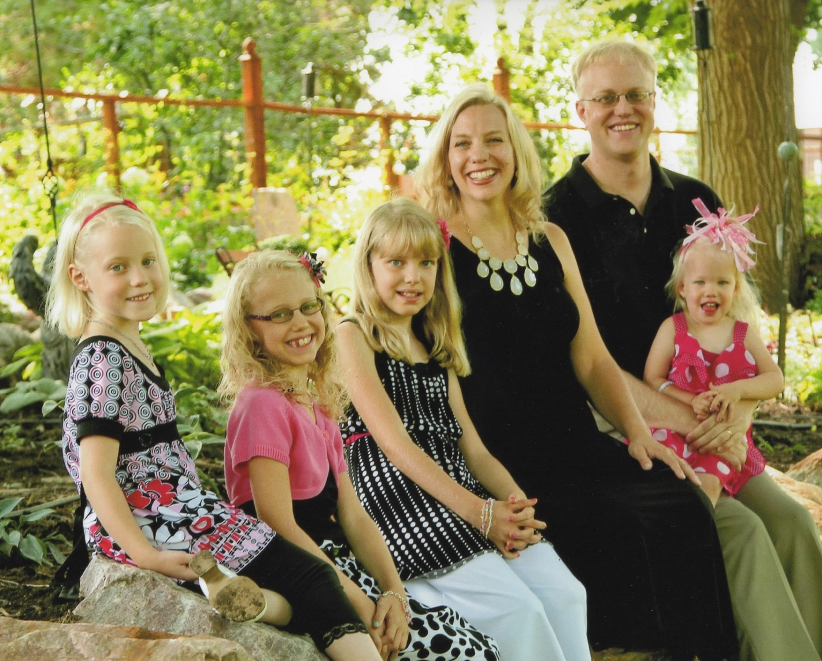
John and Rachel Wind
Christin (6), Chloe (8), Clara Anne (9), Charis (2)

Slide 3
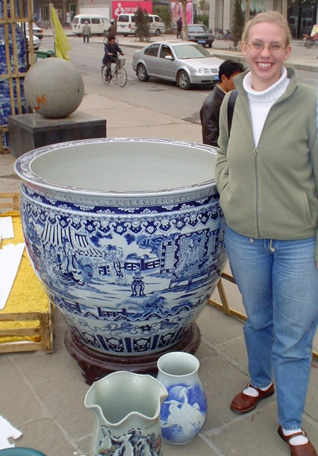
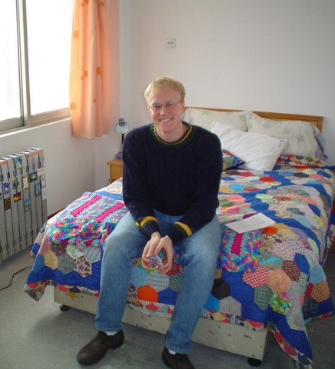
January 2004

Slide 4
1. Number of Children
2. Age of Children
3. Personalities of Children
4. Personalities of Parents
5. Children with Other Special Needs
6. Particular Work Demands
7. Particular Cultural Challenges
8. Available Schooling Options
9. Available community
10. Living space
Some Factors Making
Every Mission Field Parenting Circumstance Unique

Slide 5
Our Primary Audience
Those who are planning
to go on the mission field
or already are
and who are hoping
to be parents
or already are.

Slide 6
Our Primary Goal
To give you guidance
in constructing a personalized
Missionary Parenting Plan
and to inspire you
to set aside time to develop yours.

Slide 7
Our Plan to Achieve this Goal
Describe some of the special challenges of balancing parenting and missions
Discuss 10 elements to consider in your Missionary Parenting Plans – alternating between:
    Proclaim some of the unchanging truths for parenting from God’s Word
    Share some wisdom from our own experience of parenting on the mission field
Q & A

Slide 8
Some Special Challenges to Balancing on the Mission Field
Re-learning how to live
Daily life often more complicated
Language learning
Culture fatigue – for you and your children
Less relational support
Schooling challenges
Work responsibilities

Slide 9
Parenting Truth from God’s Word
God designed the home, when possible, to be led intentionally and actively by fathers, with fathers and mothers expressing one-flesh unity in their parenting.
  Therefore:
    Fathers – resolve to take godly leadership
    Mothers – resolve to encourage and support that leadership
    Parents – resolve to be unified in parenting

Slide 10
Ephesian 6:1-4
“Children, obey your parents in the Lord, for this is right. ‘Honor your father and mother’ (this is the first commandment with a promise), ‘that it may go well with you and that you may live long in the land.’ Fathers, do not provoke your children to anger, but bring them up in the discipline and instruction of the Lord.”

Slide 11
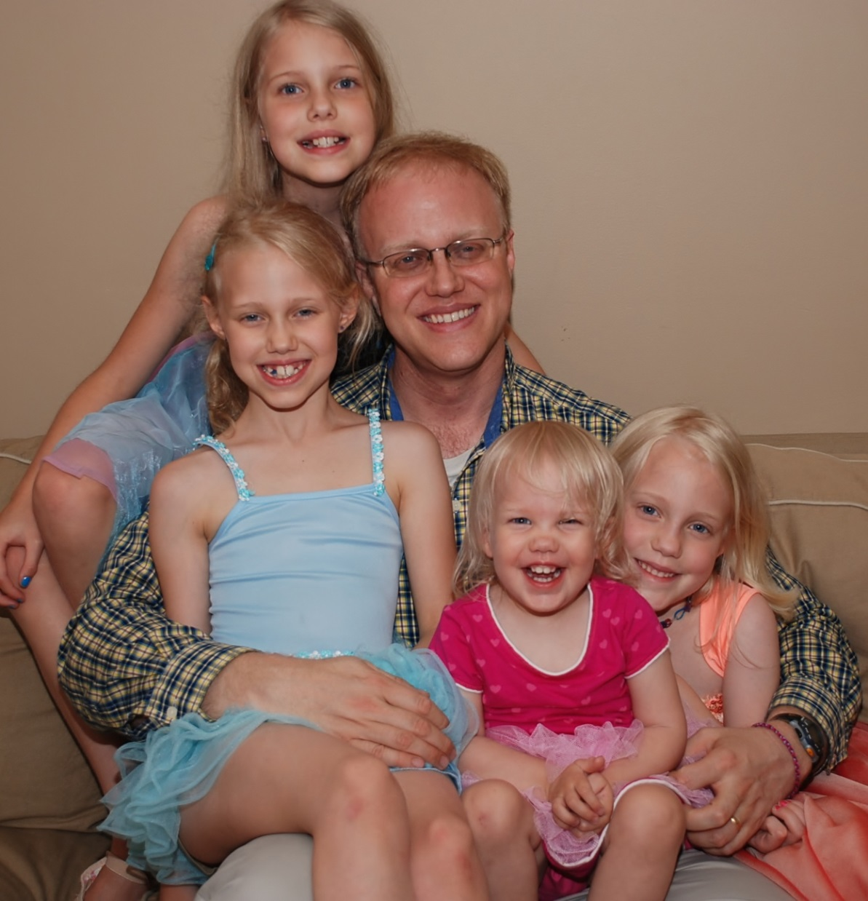

Slide 12
Parenting Wisdom from Our Experience
Set aside regular times together as husband and wife to evaluate your parenting and your family life as a whole

Slide 13
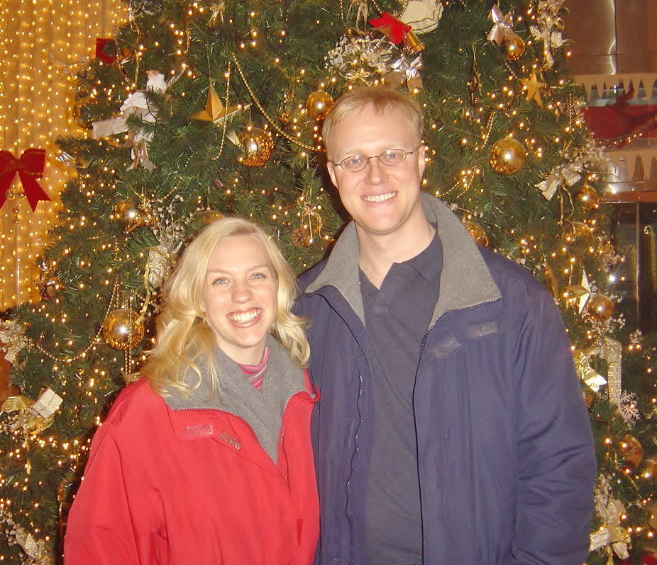

Slide 14
Parenting Truth from God’s Word
God designed parents to shepherd their children by God’s Word.
Therefore:
  Make a plan together as husband and wife for Bible intake and family worship

Slide 15
Deuteronomy 6:6-9
Moses said: “These words that I command you today shall be on your heart. You shall teach them diligently to your children, and shall talk of them when you sit in your house, and when you walk by the way, and when you lie down, and when you rise. You shall bind them as a sign on your hand, and they shall be as frontlets between your eyes. You shall write them on the doorposts of your house and on your gates.”

Slide 16
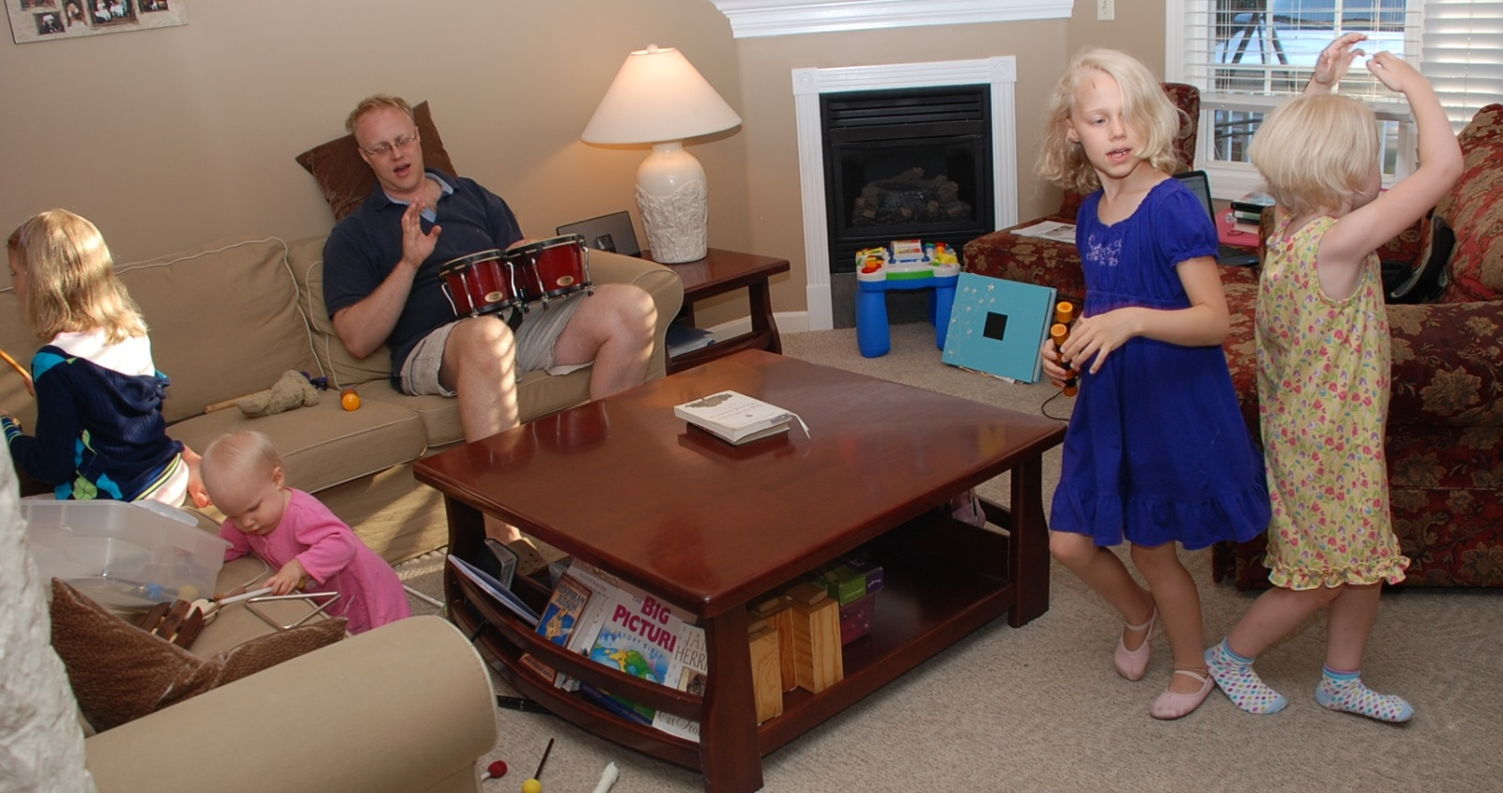

Slide 17

Parenting Wisdom from Our Experience
Confirm a shared call to the mission field as a whole family

Slide 18
Parenting Truth from God’s Word
God designed parents to be consistent authorities in the home who are loving and kind
Therefore:
  Make a plan together as husband and wife for corrective discipline of your child(ren)

Slide 19
Hebrews 12:6-11
“the Lord disciplines the one he loves, and chastises every son whom he receives.’ It is for discipline that you have to endure. God is treating you as sons. For what son is there whom his father does not discipline? If you are left without discipline, in which all have participated, then you are illegitimate children and not sons. Besides this, we have had earthly fathers who disciplined us and we respected them. Shall we not much more be subject to the Father of spirits and live? For they disciplined us for a short time as it seemed best to them, but he disciplines us for our good, that we may share his holiness. For the moment all discipline seems painful rather than pleasant, but later it yields the peaceful fruit of righteousness to those who have been trained by it.”

Slide 20
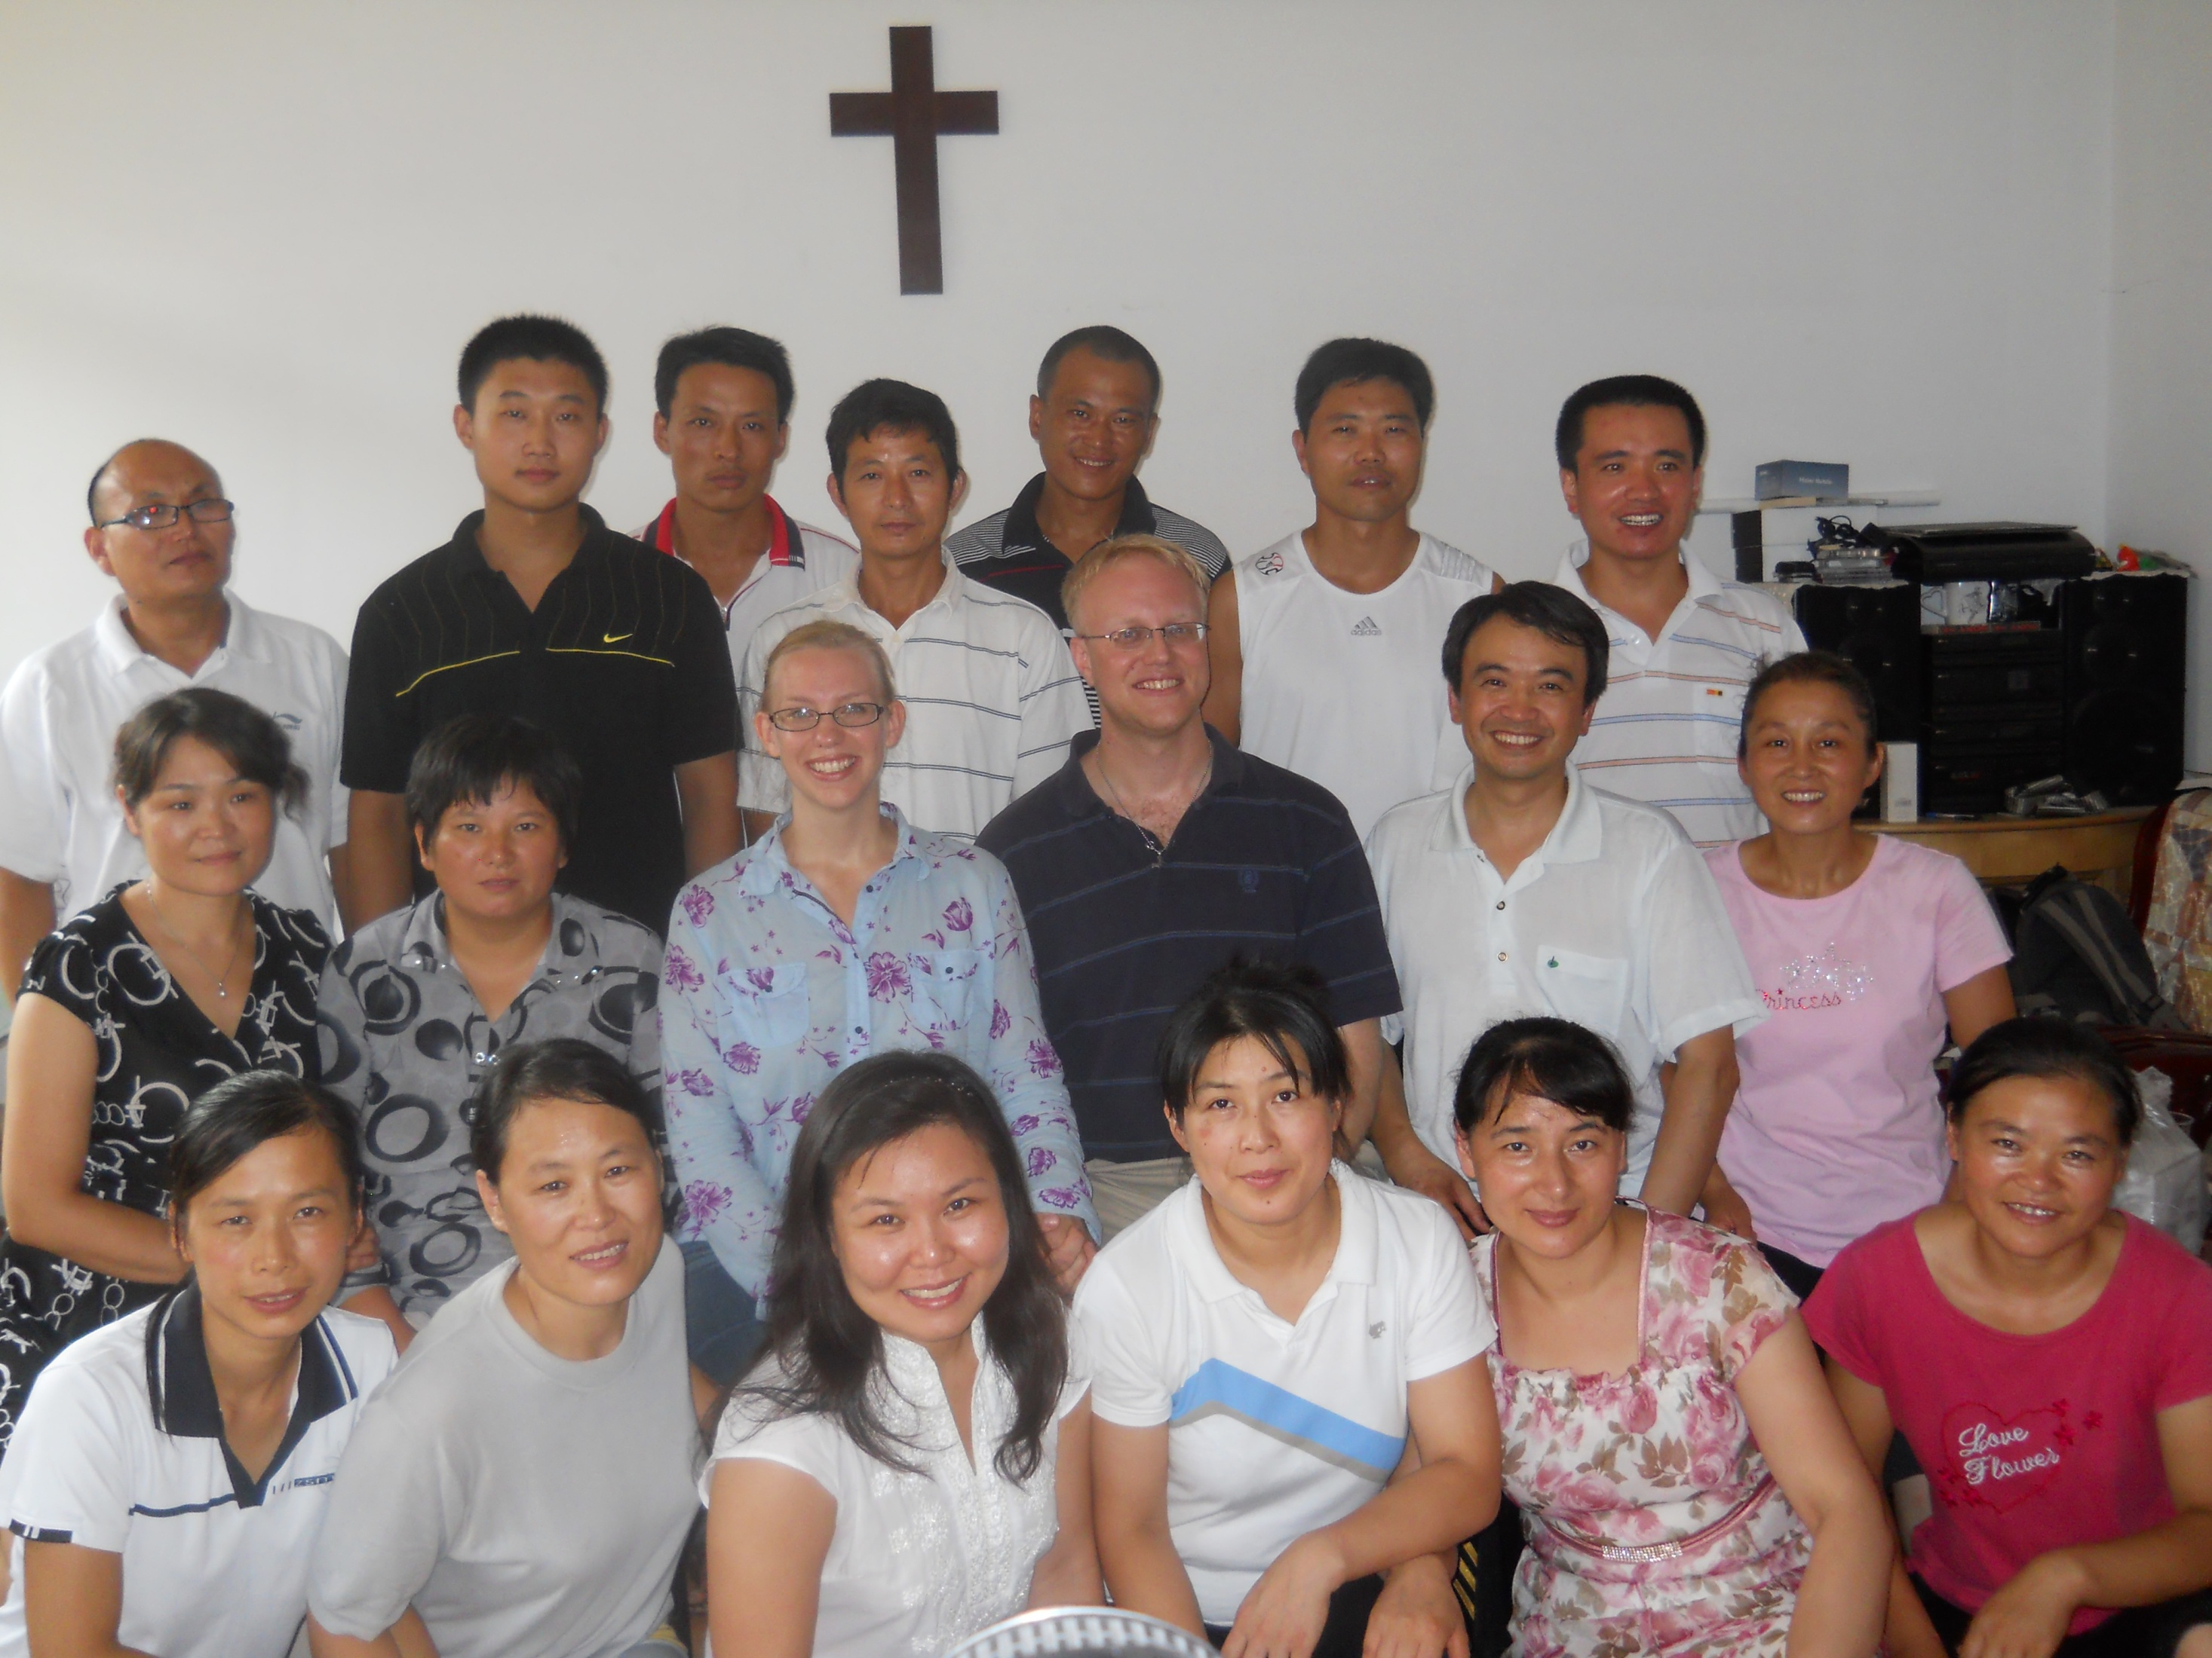

Slide 21
Parenting Wisdom from Our Experience
Establish other structures of time spent together as a family as part of the regular family routine.

Slide 22


Slide 23
Parenting Truth from God’s Word
God designed parents to communicate regularly and deeply with their children
Therefore:
  Make a plan together as husband and wife for regular channels of heart-level communication with your child(ren)

Slide 24
Proverbs 1:8-9; 20:5
“Hear, my son, your father's instruction,
and forsake not your mother's teaching,
for they are a graceful garland for your head
and pendants for your neck.”
“The purpose in a person's heart
is like deep water,
but one of understanding will draw it out.”

Slide 25
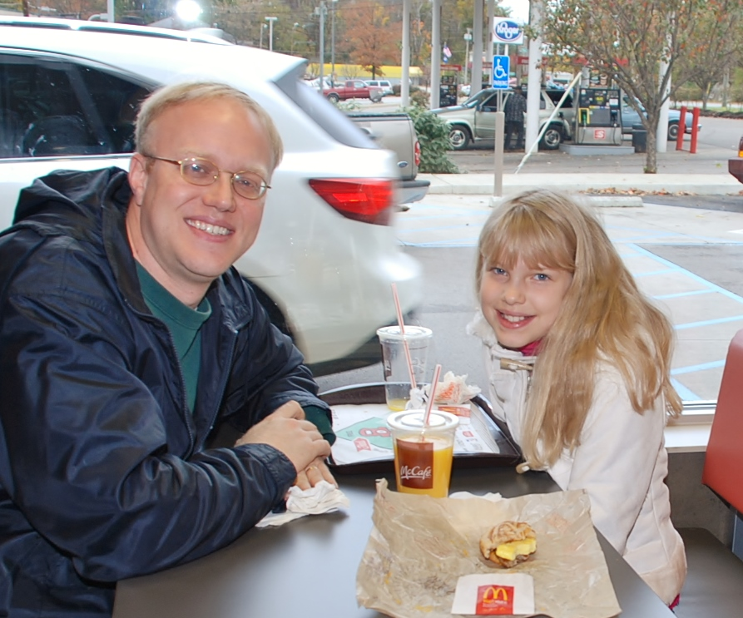

Slide 26
Parenting Wisdom from Our Experience
Creatively make use of
the resources and opportunities
at your disposal in order to
carve out family time

Slide 27


Slide 28
Parenting Truth from God’s Word
God designed the responsibility of ministry within the home to maintain priority over the responsibility of ministry outside the home
Therefore:
  Commit together as husband and wife to the priority of your parenting over your mission work

Slide 29
1 Timothy 3:4-5
      “[The overseer of the local church]
      must manage his own household well,
      with all dignity
      keeping his children submissive,
      for if someone does not know how
      to manage his own household,
      how will he care for God's church?”

Slide 30
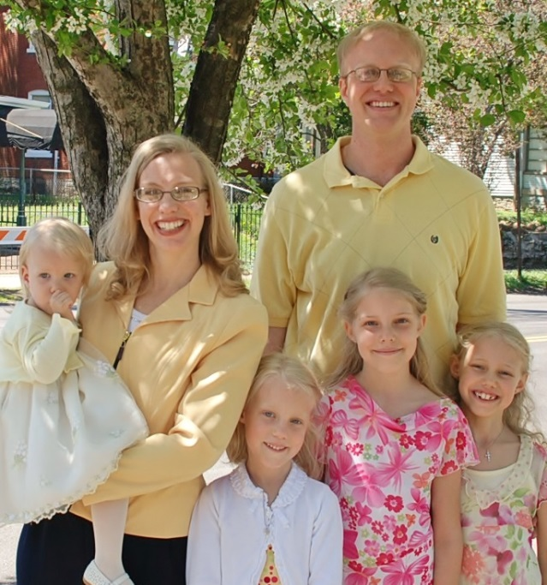
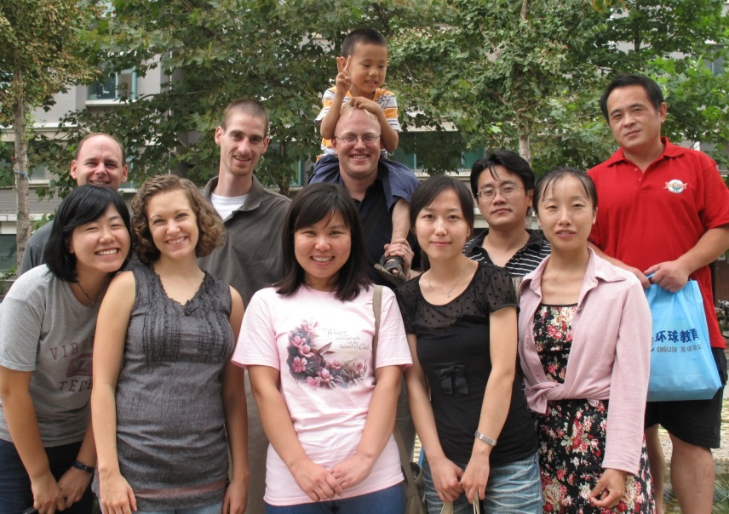
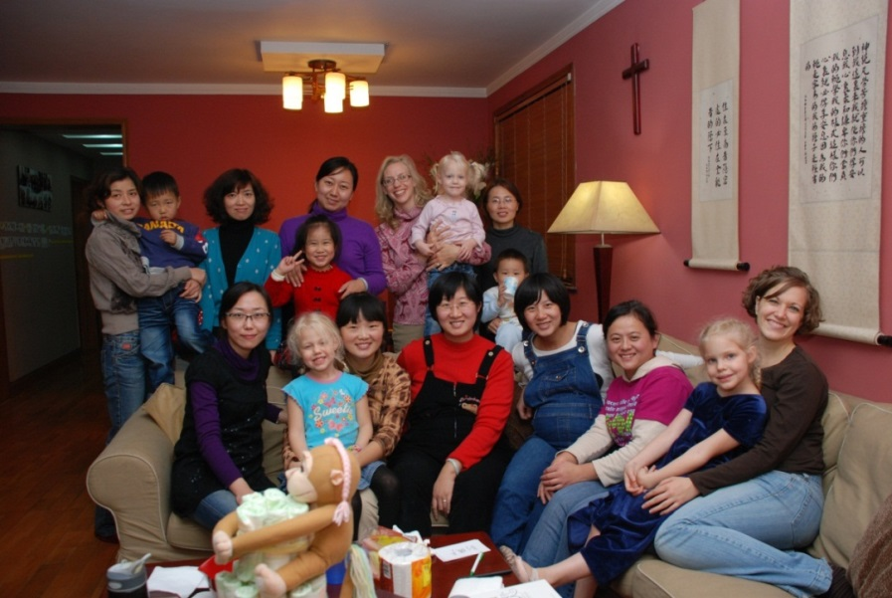

Slide 31
Parenting Wisdom from Our Experience
Develop accurate expectations for your family life and work on the mission field

Slide 32
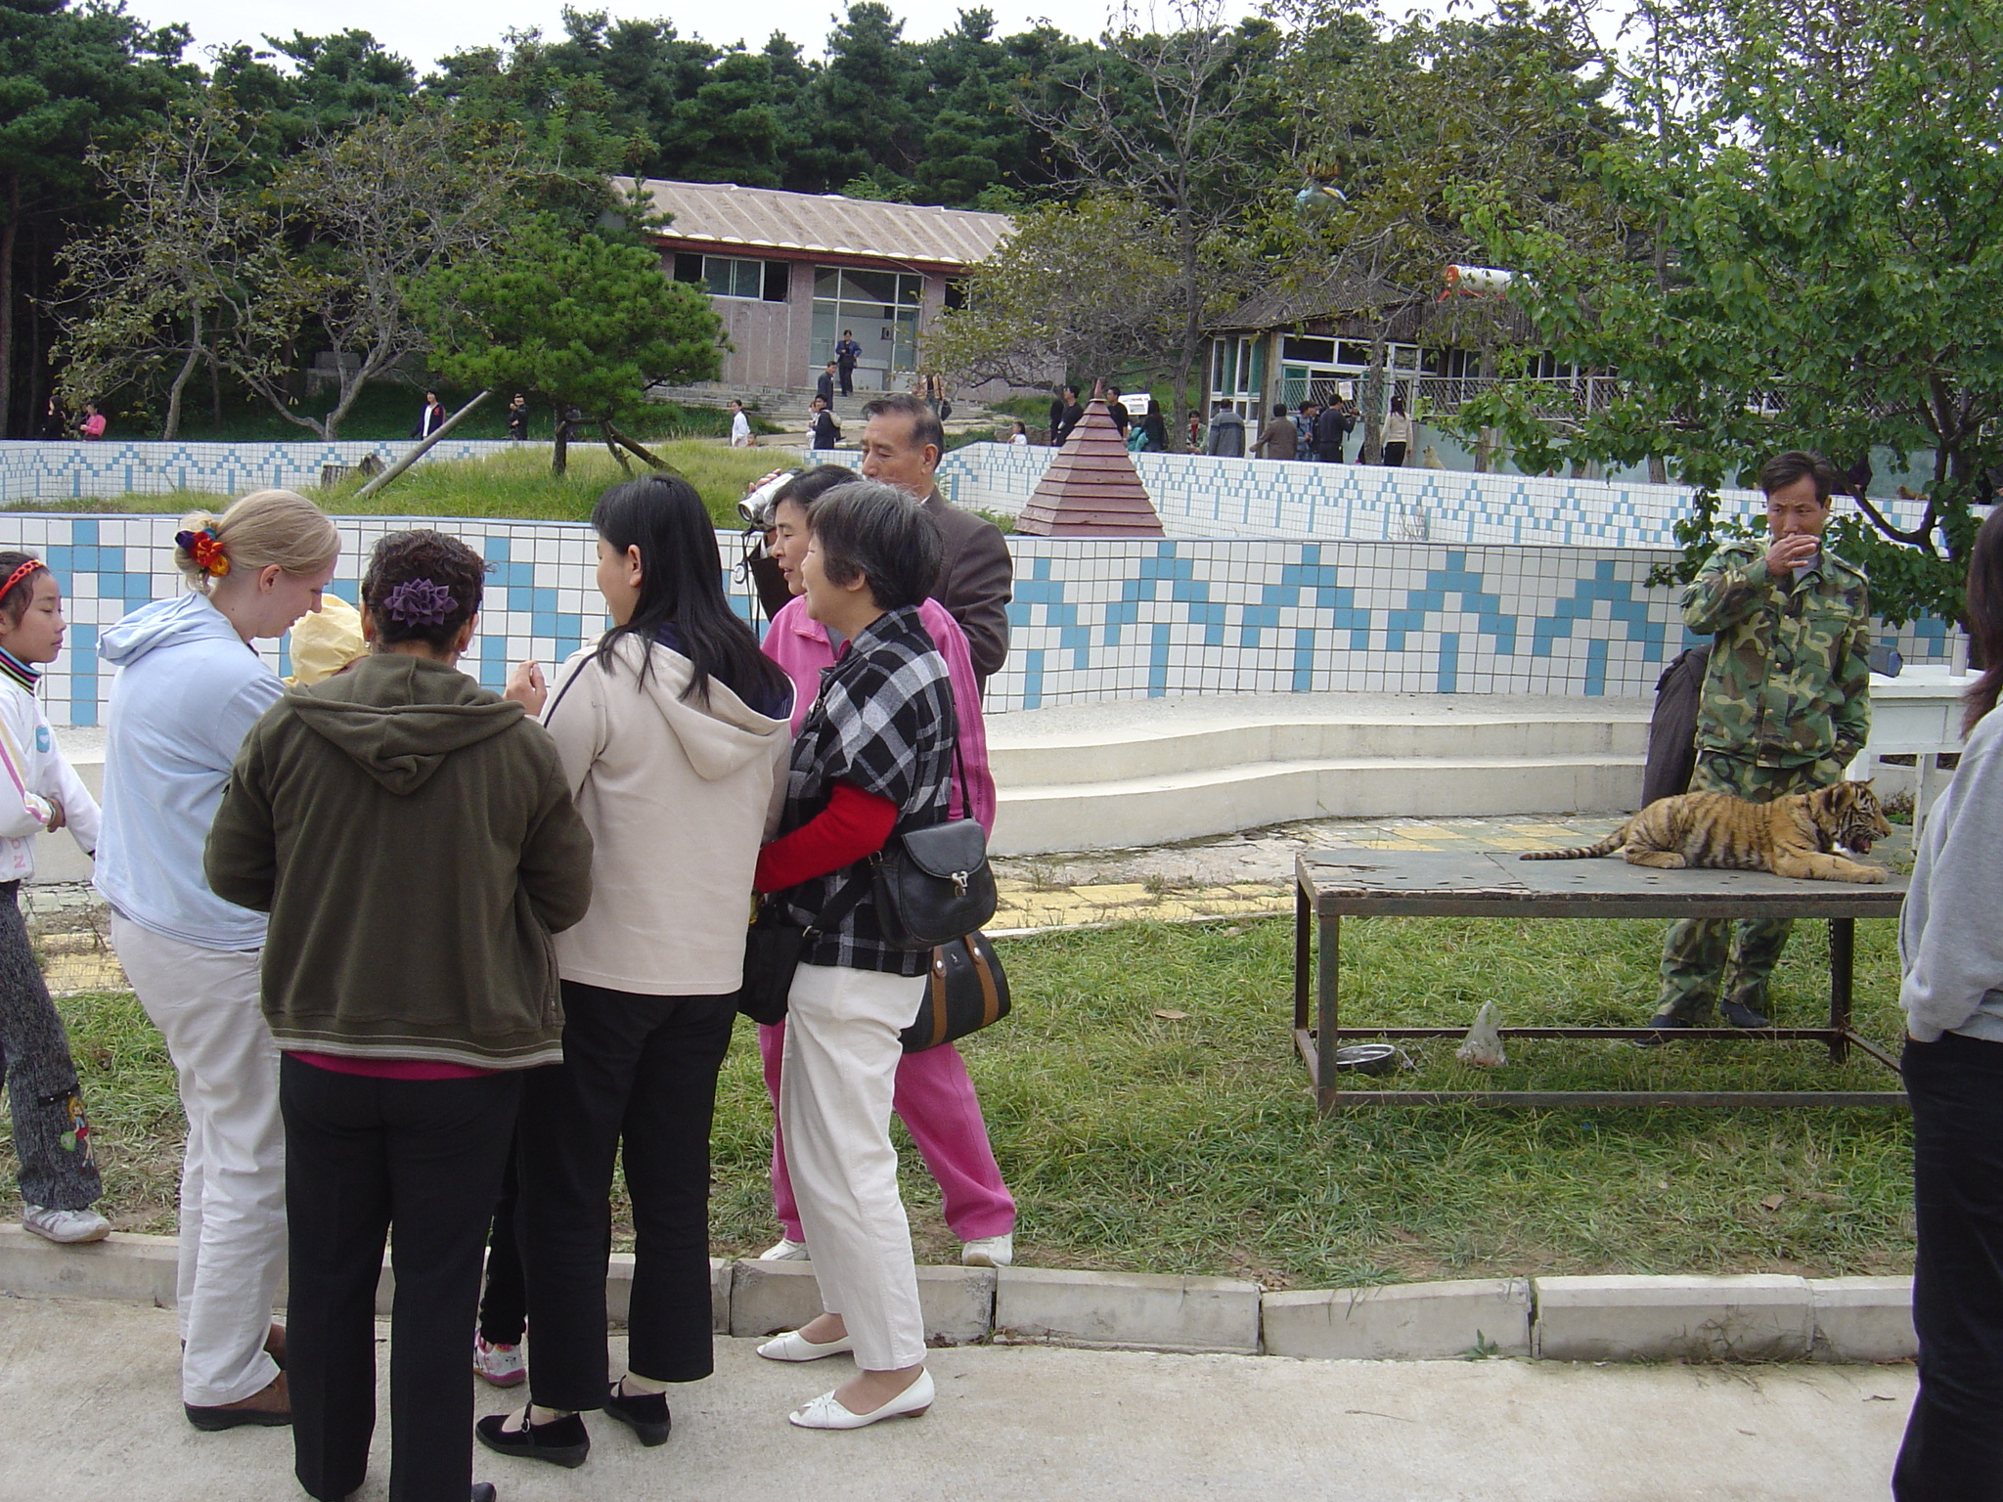

Slide 33
Questions?

