Slide 2
Pro Wrestling:
Spiritual Warfare for Missionaries
Medical Missions GMHC 2021

Slide 3
Pro Wrestling:
Spiritual Warfare for Missionaries
What is spiritual warfare?
Spiritual warfare is the advance of the Kingdom of God throughout the earth so that God is glorified and people are set free.
It is not an end in itself, and is intrinsic to this age.
Its ultimate goal is to see people set free from darkness and saved, to the glory of God.

Slide 4
Pro Wrestling:
Spiritual Warfare for Missionaries
Why is warfare necessary?
Satan’s primary objective is to prevent God from being glorified and keeping lost people from being saved.
Satan’s secondary objective is to make human beings and human society as miserable as possible in this life.
Satan’s ultimate goal is to prevent (or at least to delay) the hour of his judgment.

Slide 5
Pro Wrestling:
Spiritual Warfare for Missionaries
Levels of spiritual warfare
Occult level
Personal/Ground level
Strategic level
Occult level
Personal/Ground level
Personal/Ground level
Personal
Others

Slide 6
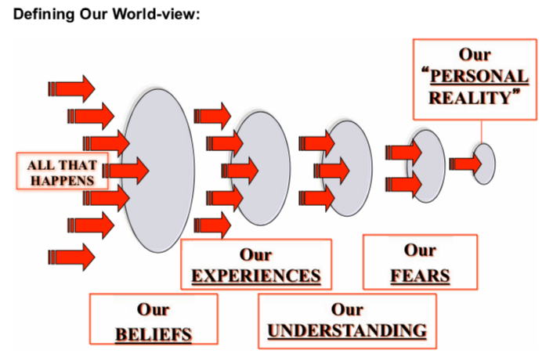
Pro Wrestling:
Spiritual Warfare for Missionaries
Importance of Worldview

Slide 7
Western
Worldview

Slide 8
Western
God
Angels
Faith
Miracles
Devil
Demons
Worldview

Slide 9
Western
God
Angels
Faith
Miracles
Devil
Demons
Worldview
Animals
Senses
Natural World
Science
Technology

Slide 10
Western
God
Angels
Faith
Miracles
Devil
Demons
Sacred
Worldview
Animals
Senses
Natural World
Science
Technology
Secular

Slide 11
Western
God
Angels
Faith
Miracles
Devil
Demons
Sacred
Worldview
EXCLUDED
MIDDLE
Animals
Senses
Natural World
Science
Technology
Secular

Slide 12
Western
Traditional
God
Angels
Faith
Miracles
Devil
Demons
God
Angels
Faith
Miracles
Devil
Demons
Sacred
Worldview
EXCLUDED
MIDDLE
Animals
Senses
Natural World
Science
Technology
Animals
Senses
Natural World
Science
Technology
Secular

Slide 13
Western
Traditional
God
Angels
Faith
Miracles
Devil
Demons
God
Angels
Faith
Miracles
Devil
Demons
Sacred
Ghosts
Witches
Sorcerers
Witchcraft
Magic
Evil Eye
Blessings
Curses
Amulets
Worldview
EXCLUDED
MIDDLE
Holistic & Intuitive
Animals
Senses
Natural World
Science
Technology
Animals
Senses
Natural World
Science
Technology
Secular

Slide 14
Western
Traditional
God
Angels
Faith
Miracles
Devil
Demons
God
Angels
Faith
Miracles
Devil
Demons
Sacred
Theology
Ghosts
Witches
Sorcerers
Witchcraft
Magic
Evil Eye
Blessings
Curses
Amulets
Western mission has been preoccupied with theology at one level, and technology at another, but has completely negated the every day application of religion.
Worldview
Holistic & Intuitive
Animals
Senses
Natural World
Science
Technology
Animals
Senses
Natural World
Science
Technology
Secular
Technology

Slide 15
Western
Traditional
God
Angels
Faith
Miracles
Devil
Demons
God
Angels
Faith
Miracles
Devil
Demons
Sacred
Theology
Ghosts
Witches
Sorcerers
Witchcraft
Magic
Evil Eye
Blessings
Curses
Amulets
Western mission has been preoccupied with theology at one level, and technology at another, but has completely negated the every day application of religion.
Worldview
Truth
Holistic & Intuitive
Animals
Senses
Natural World
Science
Technology
Animals
Senses
Natural World
Science
Technology
Secular
Technology

Slide 16
Western
Traditional
God
Angels
Faith
Miracles
Devil
Demons
God
Angels
Faith
Miracles
Devil
Demons
Sacred
Theology
Ghosts
Witches
Sorcerers
Witchcraft
Magic
Evil Eye
Blessings
Curses
Amulets
Western mission has been preoccupied with theology at one level, and technology at another, but has completely negated the every day application of religion.
Worldview
Truth
Holistic & Intuitive
Power
Animals
Senses
Natural World
Science
Technology
Animals
Senses
Natural World
Science
Technology
Secular
Technology

Slide 17
“It was not the Church’s liturgy or morals or monotheism or internal organization that seemed to non-Christians much different than other people. The one point of difference that seemed most salient was the antagonism inherent in Christianity. Antagonism of God against all supernatural powers. It was the manhandling of demons, humiliating them, making them howl, beg for mercy, tell their secrets and making them depart in a hurry that served a purpose quite essential to a Christian definition of a supreme God monotheism. It made physically and dramatically visible the superiority of the Christians’ patron’s power (i.e. Jesus Christ) over all others. Non-Christians were won over to the Church through miraculous demonstrations; head-on challenges of non-Christians to a test of power; head-on confrontations with supernatural beings inferior to God and a contemptuous dismissal of merely rational paths toward the true knowledge of the Divine.”
Ramsey McMullen; Christianizing the Roman Empire: A.D. 100-400
Notes:
Ramsey McMullen, Emeritus Professor of history at Yale University, where he taught from 1967 to his retirement in 1993 as Dunham Professor of History and Classics. His scholarly interests are in the social history of Rome and the replacement of paganism by Christianity.

Slide 18
Pro Wrestling:
Spiritual Warfare for Missionaries
Strongholds
Strongholds are located in the mind.
Strongholds are often made up of good thoughts
Strongholds often develop in the shadow of our strengths.
Strongholds are often activated by painful trauma.
Strongholds create a double mind that results in spiritual and emotional instability.

Slide 19
Pro Wrestling:
Spiritual Warfare for Missionaries
Weapons of war
The Name of the Lord
Blood of the Lamb.
Agreement.
The Word of God.
Binding and loosing.
Armor of God.
Word and testimony.

Slide 20
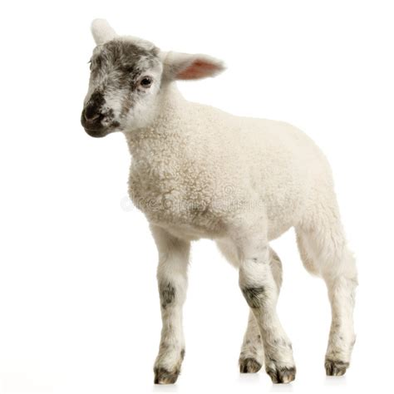
Pro Wrestling:
Spiritual Warfare for Missionaries
Weapons of war
The Name of the Lord
Blood of the Lamb.
Agreement.
The Word of God.
Armor of God.
Word and testimony.

Slide 21
Pro Wrestling:
Spiritual Warfare for Missionaries
Weapons of war
The Name of the Lord
Blood of the Lamb.
Agreement.
The Word of God.
Armor of God.
Word and testimony.

Slide 22
Pro Wrestling:
Spiritual Warfare for Missionaries
Weapons of war
The Name of the Lord
Blood of the Lamb.
Agreement.
The Word of God.
Armor of God.
Word and testimony.

Slide 23
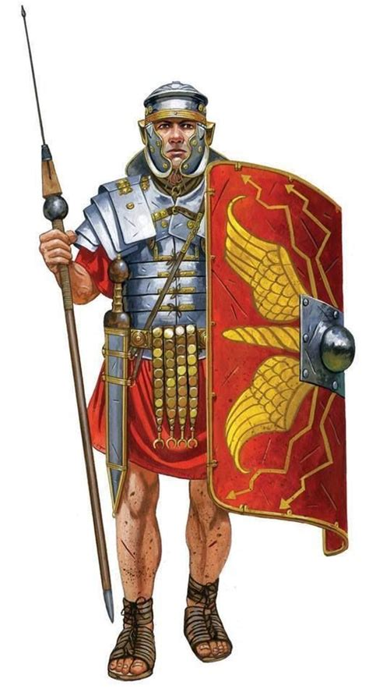
Pro Wrestling:
Spiritual Warfare for Missionaries
Weapons of war
The Name of the Lord
Blood of the Lamb.
Agreement.
The Word of God.
Armor of God.
Word and testimony.

Slide 24
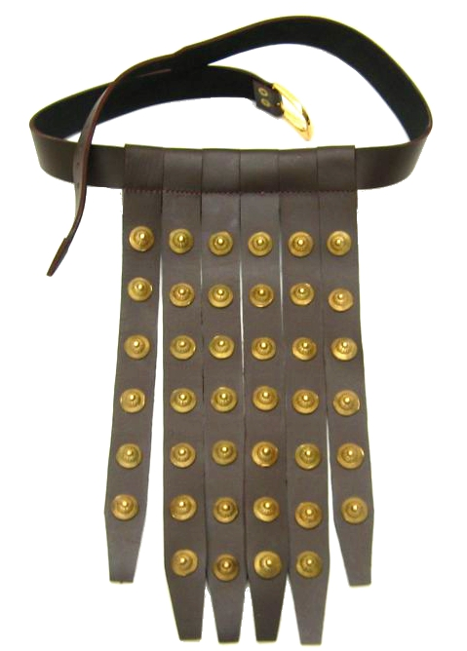
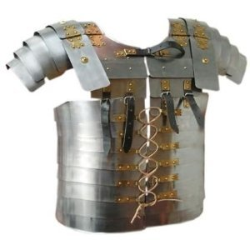
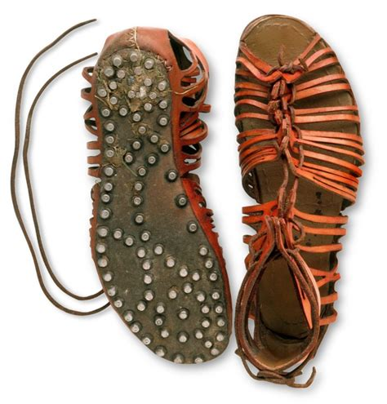
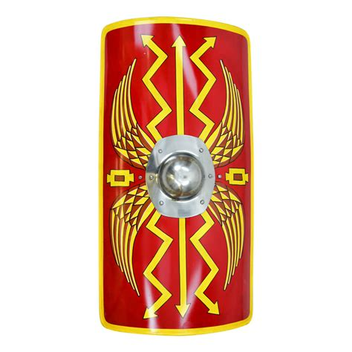
Pro Wrestling:
Spiritual Warfare for Missionaries
Armor of God
lies against the character of God
deception about who I am
error as to the way I am going
believing accusations from Satan
feeling condemned
puffed up with spiritual pride
attacked by persecution or lies
compromising the Word of God
passive and asleep
hit by flaming missile of doubt, fear, unbelief

Slide 25
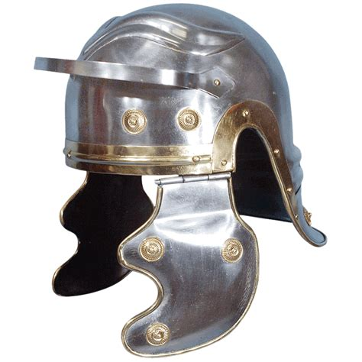
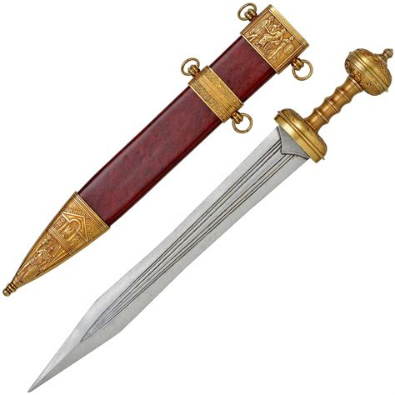
Pro Wrestling:
Spiritual Warfare for Missionaries
Armor of God
trouble with thoughts of guilt, condemnation, hatred
operating in flesh and not the spirit
remaining in darkness; unrenewed mind
whispers words such as “Hath God said?”
distortion of the Word of God
listening to doctrines of demons

Slide 26
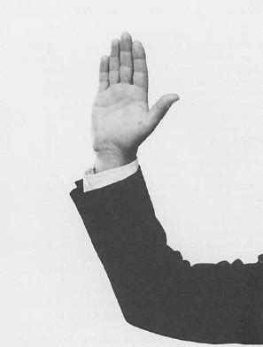
Pro Wrestling:
Spiritual Warfare for Missionaries
Weapons of war
The Name of the Lord
Blood of the Lamb.
Agreement.
The Word of God.
Armor of God.
Word and testimony.

Slide 27
Pro Wrestling:
Spiritual Warfare for Missionaries
Three types of authority
Positional
Imparted
Virtue based

Slide 28
Pro Wrestling:
Spiritual Warfare for Missionaries
Positional authority
Every believer has this authority equally
Believers differ in our exercise of it
Positional authority extends to our domain

Slide 29
Pro Wrestling:
Spiritual Warfare for Missionaries
Imparted authority
This is special authority, not every believer has it
No control or understanding of how this is imparted
Not easily duplicated

Slide 30
Pro Wrestling:
Spiritual Warfare for Missionaries
Virtue-based authority
This is the Greek word nikao, victory, overcome
There are different causes of demonization, requiring different levels of authority
Authority comes through the opposite spirit
Must learned pass tests of obedience

Slide 31
Pro Wrestling:
Spiritual Warfare for Missionaries
Final Encouragement
You can’t take ground from the enemy if he has ground in you.
Aim to be a thermostat, not a thermometer.
The Holy Spirit loves a good fight.
You’re either a target or a victim.
The more you have in God, the more you can take away from the enemy.

