Slide 1
Pediatric development: sensory, motor, and neurological milestones
Helping Parents and Caregivers Understand Developmental Delays and Sensory Processing Concepts
April D. Christopherson, OTR/L

Slide 2
What is ‘sensory processing’?
“Sensory Integration (or sensory processing) is the organization of sensation for use. Our senses give us information about the physical conditions of the body and the environment around us.”
-- Jane Ayres, OT

Slide 3
Sensory systems
Vision
Hearing
Taste
Touch
Smell
Notes:
The ‘BIG FIVE’ sensory systems we’ll touch on today

Slide 4
The sensory ‘superhighway’
“The brain locates, sorts and orders sensations, somewhat like the way a traffic light directs moving cars. When sensations flow in a well organized or integrated manner, the brain uses those sensations to form perceptions, behaviors and learning. When the flow of sensations is disorganized, life can be like a rush-hour traffic jam.”
-- Adapted from Jane Ayres, OT

Slide 5
Sensory processing disorder
“Sam’s Club on Drugs”
Notes:
Illustration of “Sam’s club” when trying to learn a new concept or listen to a story and recall details. Although we hope that people’s sensory input can be ‘just right’, there will naturally be times when people are getting ‘too little’ or ‘too much’.
• Too little stimulation, so that the person may feel bored, underwhelmed, understimulated, or underaroused.
When underwhelmed, a person may
• End up seeking stimulation or attention, many of which may be annoying. E.g. the bored child who needs to fidget, move around or be overactive. E.g. the bored child who annoys his/her siblings, or talks to peers in class.
• Too much stimulation, so that the person may feel overwhelmed, overloaded, or overstimulated.
When overwhelmed, human beings may respond with:
• the classic ‘fight’ response (responding with anger, irritability or oppositionality), or
• ‘flight’ (responding with avoidance, fear, or withdrawal) or • ‘freeze’ response (simply shutting down).
All children have unique, regulatory-sensory processing variations. E.g. some people like to be touched, some people don’t. Regulatory-Sensory Processing Disorders refer to the extremes, where sensory processing variations actually interfere and cause problems with daily function at home, school, or work. E.g. a child who is so overwhelmed by routine touch by peers that s/he is unable to be in a normal school setting.

Slide 6
Sensory ‘diet’
Metabolic ‘Nutrition’
Sensory ‘Nutrition’
Proteins
Grains
Fruit/Veg
Afternoon
Evening
Morning
Notes:
Just as our bodies need just the right combination of nutrition intake to make sure our whole body is healthy, we also need just the right amount of activity for our brains and bodies to work well.
EXAMPLES:
Morning: coffee, crunchy cereal, hot foods, hot shower
Afternoon: caffeinated drink, brisk walk, chew gum
Evening: calming tea, lying down on couch, family time
• Too little stimulation, so that the person may feel bored, underwhelmed, understimulated, or underaroused.
When underwhelmed, a person may
• End up seeking stimulation or attention, many of which may be annoying. E.g. the bored child who needs to fidget, move around or be overactive. E.g. the bored child who annoys his/her siblings, or talks to peers in class.
• Too much stimulation, so that the person may feel overwhelmed, overloaded, or overstimulated.
When overwhelmed, human beings may respond with:
• the classic ‘fight’ response (responding with anger, irritability or oppositionality), or
• ‘flight’ (responding with avoidance, fear, or withdrawal) or • ‘freeze’ response (simply shutting down).

Slide 7
Sensory over-responsivity (Avoider)
Aggression when touched or bumped
Avoidance
Gets into a lot of fights
Picky eater – defensive with new foods
Won’t touch different textures (play-doh; paint; bubbles)
Refuses to let others help with hair, nails – etc. (Self-Care)
Refuses to wear certain clothes or textures
Withdraws when in a crowd
Notes:
Sensory Oversensitivity: In these situations, the person’s body is easily overwhelmed by too much sensory input, even if it seems like normal amounts to other people, even if those behaviors seem extreme. When someone is sensitive to stimuli they will often try to avoid this stimulation to avoid becoming overwhelmed. When overwhelmed, a person’s body feels in danger, and thus the person may react with a “fight or flight” response, and they may show the following behaviors: • React to being touched with withdrawal (flight) or aggression (flight) • Be unwilling to take risks, or be extremely cautious in their environment (e.g. playgrounds) • Motion sickness, afraid of heights (e.g. carsickness, refuses to get on a slide) • Anxious/uncomfortable in over-stimulating environments (e.g. malls, playgrounds, public transportation) • Very picky eater – refuses to eat certain textured foods, sensitive to some food smells or temperatures (Oral defensiveness) • Avoiding touch with substances (e.g. messy foods, mud, sand) or will only use utensils or fingertips rather than whole hand to manipulate objects • Struggles with self-care activities; will only wear certain types of material for clothing and or wear clothing in a particular way (e.g. socks, no hats); complains with face washing, hair brushing, tooth brushing, and hair cutting.

Slide 8
Sensory under-responsivity (Seeker)
Hyperactivity – seeks movement
Impulsivity
Risk-Taker
Decreased response to pain
Unable to sit and listen
Clumsiness
Touches everything
Likes spicy, crunchy, carbonated, sour foods
Notes:
In these situations, the person’s body is doesn’t get enough sensory input, even if it seems like normal amounts to other people, and so that person might do things to get more sensory input, even if those behaviors seem extreme. They may demonstrate any or all of the following behaviors: • Hyperactivity, impulsivity, decreased response to pain • Difficulties “sitting still and listening” • Poor body awareness - clumsiness, touching objects or others too hard or too often • Love for foods that are spicy, hard/crunchy, extremely cold/hot in temperature, carbonated drinks, and over-stuffing their mouth of food

Slide 9
Motor Milestones
4-6 months
Uses hands to support self while sitting
Rolls from back to tummy and tummy to back
While standing with support, accepts entire weight with legs
Reaches for nearby toys while on tummy
While lying on back, reaches both hands to play with feet
While lying on back, transfers a toy from one hand to the other

Slide 10
Communication milestones 4-6 months
Fears loud or unexpected noises
Listens and responds when spoken to
Begins to babble with consonant sounds e.g. “da, da, da”
Uses babbling to get attention
Makes different kinds of sounds to express feelings
Imitates sounds and facial expressions
Notices toys that make sounds

Slide 11
Motor Milestones
7-9 months
Sits without support
Moves from tummy or back into sitting
Starts to move with alternate leg and arm movement e.g. creeping, crawling
Uses both hands to explore toys
Picks up head and pushes through elbows
during Tummy Time
Turns head to visually track objects, while sitting
Shows more control while rolling and sitting
Starts to pull to stand
Enjoys a variety of movements – bouncing up and down, rocking back and forth
Picks up small objects with thumbs and fingers
Tries to lean towards, reach for, and pick up toys
In simple play imitates others

Slide 12
Communication milestones 7-9 months
Uses increased variety of sounds and syllable combinations in babbling
Looks at familiar objects and people when named
Recognizes sound of their name
Participates in two-way communication
Begins using hand movements to communicate wants and needs, e.g. reaches to be picked up
Follows some routine commands when paired with gestures
Distinguishes between familiar and unfamiliar voices
Shows recognition of commonly used words
Mimics facial expressions and gestures

Slide 13
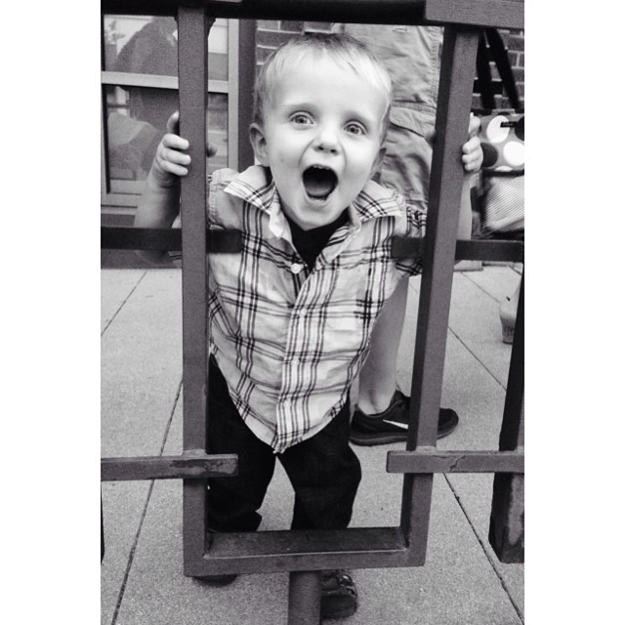
Motor Milestones
10-12 months
Pulls to stand and cruises along furniture
Stands alone -takes several independent steps
Moves in and out of various positions to explore environment and get desired toys
Sits unsupported and is able to turn head to look at objects without losing balance
Maintains balance in sitting when throwing objects
Claps hands
Uses thumb and pointer finger to pick up tiny objects

Slide 14
Communication milestones 10-12 months
Meaningfully uses “mama” or “dada”
Responds to “no”
Responds to simple directions, e.g. “Come here”
Produces long strings of gibberish (called jargoning) in social communication
Says one or two words
Imitates speech sounds
Babbling has sounds and rhythms of speech
Pays attention to where you are looking and pointing

Slide 15
Motor Milestones
13-18 months
Walks independently
Squats to pick up a toy
Stacks two objects
Helps with getting dress/undressed
Builds a three block tower
Puts four rings on a stick
Scribbles
Turns Knobs
Uses ‘Whole Arm’ Movement
Self Feeds - Brings spoon to mouth
Holds and drinks from cup

Slide 16
Communication milestones 13-18-months
Uses increased variety of sounds and syllable combinations in babbling
Looks at familiar objects and people when named
Recognizes sound of their name
Participates in two-way communication
Begins using hand movements to communicate wants and needs, e.g. reaches to be picked up
Follows some routine commands when paired with gestures
Distinguishes between familiar and unfamiliar voices
Shows recognition of commonly used words
Mimics facial expressions and gestures

Slide 17
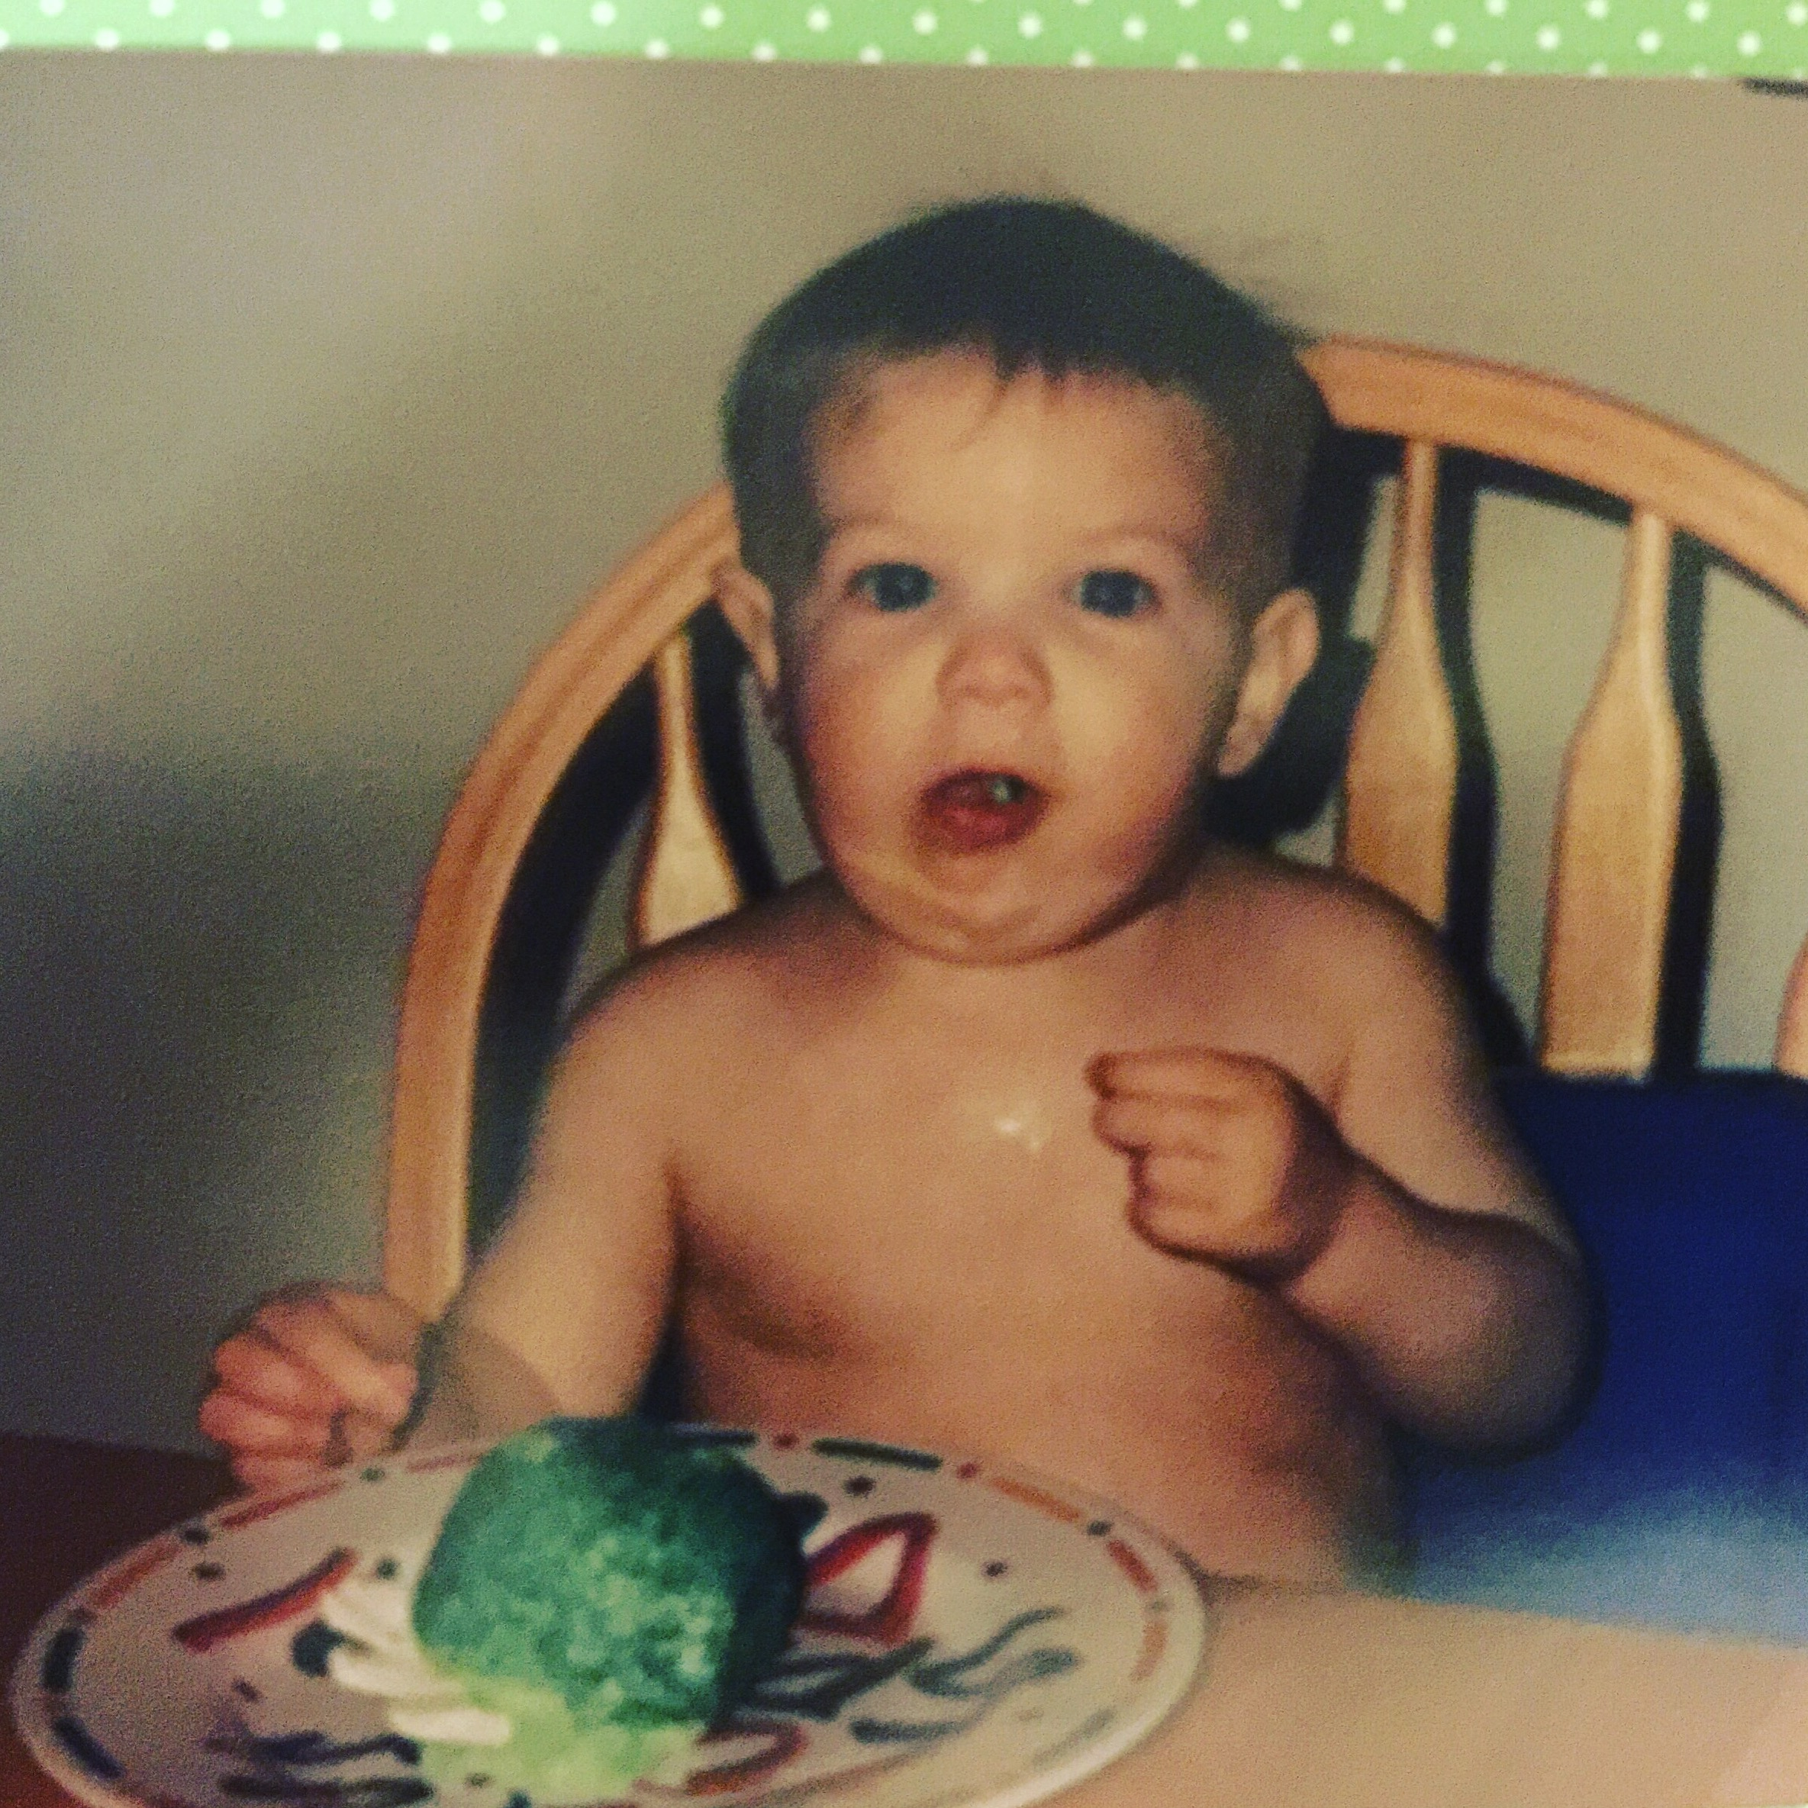
Milestones
19-24 months
Builds three block tower
Puts four rings on a stick
Places five pegs in pegboard
Turns pages 2 at a time
Scribbles
Turns knobs
Self-Feeds with minimal assistance
Brings spoon to mouth
Holds and drinks from cup

Slide 18
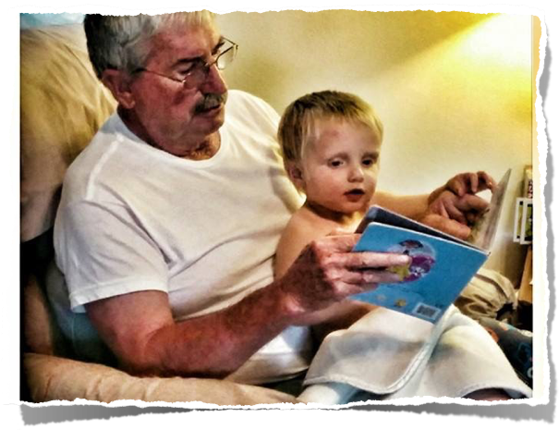
Milestones
25-36 months
Strings four large beads
Turns single pages
Snips with scissors
Holds crayon with thumb/finger (not fisted)
Uses one hand consistently
Imitates circular, vertical, horizontal strokes
Rolls, pounds, squeezes, pulls playdoh
Eats without assistance

Slide 19
Sensory systems
Vision
Hearing
Taste
Touch
Smell
Notes:
The ‘BIG FIVE’ sensory systems we’ll touch on today – let’s return to the sensory systems while we keep normal developmental milestones in mind.

Slide 20
vision
Our visual system allows us to see and perceive the world and its beauty.
Notes:
Visual Sense Our sense of vision is what enables us to see things…

Slide 21
Visual: Red flags and how to help
Child appears distracted when reading or doing puzzles
Refusal to read or do puzzles
Can’t find things in a messy drawer or cubby
Tires easily
Decreased direct eye contact
Behaves better outside in natural light
Can’t copy shapes
Decrease classroom visual stimulation
Use natural lighting
Minimize clutter or blackboard
Minimize clutter in classroom
Create a ‘soothing’ time out area with dim lighting and little to no visual stimulation
Refer for a vision exam or OT evaluation
Notes:
Behaviours seen with a person who is hypersensitive to visual input may include: • May appear distracted, and or non-functional in an environment with visual stimulation (e.g. artificial lighting), or when doing visual tasks (especially tasks such as reading). • May react strongly to colourful or complex images (i.e. they find them confusing) • They find messy desks, rooms etc. stressful (due to visual clutter) • Sensitive to direct eye contact • Difficulties copying from blackboard or books • Avoidance of visually stimulating environments • Preference for dim lighting • Tires easily or gets irritable when attending to visually complex tasks • Squinting, rubbing eyes or getting headaches after reading but not requiring glasses • May have difficulties with fluorescent lighting
Strategies to help the visually overstimulated child: • Minimize visual stimulation for the child who is overwhelmed • Minimize visual clutter on the blackboard • Teach the student to only put on their desk, what they need for the task at hand • Use natural lighting whenever possible (but place student away from window because they may be sensitive to direct sunlight) • For a time-out, soothing place, consider using dimmed lighting, or candle light
Behaviours seen with a person who is under responsive to visual input may include: • Misses visual clues • Touches everything (in order to make up for lack of visual input) • Can’t read body language • Troubles finding objects in cluttered spaces • Troubles with puzzles • Difficulties reading, because s/he loses his/her places • Student may not attend to visual cues or information because they cannot register it. • Difficulties copying from the blackboard or books • Preference for brightly lit rooms • Preference for visually stimulating lessons – facial expressions, hand gestures, colourful etc.
Strategies to help the visually under stimulated child: • Increase visual stimulation when teaching this child – use hand gestures, bright lights, lots of colour and movement. Highlight text. Use different colored papers, or headings. • Use natural lighting or bright lighting

Slide 22
hearing
Our auditory system allows us to hear and sense the world around us!
Notes:
The Auditory (Sound) System Our auditory (sound) system, or sense of hearing allows us to hear someone talking to us (i.e. the teacher in a classroom!), allows us to hear possible dangers, or to enjoy our favorite music.

Slide 23
auditory: Red flags and how to help
Child makes lots of noises
Can’t recall or follow directions
Startle response to common noises
Covers ears
Talking loudly or shouting
Crying or getting angry when classroom is noisy
Child accuses you of ‘yelling’ at him/her
Can use headphones to block noise
Play soft music with a steady beat in background of classroom
Play a metronome to help calm the classroom down (40 to 50 beats a minute)
Prepare children ahead of time for listening exercises
Move child closer to teacher – make more eye contact
Refer for an auditory exam
Notes:
Possible behaviors that may be seen • The person may make their own noise, in an attempt to block out other unexpected or untolerable noises. By controlling their sensory input, they feel better. It may not make sense that someone sensitive to noise may make more noise, but here are some examples about how being in control of input helps people handle it: • Its impossible to tickle yourself and make yourself laugh. However, when someone else tickles you, its much easier to laugh and feel ticklist. • When driving in a car, people tend to feel less carsick or nauseous if they are the person driving the car. In both these cases, the key is that when you are in control of the stimulation, it makes you more able to cope. • The child may constantly complain that others are yelling at him • The child may hear noises that others do not hear and startles in response to these noises • The child may have difficulties filtering noise in a classroom, so is unable to understand and take in what he is being taught. There are examples where children have been unable to learn from something as simple as the buzz of the fluorescent lights, and were only able to learn after the lights were changed. My hearing is like having a hearing aide with the volume control stuck on super loud. It is impossible for an autistic student to concentrate in a classroom if he is bombarded with noises that blast through his brain like a jet engine. --- Temple Grandin, PhD 11 • Such a student may cover their ears, or have a fight (i.e. become angry) or fright (i.e. run away) when triggered.
Strategies for kids who are sensitive to sound • Give warnings ahead of time, if going into a place or situation where there will be more noise • Use calming strategies to help the child better deal with any unexpected stimulation. • Reduce external stimulation whenever possible • Limit the amount of noise or sound volume that the person is exposed to • When sitting to do work (e.g. at school), seat the person farther from sounds/noise if possible • Mask out external stimulation • Consider using white noise or soothing background music, e.g. through headphones and a portable music player (e.g. Walkman, mp3 player, portable CD player) • Use earplugs, or during the winter time (ear muffs) • Distract the child from external stimulation • When in places that may be overwhelming, e.g. stores or restaurants, give the child a structured task to divert attention from excessive stimulation • Make use of quiet sanctuaries • E.g. dressing rooms or rest rooms also provide a nice escape area • Allow the student a ‘quiet space’ where s/he can go to if they feel they need it, or a place where the teacher can ask the student to go if the student appears to be getting overwhelmed • Be aware that certain situations may be more of a trigger, • e.g. enclosed spaces such as gymnasiums, cafeterias, school buses, machinery such a

Slide 24
touch
Our sense of touch allows us to feel the world around us, and plays a pivotal role in everything we do!
Notes:
Our sense of touch allows us to feel the world around us, and plays a pivotal role in everything we do, whether it is working at a job, or learning at school. It lets us sense our environment, and similarly is essentially for letting us interact with the environment. Unlike other senses such as vision, or hearing, our sense of touch is not located only in certain parts of the body, but is located all over. Through our skin, we can sense temperature, and whether something is hot, or cold. Through our hands, we can touch someone, pick up an object. Our sense of touch lets us be gentle when picking up an egg, or firm when picking up a heavy book.

Slide 25
tactile: Red flags and how to help
Constant need for ‘personal space’
Upset by light touch
Avoids ‘dirty’ hands/textures
Won’t wear clothes with tags; jeans, underwear, shoes
Refuses to let you wash face; shampoo hair; cut nails
Uses fingertips instead of hands to play with toys
Hugging with constant pressure
Having a pet or stuffed animal that is soft
Use of a weighted blanket or heavy object in lap
Heavy backpack with books – etc. to increase joint input
Put child in front or back of line to avoid touching
Chew gum or suck applesauce through straw
Notes:
They may try to keep a large ‘personal space’ away from other youth. They may “over react” to certain situations that others are able to ignore (for example, routine jostling in a school hallway, or someone brushing up lightly against them). • Upset by light touch. • Hands – dislikes “dirty” – touching unfamiliar textures – avoids touch • Body – sensitivity to clothing types and tags in clothing • Will seek out more personal space, or a larger ‘personal bubble’ from others • Withdraws when touched • Refuses to wear certain types of clothing • Complains about having one's hair or face washed • Avoids getting one's hands dirty (i.e., glue, sand, mud, finger-paint), • Uses one's finger tips rather than whole hands to manipulate objects.
Common examples of soothing deep pressure include: • getting a massage, or having a person press down on the child’s shoulders • having a pet, heavy blanket, or weighted blanket on the child’s lap • snuggling into a couch Imagine trying to pay attention in a classroom… but you can’t, because the tags on your sweater feel like sandpaper scratching on your neck… the seams on your socks feel like someone digging their fingernails into your feet… the routine jostling from a peer feels like someone punching you in the arm. How can you possibly concentrate? 13 • hugging a pet • getting hugs from people • Temple Grandin, a world famous expert on cattle, even built her own ‘hug machine’ to give herself the deep hugs that she needed School examples include: • Weighted vests (see end of document for where products can be purchased) Picture from http://www.southpawenterprises.com • Lapweights, which is a blanket or weight that a child can place in their lap (see end of document for where products can be purchased) Picture from http://www.lapweights.com • Backpack (ideally with 10% of the student’s body weight) – an adult can ask the student to put on their backpack during stressful times, e.g. transitions • Asking the student to carry objects, e.g. books
Backpack (ideally with 10% of the student’s body weight) – an adult can ask the student to put on their backpack during stressful times, e.g. transitions • Asking the student to carry objects, e.g. books Muscle activities such as: • wiping down the blackboard • cleaning desks • playing on play structures • Avoid situations where there will be unexpected touch • E.g. place the student in the front or the back of a lineup (“like a caboose”), but try to avoid placing student in the middle 14 • E.g. allow the student to have a larger personal bubble compared to others • Warn the student ahead of time when the student will be touched • Making allowances for sensitivity to clothes by • Cutting off tags • Getting ‘seamless’ clothing – for example various stores sell ‘seamless’ clothing such as Target (in the States), Sears (sells seamless socks), La Senza (sells leotards with no stitching in the foot), and even places such as Dollarama. • Allow for deep pressure oral stimulation, e.g. by chewing gum • Studies have shown that chewing gum is helpful for learning, and ideally schools could allow students to chew gum, but if not, other options include straws, plastic tubing, ice, frequent water breaks, snacks such as licorice, raisins, popcorn, having water bottles

Slide 26
smell
Our Olfactory system allows us to smell and taste!
Notes:
Smell (Olfactory) Sense With our nose, we are able to smell the world around us. Our smell sense allows us to enjoy perfumes, the aroma of food, or the smell of flowers. And when we haven’t bathed in several days, it lets us know when its time to bathe…

Slide 27
smell: Red flags and how to help
Difficulty with foods
Picky eaters
Bland food preference
Complain of strong smells
Won’t go around certain people or pets because of their smell
Avoids lunchrooms, snacktimes
Smells everything
Limit exposure to smells
Use essential oils (lavender, geranium)
Use vanilla bean to help ‘mask’ overwhelming smells
Play ‘smell’ games to reprogram olfactory system
Warn children before meals and snacktimes of pungent smells
Notes:
Difficulties with smell and taste often result in difficult or unusual responses to foods. Children who are hypersensitive tend to be very picky eaters. They tend to prefer very bland foods and are against trying new foods because they have learned this is usually an overwhelming experience). Behaviors of kids who are hypersensitive to taste and smell may include • Smell avoiding behaviors. • Exquisitely sensitivity to smells/odours, and may complain of strong smells when nobody else notices anything • Will only eat bland, neutral smelling foods. • Dislikes certain people or pets because of their smell • The sensitivities may be noticed more during allergy seasons (due to mold or other allergies)
Strategies for kids who are hypersensitive to smell • Limit exposure to smells, help the child be aware of strategies to assist them with avoiding smells that are unpleasant • Teach the child calming strategies to help them deal with the overwhelming sensory stimulation • If the child has aversions to certain smells, it may be helpful for them to carry around a pleasant smell (in a film container with a hole in the top) to use when bombarded with smells they can’t handle • Use calming smells, such as those recommended in Aromatherapy such as • Lavender essential oil • Essential oil of geranium

Slide 28
movement
The proprioceptive system are parts of our muscles, joints, and tendons that tell us what position our body is in.
Notes:
The proprioceptive system are parts of our muscles, joints, and tendons that tell us what position our body is in. Another dimension of proprioception is praxis or motor planning. This is the ability to plan and execute different motor tasks. In order for this system to work properly, it must rely on obtaining accurate information from the sensory systems and then organizing and interpreting this information efficiently and effectively.

Slide 29
movement: Red flags and how to help
Stiff movements
Uncoordinated – Bumps into things
Prefers sedentary activities
Squeezes into small places for more input
Risk taking (self-injurious) behaviors
Decreased strength
Excessing clapping, crashing, banging
Leans on walls, desks
Do ‘large’ movement activities (crab crawls, elephant walks, bear walks)
Avoid ‘W’ sitting – use tall knees, cris-cross, long leg postures
Gentle swinging (not excessive)
Gentle rotations (not excessive)
Lifting books, boxes – ‘helping’ teacher
Play ‘itsy bitsy spider’ or other finger games
Work in front of a mirror
Notes:
Proprioceptive System The proprioceptive system are parts of our muscles, joints, and tendons that tell us what position our body is in. Another dimension of proprioception is praxis or motor planning. This is the ability to plan and execute different motor tasks. In order for this system to work properly, it must rely on obtaining accurate information from the sensory systems and then organizing and interpreting this information efficiently and effectively.
Signs of proprioceptive processing difficulties: • Stiff movements, locks joints • Uncoordinated • Prefers sedentary activities • Squeezes self into small places (in order to get more proprioceptive input) • Self-injurious behaviors (in order to get more proprioceptive input) • Excessive clapping, crashing, banging • Poor posture • Leans against things, or props oneself up against things • Poor body awareness • Bumps into things • Difficulty staying in one place • Decreased strength • Tires easily • Seeks deep pressure hugs
Movement (Vestibular System) Our vestibular system includes structures in our inner ear (semi-circular canals) that let us know how our body is moving, and what position it is in. When these systems are functional, we know how to move our body properly in different situations such as: • “Gross” or large body movements such as walking, sitting, running, and other activities. • “Fine” or smaller body movements such as using our hands to write, use forks and spoons, tie shoelaces, or button a shirt.
Children with severe difficulties with coordination may have a condition known as Developmental Coordination Disorder, which benefits from proper assessment and treatment by a knowledgeable Occupational Therapist (OT). Movement (Vestibular) Hypersensitivity Behaviours of someone with vestibular hypersensitity may include: • Gets distressed by, or avoids movement • Note that a person can be upset by movement in one direction (up/down), but tolerate movement in other directions (e.g. back/forth) • E.g. Dislike of riding in cars, or gets car sick easily • E.g. Avoids rides, or swings • E.g. May get anxious when there is lots of movement

Slide 30
Poor movement patterns
Child appears clumsy
Odd body posture
Difficulty with fasteners
Sloppy, messy eater
Loves rough play
Rocks or flaps constantly
Excessive pressure when coloring
Breaks toys
Lots of movement breaks
Purposeful activity (helping teacher, being a ‘messenger’, line leader)
Jumping Jacks
Wall or chair push ups
Alternate sitting with moving activities
Use a therapy ball to sit on
‘Wiggle’ seat (deflated beach ball, etc)
Notes:
Movement (Vestibular) Undersensitivity Behaviors of someone who is under responsive to proprioceptive and vestibular input may include: • Child appears clumsy • Child has a lack of awareness of body position in space, odd body posturing, minimal crawling when young • Difficulty manipulating small objects (buttons, snaps) • Eats in a sloppy manner • Resistance to learning new motor movement activities. • Difficulties standing in line without touching others • Generally unaware of how much force they use when touching other people or handling everyday objects (hold hands too tightly, break toys accidentally) • Poke holes in their paper while writing or erasing • Loves rough and tumble play • Rocks frequently, moves constantly • Jumps on furniture. Has difficulties “sitting still and listening” • May have troubles with visual tracking
Strategies for the child who requires increased proprioceptive/vestibular input: • Give the student an opportunity to move as much as possible, e.g. allowing for washroom breaks, or asking the student to do errands as fetching things, being a messenger, cleaning the blackboard, etc. • Alternate “thinking activities” with movement activities o thinking activities for 10-20 minutes, followed by o movement such as a “Body Break” session of 2-5 minutes of physical movement, e.g. jumping jacks, squeezing a stress ball, push-ups against a wall. • Letting the student stand up and wiggle around whenever possible • Allowing the student to switch seats • Chair pushups • Have the stude

Slide 31
Self-regulation
All Systems ‘GO’!
Notes:
Self – Regulation is the culmination of all the systems working well – together! Self-regulation is when one’s nervous system is able to regulate so that it has just the right amount of stimulation. As Goldilocks showed, we want to have neither too much, nor too little, but just enough stimulation, so that one can be ‘just right’.

Slide 32
Poor self-regulation: Red flags
Too High
Just Right
Too Low
Notes:
How To Self-Regulate Figure out where you are – either 1) underaroused, 2) “optimal” or just right, or 3) overaroused. If overaroused, reduce stimulation or use calming, “wind down” or soothing strategies. If underaroused, increase their stimulation, or use activating, “wind up” or energizing strategies. It should be noted that we usually want to be in the optimal zone because this is where we are able to learn best and react to our environment most efficiently. However, there are times when it can be functional for us to be “running on low” (before we go to sleep) and “running on high” (pumping ourselves up before a long run).

Slide 33
Simple activities to help regulate
Too High
Heavy Work
Chew/Suck on Something
Calming Music or Metronome
Purposeful Activity
Notes:
Modulating Activities Modulating activities are sensory interventions that appear helpful whether one is under- or overaroused, by helping the nervous system repair of sense of harmony/balance. Examples include: • Deep pressure or muscle work, e.g. massage, stretching, or moving (reasonably) heavy objects. Most people note that when overaroused (stressed or anxious), stretching is calming, yet when underaroused (bored and sleepy), stretching helps in alerting. Most of us self-regulate without even knowing it Most people regularly employ self-regulation and sensory strategies without being aware of it. Examples of being underwhelmed or understimulated

Slide 34
Simple activities to help regulate
Too Low
Quick Activity
Food – Crunchy, Sour, Hard
Energizing Music or Metronome
Heavy Work

Slide 35
Signs of ADHD
The three primary characteristics of ADHD are inattention, hyperactivity, and impulsivity.
The signs and symptoms of attention deficit disorder may vary. Most children show some of the characteristics at one time or another, which can be age appropriate. But a child with ADHD typically shows these characteristics before the age of seven, and the behavior is consistent over a period of years. A child with ADHD will demonstrate a number of these characteristics when they are not deemed age-appropriate and are not caused by a specific situation.

Slide 36
Adhd: Inattention
Difficulty organizing tasks
Difficulty staying on task and maintaining effort
Difficulty with transitions or prioritizing tasks, following instructions, and completing school work or projects
Frequently loses or misplaces items such as homework, books, toys
Becomes easily distracted
Difficulty remembering daily activities
Doesn’t pay attention to details or makes careless mistakes
Has trouble staying focused
May appear not to listen when spoken to
Has trouble planning ahead

Slide 37
Adhd: Hyperactivity
Has difficulty remaining seated and talks excessively
Has difficulty listening to others
Becomes easily distracted while reading
Constantly fidgets and squirms
Often leaves seat in situations where sitting is expected
Moves around constantly, often running or climbing inappropriately
Talks excessively and has difficulty playing quietly
Seems to be “on the go” and always moving, as if driven by a motor
May try to do several things at once, bouncing around from one activity to the next
May become aggressive
May become easily frustrated
May have difficulty transitioning from one activity to another

Slide 38
Adhd: Impulsivity
Speaks or acts without considering consequence
Problems with self-control
Blurts out answers without waiting to be called on
Has difficulty waiting to take turns
May often disrupt other children's play, interrupt conversations, and answer questions not intended for them
Inability to keep emotions in check, resulting in angry outbursts or temper tantrums
May be moody and overreact emotionally, resulting in others viewing the child as disrespectful, weird, or needy

Slide 39
Autism Spectrum Disorder (ASD)
Autism is a disability that causes problems with communication and social interaction.
Symptoms usually start before age three and may cause delays or deficits in many skills that develop from infancy to adulthood. Different people with autism can have very different symptoms. Autism is a spectrum disorder. One person may have mild symptoms, while another may have severe symptoms. “Autism spectrum disorder” and “autism” can mean the same thing.

Slide 40
Asd: Communication
Language may be slow to develop
Speech may be delayed, or there may be no speech at all
May be no effort to use nonverbal communication (pointing and gesturing)
May use fewer gestures, and those they use are limited in function
May struggle to receptively or expressively label places, people, objects
If verbal, might not know how to start, sustain, or end conversations
May frequently use echolalia (repeating words of others), which may also be delayed
Content and grammar may be delayed, while speech skills might not be delayed
May display unusual tone of voice (e.g. monotone, robotic, or high pitch)

Slide 41
Asd: Communication
May have a rigid understanding of words, and have difficulty with the concept that objects can have more than one name
Less likely to share experiences
Less likely to make bids for social attention (e.g. “Watch me!”)
May reverse pronouns
May not respond to name consistently
Might not be able to express wants and needs
May not follow directions
May appear not to hear at times
May not point or wave “bye-bye”
May not accurately interpret puns, sarcasm, idioms, etc.
Less likely to make comments (e.g. “Look at that”), or ask questions (“What’s your name?”)

Slide 42
Asd: Socialization
Difficulties sharing emotions, understanding how others think and feel, and holding a conversation
Eye contact may not be as frequent or last as long as in other children
May not appear to notice others and seems to tune people out
Often do not build relationships with others their age at a developmental level expected
Rarely share attention with others, such as by showing something, pointing, or pointing out interests or accomplishments
May be overly active, uncooperative, or resistant
Does not know how to play with toys the way they were intended
Seems to be in his / her “own world”
Is not interested in other children

Slide 43
Asd: Socialization
Does not demonstrate emotional reciprocity (taking turns)
Infrequently take turns in play or conversation
Rarely imitate the actions of others in play or otherwise
May not respond to own name
May seem lonely
Difficulty in making and maintaining friendships
Does not consistently smile when smiled at
May seem to prefer to play alone
May have difficulty with imaginative/pretend play

Slide 44
Stereotypical Behaviors
May have an unusually strong or focused interest or fixation (such as a television program, certain toys, or games)
May repeat words, questions, or phrases and cannot move on to other topics
May repeat certain actions and get “stuck” doing the same things over and over and cannot move on to other things (e.g. closing doors, flicking lights)
May obsessively follow daily routines or schedules and be unable or unwilling to be flexible in changing these routines
May have a difficult time transitioning to a different activity
May express high levels of anxiety regarding specific objects or events (e.g. weather events, specific machines)
May play in repetitive ways
May demonstrate repetitive body or other motor movements, such as spinning, rocking, or finger flicking

Slide 45
Asd: Stereotypical Behavior
May demonstrate increased sensitivity to visual and / or auditory stimulation
May seek out additional sensory stimulation in atypical ways (e.g. licking objects, eating non-foods, smelling objects, closing one eye to gaze at object)
May resist certain food groups or food textures
May spend a lot of time lining things up or putting things in piles or rows
May have odd movement patterns
May seem very independent for his/her age
May seem to do things “early” compared to other children
May walk on his / her toes
May display tantrums that are atypical in terms of frequency, intensity, and / or durationMay show intense interest in parts of objects, as opposed to using an entire toy or object
May have movements that result in self-injury, such as scratching eyes, skin picking, biting hands, and head banging
May demonstrate increased sensitivity to certain textures, tastes, and smells

Slide 46
MiSSIONARY families have unique needs
Location
Frequent Moves
Relationships
Poor Continuity of Service
Support
Resources

Slide 47
Important thoughts
Parents will often ‘grieve’ a diagnosis given to their child
Support for the normal process of acceptance is important
Fathers (especially) have a difficult time accepting diagnosis
Military families often feel alone or separated from support
Once the process of evaluation has started, try to include both parents as much as possible
Speak frankly about the importance of follow through with recommended services
Home programming is vital (Resources – ECHO, grants – etc)

Slide 48
Who Can Help?
Primary Care Doctor (PCP):
Refer for developmental/behavioral concerns
Can ask for a specific evaluation by OT, ST, PT
May refer to a Pediatric specialist such as a Psychiatrist who can administer evaluations
May or may not get a diagnosis

Slide 49
Assistive therapy: Who Can Help?
Physical Therapy
Speech Therapy
Occupational Therapy
Music/Art Therapy
ABA Therapy
Play Therapy
Home Health
Outpatient Clinic (Rehabilitation)
Dietician
Functional Neurology
Academic – Tutors
Academic – Special Learning Centers
Certified Nursing Assistant (CNA)
Support Groups
Homeschooling Options
Notes:
A ’short’ list of professionals/organizations/ideas that can help families when seeking answers.

Slide 50
where to start
Refer to Primary Care Physician (for a diagnosis if needed)
Get team involved – communication between parents, teachers, therapists
Home Programming – carryover of programming from school to home

Slide 51
Resources
Sensory Processing Disorders: Information for Families Compiled by Michael Cheng, Child Psychiatrist and Jennifer Boggett-Carsjens, OTR
Understanding Your Child’s Sensory Signals Angie Voss, OTR www.asensorylife.com
STAR Center http://spdstar.org/
The Alert Program www.alertprogram.com
Zones of Regulation www.zonesofregulation.com

