Slide 1
Mission hospital A “TRANSFORMATIONAL” TOOL
Louisville
2015

Slide 2
Transformation rather than “evangelism”
Example from Sub-Saharan Africa
From many parts of India
“Teaching them to observe all things that I have commanded…” Matthew 28:20
Use of words is important
Proclamation
Demonstration

Slide 3
Background of this presentation
Most of this is not theoretical but has been put into practice
Understanding that has evolved over the years through intense consultation with leaders of 45 institutions (that form EHA) every 6 months for 30 years!!
Hospitals that have contributed to church planting on a large scale in North India
Hospitals that have contributed greatly to the nation’s health and has received grudging admiration from the Government Health Secretary- “a leader and an example to the nation in providing service to the poor”
30 years of work with Christian Mission hospitals as a surgeon and many of those years as Director of a chain of hospitals across North India

Slide 4
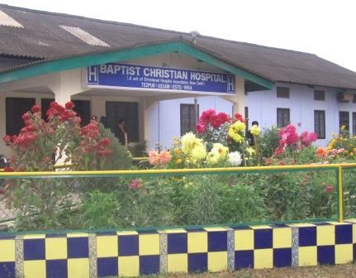
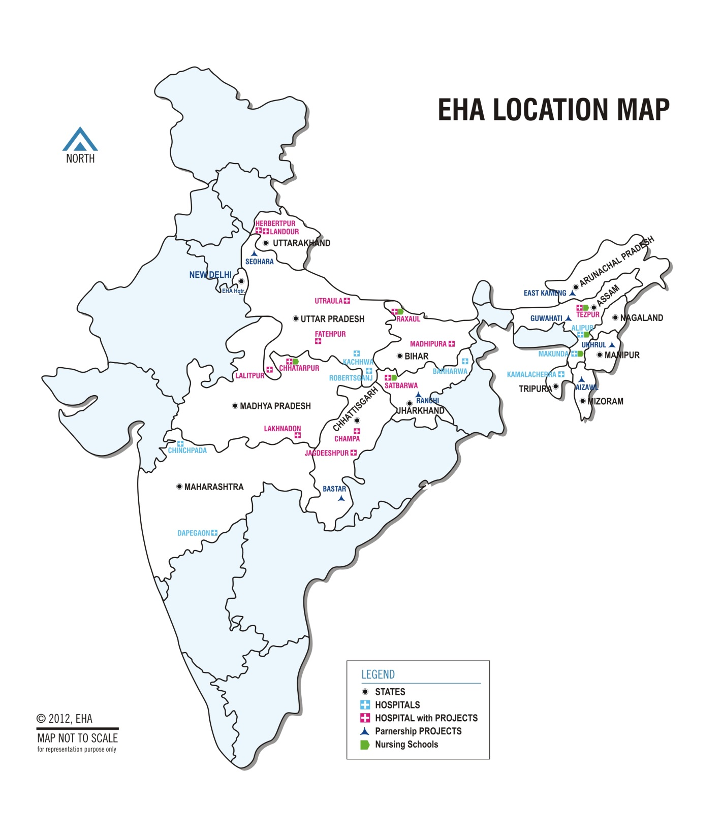

Slide 5
4 fold thesis
Vision needs to be pushed to its logical conclusion however “foolish” it may seem to health professionals
Training of human resource is a key element in the “strategy”.
A mission hospital cannot transform without partnerships.
Need to address issues of sustainability especially financial sustainability
Governance
Training
Partnerships
Sustainability

Slide 6
Mission hospital success is a Governance issue- World Council of Churches study
Study done across many countries- India, Africa and Cambodia by the World Council of Churches in 1998
Identified good governance as the key factor in the success of many mission hospitals
Since money is not the driving force there needs to be a motivation that is equal to or more powerful than “profit”
Christian doctors who are otherwise great leaders in the secular world leave behind their management skills when planning an evangelism strategy

Slide 7
Where there is no vision people perish
Often the vision is faulty (not uniquely Christian)- “the secularization of vision”
If there is a good vision statement, there is no mission or strategy planning
Need to have nurture/training and development of human resource
Need to have a budget
(People do not do what we expect but only what we inspect) Hence the need to monitor and evaluate impact
Either no vision statement or just a “motto”

Slide 8
3 levels of “vision”- Picture, big picture and the grand picture
Narrative
Meta-narrative
Grand narrative
Vision related to the institution
Vision : Changing the world
Establish the Kingdom of God in XXX community
e.g. We want to be the best hospital around
Increase Access to health care for the poor

Slide 9
Vision level I
Here the vision is related to the institution itself
Does not go beyond the walls of the hospital
E.g. I want this mission hospital to be thriving and prospering spiritually, financially and in human resource
I want this to be a place of excellence!!
Narrative understanding of “mission hospital”.

Slide 10
Vision level II
Here the vision goes beyond the walls of the hospital to the community around it, or the nation or even to the world at large.
In an area of 20 kms around the hospital, the maternal or the infant mortality should be below XYXYXY
I want all Indonesian doctors to observe some ethical norms.
Meta-narrative understanding of mission
“Changing the world”

Slide 11
Vision level III
Here the vision goes beyond the world to the creator Himself!!
The vision is not an activity or an outcome but a “person”
We not only want to change the world but want to transform both ourselves and the world.
It is more excellent to be a small part in a big vision than play a big part in a small vision
The Grand-narrative understanding of mission
“Transforming the world and being transformed”

Slide 12
But with a difference
Training with a difference
Where ever possible
Healing
Training
Explicitly Christian
Development with a difference
Fight the culture
Implicitly Christian
Mission
Health and development
Who are the poor?
Excellence
Poor
Ethics
But with a difference
But with a difference

Slide 13
Healing but with a difference
Healing a “person”
Curing a “patient” or an illness- impersonal.
Wholistic approach

Slide 14
Training but with a difference
Training in mission hospitals is not simply knowledge transfer but includes:
Attitude
Training to be a servant and
Teaching vocation
Whole person care including explicit and implicit witnessing
Policy

Slide 15
Health and development
Not resourcing but empowering
Not making them dependent but capable
How can we do this and what is the difference?
Partners in the healing ministry
Delegation of authority
Gospel of Christ
Development policy

Slide 16
Ethics but with a difference
WMA-Helsinki Declaration-1964- ratified in 2004 in Seoul- Human experimentation
1977-WPA- Ethical guidelines for psychiatry- Madrid declaration
UNESCO- Universal Bio-ethics declaration- 2004
CMA-2004- Code of Ethics
WMA-Pilasnesberg, South Africa-International Code of Medical ethics-2006
Not by consensus or through dialogue but using the word of God
Department of Bioethics

Slide 17
Our understanding of the poor is “multi-faceted”
Good News to the poor
Recovery of sight to the blind
Release to the captives
Freedom to the oppressed
No poor will be sent away without some appropriate treatment or referral
Luke 4-16-21
The Nazareth Manifesto gives us an understanding of who are the poor
Pro-poor policy

Slide 18
Excellence is different from a secular understanding
Excellence is “relevance” not simply high technology
Excellence is “appropriateness” of care not simply the best available.

Slide 19
Transformation: Impact evaluation
Parameters studied:
Spiritual impact on the communities and on the staff
Staff within their families
Staff with the patients
Staff with management
Leadership styles at all levels
Staff-Community relationships
Sense of vocation among staff at all levels
Team work and Unity within a hospital and between hospitals
Care of vulnerable populations
Equity, Justice and fairness
Each of these parameters had between 3-5 indicators

Slide 20
IMM-Institute of Medical Missions-run by EMFI
Overview of the Bible
Life of Christ
Spiritual disciplines
Vocation and Calling
Biblical Basis of Missions
Perspectives on Mission
Health and Development
Ethics in Medicine
Only guidelines provided to the resource people
Freedom to go where they want
15 doctors take this course twice a year
2 weeks course
Challenged to join mission

Slide 21
Training
Bedside training Module
Greeting
Privacy
Local language
Touching
Respect for Patient diagnosis
Getting permission to examine
Explanation before a procedure
Final explanation after examination
Taking questions
Prayer and departure
Indian context: Problems with young doctors
Treating patients like “scum”
Not communicating at all
Use of kinetic energy

Slide 22
Whole person care team training
Structure of the course-Interactive and with practical demonstration
How are we humans made
Sin, relationships and health
How does Christ “heal” us
Establishing a caring relationship
Getting acquainted with a sick person
Witnessing to sick persons
The healing power of forgiveness
Praying for the sick
Talking about death and suffering
Though these sound simple enough, they have to be taught

Slide 23
Mission update conferences
Vision for our lives
Stewardship
Spiritual disciplines
Community living
Integrity
Communication
Work ethic
Sexuality/Family
Held every year for all the staff

Slide 24
Implicitly Christian Demonstration of the gospel
Examples
The pervading culture of care
The way we respect the “low caste” and the “poor” the “women” & provide access to healthcare
Care for the dying
A definite mandate

Slide 25
Explicitly Christian-Proclamation of the gospel
While the context would be important, there is always a need to take some risks!
Very many methods in many different institutions:
Preaching in the OPD and the ward/Tracts for the literate/Witnessing by professionals/Praying at the bedside and before a procedure/Jesus movies/Singing in the ward
Integrated into history taking and caring

Slide 26
Vision
Policies
Training
Strategic plans
Mission
Evaluation
Alignment of all processes to the vision
There is more administration than meets the eye

Slide 27
Questions
If Governance is the most important issue, then in trying to help the cause of mission hospitals, are we talking to the right people- The owners of the mission institutions?
Often busy and good doctors are made CEO’s but would they have time to manage?

Slide 28
Partnerships
Impossible for a single mission hospital to achieve very much without partnerships!!

Slide 29
Keeping the chain of events in mind
CMF
Conferences
CMF Leadership development
IMM
Recruitment
Training-Human resource
Demonstration of the gospel (Implicit)
Proclamation of the gospel (Explicit)
Churches & Church planting agencies
Community Health teams
(Prayer only strategy)
Transformed communities

Slide 30
Partnerships
Other mission hospitals in the country
Christian Medical Fellowship
Government both locally and the Province
Churches &
Church planting Agencies
A mission hospital cannot do the work of transformation without partnerships

Slide 31
Examples
Share -financial & human resource ?
Common governance
Learning organization
India-EHA
Happening in Nigeria, Indonesia and Egypt
Denominational and Interdenominational

Slide 32
Huge impact
Rounding up seekers from hospital wards/OPD-(Using Mobile phones)
Preaching/Jesus movie in community project villages
Medical camps with evangelism in villages
Providing medical care- non-doctor trained career missionaries
Church planting agencies
Innumerable house churches established

Slide 33
A Church planter being trained to monitor BP

Slide 34
A batch of missionaries got trained-TOT

Slide 35
Community Lay Leaders Health Certificate Course- 2 year blended learning program

Slide 36
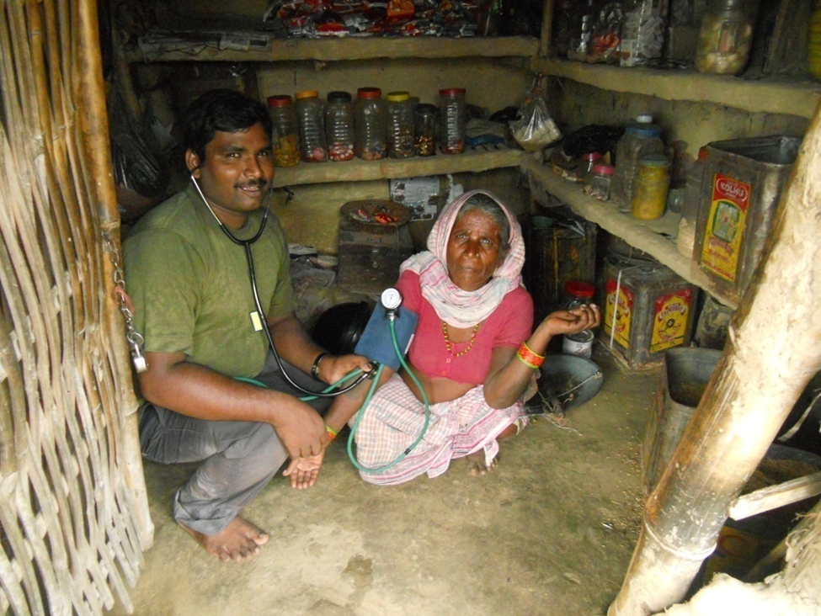
Lay Missionaries practicing their art

Slide 37
Partnerships
Recruitment for the mission hospital network
In many countries, the mission hospital network does not talk to the Christian Medical Fellowships
In India this is a powerful recruitment related partnership
Christian Medical Fellowships

Slide 38
Forging partnerships
Can all the Christian Mission hospitals of the world come under one umbrella and form the equivalent of ICMDA?
Can ICMDA and this body dialogue and partner?
Can this be a “further step” for this body?
Possible suggestion

Slide 39
Government partnerships
Mission hospital
Government health insurance programs
Government public health programs

Slide 40
Sustainability
Financial sustainability and the compulsion to serve the poor/do mission come together in a Government partnership
Indonesia and in India, the Government is finding working with the mission sector more suitable than the very expensive “for profit sector”

Slide 41
Update on Palliative and End of Life Care
Powerful witnessing tool

Slide 42
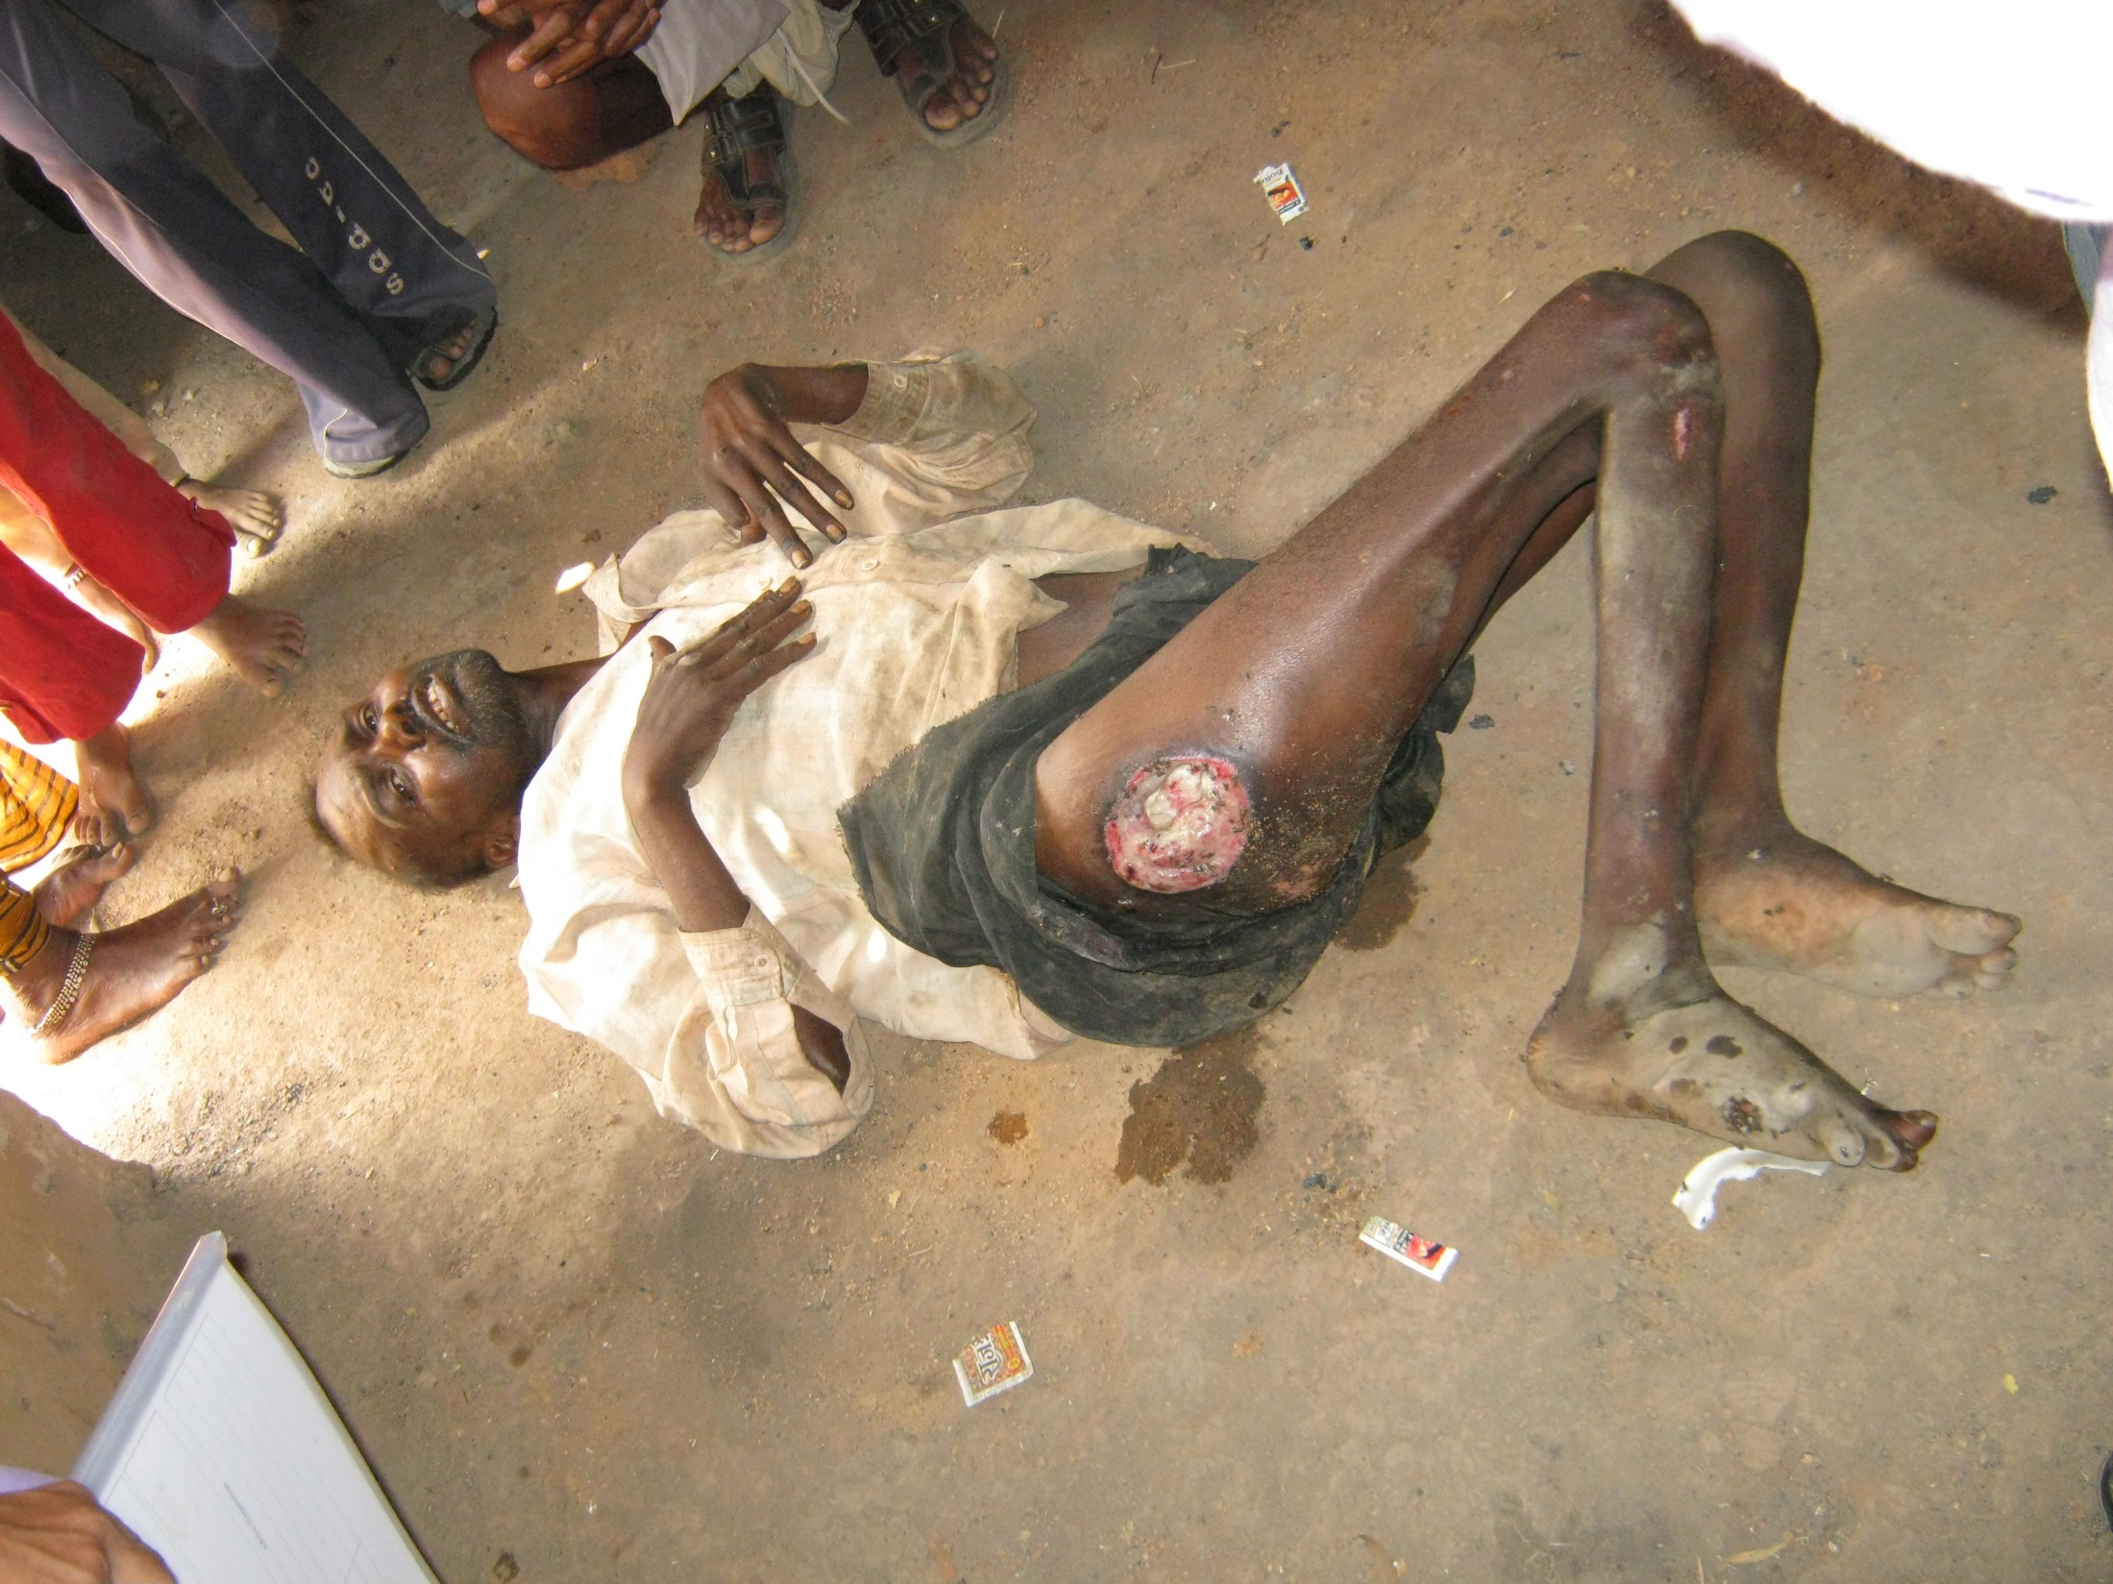
Nanhe Das with TB spine and paraplegia and bedsores left to die

Slide 43
Transformed the community

Slide 44
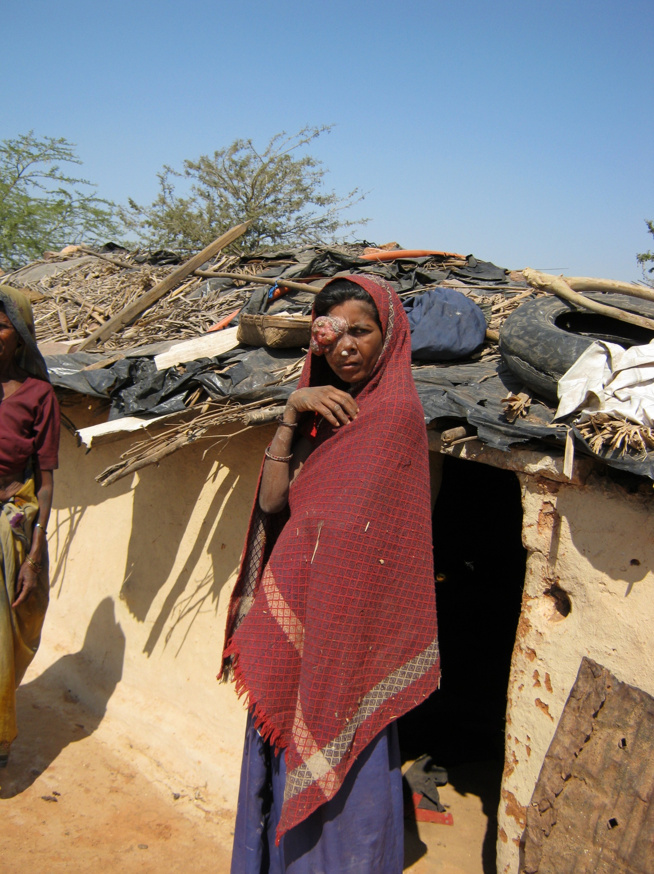
We cannot cure the incurable, but we can control many of the symptoms which cause distress
We cannot take away the pain of loss, but we can stand with those who are grieving and share their sadness
We do not have all the answers, but we can listen to all the questions

Slide 45
Issues
Relieve suffering & improve the quality of life for people facing serious, complex & advanced illness.
Almost non-existent in rural north India
Consists of:
Home based care
Hospital OPD & IP services
Bereavement Support
Community awareness building
Training of staff, families and community volunteers
Income generation program for families where main wage earner dies
Support for children to remain in school

