Slide 1
Health Training Partnerships with Christian Universities Overseas
Presented to Global Mission Health Conference 2013 by Doug Fountain

Slide 2
Summary
Human Resource in Health
Is it THE limiting factor in global health?
Issue of quantity and quality
Excellent indigenous training for Christian health professionals: one sure way to improve health services.
Local schools, colleges and universities train entire continuum of health workers – from community-based to specialty
Three challenges
There aren’t enough
Quality is uneven
Many local professionals may have not fully considered how being a Christian health professional is unique and special
Linking missions with all types of health training will help this.

Slide 3
This session:
Promote development of robust, high quality Christian training centers for health professionals through partnerships with a network of Christian health professionals
Case study: Uganda Christian University’s highly successful nursing and public health programs
Objectives
Describe how new universities and Christian universities in developing countries contribute to the formation of Christian health professionals.
Identify strategies that can be used to strengthen the quality of these universities through international partnerships and mission engagements.

Slide 4
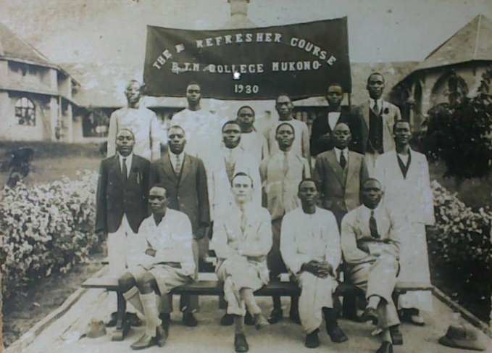
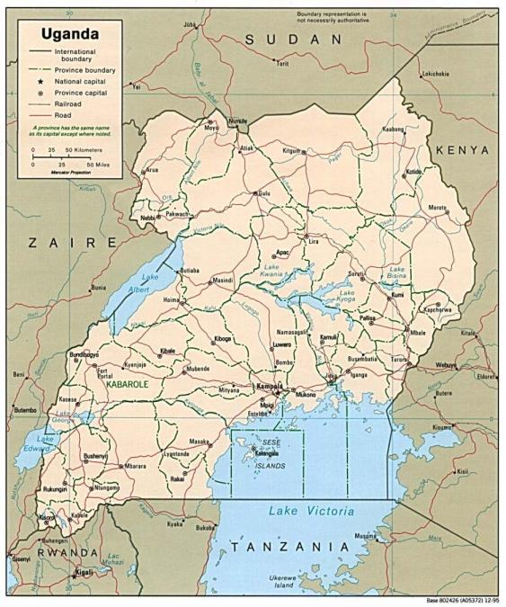
Case Study: Uganda Christian University
Established 1913 as a theological college (Church of Uganda), promoted to University in 1997
Now 12,000 students across 5 campuses nationwide
My roles 2004-2012: established the Dept o Health Science, then wrote th strategic plan, finally, VP development. Back in the US for a year.
UCU launched Nursing, Public Health and Health Admin programs, now working on a Medical School (gasp)

Slide 5
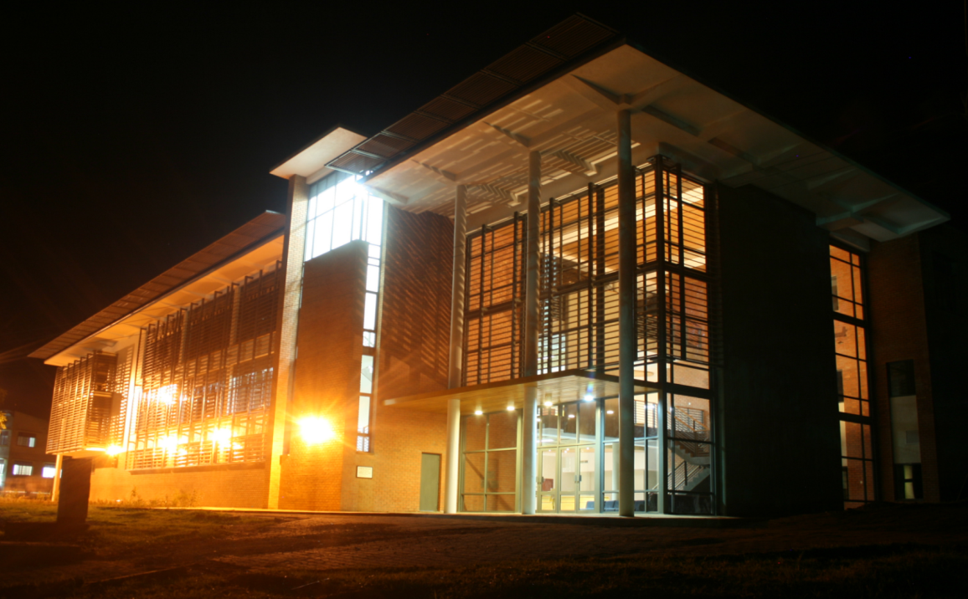
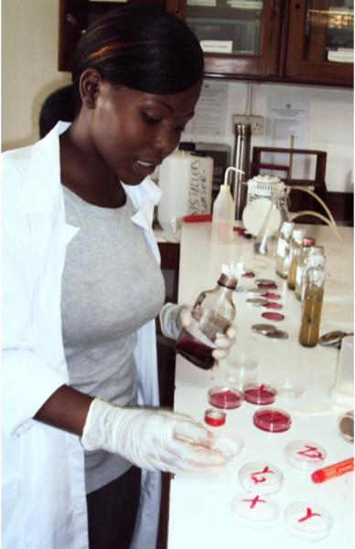
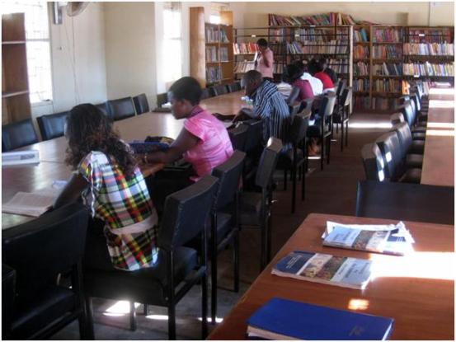
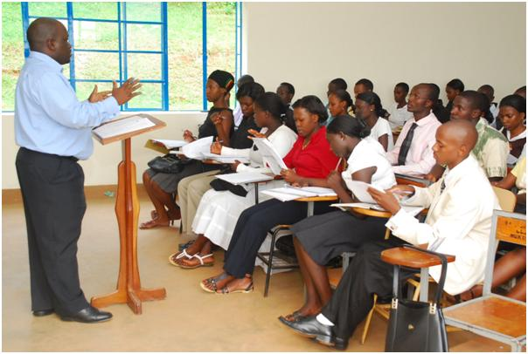

Slide 6
The Problem

Slide 7
Gaps in supply of health workers undermine health systems
Many countries in the world face severe health service and workforce shortages the WHO characterizes as a ‘crisis.’
57 countries fall below the number of medical doctors, nurses and midwives needed for example to assure safe deliveries for women in need (WHO, 2006)
Impact is felt in communities where it is estimated that 4% of the population at any moment in time are pregnant, and over the course of the year, 15% of deliveries will encounter an emergency for the mother and/or the child (Johns Hopkins & IFRC 2008).
There is a need for training of “millions” of health workers
Keep flow in greater than flow out…
Really hard to do in countries that lack training, universities (e.g, South Sudan!)

Slide 8
Strategic Response

Slide 9
What is the long term benefit of a Global short term strategy?
Short term missions is a short term solution to a long term problem.
Will we be send teams to the same places 90 years from now? “Oh my great grandfather used to come here to help you, I’m just following his footsteps.”
Two long term strategies:
Community health development (e.g., CHE)
Scale up indigenous capacity to train qualified leaders

Slide 10
Higher Education
Local universities are a starting point
Thousands of local higher ed institutions
Understand the continuum of education
Supply the top leadership and set the tone for organizations, government, civil society
Increasingly internationally interconnected
Regional catchment area, not just internal/domestic
Quality and affordable programs
Business, Social Work, Health, Law, Education, etc

Slide 11
Growing rapidly
Number of Universities increasing exponentially
Kenya, Tanzania, Uganda, Nigeria grew from 100 to 250 in just 10 years (2003-2013)
Christian universities among the fastest growing (data tracked by IAPCHE) –
Not “just” theological colleges
Over 580 in developing countries
Some are training health professionals

Slide 12
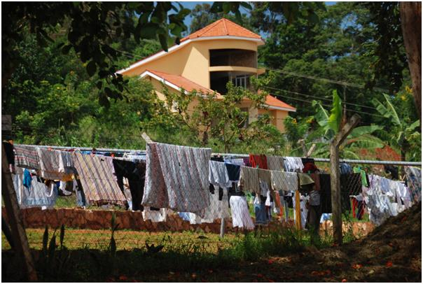
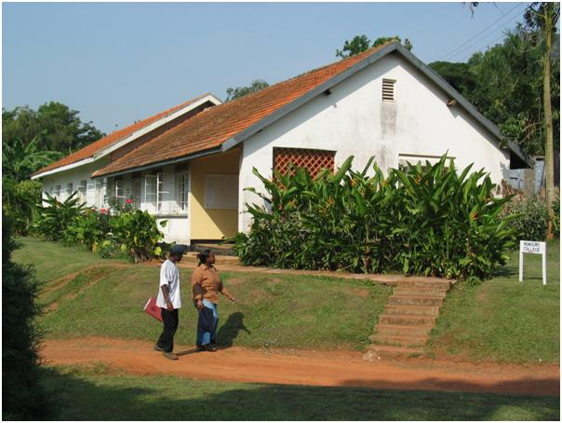
“But aren’t universities for the elite and privileged?”
Not always.
Many people from many far reaches of developing countries find their way to universities.
We had people from IDP camps, urban slums and children of subsistence farmers who sold their last cow to pay tuition.
Many want to return to their community.
Yes, sometimes.
Privileged students access better secondary schools…
Does that make the less important as health professionals?

Slide 13
The Christian “value added”
Goal - form Christian professional identity
Christians share their time and resources to help the needy.
Christian health professionals strive for standards
Respect for dignity of human life
Concern for the whole person
Ethics in practice and administration
Stewardship for God-given resources
Christians apply prayer and spiritual guidance
(How else do they differ?)

Slide 14
To our Case Study

Slide 15
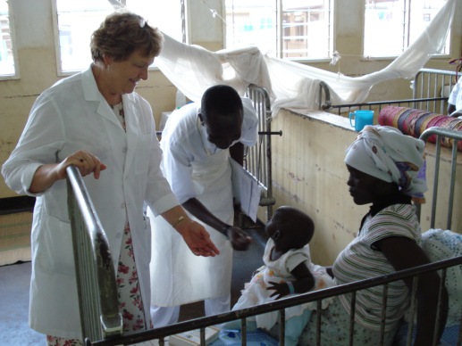
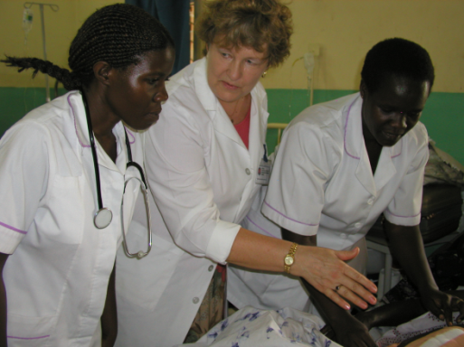
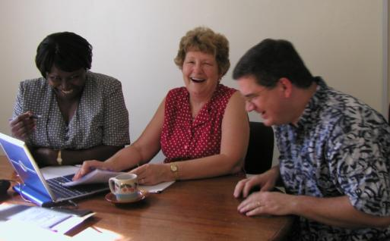
Nursing
2005: Uganda had 2 BNS programs and 5 people with a Masters in nursing
Partnered with Bethel University
Helped develop the curriculum and instructional methods,
Brought stream of health nursing educators from Bethel and beyond
Obtained grants for nursing equipment
Fulbrights for visiting professorships
“Learned cross-cultural approaches”
Launched a Masters program to train people to teach in Bachelors
Result: over 150 BSN and 10+24 MSN

Slide 16
A quote from Karen Drake:
The best way to help nurses cross culturally with nursing education - is to give them as much knowledge about what is current in nursing: theory, research, and practice and then challenge them to see if any of the ideas can be adapted to their very different setting. They are the leaders, and they know best what is going to work. Sometimes what they learn or experience is just what they need to come up with their own creative way of doing things. Education empowers nurses.

Slide 17
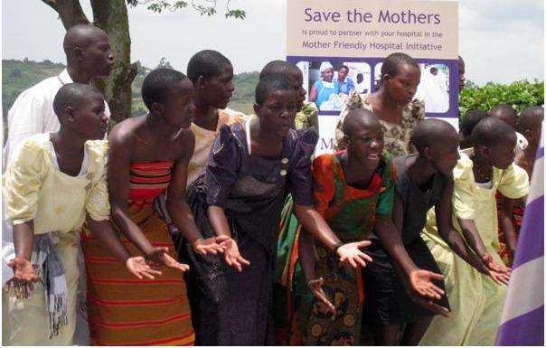
Save the Mothers
Maternal mortality epically awful in the region
Canadian Missionary Dr. Jean Chamberlain chose a ‘systems’ view
Established a Masters in Public Health Leadership to educate teachers, educators, clergy, health workers, policy makers about complex solutions required.
Raised student research grants
“Mother Friendly Hospital Initiative” –upgrade standards in local hospitals
Young people from a community are involved in a drama about preventing maternal death.

Slide 18
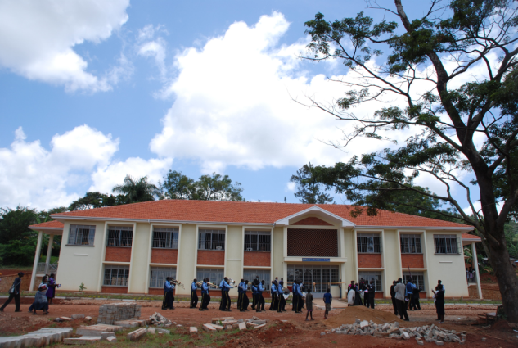
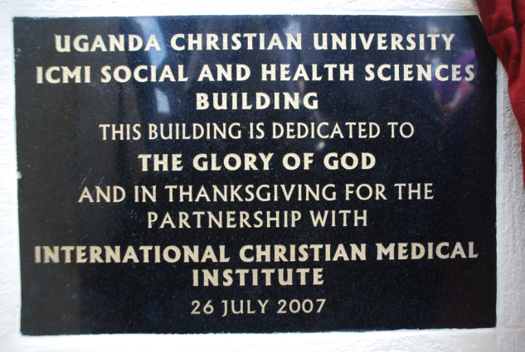
Health Administration
The International Christian Medical Institute (Victoria BC) saw a gap in admin skills among health professionals who rise to management
ICMI offers dipl and bachelors- finance, personnel, leadership
Targets Christian health centers and utilizes short term visiting educators and local experienced administrators

Slide 19
Health and Wholeness
16,000+ students (and counting) have completed a semester long course on practical health –
Goal to make them “health leaders” in own context”
Business, teachers, social workers, clergy etc
Covers basics of disease, prevention, care, special issues
Collaborative partnership with foreign and Uganda experts

Slide 20
What are we learning?

Slide 21
Recent research in foreign involvement in health professional training
Good for practical experience and training in high skill areas (e.g.,
Trauma and emergency surgical care (Cadotte et al 2013): Supervision in OR, topical lectures and supervising resident assessments.
Stimulate recruitment, retention, research (Lipnick et al 2013 study of Anesthesia/Surgery in Uganda)
Can support great clinical research if ethical issues addressed – why is the research being done “by” foreign teams, whose guidelines and what principles to follow (Meslin, Were, Ayuku, 2013).

Slide 22
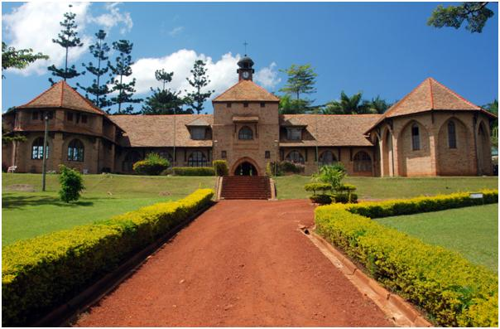
Success Factors
Champions at EACH institution
Top level commitment
Limited scope of the partnerships – not taking over!
Fit in strategic plan of both institutions
Always understand that developing country partners appreciate that “opportunity” (loved by Americans) often equals risk – reputation, finance, social
Foreign partners have plenty of international experience

Slide 23
Challenges
Higher education training often suffers from poor planning and resourcing
Cross-cultural challenges exist in how curriculum, learning processes, grading are all done
Ever present threats of corruption, inefficiency
Power differential and the potential for “exceptionalism” (that’s a nice word that means “arrogance”)

Slide 24
Planning for Partners

Slide 25
Comprehensive, integrated planning
This is the buzz in the higher ed strategic planning field
Our book (free) was designed to help universities plan, but along with that, to help international partners understand the planning challenges and issues that developing country partners address
Free at: www.developinghighered.org

Slide 26
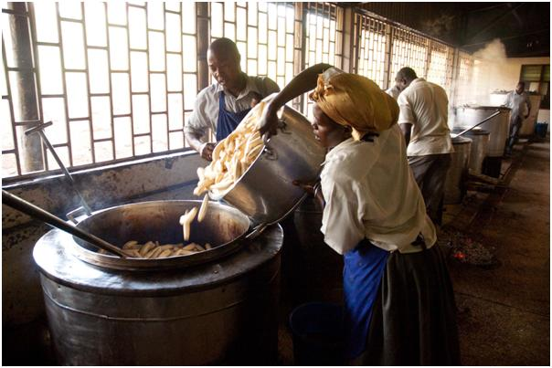
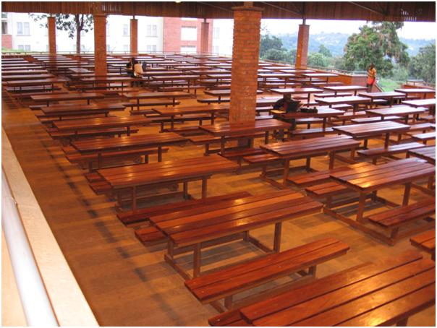
World Bank Higher Ed Expert: Salmi’s 9 Pitfalls for Young Universities
Building the campus before leadership and programs are set
Designing curriculum after constructing facilities
Importing content from somewhere else that does not fit
Planning without having governance, management, and other systems
Postponing governance and leadership
Ignoring the long-term financing plan during start up
Being too ambitious in quantitative targets
Expecting to do it all in too short a period
Relying on foreign academics without building up local capacity

Slide 27
Planning Framework (see www.developinghighered.org)
Strategic Plan (Mission, aims, strategies)
Resources
Capital
Academic Support
Student Development
Budget and Finance
Fund-raisng
Investment
New Construction
Renovation
Technology
Infrastructure
Program
Academic Program
Master Plan
Development Plan
Human Resources
Education Philosophy
Research
Systems: Leadership - Implementation - Quality

Slide 28
“We are not all academics here.”
Exactly.
Bethel/Nursing uses visiting nurses who could share their expertise.
Save the Mothers uses advocates/experts from different fields
ICMI uses health administrators
So, What’s in YOUR wallet?
Don’t always need PhD, MD, DNS
Certification in specialization helps
A willing heart, a smile, and flexible shoes…

Slide 29
If you do get to work in health professional education, remember…
Education is different, but different is not wrong
Classrooms often still didactic
Lack modern learning resources
Grading and marking (Americans love their 100%!)
Education is changing
Internet is increasing – data plans, info sharing
Innovations are important to incorporate - mHealth and eHealth
Raising scholarships, getting books and teaching aids – practical things help

Slide 30
Implications for mission…and you?!
Ask and think about how health mission fits in a larger context of total health system change
Where do health professionals train and get experience
Who owns, runs, and helps hospital sand clinics
How is the system of care functioning in local communities – from frontline workers, primary care, up through tertiary
What tools and technology support accountability
What innovations take place, how studied?
Pray and ask your developing country partners about how to shift form a “do for” to a “support your” mentality.
Recognize that training and learning is two way, you will also be transformed and learn
What can be done to achieve long term sustainable change?
What else – what’s your experience?

Slide 31
References
Cadotte DW, Blankstein M, Bekele A, Dessalegn S, Pain C, Derbew M, Bernstein M, and Howard A. (2013). Establishing a surgical partnership between Addis Ababa, Ethiopia, and Toronto, Canada. Canadian Journal of Surgery 2013 June; 56(3): E19–E23. doi: 10.1503/cjs.027011
Fountain D and Fountain J (2013) A resource and planning toolkit for universities in Africa. Journal of Planning for Higher Education 41(4) July-September 2013.
Kolars J, Cahill K, Donkor P, Kaaya E, Lawson A, Serwadda D, Sewankambo N. (2012). Perspective: Partnering for Medical Education in Sub-Saharan Africa: Seeking the Evidence for Effective Collaborations Academic Medicine: February 2012 - Volume 87 - Issue 2 - p 216–220 doi: 10.1097/ACM.0b013e31823ede39
Johns Hopkins Bloomberg School of Public Health and International Federation of Red Cross and Red Crescent Societies (2008). The Johns Hopkins and Red Cross Red Crescent Public heath guide in emergencies. 2nd Edition. Geneva: International Federation of Red Cross and Red Crescent Societies. (Accessed from http://www.jhsph.edu/research/centers-and-institutes/center-for-refugee-and-disaster-response/publications_tools/publications/_CRDR_ICRC_Public_Health_Guide_Book/Public_Health_Guide_for_Emergencies)
Lipnick M, Mijumbi C, Dubowitz G, Kaggwa S, Goetz L, et al. (2012). Surgery and anesthesia capacity-building in resource-poor settings: Description of an ongoing academic partnership in Uganda. World Journal of Surgery, March 2013, 37(3) pp 488-497.
Meslin E, Were E, Ayuku D. (2013). Taking Stock of the Ethical Foundations of International Health Research: Pragmatic Lessons from the IU–Moi Academic Research Ethics Partnership. Journal of General Internal Medicine September 2013, Volume 28, Issue 3 Supplement, pp 639-645.
Salmi J. 2011. Nine common errors in building a new world class university. International Higher Education 62, 5-7.
World Health Organization (2006), Working together for Health: The World Health Report. See also http://www.who.int/gho/health_workforce/en/index.html.

